Slide 1
Views of Climate and Learning (VOCAL): Dashboard Demo
Webinar 1: Fall 2022

Slide 2
CONTENTS
01
Views of Climate and Learning (VOCAL):
Context & New VOCAL Data
02
PowerBi/Edwin VOCAL Dashboard Demo
03
VOCAL Resources

Slide 3
Context & New VOCAL Data
01

Slide 4
VOCAL in Context: The CASEL* Wheel
Views of Climate and Learning (VOCAL)
School
Social and Emotional Indicator System (SELIS)
Classroom
Measures students’ views of their school climate
DESE supported: MCAS
  G4/G5: 46 items
  G8/G10: 48 items
Measures students’ views of 5 core SEL competencies
DESE supported: F151 Grant
  G3 - G5: 45 items
  G6 – G8: 48 items
  G9 – G10: 50 items
*Collaborative for Academic and Social and Emotional Learning

Slide 5
What does VOCAL* tell us? It tells us how students view three dimensions and nine topic areas of school climate
Engagement Dimension
  Culture competence (CLC)
  Participation (PAR)
  Relationships (REL)
Environment Dimension
  Discipline (DIS)
  Instructional (INS)
  Mental health (MEN)
Safety Dimension
  Bullying/cyber-bullying (BUL)
  Emotional safety (EMO)
  Physical safety (PSF)
*Based on U.S. Dept. of Education’s Conceptual Framework

Slide 6
New VOCAL index/scaled-score data available at the school- and student group- level (2022)
  Dimension scores (Engagement, Safety, Environment) for student groups (N≥20)
  Participation (Engagement Topic) score at school level (N≥50)
    In my academic classes, students wrestle with problems that don't have an obvious answer. G8
    In my classes, students teach each other how they solved a problem. G5
  Instructional Environment (Environment Topic) score at school level (N≥50)
  Students are given multiple opportunities to show that they have mastered their classwork. G8
  In my classes, mistakes or even failure on an assignment are viewed as an important part of our learning. G10
Bullying (Safety Topic) score at school level (N≥50)
  In my school, groups of students tease or pick on one student. G4, G5, G8, G10
  Teachers, students, and the principal work together to prevent (stop) bullying. G4, G5, G8, G10

Slide 7
New data visualization (+associated narratives): Index/scaled score distribution divided using 3 cut-points
Overall VOCAL score used to categorize student views into four scoring groups
3 cut points benchmark and describe student views (30, 50, and 70)
Reported out at state-, district-, school-, and grade-level for comparative analyses

Slide 8
VOCAL reporting details:
Report timeline (2023 going forward)
  Preliminary dashboard/report: Late June/early July
  Final dashboard/report: Early/Mid September
Access to VOCAL
  Edwin (Security Portal)
  Power BI interface – graphics, visuals (2018 through 2022…...)
  VC301 report data – downloads available for analyses

Slide 9
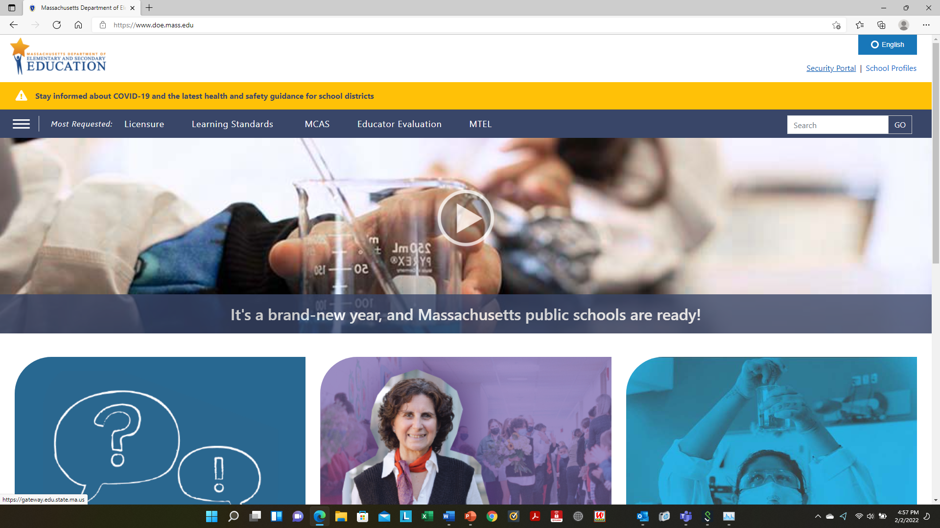
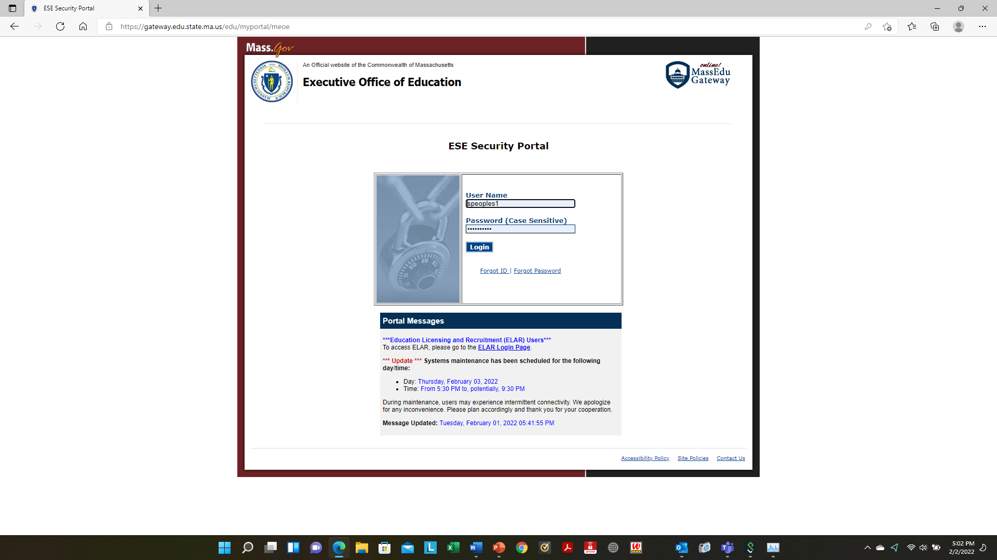
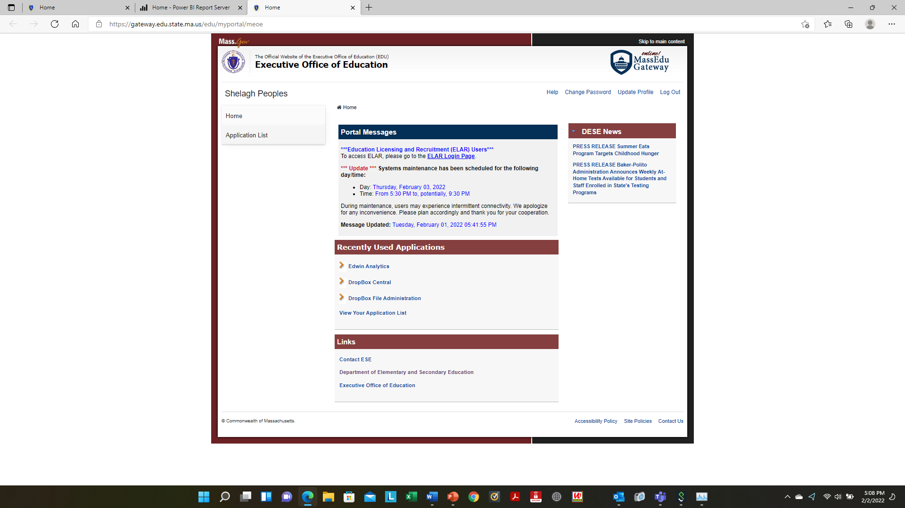
Edwin Analytics Portal is within the Security Portal and is accessed on DESE’s webpage
https://www.doe.mass.edu/
Security Portal
Enter User-Name and Password
Click on Edwin Analytics

Slide 10
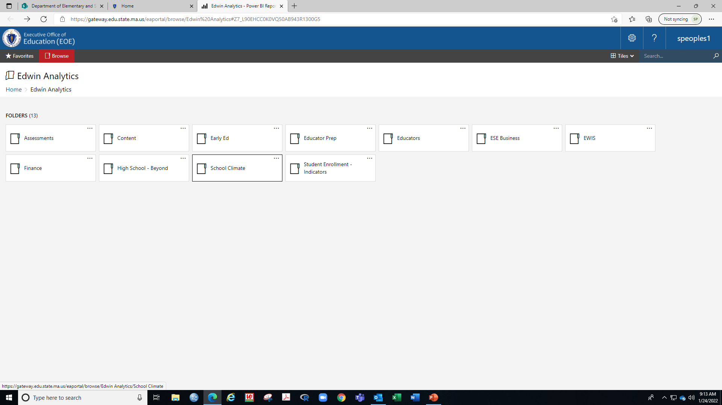
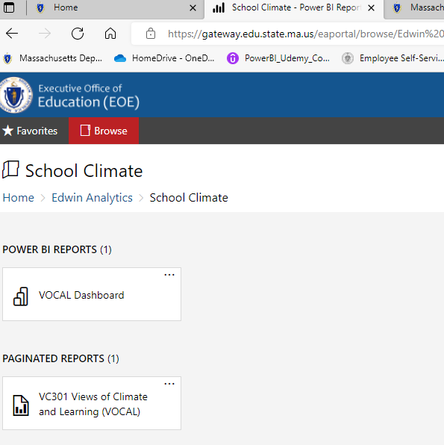
Edwin Analytics Portal
VOCAL data is found in the School Climate folder
VOCAL dashboard access

Slide 11
PowerBi/Edwin VOCAL Dashboard Demo
02

Slide 12
VOCAL Resources
03

Slide 13
Resources and VOCAL webinars
Resources:
Foreign language translations
  Brazilian Portuguese, Haitian Creole, Simplified Chinese, Spanish
User guides (2022, 2021, 2019)
Grade-level School Climate Profiles (2022, 2021, 2019, 2018)
State Reports (2022, 2021, 2019, 2018)
Interpretive guide and Action Plan template (2022, 2019, 2018)
VOCAL Item Crosswalk (CASEL SEL, PBIS, Accessible Instruction)
Upcoming Webinars:
Sept. 29, 10 a.m. Webinar 2: Data fundamentals needed to understand and make meaning of VOCAL data.
Oct. 12, 10 a.m. Webinar 3: Walks educators through a systematic analysis of a school’s data using the dashboard training environment; Action planning template

Slide 14


Thank you!
Shelagh Peoples, Psychometric Coordinator
781-338-3119
Shelagh.Peoples@mass.gov
research@doe.mass.edu

