Slide 1
Views of Climate and Learning (VOCAL): A Systematic Analysis
Webinar 3: Fall, 2022

Slide 2
CONTENTS
01
Recap (5 minutes)
02
Working through the layers of one school’s data (screenshots)
03
Action Planning Template (10 minutes)
03
Upcoming VOCAL-related workshop

Slide 3
Recap (5 minutes)
01

Slide 4
Measurement scale: Student-level data
Student-level (all grades):
Baseline average (2018)
30
50
70
1
99
SD = 20
A higher average score is indicative of a more positive climate for all dimensions and topic scores (including bullying)

Slide 5
2022: Six lower level scaled-scores and an overall climate scaled-score are aggregated to district, school, grade, and student group level
District and/or School
Grade (4, 5, 8, 10)
Low Income status
Race/
Ethnicity
English Learner status
Disability
status
Gender
Overall School Climate Score (SCL)
Engagement (ENG)
Safety
(SAF)
Environment (ENV)
Participation
(ENGPAR)
Bullying
(SAFBUL)
Instructional
(ENVINS)
Item...
Item...
Item...
Item...
Item...
Item...
Item...
Item...
Item...
Item...
Item...
Item...

Slide 6
Use for two types of data reported
Use index scores (overall, three dimensions, 3 topics) to identify meaningful differences among schools, dimensions, topics, student groups, and time
Use item response data to explain why scaled scores differ (e.g., low-income vs. not low-income students in your school); Cohort specific!!
        7 percentage point difference is a good starting point
        Can compare to district and state; Cohort specific!!
        Can identify items viewed most favorably and least favorably by students within school; Cohort specific!!

Slide 7
Interpreting school/group differences: Very small to very large effects
Index scaled score point difference | Size of effect(Negative or positive)
 | Percentile difference | Point difference description*
Less than 2 points | 2 to less than 4 | Not meaningful
2 points to less than 4 points | 4 to less than 8 | Small
4 points to less than 6 points | 8 to less than 12 | Moderate
6 points to less than 10 points | 12 to less than 19 | Large
10 points or greater | 19 and above | Very large
*Rough guide to associated scaled score point differences
IMPORTANT: Index/scaled scores, NOT percent responses, should be used to assess whether any differences are meaningful (school, grade, student group)

Slide 8
School-level analyses: Working through the layers of your data:
How is the overall school climate? Compared to the district or state?
School Climate
How do climate scores vary across the three dimensions - engagement, safety and environment? Compare to district or state?
Engagement
(+Participation)
Safety
(+Bullying)
Environment
(+Instructional)
How do topic climate scores compare to the average dimension score– participation to engagement? bullying to safety? instructional environment to environment dimension? Compare to district or state?
How does the school climate vary by student group?
Grp 1
Grp 2
Grp 1
Grp 2
Grp 1
Grp 2
Within the dimensions/topics, how does climate vary by student group?
Item...
Item...
Item...
Item...
Item...
Item...
Item...
Item...
Item...
Item...
Item...
Item...
Within a dimension, what items did students feel most positively about? Most negatively? What items contribute to index/scaled score differences found across student groups?
Item...
Item...
Item...
Item...
Item...
Item...
Item...
Item...
Item...
Item...
Item...
Item...

Slide 9
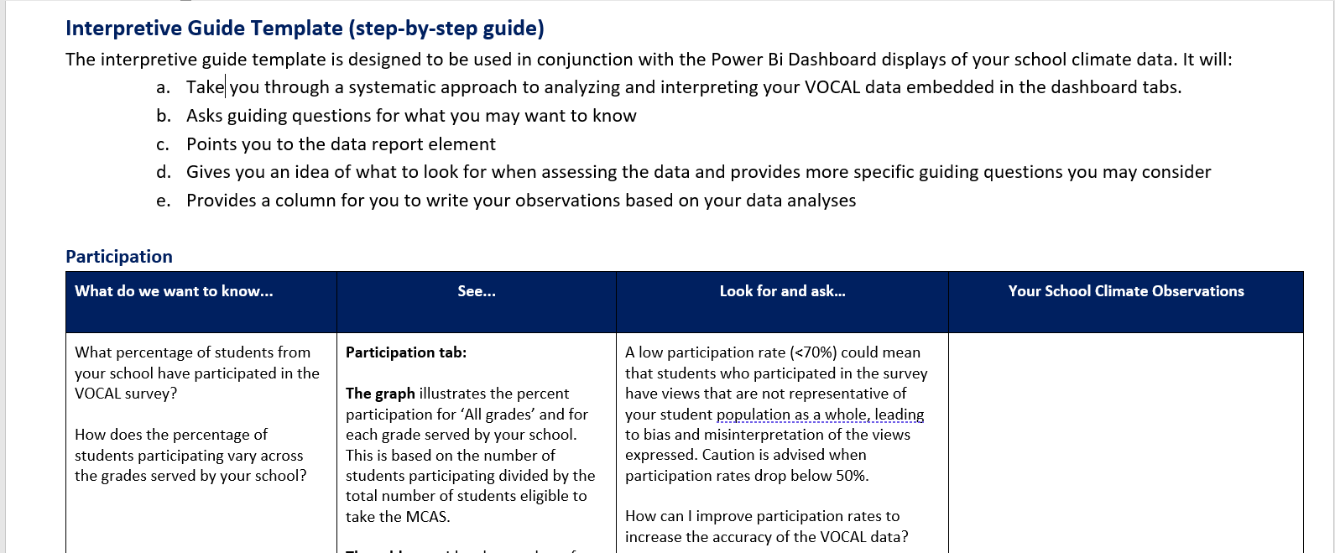
Interpretive Guide* available to support VOCAL analyses
*Interpretive Guide available on VOCAL webpage

Slide 10
Working through the layers of one school’s data (screenshots)
02

Slide 11
Scenario: Two safety concerns raised at Middle School (MS) school staff meeting
Office referrals related to fights have increased
More African American (AA) students than usual are seeking support from the nurse and school counselors

Slide 12
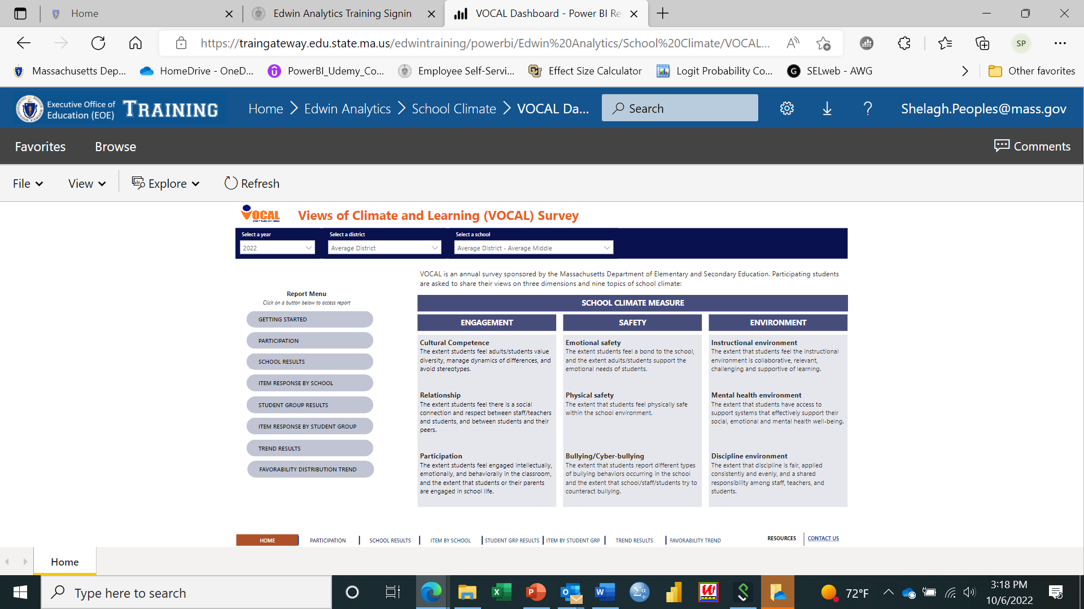
Getting started: Good to read “Getting Started” page and to review the “meaningful differences” table before you start!

Slide 13
Home tab: Looking at Average District and the Middle School within the District
Review what VOCAL is designed to measure
Select Year of analyses
Select your school of interest using the Dropdown menu (District-level analyst only)
Schools only have access to their own data

Slide 14
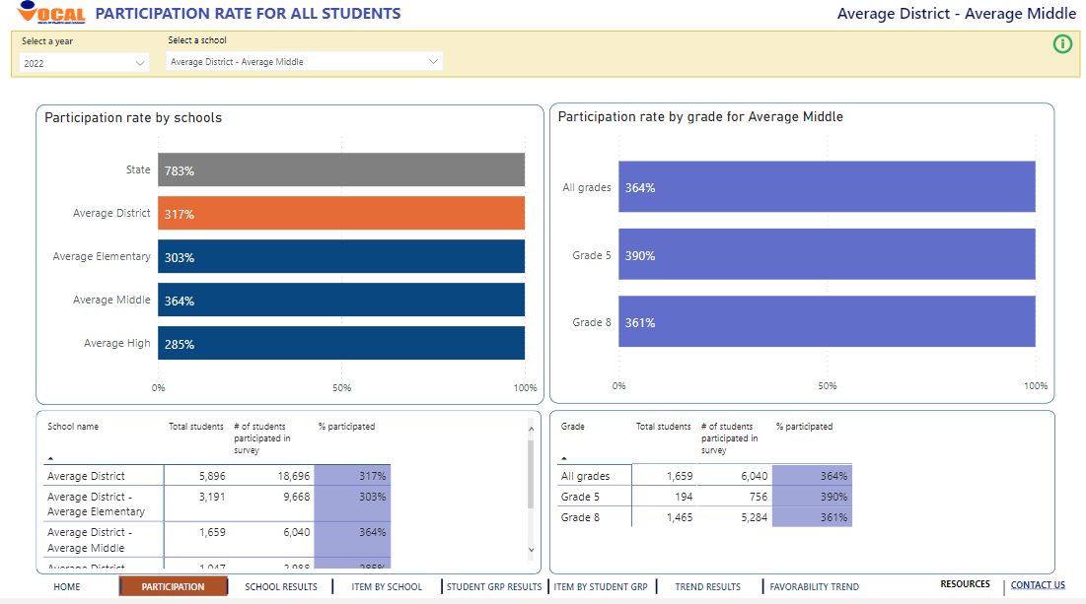
Participation tab*: Data are more reliable and trustworthy when participation rates are high
Main Findings:
Middle School (MS) participation rate is above 70%
MS student participation rate is above district average and state average
A higher percentage of students in G5 participated when compared to G8
Summary Conclusion:
Participation rates are above 70% in both grades and should provide a reasonably accurate picture of student views
70%
75%
72%
80%
78%
75%
72%
50%
* At the time of this webinar, the participation numbers were misrepresented in the training environment

Slide 15
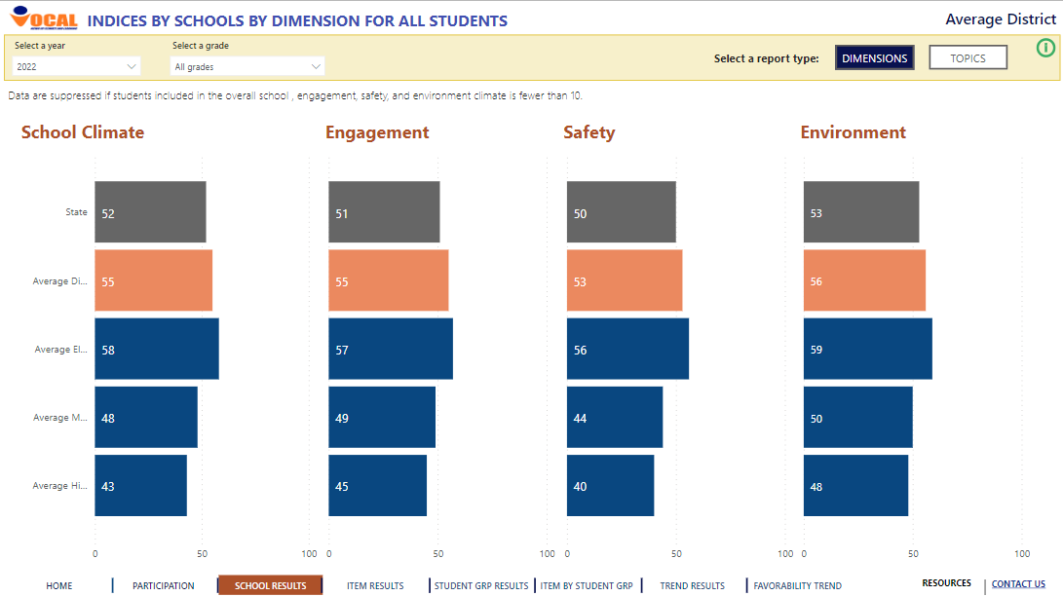
School Results tab: Looking at “All grades” served for Middle School (MS)
Main Findings:
Middle school (MS) average school climate score is 7pts lower than the district’s (large gap) and 4pts lower than the state’s (moderate)
Largest gap between the MS’s average dimension scores and district and state averages is within the Safety dimension (9pts & 6pts, resp.)
Within MS, there is moderate gap between the average Safety score and the Engagement score (5pts); large gap (6pts) compared to Environment score
Summary Conclusion:
Student perceptions of safety are less favorable and warrant a deeper dive

Slide 16
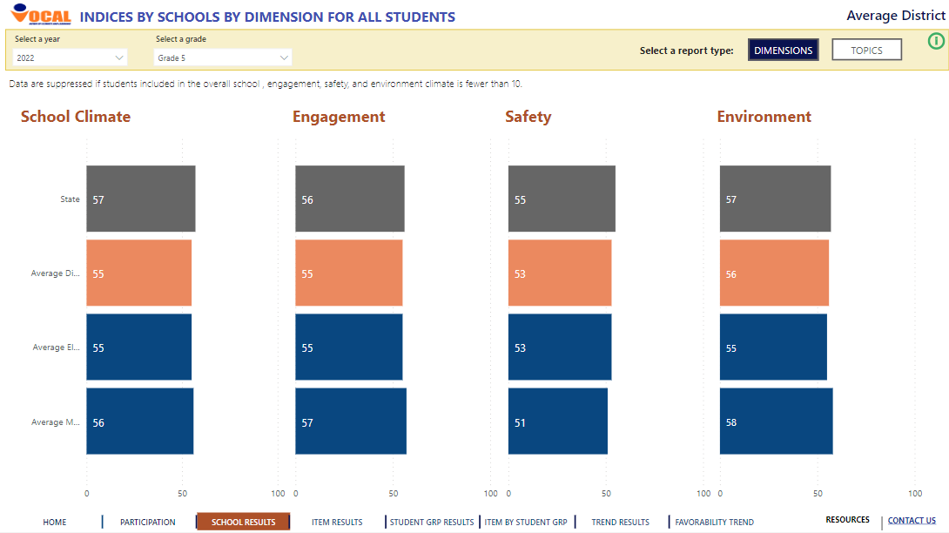
School Results tab: Looking at Middle School’s (MS) G5 results
Question: Are G5 students’ views of safety contributing to the MS gap (within gap)?
Main Findings:
MS average school climate score (56) is comparable to district’s average score (55) and state’s (57); Engagement and Environment scores are similarly comparable
Moderate gap (4pts) exists between MS’s average Safety score and state’s score; G5 Safety score is comparable to district’s
Within MS, there is a large gap between the average Safety score and the Engagement score (6pts) and with the Environment score (7pts)
Summary Conclusion:
Student perceptions of safety in G5 are less favorable and contributing to MS safety gap

Slide 17
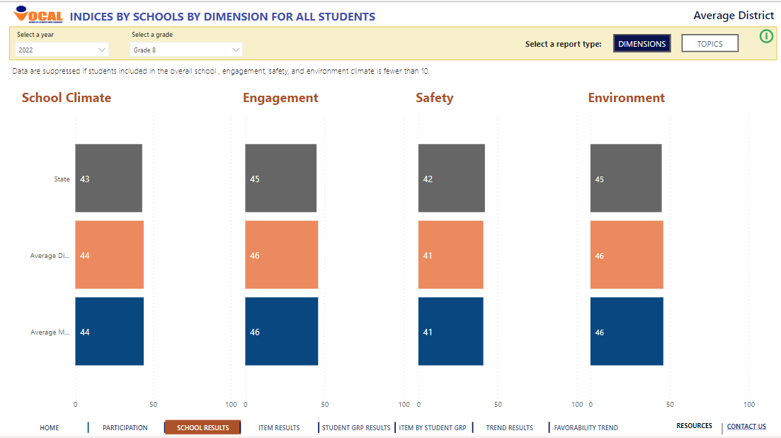
School Results tab: Looking at Middle School’s (MS) G8 results*
Question: Are G8 students’ views of safety contributing to the MS gap (within gap)?
Main Findings:
MS average school climate score is comparable to state’s average score (43); comparability extends across all 3 dimensions
Within MS, there is a moderate gap between the average Safety score and the Engagement score (5pts) and with the Environment score (5pts)
G8 students’ average scores are lower than G5 students’ average scores across all index scaled scores (overall and dimensions)
Summary Conclusion:
Student perceptions of safety in G8 are less favorable and contributing to MS safety gap
*Grade 8 students in district reside in Middle School only

Slide 18
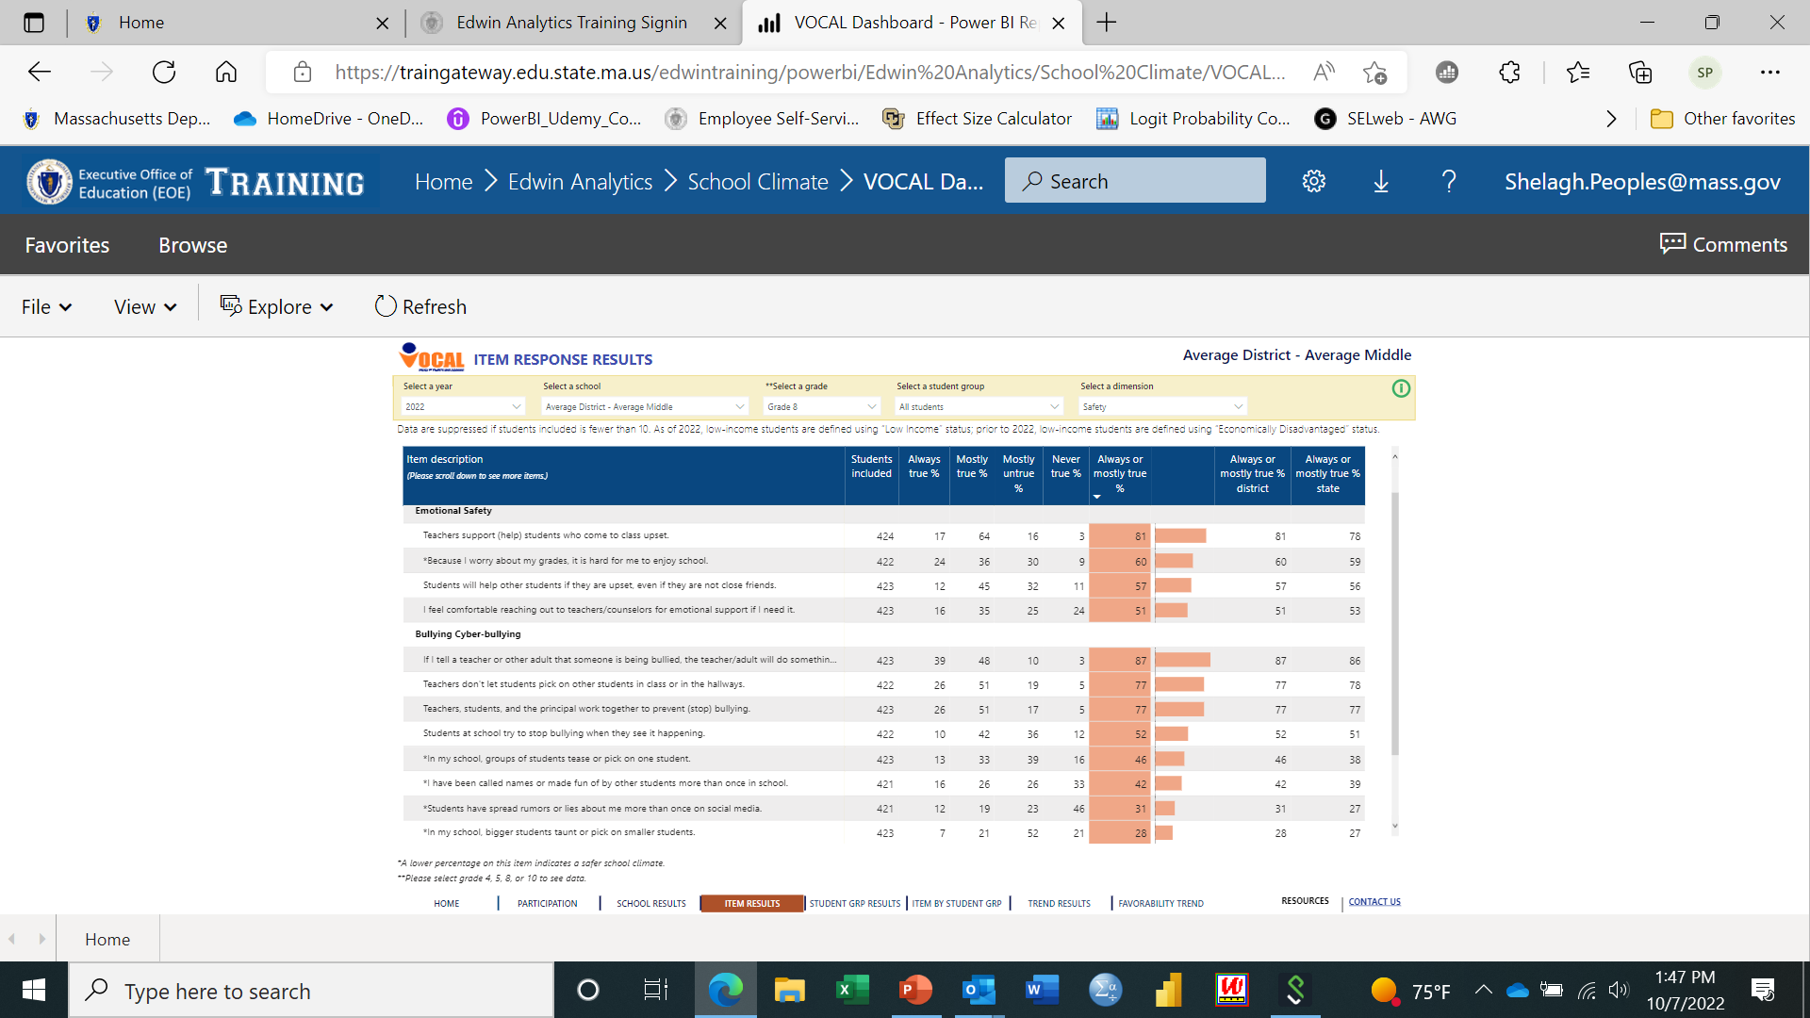

Item Results tab: Looking at G8 “All Student” item responses
Getting a sense of student perceptions of their safety in MS school
Main Findings:
Roughly 8 in 10 students report teachers are emotionally supportive, but only 5 in 10 students feel comfortable seeking help
The prevalence of bullying/physical threat in school is comparable to the district and state average but nevertheless worrisome! E.g., the percent of students responding, “Always true” or “mostly true” is close to 50% for certain bullying behaviors/physical threats
Students are less able to rely on their peers for emotional support and intervention (bullying) compared to adults
*
*

Slide 19
School Results/Item Results tab: Recap and Next Steps
Student perceptions of safety in G5 are less favorable and contributing to MS safety gap
  Large gaps exist between students’ views of safety in MS and their views of their engagement and of their learning/school environment
Student perceptions of safety in G8 are less favorable and contributing to MS safety gap
  Moderate gaps exist between students’ views of safety in MS and their views of their engagement and of their learning/school environment
Bullying behaviors are present in school with the prevalence of certain types worrisome
Most students can rely on teachers/adults to provide emotional support and protect them from bullying/physical threats; students, generally, are less able to rely on their peers for emotional support and intervention
Next Step:
Investigate if all students have less favorable views of safety or is it only certain student groups (by grade)? Data found in Student Group Results tab

Slide 20
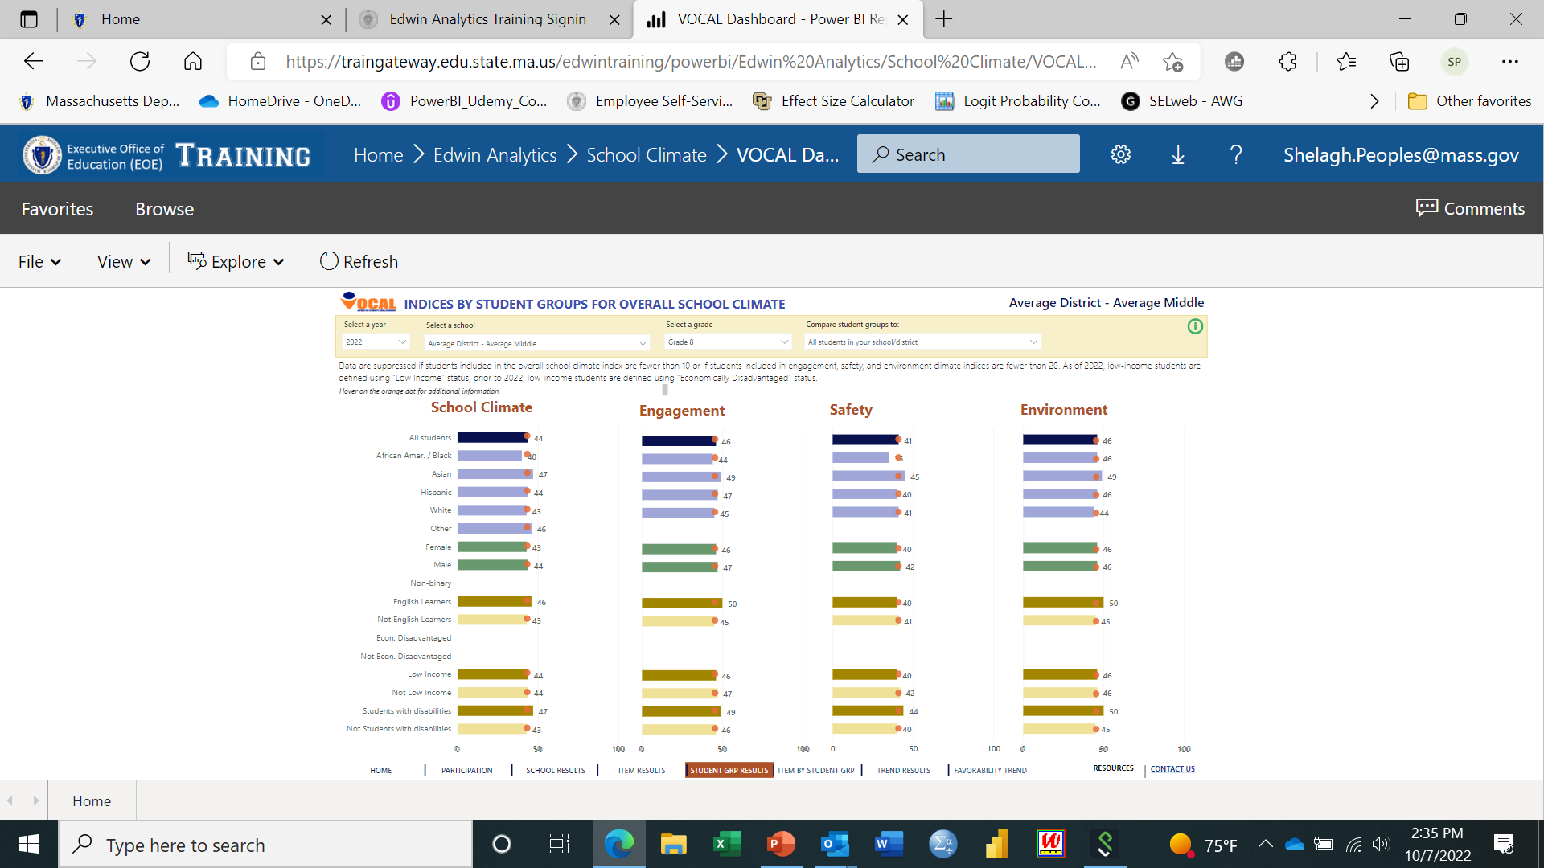
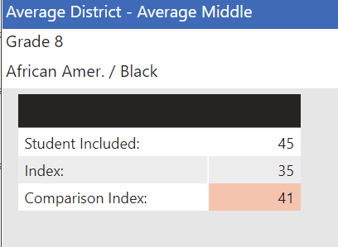
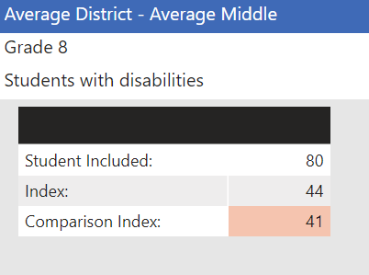
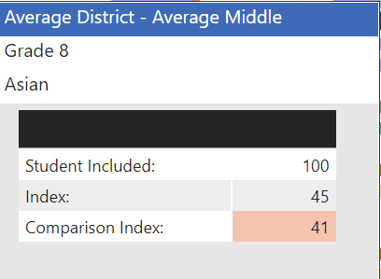
School Group Results tab: Do all G8 students in the MS have similar views of their safety within the school or does it differ by student group?
Main Findings:
African American students’ average Safety score is 6pts lower than the average of “All students”, a large gap
Asian students’ average Safety score is 4pts higher than “All students” average, a moderate gap
Students with disabilities’ (SWD) average Safety score is 3pts higher than the average of “All students”, a small gap
Summary Conclusion:
Disparities in student views of safety are evident among student groups ; African American students are unique in having less favorable views of their safety
20

Slide 21

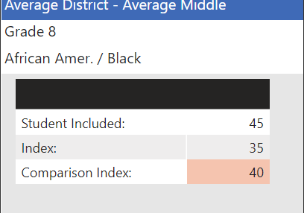
School Group Results tab: Does this difference in African American (AA) views of safety replicate when compared to their peers in the state?
Main Findings:
AA students’ average Safety score is 5pts lower than the average score of their peers in the state, a moderate gap
Summary Conclusion:
G8 AA students’ views of their safety not only differ negatively from their peers in the school/district but also when compared to their peers in the state

Slide 22
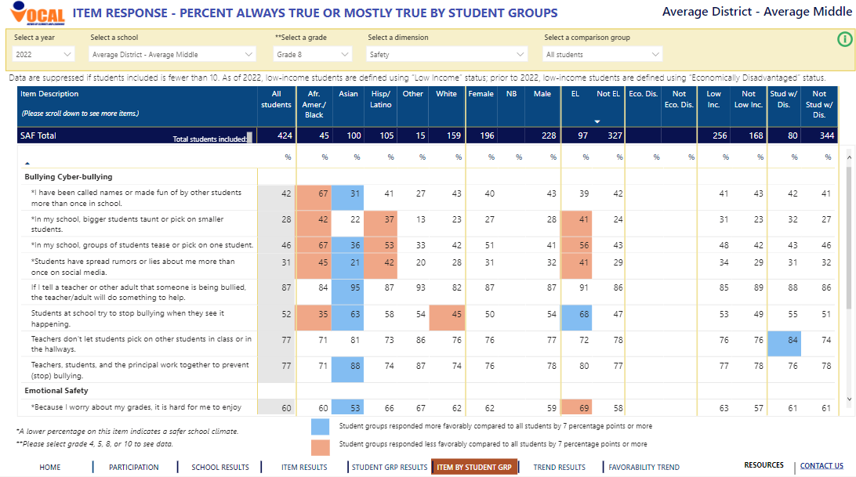
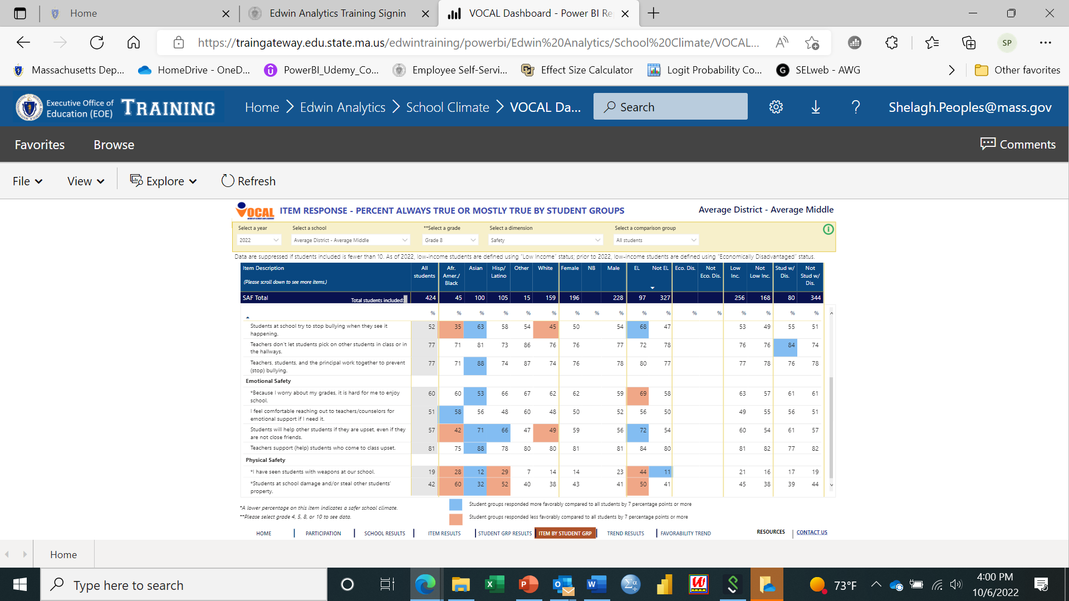
Item by Student Group tab: Focus on African American (AA) student safety gap Comparing to “All Students” average
Main Findings:
Prevalence of bullying behaviors are 14% to 25% higher for AA students; 9% & 18% higher for physical threats
AA students report that teachers/adults are less likely to intervene (bullying) or support students emotionally; prevention strategies are lower, albeit <7%.
AA students feel less able to rely on their peers for emotional support and intervention (15% and 17% difference, respectively)
AA 7% pts more comfortable reaching out for help from teachers/counselors
Summary Conclusion:
AA students experience higher rate of bullying/physical threats and would benefit from greater support from teachers, but more so, from peers
*
*
*

Slide 23

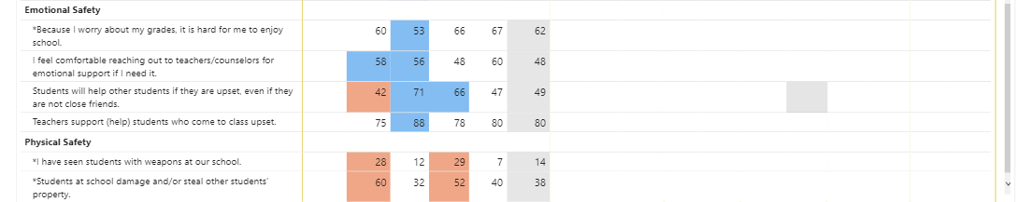
Item by Student Group tab: Focus on African American student safety gap
Comparing to white student average
Main Findings:
Prevalence of bullying behaviors are 17% to 25% higher for AA students; 14% & 22% higher for physical threats
AA students report staff are somewhat less likely to prevent bullying or support students emotionally, albeit <7%.
AA students feel less able to rely on their peers for emotional support and intervention (10% and 7%)
AA more comfortable reaching out for help from teachers/counselors
Summary Conclusion:
AA students report a higher rate of bullying/physical threats and would benefit from greater support from teachers and peers
*
*
*
*
*
*
*
*
*
23

Slide 24
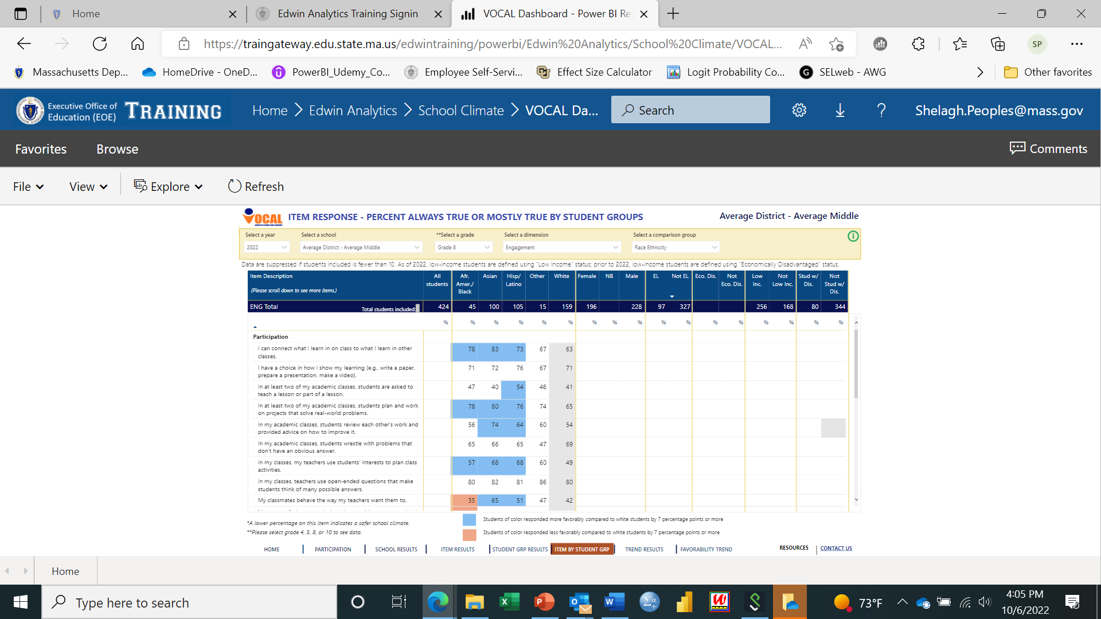
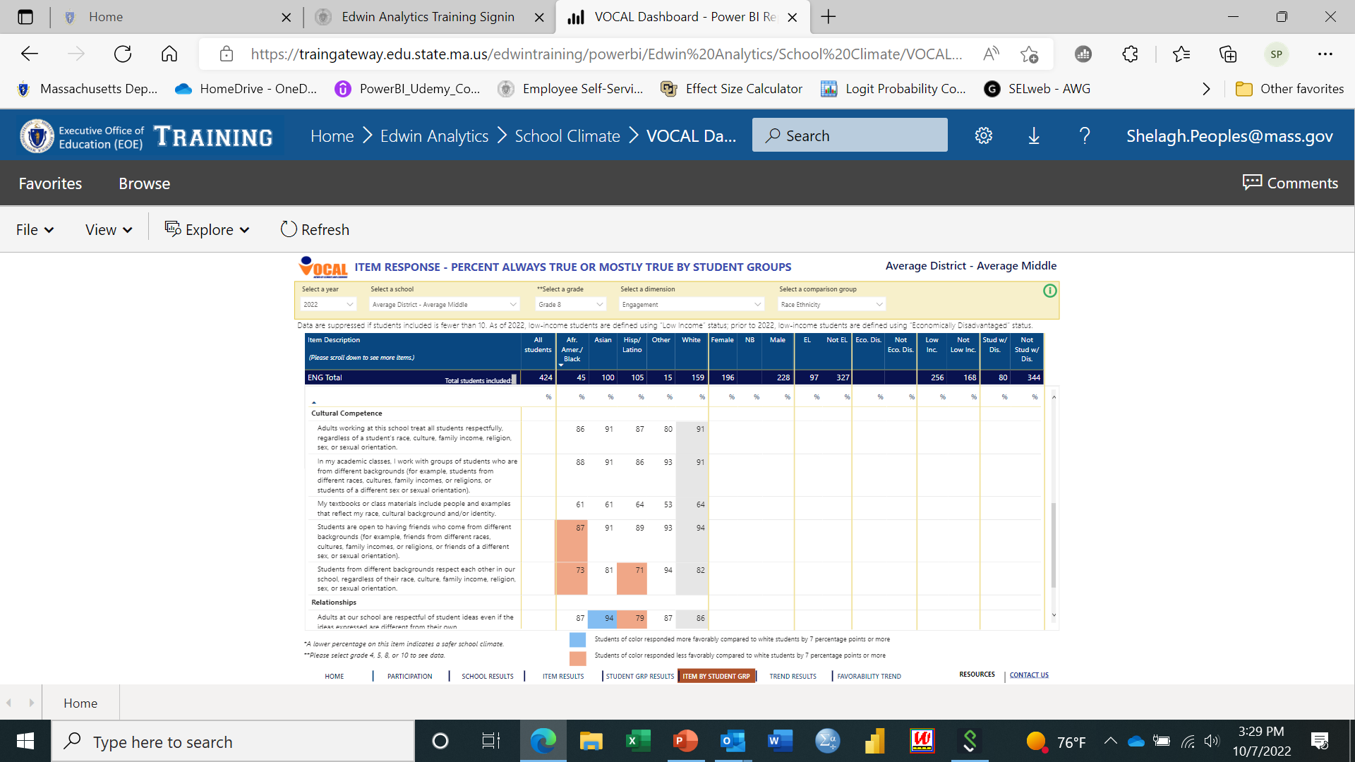
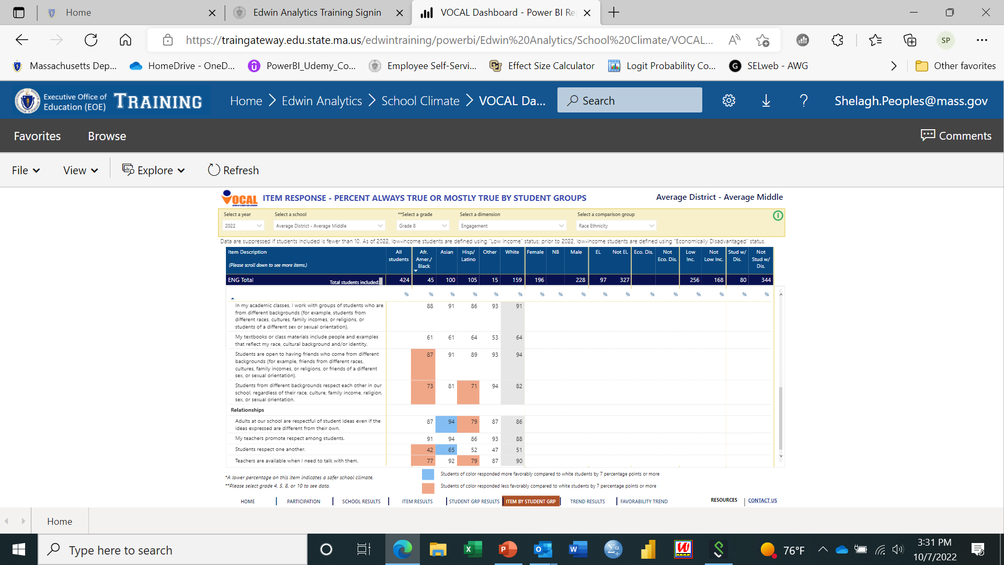
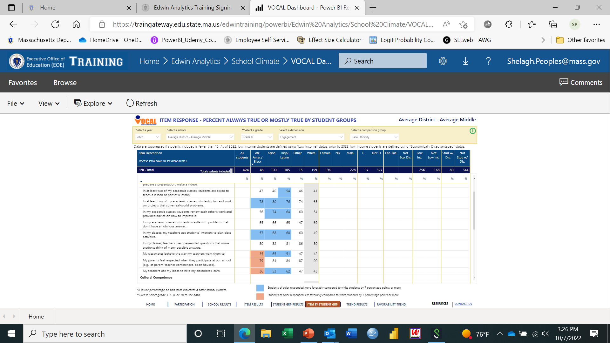
Item by Student Group tab: Focus on African American student safety gap
Any engagement factors contributing to the safety gap?; comparing to white students
Main Findings:
AA students have comparable or more favorable views of their participation in class on 7 of 11 classroom engagement practices (0 to +15%)
AA students feel that teachers/adults are less inclusive of their ideas in class (-7%) and less available to them (REL item, -13%); AA students feel their parents are less respected when visiting (-11%)
AA students view peer relationships as less inclusive (-7%, -9%) and less respectful overall (-9%)
Summary Conclusion:
Less respectful and less inclusive relationships may be impacting AA students’ physical and emotional security in school

Slide 25
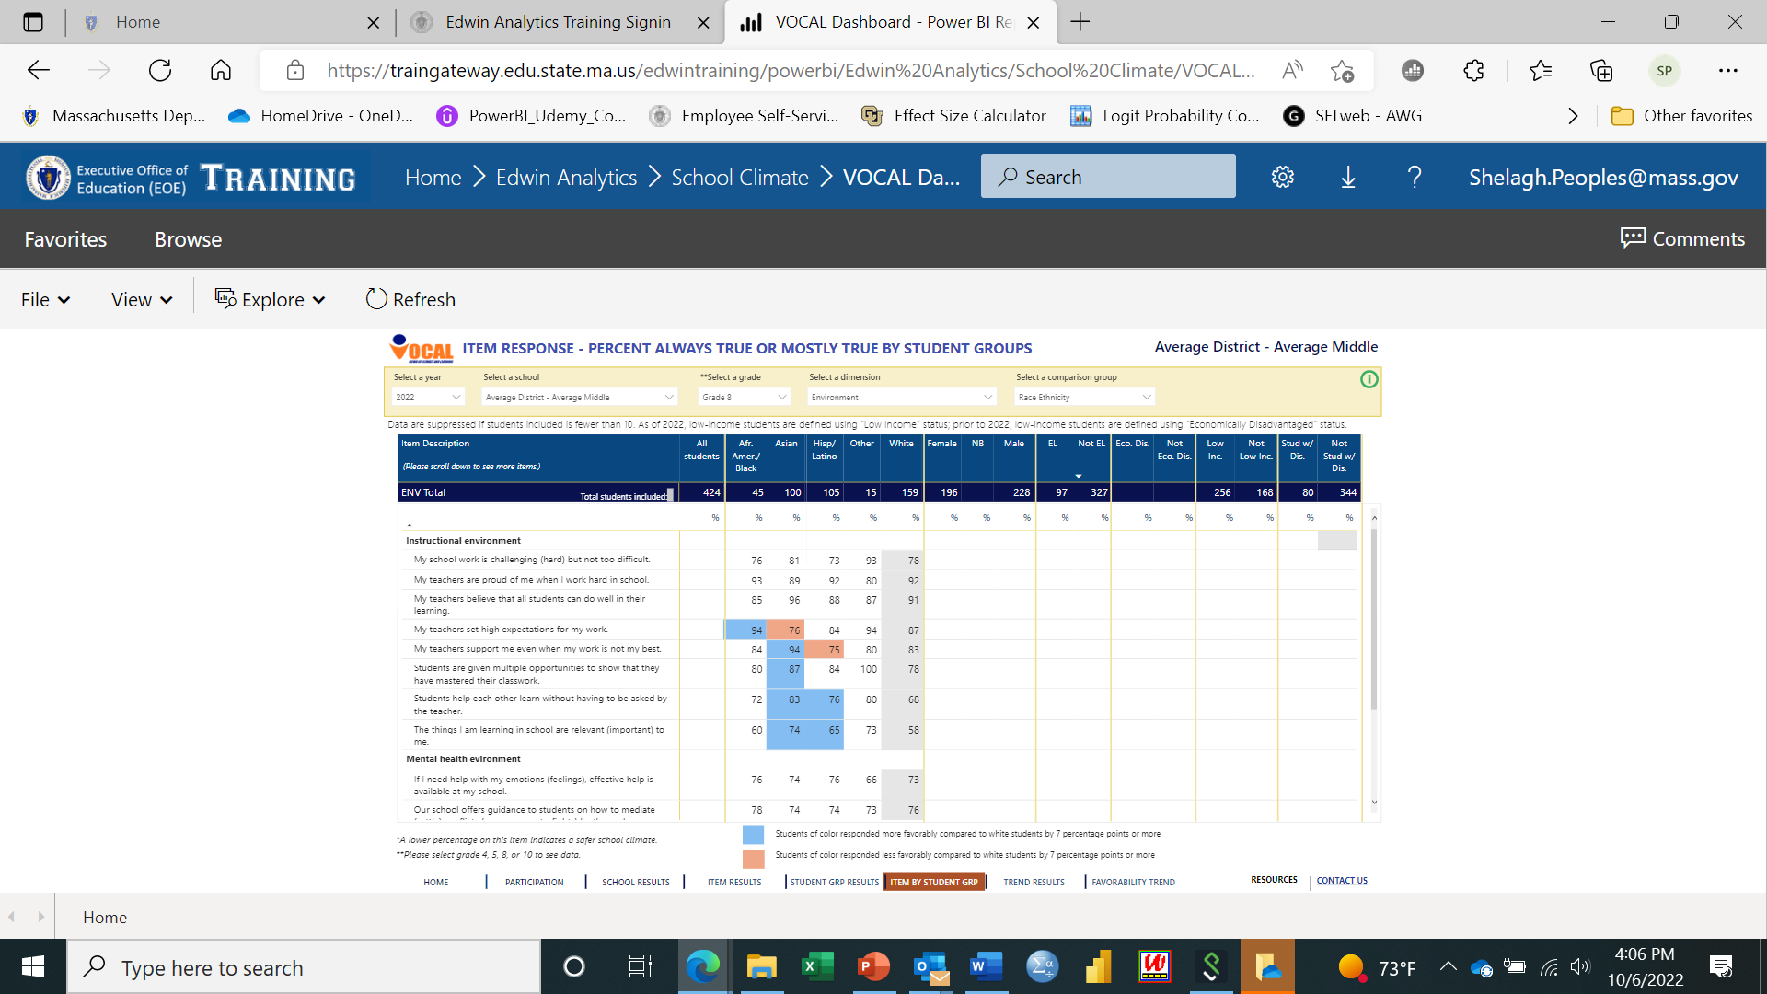
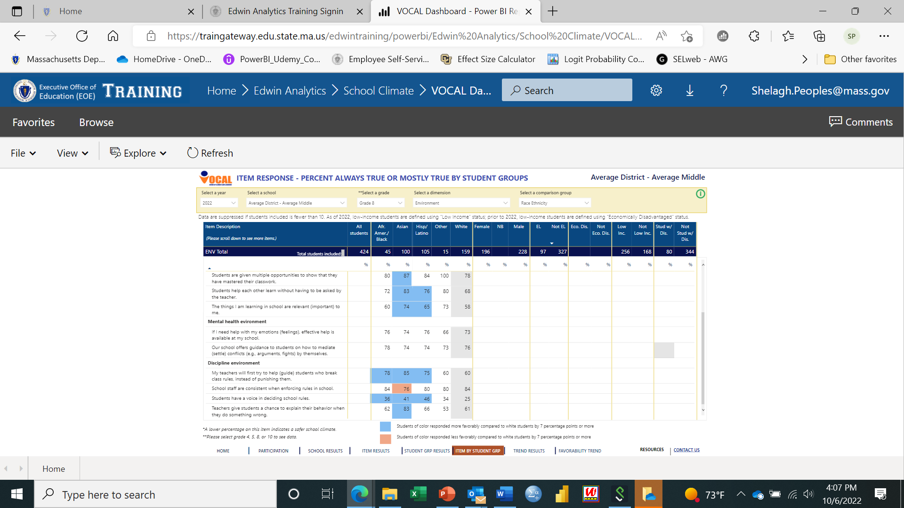
Item by Student Group tab: Focus on African American student safety gap
Any environment factors contributing to the safety gap?; comparing to white student
Main Findings:
AA students have comparable or more favorable views of their instructional environment in class on 9 of 11 practices used to create a safe and supportive learning environment (+1 to +7%)
AA students have comparable views of the mental health systems at school (+2 to +3%) and comparable or more favorable views of the discipline environment (0 to +18%)
Summary Conclusion:
AA have comparable or more favorable views of the environment within the school compared to white students. Findings suggest that views of the school environment are not contributing to AA safety gap

Slide 26
Student group results: Recap and Next Steps
African American students have less favorable views of their safety in school when compared to “All students” in the school and when compared to white students in the school (and to their AA peers in the state)
AA students experience a higher rate of bullying/physical threats; they would benefit from greater support/intervention from teachers, and from fellow students
Less respectful and less inclusive relationships are likely impacting AA students’ physical and emotional security in school; building stronger relationships among staff and students may help keep all students safer and more targeted supports for AA students could improve their sense of belonging
Positives related to AA students (vs. white): More comfortable to reach out for help; comparable or more positive views of teacher classroom engagement strategies, and of instructional, mental health and discipline environment
Next Step (not available 2022):
Do 2022 index scaled score findings replicate prior year’s findings?
    Note: No data available for ‘student group by dimension’ scores prior to 2022
    Item analyses are replicated in 2021

Slide 27
Overall Conclusion: What do students’ views of school climate tell us about the school’s two safety concerns?
Office referrals related to fights have increased
More AA students than usual are seeking support from the nurse and school counselors
Students’ views of safety within the school are less favorable when compared to student engagement views and to their views of the environment; appears to confirm concerns raised at staff meeting about student safety
The higher-than-expected prevalence of bullying reported could explain the increase in office referrals; in addition, only half of all students feel comfortable reaching out to staff for help
Disparities exist in student group perceptions of safety; the largest and singular negative disparity is among African American students who experience a higher rate of bullying/physical threats
Less respectful and less inclusive relationships between AA students and their peers may be impacting AA students’ physical and emotional security in school and explain why they seek support from the nurse and counselors (who AA students feel more comfortable approaching than other students)
Next Step:
Develop an Action Plan to address concerns highlighted

Slide 28
Action Planning Template
03

Slide 29
Action planning: Goal 1
Finding: Bullying behaviors reported by students are too prevalent and impacting their safety***
Goal #1: Implement an evidenced-based school-wide social skills program to improve positive and inclusive relationships among students with the goal of reducing bullying incidents and office referrals, and providing students with the necessary protective skills
What specific actions or implementation steps are necessary? | How will we monitor implementation? | How will we measure effectiveness? | Who will work on and be responsible for this part of this plan? | What is our timeline?
Identify evidenced-based social skills program | Decision taken by school climate committee (SCC) | Program shows strong evidence of success & includes target areas (e.g., building social awareness skills) | SCC leads (District Director of SEL/Pupil Services and Principal) | By end of December
Train teachers and counselors to embed socials skills curriculum into academic curriculum | Observe training Collect real-time feedback on training from staff | All teachers and counselors receive training Collect feedback on training from staff | Lead school counselor and Principal | Summer 2023
Implement curriculum in 2023 – 2024 | Classroom walk throughs | Classroom walk throughs Review 2024 VOCAL scores; trend! Reduced office referrals (bullying)/nurse visits | Teacher & counselor(s) implement curriculum Principal/Data Analyst evaluate effectiveness | Begin October 23’
*** This narrative provided as an example, not as a recommendation

Slide 30
Action planning: Goal 2
Finding: African American (AA) students report feeling less safe when compared to their peers in the school***
Goal #2: Improve school climate and sense of belonging for African American student group
What specific actions or implementation steps are necessary? | How will we monitor implementation? | How will we measure effectiveness? | Who will work on and be responsible for this part of this plan? | What is our timeline?
Implement a silent mentoring program to build stronger relationships between AA students and staff | Assign teacher/adult to AA students Regular check-ins with teachers at staff meetings | School climate committee reports on freq. & on teacher- reported quality of AA student engagement | All teachers and counselors Climate committee monitors program | By end of December
Focus group(s) of African American students to better understand their safety views | Checkpoints: focus groups are organized (interviewer + note taker); representative of AA students; use common “interview” protocol; notes are summarized | Students engage and recommend adoptable changes to improve climate Results reported to school climate comm. | School counselor(s) | Spring 23’
Include cultural/social awareness skill building among students in Social Skills intervention (Goal 1) | Classroom walk throughs | Classroom walk throughs Review 2024 VOCAL scores; trend! | Classroom teachers and school counselor(s) | Begin October 23’
*** This narrative provided as an example, not a recommendation

Slide 31
Upcoming VOCAL-related workshop
04

Slide 32
Upcoming VOCAL-related Workshops
October 25: In-person EWIS/VOCAL workshop
  Where: Best Western Royal Plaza, Marlborough
  Time: 8:30 a.m. to 1 p.m.
  Who: District/User data teams
What: EWIS and VOCAL Data Implementation
        New to data: Review the basics
        Familiar with data: Integrating EWIS/VOCAL data
        Plenty of time for teams to do analyses with DESE support
    More information and registration is available here

Slide 33


Questions? Thank you!
Shelagh Peoples, Psychometric Coordinator
781-338-3119
speoples@doe.mass.edu
vocalsurvey@doe.mass.edu

