Slide 1


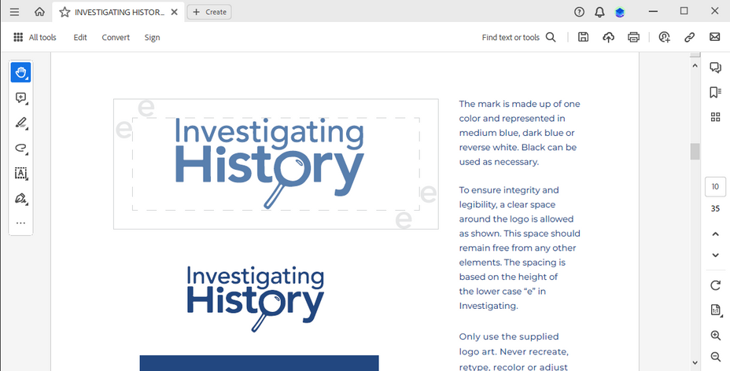


Branded House: DESE FORWARD
The DESE logo is always in front, followed by the secondary logo. Must be brand-aligned colors and fonts. This allows brands to have unique individuality while showcasing DESE as a brand priority.

