Slide 1
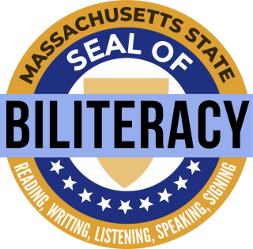
Massachusetts
State Seal of Biliteracy
Program Highlights
For PACs, Families, and Students

Slide 2
Contents
Introduction & Purpose
Overview & Recipient Reflections
Benefits of Earning the MA State Seal of Biliteracy
Participating Colleges & Universities
Eligibility
Qualifying for the MA State Seal of BIliteracy
Language Proficiency
Preparing for the Assessments
Getting Started in Your School

Slide 3
Massachusetts State Seal of Biliteracy
Introduction
The State Seal of Biliteracy (the Seal) and the State Seal of Biliteracy with Distinction (the Seal with Distinction) are official designations awarded to qualifying students upon their graduation from a Massachusetts high school to indicate that they have attained a high level of proficiency in English and at least one additional world language.

Slide 4
Massachusetts State Seal of Biliteracy
Purpose
The purpose of the Massachusetts State Seal of Biliteracy is to:
Encourage students to study and master languages;
Certify attainment of biliteracy skills;
Recognize the value of language diversity;
Provide employers with a method of identifying people with language and biliteracy skills;
Provide universities with a method to recognize and give credit to applicants for the attainment of high-level skills in languages;
Prepare students with skills that will benefit them in the labor market and the global society; and
Strengthen intergroup communication and honor the multiple cultures and languages in a community.

Slide 5
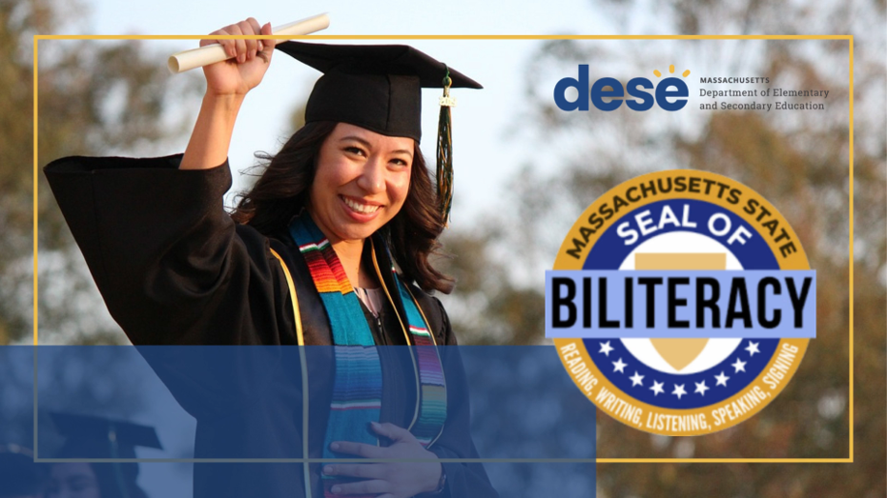
Massachusetts State Seal of Biliteracy
Overview & Recipient Reflections
Click here to watch a video providing an overview of the purpose, requirements, and benefits of the Massachusetts State Seal of Biliteracy, and reflections of students who have earned it.

Slide 6
Massachusetts State Seal of Biliteracy
Benefits of Earning the Seal of Biliteracy
The Seal award offers many benefits for recipients in Massachusetts including:
Providing colleges and universities with a method to recognize and give credit to applicants for attainment of high level skills in languages.
Colleges and universities may offer advanced language course placement to applicants for attainment of high level skills in languages.
A voucher to take a Massachusetts Test for Educator Licensure (MTEL). Recipients may choose to apply this voucher to either the Communication and Literacy MTEL, the Bilingual Education MTEL, or a world language MTEL.
Let your college, university or employer know that you have earned the Massachusetts State Seal of Biliteracy and ask them about what benefits you can receive!

Slide 7
Massachusetts State Seal of Biliteracy
Participating Colleges & Universities
The following public institutions of higher learning in Massachusetts provide language on their websites to provide credits for prior learning for students who have earned the Seal:
The list continues to grow. Check the Massachusetts State Seal of Biliteracy webpage for the most recent list of participating colleges and universities.
Bridgewater State University Bunker Hill Community College Cape Cod Community College Massachusetts Bay Community College Middlesex Community College Mount Wachusett Community College | North Shore Community College Northern Essex Community College Quinsigamond Community College Salem State University Worcester State University

Slide 8
Massachusetts State Seal of Biliteracy
Eligibility
Students of all language backgrounds are eligible, including
English learners,
former English learners,
heritage speakers/signers of world languages,
students from monolingual English-speaking homes who have acquired world languages at school or in the community,
any other students with multilingual skills.
Students can earn the Seal in any human language.
The language does not have to be among the languages which are taught at the school.
Students can earn the Seal in multiple languages.

Slide 9
Massachusetts State Seal of Biliteracy
Qualifying for the Seal: Class of 2019-2025
 | Student Criteria for the MA State Seal of Biliteracy | Student Criteria for the MA State Seal of Biliteracy with Distinction
Graduation Requirements | Meet all graduation requirements | Meet all graduation requirements
English Requirements | 472 or higher on Grade 10 ELA MCAS* | 501 or higher on Grade 10 ELA MCAS
World Language Requirements | A score equivalent to or higher than Intermediate High on an approved world language assessment | A score equivalent to or higher than Advanced Low on an approved world language assessment
*See MA State Seal of Biliteracy webpage for most recent information.

Slide 10
Massachusetts State Seal of Biliteracy
Qualifying for the Seal: Class of 2026 & Beyond
 | Student Criteria for the MA State Seal of Biliteracy | Student Criteria for the MA State Seal of Biliteracy with Distinction
Graduation Requirements | Meet all graduation requirements | Meet all graduation requirements
English Requirements | 486 or higher on Grade 10 ELA MCAS* | TBD
World Language Requirements | A score equivalent to or higher than Intermediate High on an approved world language assessment | A score equivalent to or higher than Advanced Low on an approved world language assessment
*See MA State Seal of Biliteracy webpage for most recent information.

Slide 11
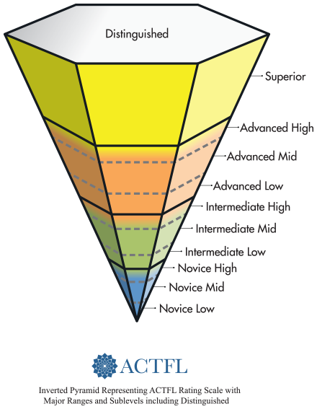
Massachusetts State Seal of Biliteracy
Language Proficiency
Advanced Low MA State Seal of Biliteracy with Distinction
Advanced Low speakers demonstrate the ability to narrate and describe in past, present, and future in paragraph-length discourse. Speakers at the Advanced Low level are able to create with language, initiate, maintain, and bring to a close simple conversations by asking and responding to simple questions.
Intermediate High MA State Seal of Biliteracy
Intermediate High speakers are able to narrate and describe in past, present, and future. They are able to handle successfully uncomplicated tasks and social situations requiring an exchange of basic information related to their work, school, recreation, particular interests, and areas of competence. They are also able to deal effectively with an unanticipated situation.

Slide 12
Massachusetts State Seal of Biliteracy
Preparing to Meet the World Language Criteria
Your languages are valuable!
If you (or your child) speak or sign a language other than English in your home, use and practice all your language skills: reading, writing, listening and speaking (ASL: viewing and signing).
If you (or your child) are learning a language other than English in school, begin coursework as early as possible and continue practicing all your language skills: reading, writing, listening and speaking (ASL: viewing and signing).
If you (or your child) have already taken a language assessment in another school, state or country, share the official report with your school.

Slide 13
Massachusetts State Seal of Biliteracy
Getting Started in Your School
Steps:
Talk to your world language teacher, ESL teacher, school administrator or guidance counselor about your interest in earning the Seal of Biliteracy.
If your school does not yet have a program, share the MA State Seal of Biliteracy webpage with a world language teacher, ESL teacher, school administrator, guidance counselor or ELPAC to help get your school started.

Slide 14
Thank you!
Webpage: [YOUR SCHOOL’S WEBPAGE]
Email: [PRESENTER’S EMAIL]

