Slide 1
School Discipline in Massachusetts: A Look at the 2015 Data and ESE Reporting Requirements
Presented by Robert Curtin
April 11, 2016
Director, Education Data Services

Slide 2
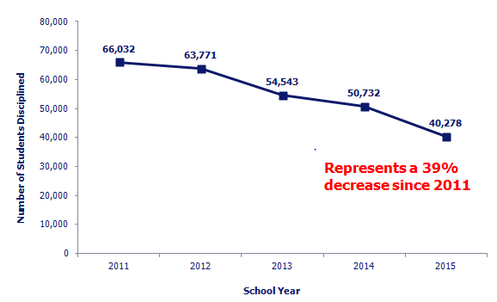
Number of Students Disciplined in Massachusetts Public Schools

Slide 3
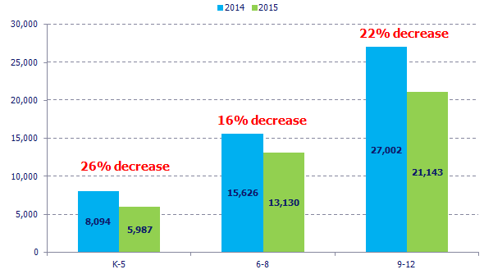
Fewer Students Disciplined Across All Grades

Slide 4
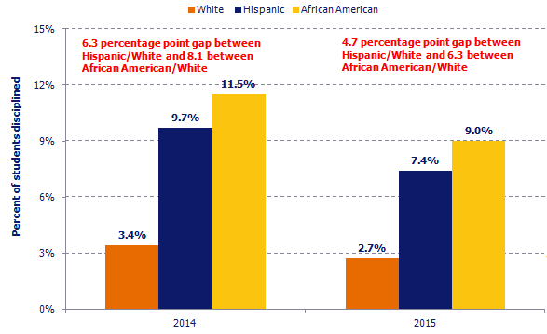
Suspension Gaps Shrinking, but Still Persist

Slide 5
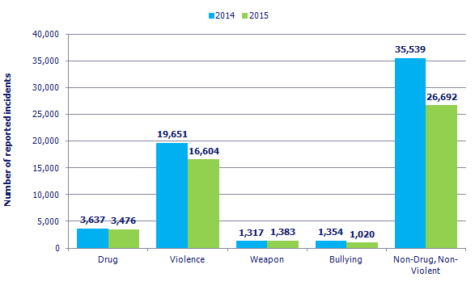
Varying Decreases in Offense Types

Slide 6
Requirement #1 – Data Reporting
603 CMR 53.14 (1) - Every school district, charter school, and virtual school shall collect and annually report data to the Department regarding in-school suspensions, short- and long-term suspensions, expulsions, emergency removals under 603 CMR 53.07, access to education services under 603 CMR 53.13, and such other information as may be required by the Department. Such data shall be reported in a manner and form directed by the Department.
Status - Complete
School Safety and Discipline Report modified to collect emergency removals

Slide 7
Requirement #2 – Public Reporting
603 CMR 53.14 (3) - In the fall of each year, the Department shall publish an analysis and report of student discipline data disaggregated by district and school, and by selected student populations, included but not limited to race and ethnicity, gender, socioeconomic status, English language learner status, and student with a disability status. The data shall be reported in a manner that protects the identity of each student and shall be made available to the public online in a machine readable format.
Status – Complete
School and district data by subgroup and offense type published to profiles
Student-level research file made available via website

Slide 8
Requirement #3 – Overuse of suspension
603 CMR 53.14 (4) - The Department shall annually determine the schools with the highest percentage of students expelled or placed on long-term suspension for more than ten cumulative days in a school year. After review of the discipline data described in 603 CMR 53.14(3) and other relevant school and district information, including but not limited to student demographics, student performance, promotion, attendance, attrition, graduation, and dropout rates, the Commissioner shall identify schools that need assistance to reduce over-reliance on long-term suspension or expulsion as a consequence for student misconduct. The Department shall identify models that such schools may use to incorporate intermediate steps before long-term suspension and expulsion and to foster positive school climate.
Status – Partially complete
Analysis on days missed has been completed

Slide 9
Requirement #4 – Disproportionate Use of Suspension
603 CMR 53.14 (4) - Through use of statistical analysis, the Commissioner shall identify schools and districts with data that reflect significant disparities in the rate of suspension and expulsion by race and ethnicity, or disability. Such schools and districts shall develop and implement a plan approved by the Department to address such significant disparities.
Status – Partially complete
Methodology has been developed with input from stakeholders

