Slide 1

Assessing Pre-K Students’ Language and Literacy Development
Focus on Pre-K Language and Literacy Screening

Slide 2



Presenters
Zach Weingarten
Senior Researcher
American Institutes for Research
Aleksis Kincaid
Senior Researcher
American Institutes for Research

Slide 3
Agenda
Importance of Early Language and Literacy Development in Pre-K
Overview of Pre-K Language and Literacy Assessment
Getting Started with Pre-K Language and Literacy Screening
Using Informal Assessments to Support Instruction
Summary

Slide 4







Warm-Up Activity
Which Picture Best Describes How You Are Feeling About Pre-K Language and Literacy Assessments?
1
3
5
2
4
6

Slide 5
Importance of Early Language and Literacy Development in Pre-K

Slide 6

Importance of Pre-K Language and Literacy Development
“Children who do not read proficiently by the end of third grade are four times more likely to leave school without a diploma than proficient readers” (Annie E. Casey Foundation, 2013).
“Overall, our findings show that the foundation for reading comprehension is established in the preschool years through the development of language comprehension and code-related skills” (Hjetland et al., 2017).

Slide 7
DESE’s Educational Vision
All students in Massachusetts, particularly students from historically underserved groups and communities, will have equitable opportunities to excel in all content areas across all grades.

Slide 8

Connecting to DESE’s Educational Vision
Attain academic knowledge and skills.
Understand and value self.
Understand and value others.
Engage with the world.

Slide 9

Key Skills Associated With Later Success
Alphabet knowledge
Phonological awareness
Print awareness
Oral language
Writing letters and name
Phonological memory
(National Early Literacy Panel, 2009)

Slide 10

Effective Language and Literacy Practices
Strong level of evidence:
  Intentionally plan activities to build children’s vocabulary and language.
  Build children’s knowledge of letters and sounds.
  Use shared book reading to develop children’s language, knowledge of print features, and knowledge of the world.
(Burchinal et al., 2022)

Slide 11

Family Engagement
Partnerships with families are essential for promoting strong language and literacy skills for all students.
Use conferences to:
  gather family observations
  offer family-friendly assessment descriptions
  engage in goal setting
  support play-based learning activities
(Zucker et al., 2022)

Slide 12
Overview of Pre-K Language and Literacy Assessment

Slide 13

Why Consider Using a Pre-K Language and Literacy Assessment?
Pre-K language and literacy assessment allows us to:
  support the language and literacy growth of all students and
  provide the instruction needed to prevent later reading challenges.

Slide 14
Types of Pre-K Language and Literacy Assessments
Informal assessments include:
  Observations
  Portfolios
  Checklists
  Teacher-created assessments
  Work samples
  Structured tasks
Research-based assessments include:
  Direct assessments of student skills
  Standardized administration and scoring procedures
  Evidence of reliability and validity

Slide 15




Types of Pre-K Language and Literacy Assessments (cont.)
Screener: A brief assessment, typically administered to all students, designed to identify those who need extra support or further evaluation of skills.
Formative: An assessment used during instruction that provides feedback to adjust ongoing teaching and learning.
Summative: Generally administered one time, usually at the end of a learning period, to evaluate student performance.
Diagnostic: Typically given to students who are identified as needing extra support, to provide specific information about a student’s strengths and needs.

Slide 16

Screener
Purpose
To identify students who need additional support and provide an indicator of the effectiveness of instruction
Focus
All students
Timeframe
Three times per year (e.g., fall, winter, spring)
A Pre-K language and literacy screener is a direct assessment of a student’s skills in important areas of language and literacy development (e.g., letter knowledge, phonological awareness).
A developmental screener may measure multiple developmental domains and may indicate if a student’s language and literacy skills are generally on track, but it is unlikely to provide in-depth information about specific areas of language and literacy development.

Slide 17




What to Look for in a Screening Assessment
Brief and easy to administer
Able to be used repeatedly across time
Sensitive to changes in student performance
Valid, reliable, and evidence-based results

Slide 18
Getting Started With Pre-K Language and Literacy Screening

Slide 19
Steps for Getting Started With Screening
Establish a team and determine needs and priorities.
Select a Pre-K language and literacy screening assessment.
Train staff and monitor fidelity.
Collect and manage data.
Use screening data to drive instruction.
(Center on MTSS, 2025)

Slide 20

Establish the Team
Identify individuals who have knowledge of or experience with:
  Pre-K language and literacy skills
  language acquisition
  assessments
  school data systems
  teaching in the program
  authority to commit resources and make programwide decisions

Slide 21

Identify Needs and Priorities: Data Use
What information about students’ Pre-K language and literacy skills is already collected by staff?
What does the program want to do with the data from the research-based screening tool?
How will data from the screening tool enhance staff discussions on supporting students’ language and literacy skills?

Slide 22
Identify Needs and Priorities: Process
What training is required for standardized administration?
Who will complete screening assessments?
When and how often will assessment occur?
Where will assessments take place?
For whom will selected measures be inappropriate, and what tools can be used in these cases?
(Missall et al., 2021)

Slide 23
Select a Pre-K Language and Literacy Assessment
Does the assessment provide the data we need to answer our questions?
How practical and relevant is the assessment, based on your context?
Is there evidence that the assessment accurately measures the students’ skills?

Slide 24
Evaluate Alignment With Priorities and Key Questions
Is the screener aligned with the outcomes of interest?
Does the screener help us answer questions about:
  the effectiveness of core curriculum and instruction, and
  the number/percentage of students who need additional support?

Slide 25
Evaluate Relevance and Evidence
Evidence and technical considerations include:
reliability evidence
Relevance considerations include:
validity evidence
classification accuracy
costs
administration time
training required to administer
types of professional development available
student population and benchmarks
level of student independence required

Slide 26

The FAIR Test
Screeners must pass the FAIR Test, meaning they are:
Feasible to implement;
Acceptable to families, students, and educators;
Effective in producing a positive Impact; and
Relevant for your identified context.

Slide 27
Train Staff and Monitor Fidelity
Ensure that all staff understand the purpose of screening and have the skills to administer the screening assessment with fidelity.
Provide training with opportunities to practice using the screening assessment and demonstrate administering the assessment accurately.
Observe and offer coaching on administering the screening tool during data collection.
Offer coaching and guidance in interpreting and making decisions with screening data.

Slide 28

Collect and Manage Data
How will we manage the collected data?
Who will oversee organizing, entering, and storing the data securely?
Who will have access to the data, and in what form?
How will the data be grouped and displayed for administrators, teachers, and parents?
(Missall et al., 2021)

Slide 29

Use Screening Data to Inform Instruction
Evaluate the effectiveness of core programming or Tier 1:
  Overall and in each classroom, how did students perform?
  Are at least 80% of students meeting the benchmarks?
  For different groups, how did students perform?
Make decisions about individual student supports
  How did the student perform relative to the benchmark?

Slide 30

Use Screening Data to Inform Instruction (Fall)
How will we use fall data to plan classroom/Tier 1 instruction and support all students?
What additional experiences would benefit students who are identified as needing extra support on fall screenings?
What evidence-based resources could we incorporate at Tier 1?
(Missall et al., 2021)

Slide 31
Use Screening Data to Inform Instruction (Winter–Spring)
What do the data tell us about Tier 1 instruction?
What additional experiences would benefit students who are identified as needing extra support?
What do the data tell us about student learning across the year?
What information will be shared across classrooms or programs as students transition?
What can we celebrate about this year?
What adjustments or refinements will improve the process next year?
(Missall et al., 2021)

Slide 32
Students With Disabilities and Pre-K Language and Literacy Screening
Screening is a universal Tier 1 approach and should include students with disabilities.
Pre-K language and literacy screening data can help teams understand the learning needs of students with disabilities and improve instruction and supports for these students.

Slide 33
Using Informal Assessments to Support Instruction

Slide 34

Formative Assessments
Purpose
Monitor students’ learning to provide ongoing feedback to inform instruction.
Focus
All students; or if progress monitoring, students identified as needing extra support.*
Timeframe
Informal formative assessments are used on an ongoing basis. Formal formative assessments are used at regular intervals (e.g., daily, weekly, monthly), and based on student need.
*Progress monitoring is a formal type of formative assessment that educators typically use with students who need extra support.

Slide 35

Informal Strategies for Assessment
Strategies include:
Observations
Work samples
Structured tasks
Common formative assessments
Family interviews

Slide 36
Examples of Informal Assessment Tasks
Phonological awareness includes:
  Recognizing words (e.g., “How many words are in this sentence?”)
  Rhymes (e.g., “Do these words rhyme?”)
  Blending (e.g., “/A/ … /T/, what word is that?”
Alphabet knowledge includes:
  Letter recognition (e.g., “Can you tell me what letter this is?”)
  Letter-sound relationship (e.g., “Can you tell me what sound it makes?”)
Print concepts includes:
  “Can you show me the front cover of this book?”
  “Can you show me a word?”

Slide 37
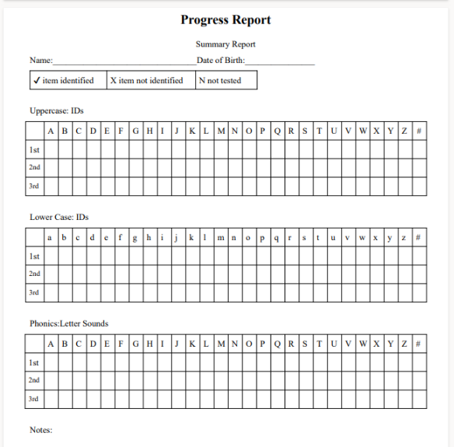

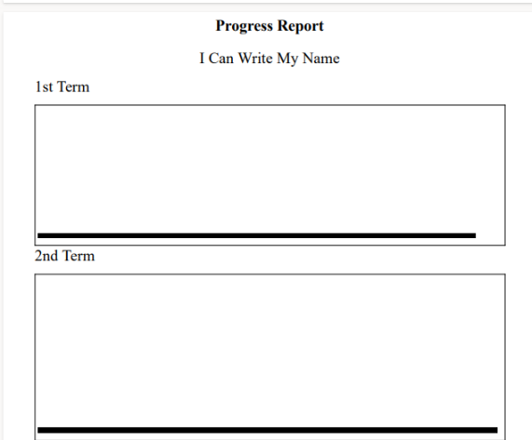
Tracking Informal Formative Data

Slide 38
Summary

Slide 39
Pre-K Language and Literacy Screening: Things to Remember
It includes all students.
It occurs three times each year (i.e., fall, winter, spring).
It identifies students who may need additional support.
It allows for an evaluation of the effectiveness of core instruction.
It depends on tools and data analysis processes that are efficient, valid, reliable, and relevant/feasible for your context.

Slide 40
Current Pre-K Language and Literacy Projects in Massachusetts
Pre-K Language and Literacy Assessments (AIR)​
  Master agreement​
  Technical assistance and webinars​
Literacy Launch Institutes (HILL for Literacy)
Curriculum Review Rubric

Slide 41
References
Annie E. Casey Foundation. (2013). Early warning! Why reading by the end of third grade matters (Special report). http://www.aecf.org/resources/early-warning-why-reading-by-the-end-of-third-grade-matters/
Center on Multi-Tiered System of Supports. (2025). Screening. https://mtss4success.org/essential-components/screening
Hjetland, H. N., Brinchmann, E. I., Scherer, R., & Melby‐Lervåg, M. (2017). Preschool predictors of later reading comprehension ability: A systematic review. Campbell Systematic Reviews, 13(1), 1–155.
Missall, K., Artman-Meeker, K., Roberts, C., & Ludeman, S. (2020). Implementing Multitiered Systems of Support in preschool: Begin with universal screening. Young Exceptional Children, 24(4), 213–224.
National Early Literacy Panel. (2009). Developing early literacy: Report of the National Early Literacy Panel: A scientific synthesis of early literacy development and implications for intervention. Jessup, MD: National Institute for Literacy
Zucker, T., Mesa, M., Crawford, A., Spear, S., & Cabell, S. (2022). Six Resources for Making the Most of Family-Educator Conferences. YC Young Children, 77(4), 52-58.

