Slide 1
Early Childhood Experiences Data Element (DOE050)
Originally Presented September 2019
Updated February 2021

Slide 2
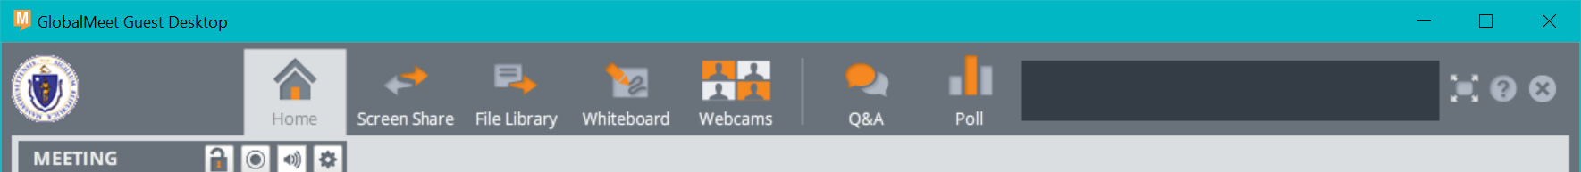
Question directions
Please enter questions in the Q&A tool at the top of the screen.
We will answer all questions at the end of the presentation.

Slide 3
What is DOE050?
Who should you be collecting data for DOE050?
  Incoming, first-time Kindergarten students
How to collect data for DOE050?
  Use of the Family Survey
Purpose of DOE 050?
  To gather data on the student’s early childhood experiences in the year prior to preschool

Slide 4
Examples of Uses of the DOE050 Data
 | State | Local
Analysis of kindergarten students with early childhood experience | X | X
Universal preschool program planning | X | X
Patterns of usage/dosage | X | X
Correlation to experience and K-3 outcomes | X | X
Understanding feeder patterns and opportunities for collaboration with community-based preschool providers and family engagement programs |  | X

Slide 5
Types of Questions These Data May Address
What are the differences in academic performance in Grade 3 between children who did and did not have at least one year of a full time preschool experience?
What percentage of students in our school/district had preK educational experiences, and what percentage had none?
For students who did have some preK experiences in group settings, which programs did they attend? What collaboration(s) exist to create greater alignment around high quality preschool opportunities?

Slide 6
Coding for the data element
Student Information Management System (SIMS):

Slide 7
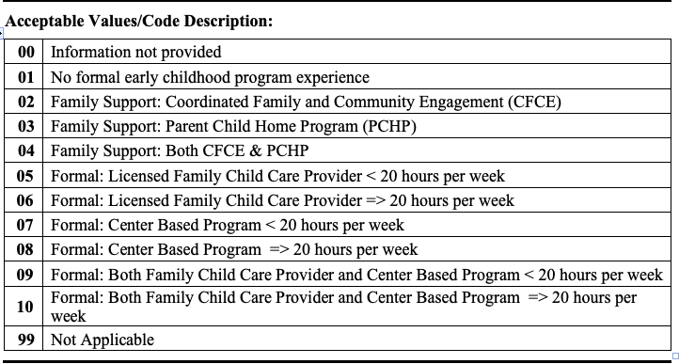
Early Childhood Experience: DOE050

Slide 8
Guidance for completing with families
Family Survey:

Slide 9
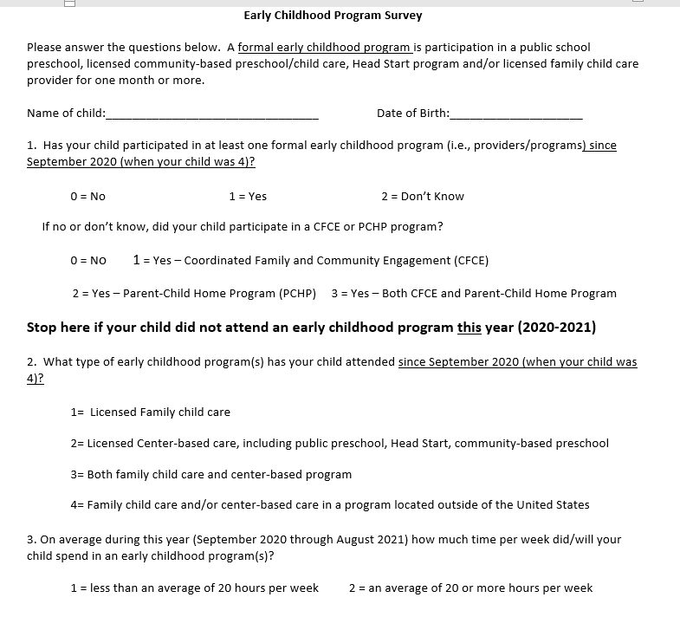
Early childhood Program Survey

Slide 10
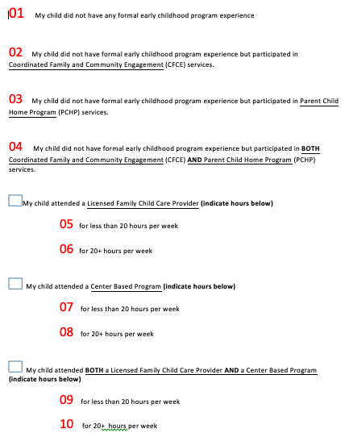
Survey with Codes

Slide 11
Family Survey
Formal Early Childhood Experience:
  Licensed Family Childcare: refers to EEC licensed child care in a group setting in a home. It may include care in the home of a family member, if the provider is both a relative and an EEC licensed child care provider providing care to children from multiple families.
  Center-Based Care: refers to care for children in a group setting, including public and private preschools, Head Start, early education and care centers, and inclusive public preschools.

Slide 12
Family Survey Cont.
Informal Early Childhood Experience
  Coordinated Family and Community Engagement (CFCE) Services: locally based programs serving families with children birth through school age (e.g. parent/child playgroups, parent-child activities).
    CFCE Search
  Parent Child Home Program (PCHP): home visiting model program funded through the Department of Early Education and Care.
    PCHP Search

Slide 13
Family Survey Cont. 2
Survey should be administered to families of all incoming, first-time kindergarten students at a time that makes sense for the district and its families (e.g., kindergarten registration; kindergarten screening; kindergarten orientation)
Questions can be added to the survey but the current questions cannot be changed (e.g., name of preschool/program child attended)
Whenever possible, families should have someone in the district who can assist (e.g., answer questions, translate, provide prompts, ask follow-up questions, etc.).
For families who opt to not complete but whose student was enrolled in the public preschool, the district can complete the survey based on district enrollment data.

Slide 14
Lessons learned from year 1 (2018-2019), Year 2 (2019-2020), and Year 3 (2020-2021)
Tips and Technical Assistance

Slide 15
When to Use Codes 00 and 99
00 is used only for those incoming Kindergarten students whose families did not provide the information and the child was not enrolled in the district’s public preschool
99 is used for:
  Public preschool students (mandatory)
  Public school students in grades 1 through 12
    *99 is not mandatory for students in grades 1 through 12. These students can have a non N/A value in this element if it is carried forward in the SIS from when the student was in Kindergarten.

Slide 16
Strengthening Data Quality:
Other Tips and Areas of Technical Assistance
Collaboration between district Data Coordinators and whoever coordinates kindergarten enrollment (e.g., early childhood coordinators, elementary principals, etc.)
Enrollment in Public Preschool
  As a data double check
  For families who answer “no” to the first question
Addressing language needs of families: the survey is available in: Arabic, Cape Verdean Portuguese, English, Haitian Creole, Mandarin, Portuguese, and Spanish
Tool for survey completion: MA Department of Early Education and Care(EEC) Child Care Search Engine
Timing

Slide 17
Questions
QUESTIONS??

Slide 18




Thank you
THANK YOU
MA Department of Elementary and Secondary Education’s Early Learning Team
781-338-3010
achievement@doe.mass.edu
www.doe.mass.edu
75 Pleasant Street, Malden, MA 02148

