Slide 1
2024-2025 Homeless and Foster Care Students
Data Collection
“Please be advised that DESE does not authorize attendees to record or to use AI transcription tools during the meeting and DESE does not endorse any unauthorized transcripts created by third parties of its meetings.”

Slide 2
Why Data Collection?
Data can help us better understand student needs and impacts on student learning. In some cases, the needs and impacts can be anticipated.
Examples of needs and district supports include food pantries, supply closets, backpacks, tutoring and social emotional support.
Data has been used in the community/state to support children and youth who are homeless or in foster care.

Slide 3
Data Collection Requirements
USED requires homeless liaisons and foster care points of contact to report enrolled students who are:
  Identified as homeless
    their living arrangement at the time they are identified, and
    whether they are unaccompanied
  In foster care
USED also requires reporting on the number of enrolled students in migratory and active military families.
This is used for accountability and to determine funding.

Slide 4
When should students be reported
Students should be reported when they are identified including
  at enrollment,
  when district staff learn that an already enrolled student has become homeless or placed in foster care,
  when Migrant Education Program (MMEP) screens as migratory, or
  the parent voluntary self-reports as active military.
Only students enrolled in the district should be entered
Do not enter a student who is sheltered/placed in the district and transported back to his/her school of origin in another district.

Slide 5
Massachusetts Migrant Education Program
The use of Migrant Screeners at enrollment can increase identification.
MMEP Vendor does the data collection and reports to DESE
Districts do not need to report this data but should be aware of identified students to ensure their educational rights.
If migratory students are in homeless living arrangements, they must be reported as homeless. MMEP is trained to identify homelessness and can provide verification.

Slide 6
Military Interstate Children’s Compact Commission (MIC3)
Data Collection of students in active military families:
Parents must be provided with the opportunity to voluntarily self-identify as active military.
Schools are required to collect data and report to DESE.
DESE is required to report it to Federal Government.
This data should be entered in the SIS and is transmitted to DESE via SIF.

Slide 7
Data Communication
SIF
Schools Interoperability Framework
Takes the district data and transfers it to DESE
Upload occurs every night!
SIS
Student Information System
District
All students enrolled and attending in a district
Homeless/foster care flags
Security Portal
Homeless and Foster Care App
DESE
District assigns the Homeless and Foster Care Student App Role
Edits and certification of data by District Designee
Notes:
If there are any left – districts not on sif are legacy districts and have to enter the data directly to the security portal . More on that later on presentation.

Slide 8
How to enter student data
Your Student Information System (SIS) displays homeless and foster care flags. These flags should be selected whenever a student becomes homeless or enters foster care.
If a student becomes homeless, select the homeless flag.
  You will then be prompted to select the dwelling arrangement (*sheltered, doubled-up, unsheltered, or hotel/motel when first identified). (*Traditional shelter versus emergency shelter expansion students.)
  You will be further prompted to indicate whether the student is also unaccompanied (Yes, No).
If the student has been placed in foster care (students in 24-hour, out-of-home care, away from parent/guardian, and for whom DCF has care and placement responsibility), select the foster care flag.
  There are no further prompts.
Notes:
*Traditional homeless students versus emergency shelter expansion students.

Slide 9
Emergency Shelter Expansion Sites
80+ emergency shelter expansion sites which include hotels and motels, temporary respite centers (TRCs) across the commonwealth to meet the demand.
Districts where these emergency shelter expansion sites were located are using a specific emergency shelter expansion flag to indicate the students’ enrollment.
This Emergency Shelter Expansion Flag must be entered manually in the portal. SIF does not transmit this data from SIS for this flag.

Slide 10

Eligible Students for Emergency Shelter Flag
Placed in an eligible emergency expansion shelter site in your community and enrolled in your district
Including students:
  who have since moved to another shelter placement, and who continue to be enrolled in your district

Slide 11
Emergency Shelter Expansion Sites Identification
Please be sure to update the Homeless and Foster Care Application to ensure that ONLY those eligible students enrolled after October 1, 2023 are identified with the “Emergency Shelter Expansion” checkbox.
Please continue to identify students who have newly enrolled in your district and are placed in an eligible emergency expansion shelter in your community by checking the “Emergency Shelter Expansion” checkbox.

Slide 12

Non-Eligible Students for Emergency Expansion Site Flag
Students experiencing homelessness who are not eligible for this flag include students who are:
Doubled up
Placed in a traditional shelter
Unsheltered (cars, parks, campgrounds, abandoned buildings, and substandard/inadequate housing)
Hotels/motels (that are not part of the state shelter system)
*Do not check the “Emergency Shelter Expansion” check box for these students.

Slide 13
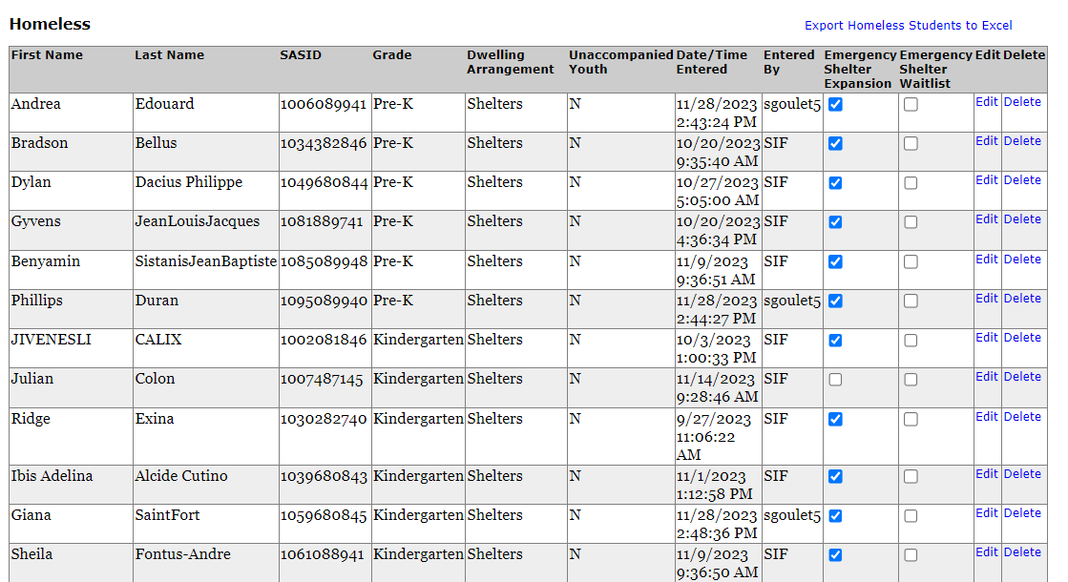



What does the “new” flag look like
Notes:
No longer a waitlist but more a contact list per Shirley

Slide 14
AGAIN!
Do not check the “Emergency Shelter Expansion” box for the non-eligible students!
Most of you know who you are that need to check this box at this point anyway!

Slide 15
Data transmission to DESE
The next time SIF runs, the data will be transferred to the Department of Elementary and Secondary Education (DESE) automatically.
Keep your SIS current. Be sure to turn off the homeless/foster care flags when the student becomes housed or exits foster care. (Districts can turn off their flags in SIS when students exit status if SIF already pulled that information over to DESE.)
SIF will not update DESE data once a student has been reported as homeless or in foster care. This allows the district/school to use the SIS to notate the student's most current status without impacting the data required by the US Department of Education (USED).
  Remember a homeless student that becomes housed during the school year retains the right to enrollment and transportation for the remainder of the school year.
Notes:
Districts can turn off their flags in sis when students exit status if SIF already pulled that information over to DESE.

Slide 16
Existing homelessness or foster care
End-of-year certification will still need to done in the security portal but all the district's/school's data should be entered and ready for a review.
As long as the SIS is up-to-date by the end of July only those students who are still homeless or in foster care will be carried over to the next school year.
This will save data entry time at the start of the school year!

Slide 17
Updating your Student Information System (SIS)
If the district’s SIS is kept up-to-date with the student’s current status, they will be accurately reported for the year(s) in which they are homeless or in foster care.
This data collection is cumulative and on-going for each school year. Though the data is not certified and submitted until the end of the school year (usually July), it is important to have it up-to-date on October 1st.

Slide 18
Legacy Districts and Schools
For Districts not on SIF:
Your students who are homeless and/or in foster care should be reported directly in the security portal. You will need their SASID and grade.
  For students who are homeless enter the dwelling arrangement when first identified and select Y (yes) or N (no) for unaccompanied youth.
  For students in foster care there no further data is needed.
Please remember that it is important for the district’s data to be up-to-date on October 1st.

Slide 19
Accessing the Homeless and Foster Care Student Application
Homeless and foster care data is stored in the DESE security portal. As a homeless liaison or foster care point of contact you must have access to the security portal.
You must be assigned the Homeless and Foster Care Student Application by the school district's Directory Administrator. See Directory Administrator page for further information.
Once you are assigned the role as a user, Homeless and Foster Care Students will appear on your application list.

Slide 20
Data Entry
School Year 2024-2025 Homeless and Foster Care Student Data Collection
On the first screen of the application scroll down and
  select your organization or district from the dropdown menu,
  select the school year and
  click on Next.

Slide 21
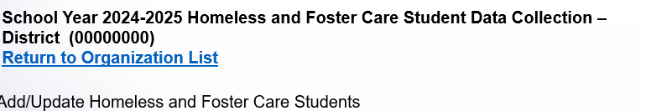
Add/Update Screen
On this screen you will see a list of the district’s students who are homeless followed by a list of students in foster care.
Note: It is possible that a student was both homeless and placed in foster care during the school year. That student should be entered in both categories and will appear on both lists.

Slide 22
For students in foster care
  Under “Add Student” select foster care
  Enter the student's SASID number
  Select his/her grade; and
  Click on Add Foster Care Student

Slide 23
For students who are homeless
Under “Add Student” select Homeless
Enter the student's SASID number
Select his/her grade
Select the dwelling arrangement (Primary Nighttime Residence),
    (Sheltered, Doubled-up, unsheltered, or hotel/motel when first identified)
Unaccompanied youth ? — click on Yes or No; and
Click on Add Homeless Student

Slide 24
Once a Student is Entered
The student will appear on the list of reported students on your Add/Update screen after SIF has transmitted the data or you have entered the student directly.
A few tips:
The Edit function is for correcting any data entry errors. For example, should numbers in the SASID be transposed.
The dwelling arrangement should not be updated in the security portal unless it is missing or erroneous.
The delete function is used only if a student is erroneously entered.
  Do not delete or update students in the security portal if they become permanently housed or leave foster care.
  This data collection is a cumulative count for the school year.

Slide 25
To Close Out the School Year
The Certify/Submit function
  is enabled when it is time to close out data entry for a school year; usually June through mid-July and
  allows districts to review and certify the accuracy of the data and finalize and submit it.
Homeless liaisons and foster care points of contact are reminded when this function is enabled (early June) and as the due date nears (mid-July).

Slide 26
Is Your Data Accurate?
Review the data as it appears on each list.
  Correct any missing or inaccurate data.
  Remember for students who are homeless the reported dwelling arrangement should be where the student was at the time they were first identified.
Click on the certify checkbox to confirm the data is accurate.
  You will not be able to complete this step if there is missing data.

Slide 27
Submitting the Data
Click on the Submit button.
Once the data has been certified/submitted, no more students can be entered. Should the Certify/Submit function be erroneously engaged, please contact us and we will manually reverse the designation.
A district that has not enrolled or identified any students who are homeless or in foster care must still Certify/Submit its data, and by doing so, certifies that no homeless or foster care students were enrolled.

Slide 28
Next School Year
Once the school year closes, data collection is ready for the new school year at the beginning of August.
Assuming your SIS is up to date, only those students who remain homeless or in foster care will be carried over to the next year.
The homeless and foster care lists are usually populated in the security portal by SIF around mid/end of August.

Slide 29
Resources
Directory Administration Page
Data Collection Guidance
For questions on submitting homeless or foster care student data, please contact Christine.H.Cowen@mass.gov

Slide 30
Due date for Certify & Submit:
This year, 2024-25 data must be certified and submitted by
Friday, July 11th.

Slide 31
Thank You for Joining the Educational Stability Team today!

