Slide 1
Homeless and Foster Care Students Data Collection
“Please be advised that DESE does not authorize attendees to record or to use AI transcription tools during the meeting and DESE does not endorse any unauthorized transcripts created by third parties of its meetings.”
SY 2025-2026

Slide 2
Why Data Collection?
Besides being a requirement by federal law...
Data can help us better understand student needs and impacts on student learning. In some cases, the needs and impacts can be anticipated.
Examples of needs and district supports include food pantries, supply closets, backpacks, tutoring and social emotional support.
Data has been used in the community/state to support children and youth who are homeless or in foster care.

Slide 3
Data Collections Requirements
USED requires homeless liaisons and foster care points of contact to report enrolled and attended students who are:
Identified as homeless
their living arrangement at the time they are identified, and
whether they are unaccompanied
In foster care
USED also requires reporting on the number of enrolled and attended students in migratory and active military families.
This is used for accountability and to determine funding.

Slide 4
When should students be reported?
Students should be reported when they are identified including
at enrollment,
when district staff learn that an already enrolled student has become homeless or placed in foster care,
when Migrant Education Program (MMEP) screens as migratory, or
the parent voluntary self-reports as active military.
Only students enrolled and attended in the district should be entered
Do not enter a student who is sheltered/placed in the district and transported back to his/her school of origin in another district.

Slide 5
Massachusetts Migrant Education Program
The use of Migrant Screeners at enrollment can increase identification.
MMEP Vendor does the data collection and reports to DESE
Districts do not need to report this data but should be aware of identified students to ensure their educational rights.
If migratory students are in homeless living arrangements, they must be reported as homeless. MMEP is trained to identify homelessness and can provide verification.

Slide 6
Military Interstate Children’s Compact Commission (MIC3)
Data Collection of students in active military families:
Parents must be provided with the opportunity to voluntarily self-identify as active military.
Schools are required to collect data and report to DESE.
DESE is required to report it to Federal Government.
This data should be entered in the SIS and is transmitted to DESE via SIF.

Slide 7
Data Communication
SIF
Schools Interoperability Framework
Takes the district data and transfers it to DESE
Upload occurs every night!
SIS
Student Information System
District
All students enrolled and attending in a district
Homeless/foster care flags
Security Portal
Homeless and Foster Care App
DESE
District assigns the Homeless and Foster Care Student App Role
Edits and certification of data by District Designee

Slide 8
How to enter student data
Your Student Information System (SIS) displays homeless and foster care flags. These flags should be selected whenever a student becomes homeless or enters foster care.
If a student becomes homeless, select the homeless flag.
You will then be prompted to select the dwelling arrangement (sheltered, doubled-up, unsheltered, or hotel/motel when first identified).
You will be further prompted to indicate whether the student is also unaccompanied (Yes, No).
If the student has been placed in foster care (students in 24-hour, out-of-home care, away from parent/guardian, and for whom DCF has care and placement responsibility), select the foster care flag.
There are no further prompts.

Slide 9
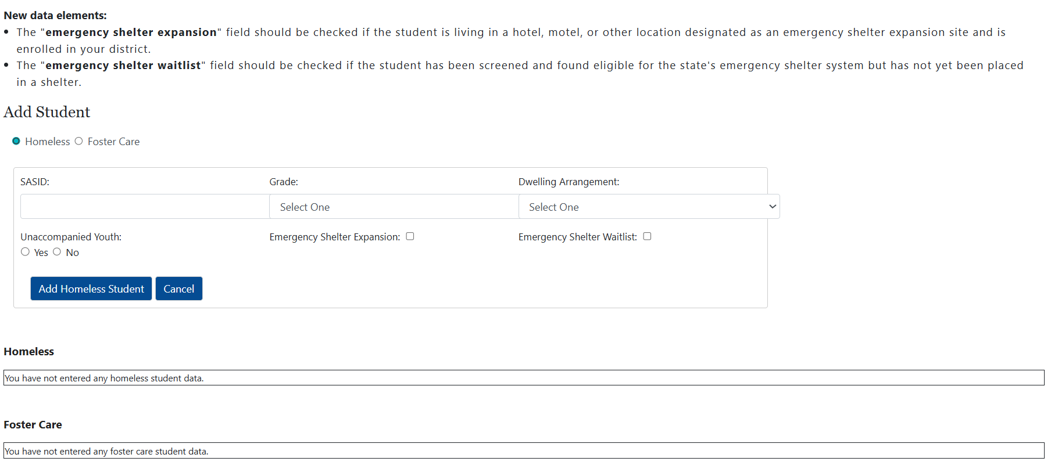
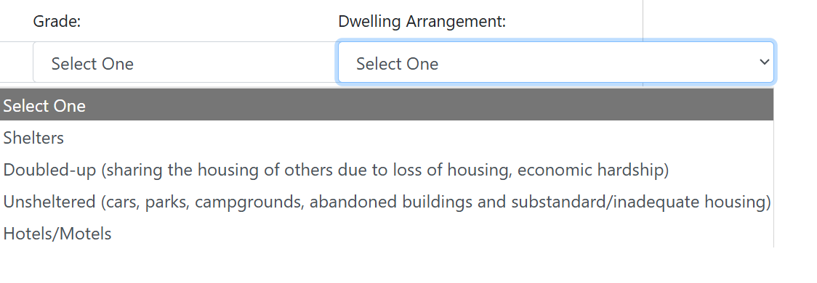
Ignore Emergency Shelter Expansion Sites
The "New" data elements should be ignored since Emergency Shelter Expansion Sites are no longer operational.
Dwelling arrangements should be chosen from the drop-down menu only.
DO NOT check the Emergency Shelter Expansion button nor the Emergency Shelter Waitlist button!
Do check-off yes or no for Unaccompanied Youth.

Slide 10
Data transmission to DESE
The next time SIF runs, the data will be transferred to the Department of Elementary and Secondary Education (DESE) automatically.
Keep your SIS current. Be sure to turn off the homeless/foster care flags when the student becomes housed or exits foster care. (Districts can turn off their flags in SIS when students exit status if SIF already pulled that information over to DESE.)
SIF will not update DESE data once a student has been reported as homeless or in foster care. This allows the district/school to use the SIS to notate the student's most current status without impacting the data required by the US Department of Education (USED).
Remember a homeless student that becomes housed during the school year retains the right to enrollment and transportation for the remainder of the school year.

Slide 11
Existing homelessness or foster care
End-of-year certification will still need to done in the security portal but all the district's/school's data should be entered and ready for a review.
As long as the SIS is up-to-date by the end of July only those students who are still homeless or in foster care will be carried over to the next school year.
This will save data entry time at the start of the school year!

Slide 12
Updating your Student Information System (SIS)
If the district’s SIS is kept up-to-date with the student’s current status, they will be accurately reported for the year(s) in which they are homeless or in foster care.
This data collection is cumulative and on-going for each school year. Though the data is not certified and submitted until the end of the school year (usually July), it is important to have it up-to-date on October 1st.

Slide 13
Legacy Districts and Schools
For Districts not on SIF:
Your students who are homeless and/or in foster care should be reported directly in the security portal. You will need their SASID and grade.
For students who are homeless enter the dwelling arrangement when first identified and select Y (yes) or N (no) for unaccompanied youth.
For students in foster care there no further data is needed.
Please remember that it is important for the district’s data to be up-to-date on October 1st.

Slide 14
Accessing the Homeless and Foster Care Student Application
Homeless and foster care data is stored in the DESE security portal. As a homeless liaison or foster care point of contact you must have access to the security portal.
You must be assigned access to the Homeless and Foster Care Student Application by the school district's Directory Administrator. See Directory Administrator page for further information.
Once you are assigned the role as a user, Homeless and Foster Care Students link will appear on your application list.
Notes:
Imperative to keep your user information up to date in the portal as well in the DESE profile. If a new staff person has taken over a role then be sure to update profiles but also remove someone no longer in the role. Only identified users in the portal can maintain the homeless and foster care data.

Slide 15
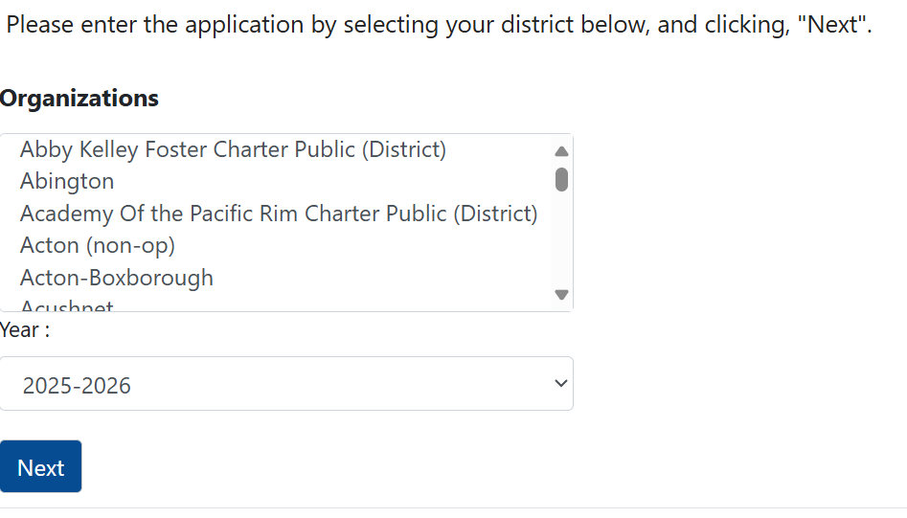
Data Entry
School Year 2025-2026 Homeless and Foster Care Student Data Collection
On the first screen of the application scroll down and
select your organization or district from the dropdown menu,
select the school year and
click on Next.

Slide 16
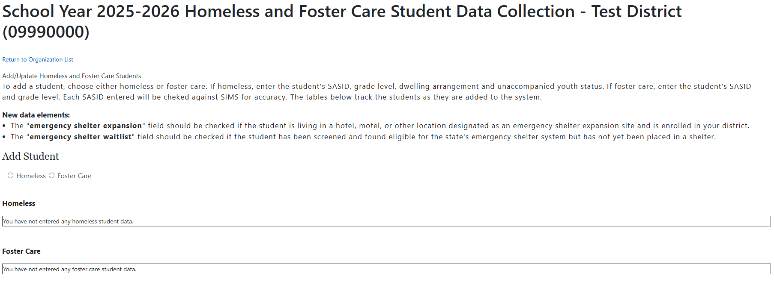
Add/Update Screen
On this screen you will see a list of the district’s students who are homeless followed by a list of students in foster care.
Note: It is possible that a student was both homeless and placed in foster care during the school year. That student should be entered in both categories and will appear on both lists.

Slide 17
For students in foster care
Under “Add Student” select foster care
Enter the student's SASID number
Select his/her grade; and
Click on Add Foster Care Student

Slide 18
For students who are homeless
Under “Add Student” select Homeless
Enter the student's SASID number
Select his/her grade
Select the dwelling arrangement (Primary Nighttime Residence),
(Sheltered, Doubled-up, unsheltered, or hotel/motel when first identified)
Unaccompanied youth ? — click on Yes or No; and
Click on Add Homeless Student

Slide 19
To Close Out the School Year
The Certify/Submit function
is enabled when it is time to close out data entry for a school year; usually June through mid-July and
allows districts to review and certify the accuracy of the data and finalize and submit it.
Homeless liaisons and foster care points of contact are reminded when this function is enabled (early June) and as the due date nears (mid-July).
Data certification only happens at the end of the school year.

Slide 20
Is Your Data Accurate?
Review the data as it appears on each list.
Correct any missing or inaccurate data.
Remember for students who are homeless the reported dwelling arrangement should be where the student was at the time they were first identified.
Click on the certify checkbox to confirm the data is accurate.
You will not be able to complete this step if there is missing data.
Notes:
Make sure your data is correct because it could have an effect on funding. An example is circuit breaker recently and foster care data.

Slide 21
Submitting the Data
Click on the Submit button.
Once the data has been certified/submitted, no more students can be entered. Should the Certify/Submit function be erroneously engaged, please contact us and we will manually reverse the designation.
A district that has not enrolled or identified any students who are homeless or in foster care must still Certify/Submit its data, and by doing so, certifies that no homeless or foster care students were enrolled.

Slide 22
Next School Year
Once the school year closes, data collection is ready for the new school year at the beginning of August.
Assuming your SIS is up to date, only those students who remain homeless or in foster care will be carried over to the next year.
The homeless and foster care lists are usually populated in the security portal by SIF around mid/end of August.

Slide 23
Resources
Directory Administration Page
Data Collection Guidance
For questions on submitting homeless or foster care student data, please contact Christine.H.Cowen@mass.gov

Slide 24
Due Date for Certify & Submit
This year, 2025-2026 data must be certified and submitted by
Friday, July 10th 2026.

Slide 25
Thank you for Joining the Educational Stability Data Collection webinar today!

