Slide 1
Educational Stability
3A. Best Interest Determinations

Slide 2
Educational Training Series
Welcome to the Educational Stability Training Series!
All children have a right to a public education.
Some children experience barriers to accessing that education as a result of high mobility.
The Every Student Succeeds Act (ESSA) and the Valor Act ensure unique educational rights for highly mobile students in foster care, in migrant and military families and who are homeless.
This module focuses on best interest determinations for students in foster care (also known as BIDs).

Slide 3
The Why and the Who of it.
Ensure unique educational rights for highly mobile students
Every Student Succeeds Act of 2015
Foster Care Students
Homeless Students
Massachusetts Valor Act of 2012
Military Connected Students
Migrant Students

Slide 4
Legal
Every Student Succeeds Act of 2015
Massachusetts Valor Act of 2012
Extends specific educational rights to these highly mobile students to ensure educational stability and their opportunity to succeed in school.
Establishes participation in the Military Interstate Children's Compact Commission
Ensuring assistance with transitions for timely enrollment, placement, eligibility, on-time graduation, and attendance.

Slide 5
Highly Mobile Students
Students who are in 24-hour out-of-home care, away from their parent(s)/legal guardian(s) and for whom DCF has care and placement responsibilities.
Foster Care
=
Students who lack fixed regular and adequate nighttime residence including those who are sharing the housing of others due to economic hardship, loss of housing or similar reason.
Homeless
=
Students or students’ parent(s)/guardian(s) who are a migratory agricultural worker, fisher, or food/fish processor, are under 21, have not completed high school, and have moved across district lines within the preceding 36 months.
Migrant
=
Students whose parent/guardian is an active member of the uniform services, or has been medically discharged, retired, or died in active duty within the past year.​
Military
=
Please see module 2. Identification for detailed definitions.

Slide 6
Content
 | What is a Best Interest Determination?
 | When and Who Should Be Included?
 | A Template for Best Interest Determination
 | Revisiting a Best Interest Determination
 | What If There Is No Agreement?
 | Contact Information
1
2
3
4
5
6

Slide 7
What is a Best Interest Determination ?
1

Slide 8
Definition Review – Students in Foster Care
Students who are in foster care are:
  In 24-hour out-of-home care, placed away from their parents or guardians, and
  for whom the Department of Children and Families (DCF) has care and placement responsibilities.
School of Origin for students in foster care:
  School the student was attending when placed in foster care, or at the time of a subsequent change in foster care placement.

Slide 9
Best Interest Determinations - defined
Best Interest Determinations, or BIDs, are mandated in ESSA, Title 1A to promote educational stability for students in foster care.
  They are collaborative discussions between the child welfare agency, DCF, and the school district where the student is enrolled and attending.
  The purpose is to come to a consensus on where the student should be enrolled at the time of a change in the student’s foster care placement.
The law presumes that students should remain enrolled in their school of origin, unless, after a best interest determination, it is decided to be in their best interest not to.

Slide 10
Best Interest Determinations – defined: Continued
A Best Interest Determination is not a special education team meeting.
While special education programming and services may come up in discussions, a BID is not the place to update/amend Individual Education Programs (IEPs), or to change special education services or placements. These are two distinctly different processes. BIDs must be done first to resolve enrollment questions.
Students in foster care have access to all special education rights and procedures. These should be followed as needed after enrollment is determined.
Students who remain in the same out-of-district placement (their school of origin) should remain enrolled in their district of origin (the district in which the student was enrolled at the time of the DCF placement).

Slide 11
Students in Special Education Public/Private Day Programs
Remain in SOO
Continue to attend the same public/private day (SOO)
Enroll Locally
Enroll immediately in new district
Convene a team to follow student’s services
Remain enrolled in DOO (no change to enrollment)
New district provide services comparable to those called for in IEP (e.g., ID new public/private day program)
BID decision:

Slide 12
Transitions outside the BID process
Just as students enter foster care and move from placement to placement there are also students who leave foster care. This happens when students are reunified, are adopted or transition out of DCF care at 18 years old.
During these transitions the law does not require a BID to take place and the student no longer has a right to their school of origin (unless they reside in the district) or to transportation.
However, the success of these transitions often hinges on the collaboration and thoughtful planning of all parties including education.
Both district and DCF POCs are strongly encouraged to work collaboratively on supporting smooth transitions and continued student success.

Slide 13
When and Who Should Be Included?
2

Slide 14

A Seat at the
(Metaphorical) Table
Consider the unique needs of the student and other factors…
Student (if appropriate), parent/guardian, foster parent
DCF Social worker, education coordinator
SOO District POC, special education, guidance counselor, teacher
Educational decision maker (EDM), legal representative
LSD District POC – from district of foster placement, (if appropriate)
Notes:
Factors to consider include:
Age/grade level
Connections to school
Distance/time to school
Anticipated time in placement
Availability of services to meet students needs, etc.
Parties to include:
DCF, student (if appropriate), family/foster family, any educational decision makers
District of origin, school personnel, local school district (where student is placed in foster care, if appropriate)

Slide 15
Best Interest Determinations - Who Participates ?
Decisions about which school a student will attend should be made collaboratively
Include those in the best position to understand the student’s unique needs
  DCF, student (if appropriate), family/foster family, any educational decision makers
  District of origin, school personnel, local school district (where student is placed in foster care, if appropriate)
Process should be collaborative…
  …but does not need to be one big meeting

Slide 16
Best Interest Determinations – When?
A Best Interest Determination must take place every time a student’s foster care placement changes – even if there is no intention of changing a student’s school.
A Best Interest Determination can be revisited at anytime.

Slide 17
Best Interest Determinations - considerations
Consider the unique needs of the student, including factors such as, but not limited to:
  student’s age and grade level;
  student’s preference, when age appropriate;
  student’s attachment to the school, including meaningful relationships with staff and peers;
  placement of the student’s sibling(s);
  distance/length of time to travel to/from school;

Slide 18
Best Interest Determinations – more considerations
Consider the unique needs of the student, including factors such as, but not limited to:
  time of academic year, academic performance, and skills;
  anticipated length of time in placement, and whether reunification is the family goal;
  number of placements to date;
  ability to maintain family relationships and engagement (including in extracurricular activities, where appropriate);

Slide 19
Best Interest Determinations – still more considerations:
Consider the unique needs of the student, including factors such as, but not limited to:
  clinical/behavioral issues;
  influence of the school climate on the student, including safety issues;
  availability and quality of the services in the school to meet the student’s educational and social emotional needs; and
  availability of special education/504 services, if applicable

Slide 20
Best Interest Determinations – and more considerations
  Parties may want to consider if the school of origin is in the best interest but only for a limited duration of time (e.g., until the end of the school year, the end of a testing or grading period, or the end of a particular grade).
  Parties involved in the decision may wish to determine a time to revisit the question of whether it is in the student’s best interest to remain in the school of origin or enroll locally.
  Transportation costs should not be a factor in determining the best interest for the purposes of school selection.
Notes:
Just a transportation costs should not be a factor in determining best interest for the purpose of school selection; the anticipated lack of transportation not being available should not factor into the decision. Districts need to make a good faith effort to obtain transportation. In the interim or short term, the district and work with DCF to provide transportation as the district is trying to arrange for long term transportation needs.

Slide 21
3
A Template for Best Interest Determination

Slide 22
Best Interest Determination Template
The following template is offered as a guide to best interest determinations and provides a way of documenting the outcomes.
It is not required but we hope you find it helpful.
The template is posted for download at the DESE Foster Care Page.

Slide 23
Best Interest Determination Process Overview

Slide 24
Best Interest Determination Process
Step 1 – BID is initiated for a foster care student.
DCF places student in Foster Care
OR
DCF changes student’s Foster Care placement
DCF Initiates Best Interest Determination (BID)
Goal: BID Completed within 5 school days
The BID should include meaningful consultation with individuals who understand the student’s unique needs.

Slide 25
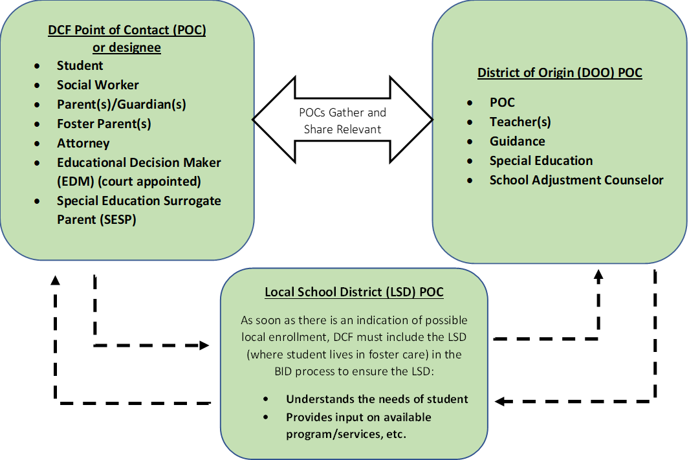
Collaboration
Step 2 – School Districts and DCF Collaborate
Note
Collaborators may want to consider if the school of origin is in the best interest but only for a limited duration of time.
Collaborators involved in the decision may wish to determine a time to revisit the question of whether it is in the student’s best interest to remain in the school of origin or enroll locally.
Transportation costs should not be a factor in determining the best interest for the purpose of school selection.
Gather and Share Relevant Factors
Gather and Share Relevant Factors

Slide 26
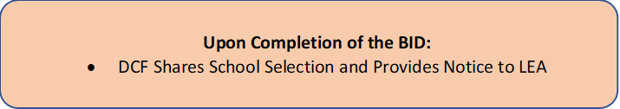
Determination
Step 3 – Upon Completion of BID
Note
Notice to LEA from DCF - includes Emergency contact, residence, social worker, record release, transportation needs, etc.

Slide 27
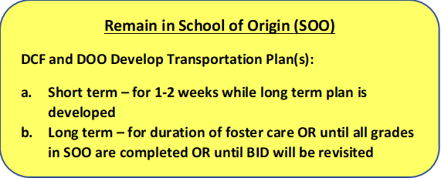
Determination: School of Origin
Step 4a – Remain in School of Origin
Note
School of origin - school the student was attending when placed in foster care, or at time of a subsequent change in foster care placement.
Districts must collaborate with DCF to establish policies and procedures to ensure that students who need transportation to remain in their school of origin get it.
Absent another agreement, districts of origin are responsible for providing transportation to and from the school of origin.
Districts should document all costs associated with this transportation.

Slide 28
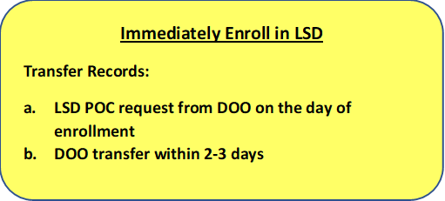
Determination: Immediate Enrollment
Step 4b – Immediately Enroll in Local School District
Note
If determined to be in a student’s best interest to attend school locally (where placed in foster care), district must enroll immediately.
With or without documentation
District POCs should initiate records transfer, help facilitate transition
***Remember if there is no change in school of origin, there should be no change in enrollment.

Slide 29
Best Interest Determination Worksheet

Slide 30
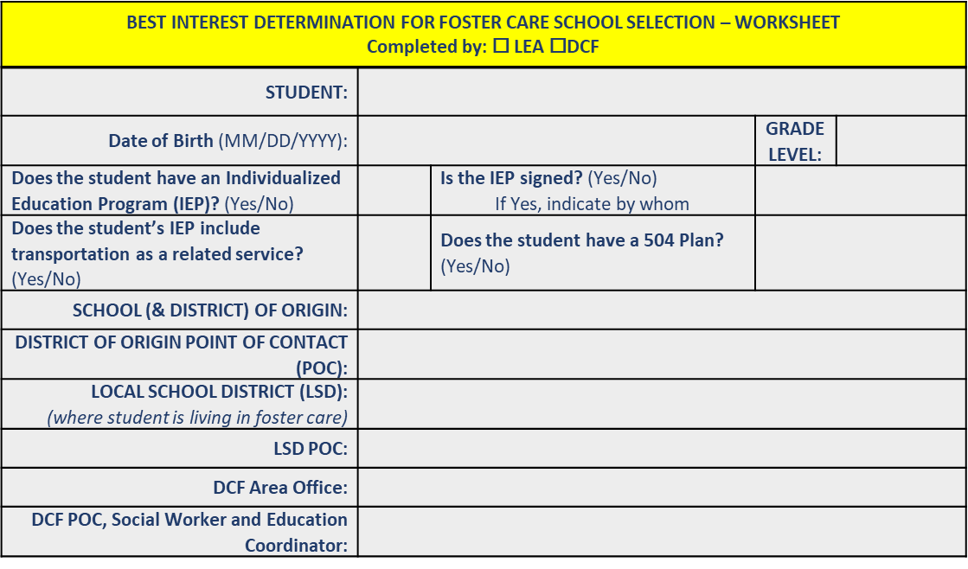
Section One

Slide 31
Section Two

Slide 32
Best Interest Determination Worksheet Page 2

Slide 33
Section Three
BID NOTES

Slide 34
Best Interest Determination Worksheet Page 3

Slide 35
IMPORTANT!
NOTE
This process and worksheet are not required, but are encouraged to facilitate and document the required BID.

Slide 36
4
Revisiting a Best Interest Determination

Slide 37
Caution!
Revisiting a BID is not a substitute for maintaining student engagement and/or appropriate services.
Rather it is a chance to be sure a student’s enrollment is working for the student given various changes the student is experiencing.

Slide 38
Why revisit a Best Interest Determination
A BID is made at a point in time and based on a certain set of facts. Sometimes those facts change and may affect what is in the student’s best interest.
A BID may be revisited at the request of any party when there have been changes in:
    any of the considerations of the original BID
    the student’s personal needs (e.g., sibling moves)
    the district’s services or learning modes, or
    if the original BID set benchmarks that have/have not been met.

Slide 39
Revisiting a Best Interest Determination
For example, siblings may each remain in their school of origin to support each other. But when the older student completes all the grades in the school the younger student is left behind. The BID might be revisited to determine if the younger student’s enrollment should be changed too.
OR
A BID may include a set a time to check back in to see how the student is progressing. An example of this when the student has a long commute back to their school of origin. At the time of the BID everyone agreed it was best for the student to remain in the school of origin. But after several weeks of a long commute the student is falling asleep in school and not keeping up.

Slide 40
What If There Is No Agreement?
5

Slide 41
No Agreement on Enrollment?
If a BID concludes without an agreement on enrollment, DCF will decide which district the student will be enrolled in.
If the district disagrees with the decision of the BID or believes the BID was not conducted correctly, the district’s foster care point of contact may seek guidance from the DESE state foster care point of contact and may initiate the foster care dispute process.

Slide 42
Contact Information
6

Slide 43
Resources – District and Area Office contacts
District liaisons and POCs
  Current list of homeless liaisons and local foster care POCs Updated by the district’s Directory Administrator
  Please verify your contact information
DCF Contacts
  DCF Area Directors (serving as local POCs)
Network of Regional Liaisons
  Carol Baez, Worcester Public schools 508-799-3652
  Jacob Hansen, Framingham Public Schools 508-782-6894
  Julie Mador, New Bedford Public Schools 508-997-4511 x14663
  Stacy Parsons, North Adams 413-776-1677

Slide 44
Resources – DESE/DCF Educational Stability Team
DESE Education Stability Website: http://www.doe.mass.edu/sfs/edstability.html
Technical Assistance: Problem Resolution Services, 781-338-3700
Staff: Christine Cowen, Migrant Education, Military Connected Students
    781-338-6301 Christine.H.Cowen@mass.gov
      Kristen McKinnon, Foster Care Point of Contact
        781-338-6306 Kristen.A.McKinnon@mass.gov
      Jim Morrison, DCF Point of Contact
      617-748-2340 James.J.Morrison@MassMail.State.MA.US
      Sarah Slautterback, State Coordinator< Homeless Education
        781-338-6330 Sarah.E.Slautterback@mass.gov

Slide 45


THANK YOU
Educational Stability, Office of Student and Family Support
781.338.3010
achievement@mass.gov
www.doe.mass.edu/sfs/

