Slide 1
Educational Stability
Office Hours and Training Resources
LEA Assignment Module
Lisa Hanafin
December 1, 2021

Slide 2
CONTENTS
01
Objectives
02
Meet the LEA Assignment Contacts
03
What is LEA Assignment?
04
Regulations 603 CMR 28.10
05
The Move-in Law
06
Homeless Information
07
Foster Care Information
08
Resources, Reminders & Wrap Up
Notes:
We are going to go through……

Slide 3
Objectives
01

Slide 4
Objectives (Continued)
By the end of this module you will know or be able to:
Provide a general definition of “LEA assignment”
Contact appropriate DESE staff for the purpose of LEA assignment/homeless/foster care/migrant & military student(s) and families
Understand the process for requesting an LEA Assignment and know when it is appropriate – this should not be an automatic ask
Know that an LEA assignment is only necessary upon request and is a service provided by DESE only after a student is enrolled in a district and receiving special education services.
Understand the importance of completing the request form with the most accurate, complete information possible
See the importance of working together as agencies for the good of the student

Slide 5
Meet the LEA Assignment Contacts
02

Slide 6
LEA Assignment Contact/Educational Stability Team Members
Lisa Hanafin LEA Assignment Coordinator
            781-338-3367
            Lisa.Hanafin@mass.gov
Members of the Educational Stability Team
Christine Cowen Migrant Education, Military Connected Students Christine.H.Cowen@mass.gov
Kristen McKinnon DESE Foster Care Point of Contact kristen.a.mckinnon@mass.gov
Jim Morrison DCF Education Manager and Point of Contact james.j.morrison@massmail.state.ma.us
Sarah Slautterback Homeless Education State Coordinator Sarah.E.Slautterback@mass.gov
6
Notes:
In addition to the Ed. Stability Team, Jamie Camacho, the Director of Special Education Planning and Policy plays an important part in Special Education and the LEA Assignment Process

Slide 7
What is LEA Assignment?
03

Slide 8
What is an LEA Assignment?
LEA Assignment is a service that DESE provides. DESE is the author of the regulations and the agency in charge of interpreting the regulations in a fair and consistent way.
  This should not be an automatic ask but should be utilized when responsibility is unclear.
LEA Assignment is specifically for highly mobile students that have been found eligible for special education and that have an accepted IEP.
  This does not include student’s who have not been found eligible for special education services.
Remember: An LEA assignment is only necessary upon request and is determined by DESE only after a student is enrolled in a district and receiving special education services.

Slide 9
What is an LEA Assignment Continued:
When students live with their parents or legal guardian and are enrolled in and attend school in the same district, in most cases, that district is programmatically and financially responsible for the student’s special education.
When students are in less traditional living arrangements, we rely on the regulations to define which district is/are responsible programmatically and financially for the students' special education.
Notes:
For the majority of students who live with their parent(s) or legal guardian in a city, town, or regional school district and who are enrolled in and attend school there, the responsibility for special education rests with the school committee of that city, town, or school district.
For students in less traditional living arrangements, including those who reside in hospitals or other institutional settings, residential schools, those who are homeless, and students in foster care, the regulations define which school committee(s) is/are responsible programmatically and financially for the students' special education.

Slide 10


Programmatic & Financial Responsibility
What does programmatic responsibility mean?
  Programmatic responsibility is to provide a special education program to eligible students. Includes responsibilities to:
    identify students, evaluate them, and determine eligibility;
    to convene the IEP Team, propose an IEP, and to implement it;
    to update IEPs, modify them, to assess progress toward goals of IEP, and to provide transition services
What does financial responsibility mean?
  Financial responsibility is paying for the costs of a student’s special education program.
Notes:
Talk to Jamie to clarify:
Programmatic district ensures to include any other district/etc. that needs to be invited to the IEP team

Slide 11
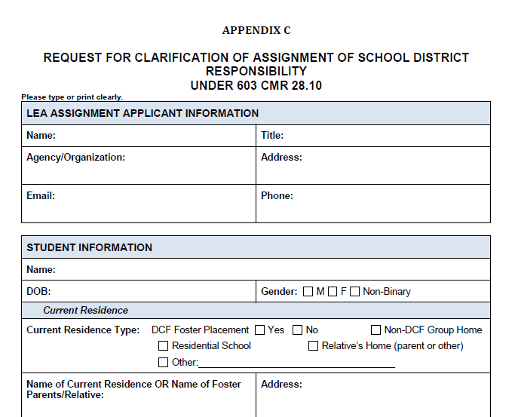
Request for Clarification of Assignment of School District Responsibility
Please use most
  current request
  form
8/2019 is the date
  in the bottom left
  Corner of each page
Any questions
  Call Lisa Hanafin
  781-338-3367
Notes:
This is the top of the first page of the Request for Clarification of Assignment of School District Responsibility or LEA Assignment Request form. This form has been revised several times so please be sure that you are using the most recent form which was revised August 31, 2019. This date is on the bottom left corner of the page.

Slide 12
IMPORTANT!! IMPORTANT!! IMPORTANT!! IMPORTANT!!
LEA Assignment is not the same as Notice to LEA
  LEA Assignment is a service provided by DESE to determine which district is programmatically and financially responsible for a student’s special education program.
  The Notice to LEA, which Follows a BID, is a document used by DCF to inform the schools district(s) that a student in foster care is changing placements. The Notice to LEA can also be used to request records, transportation, and now access to student information systems among other things.

Slide 13
Regulations 603 CMR 28.10
Amended July 1, 2018
04

Slide 14
LEA Assignment Regulations
603 CMR 28.00: Special Education
  603 CMR 28.10: School District Responsibility
Our state regulations set forth rules for allocating programmatic and financial responsibility for all publicly funded students eligible for special education based upon residency and enrollment.
Depending on where a student is considered to reside, responsibility for the student's special education services may fall:
  to the district in which the student is currently living,
  the district in which the student's parent or legal guardian resides, and
  in some cases, responsibility may be shared between them or the districts may be jointly responsible.
  in other cases, responsibility may fall to a district that the student, parent or legal guardian formerly lived. These cases are generally covered under homelessness and foster care.
Remember: An LEA assignment is only necessary upon request and is determined by DESE only after a student is enrolled in a district and receiving special education services.

Slide 15
Regulation Sections of
603 CMR 28.10
  (1) General Provisions.
  (2) School district responsibility based on student residence.
  (3) School district responsibility based on residence of parent(s) or legal guardian.
  (4) Shared school district responsibility.
  (5) Responsibility for Homeless Students and Students in Foster Care.
  (6) Program schools.
  (7) Temporary Assignments.
  (8) Department Assignment of School District Responsibility.
  (9) Appeal of Assignment of School District Responsibility.
Notes:
This is just a quick glance of the regulations. The majority of the LEA Assignment requests which this office receives fall under 2, 3, 4 & 5

Slide 16
Move-In Law
05

Slide 17

M.G.L. Ch. 71B Section 5 (Move-in Law)
The Move-in Law can be found at the link below.
  and ONLY applies to approved private day or residential school placements, including placement in pediatric nursing homes.
  does NOT apply to public day/collaborative or in-district placements.
Move-in Law

Slide 18
Move-in Law Continued
The “magic date” is April 1 –
  If a move occurs prior to April 1 the current fiscally responsible district remains responsible until 6/30 of the current school year.
  If a move occurs after April 1 the current fiscally responsible district will remain responsible to the end of the current school year and through the entire next year
Keep in mind there are several changes that can be considered “moves”.
      An actual move by the entire family, one parent, both parents, student…
      A legal guardian being named
      Termination of parental rights
      A unilateral placement by DCF for a student to reside in and receive educational services in an approved special education school
Notes:
This list of “moves” is not all inclusive.

Slide 19
Homeless Information
06

Slide 20

Homeless Definition, Rule and Contact
Homeless: Students and families who lack fixed regular and adequate nighttime residence including those who are sharing the housing of others due to economic hardship, loss of housing or similar reason.​
  Homeless students shall be entitled to either continue to attend their school of origin as defined by McKinney-Vento or attend school in the city or town where they temporarily reside. To the extent feasible, homeless students should remain in their school of origin unless doing so is contrary to the wishes of such student’s parent(s) or legal guardian.
Sarah Slautterback - Homeless Education State Coordinator Sarah.E.Slautterback@mass.gov
Regulation 603 CMR 28.10(5)(a)

Slide 21
Foster Care Information
07

Slide 22
Foster Care Definition, Rule and Contact
Foster Care: 24 hour substitute care for children placed away from their parents or guardians and for whom the Department of Children and Families has placement and care responsibility.
  A student in foster care has the right to stay in the school they were attending upon placement in foster care or a subsequent change in foster care setting, regardless of where the foster care setting is located, if it is in the student's best interest to do so. This is the School of Origin.
  Kristen McKinnon - DESE Foster Care Point of Contact kristen.a.mckinnon@mass.gov
Regulation 603 CMR 28.10(5)(b)

Slide 23
Foster Care Includes but is not limited to:
Foster Family Homes
Kinship Foster Homes
Pre-Adoptive Foster Homes
Group Homes
Emergency Shelters
STARR
Residential Facilities
Childcare Institutions
All DCF placements as explained in the definition of foster care
Notes:
If you attended the last training regarding the Best Interest Determination Meeting (BiD) you know there are many foster care placements.

Slide 24
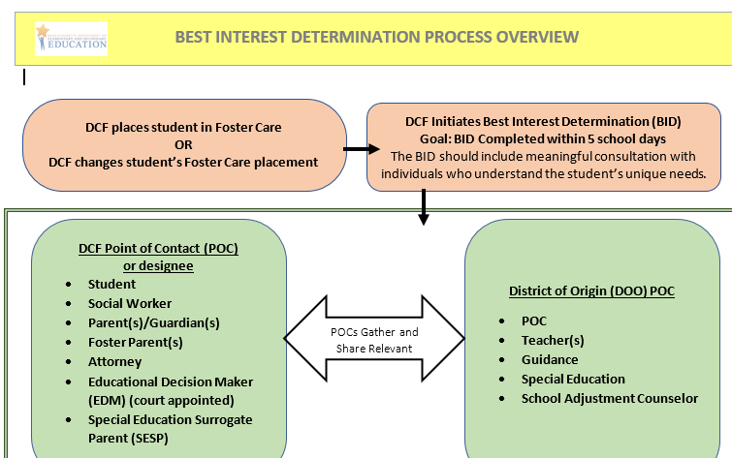
Best Interest Determination (BID)
Financial and programmatic responsibility for a student’s special education services are separate from enrollment and the BID process.
The BID Process is A determination, based on student’s best interest, about whether to remain enrolled in his/her school of origin or to enroll in the district in which the student resides in foster care.
After enrollment has been determined, DESE can apply the LEA assignment regulations to clarify programmatic and financial responsibility.
Notes:
Again, If you attended the last training regarding the Best Interest Determination Meeting (BiD) you know that each and every time a student’s foster care placement changes, a BID should be held and enrollment and placement need to be determined before an LEA Assignment is requested.

Slide 25
Resources, Reminders & Wrap up
08

Slide 26
Resources
Special Education (SEPP)
Special Education Regulations 603 CMR 28.10 School District Responsibility
Related Documents Clarification of Assignment of School District Responsibility (LEA Assignment Request Form) & the Quick Reference Guide (Cheat Sheet)
Administrative Assistance Advisory SPED 2018-3: Guidance on Amendments to Special Education Regulations, 603 CMR 28.10, to Align with ESSA Foster Care Provisions around education stability
Administrative Advisory SPED 2021-2: Assignment of Financial and Programmatic Responsibility for Special Education and Enforcement of Assignments - Special Education (mass.edu)
Educational Stability for Students in Foster Care
McKinney-Vento Homeless Education Assistance Act - Student and Family Support (SFS) (mass.edu)
Best Interest Determination Template

Slide 27
Remember:
DESE is not an investigative agency
  DESE does not track down mom/dad.
  DESE cannot base assignments on requests containing incomplete or inaccurate information.
LEA Assignment is a service to promote consistency and accuracy. DESE has no stake in the outcomes of assignments.
Relationships matter.
Districts can request reconsideration if they believe DESE has mistakenly applied the regulations.

Slide 28
Wrap Up
We’ve come to the end of this session, you
Know who to contact for LEA assignment/homeless/foster care & migrant and military questions.
Have a general understanding of what LEA assignments are.
Can articulate how LEA assignments impact districts.
Have a general idea of how to apply the regulations.
Know that if you have any questions, you can reach out to DESE for support.

Slide 29
THANK YOU

