Slide 1
Office of Student and Family Support: 2.17.2022

Slide 2
MMEP
The Massachusetts MEP is a federally funded entitlement grant
through Title I, part C of ESEA- Every Student Succeeds Act
The Collaborative for Educational Services
oversees the program as a subgrantee of MA DESE

Slide 3
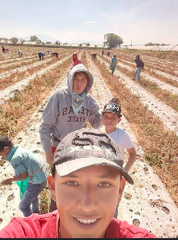
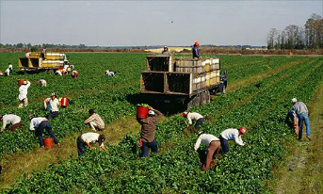
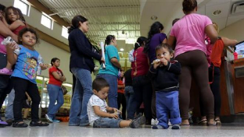
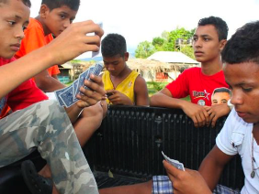
Impacts of migratory lifestyle
Work
Moves
Poverty
Often affected by weather and a need to quickly grow, harvest and process products
Often have to move frequently from one job to the next, creating a very unstable living situation
Moves and immigration status can negatively impact access to social services and community connections

Slide 4
We Open Doors
Purpose of the MEP
Help migratory students and youth meet their academic goals
Ensure that migratory students fully benefit from the same programs and supports provided to non-migratory students and youth
Guide students on a pathway that leads to high school graduation or its equivalent

Slide 5
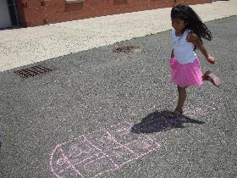
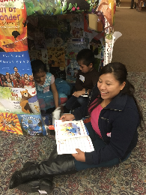
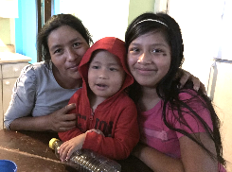
Who We Serve + What We Do
We serve:
All identified, eligible migratory children/youth between the ages of 3-21 while they live in Massachusetts
Preschoolers
K-12
Out of School Youth
We must:
Ensure we are supplementing and not supplanting services
Involve the parent/caregiver/youth and support them to advocate for their child and themselves

Slide 6
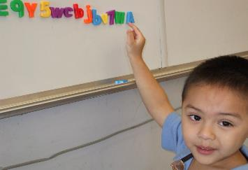
PRESCHOOL (3-5 yrs old)
Migratory preschool aged children tend to not be enrolled in structured early childhood education programs and therefore are at a high risk to enter kindergarten at a disadvantage compared to non-migratory children
Enrollment in Preschool and Summer Programs
Assistance with Kindergarten Registration
Connections with Community Based Programs
Home-Based Family Early Literacy
Summer Site-Based Programming
Examples of Indirect Services
Examples of Direct Services

Slide 7
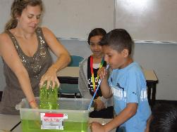
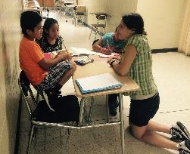
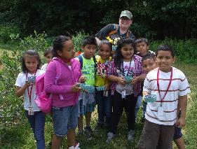
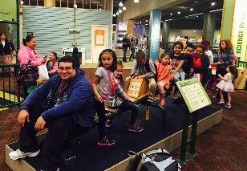
Elementary + Middle School (k-8)
Migratory elementary and middle school students experience difficulties in the first years of schooling when coming from another country and migratory students are not on par with their non-migratory peers in meeting proficiency in ELA, Math and Science assessments. They also require support in connecting with linguistically and culturally responsive school staff.
Enrollment in After school Programs + Camps
Assistance with School Registration and placement
Connections with Community Based Programs
IEP/504 Processes
Home and Site-Based Tutoring
Summer Home and Site-Based Programming
Examples of Indirect Services
Examples of Direct Services

Slide 8
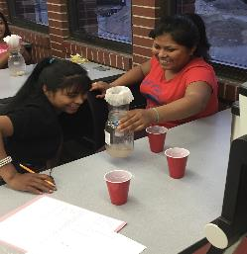
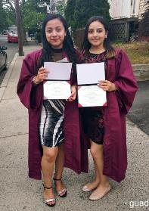
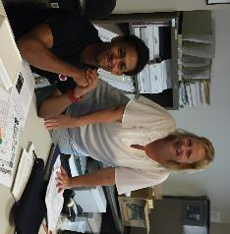
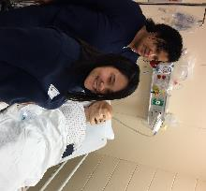
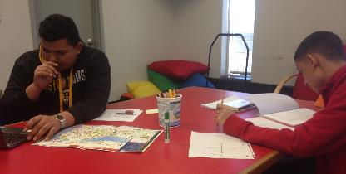
HIGH Schoolers + Umaccompanied Youth
Migratory high schoolers, many who are SLIFE, can struggle with understanding academic and participation expectations in US schools and are significantly behind non-migratory high school students in proficiency in ELA, Math and Science assessments.
The majority are unaccompanied or responsible for younger family members and balance school expectations while working and supporting themselves and their families
Assistance with school registration and placement
Advocacy within schools and social supports
Connections with Community Based Programs
Graduation requirement monitoring/tracking
Home and Site-Based Tutoring
Summer Academic Supports
English/Life Skills and Goal Setting
Participation in the iSOSY Consortium Grant
instructional Services for Out of School and Secondary Youth
Examples of Indirect Services
Examples of Direct Services

Slide 9
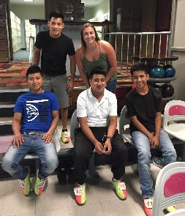
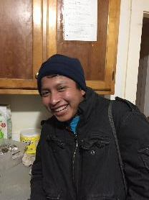
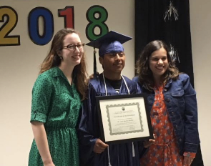
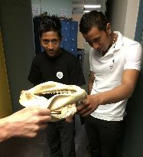
Out of School Youth (OSY)
Out of School Youth (OSY) are those who are not enrolled in school but have not completed their high school education.
They are working and are usually independent. They are usually not served by their school district and due to their work schedules and priorities/maturity, are not ideal candidates for adult education centers.
Enrollment in MassHealth and other social services
Connections with Community Based Programs
Remote English and Life-Skills Classes
HiSET Prep classes
Participation in the iSOSY Consortium Grant
instructional Services for Out of School and Secondary Youth
Examples of Indirect Services
Examples of Direct Services

Slide 10
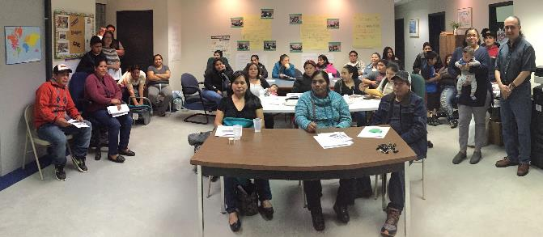
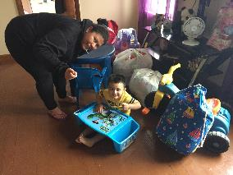
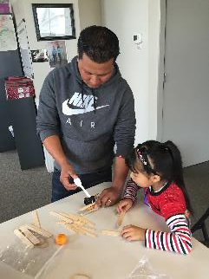
Parents/Caregivers
Regional Parent Advisory Council (RPAC)
State Parent Advisory Council (SPAC)
Connections with Community Based Programs
Referrals to legal, housing, basic needs support
Participation in community and school based activities
MMEP sponsored workshops and trainings

Slide 11
Eligibility

Slide 12
My Characteristics
MISCONCEPTION
MIGRANT IMMIGRANT
M
I
G
R
A
N
T
People Born in the United States
People Born in other countries

Slide 13
ELIGIBILITY
Is there a migratory worker?
1
Is there a migratory child/youth?
2

Slide 14
1
2
Age
School
MIGRATORY CHILD/YOUTH
3
4
Move
Family
Are they between the ages of 3-21?
Have they graduated from high school or have their equivalency?
Did they move into the school district in the past 36 months?
Do they live with or are a migratory worker?

Slide 15
1
2
3
Move
Economics
Work
MIGRATORY WORKER
Did they move into the school district in the past 36 months?
Did they move for economic necessity?
Did they engage in qualifying work soon after the move?

Slide 16
What is qualifying work?
Agriculture
Fishing
Seasonal
Temporary less than 12 months
Production or initial processing of crops, dairy products, poultry or livestock, as well as the cultivation or harvesting of trees
Catching or initial processing of fish or shellfish, as well as the raising or harvesting of fish or shellfish at fish farms

Slide 17
Examples of Companies with qualifying work
Agriculture
Fishing
Current Employers (Agriculture)
•J. Maheras
•O.J. Thrall Farm
•Garden Fresh Salad
•Da Silva Fruit
•Grower Direct, Inc.
•State Garden
•Nourse Farms
•Baldor Boston
•Czajkowski Farm
•Infinite Herbs
•Pioneer Gardens
•Szawlowski Potatoes
•Dzen Brothers
•Monrovia
Current Employers (Fish/Shellfish)
•Great Eastern Seafood
•Channel Fish
•New England Crab Company
•Tichon Seafoods
•Intershell
•Seatrade International
•Marder Trawling
•Atlantic Capes Fisheries Inc.
•Sea Watch International Limited
•Atlantic Red Crab
•Mariners Seafood
•Atlantic Fish and Seafood

Slide 18
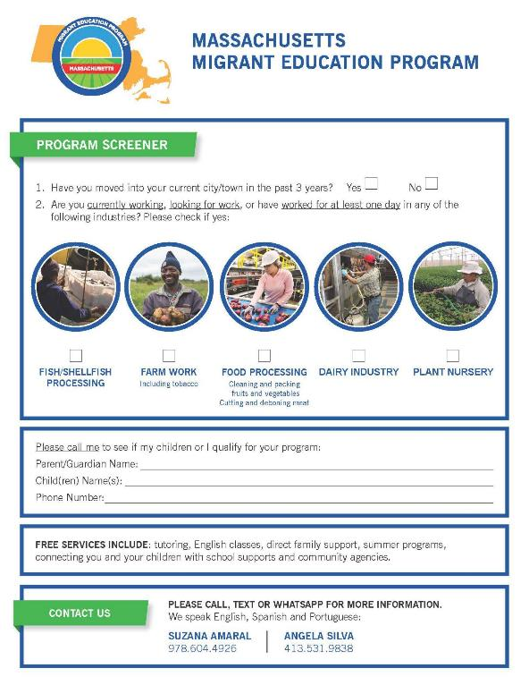
Referrals/Screener
School districts have integrated into online registration and staff trainings
Currently available in 10 languages: Spanish, Portuguese
Arabic, French, English, K’iche
Haitian Creole, Thai + Nepali
MMEP provides training, support and supplies to districts and agencies in using the screeners

Slide 19
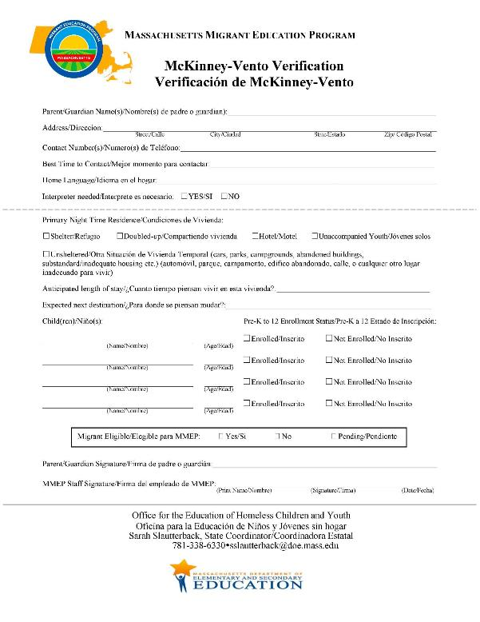
McKinney-Vento Verification
MMEP staff are trained on making determination if a child/youth is experiencing homelessness
This form assists districts with expedited student registration and can be used for both migratory and non-migratory students
MMEP will also provide verification forms for students who are already enrolled in a school district but has not been identified as experiencing homelessness

Slide 20
MMEP and SCHOOL DISTRICTS
Working Together
Parent/Caregiver Connection
Caseloads
Needs Assessments and Academic Supports
Program Recruitment
McKinney-Vento and Residency Verification
Record Exchange +Enrollment
Teamwork + Wrap Around Services
IEP/504 Evaluation/Team
Address
Basic Needs
Summer Program Enrollment
Notes:
Program Screeners
McKinney-Vento and Residency Verification

Slide 21
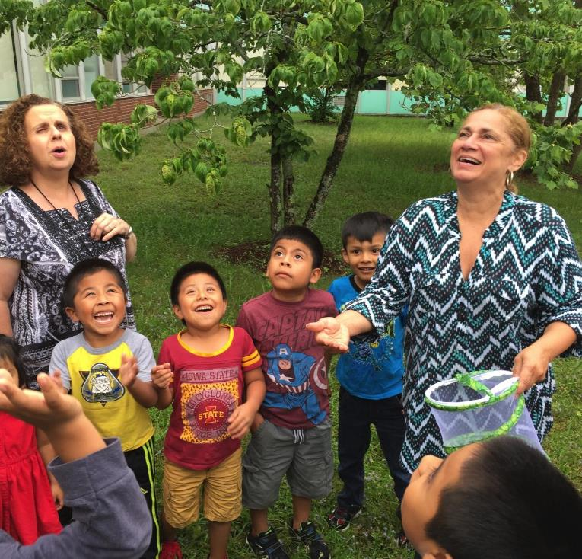
Thanks!
Emily Hoffman
State Program Director
Massachusetts Migrant Education Program
ehoffman@collaborative.org
978.604.4935
www.collaborative.org/programs/migrant-education-program

