Slide 1
Educational Stability Program Review
Educational Stability Team 2022/2023

Slide 2
Contents
1
Program Desk Review - Overview
2
Element 1 – Designated Staff
3
Element 2 - Training
CONTENTS
4
Element 3 – Policies and Procedures
5
Next Steps

Slide 3
Program Desk Review – Overview
Program Desk Review - Overview
1

Slide 4
Program Desk Review
The Program Desk Review Process
… in the best interest of our students
Tiered over six years
Tier 1 includes elements 1 to 3
Tier 2 includes elements 4 to 11 (excluding element 6)
TFM and Notification
Educational Stability Review Process and Checklist
Monitoring Criteria and Legal Standards
Educational Stability monitoring documentation submission
through Alchemer (formerly Survey Gizmo) by October 28, 2022.

Slide 5
Review Process Schedule
Notification sent approximately by May 2, 2022 to districts.
Monitoring webinar to introduce the monitoring protocol and requirements is scheduled for June 6, 2022 at 1:00 pm. You must register to attend at Registration Link on the Educational Stability training webpage.
Districts prepare and gather required documentation - being sure to label by Element number as indicated in the checklist.
Required documentation must be submitted no later than October 28, 2022 to Alchemer (formerly Survey Gizmo). Click Here to Submit Note: Access to submit will be closed on October 28, 2022 by 5:00 pm.
The Educational Stability Team sends an Initial Summary of findings approximately by December 16, 2022. Note: If the monitoring criteria have been met, the district will be issued a Final Monitoring Summary at this time.
Districts review their Initial Summaries. Districts must submit no later than January 27, 2023 final corrective responses to any findings by emailing the district’s assigned Educational Stability Reviewer.

Slide 6
Review Process Schedule
The Educational Stability Team will issue a Final Monitoring Summary as soon as possible, but no later than the week of March 3, 2023.
Note: Technical assistance may be requested at any point by emailing the district’s assigned Educational Stability Reviewer.
Districts: Andover to Edward Kennedy Christine.H.Cowen@mass.gov
Farmington to Mohawk Trail Bridget.G.Oshaughnessy@mass.gov
Monomoy to Whittier Sarah.E.Slautterback@mass.gov

Slide 7
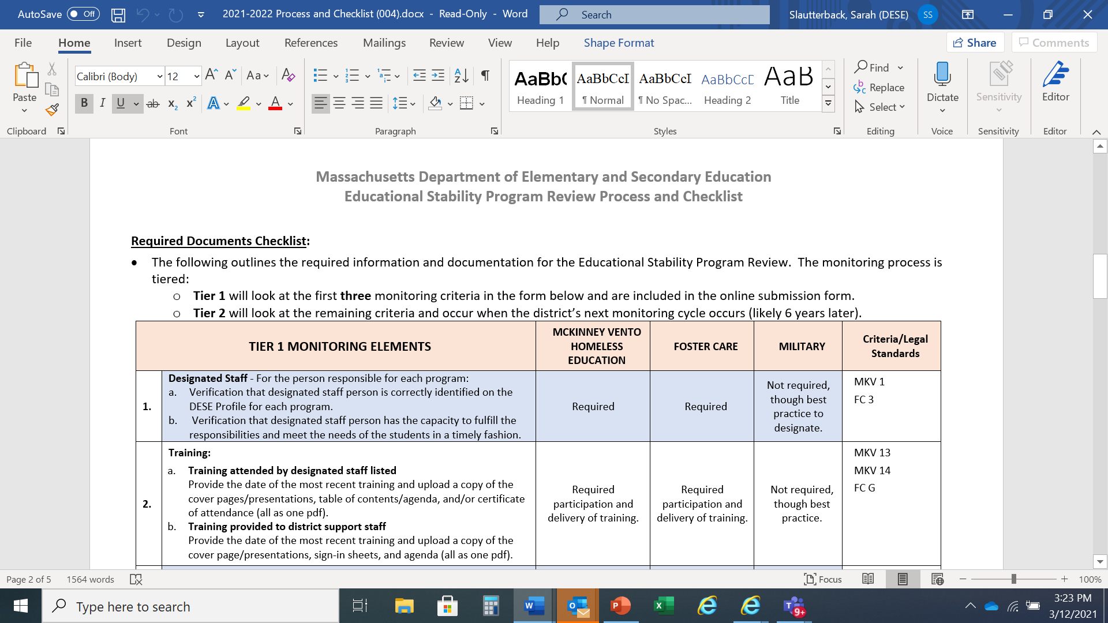
Required Documents Checklist

Slide 8
Element 1 – Designated Staff
Element 1 – Designated Staff
2

Slide 9
Element 1
Element 1 Designated Staff
Please verify with a checkmark if the designated staff person for each program is correctly identified on the DESE profile.
Please verify with a checkmark that the designated staff person has the capacity to fulfill the responsibilities and meet the needs of the students in a timely fashion.

Slide 10
Element 2 - Training
Element 2 - Training
3

Slide 11
Element 2 - Training
2a – Training attended by designated staff
Date of most recent training, Please fill in
Comments if needed
Uploads:
Copy of the cover page if a DESE presentation
Copy of the presentation if it is an outside source
Table of Contents/Agenda and/or
Certificate of attendance
Convert into one PDF to upload (Note: Up to three files may be uploaded.)

Slide 12
Element 2 - Training
2b – Training provided to district staff (by designated staff)
Note: This is not just a 5 minute announcement
Date of most recent training - Please fill in
Audience that was trained – Please fill in
Comments if needed
Uploads
Copy of the presentation(s) used (cover sheet if Ed stability resources or complete presentation if outside source or self-made materials),
Sign-in sheets
Agenda
Convert into one PDF to upload (Note: Up to three files may be uploaded.)

Slide 13
Element 3 – Policies and Procedures
Element 3 – Policies and Protocols
4

Slide 14
Element 3 - Policies and Protocols
3a and b. Program policies to be uploaded
Must be in compliance with ESSA and school committee approved (date).
Homeless policy – definition, remove awaiting foster care, designated receiving schools, preschool, summer programming, immediate enrollment and transportation to the end of the year in which a student becomes housed
Foster care – Definition, best interest determination, school of origin, immediate enrollment, ensuring transportation, includes preschool students if offered
Military connected students- Definition, eligibility includes up to one year from retirement.
MASC policies dated October 2019 are in compliance with ESSA

Slide 15
Element 3 – Policies and Protocols
3a and b. To be uploaded
Enrollment/admissions Policy -barriers to enrollment are removed for these programs.
Enrollment form(s) – addresses required documentation for these groups as an exception. Enrollment forms include the option voluntarily self-identify military status.
Residency policies – homeless and foster care policies are cross-referenced

Slide 16
Element 3 – Policies and Protocols
3c. To be Uploaded
A brief description of the enrollment process for all students
The specific processes that ensure immediate enrollment for students experiencing homelessness and/or in foster care, and processes for students from military families to facilitate transitions.

Slide 17
Next Steps
Next Steps
5

Slide 18
Program Desk Review – Next Steps
Documentation Due no later than Friday, October 28, 2022.
Use Alchemer (formerly Survey Gizmo) link initially to respond and upload documentation
Submission access to survey gizmo will be closed at 5pm on October 28,2022.
Desk Review Initial Summary sent approximately by December 16, 2022.
Districts must submit no later than January 27, 2023 final corrective responses to any findings by emailing the district’s assigned Educational Stability Reviewer.
Districts: Andover to Edward Kennedy Christine.H.Cowen@mass.gov
Farmington to Mohawk Trail Bridget.G.Oshaughnessy@mass.gov
Monomoy to Whittier Sarah.E.Slautterback@mass.gov
Final Monitoring Reports will be issued as soon as possible but no later than the week of March 3, 2023.

Slide 19
Program Desk Review – Next Steps
Helpful resources
National
National Center for Homeless Education
National Association for the Education of Homeless Children and Youth
School House Connections
DESE
Foster Care Education
Homeless Education
MIC3

Slide 20
For Technical Assistance
Technical assistance may be requested at any point by emailing the district’s assigned Educational Stability Reviewer.
Districts: Andover to Edward Kennedy Christine.H.Cowen@mass.gov
Farmington to Mohawk Trail Bridget.G.Oshaughnessy@mass.gov
Monomoy to Whittier Sarah.E.Slautterback@mass.gov

Slide 21
Thank you
THANK YOU
Educational Stability Team
Christine.H.Cowen, Sarah.E.Slautterback, Bridget.G.Oshaughnessy @mass.gov
781.338.3010
www.doe.mass.edu
75 Pleasant Street, Malden, MA 02148

