Slide 1
E
Educational Stability
Program Review
SY 2025-26
Please be advised that DESE does not authorize attendees to record or to use AI transcription tools during the meeting and DESE does not endorse any unauthorized transcripts created by third parties of its meetings.

Slide 2
Federal Program Monitoring
States are required to monitor school districts for compliance in certain federal programs under Every Student Succeeds Act (ESSA) including:
Foster Care (FC)
McKinney Vento Homeless Education (MKV)
Military Connected (MIC3)

Slide 3
Content
Program Desk Review: Overview
Element 1: Designated Staff
Element 2: Training
Element 3: Policies and Procedures
Reminder: Due Dates
Resources

Slide 4
PROGRAM DESK REVIEW OVERVIEW

Slide 5
Program Desk Review
The Program Desk Review Process
… in the best interest of our students
Tiered over six years
Tier 1 includes elements 1 to 3
Tier 2 includes elements 4 to 11 (excluding element 6)
Tiered Focus Monitoring (TFM) and Notification
Educational Stability Review Process and Checklist
Monitoring Criteria and Legal Standards
Submission of Educational Stability Review due in CHAMP by: September 30, 2025
CHAMP is the new updated monitoring software

Slide 6
Notification
Preliminary email notification was sent on April 4, 2025 to *Homeless Liaisons, as well as Foster Care Points of Contacts within identified districts-Cohort 5.
*Homeless Liaisons have been identified as the primary contacts for submission within CHAMP for their respective districts.

Slide 7
Information Sessions
Webinar 1: Introduction to the Monitoring Protocol and Requirements
April 30, 2025 9:00 to 10:30 OR May 2, 2025 3:00 to 4:30
Webinar 2: How to Electronically Submit the Districts Monitoring Review
June 16, 2025 10:00 to 12:00 OR June 23, 2025 2:00 to 4:00
Registration link will be posted on the Educational Stability training webpage.
Each webinar information topic offers two duplicated sessions.

Slide 8
Steps to Submit and Respond
Districts prepare and gather required information/documentation to be electronically submitted in CHAMP system.
Submission due no later than September 30, 2025.
The Educational Stability Team reviews submissions and sends an electronic Initial Summary Report of findings approximately by end of November. Note: If the monitoring criteria have been met, the district will be issued a Final Monitoring Summary Report at this time.

Slide 9
Corrective Responses
Districts review their Initial Summary Report. Districts must submit no later than January 9, 2026 final corrective responses to any findings within CHAMP.
The Educational Stability Team will review corrective responses and issue a Final Monitoring Summary Report as soon as possible, but no later than the week of February 16, 2026

Slide 10
Required Documents Checklist
The Checklist:
outlines the Tier 1 elements for the review.
provides details for each Tier 1 element.
serves as a guide for districts.

Slide 11
Element 1: Designated Staff

Slide 12
Element 1
Element 1 Designated Staff
Please verify with a checkmark if the designated staff* person for each program is correctly identified on the DESE profile.
Please verify with a checkmark that the designated staff person has the capacity to fulfill the responsibilities and meet the needs of the students in a timely fashion.

Slide 13
Element 2: Training

Slide 14
Element 2a: Designated Staff Training
Training attended by designated staff
Please select the date of the most recent training for each program (conducted or planned)
Provide comments, if needed.
Uploads:
If Educational Stability Team resource: upload a copy of the cover page.
If external resources: upload a copy of the presentation. table of contents/agenda and/or certificate of attendance.

Slide 15
Element 2b: Training Provided to Staff
Training* provided to district staff by designated staff identified in 2a.
Please select the date of the most recent training for each program if conducted or planned.
Provide comments, if needed.
Please fill in who was trained on each of the programs.
Uploads:
If Educational Stability Team resource: upload a copy of the cover page.
If external resources or self-created materials: upload a copy of the presentation, sign–in sheets, and agenda.
* This is not just a 5-minute announcement!

Slide 16
Element 3: Policies and Protocols

Slide 17
Elements 3a and 3b: Policies and Protocols
Policies and Protocols must be in compliance with ESSA and school committee approval including approval date.
Massachusetts Association of School Committees (MASC) policies dated October 2019 are in compliance with ESSA.
Required policy:
McKinney-Vento/Homeless policy – definition, remove awaiting foster care, designated receiving schools, preschool, summer programming, immediate enrollment and transportation to the end of the year in which a student becomes housed
Foster care policy – Definition, best interest determination, school of origin, immediate enrollment, ensuring transportation, includes preschool students if offered
Military-connected students Policy - Definition, eligibility includes up to one year from retirement. (not required but best practice)

Slide 18
Element 3a and 3b: Upload Policies and Protocols
Documents to be uploaded:
Enrollment/admissions Policy -barriers to enrollment are removed for these programs.
Enrollment form(s) – addresses required documentation for these groups as an exception. Enrollment forms include the option voluntarily self-identify military status.
Residency policies – homeless and foster care policies are cross-referenced.

Slide 19
Element 3c: Written Uploads
A brief description of the enrollment process for all students.
The specific processes that ensure immediate enrollment for students experiencing homelessness and/or in foster care, and processes for students from military families to facilitate transitions.

Slide 20
Reminder: Due Dates

Slide 21
Due Dates:
Self-assessment submissions in CHAMP are due no later than September 30, 2025.
Review of district submissions by the Educational Stability Staff and Initial Summaries available to districts approximately by end of November 2025.
Districts must submit within CHAMP final corrective responses no later than January 9, 2026.
Final Monitoring Summary Reports issued as soon as possible within CHAMPS but no later than the week of February 16, 2026

Slide 22
Resources

Slide 23
Helpful Resources:
National
National Center for Homeless Education
National Association for the Education of Homeless Children and Youth
School House Connections
DESE
Foster Care Education
Homeless Education
MIC3

Slide 24
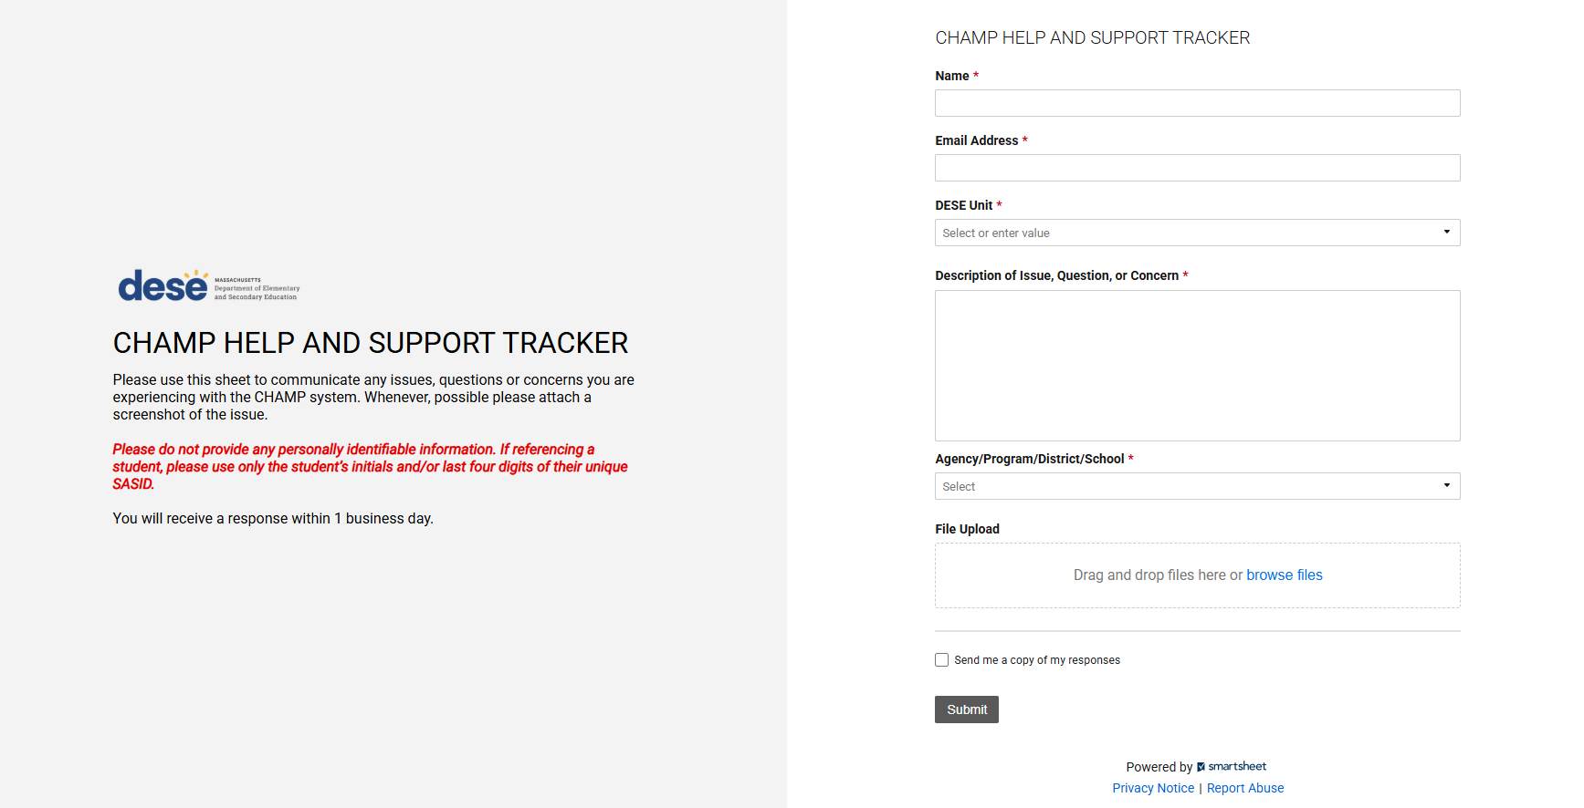
For Technical Assistance and CHAMP access
Technical assistance may be requested at any point by completing the
CHAMP HELP AND SUPPORT TRACKER﻿
CHAMP

Slide 25
Things to Know about CHAMP
It is the districts responsibility to periodically check CHAMP for any notifications from the Educational Stability Team, regarding the review.
A new user to CHAMP, you will receive an email from “Salesforce” prompting you to verify your account. Once you verify your account, you do not need to do anything further until you participate in Webinar 2.
An existing CHAMP user for another DESE program (e.g., Public School Monitoring, etc.), your user permissions will automatically be updated to include access to the Educational Stability Review. In which case, you do not have to do anything at this time within CHAMP and will learn more by participating in Webinar 2.
Webinar 2 will explain what to look for and how to submit within CHAMP.

Slide 26
COHORT 5 EDUCATIONAL STABILITY PROGRAM REVIEW
Thank You!

