Slide 1
E
“Please be advised that DESE does not authorize attendees to record or to use AI transcription tools during the meeting and DESE does not endorse any unauthorized transcripts created by third parties of its meetings.”
Educational Stability SY 2025-26
Webinar 2: How to Submit into CHAMP

Slide 2
Content
Reminder: Due Dates
Introduction to CHAMP
Step by Step Guide
CHAMP Help & Support
Resources

Slide 3
Due Dates: Early
Self-assessment submissions in CHAMP are due no later than June 13, 2025.
Review of district submissions by the Educational Stability Staff and Summaries available to districts between June 13th and July 15th.

Slide 4
Due Dates: Regular
Self-assessment submissions in CHAMP are due no later than September 30, 2025.
Review of district submissions by the Educational Stability Staff and Initial Summaries available to districts approximately by end of November 2025.
Districts must submit within CHAMP final corrective responses no later than January 9, 2026. (NOT AVAILABLE YET)
Final Monitoring Summary Reports issued as soon as possible within CHAMPS but no later than the week of February 16, 2026 (NOT AVAILABLE YET)
Notes:
The CHAMP system will be under development for the corrective action response and final reports during the summer. In the event that it is not ready for use by the time of these steps then districts will only do the initial with the receipt of an initial summery report from DESE. The district will then continue to work on any findings that would be reviewed when Tier 2 is conducted. If everything goes as planned then we will hold a brief webinar with updated steps for the corrective action submission and final summary report between now and January 9th.

Slide 5
Steps to Submit and Respond: Early
Districts prepare and gather required information/documentation to be electronically submitted in CHAMP system.
Required documentation must be submitted no later than June 13, 2025.
The Educational Stability Team will offer Office Hours specifically for Technical Support for early submitters on the due date of June 13, 2025. Register Here: Office Hours: 2:00 to 4:30
Between June 13th and July 15th, the Educational Stability Team sends an electronic Summary of findings to the districts.

Slide 6
Steps to Submit and Respond: regular
Districts prepare and gather required information/documentation to be electronically submitted in CHAMP system.
Submission due no later than September 30, 2025.
The Educational Stability Team reviews submissions and sends an electronic Initial Summary Report of findings approximately by end of November. Note: If the monitoring criteria have been met, the district will be issued a Final Monitoring Summary Report at this time.

Slide 7
Things to Know about CHAMP
It is the districts responsibility to periodically check CHAMPS for any notifications from the Educational Stability Team, regarding the review.
A new user to CHAMP, you will receive an email from “Salesforce” prompting you to verify your account. Once you verify your account, you do not need to do anything further until you participate in Webinar 2.
An existing CHAMP user for another DESE program (e.g., Public School Monitoring, etc.), your user permissions will automatically be updated to include access to the Educational Stability Review. In which case, you do not have to do anything at this time within CHAMP and will learn more by participating in Webinar 2.

Slide 8
CHAMP: User Guide

Slide 9
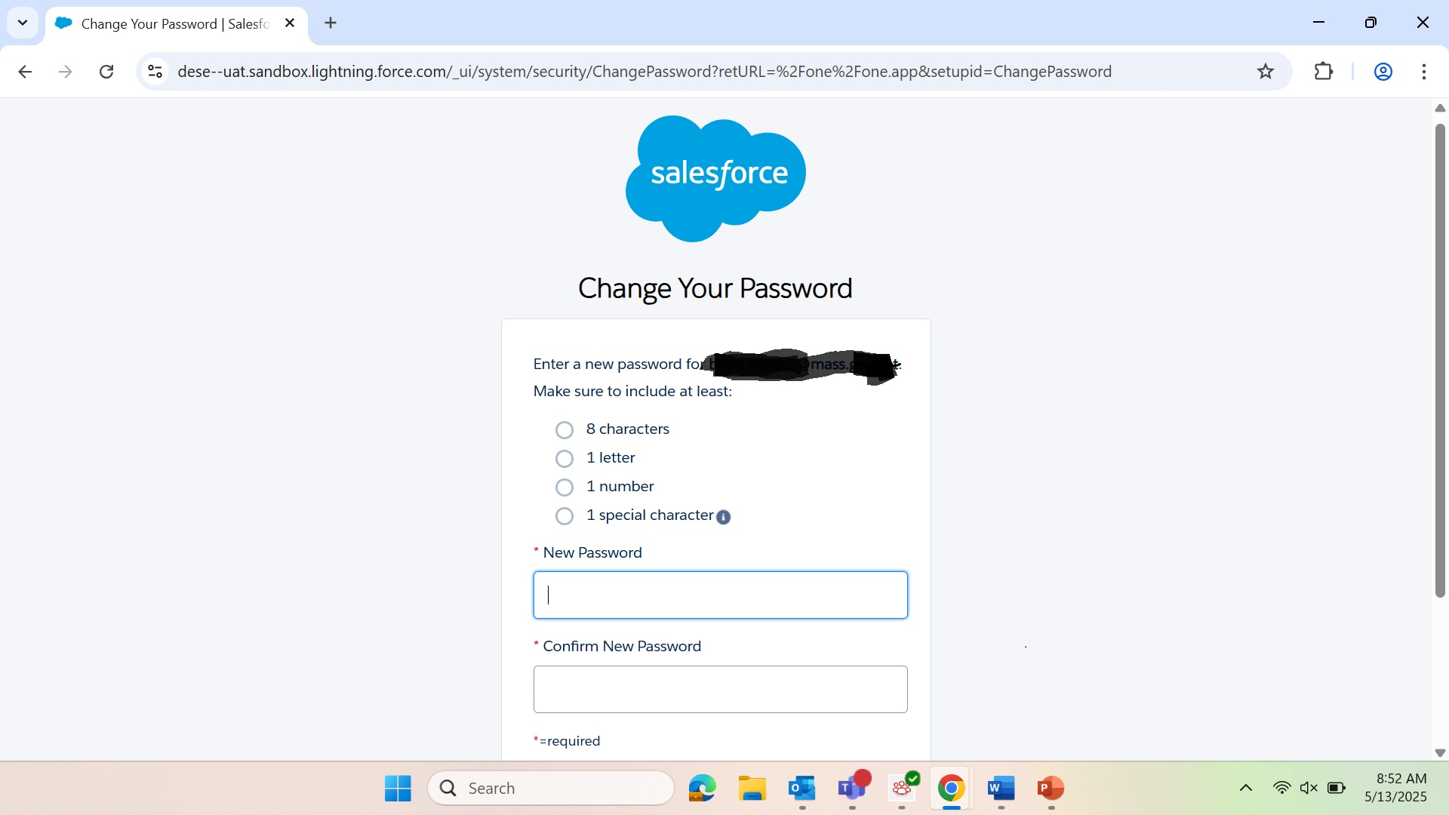
Password Reset
Notes:
If you have not received a Salesforce email that asks you to verify and change your password, then you must put in a CHAMP ticket so the team can address this issue. We will share that ticket link with you further in the presentation.

Slide 10
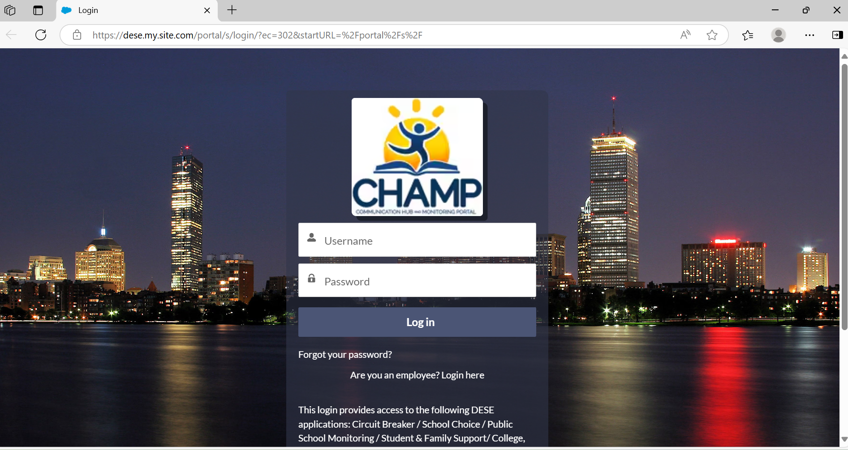
Sign into CHAMP
Notes:
This is your district login window for CHAMP. We recommend you bookmark this for future access.

Slide 11
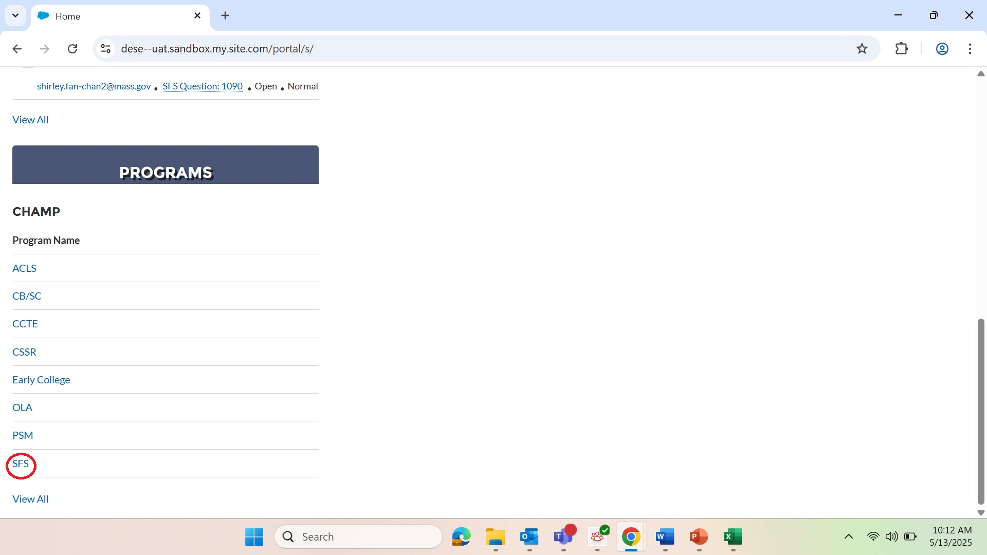
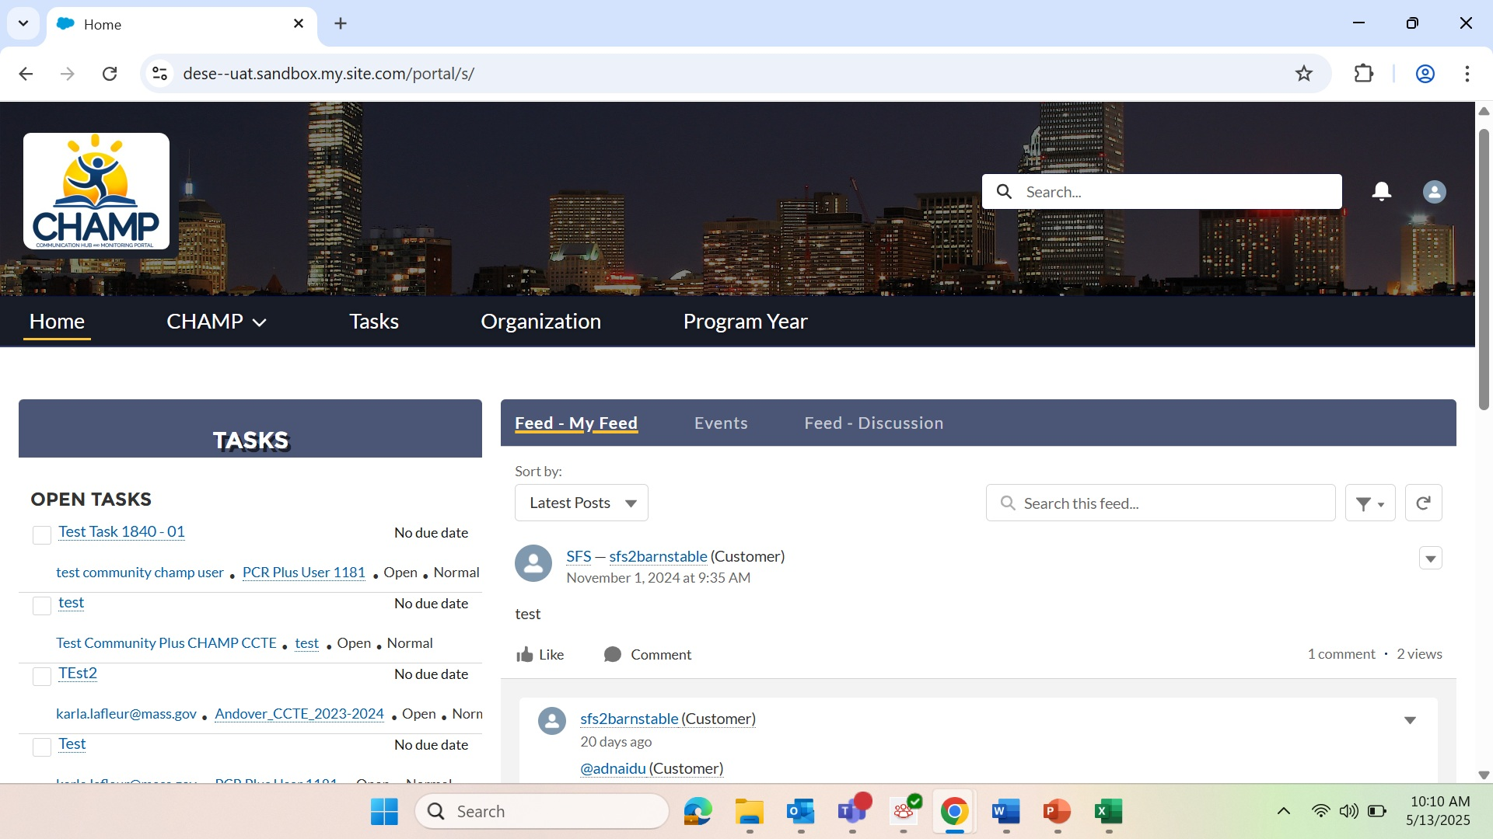
Home Page
Notes:
Your home page will look like this but may not appear with similar tasks displayed. The Program section is below on this page. Please see graphic to the right on this slide. You must click SFS (Student and Family Support) to get to your Program Year Monitoring Review. Please note that the SFS acronym will be updated to Educational Stability for Highly Mobile Students.

Slide 12
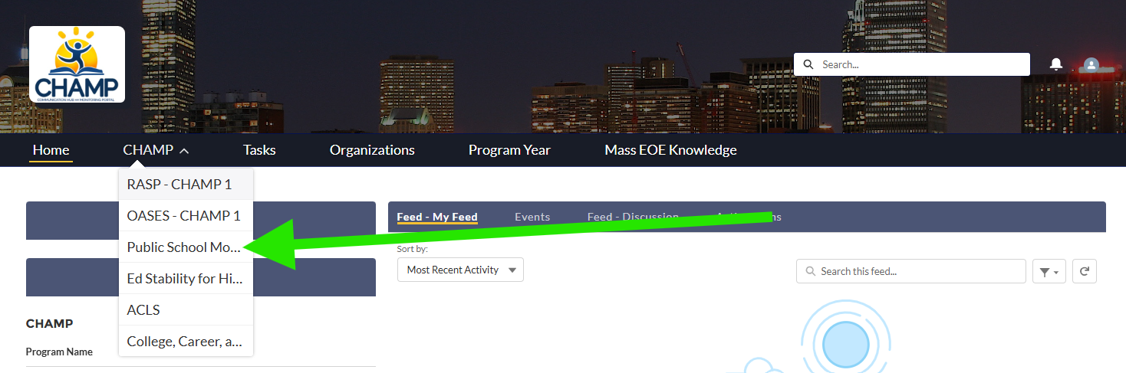
Dese name change
Notes:
Eventual name change from SFS to Ed. Stability For Highly Mobile…

Slide 13
SFS Program
Notes:
Please select or click on the SFS acronym.

Slide 14
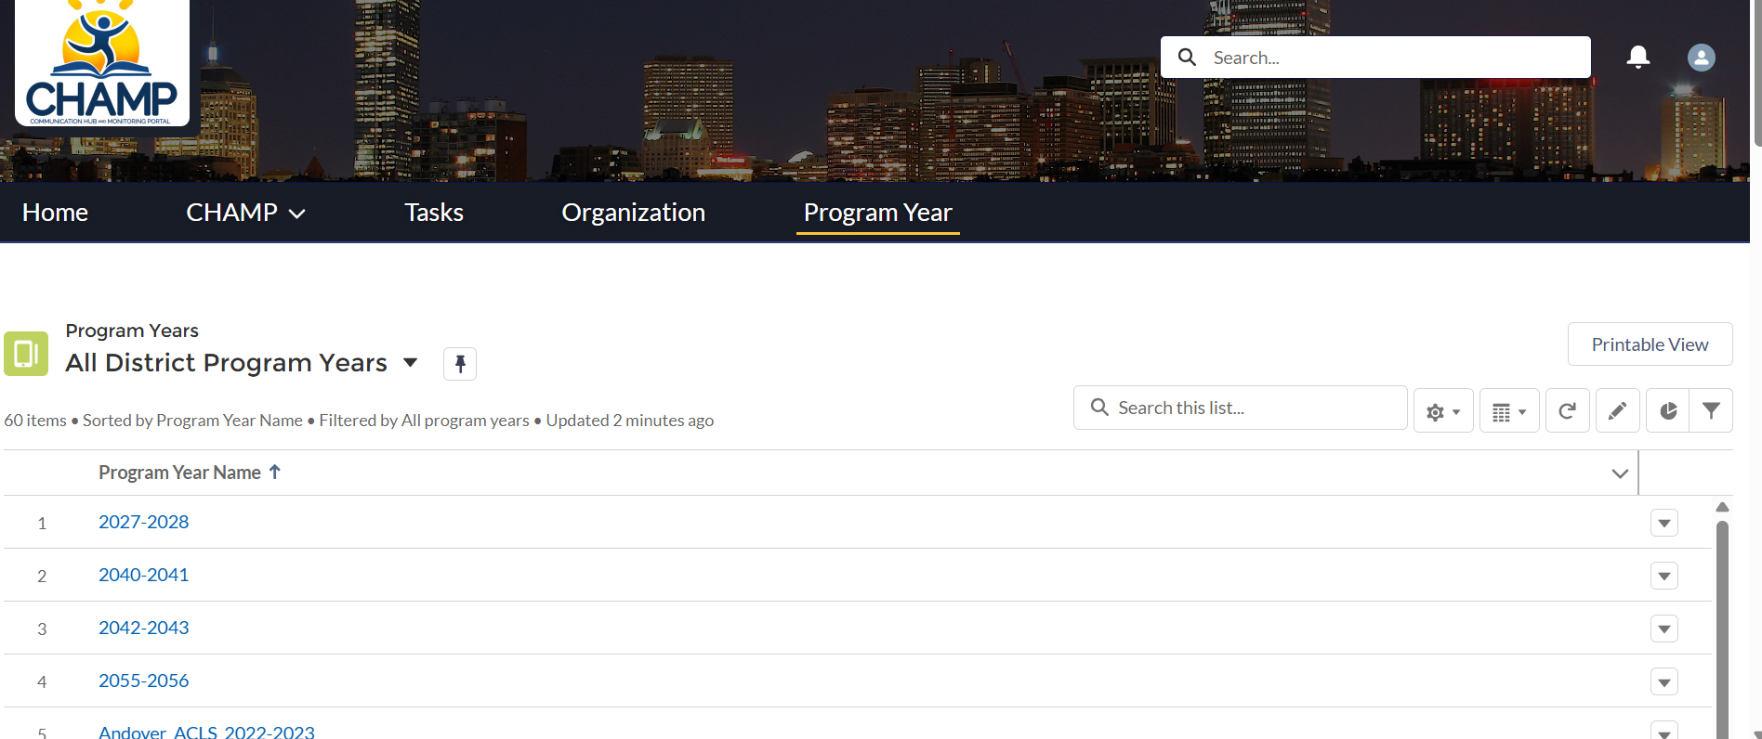
Program Year
Notes:
Click on program year tab and find your program year.

Slide 15
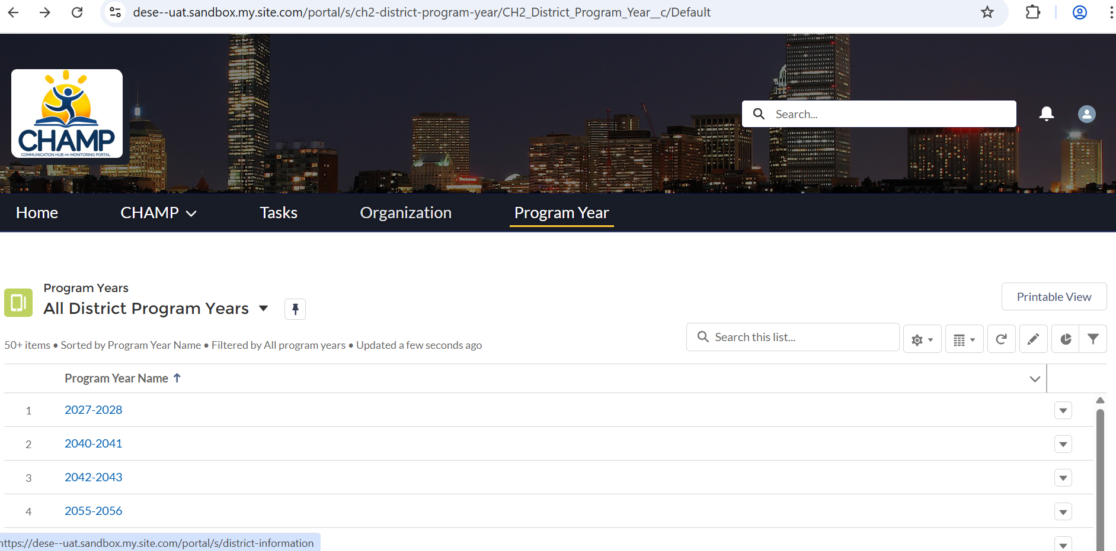
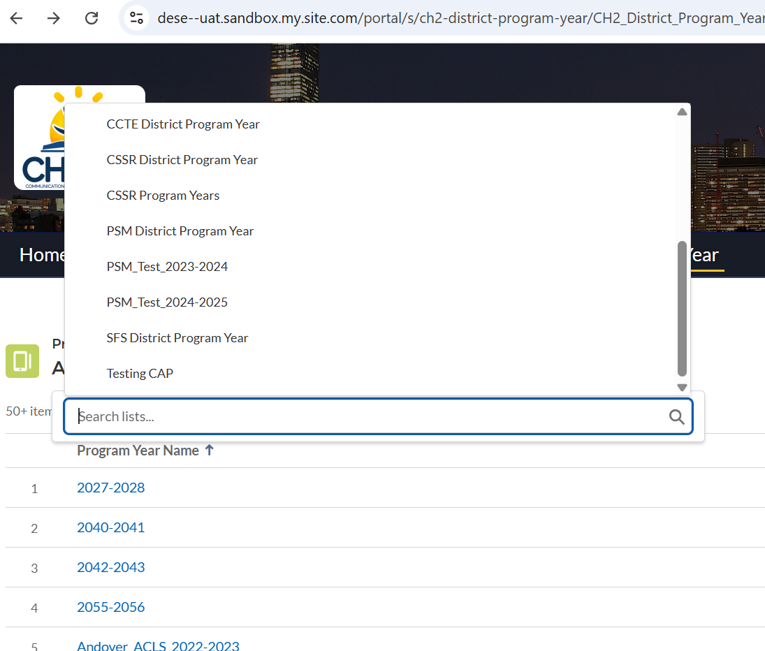
Use Drop Down arrow to select district and use the PIN to bookmark.
Notes:
Berkshire Hills SFS 2025 -2026 test

Slide 16
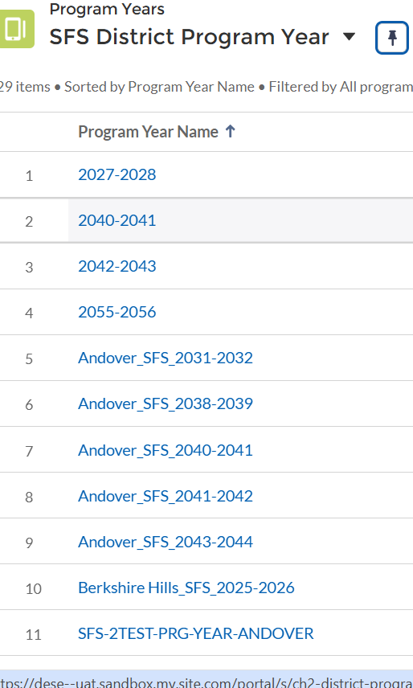
Find your Review Year
Notes:
Click on your District Program Year. For example, we are clicking on Berkshire Hills SFS 2025-2026.

Slide 17
Regional Districts and Union Disctricts:
Regional Districts will have to submit one assessment and receive one summary report to cover all the districts part of the region.
Unionized Districts will have to submit duplicate assessments for each district that is part of the union.
Notes:
The next slides outline which districts are being monitored for this round under these categories.

Slide 18
Regionalized School Districts:
Hampshire Regional SD (06830505)
  Chester-Goshen
  Hampshire
  Southhampton
  Westhampton
  Williamsburg
Martha’s Vineyard Regional SD (07000505)
  Edgartown
  Martha’s Vineyard
  Oak Bluffs
  Tisbury
  Up-Island Regional

Slide 19
Regionalized School Districts (cont.):
Mohawk Trail-Hawlemont Regional SD (07170000)
  Ashfield
  Charlemont
  Colrain
  Hawley
  Heath
  Plainfield
  Shelburne Falls
Nashoba Regional SD (07250000)
  Bolton
  Lancaster
  Stow

Slide 20
Union Districts:
Tri-Town School Union
  Boxford (00380000)
  Middleton (01840000)
  Topsfield (02980000)

Slide 21
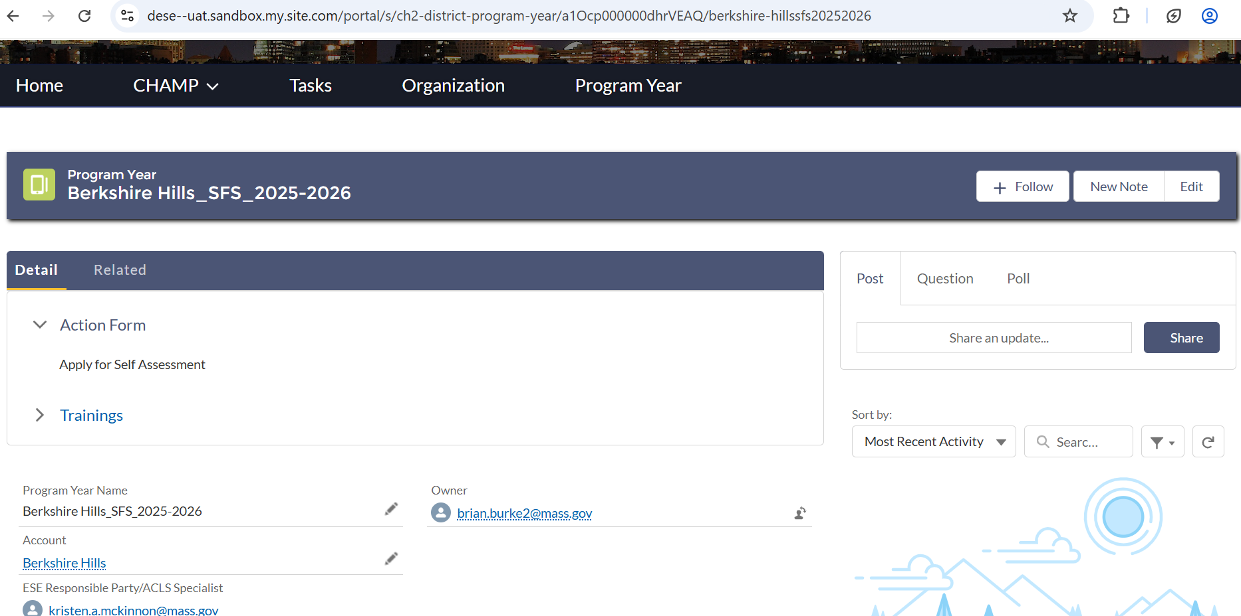
Detail Tab to Assessment Form
Notes:
Under the Detail Tab you will see Action Form. You will click on Apply for Self Assessment to begin your review submission.

Slide 22
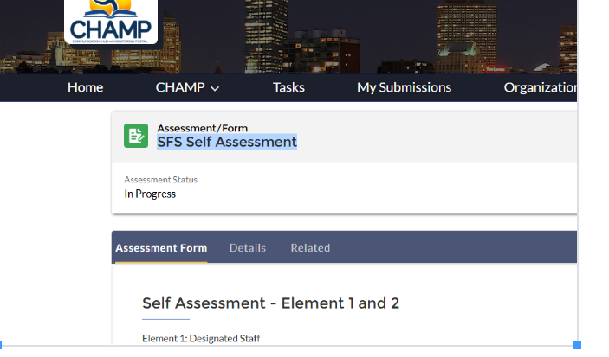
Assessment Form
Notes:
You will see a SFS Assessment window open to Elements 1 and 2.

Slide 23
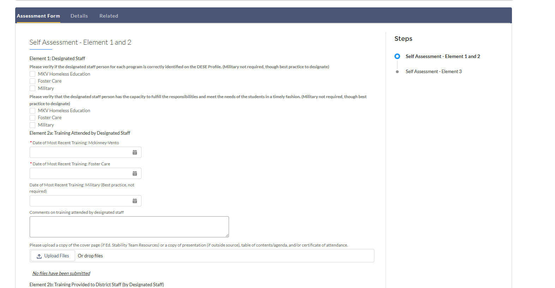
Elements 1 and 2
Notes:
This is the start of your SFS Assessment in which you will see Elements 1 and 2. For Elements 1 you will check off the appropriate box for your current response.

Slide 24
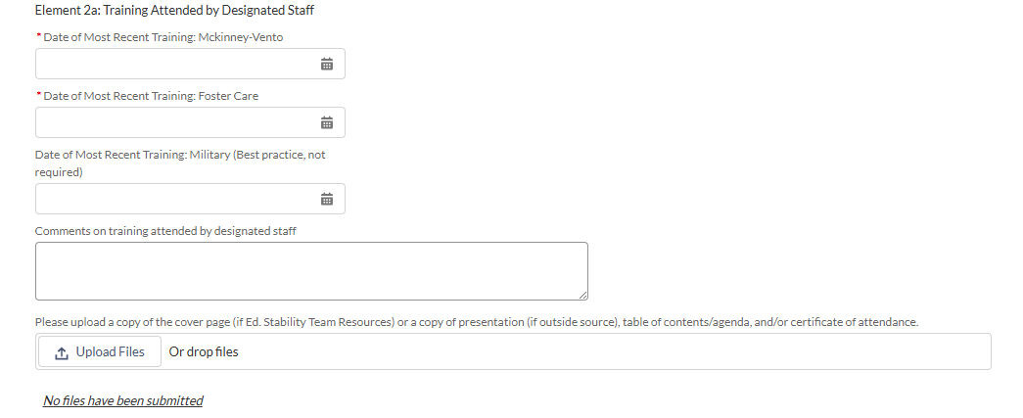
2a
Notes:
For Element 2a. You will provide a calendar date of when you attended or will attend a most current training on each of the programs. You may provide further detail in the comments. You will also upload your supporting documents for this training.

Slide 25
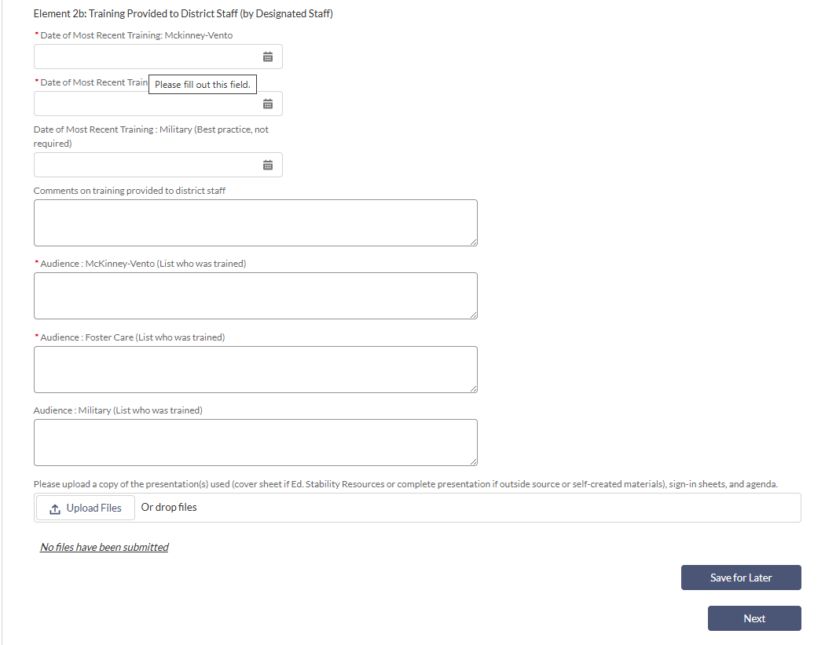
2b.
Notes:
For element 2b, you will provide a calendar date of when you provided or will provide a most current training on each of the programs. You may provide further detail in the comments. You must provide information as to who was provided the training in the audience section. You will also upload your supporting documents for this provided training. Once complete you can either save your submission to come back to it at a later date or click next to continue onto element 3.

Slide 26
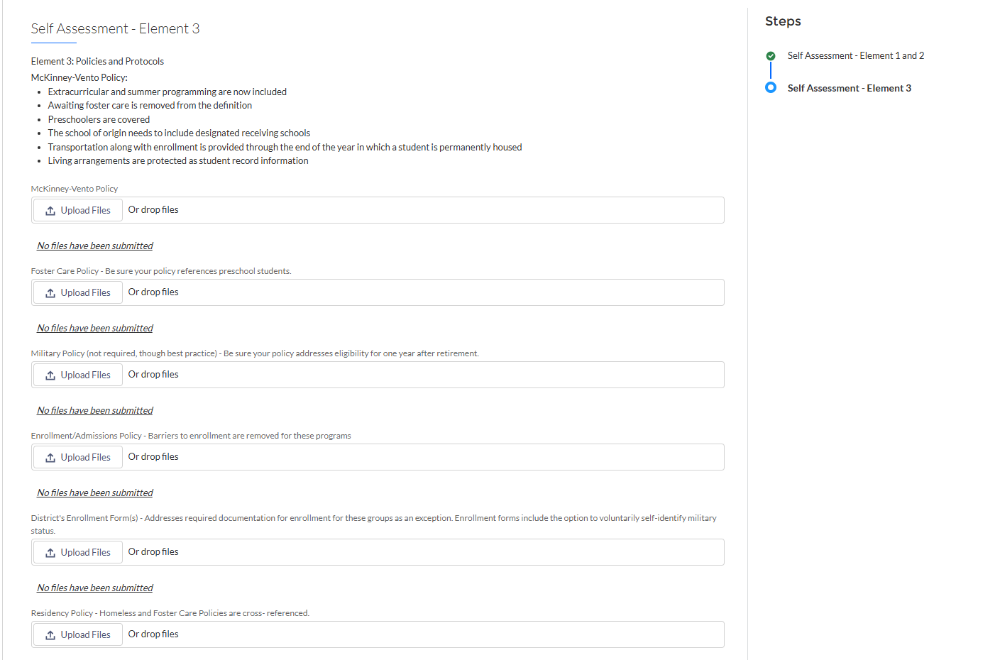
3a and 3b.
Notes:
For the combined Element 3a and 3b, you will upload your homeless, foster care, military (recommended), enrollment, and residency policies. These policies should be school committee approved as well. You also must upload your enrollment forms (no links accepted, we must have uploads of documents).

Slide 27
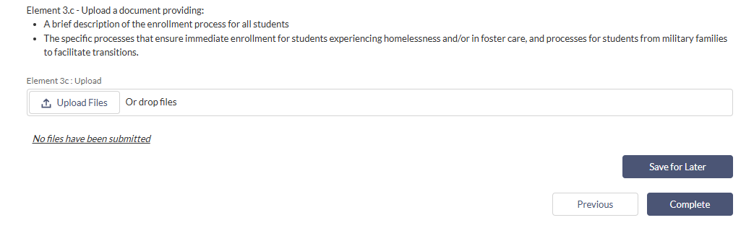
3c.
Notes:
For Element 3.c. you need to upload a brief response to the two items provided. I brief description of enrollment processes for all students in your district and then describe briefly how you enroll students who are highly mobile. Once competed you can either save for later to come back to your assessment for submission or if you are ready to submit at this point you can click complete which will take you back to the beginning assessment page.

Slide 28
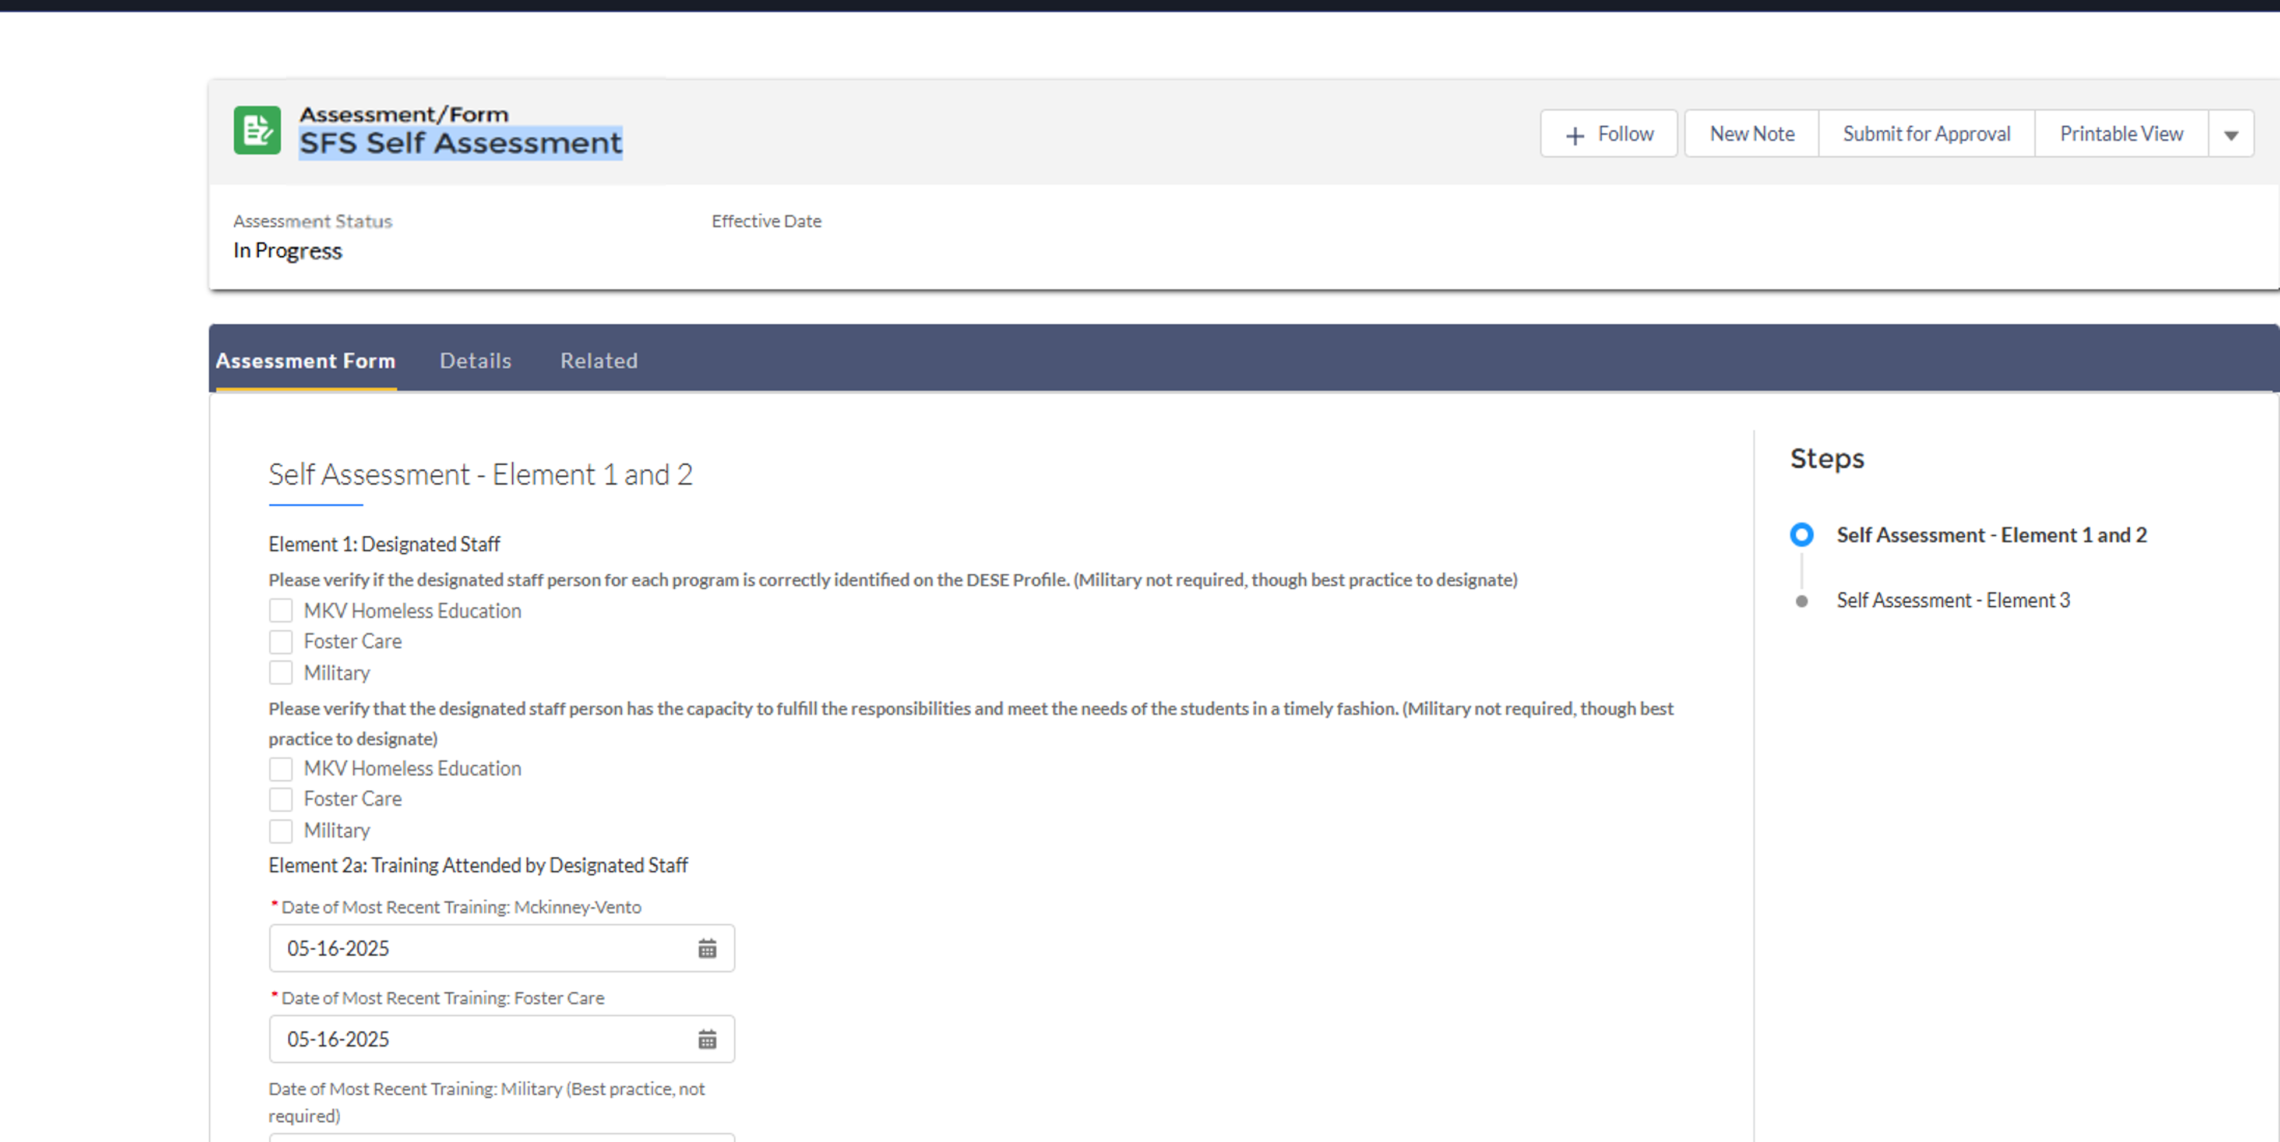
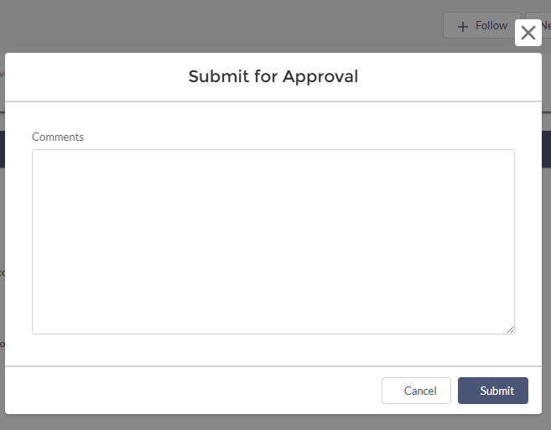

Submit for Approval
Notes:
You will then need to click Submit for Approval to officially submit your assessment for review. A pop-up window will appear with a comment box. You may provide a comment if you like but not required, but you must click the submit button to send your assessment in for review. Once you click submit, your status will change from In Progress to Submitted for Review under the Assessment Status Tab.

Slide 29
Do slides 10 to 15 to get back into your review to see the summary report.
Notes:
Follow the steps from slides 10 to 15 to get back into CHAMP to view your summary report.

Slide 30
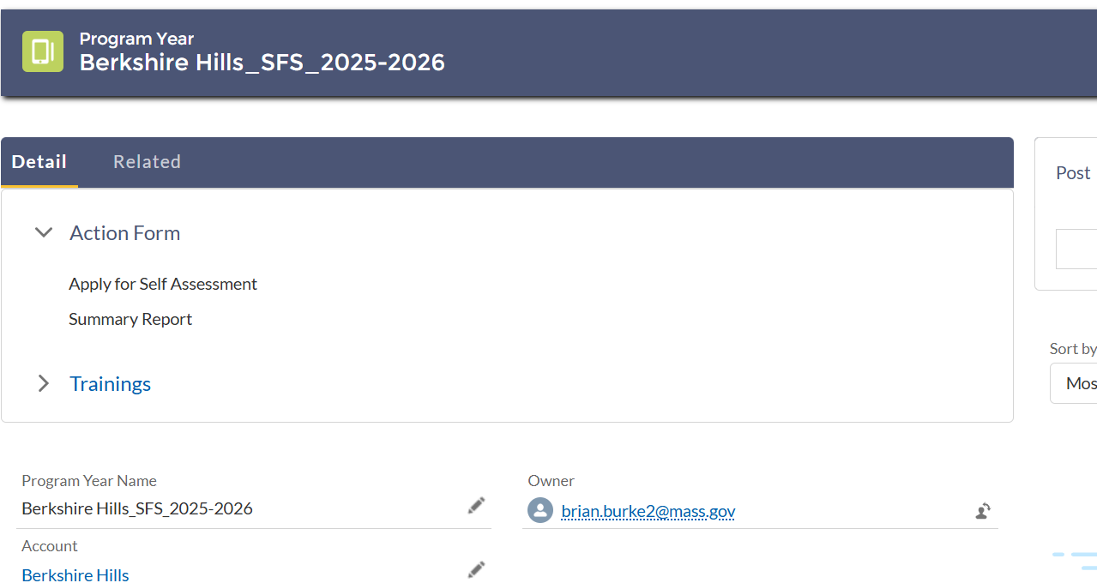
Click on summary report
Notes:
Under the Detail tab, locate the Summery Report. You will click on this to take you to your DESE issued report for review. It is here you will see whether you are in full, partial, or not in compliance at all for each element.

Slide 31
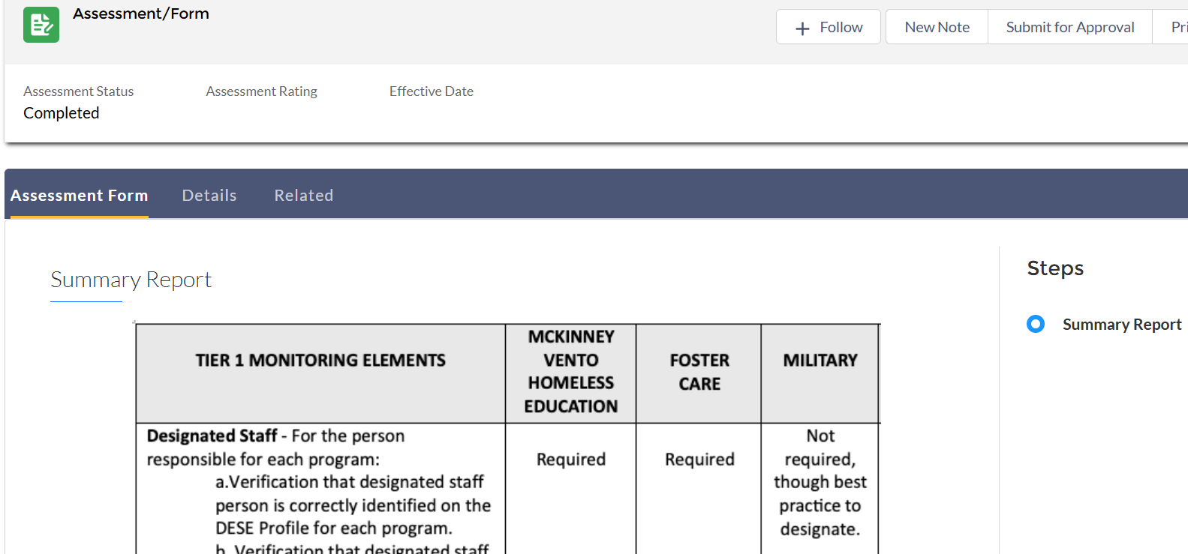
Review summary
Notes:
Once you click the summary report you will see the Assessment Form open up for you. The status will be completed meaning your DESE reviewer has reviewed your submission and rated each element. This does not mean you are in full compliance but that a rating was completed. You must review each element for the assigned rating and any items needing further information.

Slide 32
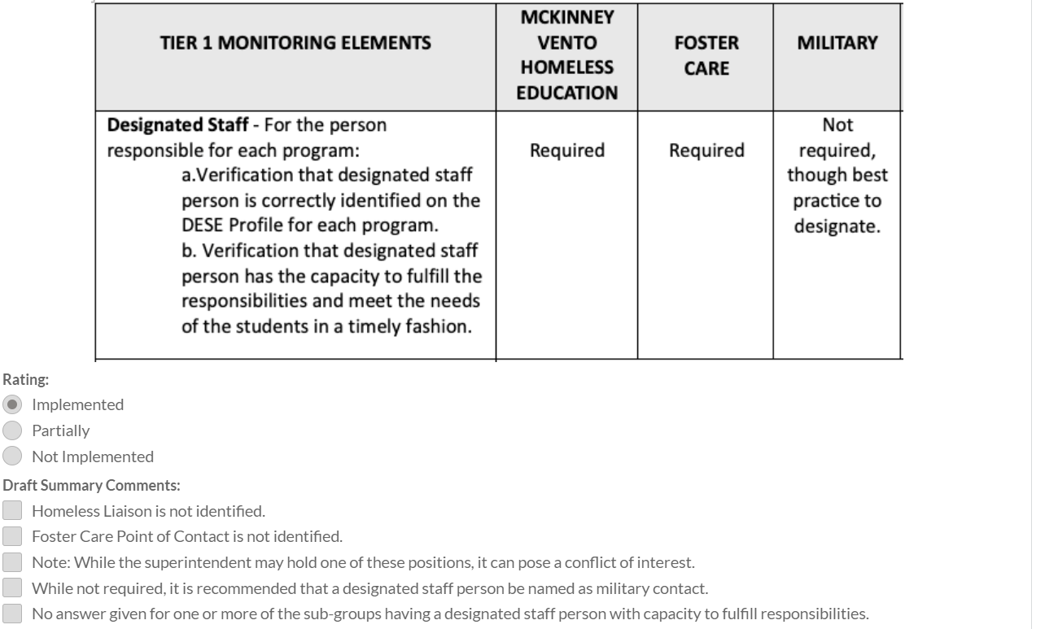
Full compliance example
Example of Element 1:
Fully Implemented. No Draft Summary Comments to address.
Notes:
This is an example of what to expect when an element is in full compliance. Your DESE reviewer will check off implemented to indicate full compliance for the element. If the element was not in compliance, the reviewer would have checked off the appropriate rating and then checked-off the reason why under the Draft Summary Comment section.

Slide 33
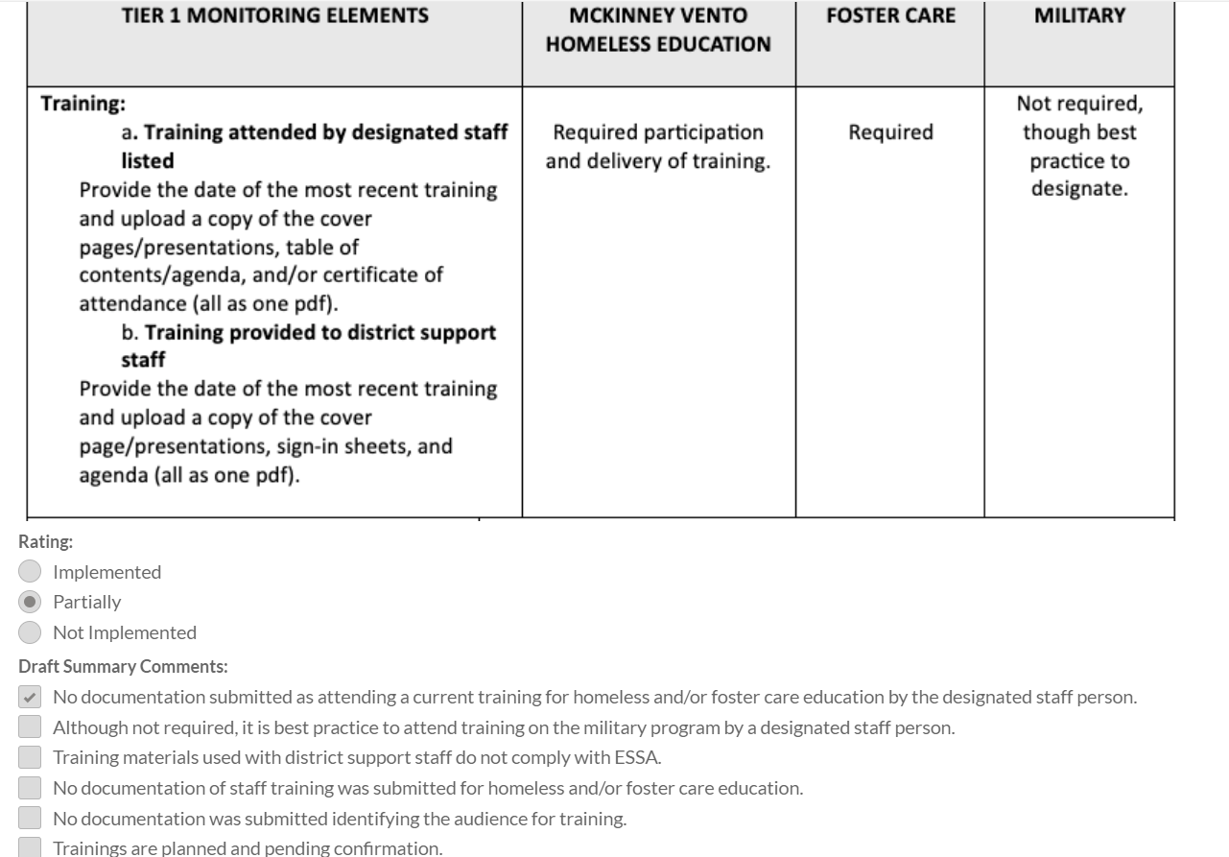
Example of non-compliance
Notes:
This is an example using element 2 of what you would see if not in compliance. The appropriate rating is checked to indicate the level of non-compliance and the reason why. For training, in this example, no documentation was uploaded. This means for you to meet full compliance, you will have to upload documentation for further review after reviewing the remaining elements in the report. Be sure to see if there are any comments from the DESE reviewer in the comment boxes after each element. The reviewer may have added information to assist you to become full compliance in additional to the checked-off items.

Slide 34
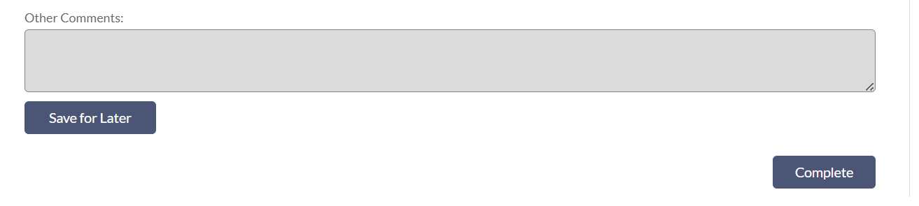
resubmitting
Notes:
After you are done reviewing element 3, you will have the choice to save for later if you need to compile additional information and want to be able to review what is needed from the summary. If you are ready to resubmit or know what you need to resubmit then you can click complete to give you the availability to resubmit items. Once you click save for later or complete the system takes you back to this second window indicating you have reviewed your summary report. AT THIS TIME RESUBMITTING WILL NOT BE DONE! SEE NEXT SLIDE FOR DIRECTIONS!

Slide 35
IMPORTANT!
Due to some current electronic limitations with CHAMP, early submitters are only doing one submission with one summary report to be issued by DESE. If you are issued findings in this summary report, we will expect you to work on correcting those findings and we will review in tier 2 for those corrections.
Notes:
Districts will need to look at the “draft summary comments” to guide them in correcting those findings issued for elements 1 to 3 that will be reviewed in Tier 2 as a result of this current electronic issue to be fixed. More than likely “final summary report comments” will be checked off for tier 1 when tier 2 is completed.

Slide 36
IMPORTANT!
Due to some current electronic limitations with CHAMP, regular submitters are only doing one submission with one summary report to be issued by DESE. If you are issued findings in this summary report, we will expect you to work on correcting those findings and we will review in tier 2 for those corrections.
Notes:
Districts will need to look at the draft summary comments to guide them in correcting those findings issued for elements 1 to 3 that will be reviewed in Tier 2 as a result of this current electronic issue to be fixed. More than likely “final summary report comments” will be checked off for tier 1 when tier 2 is completed.

Slide 37
Resources

Slide 38
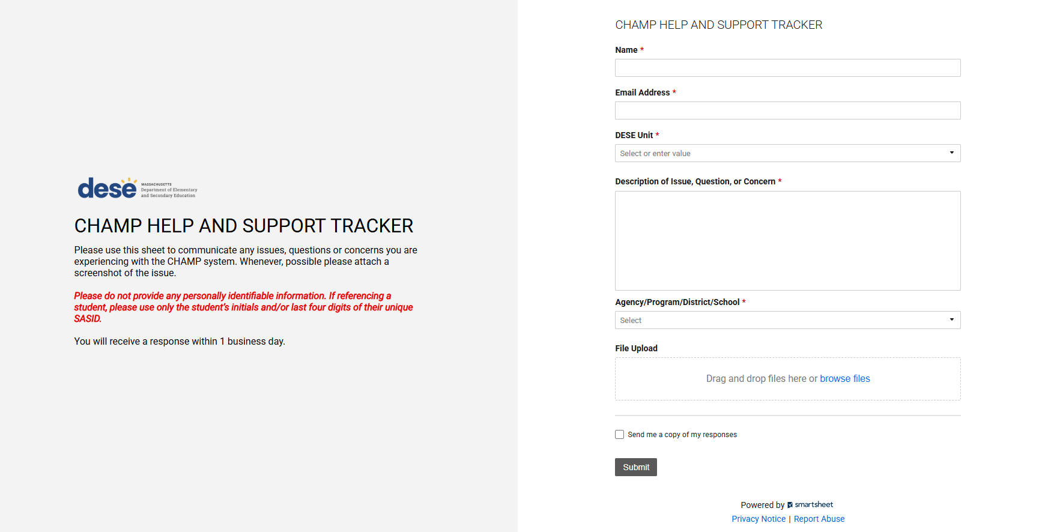
For Technical Assistance:
Technical assistance may be requested at any point by completing the
CHAMP HELP AND SUPPORT TRACKER﻿
Notes:
This is the link for any technical issues or questions that you have. You must complete this form to submit to the team. Again, if you have not received an email from Salesforce to verify and change password you must complete this form by clicking on the link.

Slide 39
THANK YOU

