Slide 1
Introduction to the Sample Foster Care Best Interest Determination Worksheet
Kristen McKinnon and Christine Cowen
April 23 , 2019 and April 29, 2019

Slide 2

Let’s Get Started
Logistics
Can you hear us ?
Using the Public Chat and Q&A
Availability of Forms and Webinar Slides
Role Poll
Welcome

Slide 3
Agenda
ESSA Title 1A Foster Care Provisions
Overview of the Best Interest Determination Process and Rights
Review of Best Interest Determination Worksheet
Disputes
Questions and Answers

Slide 4
ESSA: Title 1, Part A Provisions
Ensures educational stability for students in foster care
Requires a foster care point of contact in every district
Requires a state foster care point of contact at DESE and DCF
Establishes specific educational rights for students in foster care
  School of Origin
  A Best Interest Determination
  Transportation
  Immediate Enrollment

Slide 5
BEST INTEREST DETERMINATION PROCESS OVERVIEW
Overview Chart is Now Available!

Slide 6
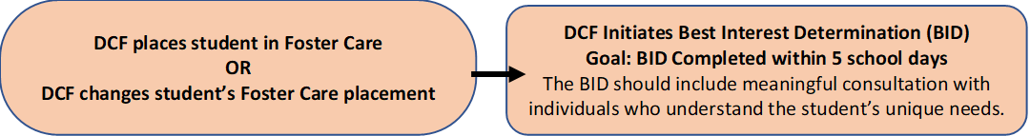
Foster Care Identified
Step 1 – DCF Identifies FC student and initiates BID
Note
Decisions about which school a student will attend should be made collaboratively.
Should include those in the best position to understand the student’s unique needs.
Student should remain in their school of origin until BID is completed.
Process should be collaborative…but doesn’t need to be one big meeting!

Slide 7
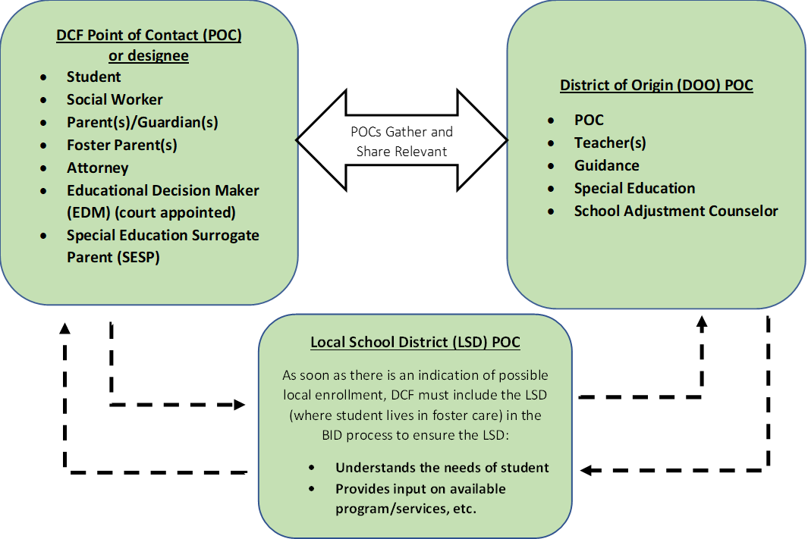
Collaboration
Step 2 – School Districts and DCF Collaborate
Note
Collaborators may want to consider if the school of origin is in the best interest but only for a limited duration of time.
Collaborators involved in the decision may wish to determine a time to revisit the question of whether it is in the student’s best interest to remain in the school of origin or enroll locally.
Transportation costs should not be a factor in determining the best interest for the purpose of school selection.
Gather and Share Relevant Factors
Gather and Share Relevant Factors

Slide 8

Determination
Step 3 – Upon Completion of BID
Note
Notice to LEA from DCF - includes Emergency contact, residence, social worker, record release, transportation needs, etc.

Slide 9
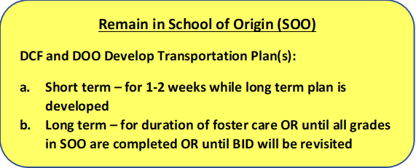
Determination: School of Origin
Step 4a – Remain in School of Origin
Note
School of origin - school the student was attending when placed in foster care, or at time of a subsequent change in foster care placement.
Districts must collaborate with DCF to establish policies and procedures to ensure that students who need transportation to remain in their school of origin get it.
Absent another agreement, districts of origin are responsible for providing transportation to and from the school of origin.
Districts should document all costs associated with this transportation.

Slide 10
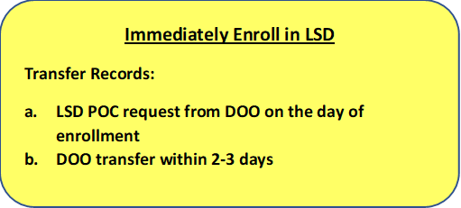
Determination: Immediate Enrollment
Step 4b – Immediately Enroll in Local School District
Note
If determined to be in a student’s best interest to attend school locally (where placed in foster care), district must enroll immediately.
With or without documentation
District POCs should initiate records transfer, help facilitate transition
***Remember if there is no change in school of origin, there should be no change in enrollment.

Slide 11
Best Interest Determination Worksheet
Worksheet Page 1 Now Available!

Slide 12
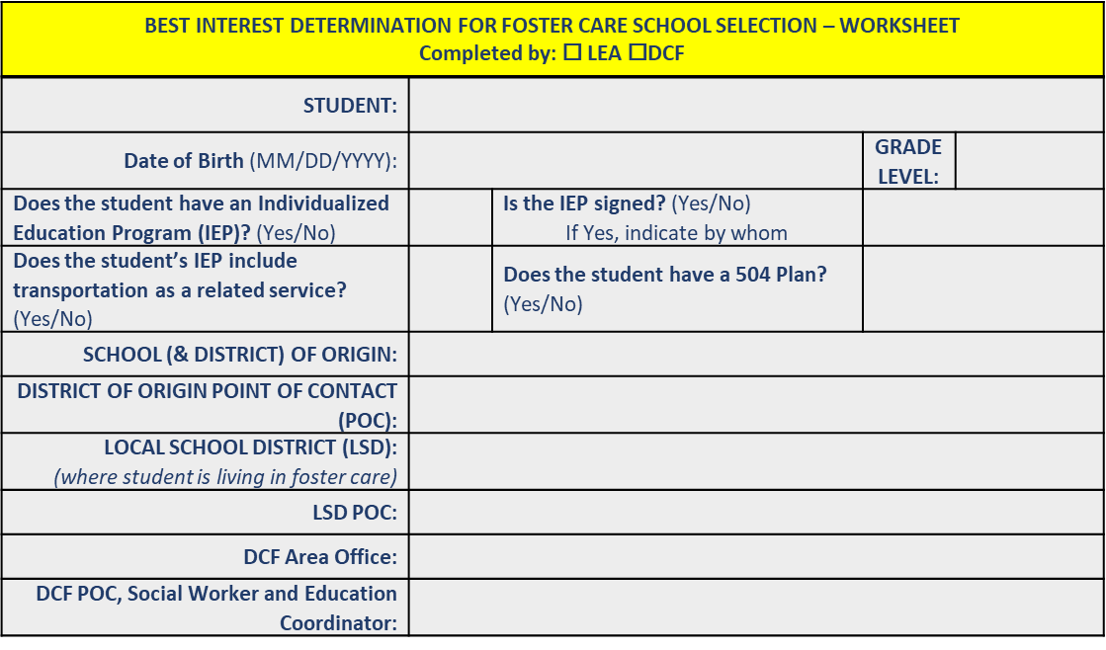
Section One

Slide 13
Section Two

Slide 14
Best Interest Determination Worksheet Page 2
Worksheet Page 2 Now Available!

Slide 15
Section Three
BID NOTES

Slide 16
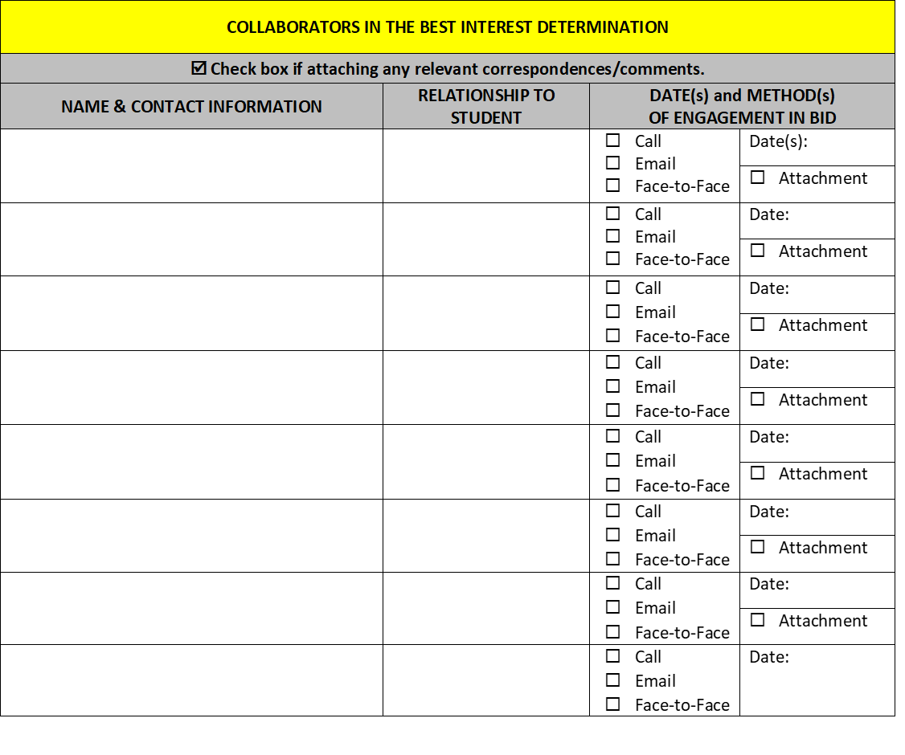
Section Four

Slide 17
Best Interest Determination Worksheet Page 3
Worksheet Page 3 Now Available!

Slide 18
IMPORTANT!
NOTE
This process and worksheet are not required, but are encouraged to facilitate and document the required BID.

Slide 19
School Selection Disputes
  Upon completion of the best interest determination, DCF has the authority to make final decisions about a student’s best interest, but a school district may dispute DCF’s best interest determination.
  During the dispute resolution process, the student must attend the school selected by DCF following the local BID process. Transportation must be provided for the student, if needed.
  The dispute process and form can be found on DESE’s Foster Care Webpage: http://www.doe.mass.edu/sfs/foster/ and should be submitted to DESE at achievement@doe.mass.edu.

Slide 20
Almost done!
Questions?

Slide 21
Contact Information for Educational Stability Team
Christine Cowen, Migrant Education, Military Connected Students
781. 338.6301 ccowen@doe.mass.edu
Kristen McKinnon, Foster Care Point of Contact
781.338.6306 kmckinnon@doe.mass.edu
Sarah Slautterback, Homeless Education
781.338.6330 sslautterback@doe.mass.edu
****************************************************************************************
Technical Assistance: Problem Resolution Services, 781.338.3700

Slide 22




THANK YOU
Educational Stability Team, Office of Student and Family Support
781.338.3010
achievement@doe.mass.edu
www.doe.mass.edu
75 Pleasant Street, Malden, MA 02148

