Slide 1
Purple Star Award Designation: Application Webinar
Class of 2025

Slide 2
Agenda
Who can Apply?
Timeline
Criteria for Award
Tips
Let’s take a look at the Application
Award Notification
Application Link, and Notification of Live Link
Contact information

Slide 3
Who can Apply?
All public schools, including
charter
vocational technical
elementary
middle, and
high schools.

Slide 4
Application and Award Timeline
Webinar Sessions: October 22 and October 28, 2024.
Application Link available on webpage around November 1, 2024.
Applications must be submitted no later than 5:00 p.m. January 31, 2025.
Award notifications go out approximately in April 2025.

Slide 5
General Information
Is this a New application or Renewal application?
New Awardee Designations are good for a three-year cycle. Upon completion of the third year, schools can apply for a renewal of the award.
Who is completing the application?
Provide School and District Information.

Slide 6
Criteria for Application
Military Liaison Contact Information
Military-Connected Students Data
Processes and Implementation by Military Liaison
Provide a Webpage Address specific in supporting military-connected students and their families
A Student Led Activity (age appropriate) that supports military-connected students transitioning into the school

Slide 7
Criteria Continued
Professional Development attended by the Military Liaison and additional staff
Implementation of Professional Development
Plans and Strategies over the next three years
One Additional Qualifying Activity (resolution; event; and/or partnership)
Optional submission of supporting documentation

Slide 8
Military Liaison
Provide the name, email address and phone number for the staff member identified as the military liaison for your school.
Some schools may have more than one military liaison, if so, provide the name , email address and phone number for the second staff member identified.
The military liaison is the point person for the military-connected students.

Slide 9
Data: New Applicants
Provide data for military-connected students for previous and current school years.
How many are…
Enrolled*
Low Income
Disability
SPED
English Learners
Advanced Coursework
Extra Curricular Activity
Race/Ethnicity*
* required

Slide 10
Data: Renewal Applicants
Provide data for military-connected students for designated award year (SY1), previous(SY2) and current school years(SY3).
How many are…
Enrolled*
Low Income
Disability
SPED
English Learners
Advanced Coursework
Extra Curricular Activity
Race/Ethnicity*
* required

Slide 11
Processes and Implementation at the School
Describe how military-connected students are identified.
Describe how the military liaison…
serves as a point of contact for the school, military-connected students, and their families.
determines the appropriate school services available to military-connected students.
assists in the coordination of relevant school programs for military-connected students.
Collaborates with any community entities and/or district partners to support military-connected students and their families.

Slide 12
Processes and Implementation at the School: Continued
Renewal Applicants:
Describe any successes and/or challenges your school has encountered in supporting military-connected students and families.
Describe how your school culture has changed during the timeframe from the designation to the renewal regarding military-connected students and families. Describe any supports to bridge gaps in the school culture.

Slide 13
Webpage
Provide a direct link to the military resources’ webpage located on the school’s or district’s website which includes…
Ease of accessibility for military-connected students and their families.
Information about school relocation, enrollment and registration, including the transfer of records
Information about academic planning, course sequences and advanced classes available at the school.
Information about support services, including available counseling at the school.

Slide 14
Student Led Activity
Describe the student led activity that supports military-connected students transitioning in the school.
The activity should be age appropriate for the school.

Slide 15
Professional Development
Provide the names of the providers, titles of pd and dates that military liaison attended pd to support their work with military-connected students and families.
Describe how the pd provided has contributed to supporting your work with the school community.
Describe two ideas from pd that were implemented in your school.

Slide 16
Professional Development Continued
Have other school staff participated in pd related to military-connected students and their families.
Describe the school climate:
Connections between military-connected students and staff
Connections between military-connected students and other students
Connections among staff in regards to military-connected students
How has the pd influenced these connections?

Slide 17
PD: Plans and Strategies
Describe the plans and strategies to be implemented to support military-connected students and families for the next three years.
Describe how you assess for quality pd and the impact of the implemented strategies from the pd.

Slide 18
Additional Qualifying Activity
At least one of the following initiatives offered at your school:
Support a military-connected student and/or family resolution.
Host an event in recognition of the Month of the Military Child or Military Family.
Partner with a local military installation to provide active-duty military members to volunteer at the school, speak at an assembly, or host a field trip.
Describe the initiative(s) from the above choices.

Slide 19
Optional
Upload as a single file any documents, photos, videos you wish to share.
The file may need to be zipped/compressed if large before uploading.
This is not a requirement.

Slide 20
Certification
Sign and date submission using your mouse or touch pad.

Slide 21
Tips
Do not answer questions by listing assurances!
Open response answers are mostly limited to 250 words.
Some drop down menus.
Fill in the blank.
Yes or No.
Prepare responses ahead of time to cut and paste into application.
Place responses and one document for upload (if you want to submit and preferably as pdf) on your desktop for ease of access to cut and paste.
Once submitted, email Christine.H.Cowen@mass.gov to notify that an application was completed for review.

Slide 22
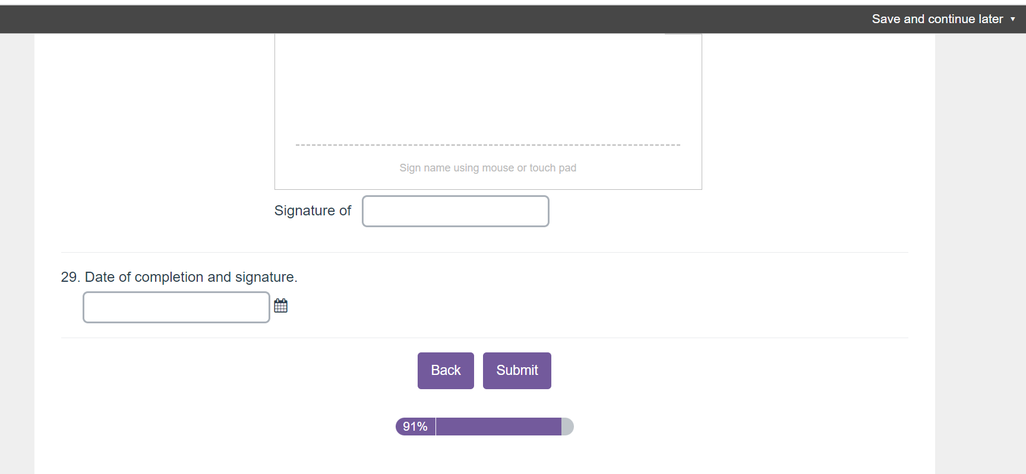
Save and Submit Buttons

Slide 23
Let’s take a look at the Application
Notes:
https://survey.alchemer.com/s3/7931361/Class-of-2025-Purple-Star-Award-Application

Slide 24
Award Notification
DESE Signed Letter with Purple Star Award Logo for display.
Official acknowledgement will take place in April – the month of the military child.

Slide 25
Application Link and Notification of Live Link
Applications will go live on or around November 1, 2024.
DESE Military-Connected Student Webpage

