Slide 1
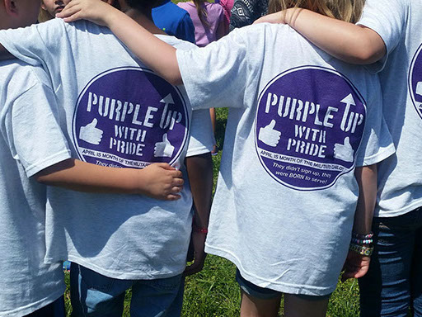
April is the month of the Military Child
Most military children will attend
Six to Nine
Schools between
K -12 Grade.
In School Year 2017 there were
7,458*
Military Connected students enrolled in
293
Districts across Massachusetts.
Show your support for military children during the month of April by wearing PURPLE, which symbolizes all branches of the military, a combination of Army Green, Air Force Blue, Coast Guard Blue, Marine Red, and Navy Blue.
M C3
Military Interstate Children’s Compact Commission www.mic3.net
Student and Family Support: MIC3 www.doe.mass.edu/ssce/military.html
* Due to frequent moves and resulting enrollments in new districts, numbers are reported in duplication for some students.

