Slide 1
Mathematics and Special Education Leadership Protocols
Developed in collaboration with the MA DESE, the MA Math Support Specialists’ Network and Education Development Center, Inc.

Slide 2
Acknowledging the Team
Who’s here?
What is each person’s role?
What does each person hope to bring to this team’s work?

Slide 3
Overview of the Protocols
Take a few minutes to read or review pages 1-3 of the Prologue document.
This important information provides context for the protocols.
Premise of the protocols
By focusing on students with disabilities when planning math instruction, educators will be better able to address the needs of all learners.

Slide 4
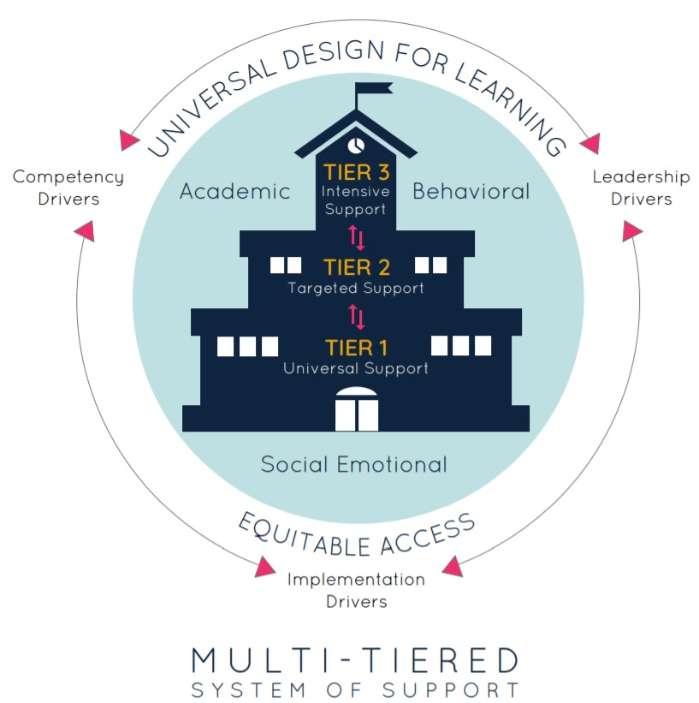
Connections to Multi-Tiered System of Supports (MTSS): The Protocols...
Promote an understanding of both mathematics and the variability of learners
Build shared responsibility, collaboration and leadership
Model strong, universally designed core instruction in mathematics (Tier 1) using multiple accessibility strategies

Slide 5
Mathematics and Special Education Leadership Protocols
Protocol 1: Shared Beliefs About Mathematics Instruction for Students with Disabilities

Slide 6
Today’s Work with the Protocols
1: Shared Beliefs About Mathematics Instruction for Students with Disabilities
2: Essential Understandings About Students with Disabilities
3: Essential Understandings About Rigorous Mathematics Instruction
4: Aligning Barriers and Strategies
5: Responding to a Range of Learning Needs
Notes:
Today, we’ll launch into Protocol 1 to have a conversation about both our shared and differing beliefs and assumptions about math instruction for students with disabilities.

Slide 7
Protocol 1 Goals
To identify both the team’s shared and differing beliefs about math instruction for students with disabilities;
To use those areas of shared beliefs and differences to fuel discussion within the team that leads to greater understanding and agreement among the team about expectations in mathematics instruction for students with disabilities.

Slide 8
Agenda
Getting started
Complete the Beliefs Inventory
Tally and discuss results
Individual reflect-and-write
Next steps

Slide 9
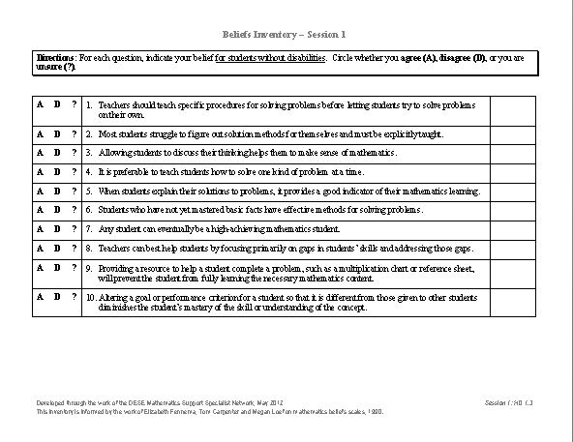
The Beliefs Inventory
Think about a classroom of students
For each statement, circle either: A (Agree) D (Disagree) ? (Not sure)

Slide 10
The Beliefs Inventory
Re-read each question, thinking specifically about students with disabilities
Write A, D or ? in the right-hand column.

Slide 11
The Beliefs Inventory
Which beliefs appear to be mostly shared?
What are the points of disagreement?
Are there any surprises?
What are the underlying assumptions behind our points of disagreement?
Do we have different beliefs for students with and without disabilities? If so, why? How can we reconcile our differences?

Slide 12
Write and Reflect
What are some important ideas from today that you want to note for yourself?

Slide 13
Wrap-Up
Summarize and list any outstanding questions that have not been answered yet and that are still under discussion.
Review any parking lot questions
Any “To-Do” items for next meeting
Review the purpose of next meeting.
Clarify date, time and location of next meeting.

Slide 14
Next Time…
#1 Shared Beliefs About Math Instruction for Students with Disabilities
#2 Essential Understandings About Students with Disabilities
#3 Essential Understandings About Rigorous Mathematics Instruction
#4 Aligning Barriers and Strategies
#5 Responding to a Range of Learning Needs
Notes:
Today’s protocol gave us an opportunity to discuss any differences in our beliefs and assumptions about students with disabilities.
The next protocol will delve into some important foundational information about areas of difficulty specific to mathematics learning, and will give us an opportunity to learn about using the IEP as a valuable tool to informing instruction.

