Slide 1
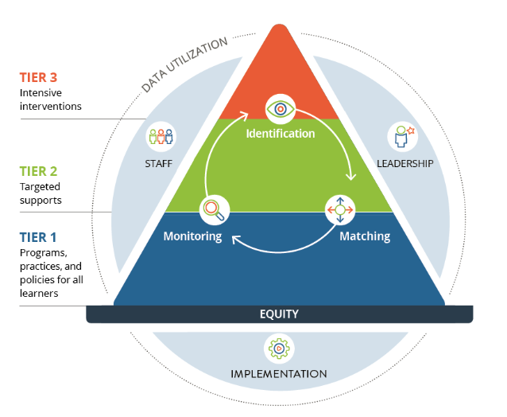
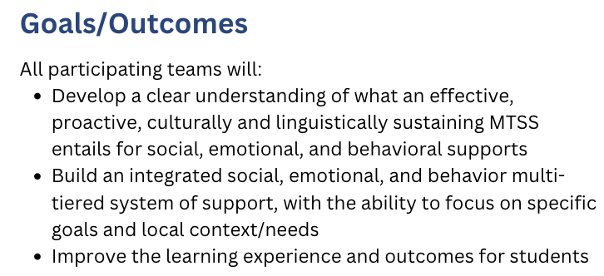
Social, Emotional & Behavior Academy
Alignment to DESE priority #1:
Cultivate systems to support the whole child and foster joyful, healthy, and supportive learning environments so that all students feel valued and connected.

Slide 2
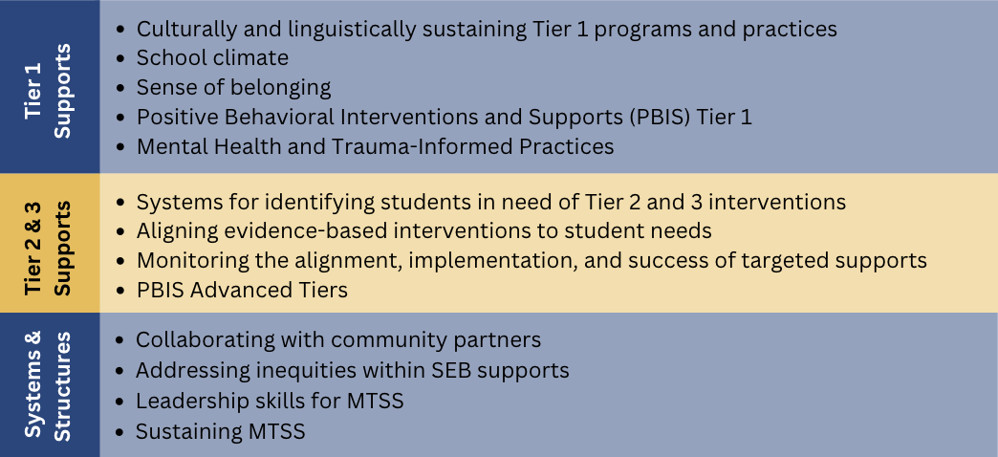
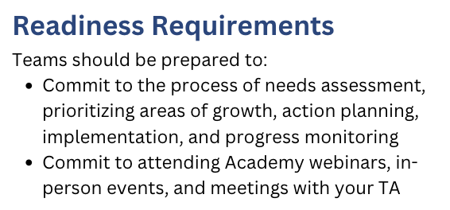
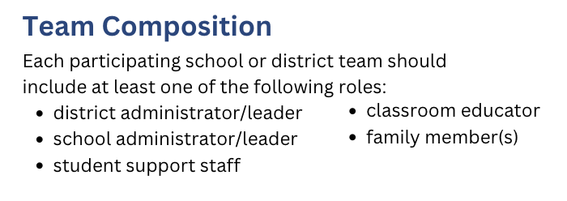
Topics Covered Through the SEB Academy
“The Academy is an important resource that can help schools and district advance SEL/MH work, and I appreciate the…personalized technical assistance approach.”
-Academy participant
To learn more, watch our video overview.
Contact Information:
Shai Fuxman
sfuxman@edc.org

