Slide 1
Overview of FY26 SOA Plan Progress Reports
Thursday February 5, 2025

Slide 2
Agenda
Introductions
Quick refresher on the Student Opportunity Act
Overview of FY26 SOA Plan Progress Report Process
What’s the same and what is different this year
Walkthrough of template
Resources and supports for districts
What to expect after submitting your FY26 SOA Plan Progress Reports
Q and A

Slide 3



Overarching Goal of Student Opportunity Act
To ensure that that every student in the Commonwealth has access to a high-quality public education regardless of zip code

Slide 4
SOA introduced two key components
Fiscal: Changes to Chapter 70 funding
Policy Updates: Plans every 3 years
Focus on addressing disparities in learning experiences and outcomes for student groups that are least-well served
New investment in education
Revised funding formula reflects equitable distribution of state education funds
Implementation of evidence-based practices

Slide 5
SOA Plans versus District Improvement Plans
The District Improvement Plan (DIP) serves as a comprehensive plan that describes the full set of strategies that a district will implement to support all students in their district.
By contrast, the SOA Plan centers on student groups experiencing disparities in educational opportunities and outcomes – and describes key evidence-based strategies the district is implementing to reduce those disparities.

Slide 6
SOA Plan Submission Cycle
January 2021: Districts submitted an initial three-year SOA plan
April 2022: Districts submitted a comprehensive amendment to their original plan
April 2023: Districts submitted a progress update
April 2024: Districts will submit a new three-year SOA plan
Spring 2025: Districts will submit a progress update
Spring 2026: Districts will submit a progress update
April 2027: New three-year SOA plans are due
The first submission cycle was modified due to COVID
This is a return to the regular submission cycle as required by law

Slide 7
FY26 SOA Plan Progress Report
Progress reports are due in GEM$ by April 1, 2026*
*Progress reports from Charter Schools are due August 1, 2026

Slide 8
What’s remains the same and what’s new?
Most of the FY26 SOA Plan Progress report template will look very familiar and asks districts for:
a summary of progress to date as of academic year 2025-2026;
information about any key changes to your SOA plan since last year and next steps for implementation in the upcoming academic year (2026-2027);
new activities launched in academic year 2025-2026 to engage families/caregivers and other stakeholders.

Slide 9
What’s new this year?
The Mass Leads Act, enacted November 20, 2024, requires districts to develop and submit to DESE plans for strengthening workforce diversity.
DESE’s Office of Strategic Initiatives, which is leading this work, is working collaboratively with the SOA Team and other stakeholders as it develops guidance for these plans.
Data collection for the FY26 SOA Plan Progress Reports is being leveraged to gather baseline data from districts on strategies fostering workplace diversity that are already underway or that are in the planning stages.
These data will be used to inform their planning process. DESE staff leading this work will provide additional context during the overview webinar.

Slide 10
Technical details
Progress Reports will be submitted in GEM$
Make sure your district’s User Access Administrator assigns the LEA SOA Plan Writer role to anyone entering responses in GEM$
Note: this includes Superintendents, who need to be assigned the LEA SOA Plan Writer role before they can enter information into template
All future SOA Plan Progress Reports reminders and updates will be sent via GEM$ system

Slide 11
Quick Start Instructions for GEM$
1. Log into GEM$ using your email and password
2. Select Search, and then Application Supplement from the dropdown menu
3. Set Fiscal Year to 2026
4. Select SOA Plan Progress Report from list of application supplements
5. Change Status from Not Started to Application Supplement Started
6. Select section of FY26 SOA Plan Progress Report to begin entering information into template
7. Remember to save your work at regular intervals!

Slide 12
Two final points
FY26 SOA Plan Progress Reports do not need to be formally approved by School Committees—but we encourage districts to collaborate with their school committees and share progress reports with them.
Priority districts are not be required to submit a budget addendum

Slide 13
As you shape your narrative:
Celebrate wins and acknowledge challenges
Primary audience = your local stakeholders
Keep it succinct, clear, and easy to digest
Address all evidence-based programs (EBPs) in your plan
Center student groups experiencing disparities throughout

Slide 14
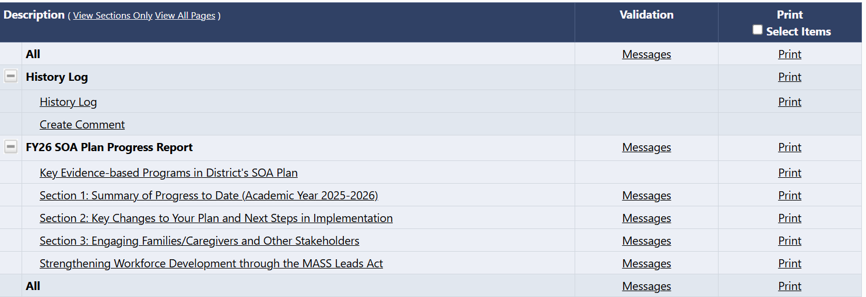
FY26 SOA Plan Progress Report Template

Slide 15
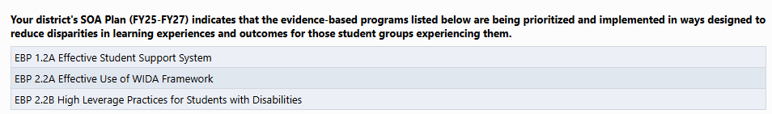
Key Evidence-Based Programs in SOA Plan

Slide 16
Section 1: Summary of Progress to Date
Covering Academic Year 2025-2026

Slide 17
Section 1: Summary of Progress to Date
Reflect upon your progress monitoring data and share highlights about:
Progress of implementation for the evidence-based programs in your SOA Plan
Early evidence of change you are seeing as a result of your implementation;
Progress in closing gaps in disparities, highlighting:
improvements for student groups identified in your SOA Plan
evidence that gaps in outcomes are closing for student groups identified in your plan
extent to which your district is meeting Math and ELA MCAS targets for the lowest performing student group

Slide 18
Progress Monitoring Data
We anticipate that districts will use a combination of local and state data sources to complete this section.
Section 5 of your SOA Plan (FY25-FY27) lists the metrics your district plans to use to monitor progress for each EBP
You are not required to report on every indicator listed
You may also use other metrics that better describe district progress
The FY24 SOA Plan guidance includes recommended local metrics for each EBP beginning on page 10.

Slide 19
Implementation Activities
Template prompt: During academic year 2025-2026, what steps did your district take to launch, expand, or deepen the implementation of each EBP in your SOA Plan?
Highlight key accomplishments
Share what is working well
Reflect upon places where you may need to revisit/adjust your approach?
Indicate what you are you doing differently this year
Address how implementation is addressing needs of student groups experiencing disparities
Notes:
.Your original plan describes what implementation will look like in 3 years – here you want to look at your progress monitoring data and:
highlight key accomplishments/what is working well? Where do we need to revisit approach?
what steps did your district take to launch, expand, or deepen the implementation/ Tell us what are you doing differently this year. Focus on aspects of implementation that are not business as usual – but ways in which implementation is driving improvement. Could be launching a new strategy – perhaps you are just getting started with co-teaching, or had a pilot program that is expanding to other schools in district; Don’t simply describe business as usual
Remember to center on student groups experiencing the greatest disparities

Slide 20
Early Evidence of Change
Template prompt: Please describe and reflect upon the extent to which progress monitoring data reflects early evidence of change that you anticipate will lead to smaller disparities in outcomes for student groups targeted in your SOA Plan
Early evidence of change = hypothesized shifts that need to happen before can expect to see changes in student outcomes linked to implementation
Includes changes in actions, discourse, beliefs, expectations, and instructional practices (to name a few)

Slide 21
Progress in Closing Disparities
Template prompt: Please describe and reflect upon the extent to which progress monitoring data on interim and longer-term student outcomes reflect the following:
Improvement for the student groups targeted in your SOA Plan
Reduced disparities for student groups targeted in your SOA Plan
Progress towards meeting targets for in MCAS ELA and Mathematics for the lowest performing students group

Slide 22
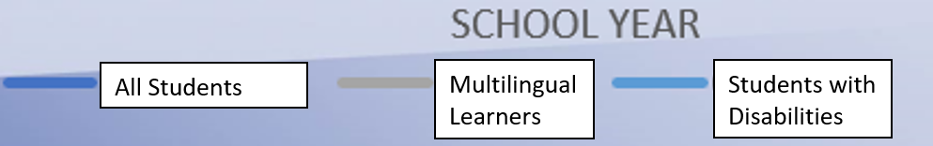
Improving Outcomes and Reducing Disparities
In this example, every student group improves over the course of several years.
Importantly, the disparity between outcomes for students overall and for students with disabilities and multilingual learners is beginning to narrow.

Slide 23
Progress towards meeting targets: lowest performing students group
SOA legislation requires DESE to set statewide and district targets in achievement and track progress over time for students experiencing disparities
To fulfill this requirement, DESE is tracking annual state and district progress towards meeting MCAS targets for the lowest performing students group, as reported via the state’s district and school accountability system
In your progress report: include data from most recent accountability data (2025 Accountability Targets and 2025-2027 Increments)
Briefly reflect on the extent to which you are making progress towards meeting those targets and whether/how that data may impact implementation of SOA Plan

Slide 24
Section 2: Key Changes to your plan and Next Steps in Implementation

Slide 25
Section 2: Key Changes and Next Steps
If applicable, describe any key changes to your district’s SOA Plan that your stakeholders should be aware of:
Substantial shifts in your approach to EBP
Significant changes to 3-year budget
Dropping or adding an EBP
Implementation plans for academic year 2026-27 to expand, deepen, and/or strengthen your implementation of the EBPs in your SOA plan

Slide 26
Section 3: Engaging families/caregivers and other stakeholders

Slide 27
Section 3: Engaging families/caregivers and other stakeholders
Families/caregivers
Please briefly describe any new or expanded efforts introduced during the 2025-26 school year to engage families/caregivers—particularly those representing student groups you have identified for targeted support—about how to best address their students’ needs.
Please share evidence of increased or improved engagement with families/caregivers—particularly those representing the student groups targeted in your SOA Plan—during Academic Year 2025-2026. (Either metrics described in your SOA Plan or other relevant measures)

Slide 28
Section 3: Engaging families/caregivers and other stakeholders
Stakeholder engagement related to SOA Plan
Please briefly describe the following types of stakeholder engagement during the 2025-2026 school year, making certain to include information on stakeholders representing student groups targeted in your SOA Plan
How your district shared updates on SOA Plan implementation, early evidence of change, and outcomes with different stakeholder groups
the ways in which your district collected input and feedback from different stakeholder groups
The substantive input you have received to date—and whether/how that has impacted SOA plan implementation

Slide 29
Strengthening Workforce Development through the MASS Leads Act (New section)

Slide 30
Mass Leads Act
On November 20, 2024, the Governor’s Office signed the Economic Development Bill into law. Within the bill is the Mass Leads Act which requires districts to create and implement the following:
Create a Diversity Plan and have it approved by DESE
Appoint a DEI Officer or establish a Diversity Team which will advise the School Committee on the progress to establish a more diverse, equitable, and inclusive school district
Require school district employees and school committee members to attend Diversity and Implicit Bias Training. The Mass Commission Against Discrimination is responsible for providing the guidance in this area.

Slide 31
New Section of SOA Plan: Strengthening Workforce Development
DESE is currently working to provide guidance, processes, and procedures to implement the different elements of the Mass Leads Act
This new section of the SOA Plan for this year will act as a baseline set of data for DESE to use to further develop guidelines.
Answering the following four questions will cover your district for the 2026-27 school year while guidelines are finalized

Slide 32
Mass Leads Act - Questions for Districts
What systemic barriers to hiring a diverse workforce does your district encounter? What steps is your district currently taking to address and eliminate those barriers?
What steps does your district currently take to identify, recruit, and hire employees who are members of groups underrepresented in the educator workforce?
What strategies does your district currently use to develop, promote, and retain employees who are members of groups underrepresented in the educator workforce?
What does your district currently do to promote equal opportunity in employment for educators?

Slide 33
Mass Leads Act: What will Happen Next
By summer of 2026, DESE will publish guidelines for districts’ diversity plans that increase teacher diversity
Districts will provide final Diversity Plans no later than April 1, 2027, as part of their SOA plans
DESE will establish a process for reviewing the diversity plans and give feedback to Districts no later than June 1, 2027

Slide 34
Resources and Supports

Slide 35
Resources and Supports for Districts
FY26 SOA Progress Update Overview Webinar (recording and slide)
Links to data resources:
Massachusetts Education-to-Career Research Data Hub’s Data Tools for Educators
Student Outcomes Comparison Dashboard will be posted there.
FY26 SOA Progress Update – Example of completed progress report
Instructions for Completing FY26 SOA Progress Updates in GEM$
SOA Office Hours: ½ hour consultations
Dedicated SOA email address for SOAPlans@mass.gov
Questions about MASS Leads Act: Email Lola.Shoyinka@mass.gov

Slide 36
Once Progress Reports Are Submitted
April–June: SOA Team will be reading progress reports in GEM$
You will be notified via GEM$ once your progress report is approved.
We will follow up directly in GEM$ if we have questions and/or need additional information.
July 2026: SOA Plan Progress Reports are posted in GEM$

Slide 37
Contacts
For questions about sections 1-3 of the SOA Plan Progress Reports, reach out to Karen Johnston.
Option 1: Send an email to SOAPlans@mass.gov
Option 2: Set up a ½ hour consultation using this scheduling link.
For questions about workforce diversity section, reach out to Lola Shoyinka (Lola.Shoyinka@mass.gov)

Slide 38

Questions?

