Slide 1
Twenty-First Century Education Advisory Council Meeting
January 29, 2024

Slide 2
Agenda
Welcome and Icebreaker
Budget Update:
Cuts, Reductions, and Implications
UPDATE AND DISCUSSION
Update on Evaluation: Focus on Co-Teaching and Inclusion
Student Opportunity Act (SOA) Plans:
UPDATE
Close
Notes:
Steve – Review Agenda and Present Ice Breaker – 5-10 minutes

Slide 3
Budget Update: 21st Century Education Trust (1595-0035) Governor’s Budget
FY24 9C Cuts – Reduced by $2 million
FY25 Budget – Reduced from $5 million to $1 million
Implications for Grant
  Trying to identify other financial resources to fund the last year of grant for current cohort in FY25.
Budget moving through House and Senate – Final Budget in July
Notes:
Moira – 20 min for section

Slide 4
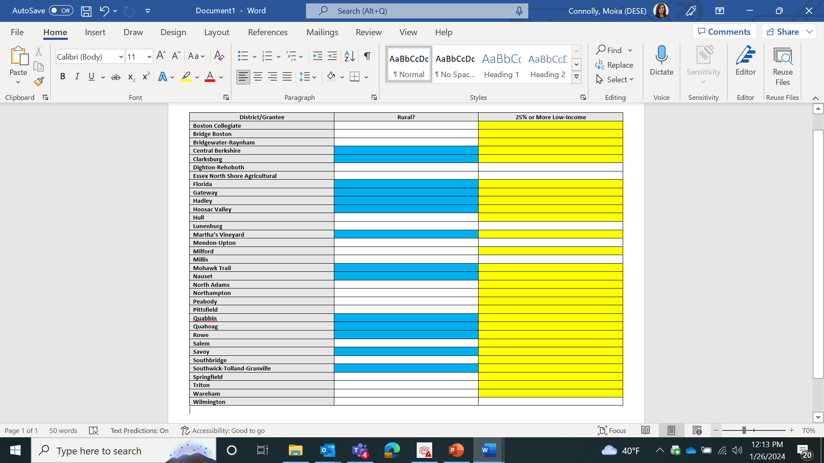
District/Grantee
Notes:
Legislation notes a focus on rural. Most also serve high populations of low-income families. Vulnerable populations in districts receiving little additional ch. 70 funding. We cannot advocate. Discuss.

Slide 5

Update on Potential Evaluation
WT Grant Foundation Research Grants on Improving the Use of Research Evidence
August Submission
RFR for Partner – in Process
Requirement – Absorb Cost for Districts
Notes:
Moira – 15 minutes

Slide 6
Why Co-Teaching & Inclusion?
18 of 35 Grantees Focusing on Co-Teaching & Inclusion
  FLNE and EL – 39.1% of Student Population in MA
  Students with Disabilities – 20.2% of Student Population in MA
  11% Attained Proficiency on ACCESS 2023
  38% Making Progress on ACCESS 2023
  6% of ELs M/E on ELA MCAS; 9% ELs M/E on Math MCAS
  12% of SWD M/E on ELA MCAS; 11% SWD M/E on Math MCAS
Several other DESE grants focus on supporting this strategy, which allows DESE to study intersection of strategy AND funding
Notes:
Strategy is touched by many funding streams and evaluation would encompass many. Will make for a more dynamic study. Based on discussions.

Slide 7
Student Opportunity Act (SOA) Plan Update
Dissemination of Best Practice
Next round of plans due April 1;
FAQ in Process;
Review Process Planning - Finalizing
Current Supports Available:
    Updated Guidance
    Webinar
    Student Outcome Comparison Tool
    SOA Office Hours
Notes:
Moira introduce – Appreciated feedback related to dissemination. Using SOA plan round to consider how to disseminate best practice.
Karen – Will help to inform design of next cohort of grants should the trust be funded. 10 minutes

Slide 8
Closing
Next Meeting
  May 13, 2024 5:00 p.m. – 6:15 p.m.
Thank you!

