Slide 1
Overview and Guidance for
FY23 SOA Progress Reports
February 16, 2023
Notes:
This webinar and it’s accompanying slide deck are designed to provide districts with an overview of the FY23 SOA Progress Report and offer instructions and guidance for completing it.
These materials, which are posted on DESE’s SOA District Resources web pages, will serve as your primary guidance resource as you prepare your FY23 SOA Progress reports. pages. Screen shots of the complete on-line template begin on Slide 44 in this slide deck.

Slide 2




Welcome
Agenda
Welcome
Framing/Background
FY23 SOA Progress Report Template
SOA Team Supports for Districts
05
Q and A
Notes:
After a brief welcome, we’ll provide a brief refresher on the Student Opportunity Act and its goals and offer a snapshot of some of the things we are learning from the FY22 SOA Plan Amendments districts submitted last year. We’ll spend the bulk of our time walking through the FY23 SOA Progress Report Template. Following that, we’ll highlight some of the supports available as you develop your projects and then provide an opportunity to ask questions.

Slide 3
Before we get started….
A brief word about the FY23 SOA Progress Report
Meet DESE’s SOA Team
Notes:
Before we get started I just want to say a brief word about the FY23 SOA Progress report. Last year, due to the impact of the pandemic, we asked districts to engage in a reflection and review process of their original plans; many of you made fairly robust revisions to your plans. This year’s progress report is largely intended to serve as an update on the implementation and outcomes of those plans. It also asks for an update on how resources are being used in FY23 to support the implementation of the evidence-based program areas highlighted in your plans.
We urge you to take a moment to pause and, using your progress monitoring data, step back and reflect upon all the work that has gone into implementation over the past year. This progress report offers an opportunity for your districts to celebrate wins both large and small and, where implementation has run into challenges, pause and think strategically about how to make adjustments to address those challenges.
I also want to take a moment to acknowledge the SOA Team that supports this process at DESE – many of whom have joined us this afternoon. They include include Erica Champagne, Rebecca Shor, Moira Connolly, Alison Stevens, Michael Seymour, Susan Fischer, Hubert Zong, Andrea Ricotta, and our partners at Open Architects, Seth Racine and Tom Jacobs. Although my role in the project means I have the good fortune to be involved with much of the public-facing engagement with districts, there are many others here at DESE who support this project – whether in the form of thought partnering, reading plans, or (most recently) helping to pilot test the FY23 Progress report templates.

Slide 4
Framing/Background
Agenda
Welcome
Framing/Background
FY23 SOA Progress Report Template
SOA Team Supports for Districts
05
Q and A

Slide 5



Overarching Goal of Student Opportunity Act
To ensure that that every student in the Commonwealth has access to a high-quality public education regardless of zip code
Notes:
I want to take a moment to share the overarching goal of the Student Opportunity Act, which is to ensure that every student in the Commonwealth has access to a high-quality public education regardless of zip code.
Ultimately this act is a recognition that some of our districts have been historically underfunded, and the goal was to fund them equitably.

Slide 6
The SOA has two key components
Fiscal: Changes to Chapter 70 funding
Policy Updates:
Focus on closing gaps for student groups least-well served
New investment in education
Revised funding formula reflects equitable distribution of state education funds
Implementation of evidence-based practices
Notes:
The two primary components the legislation uses to address support equitable outcomes are fiscal changes to Chapter 70 funding and policy updates that set out an expectation that all districts across the Commonwealth will focus on gap-closing for student groups that are least-well served –and to do that through the implementation of evidence-based practices.
On the fiscal side -- the SOA represents an enormous new, ongoing investment in education. The legislation adopted all recommendations of the Foundation Budget Review Commission’s October 2015 report. In doing so it commitred to adding well over a billion dollars in new education by 2027 to address the state’s overall underinvestment in education. Combined increases in FY22 and FY23 totaled $547 million. That increase was coupled with a revised funding formula that set the stage to greatly accelerate gap-closing by providing more funding for students who need more services to be successful, such as multilingual learners, student with disabilities, and students living in poverty. In addition, recognized the increasing cost of health care by basing costs on up-to-date health insurance trend data collected by the state’s Group Insurance Commission (GIC).
On the policy side -- the legislation’s focus on gap-closing and implementation of EBPs includes a requirement that districts develop gap-closing plans every three years, and provide annual reports on progress closing gaps. Districts are required to submit those plans to DESE annually by April 1 of each year. (And as a side note, we pushed this year’s due date to April 3 since the April 1 is on a Saturday this year.
We frequently get the question ‘Does my district need to develop a plan?’ from districts receiving little or no additional Chapter 70 aid. The answer to that is Yes. There are gaps in learning experiences and outcomes for students with disabilities, English learners, students from low-income communities and other student groups in most, if not all districts, across the Commonwealth. It is our shared work to close these gaps. And every district in the Commonwealth is expected to develop and implement gap closing plans whether they receive no additional Chapter 70 aid, a small amount of additional aid, or large amounts of additional aid.

Slide 7
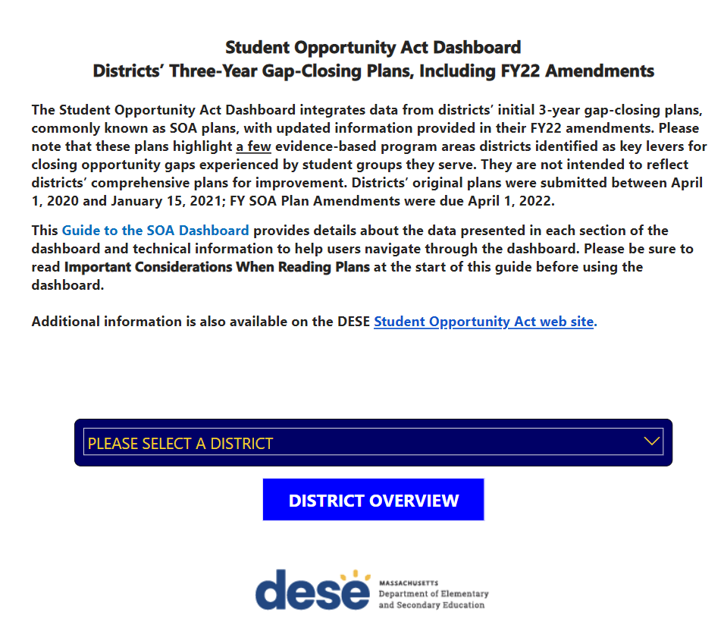
SOA Dashboard
Notes:
The SOA legislation also requires DESE to publicly post districts’ 3-year gap-closing plans – and since July 2022, those plans have been posted in the SOA Dashboard, which is available on our website.
The dashboard offers interested stakeholders an opportunity to see what kinds of gap-closing measures are engaged in.
The on-line templates districts complete also allow us to aggregate data statewide and are already offering valuable an invaluable snapshot of the student groups districts are targeting for gap-closing, the evidence-based program areas districts are prioritizing, what elements of EBPs districts are implementing, and how financial resources are being utilized to support implementation. The next few slides share a few highlights of what we are learning from your plans.

Slide 8
SOA plans are targeting the student groups the legislation intends them to target
Notes:
Statewide: On average districts are targeting 3 student groups.
On average, those districts receiving more than $1.5 million in additional Chapter 70 funding in FY22 reported targeting 5 student groups (N=25 districts)
On average, those districts receiving less than $1.5 million, reported targeting 2.5 student groups

Slide 9
Evidence-based Program Areas most often appearing in district plans
Notes:
You can see statewide, the EBPs appearing most often in district’s plans are those focusing on: implementation of High-Quality Instructional Materials; Inclusion and co-teaching for students with disabilities and multi-lingual learner, expanding the capacity to address students’ social-emotional learning and mental health needs; and the implementation of research-based early literacy programs.
On average, districts receiving $1.5 million or more in additional Chapter 70 aid in FY22 reported they would focus on 4 EBPs (N=25 districts)
On average, districts less than $1.5 million or more in additional Chapter 70 aid in FY22 reported they would focus on 2.5 EBPs (N=320)

Slide 10
Reported Investments in EBPs in FY22
Evidence-based program area | Total $ | Total % of reported $
HQIM | $74,195,293 | 22%
Co-teaching & Inclusion | $68,281,163 | 20%
SEL/Mental Health | $49,991,834 | 15%
Early Literacy | $28,915,991 | 9%
Cycle of Continuous Improvement | $17,844,929 | 5%
Pre-K/Full K | $16,136,492 | 5%
Acceleration Academies | $13,203,185 | 4%
Funding sources: ESSER I, ESSER II, ESSER III, Local funding (including Chapter 70), Other Federal grants (e.g., Title grants), other state grants (e.g., GLEAM grants), Mass Business Authority Funds, Other
Notes:
And here's a picture of how much districts report they are investing in some of these evidence-based program areas. Please note that it describes funding from multiple funding sources. The total investments reported for just these 7 EBPs is more than the entire increase in Chapter 70 aid phased in by the legislature in FY22.

Slide 11
Examples of how DESE is using data
Statewide snapshot of district priorities, what is being implemented, and how fiscal resources are utilized
Data source as we engage in planning and resource development
Useful reference for offices working with individual districts
Notes:
In addition to providing a snapshot of district priorities, statewide inform DESE’s planning and development of resources and supports for districts. For example, data from SOA Plans were used as DESE weighed funding priorities for the competitive EBP grant opportunities for which some of you recently submitted applications.
Individual district plans are also a useful reference for offices that provide direct supports to individual districts. Our Statewide System of Support Team members, for example, are familiar with districts’ 3-year gap-closing plans and use them to inform their supports as they partner with districts and schools.

Slide 12
FY23 SOA Progress Report Template
Agenda
Welcome
Framing/Background
FY23 SOA Progress Report Template
SOA Team Supports for Districts
05
Q and A

Slide 13
Before you begin, some advice…
Prepare as much of your progress report as possible off-line
Assemble the progress monitoring data you are using to assess the implementation and impact of the EBPs in your plan
Work with your school business manager to respond to the budget items
Consult the Overview and Guidance for FY23 SOA Progress Reports (i.e., the slide deck to this Webinar)
Notes:
Before you begin, just a few words of advice from us:
Prepare as much of your progress report as possible off-line. You will better appreciate this recommendation as we walk through the template together.
Assemble and review the progress monitoring data you are using to assess the implementation and impact of the EBPs in your plan in preparation for writing your Summary of Progress to Date,
Work with your school business manager to respond to budget items, particularly if your district is providing additional information in Section 4: Other Uses of Additional Chapter 70 aid.
Consult the Overview and Guidance for FY23 SOA Progress Reports (i.e., this slide deck) as you work your way through different sections of the template. As noted previously, screen shots of the on-line instructions and data-entry templates appear beginning on slide 44.

Slide 14
Overview of FY23 SOA Progress Report Template
A brief narrative update on progress to date (New section)
Updated implementation detail for each evidence-based program
Updated budget information on FY23 expenditures for each EBP
Other uses of additional Chapter 70 aid (New section)
Updated information on progress in engaging family and caregivers
Update on stakeholder engagement in plan development and implementation
Notes:
Due to the pandemic, districts were asked to provide a robust update to your original plans. Now that you’ve had more time to focus on implementation and now your letting your stakeholders know how things are going. We’ll go into more detail on subsequent slides, but here in a nutshell is the information you will be providing in your update.
Most of it will look familiar to those of you who completed the on-line template last year. As we walk through the template, we’ll spend more time on new items.

Slide 15
Technical features of on-line template
Unique district link and log-ins can be shared
  HOWEVER, only one person at a time may enter data in the template
Progress is automatically saved when you hit Next button
If you exit, original link takes you back to where you left off
Template won’t let you skip from section to section
A red asterisk (*) indicates that the item is required
Some sections of the template allow you to import and view data provided by your district in April 2022
One you hit the Submit button, you will not be able to get back into the template.
Notes:
There are a few technical features of the on-line template that you should be aware of:
Unique district link and log-ins can be shared
HOWEVER, only one person at a time may enter data in the template
Progress is automatically saved when you hit Next button
Data are automatically saved every time you hit the Next button at the end of a section.
This features allows you to exit and re-enter a partially-completed template.
HOWEVER, if you begin entering data in a section of the template and exit before completing the section and clicking the Next button, your data will not be saved and will need to be re-entered.
The link from your original email invitation will take you directly to the place where you left off in the template. You can continue entering data and/or review and revise data entered previously.
Once you hit the Submit button at the end of the template, you will not be able to get back into your template.
The template does not permit you to skip from section to section. This means each section must be complete before you will be able to continue to the next section.
A red asterisk (*) indicates that an item is required. You will not be able to progress to the next section until all required items for that item are complete.
Some sections of the template allow you to view data provided by your district in its FY22 SOA Amendment. Instructions are provided wherever that option is available.
Note: Districts with 3 or more evidence-based program areas in their plans may find it easier to use their full plan from the SOA Dashboard.

Slide 16
Once you log in:
  Confirm your district’s name
  Provide contact information
Notes:
Please let us know who to contact if we have any questions or requests for additional information once your progress report is submitted.
Emails went out to superintendents from Alchemer on Thursday morning with links to the template and the district’s unique log-in information.
The email invitation from Alchemer went out to district superintendents

Slide 17
Summary of Key Elements in FY22 SOA Amendments
This in-template feature allows you to view:
the evidence-based program (EBP) areas in your plan
The student groups targeted by each EBP
The metrics you plan to use to measure progress
Alternatively: You may also open your plan in the SOA Dashboard and keep it open as a reference as you work on your progress report
Notes:
There are several places throughout the template where you will be able view selected data from your FY22 SOA Plan without existing the template. These features work best for districts with only one or two EBPs in their plans. Districts with 3 or more EBPs will probably find that opening their plan from the SOA Dashboard to be a more efficient option.

Slide 18
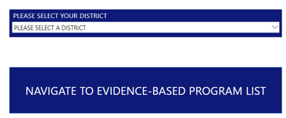
FY22 SOA Summary data - example
Notes:
You may either use the dropdown menu to select your district, or use the search feature at the top of the dropdown menu to type in your district’s name. Then click on “Navigate to Evidence-based Program List.”

Slide 19
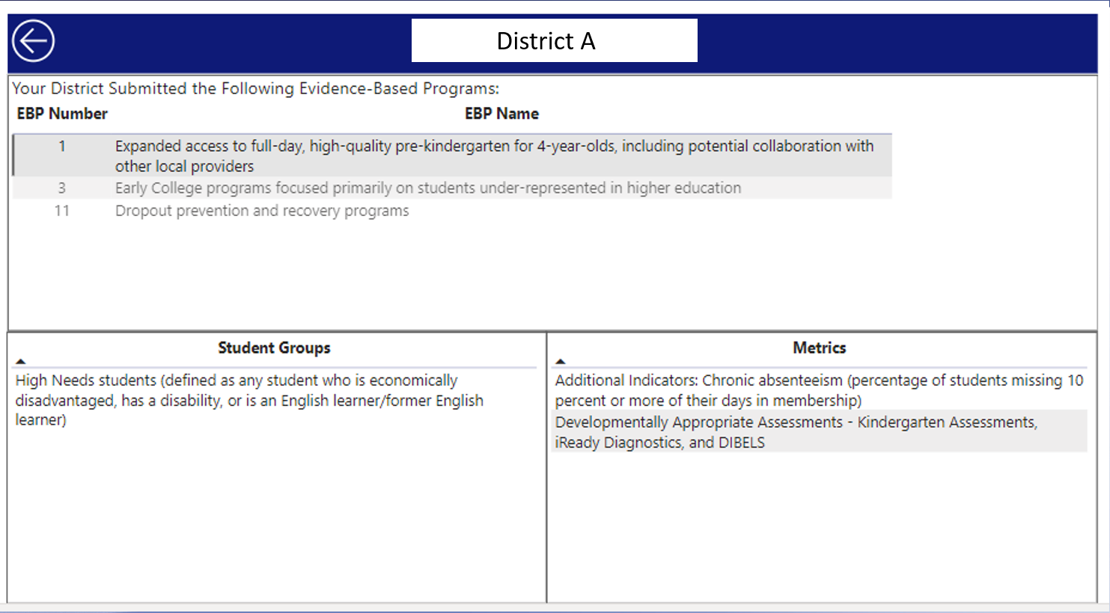
Summary data - example
Notes:
This district has selected 3 EBPs. The first EBP on the list Expanded access to full-day, high-quality pre-kindergarten for 4-year-olds is selected in this example.
The Student Groups the district is targeting for gap closing and the Metrics it will use to measure progress for that EBP appear n the two boxes at the bottom of the page. When Early College programs is selected, the Student Groups and Metrics will change to reflect the student groups targeted by that EBP and the measures it will use to measure progress.
If the data for your district looks incorrect, please reach out to us at SOAPlans@mass.gov.

Slide 20
Section 1: Summary of Progress to Date
NEW SECTION!
What evidence have you seen that your implementation of EBPs is leading to the desired gap-closing for targeted students?
Primary audience = your local stakeholders
Keep it succinct, clear, and easy to digest
Lead with evidence of gap-closing outcomes for targeted student groups
  Explain how those outcomes flow from the implementation of EBPs in your plan
  Address implementation success/challenges that impact outcomes
Notes:
The key question you are answering in your summary is this: What evidence have you seen that your implementation of EBPs is leading to the desired gap-closing for targeted students?
We encourage you to use your progress monitoring data to look for opportunities to celebrate successes and acknowledge challenges and how they will be addressed.
As you to shape your district's story, please keep in mind that your primary audience is your local stakeholders​.
Keep your summary succinct, clear, and easy to digest, making certain to:
Lead with evidence of gap-closing for learning experiences and outcomes for student groups targeted in your plan
Include specific examples drawn from your progress monitoring data to support your narrative
Convey to your audience how the gap-closing outcomes you describe are related to the implementation of EBPs
Address implementation successes/challenges and how they are impacting gap-closing
How long should the summary be? Perhaps a paragraph of two if your district is implementing 1 or 2 EBPs; may need more space if you are implementing 3 or more multiple EBPs.
Do I need to write a separate narrative for each EBP? We understand that not all EBPs are mutually exclusive, so you do not need to write a separate narrative for each EBP in your plan (although you can, of course, opt to do that—and your summary should touch upon each EBP in your plan). Do what makes the most sense in terms of telling your district’s story. For instance, if the EBPs in your plan include implementing HQIM, a research-based early literacy program, and introducing/strengthening teacher capacity to use PLCs to support data-driven improvement cycles, it may make more sense to integrate that information into a single summary. On the other hand, if the two EBPs in your plan focus on research-based early literacy and Early College programs, it probably makes more sense to describe them separately.
Please be aware! The template will accept relatively little in the way of formatting. This means no underlining, italics, or bold, no tables, no graphics of any kind. If your district would like to give your stakeholders access to a formatted version, you can include a URL in your summary and instruct stakeholders to copy and paste it into their browsers.

Slide 21
Evidence: More Than MCAS scores
At this point in your implementation your best data reflecting gap-closing may very well come from other sources of evidence:
  Classroom observation data
  Local assessments
  Student perception data
You do not need to report on every metric listed in your plan
You can use metrics other than the ones listed in your plan
Notes:
What if we are not yet seeing evidence of gap-closing? It is probably too soon to realistically expect to see gap-closing in MCAS achievement scores (especially since the most recent MCAS data available are from spring 2022). At this point in your implementation your best data reflecting progress will most likely come from sources of evidence other than MCAS scores--classroom observation data, local assessments as you implement new early literacy program, VOCAL data reflecting student perceptions of climate, culture and learning experiences. Of course, if you so see gap-closing based on MCAS, by all means report them—but only if it’s reasonable to draw a connection between your implementation of the EBPs in your plan and the gap-closing you are seeing.
Think about the leading indicators of change for your EBPs – what has to change before you can expect to see changes? What will teachers be doing differently? How will student learning experiences change? And what data are you using to understand whether those changes are taking place?
Avoid over-reliance on anecdotes. Anecdotes can be powerful story-telling devices, but please don’t limit your evidence to vague comments such as ‘we hear from students….’ That type of anecdote packs much more of a punch when it can be linked to data that have been more systematically collected. (e.g., disaggregated student survey data + classroom observation data + anecdote). The jargony term for combining multiple data points to reinforce a finding triangulating data = triangulating data.
If your early indicators aren’t in In this case it would be appropriate to acknowledge the fact and go on to provide context from your implementation that may explain why not seeing hoped for outcomes (or why you are not seeing them yet). Describe what adjustments, if any, you are making or approaches you are taking to address any implementation challenges (Though be aware that you will be asked to provide a few sentences about next steps in implementation for each EBP in section.)

Slide 22
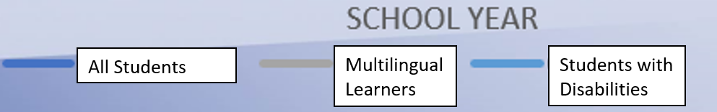
What do we mean by gap-closing?
In this example, every group of students improves over the course of several years.
Importantly, the gap between each of the groups narrows as well.
You will need data disaggregated by student group to assess gap-closing
Notes:
Many districts are selecting evidence-based programs that benefit all students (e.g., evidence-based early literacy programs)– and that’s terrific. We want to see learning experiences and outcomes improving for all students. (And we certainly don’t want to see gaps closing because overall outcomes are declining!)
That said, the goal of the Student Opportunity Act is to close existing gaps between student groups. In this example, students overall, as well as multilingual learners and students with disabilities show improvement in reading scores over the course of several years. Between 2020 and 2022 we see more of a ‘rising tides lifts all boats’ scenario, where every student groups improves more-or-less at the same pace, without much in the way of discernable gap-closing. Between 2022 and 2023, however, we begin to see gap closing for both multilingual learners and students with disabilities. This is the type of gap closing that that the districts’ SOA plans are intended to foster and drive.
You will need to look at data disaggregated by student group to assess gap-closing. We recommend examining both within-district comparisons and comparisons to state data (where relevant) to gain a broad understanding of gaps and gap-closing in your districts. The example in this slide focuses on within-district comparisons between students overall, multilingual learners and students with disabilities. Another approach would be to look at within-district comparisons between students with IEPs and those without IEPs, or comparisons between multilingual learners and those who are not multi-lingual learners. Comparisons between district and state learning experiences and outcome can also offer useful context about your students’ experiences and outcomes relative to the rest of the state.

Slide 23
Section 2. Update on FY23 Implementation of EBPs
Update information provided in April 2022 about the stage of implementation for components of high-quality implementation for each EBP (i.e., closed-ended Implementation indicators )
Two or three sentences describing your district’s immediate next steps in implementation for each EBP
Notes:
This section will be familiar to those of you who completed the FY22 SOA Amendment. You may remember the matrices listing a set of implementation components of EBPs in your plan that asked you to indicate what stage of implementation you were at – e.g., Not started; Pre-implementation planning/capacity building; Partial implementation; Full implementation; and Not a component of our approach
You will be completing the same matrices for each EBP in your plan this year.
Please note: Rolling out the implementation of new approaches and practices is often a multi-year process. We fully expect many of you who reported that you had partially implemented a component to report that you are still at a partial stage of implementation. Full implementation is intended to reflect a mature state of implementation. Keep in mind as well, that the matrix offers only a very high-level snapshot of implementation. We are looking for an accurate picture of where implementation stands and do not want districts to feel pressured to show ‘progress’ by checking full implementation this year. Your open-ended response will provide additional context that will help stakeholders better understand the progress of implementation.

Slide 24
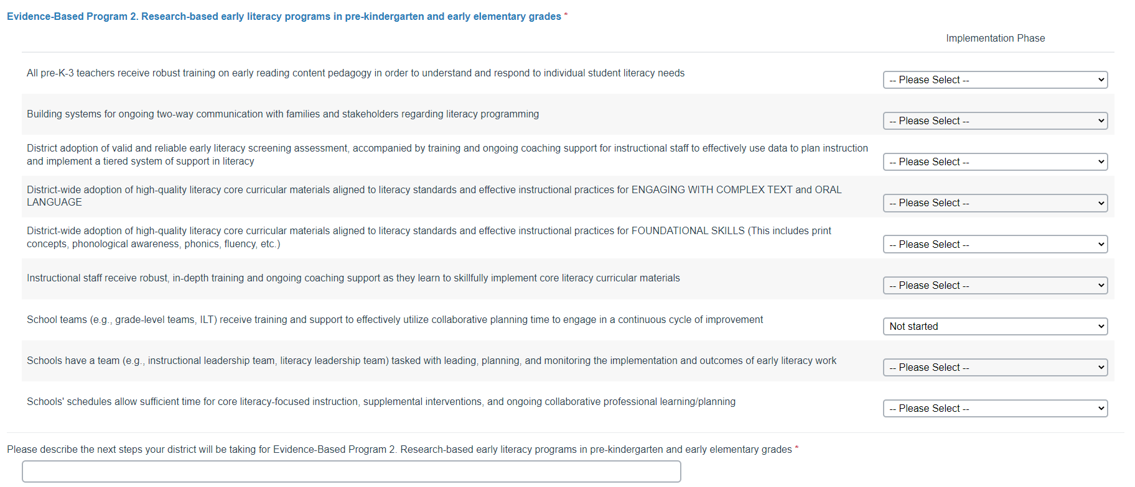
Implementation indicators: blank template
Add screenshot of blank implementation tables?
Notes:
There are the same implementation indicators you completed last year. This year, you will use a dropdown menu to select the stage of implementation. (Last year you were presented with a matrix with radio buttons)
Dropdown menu
Not started
Pre-implementation planning/capacity building
Partial implementation
Full implementation
Not a component of our approach
.

Slide 25
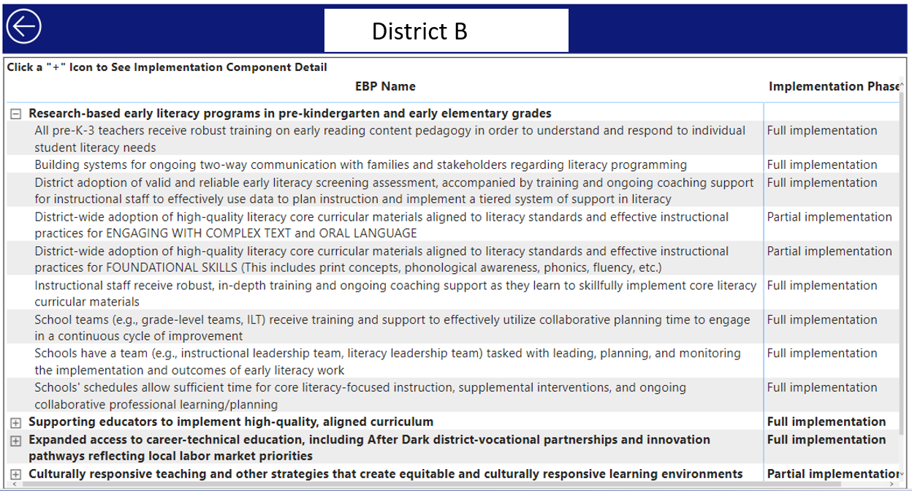
Section 2. Update on FY23 Implementation of EBPs
Districts have the option of viewing responses provided last year before providing FY23 update
Notes:
This section offers another opportunity for you to view information from your FY22 SOA Amendment while you are in the template. In order to use it, just select your district’s name from the dropdown menu and click the Navigate button, and an interactive table will appear listing the EBPs in your plan.
This works best for districts with only one or two EBPs in their plans. Otherwise, recommend opening full plan in SOA dashboard. There is a link to the dashboard in the template.
Clicking on the plus button next to any EBP will open up to reveal the 3-10 implementation components for that EBP and your district’s FY22 response for each. From here, you can scroll down to the blank template for the corresponding EBP and complete your FY23 responses. Again, this approach works reasonably well if you have only 1-2 EBPs in your plan. Districts with 3 or more EBPs in their plans may find it more efficient to open their full plan in the SOA Dashboard in another window.
Note: When the implementation tables are collapsed, as it is for the three additional EBPs you see on this slide (e..g, Supporting educators to implement high-quality, aligned curriculum) the Implementation Phase indicator you see in the right-hand column does not represent overall implementation for that EBP. Rather, it simply displays the response for the first component of that EBP. This is an artifact of the PowerBI program.

Slide 26
Section 3: Anticipated FY23 Budget Expenditures
How are you braiding together funds from different sources to implement the EBP(s) in your plan?
Addresses the full cost to districts of implementing EBPs, not just how additional Chapter 70 aid received in FY23 is being used
Same type of budget information districts were asked to provide in FY22 SOA Amendments
  this year documenting expenditures for FY23 (i.e. July 1, 2022 – June 30, 2023)
Notes:
Last year’s FY22 SOA Plan Amendments asked about anticipated expenditures for FY22. This year’s update is documenting anticipated expenditures for FY23 (i.e., July 1, 2022 – June 30, 2023)

Slide 27
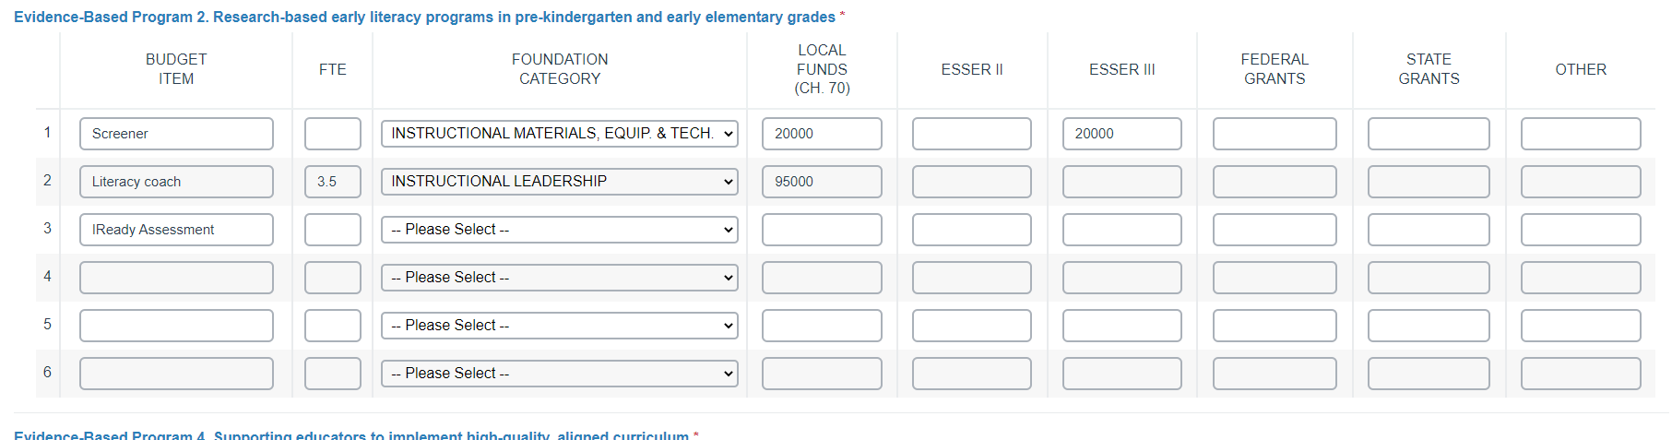
FY23 Budget Template
Notes:
We think you will find this year’s data entry tables more intuitive and user-friendly that last year’s. It asks for the same information, but the data-entry screen presents more like a spreadsheet than last year.
Here are brief definitions/explanations of the information for each column:
Budget Item: Enter a very brief descriptor that offers more specific detail than the Foundation Category within which it is categorized (e.g. Special Education Teachers offers more information than offered by the Foundation Category 'Classroom and Specialist Teachers'). Note: Due to space limitations in the table, you may not be able to see your entire entry.
FTE: Where relevant (e.g., Classroom and Specialist Teachers), enter the number of full-time equivalent positions (FTEs) support by the budget items. Please enter numbers only. (i.e., no text). Please leave the column blank if it is not relevant
Foundation Category: Select the relevant Foundation Category from the dropdown menu for each budget item:
Administration
Classroom & Specialist Teachers
Employee Benefits/Fixed Charges
Guidance and Psychological
Instructional Leadership
Instructional Materials Equipment & Technology
Operations and maintenance
Other Teaching services
Professional Development
Pupil Services
Other
Total Amount by Funding Source: For each budget item, enter the amount of funding from each funding source in the appropriate column(s).
Please note: Budget tables are intended to reflect the full cost to districts of implementing EBPs, not just the amount of additional FY23 Chapter 70 aid used to support them. The Local Funds (incl Chapter 70) refers to all locally-appropriated funds, including all Chapter 70 aid--not just the additional Chapter 70 aid districts received in FY23.
Please enter numbers only in these columns (i.e., no dollar signs and no commas, which are interpreted as text). In other words, $50,000 should be entered as 50000.
Do not include per pupil amounts. Please provide your best estimate of totals.

Slide 28
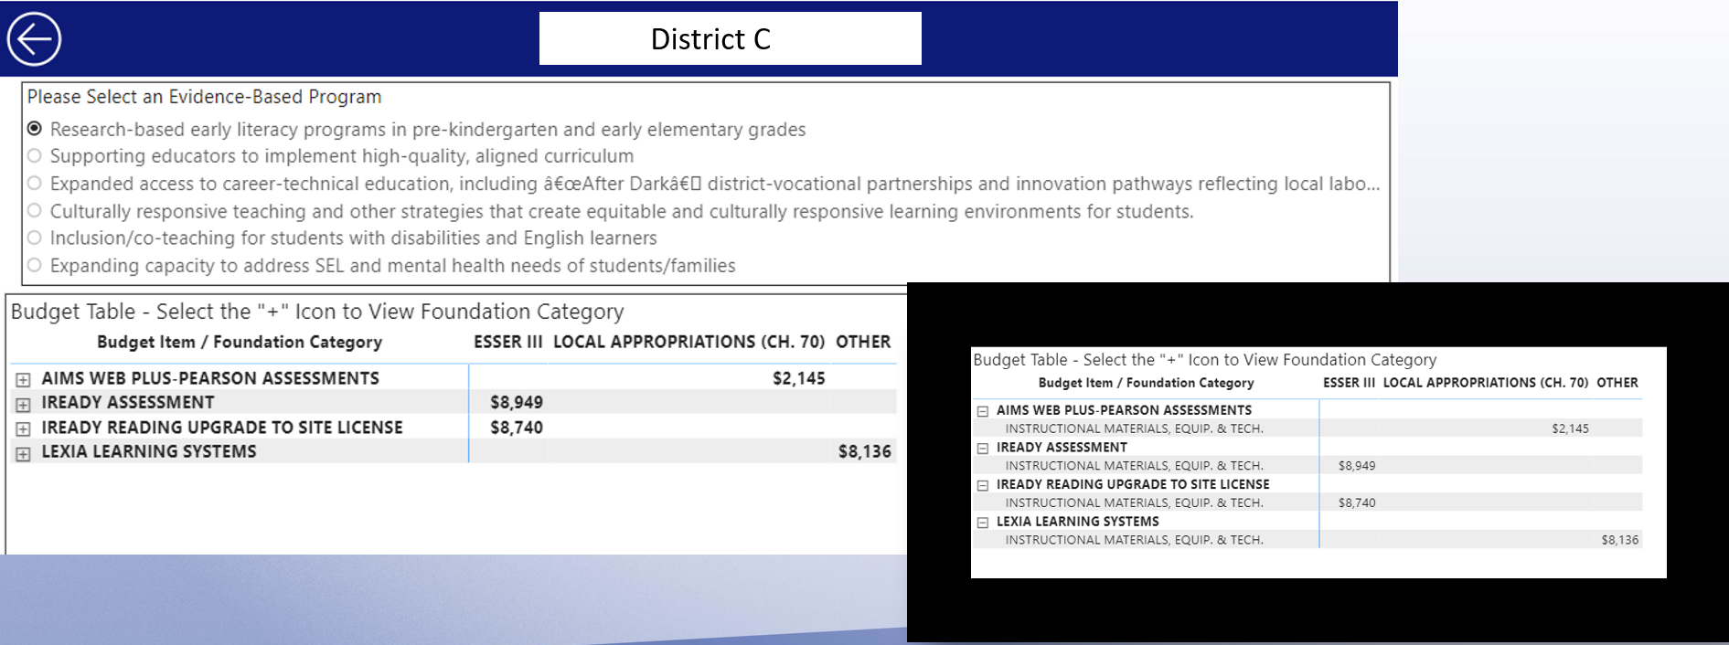
If you want to review your FY22 budget
District C
Notes:
Before you get to the blank table(s) for your FY23 data, you will be offered the option of opening the budget(s) from your district’s FY22 SOA Plan Amendment within the template by choosing your district’s name from the dropdown menu and clicking the ‘Navigate to…’ button.
A screen similar to the one above will open, with all the EBPs in your plan listed. Click the radio button for any EBP and your FY22 budget will appear. Click on the plus (+) to expand the row if you need to see the foundation category for an item. The left hand side of the screen shows the table that will open within Alchemer; on the right is an image of the same table expanded to reveal Foundation Categories.
Scroll down to the budget table for the corresponding EBP to complete your FY23 budget.
Once again – If your district has multiple EBPs, you may find that scrolling up and down is an inefficient method for moving between the FY22 entries and the FY23 budget template. If you do want to have your FY22 budgets open while you are in the on-line template, it may be more efficient to open your plan from the SOA Dashboard. Note, however, that data Foundation Categories and FTEs are not reported in the SOA Dashboard.

Slide 29
Before you leave your budget tables!
Calculate the total amount in the Local Funds (including Ch 70) column across all EBPs in your plan and write down the number
You’ll need the number to complete the next section
Notes:
Please see next 2 slides for an example….

Slide 30
Here’s an example
EBP Budget Items | Local Funds (CH 70) | ESSER II | ESSER III | Federal Grants | State Grants | Other
HQIM Implementation | $900,000 | $500,000
SEL & Mental Health | $800,000
Co-Teaching & Inclusion | $1,100,000 |  | $500,000 |  | $100,000
$2,800,000 in locally appropriated funds detailed in SOA Plan
Notes:
Here is an example of how to approach this process:
Let’s say that your district received $4,000,000 of additional Chapter 70 aid in FY22
Your SOA plan includes three EBPs with the following budget allocations:
HQIM Implementation, with a budget including $500,000 in ESSER II funds and $900,000 in locally-appropriated funds (including Chapter 70 aid);
SEL/Mental Health, with a budget including $800,000 in locally appropriated funds (including Chapter 70 aid); and
Co-Teaching & Inclusion, with a budget including $500,000 in ESSER III funding, $100,000 in state grants, and $1,100,000 in locally appropriated funds (including Chapter 70 aid)
__________________________________________________________

Slide 31
Section 4: Other Uses of Additional Chapter 70 Funds in FY23
New Section!
Student Opportunity Act represents a significant new and ongoing investment for education
Some districts’ budget expenditures in FY22 SOA Amendments reported expenditures of locally appropriated funds (including Chapter 70 aid) that was below the additional amount received in FY22.
Legislature and other stakeholders are looking for a more complete understanding of how SOA funds are utilized
Notes:
Some context
Well over a billion dollars over 7 years is being phased in
There are lots of reasons why this is so – These aren’t comprehensive DIP and DESE asked districts to focus on a few key EBPs that they thought would do the most to move the needle for gap-closing; many of the same districts getting substantial additional Chapter 70 aid also received even more in the way of ESSER funding. The new funding also recognizes that health care costs for current & retired educational employees was underestimating actual costs - .
Many of y
Snapshot of what is happening with those funds.
ou will find not need to provide any additional information.

Slide 32
Will my district need to provide additional information?
Step 1: What is the total of FY23 budget expenditures that come from your FY23 EBP-specific budgets? (e.g., the $2,800,000 from example on Slide 30)
Step 2: Is that amount greater than your districts FY23 Chapter 70 aid increase?
  If yes: No additional information is required
  If no: Your district will be asked to provide additional information
  (The district from the example on Slide 30 is receiving $4,000,000. It would reply No and will be required to provide additional information)
Where can I find my district’s FY23 Chapter 70 aid increase? The FY2023 Chapter 70 Aid and Net Spending file lists each district’s FY23 Chapter 70 aid increase in the Change in Aid column (Column N) in the Comparison to FY22 tab
Notes:
If you answer ‘yes’ in Step 2, your district will not need to provide any additional information and you will be directed to Section 5: Family/Caregiver Engagement
If you answer no- the table on the next slide will open.

Slide 33
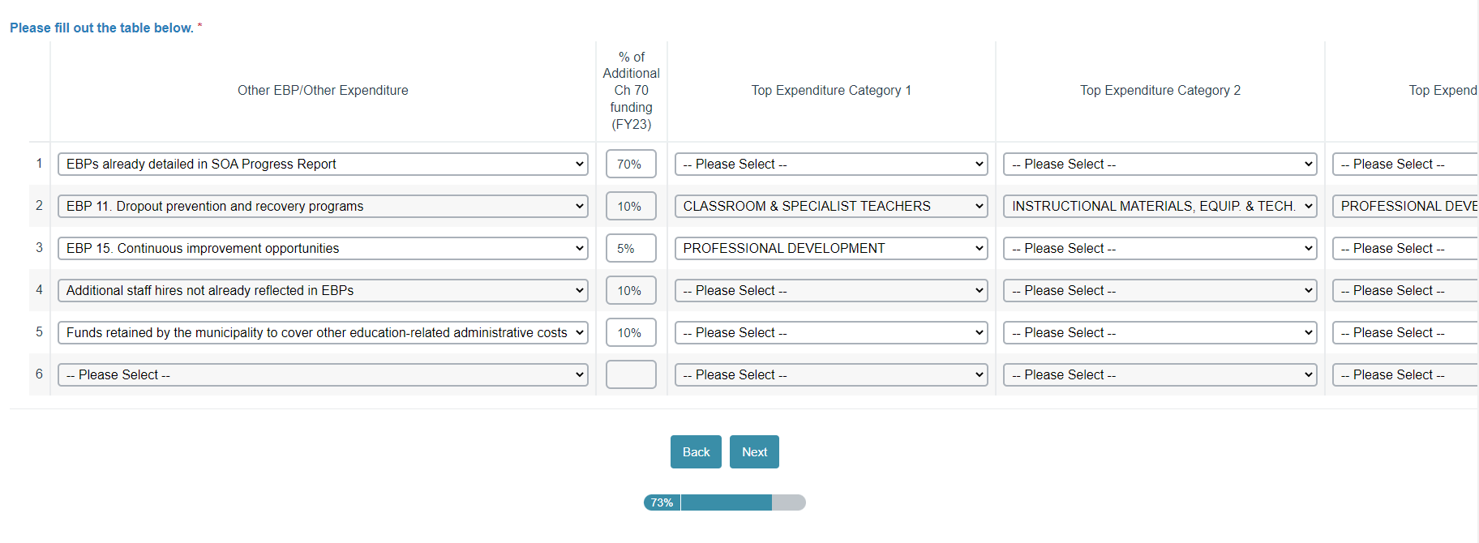
Section 4: Other Uses of Additional Chapter 70 template
Notes:
This is a screen shot of the table you will be asked to complete. What you are looking at is partially completed, using the example we began sharing on Slide 30, because we think it will make better sense to you if we walked you through an example.
Before we do that though, we want to provide a bit more context. The table is intended to allow key stakeholders to get a fuller picture of how the remaining increase in Chapter 70 aid for FY23 is being allocated in your district. This may include support for other EBPs that you did not write about in your SOA plan. It could also reflect other types of allowable expenses under Chapter 70 (e.g., increases in health insurance coverage, funding claimed by the municipality, etc.).
You will want to represent as close to 100% of this amount as possible.
We understand that not all expenditures are mutually exclusive, and that apportioning locally appropriated funds in districts is a complex endeavor, and section asks you to think about resource allocations in ways in probably aren’t part of your standard operating procedures.
The information collected here is not connected to the data the state uses to make accountability decisions.
It’s simply an effort to provide additional information that our stakeholders are asking for in order to help them better understand the impact of the SOA legislation on how additional resources are being allocated. So please do your best to estimate the ways in which your district has been able to leverage additional funds afforded to you through Chapter 70 and the Student Opportunity Act.
Instructions/Recommendations for Completing Table
Step 1: Complete row 1 of the table. In the first row of the Other EBPs/Other Expenditures column, use the dropdown menu to select the first option, EBPs already detailed in SOA Progress Report.
In the % of Additional Ch 70 funding (FY23) column, enter in the percentage of your district’s additional Chapter 70 funding already reported in your SOA Progress Report, i.e., the total of Local Appropriations (incl CH 70) across all EBP-specific budgets divided by the additional Chapter 70 funds in FY23 for your district.
Continuing the example from slide 30: This district’s EBP budgets included $2.8 million drawn from locally-appropriated funds (including Chapter 70 aid), which reflects an amount equivalent to 70% of the $4 million in additional Chapter 70 aid it received in FY23, so the district would type 70 percent in the % of Additional Ch 70 funding (FY23) column of row 1. This means that you need to share more information about 30%, or $1,200,000, of your additional locally appropriated funds.
Note: You do not need to enter any data into the three “Top Expenditure Category” columns in row 1.
Step 2: Use the remaining rows (i.e., rows 2-6) to indicate other ways the additional CH 70 funding was utilized
Step 2a. Begin with other EBPs that you are part of your district’s improvement plan but are not detailed in your SOA plan.
Select an EBP from the dropdown menu in the Other EBP/Other Expenditure column.
Describe your district's investment in each EBP as a percentage of the additional Chapter 70 funding your district received in FY23.
Continuing the example from slide 30: This district estimates that its increase in funding benefitted its dropout prevention and recovery programs, to which it allocated approximately $400,000—an amount reflecting approximately 10% of the $4 million in additional FY23 Chapter 70 aid. It also estimates that it allocated $200,000 to support expended opportunities to implement continuous improvement efforts (e.g., professional learning communities) in schools throughout the district—approximately 5%
Step 2B. Using the dropdown menus in the three Top Expenditure Category columns, indicate the primary way(s) in which funds were used by foundation category (e.g., Classroom & Specialist Teachers, Guidance and Psychological; Professional Development) for each EBP. These are the same Foundation Categories detailed in Slide 27
Step 2C. Once investments in other EBPs are detailed, use additional rows (if applicable) to indicate other allowable Chapter 70 expenditures for which your district/municipality is leveraging a substantial proportion its additional chapter 70 funding. These options also appear on the dropdown menu once you scroll past the EBP options. Slide 34 outlines the selections included in the Other EBP/Other Expenditure dropdown menu.
Describe your district’s allocation to this expenditure as a percent of additional Chapter 70 aid in FY23.
Use the Top Expenditure Category columns to indicate the Foundation Category(ies) describing how funds were utilized.
Continuing the example from slide 30: This district estimates that its increase in funding allowed them to fund make additional staff hires that are not reflected in the EBPs they already reported on that amounted to . in which it allocated approximately $400,000—an amount reflecting approximately 10% of the $4 million in additional FY23 Chapter 70 aid. It also estimates that it allocated $200,000 to support expended opportunities to implement continuous improvement efforts (e.g., professional learning communities) in schools throughout the district—approximately 5%
Step 3: Please double-check your percentages. As a reminder, the goal is to represent as close to 100% as possible of your additional Chapter 70 funding in FY23.

Slide 34
Detail on Dropdown Menu for Other EBP/Other Expenditures Column
EBPs already detailed in SOA Progress Report
List of 21 SOA Evidence-based Program Areas
Other allowable expenditures
  Funds retained by the municipality to cover other education-related administrative costs
  Increased health care costs for current staff and retirees
  Additional staff hires not already reflected in EBPs
  Other salary increases not already reflected in EBPs

Slide 35
Section 5: Family/Caregiver Engagement
Very similar to FY22 SOA Plan Amendment
Update the Family/Caregiver Engagement Implementation Rubrics for FY23
  Note: If family/caregiver engagement is an EBP in your SOA plan, you have already completed this rubric and will not be prompted to complete it a second time.
Briefly describe evidence of progress your district has made in improving and/or increasing family/caregiver engagement over the past year
  Focus on families/caregivers of student groups targeted for gap-closing
  Use the metric(s) described in your FY23 SOA Plan Amendment
Notes:
The SOA legislation highlights the critical role families and caregivers play in supporting education and includes a focus on districts’ efforts to engage meaningfully with them—particularly families and caregivers of those students in student groups targeted in SOA plans.
This section should also look familiar to anyone who involved in developing FY22 SOA Plan Amendments.
1. You will first be asked to update the family/caregiver implementation rubrics you completed in your FY22 SOA Plan Amendment. (i.e., closed-ended Implementation indicators). A copy of the rubric appears on the next page.
2. Using the metric(s) provided in your FY22 SOA Plan Amendment, describe evidence of progress you district has made in improving and/or increasing family/caregiver engagement since you submitted your amendment.
You may use a different metric from the on(s) in your FY23 SOA Plan amendment, so long as it/they can be used to measure meaningful progress.
NOTE: This section offers the option of viewing information you provided in your FY22 SOA Plan Amendment directly in the template. Simply select your district’s name from the dropdown menu (or type it in using the Search feature) and click on the Navigate to Family/Caregiver Rubrics button.

Slide 36
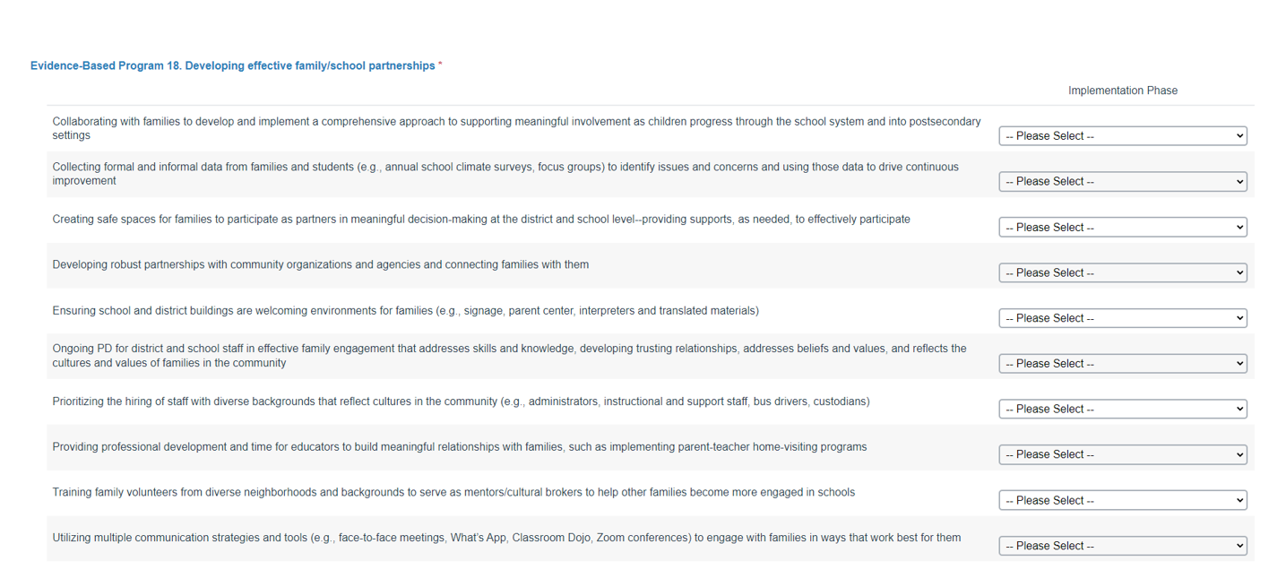
Section 5: Family/Caregiver Implementation Rubric
Notes:
T

Slide 37
Section 6: Stakeholder Engagement
Describe your district’s ongoing approach to engaging with different stakeholder groups
  How is your district sharing updates on plan implementation and early evidence of gap-closing outcomes with different stakeholder groups?
  How is your district collecting input and feedback from different stakeholder groups?
  What substantive input and feedback has your district received from different stakeholder groups since your FY22 SOA Amendment was submitted – and how has that affected your plan implementation? Please be sure to include a focus on specific feedback from stakeholders representing student groups targeted for gap closing.
Notes:
Meaningful engagement of stakeholders involves ongoing communication at regular intervals to both provide updates on the progress and outcomes of implementation and continue to collect input and feedback from them on that progress.
This section asks you to describe your district’s ongoing approach to engaging with different stakeholder groups
How is your district sharing updates on plan implementation and early evidence of gap-closing outcomes with different stakeholder groups?
How is your district collecting input and feedback from different stakeholder groups?
What substantive input and feedback has your district received from different stakeholder groups since your FY22 SOA Amendment was submitted – and how has that affected your plan implementation? Please be sure to include a focus on specific feedback from stakeholders representing student groups targeted for gap closing.

Slide 38
04 SOA Team Supports for Districts
Agenda
Framing/Background
Snapshot of What We are Learning from Plans
FY23 SOA Progress Report Template
SOA Team Supports for Districts
05
Q and A

Slide 39
District Supports
Consultations with SOA Team member
Email questions to SOAPlans@mass.gov
Keep checking SOA District Resources page
Check the Commissioner’s Weekly Update
Want to be added to our SOA contact list?
  Please provide contact information using this form
Notes:
Last year we offered ½ hour consultations to districts that proved to be quite popular and productive. We are providing that type of support again this year. You can use the link in the slide to schedule a consultation. Half hour consultations will be available Tuesday-Thursday between the hours of 2-4 beginning Monday February 27.
You can always email questions to SOAPlans@mass.gov. You should receive a response from us within 48 hours (and usually much sooner than that).
Keep checking our SOA District Resources web page (link in slide), where you will find all the resources shared today, as well as new ones that are added throughout the data collection window.
We typically post reminders in the Commssioner’s Weely Update, so recommend keeping an eye on that as well. (link in slide)
All email reminders will automatically be sent to district superintendents. If you would like to receive a copy of those reminders, please provide your contact information using the link in the slide.

Slide 40
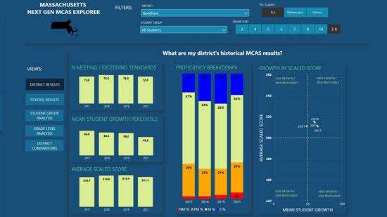
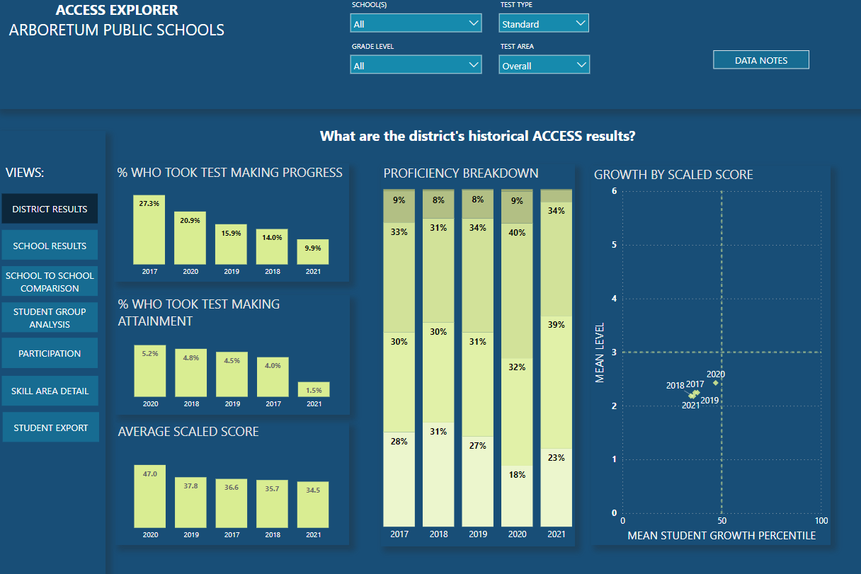
DESE Supports: Data Analytics
DESE has partnered with Open Architects to provide free support for developing your district goals and progress monitoring.
www.openarchitectsk12.com/soa-support
Notes:
DESE has partnered with Open Architects to provide free support for developing your district goals and engage in progress monitoring. These visualizations give MCAS and ACCESS insights at the district, school and student level. To learn more, you can visit the web address listed here. The link is also available SOA District Resources webpage.

Slide 41
Once Plans Are Submitted
SOA Team will be reading plans
  No formal feedback memos this year
  We will follow up directly if necessary
Updated SOA Dashboard incorporating progress reports
  Posted this summer
New 3-year gap-closing Plans will be due in April 2024
Notes:
The SOA Team will be reading all of your plans again this year. Because this is an update, we will not be providing formal feedback memos this year. Someone from the SOA Team will follow up directly with any questions or requests for additional information
An updated SOA Dashboard incorporating progress reports will be posted on the SOA Website this summer.
And just a heads up that new 3-year gap-closing will be due in April 2024, as required by the SOA legislation. Stay tuned for additional information.

Slide 42
Thank you!
Please reach out to the SOA Team with questions:
SOAPlans@mass.gov

Slide 43
Appendix: FY23 Progress Report Template

Slide 44
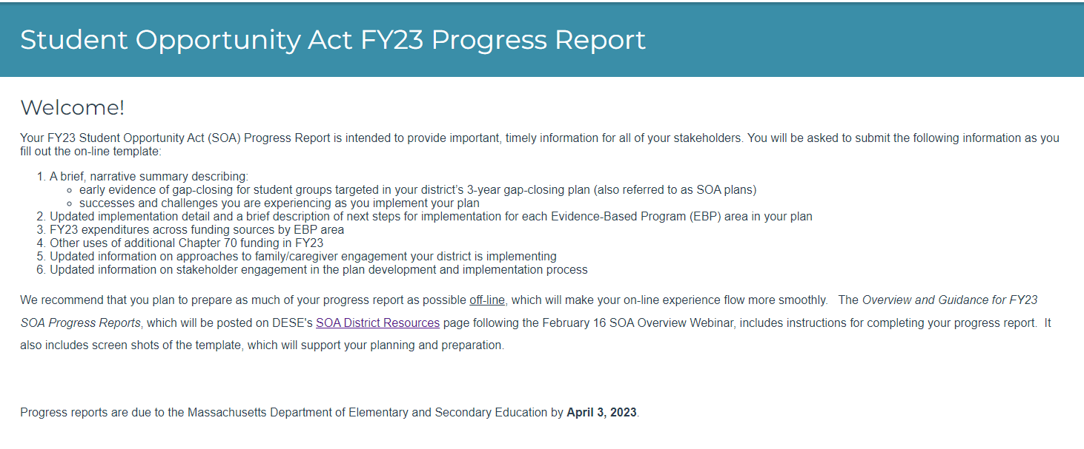
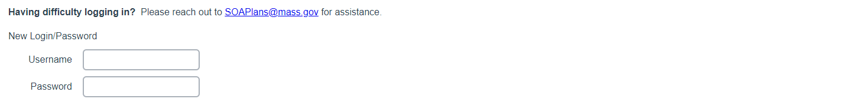
Student Opportunity Act FY23 Progress Report

Slide 45
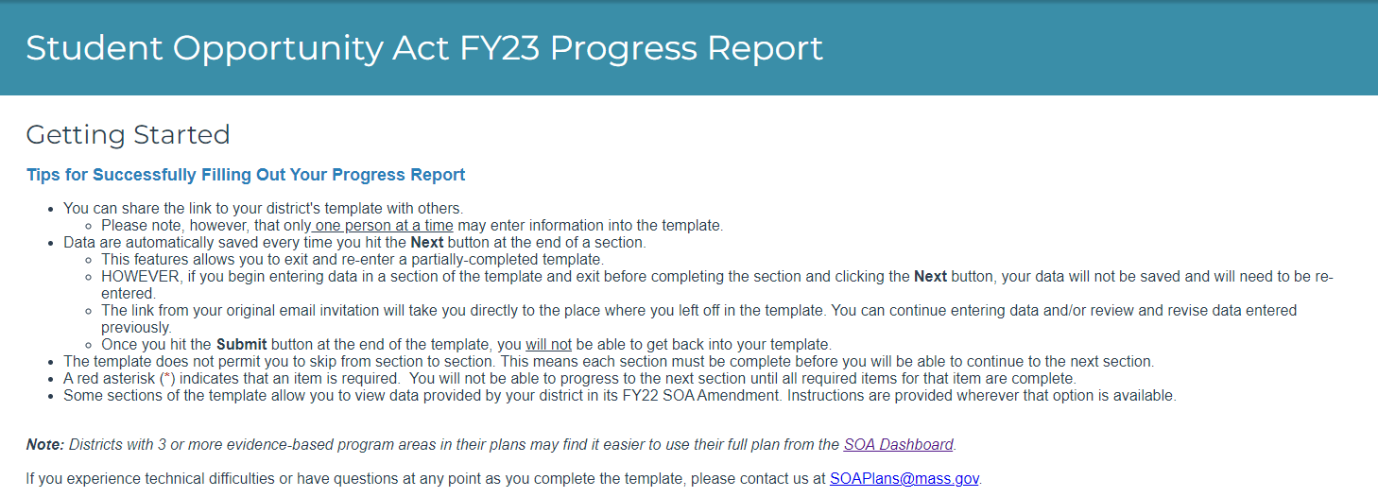
Getting Started

Slide 46
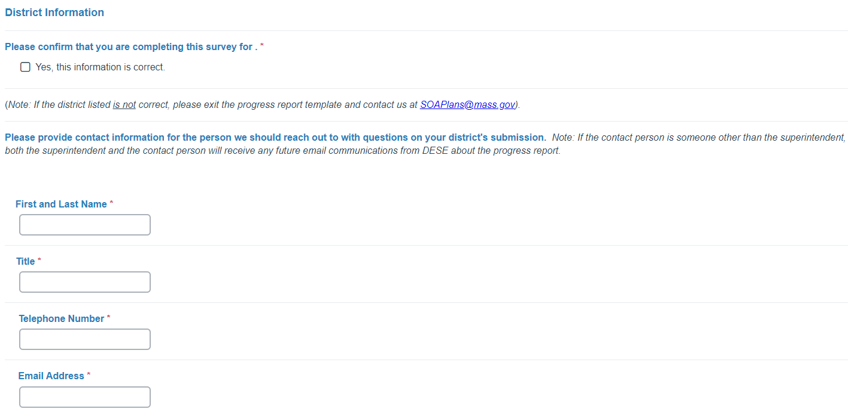
District Information

Slide 47
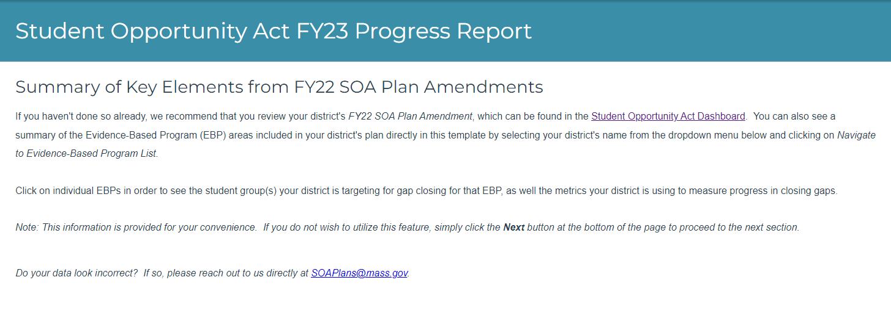

Summary of Key Elements from FY22 SOA Plan Amendments

Slide 48
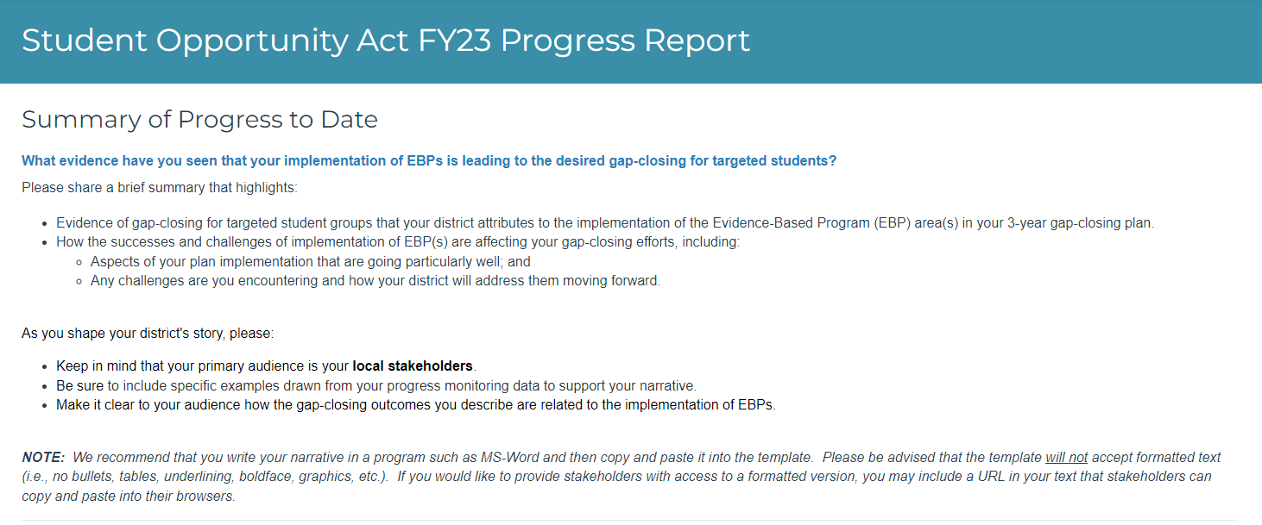
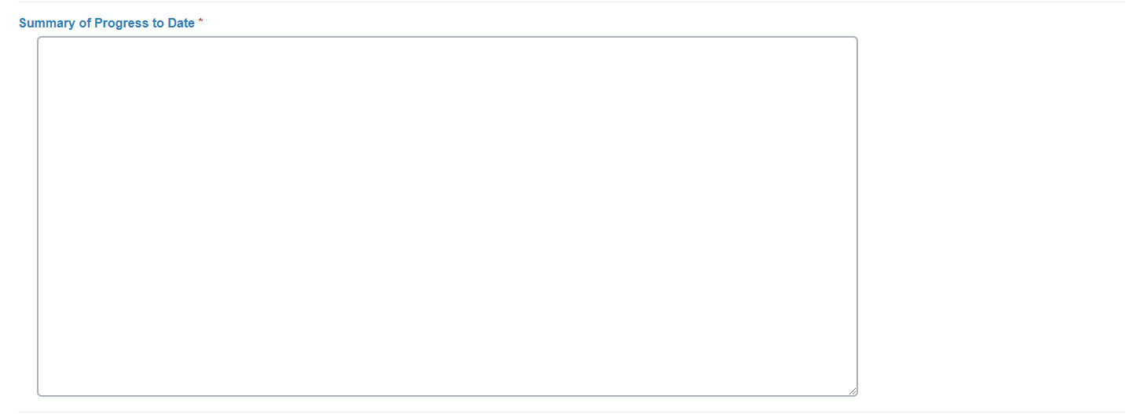
Summary of Progress to Date

Slide 49
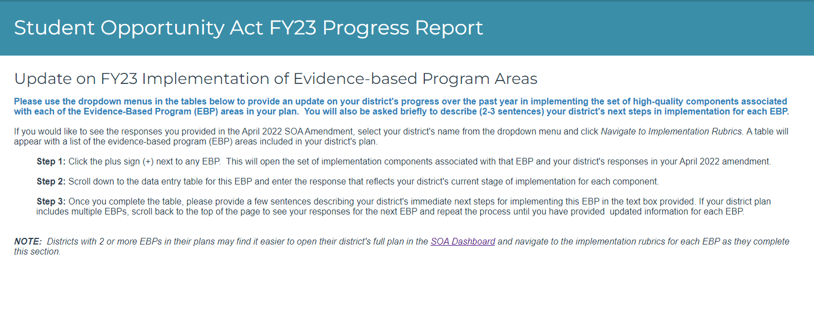

Update on FY 23 Implementation of Evidence-based Program Areas

Slide 50
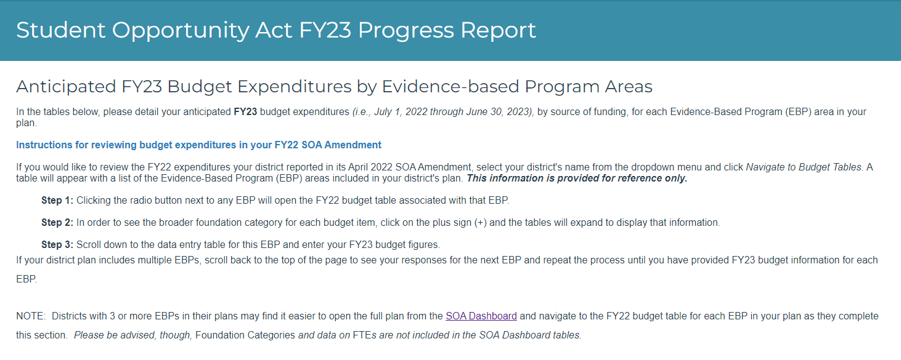

Anticipated FY23 Budget Expenditures by Evidence-based Program Areas

Slide 51
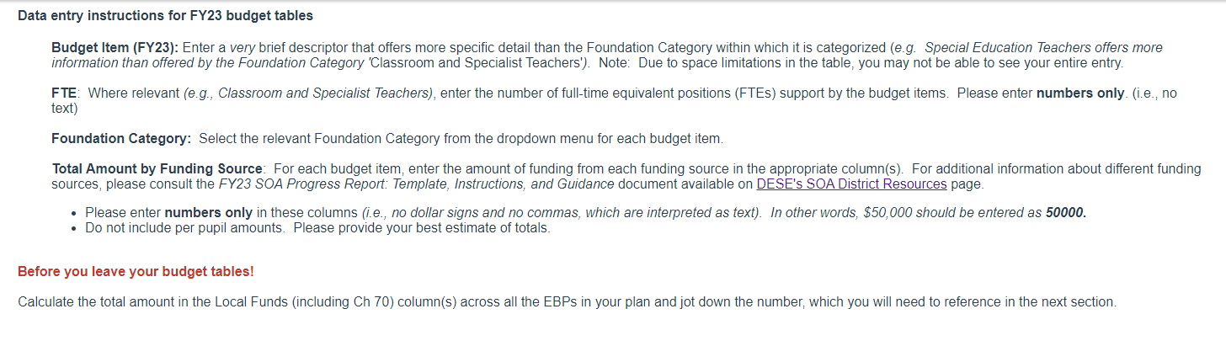
Data Entry instructions for FY23 budget tables

Slide 52
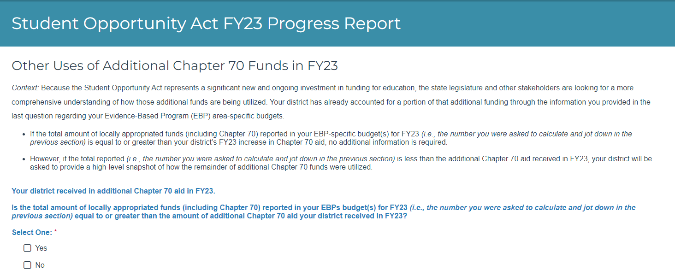
Other uses of Additional Chapter 70 Funds in FY23

Slide 53
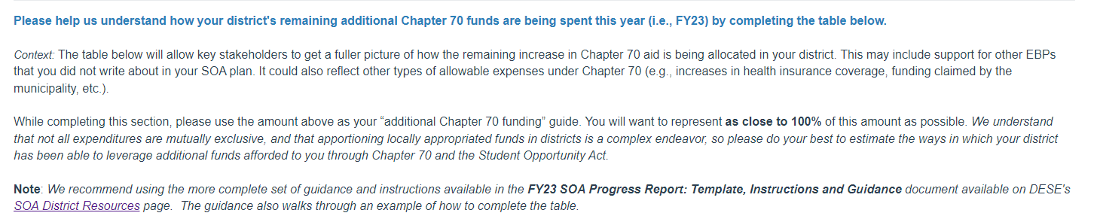
District’s remaining Chapter 70 funds being spent

Slide 54
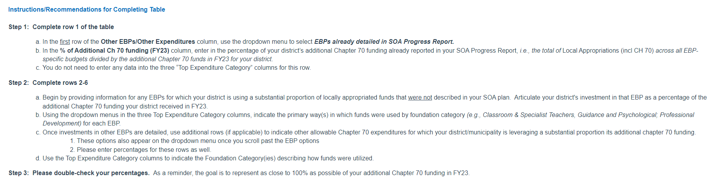
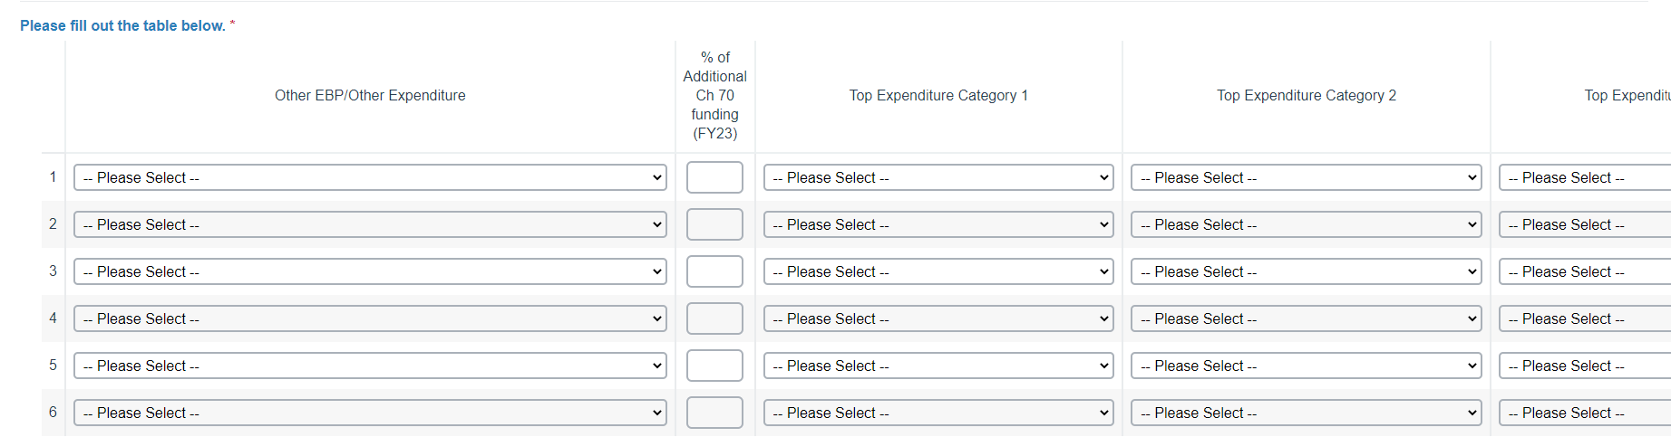
Instructions /recommendations for completing table

Slide 55
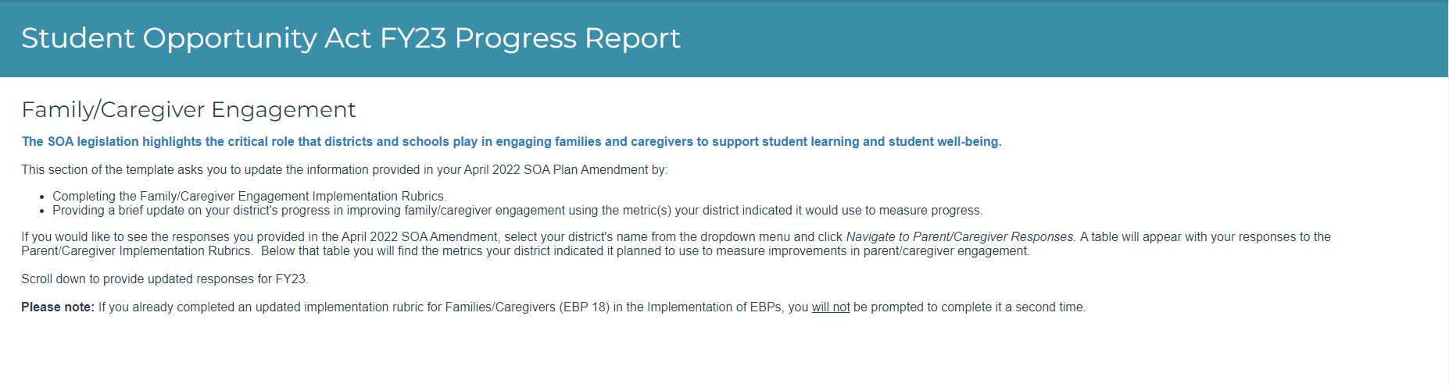

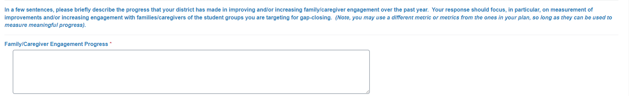
Family/caregiver engagement

Slide 56
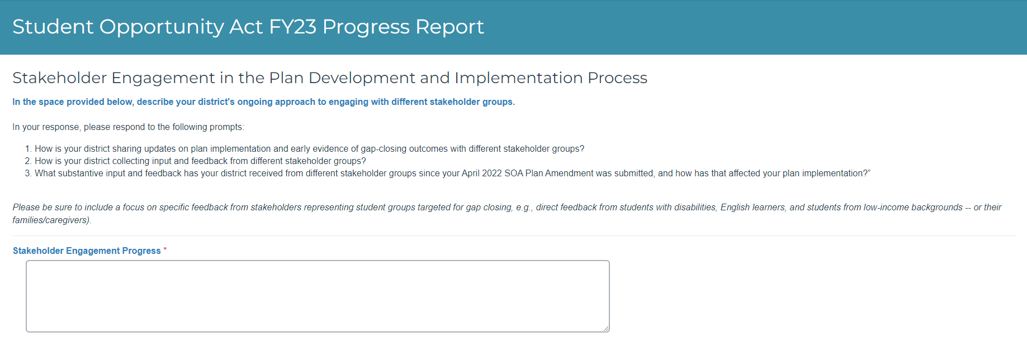
Stakeholder engagement in the plan development and implementation process

Slide 57
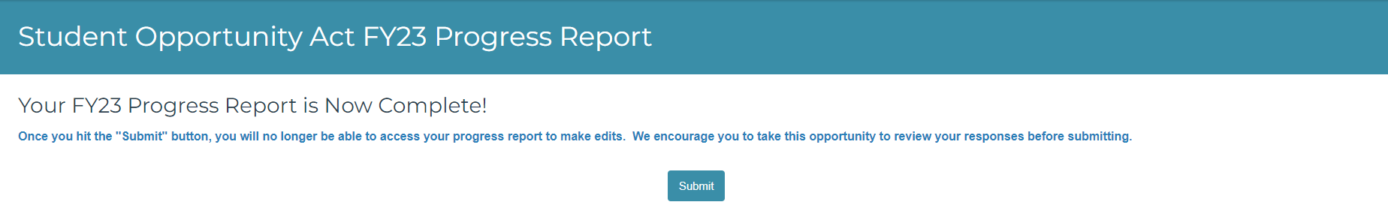
Your FY23 progress report is complete

