Slide 1
FY24 SOA Plans
Overview of New 3-Year Cycle
District Webinar
January 9, 2024
Notes:
Welcome everyone to this overview of the new 3-year cycle for FY24 SOA Plans.
I’m Karen Johnston, Student Opportunity Act Coordinator, and the public face of the SOA for many districts.

Slide 2
Before we get started
We will be recording today’s webinar
  Recording and slide deck will be posted on SOA Website
Feel free to share questions in chat throughout the presentation
Please let us know who is joining us today by entering your name and district in Chat.

Slide 3
Agenda
Overview and Background of SOA
SOA Plan Elements and FY24 Updates
Plan Submission Guide (2-page template)
DESE Supports for Plan Development and Submission
Questions
Contact Information

Slide 4



Overarching Goal of Student Opportunity Act
To ensure that that every student in the Commonwealth has access to a high-quality public education regardless of zip code
Notes:
I want to take a moment to share the overarching goal of the Student Opportunity Act, which is to ensure that every student in the Commonwealth has access to a high-quality public education regardless of zip code.

Slide 5
The SOA has two key components
Fiscal: Changes to Chapter 70 funding
Policy Updates: Plans every 3 years
Focus on addressing disparities in learning experiences and outcomes for student groups that are least-well served
New investment in education
Revised funding formula reflects equitable distribution of state education funds
Implementation of evidence-based practices
Notes:
The two primary components the legislation uses to address and support equitable outcomes are 1) fiscal changes to Chapter 70 funding and 2) policy updates that set expectations for the state and districts to focus on addressing disparities in learning and experiences and outcomes for student groups that are least well served. On the policy site, the legislation includes a requirement that every district in the Commonwealth develop a plan to address disparities for student groups in their districts through the implementation of evidence-based strategies, approaches and programs. These are the SOA Plans that are due every three years, which we will be discussing today.
On the fiscal side -- On the fiscal side -- the SOA represents an enormous new, ongoing investment in education. The legislation adopted all recommendations of the Foundation Budget Review Commission’s October 2015 report. In doing so it committed to adding well over a billion dollars in new education by 2027 to address the state’s overall underinvestment in education. Since FY21, the state has increased funding for the Chapter 70 program by $1.3 billion. The FY24 budget that Gov. Healey signed included a $594 million, or 9.9 percent increase, in Chapter 70 funding over FY23 levels.
That increase was coupled with a revised funding formula that, adjusted it in ways that recognized that some of our districts have been historically underfunded, and the goal was to fund them equitably. This set the stage to greatly accelerate gap-closing by providing more funding for students who need more services to be successful, such as multilingual learners, student with disabilities, and students living in poverty. In addition, recognized the increasing cost of health care by basing costs on up-to-date health insurance trend data collected by the state’s Group Insurance Commission (GIC).
On the policy side – this is where the legislation addresses the SOA Plans that are due every three years and which we will be discussing today.
Before we go any further, I want to take a moment to address Two common misconceptions about SOA plans.
We frequently get the question ‘Does my district need to develop a plan?’ from districts receiving little or no additional Chapter 70 aid. The answer to that is Yes. Plans are driven by your analysis of disparities for student groups, their underlying causes, and the evidence-based approaches There are gaps in learning experiences and outcomes for students with disabilities, English learners, students from low-income communities and other student groups in most, if not all districts, across the Commonwealth. It is our shared work to close these gaps. And every district in the Commonwealth is expected to develop and implement an SOA plan whether it receives no additional Chapter 70 aid at all, a small amount of additional aid, or large amounts of additional aid.
2) A second misconception (on the part of some districts) is that plans should focus narrowly on how any additional Chapter 70 funds they receive in that fiscal year are being utilized. Plans do ask for information about investments –but ask about the level of investment across all funding sources that support the implementation of the EBPs in their plans. Any additional Chapter 70 funds a district receives represents the amount being added to your district’s overall Chapter 70 allocation. It is NOT analogous to a grant allocation and the SOA Plan is not intended to describe how additional Chapter 70 funds will be used the way a grant allocation would be.

Slide 6
SOA Plans versus District Improvement Plans
The District Improvement Plan (DIP) serves as a comprehensive plan that describes the full set of strategies that a district will implement to support all students in their district.
By contrast, the SOA Plan addresses a subset of a district’s overall initiatives, focusing on evidence-based programs and strategies that will improve the educational experiences and outcomes of students, including English learners, students with disabilities, and low-income students.
Notes:
We also want to highlight the distinction between SOA Plans and District improvement plans., because we get a lot of questions about this from districts.
The District Improvement Plan (DIP) serves as a comprehensive plan that describes the full set of strategies that a district will implement to support all students in their district. Tremendous variation in the level of detail districts include in their plans. DESE does not collect these plans, although they are utilized as a data source during periodic district reviews.
By contrast, the SOA Plan addresses a subset of a district’s overall initiatives, focusing on specific evidence-based programs and strategies that will improve the educational experiences and outcomes of students, including English learners, students with disabilities, and low-income students. As you prepare your SOA plan, you may find that your analysis of disparities for student groups and their underlying causes will lead you to focus on EBPs that aren’t currently in your comprehensive district plan.
We want to acknowledge here that we know districts develop multiple plans for all kinds of purposes in addition to district improvement plans and SOA plans -- (Title grants and other grant opportunities; when participating in MTSS academies and other professional development opportunities. These often involve engaging in many of the same processes (e.g., disaggregated data analysis, stakeholder engagement, selection of evidence-based practices). And we he have already gotten questions from districts about whether they are expected to engage in a stand-alone process for developing their SOA Plans.
What you have learned as a launching point for developing SOA plan and can certainly inform them. Please read the guidance carefully, to ensure that you are fulfilling the requirements and expectations for SOA Plans. You may find that your district needs to conduct additional analyses of disaggregated student data or engage in a deeper exploration of the factors that contribute to the disparities you are seeing in your data, and the specific EBPs that will do the most to address those disparities.
That’s a very long way of saying – It depends!
Our hope is that districts will increasingly develop systemic approaches to analysis, stakeholder engagement and other processes that they can leverage as they develop multiple plans, including SOA plans -- And that they will utilize these systemic processes to ensure that their plans align with one another.

Slide 7
SOA Plan Submission Cycle
January 2021: Districts submitted an initial three-year SOA plan
April 2022: Districts submitted a comprehensive amendment to their original plan
April 2023: Districts submitted a progress update
April 2024: Districts will submit a new three-year SOA plan
Spring 2025: Districts will submit a progress update
Spring 2026: Districts will submit a progress update
April 2027: Districts will submit a new three-year SOA plan
The first submission cycle was modified due to COVID
This is a return to the regular submission cycle as required by law
Notes:
Moving on to a quick refresher on SOA Plan submission cycle. The first three bullets describe the cycle for the first round of SOA Plans which, of course, was substantially impacted by COVID.
The lower half of the slide picks up with the cycle for FY24 plans. You will be submitting your next plan by April 1, 2024, and progress reports will be due by the same date in 2025 and 2026. Then a new three year cycle begins in April 2027.
This raises a third misconception on the part of some districts. The SOA Plan submission cycle does not end once the Commonwealth completes the process of phasing in additional funding in 2027. This cycle is written into the SOA legislation and will continue indefinitely.

Slide 8
SOA Plan Elements and FY24 Updates
Notes:
Next on our agenda is a high level overview of SOA Plan Elements and FY24 updates.

Slide 9
FY24 SOA Plan Elements
Summarize Your District Plan
Analyze Your Data and Select Student Groups for Focused Support
Set Ambitious Three-Year Targets for Improving Student Achievement
Engage Families/Caregivers and other Stakeholders
Select Evidence-Based Programs and Strategies to Address Disparities
Notes:
Most of the SOA Plan elements listed on this slide will look familiar to those of you who developed the first set of SOA Plans.
For those of you who have already reviewed the guidance, I want to note that the order of the sections has been revised since we sent the original guidance . The Summary of your plan now appears first, since it’s the first thing stakeholders will read. Typically, this would be completed AFTER completing the data analysis, engaged with your stakeholders, and the development and decision-making processes about which EBPs to include in your plan.

Slide 10
Key updates
New Resource: Student Outcomes Comparison Tool
Improvement targets for all districts focusing on the lowest-performing student group
Evidence-Based Programs (EBPs) are now aligned with DESE’s new Educational Vision and Strategic Objectives
Plans will be submitted in GEM$ system
SOA Plan examples (New resource -- Coming soon!)
A small number of districts (17) will complete an SOA Plan Addendum
Notes:
Here are some of the key updates for FY24 SOA Plans, some of which we will be discussing in greater detail later in this presentation.
Read through the bullets…
We will go into additional detail about the first four bulleted items as as we work our way through the plan submission guide and guidance.
Although we won’t be discussing the SOA Plan examples during this overview, I wanted to highlight this new resource, which provides examples of completed SOA plans from two fictitious districts. We hope you will find the examples to be a useful companion to the guidance. We expect to have the plan examples posted on the SOA website’s District resources page shortly–hopefully by the end of this week.
We will not be discussing the plan addendum, since only a small number of districts that received $75 million or more in overall Chapter 70 funding in FY24 will be completing the addendum. Those districts will be offering those districts a separate session describing the addendum, guidance, and supports for completing in late January.

Slide 11
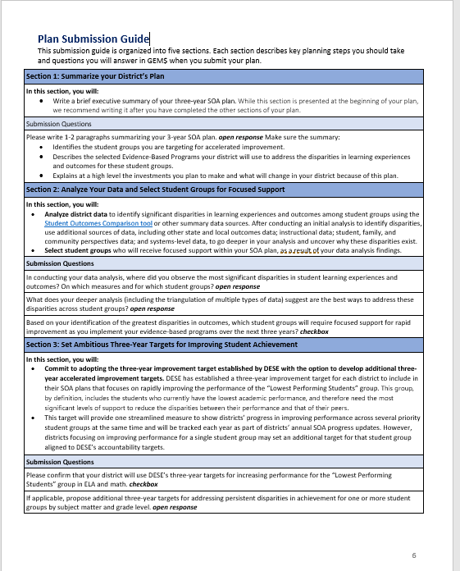
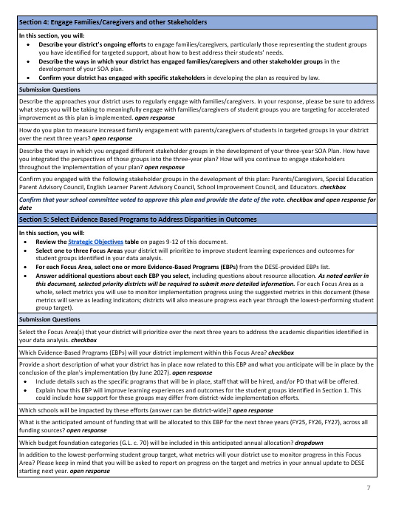
Plan Submission Guide
Section 1: Summarize Your District’s Plan
Notes:
A 2-page Plan Submission Guide appears on pages 6-7 of FY24 SOA Plan Guidance. I’m going to ask Erica or Kinnon to drop a link into the most recent version of the guidance into the chat in case anyone would like to have it open as we walk through the sections ( FY24 SOA Plan Guidance Materials)
The template is organized into the five sections of the plan we highlighted earlier. Each section describes key planning steps you should take and details the questions you will be responding to in GEM$.
We will be posting another updated to this version later in the week, as we have discovered that we needed to make some minor adjustments as the template is programmed in GEM$.
Before we do dig in, I just want to mention that if you hear me use the term ‘template’ at any point – I am referring to the plan submission guide.
The green highlighting on this slide highlights Section 1: Summarize your district plan

Slide 12
Section 1: Summarize your District’s Plan
Share a 1-2 paragraph summary of your district’s plan that incorporates the following information:
The student groups you are targeting for accelerated improvement;
The Evidence-Based Program(s) your district will use to address the underlying factors contributing to these disparities;
The investments you plan to make in these EBPs over the next 3 years, and
What will change because of this plan
Notes:
This is the first thing that your stakeholders will read, and it’s intended to be a relatively high-level overview of your district’s SOA plan. It’s relatively straightforward – in it you will share a 1-2 paragraph summary of your district’s plan that lays out:
The student groups you are targeting for accelerated improvement;
The Evidence-Based Program(s) your district will use to address the underlying factors contributing to these disparities;
The investments you plan to make in these EBPs over the next 3 years, and
what will change because of this plan -- what will you be doing differently and what will change for student groups experiencing the greatest disparities?

Slide 13
Plan Submission Guide Section 2
Section 2: Analyze Data and Select Student Groups
Notes:
Your analysis of disparities in learning experiences and outcomes for the student groups your district serves, and the exploration of the underlying factors for those disparities is what ultimately what drives the substance of your SOA plan

Slide 14
Section 2: Analyze Data and Select Student Groups
Step 1: Identify disparities in learning experiences and outcomes for student groups
Step 2: Explore underlying factors contributing to those disparities (that are within district control)
Notes:
Your analysis of disparities in learning experiences and outcomes for the student groups your district serves, and the exploration of the underlying factors for those disparities is what ultimately what will drive the substance of your SOA plan
Broadly speaking this districts are asked to do two things--
Step 1: Identify disparities in learning experiences and outcomes for the student groups your district serves. This will entail looking at disaggregated data for SWD, MLs, economically disadvantaged backgrounds, students of color. It also entails looking beyond MCAS data to other kinds of outcomes. Which gets at Who is experiencing gaps and on what metrics?
Step 2: Looks at the why by exploring the underlying factors contributing to those disparities. This is sometimes described as a root cause analysis.
Instructional Data: using or collecting data on the student experience in the classroom, examining curricular materials, observing instructional strategies. (Mention SLE reports as a resource)
Perspectives data: Hear from Students and Other Stakeholders School systems should use the data analysis conducted with accountability and instructional data to speak directly to students and other stakeholders (including staff members and families) about their perspectives and experiences. Here’s a place where you may want to conduct focus groups with stakeholders who know the most about the students experiencing the greatest disparities)
Relevant Systems Information: to identify particular systems and structures closely linked to the focus areas identified for improvement efforts. You may review additional system-specific documentation and/or data, such as policy handbooks, equity reviews, or staffing plans to better understand where these systems are or are not being leveraged effectively. District review/targeted focused monitoring
As I mentioned earlier, If you have not already done so, you may need to engage in a deeper analysis of underlying factors contributing to the disparities identified in step one, This step is important in order to check any assumptions you may have about what those underlying factors are and see whether they are really driving the gaps you are seeing.
Next, we want to take a moment to describe some of DESE resources that will support these two steps.

Slide 15
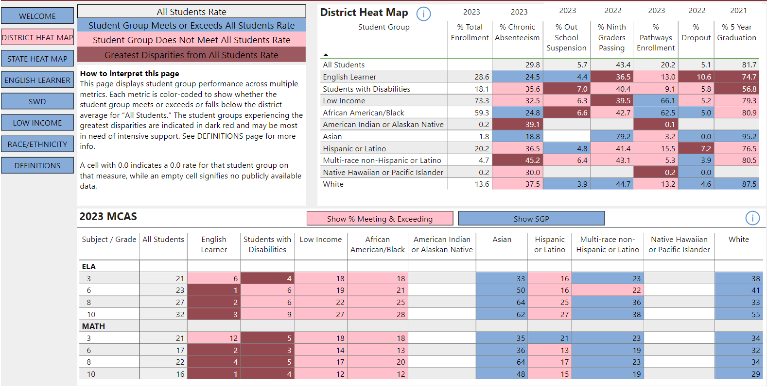
Provides more detailed outcome data by student group
Student Outcomes Comparison Tool
Purpose: Districts can review data across student groups for critical indicators to pinpoint where disparities in learning experiences and outcomes are most prominent.
Includes district and statewide "heat maps" that offer an at-a-glance view of student group outcomes across all indicators.
Indicators include:
student achievement and growth (MCAS),
chronic absenteeism,
out of school suspension rates,
graduation and dropout rates,
ninth grade course passing rate, and
secondary pathways and programs enrollment.
Notes:
The first of these is the Student Outcomes Comparison Tool – a new resource that…. Districts can review data across student groups for critical indicators to pinpoint where disparities in learning experiences and outcomes are most prominent. We shared this link when the guidance was released -- Let us know in chat 1) whether you have tried out the resource (and any questions you already have) and 2) whether you would be interested in having us run a stand-alone hands-on demo/Q and A session on using the tool.
Unfortunately, we won’t have time to do a demo during this overview, but we do want to take a moment to highlight a few features. Drop link into chat: Microsoft Power BI (powerbigov.us) This link is available on the SOA District Resources page.
What you are looking at the District Heat Map feature. Includes an at-a-glance view of multiple indicators by student groups. (list some indicators)
A heatmap, for anyone unfamiliar with the term, is a graphical representation of data where values are depicted by color. The top row of data on the upper table and leftmost column of reports on data for all students. The color coding contrasts outcomes for student groups. Blue – meets or exceeds values for all students; pink and red, where values are lower. Those in dark read are the two groups with the greatest disparities.
In this case, the dark red cells highlight places the student groups experiencing the greatest disparities, compared to all other students in the district . This MAY mean that these groups are the most need of support, but your team will need to reflect upon the extent to which disparities are meaningful.
Additional tabs offer more detail on student groups over a two-year period
Strategic Objective 1: Cultivate systems to support the whole student and foster joyful, healthy, and supportive learning environments so that all students feel valued, connected, nourished, and ready to learn
Strategic Objective 2: Promote deeper learning so that all students engage in grade-level work that is real-world, relevant, and interactive
This resource is Intended to start a conversation in step 1 -- for which students are you seeing the most substantial gaps? This won’t be the only data you look at -- DESE has many different data resources that support data exploration – including tracking longer term progress. I’m guessing many of you are familiar with District Analysis and Report (DART) tools (for districts and schools; English learners; success after high school) to Edwin reports (e.g., student achievement, as well as student learning experience; student perspectives in VOCAL data) --

Slide 16
Exploring underlying causes of disparities
Coherence Guidebook
Equity Pause Protocol
Analyzing Data for Root Cause - Planning for Success
Notes:
DESE’s Coherence Guidebook contains information and resources on strategic planning for districts and schools --
included here because it has a useful reference different types of data to examine when doing a deeper analysis (e.g., perspectives data, instructional data, systems data).
an Equity Pause Protocol, which is also available in the the Coherence guidebook, can be used to identify equity gaps
Planning for Success: Analyzing Data for Root Causes: A useful Facilitation guide for analyzing data to understand underlying factors or conditions leading to disparities that, if addressed, would eliminate or dramatically alleviate them

Slide 17
Section 2: Submission Questions in GEM$
Where did you observe the most concerning disparities in student learning experiences and outcomes?
  On which measures and for which student group(s)?
What does your deeper analysis suggest are:
  the underlying factors (within district and school influence) that contribute most to the causes of these disparities?
  the best evidence-based strategies and approaches to address them?
Which student groups will require focused support for rapid improvement as you implement your evidence-based programs over the next three years (check box)
Notes:
We are looking for robust information about the gaps for you are seeing student groups, and your analysis of their underlying causes in your FY24 plans.

Slide 18
Plan Submission Guide Section 3
Section 3: Setting Ambitious Targets for 3-year Improvement

Slide 19
Section 3: Setting Ambitious Targets for 3-year Improvement
Targets are required by SOA Legislation
3-year improvement targets in ELA and math for the lowest performing student group established by DESE will be used to assess individual district and state progress over time
Districts have the option of setting rigorous 3-year targets for a single student group
Anticipated release of individual district targets: late January
Notes:
Setting ambitious targets for 3-year improvement is a requirement in SOA Legislation. It’s a requirement for state as well as individual districts and calls out achievement targets.
The Commissioner’s office has opted to use 3-year targets in ELA and Math for the lowest performing student group category for progress in meeting targets at the state and district level. Streamlines the process for districts and DESE.
By definition, this group includes the students who currently have the lowest academic performance, and therefore need the most significant levels of support to reduce the disparities between their performance and that of their peers. This group typically includes a substantial proportions of a districts’ high needs population, as well as other student groups.
The SOA guidance document includes a link to a document that Explains the rationale and methodology for the lowest performing students group accountability measure. (p 8)
It also streamlines the process of assessing targets.
All districts need to do in the GEM$ template in this section is check box confirming that the targets for low performing group set by DESE will be utilized in your plan (and FY25 and FY26 progress reports).
IF your district wants to set targets for other student groups, there is an open-ended question you will complete in which you describe the measure you are using and the ambitious targets you plan to meet. Your FY25 and FY26 updates will track progress towards meeting these targets.
Our accountability office anticipates releasing targets in late January. We will send an email to district superintendents as soon as targets are posted. DESE Security Portal. The composition of your district’s “Lowest Performing Students'' group can be accessed via the security portal.

Slide 20
Plan Submission Guide
Section 4: Engage Families/Caregivers and other Stakeholders
Notes:
If you hear me say template at any point
As we mentioned earlier, our hope is that districts are increasingly taking systemic approaches to engaging families/caregivers and other stakeholders in a variety of meaningful ways that support student needs and student learning.
Benefits --
Incorporates diverse set of perspectives
Contributes to a positive culture of inclusiveness and collaboration
Helps to build a shared understanding of the work
Ensures plans meet the needs of different student groups and your community
Builds shared ownership and advocacy
– I am referring to the plan submission guide.

Slide 21
Section 4: Engage Families/Caregivers and other Stakeholders
Describe approaches used to regularly and meaningfully engage families/caregivers about how best to address their students’ need
  Highlight specific approaches with families/caregivers of student groups experiencing the greatest disparities
  Indicate how you will measure increases and improvements in meaningful engagement with families/caregivers of student groups experiencing
Describe the ways in which you engaged different stakeholder groups in the development of your SOA plan
Confirm your district has engaged with specific stakeholders in developing the plan as required by law
Notes:
This question refers to the broad and varied engagement of families and caregivers, not simply their engagement in the development of the SOA plan. In particular, highlight steps your district takes to engage with families/caregivers of student groups experiencing the greatest disparities in your district. The legislation explicitly calls for districts to indicate how they will measure increases and improvements in engaging with families/caregivers. There’s a separate response for this – and you will be asked to report on this measure in your FY25 and FY26 SOA Progress Reports.
Be clear that if you have done robust engagement for other planning purposes, like district strategic plan, then no need for another full process.
Stakeholder engagement is an ongoing process. If tapped into other stakeholder engagement, describe what it looked like.

Slide 22
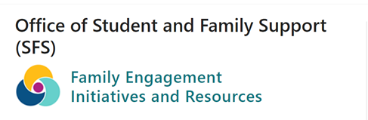

Engage family and caregivers
Notes:
The Office of Student and Family Support web pages feature a number of family engagement resources. Linked here is the
Better together – reusable learning object designed to help districts engage with The Family, School and Community Partnership Fundamentsls Self-
Assessment.what the research says; reflection process toolkit; spotlights examples in practice; links to resources to go deeper into the process/
Links to DESE resources
The Massachusetts Department of Elementary and Secondary Education's (DESE) definition of Family Engagement:
The primary goal of family engagement is to facilitate shared responsibility that contributes to the healthy development, learning, and growth of children - from the earliest ages into young adulthood. Family engagement builds relationships between students, families, educators, and the community. These relationships over time develop into meaningful partnerships rooted in the strengths and assets of all.
Effective family engagement is culturally responsive, collaborative, equitable, and respectful of diverse languages, norms, and values.
Effective engagement strives to eliminate barriers to participation.
These engagement practices take place in schools, in the community, and wherever students live and learn.

Slide 23
Engage stakeholders
Describe the ways in which your district engaged different stakeholders groups in the development of your SOA plan
  How are these differing perspectives integrated into in the plan?
  How will you continue to engage stakeholders throughout the implementation of your plan
Stakeholders
  Students, parents/caregivers, Special Education Parent Advisory Council, English Learner Parent Advisory Council, School Improvement Councils, educators and other school staff, other community partners and agencies with connections to your students and families
  *Stakeholders in blue are specified in the SOA legislation
Notes:
We do get questions from districts as to whether they need to begin a whole new process. Any work you have done previous can serve as a launching point for informing this plan. Can leverage it, but you may find that you do need to go back and engage other stakeholders and engage other families. Make be sure that what you have done previously meets the needs of the SOA plan.
We view stakeholder engagement as an ongoing process involving a variety of approaches that can vary for different stakeholder groups and serve different purposes. If you’ve done stakeholder engagement you can utilize what you have learned in this section. You may find that you need to do some additional outreach to stakeholders representing student groups targeted in your plans.
We are looking efforts that describe than just informing/updating your community on what you’re doing once the SOA plan is virtually complete -
What are the opportunities your stakeholders have been offered to provide Input and feedback – in a time frame that allows for their input and feedback to be incorporated into the plan
There are a variety of ways of doing this. Earlier we mentioned collecting data on perspectives from different stakeholder groups – these could be focus groups with stakeholders representing different student groups (students themselves, parents/caregivers) -- it could be surveys about school and learning. In addition to VOCAL data, there are perspectives surveys that ask similar questions of different stakeholder groups (e.g., parents, teachers, and students) that are useful for highlighting disparities in perceptions (e.g., a number of districts around the state contract with Panorama to do this)
If your district is at the visioning stage, * DESE’s Planning for Success: Envisioning the Future Protocol. DESE’s Planning for Success process includes resources to support districts to engage with stakeholders and families to develop a shared vision for the future (adapted from The School Reform Initiative’s Future Protocol) offers an engaging hands-on approach to the visioning process – and can be used with multiple stakeholders.
There are also districts that set up planning teams that include broad stakeholder engagement, allowing them deeper engagement in the planning process
Let your stakeholders know where their input is reflected in the final SOA plan
The stakeholders bullet lists a set of potential stakeholders to include – those highlighted in blue are those called out be the legislation; we have included other stakeholders we think add meaningfully to the process.

Slide 24
Affirmations
Stakeholders included in process (check box)
Confirm that school committee has voted to approve the plan (check box)
Date of vote
  Check your school committee calendar now to ensure that the school committee vote takes place before the April 1 deadline!
Notes:
At the end of this section you will be asked to confirm that you have engaged with the stakeholders highlighted in blue on the previous slide.
The SOA legislation calls for the superintendent to consult with the School Committee on the SOA Plan. You will be also be asked to confirm that the school committee has voted to approve your district’s SOA plan and to provide the date of the vote.
Please check you school committee calendar now to ensure that the vote can take place before the April 1 deadline!

Slide 25
Plan Submission Guide
Section 5: Select Evidence-Based Programs to Address Disparities in Outcomes
Notes:
In this section of your plan submission you will provide additional detail about the specific EBP or EBPs you are selecting for your new three year plan.

Slide 26


Context: Evidence-Based Programs are now aligned to DESE’s Educational Vision and Strategic Objectives
Strategic Objective 1: Cultivate systems to support the whole student and foster joyful, healthy, and supportive learning environments so that all students feel valued, connected, nourished, and ready to learn
Strategic Objective 2: Promote deeper learning so that all students engage in grade-level work that is real-world, relevant, and interactive
Strategic Objective 3: Develop and sustain a workforce that is diverse, culturally responsive, well-prepared, and committed to continuous improvement, so that all students have equitable access to effective educators
Notes:
One key update for this year is the alignment of the EBPs to DESE’s new educational vision and strategic objectives. We received feedback from districts that indicated the previous year EBPs felt like a list of initiatives and we are excited to ground them in this new framework. We also received feedback on the grain size of the EBPs – some were very broad and others very specific. As a result, we tried to norm all of the EBPs so they are similar.

Slide 27
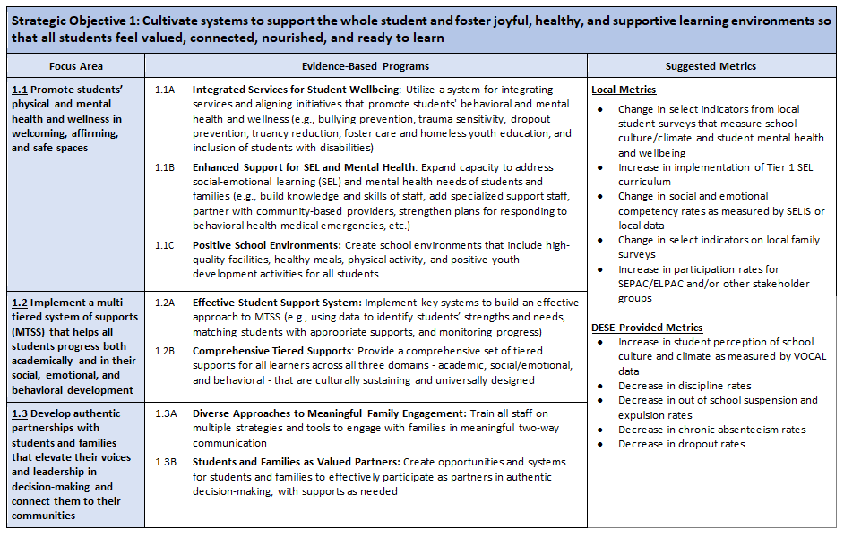
Strategic Objective
Strategic Objective Focus Areas
2024 Evidence-Based Programs (EBPs)
Suggested Metrics
Notes:
The strategic objectives table that includes the EBPs can be found on pages 10-13 of the guidance. The table includes the Strategic objective, the focus areas and aligned EBPs and suggested metrics. Here is an example of the SO1 table.

Slide 28
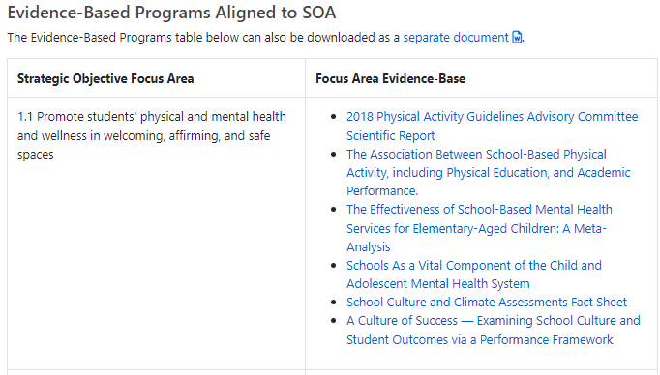
Context: Evidence Base
DESE’s How Do We Know? website reflects the analysis we have done to highlight programming and strategies that are most likely to have the greatest impact on students
Notes:
In addition to the updated EBPs, we have also included an updated evidence base on our “How Do We Know” initiative website.

Slide 29
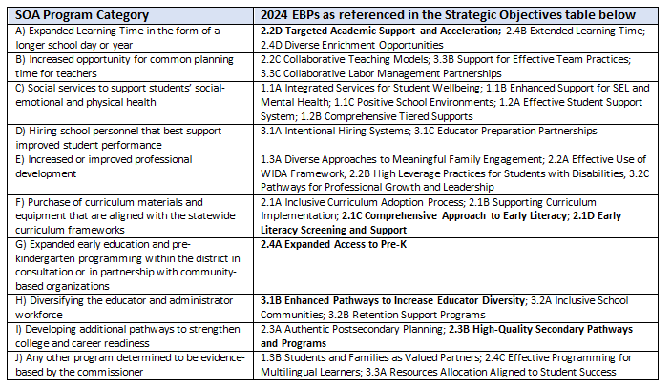
Context: EBP Crosswalk
The list of EBPs for this year includes all previous EBPs and also align to the program categories outlined in the SOA.
A crosswalk of SOA program categories and 2024 EBPs can be found on page 9 of the guidance
Notes:
EBPs from previous years are all represented in the new list, although they may be worded slightly differently. Additionally, on page 9 of the guidance you will find a crosswalk of the EBPs to the SOA program categories as required by law.

Slide 30
Selecting EBPs for your plan
Review the Strategic Objectives table on pages 9-13 of the guidance document
Select one to three Focus Areas your district will prioritize, based on your data analysis
For each Focus Area, select one or more EBPs from the DESE-provided list.
Answer additional questions about each EBP you select, including questions about resource allocation.
Notes:
So how will districts indicate their EBP selections in the new plan submission guide? You will be asked to select 1-3 focus areas that your district will prioritize over the next three years. For each focus area, you will be asked to select one or more aligned EBPs for implementation. You will also identify metrics for your focus areas as well as answer additional questions about each EBP.
Some districts have asked whether they need to start from scratch or whether they can continue with the same EBPs from their original plan.
If your analysis of disparities for student groups and their underlying causes suggest that these are still the right evidence-based programs to focus on, then the answer is yes you may continue the same EBPs.

Slide 31
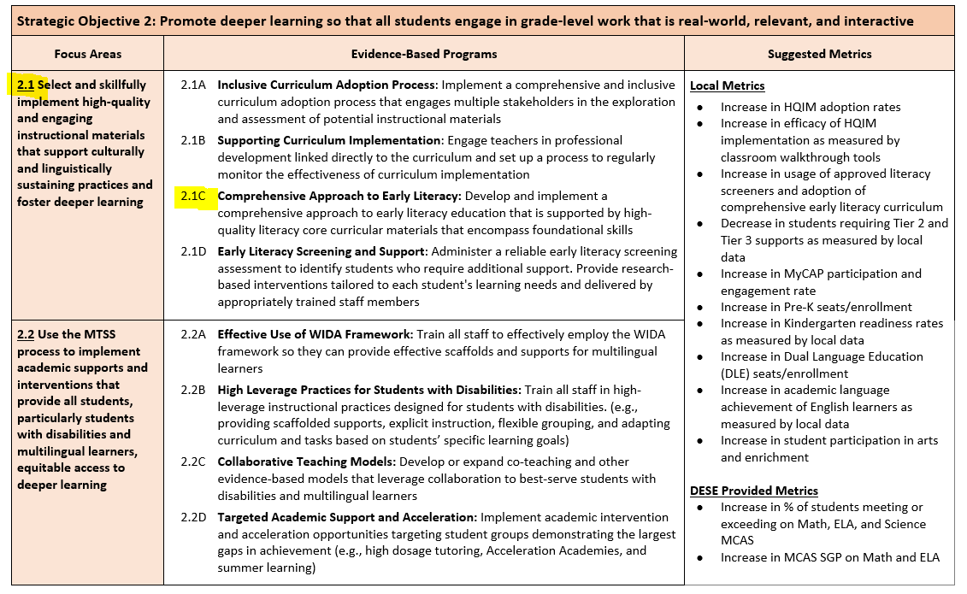
Strategic Objective 2: Promote deeper learning so that all students engage in grade-level work that is real-world, relevant, and interative

Slide 32
Additional questions for each EBP you select
Provide a short description of what your district has in place now related to this EBP and what you anticipate will be in place by the conclusion of the plan's implementation, particularly to support targeted student groups. Open response
Which schools will be impacted by these efforts (answer can be district-wide)? Open response
What is the anticipated amount of total funding that will be allocated to this EBP over the next three years (FY25 + FY26 + FY27), across all funding sources? Numerical response
Describe the anticipated allocation of funds to this EBP in more detail. Open response
Which budget foundation categories (G.L. c. 70) will be included in this anticipated annual allocation? Dropdown with checkbox
What metrics will your district use to monitor progress in this EBP? Open response
Notes:
Here are a list of the questions you will answer for each EBP – so working off of the previous slide, you would answer the questions for both 2.1C and 2.1D.
The new sample SOA Plans resource we mentioned earlier will offer examples of what kinds of information we are looking for.

Slide 33
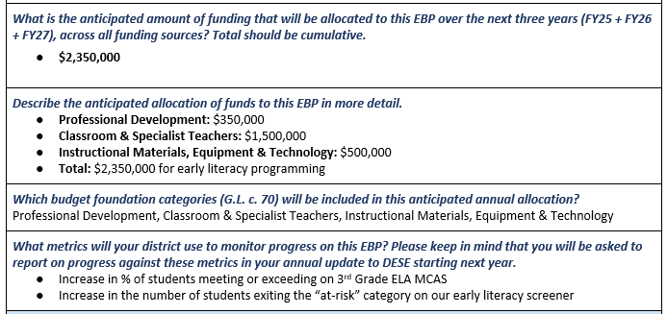
EBP Selection
Notes:
So going in terms of EBP selection and additional questions, here is an example. On the lefthand side your district may select focus area 2.1 and then EBP 2.1C comprehensive approach to literacy. In your plan, you will answer the following

Slide 34
DESE Supports for Plan Development and Submission

Slide 35
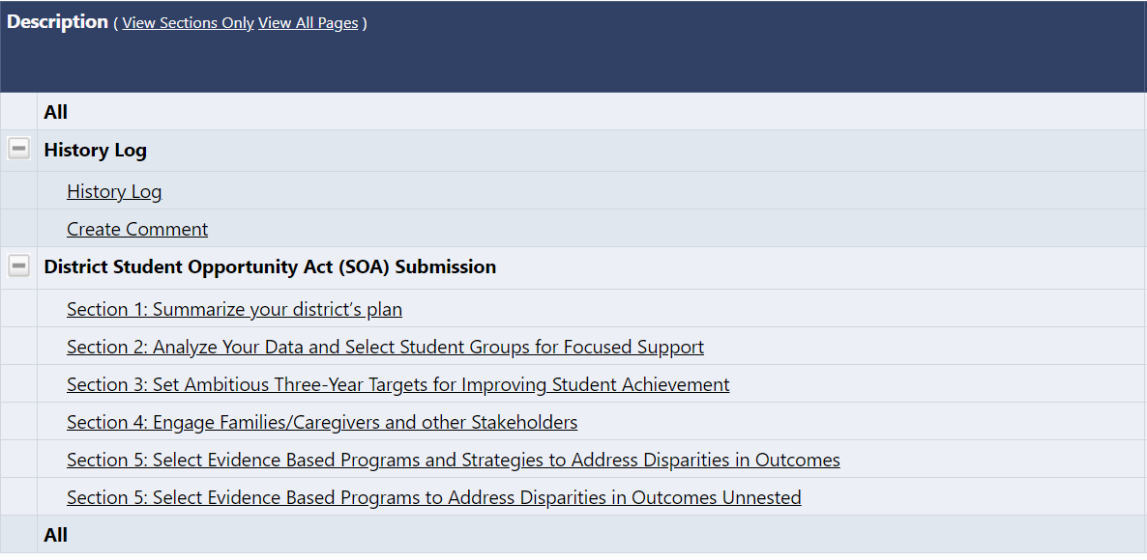
GEM$ preview
Notes:
The GEM$ template is entering the final phases of development. Barring any complications, we currently anticipate opening it up to districts in late January
I know that GEM$ is DESE’s new grant system, but I just want to emphasize for the record that SOA Plans, even though we are leveraging the system to collect information.
We want to give you a brief look at what to expect and highlight some of the advantages of GEM$ over the Alchemer – the system we have used to collect SOA plans and updates until now.
1. Your GEM$ administrator will assign the roles of SOA Plan Writer and SOA Plan approver in GEM$. No more sign in links and/or links to get back into your district’s plan.
2. You will be able to complete sections in any order by clicking on the section you want to work on. As some of you may recall, in Alchemer, you weren’t permitted to advance to the next section until the previous section was complete.

Slide 36
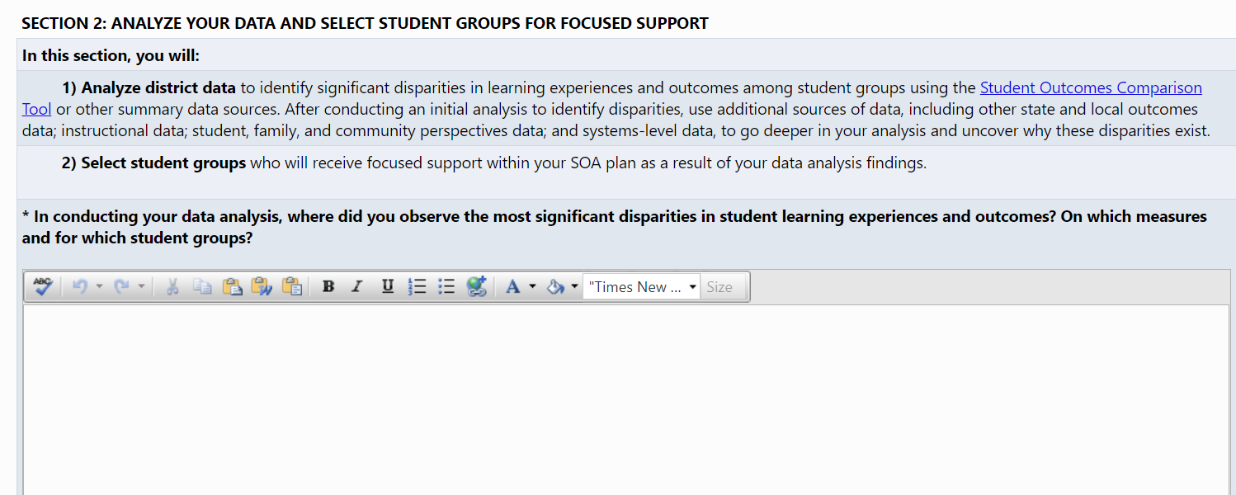
GEM$ Preview (continued)
Notes:
*GEM$ permits you to format your narratives.
Not every formatting feature in available within GEM$, but you can copy and paste text, including links, tables into GEM$
You can print out a copy of your submission (either by section or in its entirety) from the GEM$ system.

Slide 37
Other DESE supports
SOA Office Hours
  Districts can schedule ½ hour consultations to discuss overall plan development using this link.
Districts Completing SOA Plan Addendum will receive more detailed information and guidance this month.
Email questions to SOAPlans@mass.gov
  What other supports would be helpful?
Notes:
We will, once again, be offering SOA Office hours. You will be able to schedule ½ hour consultations. The link is available in materials previously shared with district leaders, and appears on the SOA District resources web page.
If any districts that will be completing the plan SOA Plan Addendum are with us this afternoon – the addendum itself, along with Guidance completing it will be available later this month. We will also be hosting a webinar for those districts at the end of the month. At that time, we will share additional supports the SOA Team will provide to districts to assist them with developing them.
Questions can be submitted at any time to the SOAPLans@mass.gov email
Announcements will be made in Commissioner’s weekly update
Want to take a moment to ask you to type your suggestions for other supports that would be useful into chat.

Slide 38
Our plan is submitted. Now what?
FY24 SOA Plans will be reviewed between April and June
  Meets statutory requirements
  Responsiveness to prompts in template
  Questions, feedback, and requests for additional information will be communicated via GEM$
FY24 SOA Plans will be publicly available via GEM$
Notes:
Between April and June, plans will be reviewed reviewed by members of SOA Team. We expect that review to focus on whether plan elements meet statutory requirements, their responsiveness to prompts in the template. Any questions, feedback and requests for additional information will be communicated via the GEM$ system. Additional details will be provided in February.
GEM$ includes a public facing feature where data can be shared with the public, so FY24 Plans will be made publicly available (as required by law) via the GEM$ system. Districts are also required to post their SOA Plans on their websites.

Slide 39
SOA Plan Team
Karen Johnston Karen.S.Johnston@mass.gov
Erica Champagne Erica.Champagne@mass.gov
Kinnon Foley (SOA Plan Addendum) Kinnon.Foley@mass.gov

Slide 40
Questions?

