Slide 1
Equitable Services for Children With Disabilities Enrolled by Their Parents in Private Schools (34 C.F.R. §§ 300.130 - 300.144)
April 2019

Slide 2
Agenda
Background and Context
Consultation
Child Find, Child Count, Calculation
Evaluations, Eligibility
Services Plans
Expenditures
Administrative Advisory SPED 2018-1: Guidance and Workbook for Calculating and Providing Proportionate Share Services for Students with Disabilities Enrolled by Their Parents in Private Schools
Notes:
All guidance is based on Administrative Advisory SPED 2018-1

Slide 3
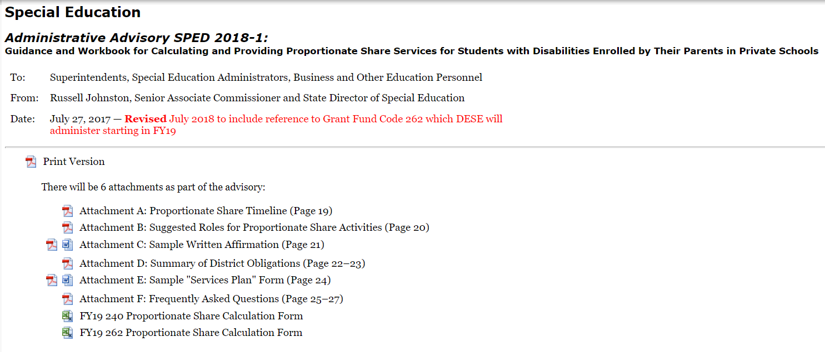
Background
Administrative Advisory SPED 2018-1
IDEA Equitable Services for Students with Disabilities Enrolled by Their Parents in Private Schools webpage
DESE Guidance, Memos, Sample Documents, Federal Resources
Notes:
Note various attachments and sample documents .

Slide 4
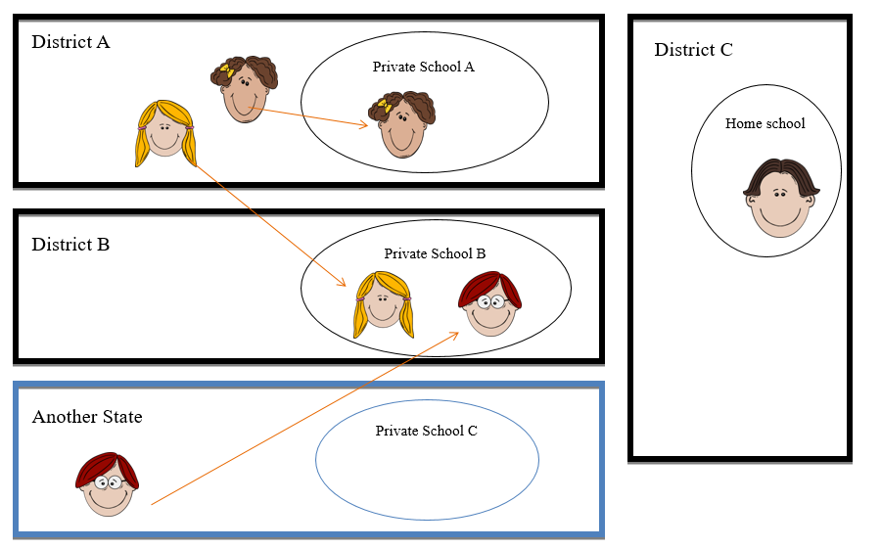
District of Residence vs. District of Location
Notes:
Operating under 2 sets of laws not just one –
State and Federal run in parallel. Both are required
Sets the stage for district of residence (where a student lives) and district of location (where a student attends school)

Slide 5
What are equitable services?
34 C.F.R. §§ 300.130-300.144 = Federal Provisions Related to Children With Disabilities Enrolled by Their Parents in Private Schools
In its simplest form:
Services for privately-enrolled children with disabilities
Public school districts must spend a proportionate share of federal special education entitlement funds on services for eligible parentally-placed private school students attending school in the district’s catchment area.
Excluded: Charter Schools, Vocational Technical Schools, and Virtual Schools
OSERS document: Questions and Answers on Serving Children with Disabilities Placed by Their Parents in Private Schools

Slide 6
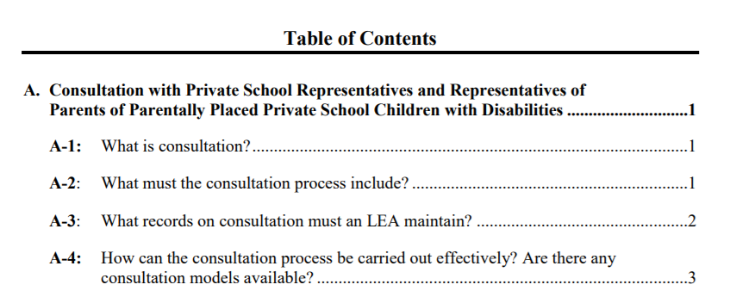
Federal Questions and Answers on Serving Children with Disabilities Placed by Their Parents in Private Schools
Questions and Answers On Serving Children With Disabilities Placed by Their Parents at Private Schools

Slide 7
Who are the eligible children?
Parentally-placed private school children with disabilities enrolled by their parents in private, including religious, schools or facilities that meet the definition of elementary school or secondary school …
Definition of an elementary school:
34 C.F.R. § 300.13 Elementary school means a nonprofit institutional day or residential school, including a public elementary charter school, that provides elementary education, as determined under State law.
Note: this does not include children who are district placed nor students placed by a settlement agreement.
Remember in Massachusetts, district-approved home schooled students are considered private school students.

Slide 8
IDEA Allocation Calculation – Where does the # come from?
LEA Base Amount + Enrollment = IDEA Allocation
Enrollment=
Combined enrollment = (85%)
Total # of public and private students in the catchment area
Low-Income/Poverty (15%)
Total # of public and private low income/poverty students
SIMS:
DOE012 - Enrollment Status at Time of Data Collection
40 - Not enrolled but receiving special education services only.

Slide 9
Public School District Documentation Requirements
With 240/262 DESE receives:
Districts keep and document:
Child count & calculation
Narrative about consultation
Number of private school students evaluated, found eligible, and served
Planned expenditures
*Written affirmation not received (email)
Written affirmations
Written explanations
Services plans

Slide 10
Timely and Meaningful Consultation
Cornerstone of all proportionate share activities
Occurs prior to other required activities and throughout the year
Responsibility is on the public school district to initiate consultation with private schools and home school representatives
Provides an opportunity for all parties to express their views and consider others’ views
Collaborative decision making & communication process
Required Topics: 34 C.F.R. § 300.134
Child find (of resident and non-resident students) attending the private school in the district
Determination of Proportionate Share for the whole pool of eligible students attending private school in the district
The consultation process, methodology, and schedule for the school year
Determination of services and their method(s) of provision for the whole pool of students

Slide 11
Consultation
Consultation is ongoing throughout the year, as necessary. Districts will reach out regularly to private schools and home school parents.
It is recommended to meet at least, the beginning, middle, and end of the school year.
The public school district must document their consultation and outreach efforts:
The dates of attempts to participate in the consultation process,
The nature of the attempts, and
The results of each attempt for consultation.

Slide 12
Common Consultation Questions
Are all private schools in the geographic catchment area invited to the same consultation meeting?
This is not required. Meetings are ongoing and scheduled throughout the year. There can be as many separate meetings as desired, or there could be one large meeting for all each time you meet. This is the school district’s decision.
Are the home school parents invited to the same timely and meaningful consultation as the private school representatives and parents?
Home school parents may be invited to the same consultation meeting or the district may convene separate meetings.

Slide 13
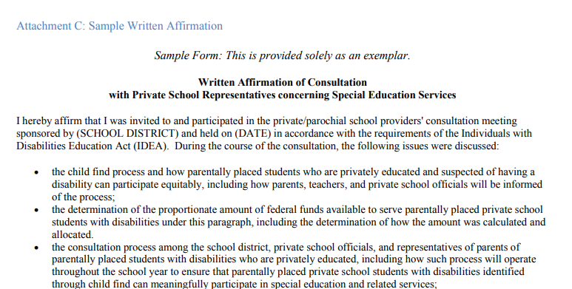
Written Affirmation 34 C.F.R. § 300.135
Anytime meaningful consultation occurs, public school district obtains written affirmation of the consultation from meeting participants…
Written Affirmation does not indicate "agreement" but merely that the meeting and discussion took place, so it must be signed at the conclusion of the meeting or as soon as possible thereafter.

Slide 14
If written affirmation is not obtained…
§ 300.135 Written affirmation.
(a) When timely and meaningful consultation, as required by § 300.134, has occurred, the LEA must obtain a written affirmation signed by the representatives of participating private schools.
(b) If the representatives do not provide the affirmation within a reasonable period of time, the LEA must forward the documentation of the consultation process to the SEA.
If written affirmation is not obtained, Districts should email ideaequitablservices@doe.mass.edu with information about their consultation and outreach efforts to the private schools and home school representatives.

Slide 15
Written Explanation
Once timely and meaningful consultation meetings have taken place with all relevant parties, the school district will make a final decision about which services to provide and for which students.
If the district disagrees with the views of the private school officials on the provision of services or the types of services (whether provided directly or through a contract), the district will provide to the private school officials a written explanation of the reasons why the district chose not to provide services directly or through a contract. 34 C.F.R. § 300.134(e)
The public school district has the final decision-making authority. 34 C.F.R. § 300.137(b)(2)
Notes:
LEAs do not send us written explanation. Documentation is kept at the local level.

Slide 16
Child Find versus Child Count
Child Find: 34 C.F.R § 300.131
Child Count: 34 CFR § 300.133
Ongoing throughout the year
Similar to the activities for public school children
Should include explicit outreach to private schools, parents, and parents of home school in the district.
Determines children you may provide services to throughout the year
Residents and non-residents
Happens once a year anytime between Oct. 1 and Dec. 1
Determines the number of students to include for the proportionate share calculation submitted in the subsequent year IDEA grant applications (240, 262)
Residents and non-residents

Slide 17
Evaluation and Eligibility
Notes for LEAs
Help educate parents about the different options for evaluation, including the different outcomes of each.
If a child is found eligible, they are counted in child count for the 3 years, unless reevaluated determines them ineligible.
All students have a District of Location and District of Residence.
District of Location and District of Residence have distinct obligations to determine eligibility for special education services under separate laws.
District of Location - Federal (IDEA): Districts evaluate, and determine eligibility for students attending private school in the district regardless of where they live.
District of Residence - State: Districts evaluate, determine eligibility, and, if eligible, write IEPs for their resident students regardless of where they attend school.

Slide 18
Evaluation and Eligibility Continued…
District of Residence (State) | District of Location (Federal)
Conducts evaluations and determines eligibility for resident students of the district regardless of where they attend school | Conducts evaluations and determines eligibility for students who attend private school in the district regardless of where the live
Student has individual entitlement (FAPE) to special education services and dispute resolution procedures | No guarantee for individual services, joins pool of eligible students to be considered for services
Writes an IEP | Writes separate service plan each student receiving services

Slide 19
Child Find Sample– Verification of Eligibility
Pvt. school indicates one eligible student enrolled at their school
Ask pvt. school if they have documentation of eligibility.
Pvt. school will need a release from parents to share with you.
If pvt. school gives you parent contact info, you can contact parents directly.
Ask parent to share current IEP, evaluations, etc.
Review documents provided. See if additional evaluations are needed.
If there is no documentation, treat this like a referral for evaluation.
Notes:
IEPs not created under IDEA (e.g “IEP” created by private schools) are not sufficient

Slide 20
Evaluations
Best practice recommendation for large districts:
Develop evaluation teams that can go on-site to the private schools.
It is an appropriate use of federal funds.
Reminder: evaluation costs do not count for meeting the proportionate share obligation.
Try to make it as easy as possible to conduct the evaluations.

Slide 21
Child Count and Eligibility
Notes for LEAs
If necessary, suggest private school reps obtain consent from parents to share information.
Suggest private school reps come prepared to the consultation meeting with supporting documentation.
A list of student names or a total number of students alone is not sufficient documentation.
To accurately count the privately-enrolled special education population, the public school districts require the following information from each private school in the district:
Supporting documentation (e.g. IEPs) verifying eligibility of parentally-placed students
Names of the children
LEAs can impose deadlines for this documentation.
A child with a 504 Plan alone is not considered eligible for special education under IDEA.

Slide 22
Sample Calculation Ages 3-21 (Fund Code 240)
There are five (5) eligible private school students enrolled in private schools or home schooled within the geographic boundaries of Anytown District; two (2) are district residents, one (1) lives in another Massachusetts town, one (1) lives in another state, and one (1) is home schooled. The district also serves 495 eligible students who reside and are enrolled in the district.
Anytown District also serves five (5) students who are enrolled in private schools located in other districts, as required by Massachusetts law. These students are, however, not included in Anytown District's proportionate share calculation. Rather, these students must be included in the proportionate share calculation for the districts in which the private schools they attend are located.
The total number of eligible students both privately enrolled and enrolled in public schools in Anytown District is 500. This includes the five privately enrolled or home schooled students referred to above and 495 eligible students enrolled in the district. The district's proportion of eligible parentally-placed private school students to all eligible students is 5:500 or 1%.
Anytown District received $200,000 as its Fund Code 240 grant. Because the proportion of private school students with disabilities is 1% of all students with disabilities, the "proportionate share" of the 240 funds is 1% of the total grant of $200,000, or $2,000. Anytown District must spend at least $2,000 of its 240 grant on services for the five parentally-placed private school students and home schooled students educated in the district to meet its proportionate share obligation under Fund Code 240.
5
495
+
500
5/500=.01
1% * $200,000=
$2,000

Slide 23
IEP ≠ Services Plans
IEPs must document the provision of FAPE in the LRE from the public school district of residence (state).
A services plan describes the services provided to a private school student by the public school district of location (federal).
Scenarios:
An eligible student could have:
an IEP and a services plan
an IEP only
a services plan only
neither

Slide 24
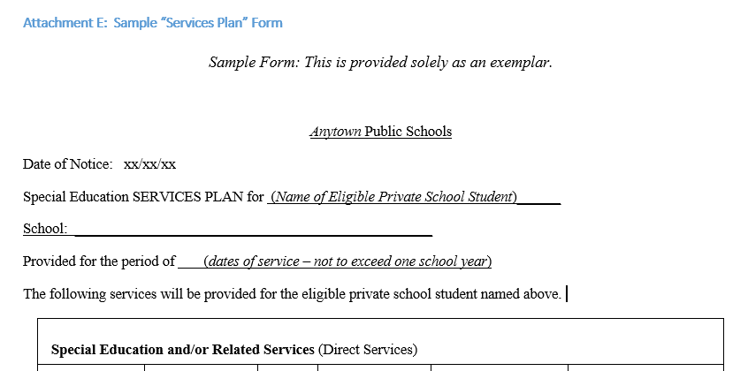
Services Plans
Each parentally-placed private school child with a disability who has been designated to receive proportionate share services must have a separate services plan written by the public school district

Slide 25
Annual Services Plans
Notes for LEAs
Ensure parents attend services plan meetings.
Ensure private school representatives attend services plan meetings.
A separate and distinct document from an IEP
Developed, reviewed, and revised by the District of Location similarly to IEP process
Parents are required participants at the meeting at which their child's service plan will be developed.
Representatives from the private school are required to attend as well.
If the representatives cannot attend, use other methods for their participation including individual or conference calls.
The District of Residence is not a required participant for a Services Plan meeting.

Slide 26
Expenditures
Federal funds can be used to provide services on the grounds of the private school; state and local funds cannot.
IDEA funds are not given to the private school to use at its discretion.
Because private schools are not at any time receiving federal funds from the public school district, they are not subject to federal oversight.
The public school district must determine the services, pay for them, and monitor vendors/providers as they would any service provider.
LEAs can adjust services throughout the year. Decision-making is a collaborative process.
Any non-disposable items purchased with IDEA funds belong to the public school district, not the private school.

Slide 27
Attachment F: Frequently Asked Questions Question #10
Notes for LEAs
Funds are for the pool of eligible students. There is not an individual student entitlement nor an individual private school entitlement to funds.
The decision of provision of services, and for whom, is reached following the consultation process.
How will the district determine the use of proportionate share amongst the numerous private school students?
DESE does not prescribe how districts spend the proportionate share funds. Each district, after timely and meaningful consultation with private schools and home school representatives, determines the services they are able to provide. The district must take into consideration input from the private school representatives and parents. If the school district disagrees with the views of the private school officials on the provision or type of services, the district must provide private school officials with a written explanation of the reasons the district chose not to provide services directly or through a contract. Follow up with private school and home school representatives is recommended regarding that determination.

Slide 28
Expenditure
Each public school district must spend its calculated IDEA proportionate share amount each year from the Part B IDEA entitlement funds.
If the public school district cannot expend all of the funds, the unfulfilled part of the obligation will be carried over and expended in the next fiscal year, independent of that new year’s proportionate share calculation.
Must use the first in/first out procedures for the monies.
Funds should be spent by the end of the second fiscal year.
State and local funds may only supplement, not supplant. 34 C.F.R. § 300.133(d)

Slide 29
Expenditure: Eligible
* (34 C.F.R. § 300.139) If necessary for the child to benefit from or participate in the services provided under this part, a parentally-placed private school child with a disability must be provided transportation…
Direct Student Services
Costs of providing special education and related services
IDEA encourages on-site services or
If off-site, may include transportation*
Indirect Student Services
Professional development for private school personnel
Consultative services
Assistive technology

Slide 30
Expenditures:
Not eligible for meeting proportionate share obligation
Child find activities
Special education evaluations
Administrative costs – clerical, director, etc.
Remodeling or repairs of private school facilities.
Paying salaries of private school staff for part of their regular duties.
Supports for students without disabilities.
Notes:
NOTE – if the LEA wants a pvt school staff member to provide services, the LEA will contract with that employee, not the pvt school.

Slide 31
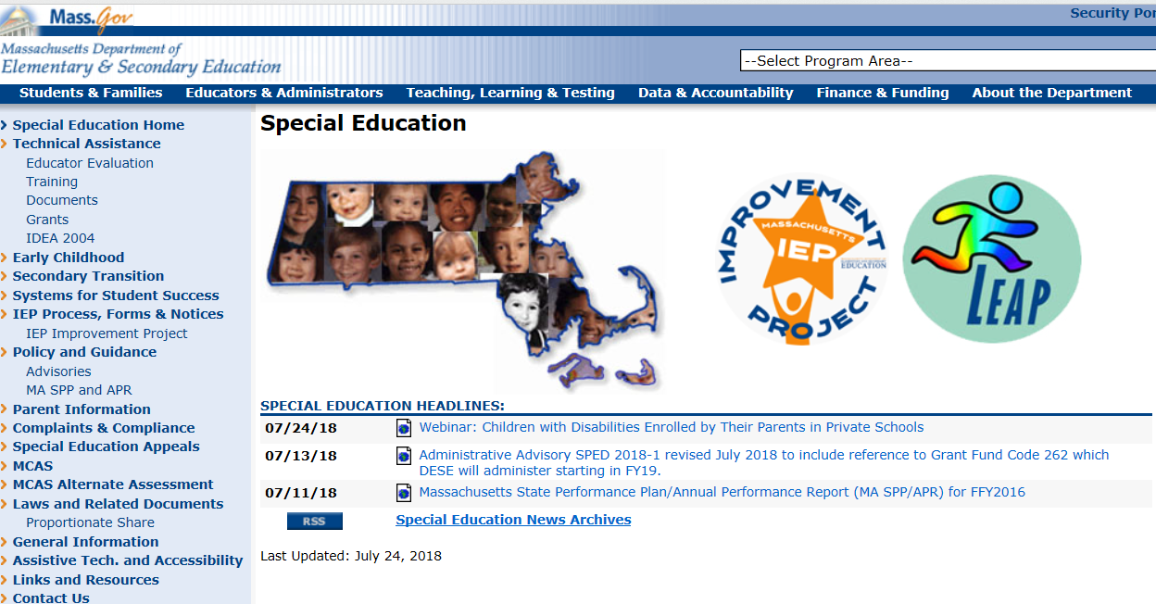
Links to Resources
Available on http://www.doe.mass.edu/sped/

Slide 32
Helpful Resources
Proportionate Share Services for Students with Disabilities Enrolled by Their Parents in Private Schools
Advisory Link with Attachments
Memos
Federal Guidance Documents
Draft Child Find Letters / Child Find Notices
Draft Consultation Meeting Invitations
Draft Quick Reference Guide for Private Schools and Home School Parents
DESE Federal Grants Office IDEA Resources:
Allowable Costs for IDEA Entitlement Grants
IDEA Fund Code 240 Quick Reference Guide
IDEA Fund Code 262 Quick Reference Guide
Proportionate Share Quick Reference Guide
NEW!!

Slide 33
Private School Responsibilities (Advisory 2018-1 page 20)
Suggested roles for private school / home school representatives – schools located within the district and home schooled students residing in the district:
1. Update private school contact information on the DESE Profiles website. (private schools only)
2. Establish a private school point-of-contact to liaise with the public school district.
3. Attend consultation meeting(s) with the public school district and discuss the provision of services.
4. Provide signed written affirmation of participation to public school district following consultation meeting.
5. Provide information to private school parents about child find and referral processes.
6. Provide information to the public school district about eligible students attending the private school. (Obtain consent from your student’s parents consistent with your school’s policies.)
7. Attend each meeting that occurs for writing individual student services plans.
8. Return special education equipment/technology materials to public school district at the end of the service year, or earlier if necessary.

Slide 34
IDEA Regulations
Children in Private Schools (34 C.F.R. § 300.129)
34 C.F.R. Section 300.129 State responsibility regarding children in private schools.
Children With Disabilities Enrolled by Their Parents in Private Schools
34 C.F.R. Section 300.130 Definition of parentally-placed private school children with disabilities.
34 C.F.R. Section 300.131 Child find for parentally-placed private school children with disabilities.
34 C.F.R. Section 300.132 Provision of services for parentally-placed private school children with disabilities - basic requirement.
34 C.F.R. Section 300.133 Expenditures.
34 C.F.R. Section 300.134 Consultation.
34 C.F.R. Section 300.135 Written affirmation.
34 C.F.R. Section 300.136 Compliance.
34 C.F.R. Section 300.137 Equitable services determined.
34 C.F.R. Section 300.138 Equitable services provided.
34 C.F.R. Section 300.139 Location of services and transportation.
34 C.F.R. Section 300.140 Due process complaints and State complaints.
34 C.F.R. Section 300.141 Requirement that funds not benefit a private school.
34 C.F.R. Section 300.142 Use of personnel.
34 C.F.R. Section 300.143 Separate classes prohibited.
34 C.F.R. Section 300.144 Property, equipment, and supplies.

Slide 35
Thank you slide and contact information
THANK YOU
Special Education Planning and Policy Office
Teri Williams Valentine, Director
Andrea Cote, Professional Development Programs Manager
Should you have questions, we encourage you to send them to ideaequitableservices@doe.mass.edu .

