Slide 1
Secondary Transition Basics for School Professionals
February 25, 2021

Slide 2
Is this the right training for you?
New to secondary transition:
  Special educators,
  Team chairs,
  Related service providers,
  General educators,
  School counselors, and
  Any other school personnel who participate in IEP meetings for students aged 14-22
Experienced but you want a refresher

Slide 3

COVID-19 Pandemic?
Information applies at all times. Not COVID-specific.
Some reflection questions will ask you to think about implementation during the pandemic.

Slide 4

Agenda
1 ½ hour presentation with Four 5-minute breaks for reflection
  Recorded
  30 minutes for questions
  Not recorded

Slide 5
This training will help you to:
  Understand fundamental concepts in secondary transition.
  Understand the secondary transition process overall.
  Understand how to use the Transition Planning Form (TPF) and IEP to guide and document a coordinated planning process.
  Understand what transition assessment is, why it’s important, and how to document it.

Slide 6

Fundamental Concepts

Slide 7
Purposes of IDEA
…to ensure that all children with disabilities have available to them a free and appropriate public education that emphasizes special education and related services designed to meet their unique needs and prepare them for further education, employment, and independent living….
20 USC §1400(d)(1)(A)

Slide 8

Our common goal
The goal of the Massachusetts public K-12 and adult education system
is to prepare all students
for success in life.
https://www.doe.mass.edu/

Slide 9
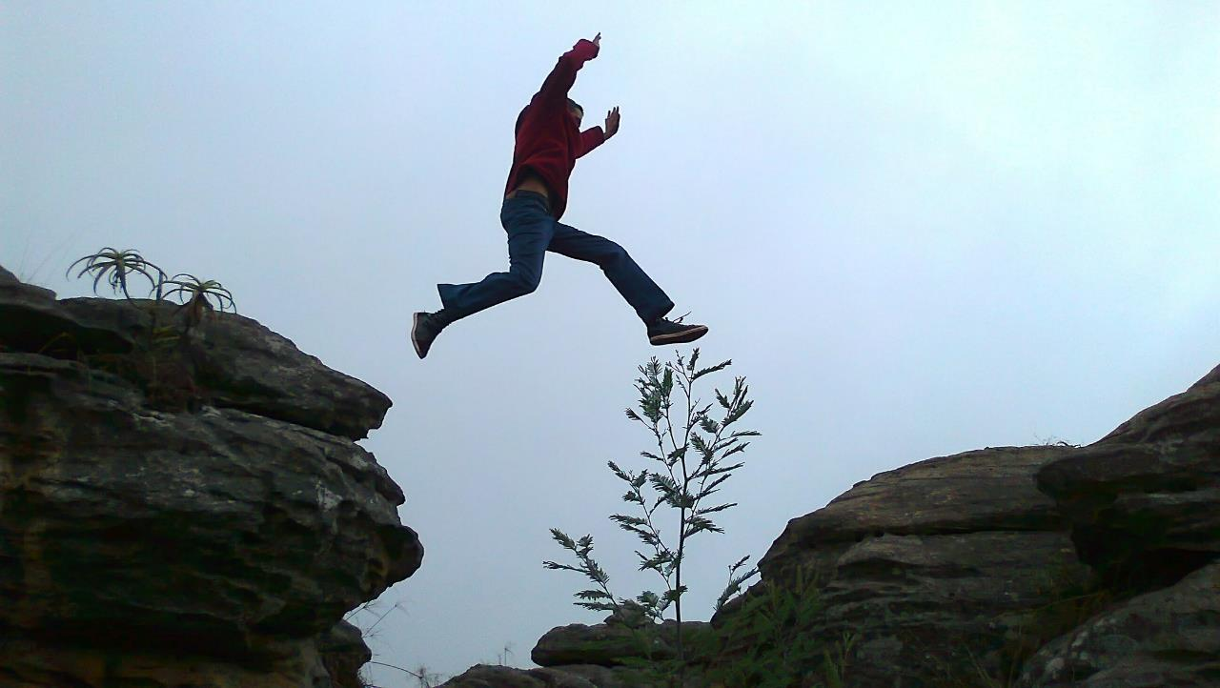
Wehmeyer statement on the nature of disability
“Disability exists only in the gap between the individual’s personal competence and the demands of the environment.
If we can close that gap, disability becomes irrelevant.”
-- Dr. Michael Wehmeyer, University of Kansas

Slide 10
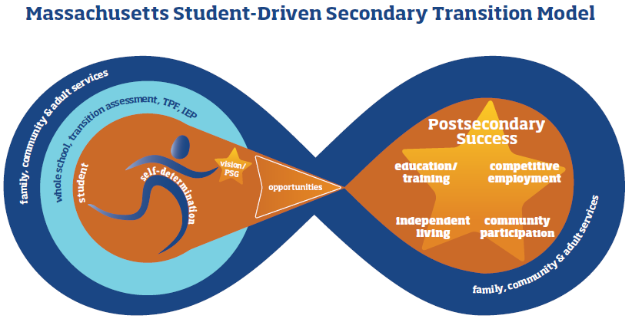
Massachusetts Student-Driven Secondary Transition Model
http://www.doe.mass.edu/sped/2013/SecondaryTransition/VisualModel.pdf

Slide 11

Family engagement
Take a strengths-based approach that is culturally and linguistically responsive. Throughout the school year, how do you:
Recognize the strengths of families?
Acknowledge, respect, and learn from individual and group differences?
Consider family preferences while adapting practices?
Share decision-making with family members?
Approach families as equal and reciprocal partners?
STRENGTHENING PARTNERSHIPS: A Framework for Prenatal through Young Adulthood Family Engagement in Massachusetts, https://www.doe.mass.edu/sfs/family-engagement-framework.pdf#search=%22family%20engagement%22

Slide 12

Self-determination is essential. Research has spoken.
Throughout the school year, how do you support students to:
  Understand, evaluate, and express their strengths and challenges to a variety of adults and peers, across environments?
  Track their own progress?
  Find and benefit from a supportive mentor?
  Know their rights under the law?

Slide 13
Voices of students one year after exit (Indicator 14 survey 2020)
Never be afraid to ask/get help whenever you feel you need the help. Getting help isn't because there's something wrong with you, it's because there is a new door to explore and acknowledge.
Don't let the outside world get to you. Pave your own road; it will make you happy.
I needed to learn more independence earlier on.
The support you get in high school is not found in college so try to do more things on your own
Have a plan, or at least a start of one, for after high school.
The one thing that I would suggest to other students to be ready for adult life is always work hard, never give up and never lose your passion for what you like to do.

Slide 14

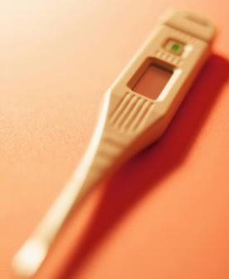





An All-Student Perspective
What experiences would a student without disabilities be expected to have?
These set the standard for the kinds of experiences that students with disabilities can have, with greater or lesser levels of support, based on each student’s individual needs, strengths, preferences, and interests.

Slide 15

Please take time to reflect for five minutes.
Which fundamental concepts resonate with you and your colleagues?
In what areas can you grow?

Slide 16

Secondary Transition Overview
Secondary Transition Overview

Slide 17
Secondary transition services in federal law
A coordinated set of activities for a child with a disability that is designed to be within a results-oriented process, that is focused on improving the academic and functional achievement of the child with a disability to facilitate the child’s movement from school to post-school activities, including postsecondary education, vocational education, integrated employment (including supported employment), continuing and adult education, adult services, independent living, or community participation.
-- IDEA 2004: 34 CFR 300.43 (a)(1)

Slide 18
The coordinated set of activities must:
Be based on the individual child’s needs, taking into account the child’s strengths, preferences, and interests; and includes:
  Instruction;
  Related services;
  Community experiences;
  The development of employment and other post-school adult living objectives; and
  If appropriate, acquisition of daily living skills and provision of a functional vocational evaluation.
  --IDEA 2004: 34 CFR 300.43 (a)(2)

Slide 19
Secondary transition IEP process throughout the year
Year-round, ongoing age-appropriate assessment
Strengths
TPF - brainstorm
Vision/PSG
IEP - contract
Vision
Needs
Preferences
Interests
Disability-Related Needs
Action Plan
Supports
Services
Concerns
Assessment
Goals
Year-round Implementation

Slide 20

How to look at the TPF and IEP holistically
When we look through a secondary transition lens, we ask:
  Do the TPF and IEP document a coordinated set of activities that address the student’s disability-related needs and builds skills that the student will need to succeed in their desired future in:
    Postsecondary education/training?
    Competitive employment?
    Independent living?
    Community participation?
    Can any reader understand this plan? Is it a true roadmap?

Slide 21

Please take time to reflect for five minutes.
Do all students with IEPs in your school and district experience a coordinated set of transition activities from age 14 onward?
How can you improve?
What is different during the pandemic? What will change when the pandemic ends?

Slide 22

At the IEP Table
At the IEP Table

Slide 23
Your Student’s Voice
The public agency must invite a child with a disability to attend the child’s IEP Team meeting if a purpose of the meeting will be the consideration of the postsecondary goals for the child and the transition services needed to assist the child in reaching those goals….
If the child does not attend the IEP Team meeting, the public agency must take other steps to ensure that the child’s preferences and interests are considered.
§ 300.321(b)(1)(2)

Slide 24
Student-Led IEPs
Possible questions for students at IEP meetings:
  What are you proud of?
  What do you worry about?
  If you had an IEP before, which goals from your last IEP did you reach?
    What helped you reach your goals?
    What kept you from reaching your goals?
  Thinking about the conversation so far, do you think the plans will help you learn and grow this year? Why/why not?
  * Seekonk * Sturgis Charter * Lexington * Wellesley * Beverly * Newburyport * North Attleboro * Central Berkshire * Seven Hills Charter * Rising Tide High School * Boston Collegiate Charter *

Slide 25
Resources on Student-Led IEPs
Getting the Most Out of IEPs: An Educator’s Guide to the Student-Directed Approach by Colleen A. Thoma and Paul Wehman
Student-Directed Transition Planning resources from the Zarrow Center at the University of Oklahoma, http://www.ou.edu/education/centers-and-partnerships/zarrow/transition-education-materials/student-directed-transition-planning
Supporting Student-Led Transition Planning for Students with Emotional Behavioral Disturbance (UMass Medical) http://umassmed.edu/contentassets/7ffeebded6274601b3baa4de4a33b630/updated-test-guides/student-led-support-pre-pub.pdf

Slide 26

The Transition Planning Form (TPF)

Slide 27
The Transition Planning Form (TPF) – 28M/9
Flexible brainstorming tool used at the beginning of the IEP meeting when the student turns 14.
Guides and documents the team’s Transition planning discussion. Allows the Team to “think outside the box.”
Informs IEP development.
Provides an action plan to be implemented by student, family, community members, adult agencies, etc.
A state-mandated form (28M/9) that must be maintained with the IEP but is not part of the IEP. Nothing on the TPF is mandated to occur. The contents are not contractual.
Use previous TPF, IEP, and Progress Reports as starting point for the meeting.
A required document for districts to demonstrate compliance with Indicator 13 for federal reporting.

Slide 28
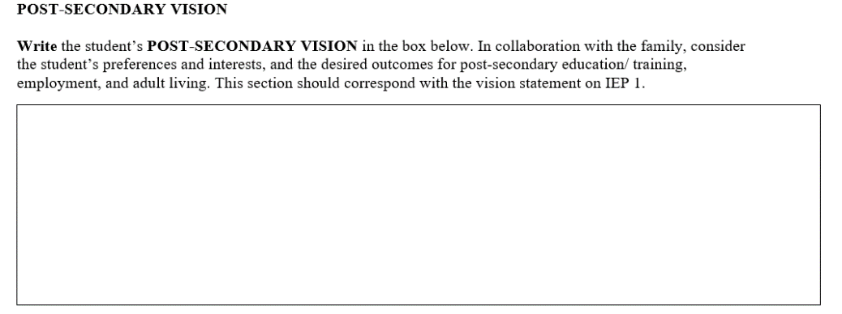
Top of Page One of the Transition Planning Form (TPF)
Top of Page One

Slide 29
Two kinds of “goals” in IDEA
Postsecondary Goal (Vision) $≠$ Annual IEP Goal

Slide 30
IDEA Requirements for Postsecondary Goals (Vision)
Each student's TPF and IEP vision statement should explicitly include at least*:
One measurable postsecondary goal in the area of education/training;
One measurable postsecondary goal in the area of employment;
If appropriate, one measurable postsecondary goal in the area of independent living.
The Team records the student’s vision on the TPF – not anyone else’s vision. The student’s vision from the TPF will be cut-and-pasted into the IEP when the Team discusses the IEP.
*34 CFR 300.320(b)(1)

Slide 31
What if students have no idea what they want to do?
Young students may not have a clear vision of their future. Start the conversation. Provide experiences over time which can help students discern what they want.
All school professionals can talk with students about vision in many contexts, over time. Avoid introducing the vision discussion at the IEP table, when students may feel overwhelmed.
Engage families, encourage conversations at home and in the community.
All students can communicate. Ensure that their expressed preferences and interests are explored and incorporated into the vision.

Slide 32
What if students know exactly what they want to do, but I think it’s unrealistic?
“Experience has taught me that you cannot value dreams according to the odds of their coming true. Their real value is in stirring within us the will to aspire.”
― US Supreme Court Justice Sonia Sotomayor
Respect the student’s vision.
Identify the skills required by the vision and provide opportunities to develop those skills.
Brainstorm and provide related employment or educational opportunities/experiences, including informational interviews, job shadowing, job carving, internships, campus visits, college classes, peer mentoring.

Slide 33
What if students know what they want to do, but their families are not on board?
Educators should:
  Listen with respect and build strong relationships over time.
  Learn about the family’s background, culture, perspective.
  Be aware of and mitigate against their own biases regarding disability, race, ethnicity, gender, etc.
  Promote high expectations. Have a strengths-based mindset.
  Brainstorm assistive technology, mentoring, or other supports to help make possible what originally may seem impossible.
  Address families’ fears about safety.
  Facilitate relationships with other families/SEPAC.

Slide 34
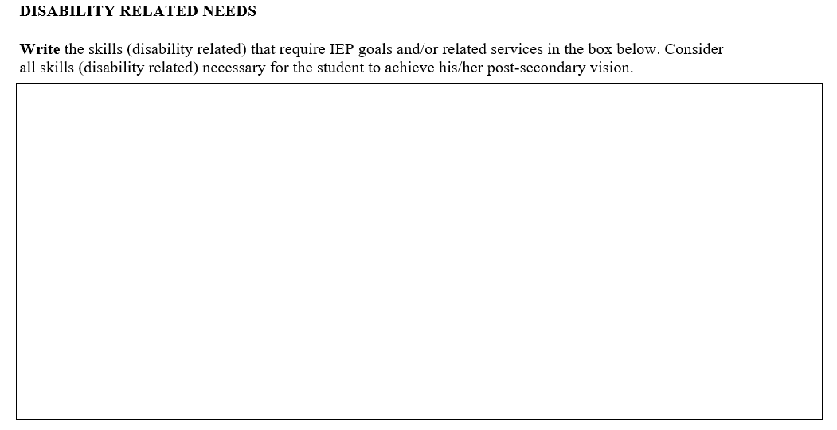
Bottom of Page One
Annual IEP Goals do not go here, because they aren’t written yet.
Examples:
Reading skills
Functional math skills
Skills in using augmentative communication technology
Travel skills/Orientation and mobility
Communication (making choices, associating cause-effect, language pragmatics)
Career skills (career exploration skills, skills related to specific job experiences, e.g., internships)
Activities of daily living (self-care, menu planning, personal safety, money management, healthcare management, self-advocacy)

Slide 35
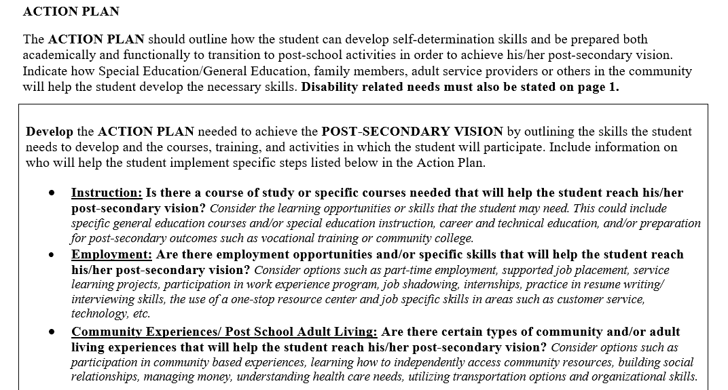
Page Two
What will the student, teacher, counselor, parent, coach, adult service provider, employer, etc. do?

Slide 36

Think about Page 2
like this:
Instruction
What? | How? | Who?
Help student develop necessary skills: self determination functional academic | Opportunities/Experiences: | Student Educators Family Adult service providers Community Members Etc.
Employment
What? | How? | Who?
Help student develop necessary skills: self determination functional academic | Opportunities/Experiences: | Student Educators Family Adult service providers Community Members Etc.
Community Experiences/Post School Adult Living
What? | How? | Who?
Help student develop necessary skills: self determination functional academic | Opportunities/Experiences: | Student Educators Family Adult service providers Community Members Etc.
Notes:
.

Slide 37
In What Order?
The Team discusses and completes the TPF before completing the IEP form.
The student’s vision statement/postsecondary goals from the TPF is transferred directly to the Vision statement on the IEP. (The rest of the Team may add their thoughts to the Vision statement when it is on the IEP, if desired.)
The student’s disability-related needs from the TPF are used to inform annual goal development on the IEP. An annual IEP goal should focus on building skills that will make the biggest difference to the student during that school year. Each year’s annual goals build skills, year over year, that will promote the realization of the student’s vision/postsecondary goals.
Elements from the Action Plan may be included in the IEP, if the school district is responsible for them.

Slide 38


Individualized Education Program (IEP)
A roadmap for the student to achieve their vision through specially designed instruction, related services.
A legal document spelling out what the district will do.

Slide 39
Using the Vision and Disability-Related Needs to develop Annual IEP Goals
The Team considers the student's vision/postsecondary goals and asks:
What skills, strengths, interests, personal attributes, and accomplishments does the student currently have that will contribute to their postsecondary success? (How do you know? Transition Assessment! – Stay tuned.)
Given the student’s disability-related needs, what skills will the student need to acquire in order to achieve their desired postsecondary outcomes?
The Team then writes measurable annual goals and documents services that will support the student to gain the needed skills.

Slide 40
Possible Goal Focus areas
Reading comprehension skills
Communication skills
Time management skills
Self-advocacy skills
Self-regulation skills
Organization skills
Independent travel skills
Money management skills
Interpersonal and social skills
College and career exploration skills
Mathematics skills
Fine Motor skills
Healthcare skills
Writing skills
Etc.
Reminder:
Goals are written to reflect what the student will do, not what service is provided.
Reminder:
The Goal Focus targets priority skill-building needs that clearly align with the student’s vision statement.
Reminder:
“Transition” is too broad a term to be used as a Goal Focus.

Slide 41

Please take time to reflect for five minutes.
How do your students participate in their own IEP meetings?
Do you and your colleagues understand the distinction between the TPF and IEP? Do you use them together effectively?
What can improve? How?
What is different during the pandemic? What will change when the pandemic ends?

Slide 42

Transition Assessment

Slide 43
What Are Transition Assessments?
An ongoing process of collecting data on the individual's needs, strengths, preferences, and interests as they relate to the demands of current and future working, educational, living, and personal and social environments.
Formal and informal assessment data serve as the common thread in the transition process and form the basis for defining goals and services to be included in the IEP.
-- Adapted from Sitlington, Neubert, & LeConte, 1997; p. 70-71

Slide 44


What do transition assessments help us to do?
Discern the student’s vision
Understand the student’s needs, strengths, preferences, and interests
Measure the student’s current performance and progress towards the development of skills

Slide 45

A Transition frame of mind
Any assessment that is conducted when a student with an IEP is aged 14-22 can be viewed as a transition assessment, because it affords information which can be utilized to discern the student’s vision; understand the student’s needs, strengths, preferences, and interests; and measure progress towards the acquisition of skills.

Slide 46

An individualized, question-driven process
The number and type of assessments
which are appropriate to conduct for
each student is determined
by the number and type of questions about the student
for which answers are needed.

Slide 47
Transition Assessment Requirement -
The Four Secondary Transition Domains:
Postsecondary Education/Training
(Competitive) Employment
Independent Living
Community Participation
What information do we already have about this unique student in each transition domain?
What do we need to find out about this unique student in each transition domain?
Conduct Transition Assessment, to obtain needed information in any or all of the domains, as appropriate for each unique student. Not every student needs assessment in every domain, because the IEP Team may already have all of the information it needs.
What are the student’s needs and strengths in each domain?
What does the student want to be or do in adult life, in each domain?
What is the fit between the student right now and the adult life they want for themselves, in each domain?
What skills (if any) does the student need to build in each domain, in order to move closer to the desired future?

Slide 48
Assessment Data Can Be Collected:
Across multiple settings
  School
  (both academic and
  “life of the school”)
  Home
  Community
  Workplace
From a variety of people who know the student well, e.g.,
  The student
  Family
  Teachers
  School counselors
  Related service providers
  Friends
  Employers
  Coaches
  Agency personnel/Pre-ETS providers
An Ongoing Process Over Time

Slide 49
Where can transition assessment be documented on the IEP?
Student Strengths and Key Evaluation Results Summary
PLEP: “How does the disability(ies) affect progress in the curriculum area(s)?” Or “…in the indicated area(s) of other educational needs?”
Current Performance Level (each goal focus): “What can the student currently do?”

Slide 50
In the Key Evaluation section, consider documenting by transition domain:
Postsecondary Education/Training
  Interest assessments
  Curriculum-based assessments
  Executive function assessments
  Assistive technology assessments
  Reading assessments
Competitive Employment
  MA Work-Based Learning Plan
  Occupational Therapy assessment
  Social Skills Assessment
  Situational assessment
Independent Living
  Self-determination assessment
  Adaptive skills assessment
  Speech assessment
  Parent interview
  Healthcare skills assessment
Community Participation
  Travel assessment
  Orientation and Mobility assessment
  Financial skills assessment

Slide 51
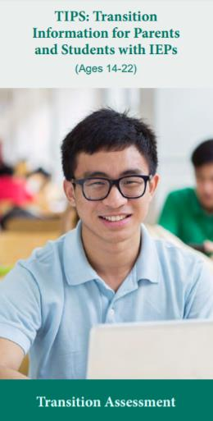
Resources on transition assessment
Technical Assistance Advisory SPED 2014-4: Transition Assessment in the Secondary Transition Planning Process, www.doe.mass.edu/sped/advisories/2014-4ta.html
Transition Coalition assessment reviews: https://transitioncoalition.org/tc-assessment-reviews/
NTACT Age-Appropriate Transition Assessment Toolkit: https://www.transitionta.org/system/files/toolkitassessment/AgeAppropriateTransitionAssessmentToolkit2016_COMPLETE_11_21_16.pdf?file=1&type=node&id=1112
https://fcsn.org/linkcenter/transition-resources/brochures/

Slide 52

Please take time to reflect for five minutes.
Do you and your colleagues have a shared planning and implementation protocol for ongoing transition assessment, ensuring that it is an individualized, question-driven process tied to the four domains, and that it is used to inform the development and provision of individualized goals and transition services?
What can improve? How?
What is different during the pandemic? What will change when the pandemic ends?

Slide 53

Resources
Resources

Slide 54
Please study these DESE resources for educators:
Technical Assistance Advisory SPED 2009-1: Transition Planning to Begin at Age 14
Administrative Advisory SPED 2011-1: Age of Majority
Technical Assistance Advisory SPED 2013-1: Postsecondary Goals and Annual IEP Goals in the Transition Planning Process
Technical Assistance Advisory SPED 2014-4: Transition Assessment in the Secondary Transition Planning Process
Technical Assistance Advisory SPED 2016-2: Promoting Student Self-Determination to Improve Student Outcomes
Technical Assistance Advisory SPED 2017-1: Characteristics of High-Quality Secondary Transition Services
Administrative Advisory SPED 2018-2: Secondary Transition Services and Graduation with a High School Diploma
Technical Assistance Advisory SPED 2018-4: Guidance on Massachusetts Commission for the Blind Pre-Employment Transitions Services
Technical Assistance Advisory SPED 2020-1: Massachusetts Rehabilitation Commission Pre-Employment Transition Services (Pre-ETS)
Notes:
.

Slide 55
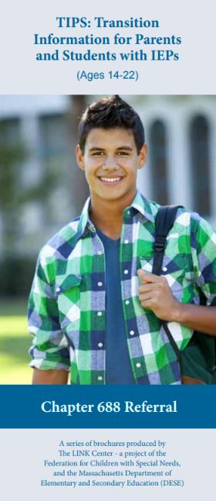
Family resources
Eleven parent/student brochures in 6 languages, https://fcsn.org/linkcenter/transition-resources/brochures/
  The Secondary Transition Planning Process
  Transition Assessment
  Self-Determination
  Transition Services
  Decision-Making and the Age of Majority
  Disability Disclosure
  Transition Planning Form
  Graduation and Students with IEPs
  Autism Spectrum Disorder
  Pre-Employment Transition Services (Pre-ETS) through MRC
  Chapter 688 Referral

Slide 56

More Resources
More Resources

Slide 57
Components of Self-Determination
Internal Locus of Control: the belief that I – and not some external factor(s) – have control over outcomes that are important to my life
Self-Efficacy: the conviction that I can successfully execute whatever behavior is required to produce a given outcome
Choice- and Decision-Making: acquiring needed information and choosing among two or more known options
Problem-Solving: overcoming challenges to achieve a solution when the solution is not initially obvious
Goal-Setting and Attainment: deciding what I want, determining how I am going to accomplish what I want, implementing and adjusting my strategy, and then measuring success
Self-Regulation: observing, evaluating, and rewarding myself; monitoring my own actions and others’ response to my actions
Self-Advocacy: being able to speak and act effectively on my own behalf, in order to obtain what I need and want; being a leader in my own life
Self-Awareness and Self-Knowledge: knowing my own strengths, weaknesses, abilities, and limitations, and knowing how to use these to beneficially influence my life

Slide 58
Dignity of Risk
A person who is self-determined is one who has been afforded the respect that accompanies personhood, including the right to try and fail.
Without the opportunity to experience both the positive and negative consequences of their decisions, young people have difficulty understanding the connection between their choices and the full range of possible outcomes.
Learning to say “no” and having the expectation that “no” will be respected is an important leadership and safety skill.

Slide 59

Mapping the TPF to the IEP

Slide 60
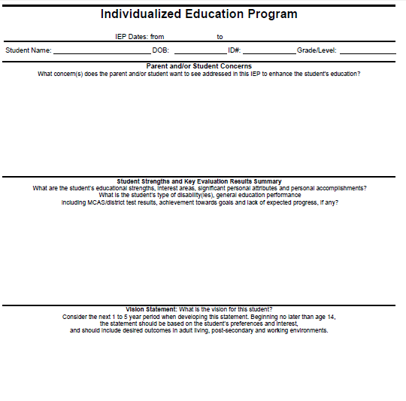
IEP 1
Student Concerns can go here, as well as Parent Concerns
Age-Appropriate Transition Assessments
Postsecondary goals (cut-and-pasted from the TPF Vision Statement)

Slide 61
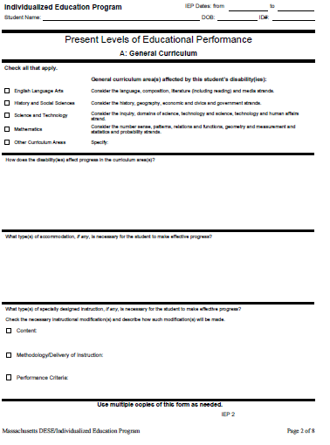
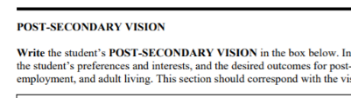
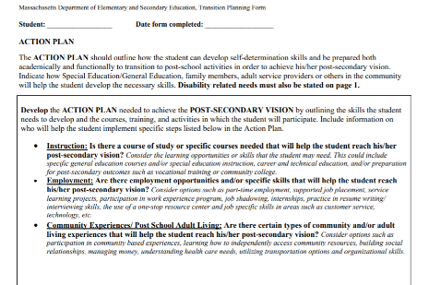
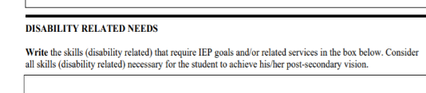
IEP 2
IEP 2:
Aligning Vision & Academic Needs
College Readiness, Career Readiness, Community Participation and Independent Living, if appropriate

Slide 62
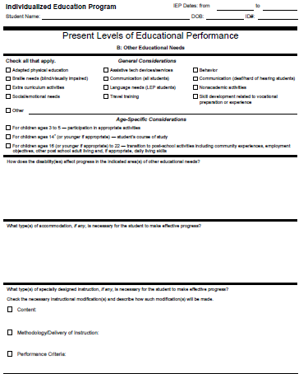
IEP 3
IEP 3:
Aligning Vision & Other Educational Needs
College Readiness, Career Readiness, Community Participation and Independent Living, if appropriate

Slide 63
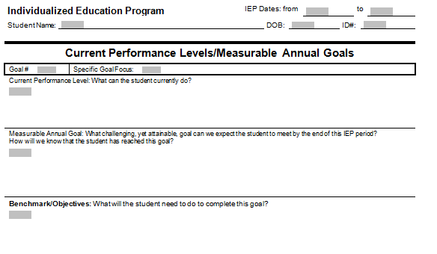
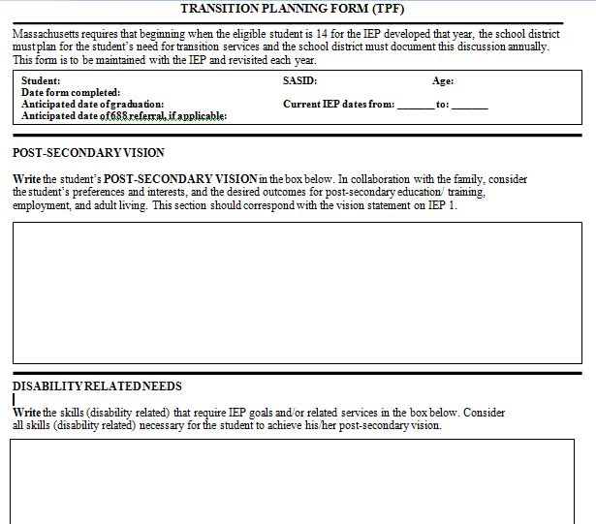
IEP 4:
Once the TPF is complete, the student’s vision and disability-related needs are used to write annual goals.

Slide 64
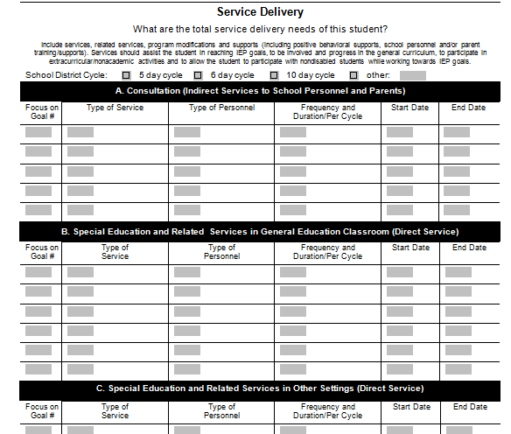
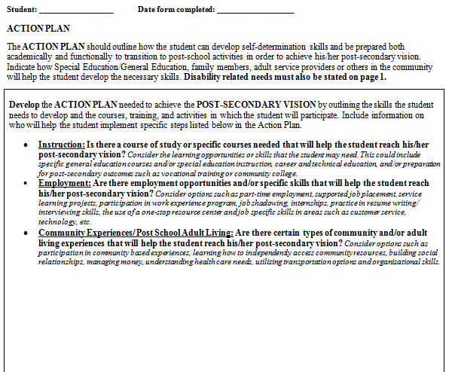
IEP 5:
Once the TPF is complete, some of the action plan can be transferred to IEP 5

Slide 65
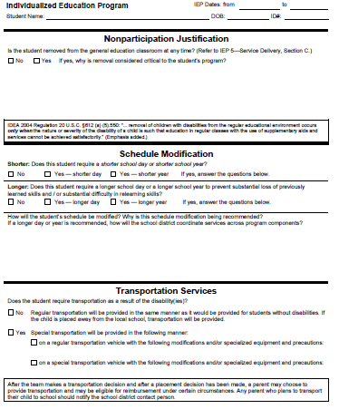
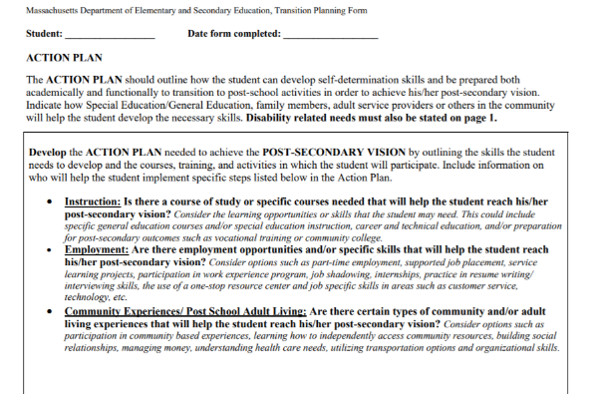
IEP 6:
Document community-based learning opportunities, if appropriate, e.g., group employment in the community or college program may require shorter or longer days.

Slide 66
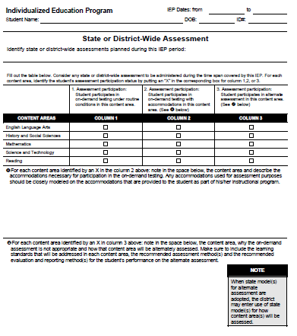
IEP 7:
Assessments

Slide 67
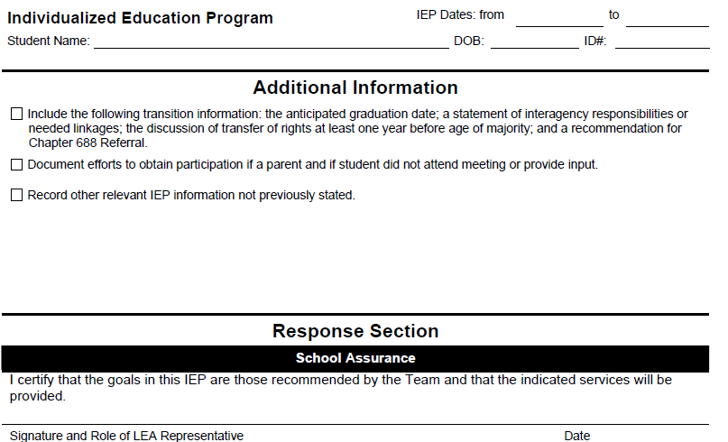
IEP 8:
Additional Transition Information
Anticipated graduation date,
statement of interagency responsibilities or needed linkages,
transfer of age of majority rights,
recommendation for 688 referral,
Any other important information

Slide 68




THANK YOU
Amanda Green, Statewide Secondary Transition Supervisor
781-338-3368
Amanda.C.Green@mass.gov
www.doe.mass.edu
Office of Special Education Planning & Policy
75 Pleasant Street, Malden, MA 02148

Slide 69

Questions?

