Slide 1
Special Education
Leaders Meeting
Friday, September 13, 2024

Slide 2
Our Educational Vision
From DESE's Educational Vision:
DESE works with districts, schools, and educators to promote teaching and learning that is antiracist, inclusive, multilingual, and multicultural; that values and affirms each and every student and their families; and that creates equitable opportunities and experiences for all students, particularly those who have been historically underserved.

Slide 3
Today’s Agenda
General Supervision Updates
Special Education Updates
New IEP Updates

Slide 4
General Supervision Updates

Slide 5
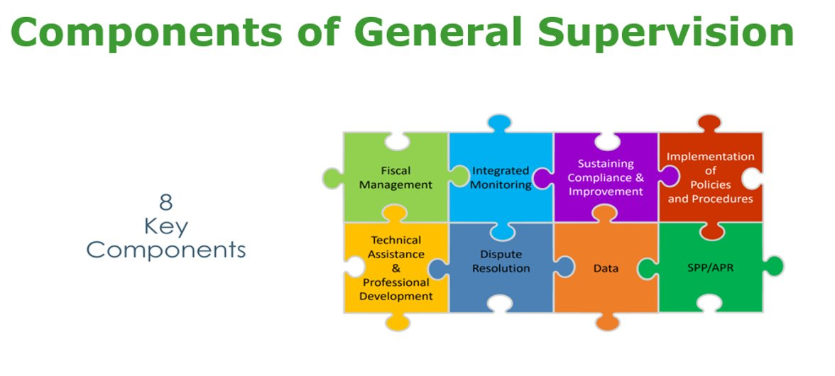
.

Slide 6
Special Education Priorities
2024-2025
OASES Monitoring Procedures
PRS General Education Procedures
Champ Software Development Across Offices
Fiscal Monitoring Procedures
LEA Determinations and Aligned Technical Assistance
Policies and Procedures
Collection, Reporting, and Use of Data
Special Education Website

Slide 7

OASES Integrated Monitoring Procedures
Today, the Department of Elementary and Secondary Education (DESE) is releasing and posting on its website updated procedures for the Office of Approved Special Education Schools (OASES) as part of its continuous efforts to improve its system of general supervision. The Department previously released (April 5, 2024) and posted on its website updated procedures for the Problem Resolution System Office (PRS) and Public School Monitoring Office (PSM).

Slide 8
Federal Grant Application: Conditions of Assistance
Under the IDEA, an LEA is eligible for fiscal assistance under Part B of the Act for a fiscal year if the agency submits a plan that provides assurances to the Department that the LEA meets each of the conditions in 34 C.F.R. § 300.201 through 34 C.F.R. § 300.213. 34 C.F.R. §300.200.
The LEA, in providing for the education of children with disabilities within its jurisdiction, must also have in effect policies, procedures, and programs that are consistent with the state policies and procedures established under 34 C.F.R. § 300.101 through 300.163, and § 300.165 through 300.174.
Every LEA must submit a new Conditions of Assistance: IDEA Part B Funding Certifications (Individual District or Regional District ) to the Department annually.
Any policies, procedures related documents need to be available for the public upon request if it is not published on a website or any public platform.

Slide 9
Special Education Updates

Slide 10
DESE Special Education Leadership
Iraida J. Alvarez, Acting Executive Director of Special Education
Jamie Camacho, Acting State Director of Special Education
Office of Approved Special Education Schools
Jannelle Roberts, Acting Director
Special Education Planning and Policy Development
Jamie Camacho, Director
Patrick Fitzgerald, Assistant Director
Theresa Senio, Assistant Director
Office of Public School Monitoring
Vani Rastogi-Kelly, Director
Amy Paulin, Assistant Director
Office of Problem Resolution System
Vacant, Director
Kelsey LoDuca-Towne, Assistant Director
Special Education in Institutional Settings
Shawn Connelly, Director

Slide 11
Information for Special Education Leaders
Regular Updates and Information
  Special Education Bulletin
  Special Education Website (Announcements)
Update Information in the Directory Administration
  Special Education Leaders Meeting Invites and Memos
Email Contacts
  specialeducation@mass.gov (General Special Education Inquiries)
  ideafiscal@mass.gov (IDEA fiscal Inquiries)

Slide 12
Important Dates: Special Education Leaders
9/2024 Indicator 7 Entry/Exit Data Submission
9/20/2024 Indicator 14 Data Collection Closes
9/30/2024 FY23 IDEA FC 240 & 262 Tydings Period Ends
9/30/2024 Districts, Regional and Vocational Schools FY24 EOY Financial Report due to Office of School Finance
9/30/2024 Submission Deadline for IDEA Application (Fund Codes 240 & 262)
10/1/2024 Child Count for Parentally Placed and Homeschooled Children
11/29/24 Charter Schools FY24 EOY Financial Report due to Charter School Office

Slide 13
Reduce or Eliminate the Use of Time-Out Rooms
Guidance on Reducing or Eliminating the Use of Time-Out Rooms in Effect
If used, must ensure they are in compliance with 603 CMR 46.02 :
  Clean
  Safe
  Sanitary
  Appropriate for the Purposes of Calming
Alternatives: Links and Resources - Special Education (mass.edu)
Sample log available: https://www.doe.mass.edu/sped/timeout-room-log.xlsx

Slide 14
Grant Opportunity Coming Soon!
Implementing Strategies to Reduce or Eliminate the Use of Time-Out Rooms
Purpose: To support schools and districts as they implement strategies, interventions, and supports to reduce or eliminate the use of time-out rooms and increase the amount of time that students spend learning alongside their peers. Strategies, interventions, and supports to promote the social emotional wellbeing of students and reduce exclusionary practices are outlined in the memorandum sent on September 10, 2021 and reposted in May of 2023.
Eligibility: Any Massachusetts public school district, public school, collaborative, approved special education program, or charter district/school that currently employs the use of one or more time-out rooms are eligible to apply.
Expected outcomes:
A significant reduction in the use of time-out rooms and an increase in the amount of time students spend learning alongside peers.
Improved student emotional and behavioral regulation (self- and/or co-regulation) and overall school climate.
Increased collaboration and communication among school staff, parents, and the community.

Slide 15
Special Education in Institutional Settings (SEIS):
LEA Responsibilities
Technical Assistance Advisory SPED 2021-3:
IEP reconvene will be held early in stay at any of the host agency facilities.
Meetings should include student, parent or legal guardian, LEA, SEIS, and host agency.
Meeting purpose is to determine how the IEP will be implemented while youth is in the host agency setting.
The process encourages continuous communication and collaboration during transitions and return to the community.
The focus of meetings and collaboration is on student success.
Placement page on IEP should be adjusted to reflect that student is in institutional setting
  IEP should have a normal placement where Student receives FAPE in LRE
  IEP should also indicate institutional placement
Consensus of Reconvene should be documented

Slide 16
Early Childhood (EC) Transition Collaborative Convenings
AnLar is hosting four statewide EC Transition Collaborative Convenings throughout the 2024-2025 school year. These convenings will feature a panel discussion highlighting strategies that LEAs and EIS providers are using to support smooth transitions from Part C early intervention to Part B early childhood special education services. They will also include opportunities for you to connect with your colleagues and partner agencies to discuss specific topics related to early childhood transition. Each meeting will feature a different topic, outlined below. We encourage you to register for each meeting and invite your catchment area partners in early childhood transition!
Register here for October 8, 2024, 2:30 - 4:30 PM: Partnerships among LEA and EIS providers
Register here for January 15, 2025, 11:00 - 12:30 PM: Streamlining the Referral Process
Register here for March 13, 2025, 2:00 - 3:30 PM: Transition Conference
Register here for May 14, 2025, 10:30 - 12:00 PM: Streamlining Data Collection

Slide 17
Updates on IDEA Data
Indicators 7 and 14

Slide 18
Early Childhood Outcomes: Indicator 7
Indicator 7 Data Measures Three Child Outcomes for children receiving early childhood special education services.
  Positive social-emotional skills (including social relationships),
  Acquisition and use of knowledge and skills (including early language/communication and early literacy), and
  Use of appropriate behaviors to meet their needs.
The data allows us to look at trends to understand children’s outcomes over time.

Slide 19
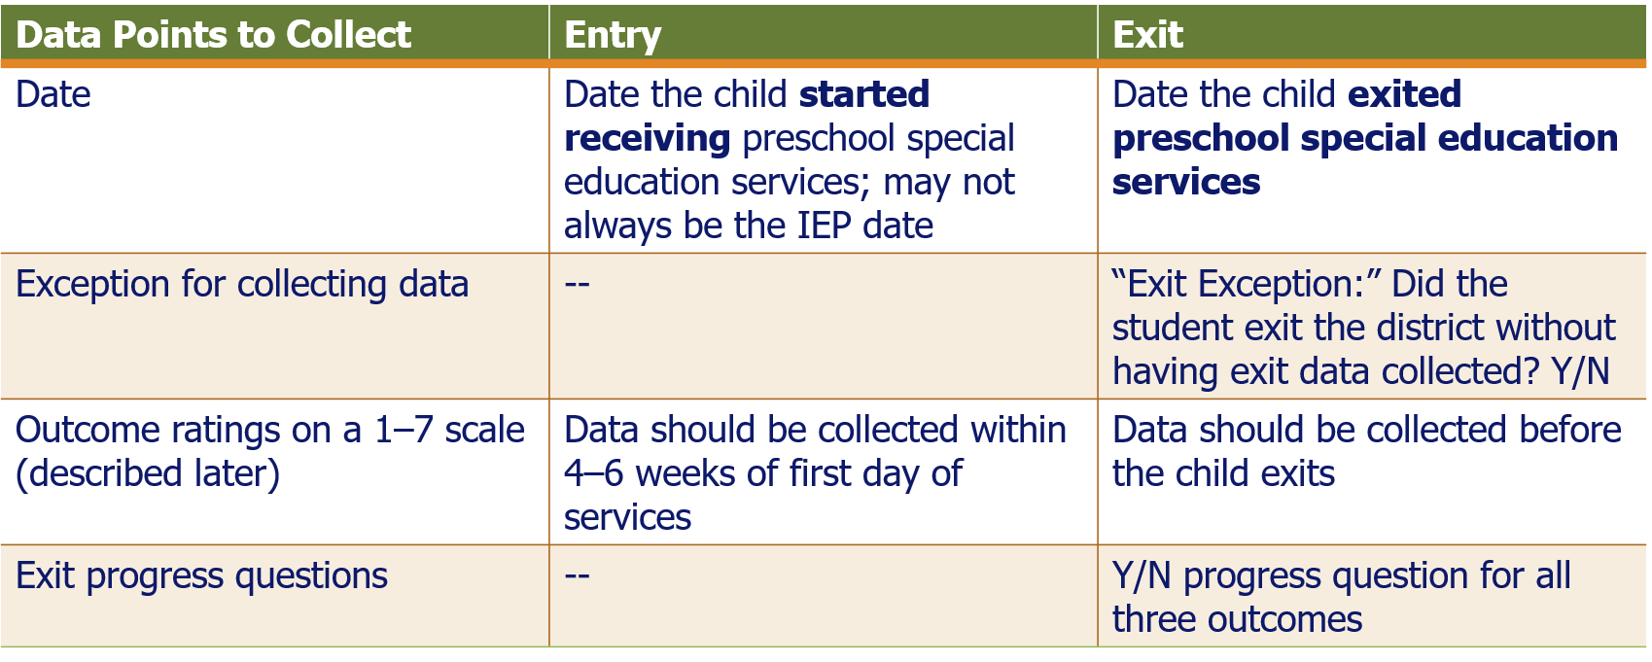
Indicator 7 Data Collection and Entry

Slide 20
Which Children Need Indicator 7 data?
All children who enter or exit early childhood special education annually.
  Entry data should be collected and/or recorded 4-6 weeks after the child begins receiving services.
Cohort system phase-out will be complete in 2024–25 school year. All children from all districts should have entry and exit data.
More information about Indicator 7 and completing the Outcomes Summary can be found here:
  District User Guide for Indicator 7 Data Submission
  School User Guide for Indicator 7 Data Submission
  Indicator 7 Data Collection Webinar Resources — Recorded Webinar and PowerPoint

Slide 21
Indicator 14: Post-School Outcomes Data Collection
The data collection period for Indicator 14: Post-School Outcomes will end on Friday, September 20, 2024.
As new school year activities ramp up, it is important that you continue to contact your exiters! Please continue your outreach to ensure the highest possible response rate.
A file with a list of exiters from the 2022-2023 school year can be found in the Indicator 14 folder in Dropbox Central. To ensure the highest possible response rate, please make at least three attempts to contact your former students.

Slide 22
The Indicator 14: Post-School Outcomes Survey
  To increase the likelihood of response, we suggest that you vary the means of contact and the time of day of your outreach. Some suggested methods of contact include:
  Email
  Telephone
  In Person
The resources and tools section of our Indicator 14 web page includes a step by step instruction document.
If you have questions about the online survey, e.g., how to access it or whether your district’s exiters have completed the survey yet, please contact PIAR representative Patrick Cerio at piarmass14@potsdam.edu, 888-419-2697, or 315-267-2718.
For all other Indicator 14 questions, please contact Kristin Castner at kristin.castner@mass.gov.

Slide 23
IDEA Fiscal Updates
FY 2025 IDEA Grant Applications (Fund Codes 240 and 262)
Resolution Funds and Equitable Services

Slide 24
FY25 IDEA Application (FC 240 & 262)
Available NOW in GEM$!
Due September 30, 2024
FY25 allocation trends
  Private school child counts
No obligation of FY25 funds before a "substantially approvable" application is received
Object & Function Codes in Budget
GEPA Statement
  Barrier(s), Plan, Timeline & Milestones

Slide 25
Resolution Funds & Equitable Services
If you are unable to expend any remaining FY24 Resolution and/or FY23 Proportionate Share funds, provide the following to IDEAFiscal@mass.gov to receive written permission to revert for general allowable Part B expenses:
  Proportionate Share Questionnaire. Available in FY25 IDEA Application.
  Copies of all written affirmations and other evidence of meaningful consultation and participation by schools and families at least three times a year including a narrative description of all efforts to engage and results
  Detailed explanation and all supporting documentation supporting the rationale claimed in the Questionnaire for not expending the funds.
  General ledger evidence of the accounting of your district's unexpended funds.
  Copy of the district's child find procedures for parentally placed private school and home school students in the district.

Slide 26
General Supervision – Fiscal Management and Compliance
Fiscal Self Assessment
  Fiscal and accounting systems and controls
  Fiscal and accounting policies and procedures
  Fiscal resources and personnel
Integrated Fiscal Monitoring & Auditing
  Risk assessment determines level and frequency
Targeted Fiscal Monitoring & Auditing
  Identified and potential noncompliance
More information to come

Slide 27
Updates for NI and NA Districts
Technical Assistance and Support
Fall 2024 Convenings

Slide 28

LEAs with NI & NA Determination
TA and Support
SPED Strategies will continue to provide Special Education Determination improvement planning and support this year.
LEA Determination Status Timeline
  Webinar Recording will be posted soon!
  One-pagers are available now
  Needs Assistance (NA) Needs Intervention (NI)
New Special Education Administrator? Or New to Your LEA?
  Check your LEA’s Determination and access information and resources
  Visit School and District Profiles to check that your name and current email address are listed in your district’s directory and if not, contact your LEA’s Directory Administrator.

Slide 29
Save the Convening Dates and
Register ASAP!
Needs Intervention Districts | Needs Assistance Districts
East: Oct 8-9th and Jan 15th Central: Oct 15-16th and Jan 22nd North: Oct 22-23rd and Jan 29th | East: Oct 10th and Jan 16th Central: Oct 17th and Jan 23rd North: Oct 24th and Jan 30th
If you haven’t received an email with registration information, please contact specialeducation@doe.mass.edu.

Slide 30
Special Education Leaders Meetings
2024-2025
  September 13, 2024 11:00-12:00
  October 18, 2024 11:00-12:00
  November 15, 2024 11:00-12:00
  December 13, 2024 11:00-12:00
  January 17, 2025 11:00-12:00
  February 14, 2025 11:00-12:00
  March 14, 2025 11:00-12:00
  April 18, 2025 11:00-12:00
  May 16, 2025 11:00-12:00
  June 13, 2025 11:00-12:00

Slide 31
New IEP Updates

Slide 32

IEP Improvement Process Timeline
Winter 2023
Spring 2023
SY 23-24
Fall 2023
Fall 2024
Finalize Forms and Tech Specs
Initial Training for Schools and Districts
Continued Training and Technical Assistance
Initial Adoption (at discretion of schools and districts)
Full Adoption Statewide
NEW!
Thanksgiving

Slide 33
Updated IEP Forms
Extended Evaluation Form — Revised 2/7/2024
Individualized Education Program (IEP) Amendment — Revised 2/7/2024
Level of Need: aged 3 through 21 — Revised 2/7/2024
Notice of Proposed School District Action — Revised 2/7/2024
Notice of School District Refusal to Act — Revised 2/7/2024
Placement Consent Form: aged 3 to 5 — Revised 2/7/2024
Placement Consent Form: aged 5 (enrolled in kindergarten) and aged 6 through 21 — Revised 2/7/2024
Special Education Eligibility—Initial and Reevaluation Determination — Revised 2/7/2024
Administrative Data Sheet — Revised 6/14/2023
Individualized Education Program (IEP) Form — Revised 1/23/2024
IEP Meeting Invitation — Revised 5/15/2023
Attendance Sheet—Special Education Team Meeting — Revised 2/7/2024
Educational Environment and Placement: aged 3 to 5 — Revised 2/7/2024
Educational Environment and Placement: aged 5 (enrolled in kindergarten) and aged 6 through 21 — Revised 2/7/2024
Evaluation Consent Form—Attachment to Notice of Proposed School District Action — Revised 2/7/2024

Slide 34
Implementing the New IEP
Technology
  Including IEP Platforms
  Access to the full IEP for parents
Plan for getting started (Example: Starting with Initials and Reevaluations)
Preparation for IEP Team meetings
Ongoing Professional Development

Slide 35
IEP Improvement Implementation Assistance Grant
FY2024 Grants (fund code 274) must be expended by September 30, 2024
New Grant opportunity is coming soon!

Slide 36
Q&A

