Slide 1
Special Education
Leaders Meeting
Friday, November 15, 2024

Slide 2
Our Commonwealth’s Educational Vision for All Students
What does this look like in a classroom?
What do we envision?
All students in Massachusetts, particularly students from historically underserved groups and communities, will have equitable opportunities to excel in all content areas across all grades.
Culturally and linguistically sustaining classroom and school practices will support students to thrive by creating affirming environments where students:
  have a sense of belonging,
  engage in deeper learning,
  and are held to high expectations with targeted support.
Learning experiences
Individualized supports
Enable students to excel at grade level or beyond
Are relevant, real-world and interactive
Are known and valued
All students
Learn more: https://www.doe.mass.edu/commissioner/vision/default.html
Notes:
This is our what

Slide 3
Today’s Agenda
General Supervision Updates
Special Education Updates
New IEP Updates

Slide 4
General Supervision

Slide 5
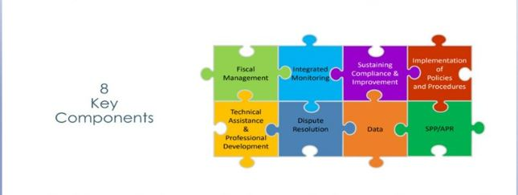
Components of General Supervision

Slide 6
Special Education Priorities
2024-2025
OASES Monitoring Procedures
PRS General Education Procedures
Champ Software Development Across Offices
Fiscal Monitoring Procedures
LEA Determinations and Aligned Technical Assistance
Policies and Procedures
Collection, Reporting, and Use of Data
Special Education Website

Slide 7
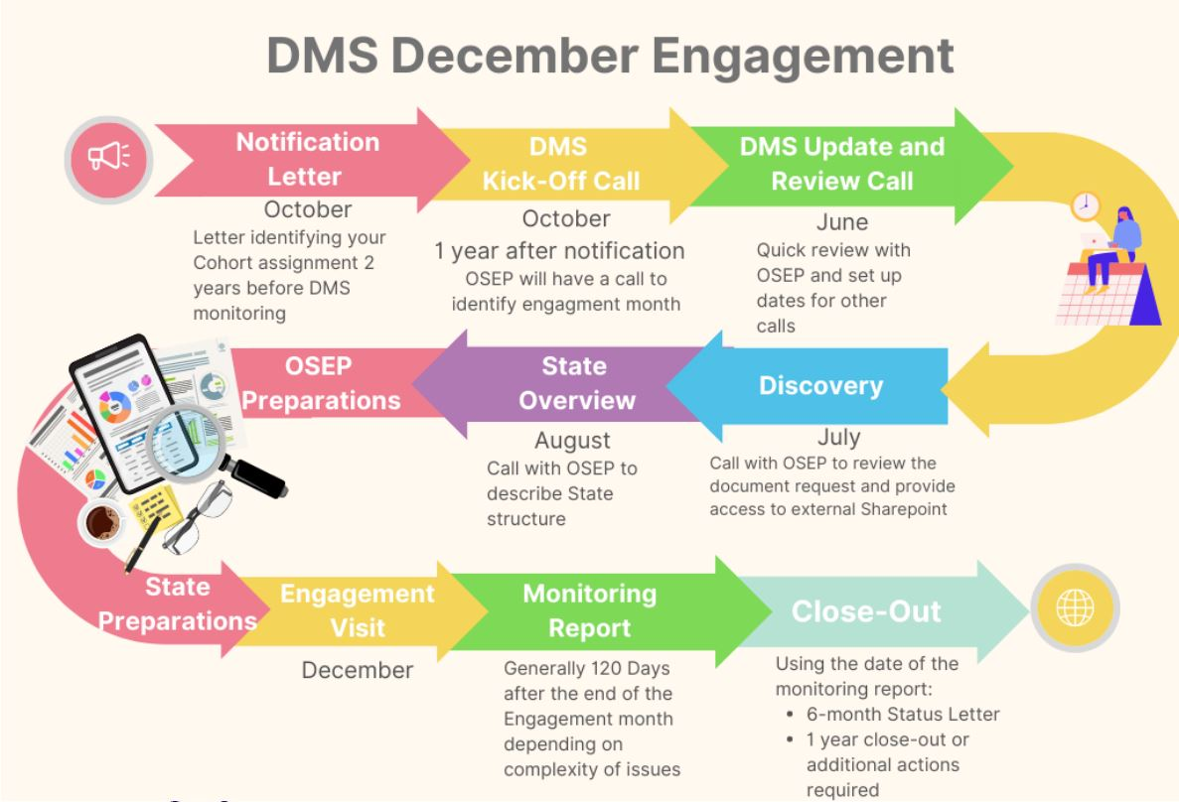
OSEP Differentiated Monitoring System Flowchart
Office of Special Education Programs (OSEP)
Differentiated Monitoring System
December 2025

Slide 8
Special Education Updates

Slide 9
DESE Special Education Leadership
Iraida J. Alvarez, Acting Executive Director of Special Education
Jamie Camacho, Acting State Director of Special Education
Office of Approved Special Education Schools
Jannelle Roberts, Director
Special Education Planning and Policy Development
Jamie Camacho, Director
Patrick Fitzgerald, Assistant Director
Theresa Senio, Assistant Director
Office of Public School Monitoring
Vani Rastogi-Kelly, Director
Amy Paulin, Assistant Director
Office of Problem Resolution System
Vacant, Director
Kelsey LoDuca-Towne, Acting Director
Special Education in Institutional Settings
Shawn Connelly, Director

Slide 10
LEA Policies and Procedures
Examples of Required LEA Policies and Procedures:
District’s child find activities
Evaluation and determination of eligibility
Development and implementation of IEPs
Parentally placed private school children with disabilities
Students with disabilities placed in or referred to private schools by the District
Procedural safeguards

Slide 11
Website Survey Due 1/1/2025
The Special Education office sent out a survey to gain feedback on how schools and families use the special education content on the DESE website.
The survey will be anonymous and take approximately 7-10minutes
The survey will be linked in the Special Education Bulletin and future Special Education Webinar slides
Districts should have received the survey link directly from DESE with communication for families (and the survey will offer translations for families as well)
Your feedback will help us identify what’s working well and where improvements can be made to better meet the needs of the special education community.

Slide 12
Updates on IDEA Data
Significant Disproportionality
LEA Determinations

Slide 13
Significant Disproportionality SY24/25
Data published in Edwin on Friday, November 8
  Edwin Analytics > Student Enrollment – Indicators > Special Education > SP301 Significant Disproportionality in Special Education
All Superintendents/Charter School Leaders and Special Education Directors were notified on November 8
  Provided school/district statuses on:
    Indicator 4B Significant Discrepancy in Suspensions/Expulsions
    Indicator 9 and 10 Disproportionate Representation in Identifications
    Significant Disproportionality (Identified and At Risk)
  “No Status” means that as a result of the data review you were not flagged or identified for any Special Education Equity Initiative and no action is required

Slide 14
Significant Disproportionality
Identified vs. At Risk
Identified
  Over the threshold (3.0) for 3 consecutive years in a particular category
Identified with Reasonable Progress
  Over the threshold for 3 consecutive years, but an improvement (lessening of 0.1 or more) of the data for two consecutive years
At Risk
  Over the threshold for two consecutive years
    If trend continues for an additional year, then Identified

Slide 15
Significant Disproportionality Requirements – Identified
Conduct a Root Cause Analysis for the area of identification
  Review of Policies, Practices, and Procedures (PPPs)
  Profile of students impacted by the disproportionality
Develop an Action Plan with strategies to address the disproportionality
Set aside 15% of IDEA funds for Coordinated Comprehensive Early Intervening Services for use in FY26 (SY25/26)
  Target population: students with and without disabilities in the area of identification
Participate in virtual convenings to assist with root cause analysis and understanding Significant Disproportionality

Slide 16
Significant Disproportionality Requirements – At Risk
No actions are required, however DESE strongly suggests conducting a Root Cause Analysis
  Materials that are sent to Identified schools/districts are also sent to At Risk schools/districts
Voluntary Comprehensive Early Intervening Services (CEIS) participation is an option
  Schools/districts may set aside up to 15% of IDEA funds to provide services to students with disabilities in the At Risk category

Slide 17
Annual LEA Determinations
Determinations will be issued in mid to late Spring 2025
Upcoming changes:
  Moving from Rubric to Matrix
  Separating out combined categories into their own
    For example, Indicators 11-13 were a single category on last year’s Rubric, in the new Matrix they will each be their own category
  Additional criteria using more data on a LEA’s performance on the State Performance Plan and Annual Performance Report (SPP/APR) Indicators

Slide 18
LEA Determination Categories
School and District Performance on:
  Graduation Rates for Students with Disabilities
  Drop Out Rates for Students with Disabilities
  MCAS Proficiency for Students with Disabilities
  Educational Environments (Full Inclusion) for Students with Disabilities
  Compliance Findings
  Fiscal Considerations
  District collection of Preschool and Post School Outcomes
  Timely and Accurate Reported Data
Categories that will be included in the future are noted on the Matrix but will not be included in this years Determination calculations

Slide 19
IDEA Fiscal Updates
Child Count
Excess Cost

Slide 20
Child Count – Parentally-Placed Private and Home School Children
MA Education Security Portal Child Count NOW OPEN for SY24-25
2024-2025 Child Count & Record Keeping Memorandum
FC 240 (ages 3-21) - as of October 1, 2024
Number of eligible parentally placed private school students attending school in the district who reside in the district.
Number of eligible parentally placed private school students attending school in the district who reside outside the district.
Number of eligible students who reside in the district and homeschooled under a district-approved plan.

Slide 21
Child Count – Parentally-Placed Private Preschool Students
FC 262 (ages 3 – 5, not entered Kindergarten) as of October 1, 2024
Number of eligible both resident and nonresident students parentally placed in a private elementary preschool in the district
“Elementary school” is defined in 34 C.F.R. § 300.13 as a nonprofit institutional day or residential school, including a public elementary charter school that provides elementary education, as determined under State law.
In Massachusetts, an elementary school is a school that provides instruction for grades one through five, six, seven, or eight.
FC 262 Child Count is included in FC 240 Child Count

Slide 22
Record Keeping: Parentally-Placed Private and Home School Students
Number of parentally placed private and home school students ages 3-21 evaluated by the district in SY 23-24
Of those students evaluated, the number of parentally placed private and home school students ages 3-21 found eligible for services by the district in SY 23-24
Total number of eligible parentally placed private and home school students ages 3-21 who received equitable services from your district in SY 23-24

Slide 23
Excess Cost 34 CFR 330.16 & 300.202
Appendix A to Part 300, Title 34 - Excess Cost Calculation
DESE Excess Cost Calculation Worksheet
Charter & Virtual Schools - FY25 Due: January 31, 2025 IDEAFiscal@mass.gov
FY26 and beyond – due with EOYR

Slide 24
Technical Assistance Updates
Technical Assistance and Support for NI and NA Districts
Early Childhood Transition Collaboratives

Slide 25

LEAs with NI & NA Determination
TA and Support
SPED Strategies will continue to provide Special Education Determination improvement planning and support this year.
LEA Determination Status Timeline
  Webinar Recording posted!
  One-pagers are available now
  Needs Assistance (NA) Needs Intervention (NI)
New Special Education Administrator? Or New to Your LEA?
  Check your LEA’s Determination and access information and resources
  Visit School and District Profiles to check that your name and current email address are listed in your district’s directory and if not, contact your LEA’s Directory Administrator.

Slide 26
Save the Convening Dates and
Register ASAP!
Needs Intervention Districts | Needs Assistance Districts
East: Oct 8-9th and Jan 15th Central: Oct 15-16th and Jan 22nd North: Oct 22-23rd and Jan 29th | East: Oct 10th and Jan 16th Central: Oct 17th and Jan 23rd North: Oct 24th and Jan 30th
If you haven’t received an email with registration information, please contact specialeducation@doe.mass.edu.

Slide 27
Early Childhood (EC) Transition Collaborative Convenings
AnLar is hosting several statewide EC Transition Collaborative Convenings throughout the 2024-2025 school year. These convenings will feature a panel discussion highlighting strategies that LEAs and EIS providers are using to support smooth transitions from Part C early intervention to Part B early childhood special education services. They will also include opportunities for you to connect with your colleagues and partner agencies to discuss specific topics related to early childhood transition. Each meeting will feature a different topic, outlined below. We encourage you to register for each meeting and invite your catchment area partners in early childhood transition!
Register here for January 15, 2025, 11:00 - 12:30 PM: Streamlining the Referral Process
Register here for March 13, 2025, 2:00 - 3:30 PM: Transition Conference
Register here for May 14, 2025, 10:30 - 12:00 PM: Streamlining Data Collection

Slide 28
New IEP Updates

Slide 29

IEP Improvement Process Timeline
Winter 2023
Spring 2023
SY 23-24
Fall 2023
Fall 2024
Finalize Forms and Tech Specs
Initial Training for Schools and Districts
Continued Training and Technical Assistance
Initial Adoption (at discretion of schools and districts)
Full Adoption Statewide
Thanksgiving

Slide 30
Meeting with IEP Vendors
Several vendors have been involved with districts throughout the state.
DESE has received questions regarding the requirements for IEP platforms.
DESE met with vendors to review requirements and discuss the status of the IEP platforms on November 8, 2024.

Slide 31
Communicating with Families
Parent Letter
The New IEP will help teams to effectively address the needs of students eligible for special education services
Benefits include:
  Enhanced Collaboration
  Clarity and Consistency
  Comprehensive Documentation of the Program
District Contact Information
Resources on the New IEP

Slide 32
Information for Special Education Leaders
Regular Updates and Information
  Special Education Bulletin
  Special Education Website (Announcements)
Update Information in the Directory Administration
  Special Education Leaders Meeting Invites and Memos
Email Contacts
  specialeducation@mass.gov (General Special Education Inquiries)
  ideafiscal@mass.gov (IDEA fiscal Inquiries)
  IDEAData@mass.gov (IDEA Data Inquiries- Special Education or SPP/APR Data)

Slide 33
Special Education Leaders Meetings
2024-2025
  December 13, 2024 11:00-12:00
  January 17, 2025 11:00-12:00
  February 14, 2025 11:00-12:00
  March 14, 2025 11:00-12:00
  April 18, 2025 11:00-12:00
  May 16, 2025 11:00-12:00
  June 13, 2025 11:00-12:00

Slide 34
Q&A

