Slide 1
Special Education
Leaders Meeting
Friday, December 13, 2024

Slide 2
Our Commonwealth’s Educational Vision for All Students
What does this look like in a classroom?
What do we envision?
All students in Massachusetts, particularly students from historically underserved groups and communities, will have equitable opportunities to excel in all content areas across all grades.
Culturally and linguistically sustaining classroom and school practices will support students to thrive by creating affirming environments where students:
  have a sense of belonging,
  engage in deeper learning,
  and are held to high expectations with targeted support.
Learning experiences
Individualized supports
Enable students to excel at grade level or beyond
Are relevant, real-world and interactive
Are known and valued
All students
Learn more: https://www.doe.mass.edu/commissioner/vision/default.html

Slide 3
Today’s Agenda
General Supervision Updates
Special Education Updates
New IEP Updates

Slide 4
General Supervision

Slide 5
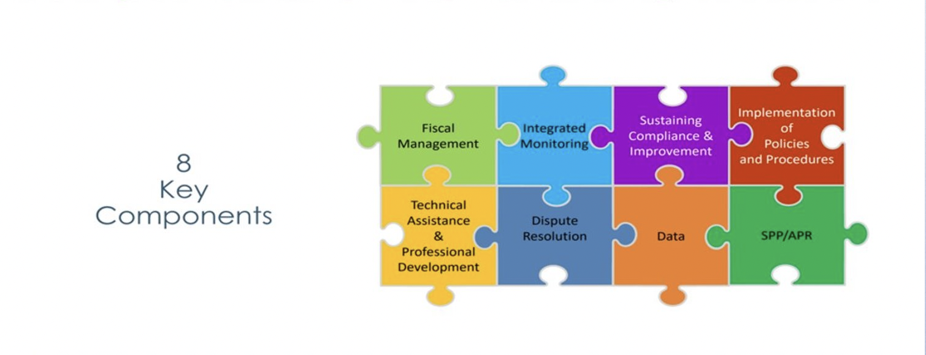
Components of General Supervision

Slide 6
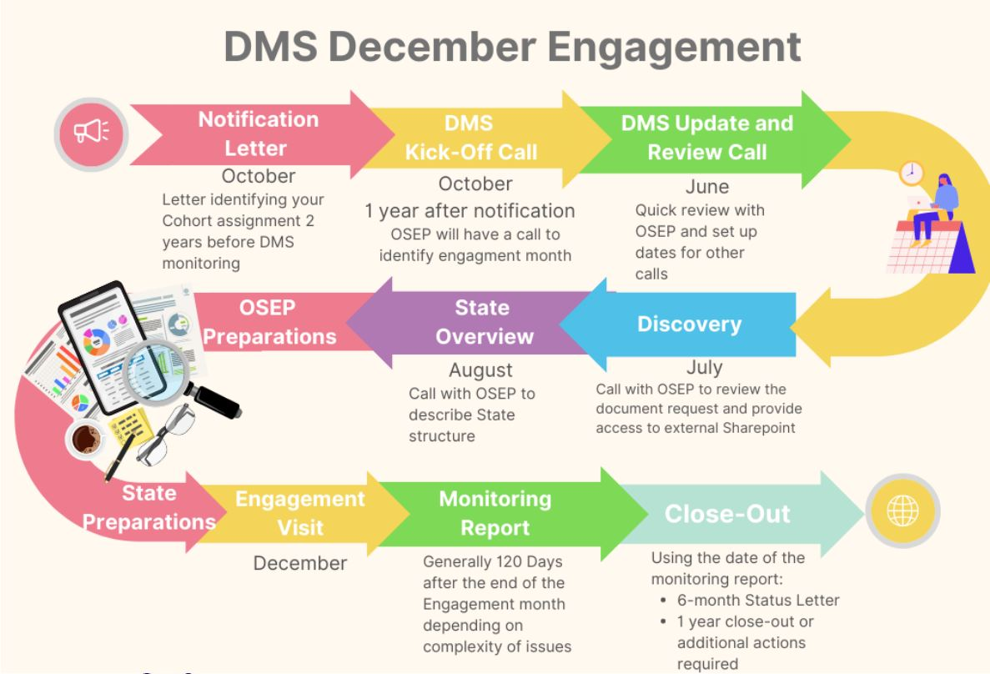
Office of Special Education Programs (OSEP)
Differentiated Monitoring System
December 2025

Slide 7
Special Education Priorities
2024-2025
OASES Monitoring Procedures
PRS General Education Procedures
Champ Software Development Across Offices
Fiscal Monitoring Procedures
LEA Determinations and Aligned Technical Assistance
Policies and Procedures
Collection, Reporting, and Use of Data
Special Education Website

Slide 8
Special Education Updates

Slide 9
DESE Special Education Leadership
Iraida J. Alvarez, Acting Executive Director of Special Education
Jamie Camacho, Acting State Director of Special Education
Office of Approved Special Education Schools
Jannelle Roberts, Director
Special Education Planning and Policy Development
Jamie Camacho, Director
Patrick Fitzgerald, Assistant Director
Theresa Senio, Assistant Director
Office of Public School Monitoring
Vani Rastogi-Kelly, Director
Amy Paulin, Assistant Director
Office of Problem Resolution System
Vacant, Director
Kelsey LoDuca-Towne, Acting Director
Special Education in Institutional Settings
Shawn Connelly, Director

Slide 10
State Agency Collaboration
Department of Developmental Services

Slide 11

DDS, DESE and the T22 Process
December 13, 2024

Slide 12
Why does the 688 Process matter?
  LEA Submits 688 Referral
    17.5 years old is the ideal
    To initiate DDS adult eligibility determination process
  Entitles a young adult to an Individual Transition Plan and specific Turning 22 funding.
  Planning for Life-long Adult Services
    Day Programming
    Supportive Technology
    Housing
  DDS eligible students with Autism who are on a 504 plan are eligible for Turning 22 funding.

Slide 13
DDS continues to see an increase with those turning 22 (1,475 in FY25)

Slide 14
DDS continues to benefit from the turning 22 budgetary support from the Governor and Legislature

Slide 15
Internal/External Meetings
  DDS Central Office meets on a regular basis with the transition and autism service coordinators to discuss Turning 22 issues and identify alternative support models.
  DDS works collaboratively with DESE and the other EOHHS agencies to address the unique needs of the individuals as they enter the DDS adult services.

Slide 16
Contact

Slide 17
DESE Updates
Web Survey
MCAS ALT
IDEA Fiscal
IDEA Data
Technical Assistance

Slide 18
Website Survey Due 1/1/2025
The Special Education office sent out a survey to gain feedback on how schools and families use the special education content on the DESE website.
The survey will be anonymous and take approximately 7-10minutes
The survey will be linked in the Special Education Bulletin and future Special Education Webinar slides
Districts should have received the survey link directly from DESE with communication for families (and the survey will offer translations for families as well)
Your feedback will help us identify what’s working well and where improvements can be made to better meet the needs of the special education community.

Slide 19
MCAS-Alt Updates
New DESE Coordinator for the MCAS-Alt
We are pleased to announce that Asaad Fulton is now serving as the Coordinator for the MCAS-Alt, and administrators can contact Asaad at Asaad.Fulton@mass.gov with MCAS-Alt questions and concerns.
Recordings of the MCAS-Alt Trainings Now Available
For additional assistance and support, recordings of the fall MCAS-Alt trainings are available on DESE's MCAS-Alt web page.
MCAS-Alt Review Sessions: January 2025
Review sessions for the MCAS-Alt will be offered in person and virtually in January. Online registration opens December 2.
MCAS-Alt Materials Ordering Registration: January 2–17, 2025
MCAS-Alt submission materials can be ordered from January 2 to January 17, 2025. Ordering these materials is separate from the student registration process for MCAS testing. Log in to the MCAS Service Center and select MCAS Alternate Assessment.
One-Percent Waiver Statement of Assurances
All districts that assessed more than 1.0% of their students with an MCAS-Alt in in 2024 will receive a Statement of Assurances to be completed by the end of January 2025.
Districts should use resources at the MCAS-Alt Eligibility/ESSA web page for assistance completing the Statement of Assurances.

Slide 20
IDEA: Grants Expired September 30, 2024
FY23 FC 240 – ages 3-21
FY23 FC 262 – ages 3-5, not entered Kindergarten
FY24 FC 213 – Strategies to Reduce or Eliminate Use of Time-Out Rooms
FY24 FC 274 – IEP Improvement Project
Final Expenditure Report (FER) due December 31, 2024
Final reimbursement claims for expenses obligated prior to September 30, 2024 may be included in the FER filed on or before December 31, 2024

Slide 21
IDEA: Grants Management
GEM$ Messages!
Grant Award Notice (GAN) available once DESE Fiscal Budget Approved in GEM$
GAN includes award end date
Final draw down is 60 days post end date
Final Expenditure Report (FER) due 90 days post end date
  FER for June 30 end dates must be filed by August 15
May include final reimbursement claim in FER

Slide 22
IDEA: Fiscal Monitoring & Auditing
FY24 Comprehensive Coordinated Early Intervening Services (CCEIS)
  Respond to request for audit documentation IDEAFiscal@mass.gov
FY24 Resolution Funds for Equitable Services
FY24 Proportionate Share for Equitable Services
  Carryover Period ends June 30, 2025
FY24 Maintenance of Effort Compliance
  FY24 End of Year Report – total state and local fund expenditures
  FY25 GEM$ Application – compliance standards based on last time MOE was met

Slide 23
Excess Cost 34 CFR 300.16 & 300.202
Appendix A to Part 300, Title 34 - Excess Cost Calculation
DESE Excess Cost Calculation Worksheet
Charter & Virtual Schools - FY25 Due: January 31, 2025 IDEAFiscal@mass.gov
Office Hour: Wednesday January 15, 2025, 3:00 – 4:00 pm

Slide 24
Child Count & Record Keeping: Parentally-Placed Private and Home School Children
MA Education Security Portal Child Count NOW OPEN for SY24-25
  DUE January 31, 2025
2024-2025 Child Count & Record Keeping Memorandum
FC 240 (ages 3-21) & FC 262 (ages 3 – 5, not entered K) - as of October 1, 2024
FC 262 Child Count is included in FC 240 Child Count
Record Keeping
evaluated by the district in SY 23-24
found eligible for services by the district in SY 23-24
received equitable services from your district in SY 23-24

Slide 25
Required Reporting for CCEIS
Starting in SY2023-24 new reporting requirements for CCEIS districts:
  Amount reserved for CCEIS during the fund use school year
  Number of children between the ages of 3 and 5 (not in kindergarten) who received CCEIS under IDEA during the fund use school year
  Number of children ages 5 (in kindergarten) and 21 who received CCEIS under IDEA during the fund use school year
  Number of children with disabilities who received CCEIS under IDEA during the fund use school year
  Number of children without disabilities who received CCEIS under IDEA in during the fund use school year
Districts should develop a tracking system and maintain the records for students who were serviced using CCEIS funds
The Department will request this information after the school year to be included in federal reporting submissions

Slide 26
Save the Convening Dates and
Register ASAP!
Needs Intervention Districts | Needs Assistance Districts
East: Jan 15th Central: Jan 22nd North: Jan 29th | East: Jan 16th Central: Jan 23rd North: Jan 30th
If you haven’t received an email with registration information, please contact specialeducation@doe.mass.edu.

Slide 27
Early Childhood (EC) Transition Collaborative Convenings
AnLar is hosting several statewide EC Transition Collaborative Convenings throughout the 2024-2025 school year. These convenings will feature a panel discussion highlighting strategies that LEAs and EIS providers are using to support smooth transitions from Part C early intervention to Part B early childhood special education services. They will also include opportunities for you to connect with your colleagues and partner agencies to discuss specific topics related to early childhood transition. Each meeting will feature a different topic, outlined below. We encourage you to register for each meeting and invite your catchment area partners in early childhood transition!
Register here for January 15, 2025, 11:00 - 12:30 PM: Streamlining the Referral Process
Register here for March 13, 2025, 2:00 - 3:30 PM: Transition Conference
Register here for May 14, 2025, 10:30 - 12:00 PM: Streamlining Data Collection

Slide 28
Section 504 Resources
U.S. Department of Education’s Office for Civil Rights (OCR) has released various fact sheets regarding schools’ obligations under Section 504 of the Rehabilitation Act of 1973
  Section 504 Protections for Students with Diabetes
  Section 504 Protections for Students with Migraines
  Section 504 Protections for Students with Narcolepsy
Additional fact sheets are available on OCR’s website

Slide 29
Students in Out-of-District Placements
Expect collaboration and coordination between school districts and out-of-district placements (e.g., approved private special education schools) to meet the needs of students.
The school district is required to monitor the provision of services to and the programs of individual students placed out-of-district.
Documentation of monitoring plans and all actual monitoring shall be placed in the files of every eligible student who has been placed out-of-district. 603 CMR 28.06(3)(b).

Slide 30
New IEP Updates

Slide 31

IEP Improvement Process Timeline
Winter 2023
Spring 2023
SY 23-24
Fall 2023
Fall 2024
Finalize Forms and Tech Specs
Initial Training for Schools and Districts
Continued Training and Technical Assistance
Initial Adoption (at discretion of schools and districts)
Full Adoption Statewide
Thanksgiving

Slide 32
Continued Support for the New IEP
FY2025 IEP Grant (Fund Code 274)
Contract Awarded for:
  Professional Development
  Technical Assistance
  Family Resources
  Additional IEP Forms

Slide 33
Polls for Special Education Leaders

Slide 34
Information for Special Education Leaders
Regular Updates and Information
  Special Education Bulletin
  Special Education Website (Announcements)
Update Information in the Directory Administration
  Special Education Leaders Meeting Invites and Memos
Email Contacts
  specialeducation@mass.gov (General Special Education Inquiries)
  IDEAfiscal@mass.gov (IDEA Fiscal Inquiries)
  IDEAdata@mass.gov (IDEA Data Inquiries- Special Education or SPP/APR Data)

Slide 35
Special Education Leaders Meetings
2024-2025
  January 17, 2025 11:00-12:00
  February 14, 2025 11:00-12:00
  March 14, 2025 11:00-12:00
  April 18, 2025 11:00-12:00
  May 16, 2025 11:00-12:00
  June 13, 2025 11:00-12:00

Slide 36
Q&A

