Slide 1
Special Education Leaders Meeting
Friday, January 17, 2025

Slide 2
Our Commonwealth’s Educational Vision for All Students
What does this look like in a classroom?
What do we envision?
All students in Massachusetts, particularly students from historically underserved groups and communities, will have equitable opportunities to excel in all content areas across all grades.
Culturally and linguistically sustaining classroom and school practices will support students to thrive by creating affirming environments where students:
have a sense of belonging,
engage in deeper learning,
and are held to high expectations with targeted support.
Learning experiences
Individualized supports
Enable students to excel at grade level or beyond
Are relevant, real-world and interactive
Are known and valued
All students
Learn more: https://www.doe.mass.edu/commissioner/vision/default.html

Slide 3
Today’s Agenda
General Supervision Updates
Special Education Updates
New IEP Updates

Slide 4
General Supervision

Slide 5
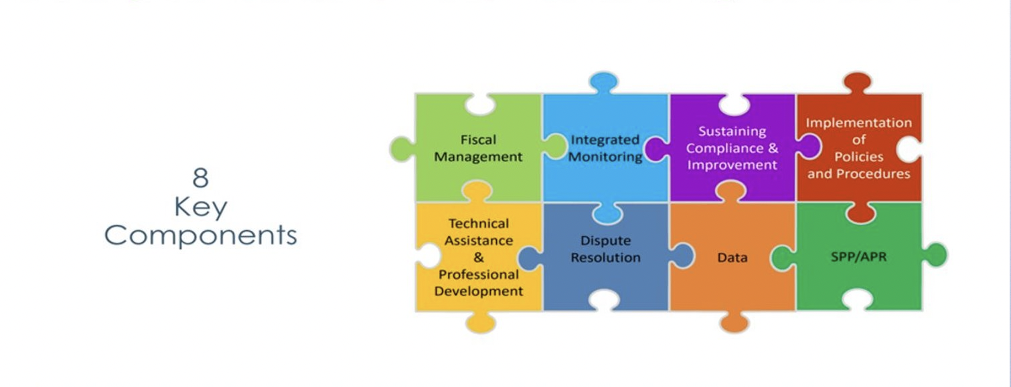
Components of General Supervision

Slide 6
Special Education Priorities 2024-2025
OASES Monitoring Procedures
PRS General Education Procedures
Champ Software Development Across Offices
Fiscal Monitoring Procedures
LEA Determinations and Aligned Technical Assistance
Policies and Procedures
Collection, Reporting, and Use of Data
Special Education Website

Slide 7
Secretary Cardona Letter on Restraints and Seclusion in Schools. January 8, 2025
Collective responsibility to ensure that all children are educated in learning environments that are safe, supportive, and responsive to their needs
More than 50,000 public school students were restrained or secluded in public schools during the 2020-2021 school year
Align practices to ensure all children are educated in learning environments that are safe, supportive, and responsive to their unique needs
Opportunities for educators to learn about and implement positive, proactive practices in schools and early childhood programs and how to effectively support and respond to students’ behavioral needs
Notes:
U.S. Secretary of Education Miguel A. Cardona policy letter on restraints and seclusion. January 8, 2025

Slide 8
Recommendations from USED
Using practices that provide a behavioral framework to support the social, emotional, physical, and mental health needs of students, including through the use of multi-tiered systems of supports with individualized, targeted, and effective interventions for high-need students
Evidence-based practices to foster climates of inclusion, safety, and belonging as an alternative to exclusionary discipline and restraint and seclusion practices
Guiding Principles for Creating Safe, Inclusive, Supportive, and Fair School Climates
Notes:
Guiding Principles for Creating Safe, Inclusive, Supportive, and Fair School Climates
guiding-principles.pdf

Slide 9
Dear Colleague Letter on Special Education Personnel Retention. (Jan. 13, 2025)
Highlights the critical importance of retaining special educators in their positions, and the crucial role principals play in retaining special education personnel
Principal Navigator for Special Educator Retention includes high leverage practices and actionable steps that can be used immediately by local administrators to improve retention of special education personnel
Created in partnership with the LEAD IDEA and CEEDAR Centers
Notes:
OSEP Dear Colleague Letter on Special Education Personnel Retention. January 13, 2025
Principal Navigator: Special Educator Retention | Lead IDEA
Home | Lead IDEA
The CEEDAR Center at the University of Florida | The CEEDAR Center

Slide 10
Fast Facts from OSEP
OSEP Fast Facts is an ongoing effort to display data from the 12 data collections authorized under IDEA Section 618
IDEA 618 data on personnel and educational environments of children with disabilities in early childhood settings
Visualizations that help make IDEA 618 data easy to interpret and share
OSEP Fast Fact: Educational Environments of Children with Disabilities Served under IDEA Part B Section 619
OSEP Fast Fact: Part B Personnel
Notes:
OSEP Fast Fact: Educational Environments of Children with Disabilities Served under IDEA Part B Section 619 explores data on children with disabilities, ages 3-5, in early childhood settings in SY 2023-24. This Fast Fact explores data on our youngest children served under IDEA Part B collected through the child count and educational environments data collections. Highlights from OSEP Fast Facts: Educational Environments of Children with Disabilities Served under IDEA Part B Section 619:
In the US, Outlying Areas, and Freely Associated States, 59.28% of children with disabilities ages 3-5 (not in kindergarten) are enrolled in a regular early childhood program. However, there is a large variation between states as low as 16.73% to as high as 97.52%.
In the US, Outlying Areas, and Freely Associated States, 38.06% of children with disabilities ages 3-5 (not in kindergarten) are in a separate setting. More Asian, Black or African American, Hispanic/Latino, and Native Hawaiian or Other Pacific islander children are in separate settings than all children.
In the US, Outlying Areas, and Freely Associated States, the percentage of children with disabilities ages 3-5 (not in kindergarten) that attend a regular early childhood program and receive the majority of services in some other location increases from age 3 (37.2%) to age 5 (49.8%).
In the US, Outlying Areas, and Freely Associated States, 6.24% of 3-5 (not in kindergarten) year olds with disabilities are identified as English Learners.
OSEP Fast Fact: Part B Personnel we present data from the IDEA Part B Personnel data collection in SY 2022-23. This Fast Fact examines data on the special education teachers, paraprofessionals, and related service providers employed or contracted to work with children with disabilities ages 3 through 21. Highlights from OSEP Fast Facts: Part B Personnel:
In the US, Outlying Areas, and Freely Associated States, there were 13.51 children with disabilities, ages 3 through 21, per paraprofessional, 15.85 per teacher, and 30.11 per related service provider.
More than 30% of the related service personnel were speech-language pathologists in the US, Outlying Areas, and Freely Associated States.
In the US, Outlying Areas, and Freely Associated States, the number of children with disabilities, ages 3 through 21, per special education teacher, paraprofessional, and related service personnel has decreased since 2015.
More than 90% of special education teachers and paraprofessionals in the US, Outlying Areas, and Freely Associated States were fully certified and fully qualified (respectively).
Visit the OSEP Fast Facts page for existing and future Fast Facts.

Slide 11
Special Education Updates

Slide 12
State Agency Collaboration
Massachusetts Commission for the Deaf and Hard of Hearing
Executive Office of Health and Human Services

Slide 13
Massachusetts Commission for the Deaf and Hard of Hearing

Slide 14
Sign Language Proficiency Interview (SLPI)
Who should take the SLPI?
New licensure/certification applicants for teacher of the deaf
Renewal of licensure/certification for teacher of the deaf
Professionals acting as teachers who are not yet licensed
Itinerant teachers of the deaf who provide services for your district/school
Anyone with a contingency or provisional plan in place ASL benchmarks for improvement they must meet (within your hiring protocols)
Classroom aides that work 1:1 as tutors or academic support for Deaf or hard-of-hearing students that sign
"Communication facilitators’" or "signing para" that work 1:1 as tutors or academic support for Deaf or hard-of–hearing students that sign

Slide 15
MCDHH can help
MCDHH Youth and Families can assist with newcomer students who may not have been properly identified as a signing-based, deaf child.
https://www.mass.gov/info-details/massachusetts-commission-for-the-deaf-and-hard-of-hearing-mcdhh
"Signing Staff" may email MCDHH with any questions about the SLPI
MCDHH is scheduling appointments for 2025
mcdhh_slpi@mass.gov

Slide 16
Why Medicaid Matters to Schools School Based Medicaid Program (SBMP)
DESE State Special Education Directors Meeting
1/17/2025

Slide 17
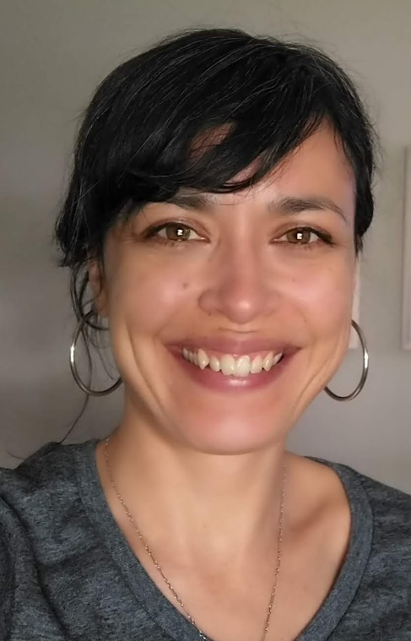
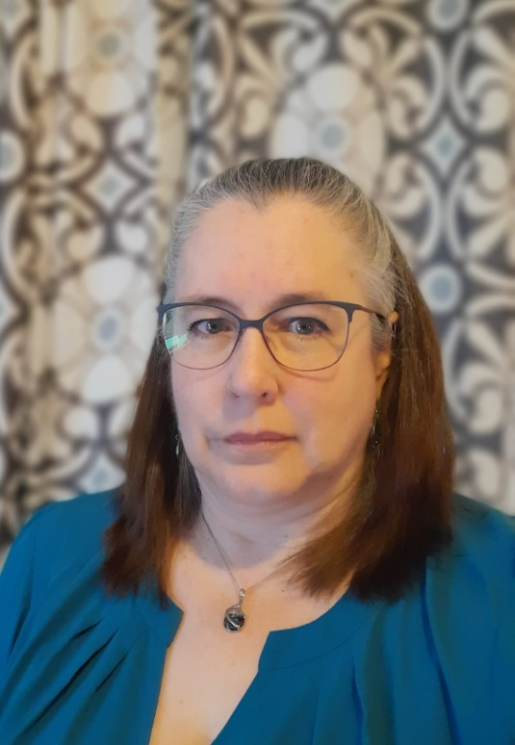
Introductions
Margot Tracy, MPH
School-Based Medicaid Program Manager
Emily Hall, MBA
Center for School Based Claiming Director
School-Based Medicaid Program | www.mass.gov/masshealth/schools

Slide 18
What is the MassHealth School Based Medicaid Program (SBMP)?
SBMP provides federal funds that help LEAs offset the costs of delivering medically necessary services to students who are enrolled in MassHealth, e.g., personnel, specialized equipment
It also reimburses for the costs of administrative activities that support Medicaid-covered services (e.g., when LEA personnel help families enroll in MassHealth and access services, coordinate care, arrange for specialized transportation)
Prior to 2019, LEAs could only claim for the costs for the related health services on an IDEA plan, i.e., those related services necessary for providing a FAPE
As of 7/1/2019 SBMP expanded so that LEAs could claim the costs related to providing covered health services to their MassHealth enrolled students regardless of IEP status

Slide 19
Why does the expansion of SBMP matter?
Because it expands reimbursement potential for the vital health (physical and behavioral) services and administrative activities schools provide to all their MassHealth enrolled students, regardless of IEP status.
And increased reimbursement means more available funding that can support health staffing, programming and infrastructure which can benefit all students, not just those with MassHealth
School-Based Medicaid Program | www.mass.gov/masshealth/schools

Slide 20
Most Common In-District IEP Services
School-Based Medicaid Program | www.mass.gov/masshealth/schools

Slide 21
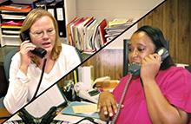
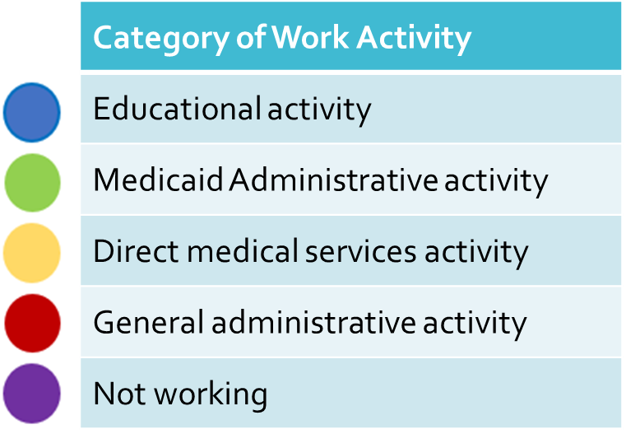
What is the Random Moment Time Study(RMTS)?
It’s how we identify time spent on Medicaid activities—this drives reimbursement
The RMTS is a series of “snap shots” of the working days of school health staff that allows MassHealth to allocate costs.
All participating staff are placed into mutually exclusive cost pools and MassHealth randomly select minutes from across the state.
We survey a small number of school staff each quarter and determine at the state level how much time school staff spend doing Medicaid reimbursable activities (direct and administrative).
Based on their responses, activities are categorized for Medicaid purposes.
School-Based Medicaid Program | www.mass.gov/masshealth/schools

Slide 22
Both! (they are clinically trained professionals operating in an educational context who provide educationally relevant health services)
Q:
Are your related service providers (i.e., SLP/PT/OT) Specialized Educators or Clinically Trained Health Professionals?
A:
They have as an important role in kids’ healthy development as their health providers in the community.
They see kids in their natural context of school, where they grow, develop, and learn.
But related service providers often respond to their RMTS moments wearing their “Specialized Educator hat,” which has an impact on LEA reimbursement.

Slide 23
How can I support my staff participation in SBMP (to increase potential reimbursement to my district)?
Reinforce their role as health AND educational
Ensure your staff are up to date on SBMP training (see resource slide)
Make sure your LEA Medicaid Coordinator (or the staff person with primary responsibility for SBMP) joins our Medicaid Coordinators PLC to receive on-going TA and peer-to-peer learning (see next slide)

Slide 24
LEA Medicaid Coordinators Professional Learning Community (PLC)
A virtual, facilitated peer-to-peer learning community for individuals responsible for
Oversight and management of Random Moment Time Study (RMTS) participation
Oversight and management of direct service interim billing processes
Submission of Administrative Activity Claim or Cost Report information, and
Other important tasks, such as ensuring staff participants have reviewed relevant trainings on the program website.
Next meeting is Wednesday, Jan 22 at 1:00 on Zoom
More information, including a schedule of upcoming meetings can be found here:
https://www.mass.gov/info-details/local-education-agency-medicaid-coordinators-professional-learning-community
To receive a registration link, send an email to with subject line LEA Medicaid Coordinator PLC: SchoolBasedClaiming@umassmed.edu

Slide 25
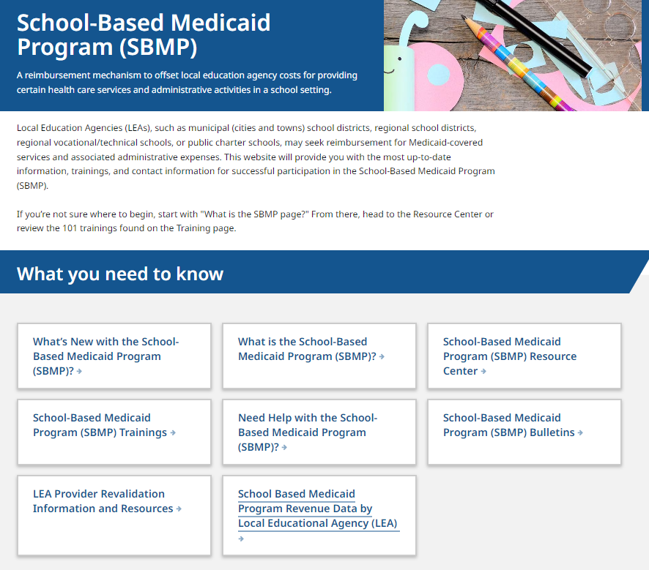
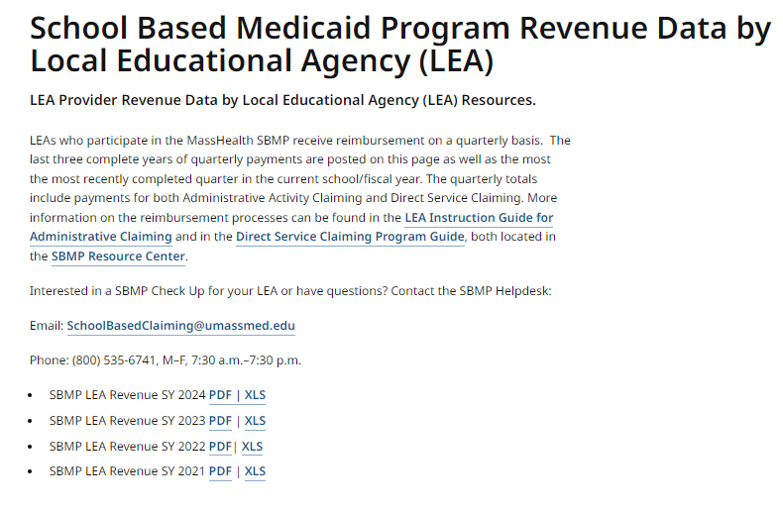
SBMP Revenue Data by LEA is publicly available…..
Check-in with your district leadership, including your superintendent and school business manager to learn more about your LEA’s SBMP operations and if/how town shares reimbursement
www.mass.gov/masshealth/schools
School-Based Medicaid Program | www.mass.gov/masshealth/schools

Slide 26
SBMP Resources
SBMP Website
All SBMP information, including program guidance, covered services & qualified providers, and announcements are posted on the program website.
SBMP Revenue Data by LEA
LEAs who participate in the MassHealth SBMP receive reimbursement on a quarterly basis. The last three complete years of quarterly payments are posted on this page as well as the most the most recently completed quarter in the current school/fiscal year. The quarterly totals include payments for both Administrative Activity Claiming and Direct Service Claiming.
Health Care Services and Supports Needs Assessment for School Districts (LEAs) in Massachusetts
For LEA School Leadership: Use this tool to take stock of your infrastructures to support health services and Medicaid reimbursement processes. You can download it in Word and adapt as needed for your district. PDF | Word
SBMP 101 Training Modules
In addition to viewing recorded trainings, you can download transcripts and copies of the presentations. Module 1 provides a general overview for all audiences. Module 2 is designed for LEA leadership. Modules 8, 9 & 10 are most relevant to school health providers.
Top 5 Things Providers Should Know
A brief resource of the most pertinent program information for your school health staff.
Random Moment Time Study Training and Resources
Required training for RMTS Coordinators
RMTS Quick Reference Guide
Training for RMTS participants
Need Help?
Email: SchoolBasedClaiming@umassmed.edu
or call (800) 535-6741, M–F, 7:30 a.m.–7:30 p.m.
School-Based Medicaid Program | www.mass.gov/masshealth/schools

Slide 27
DESE Updates
Technical Assistance
IDEA Data
IDEA Fiscal

Slide 28
Save the Convening Dates and Register ASAP!
Needs Intervention Districts | Needs Assistance Districts
Central: Jan 22nd North: Jan 29th | Central: Jan 23rd North: Jan 30th
If you haven’t received an email with registration information, please contact specialeducation@doe.mass.edu.

Slide 29
Early Childhood (EC) Transition Collaborative Convenings
AnLar is hosting several statewide EC Transition Collaborative Convenings throughout the 2024-2025 school year. These convenings will feature a panel discussion highlighting strategies that LEAs and EIS providers are using to support smooth transitions from Part C early intervention to Part B early childhood special education services. They will also include opportunities for you to connect with your colleagues and partner agencies to discuss specific topics related to early childhood transition. Each meeting will feature a different topic, outlined below. We encourage you to register for each meeting and invite your catchment area partners in early childhood transition!
Register here for March 13, 2025, 2:00 - 3:30 PM: Transition Conference
Register here for May 14, 2025, 10:30 - 12:00 PM: Streamlining Data Collection

Slide 30
Early Childhood and Part B Requirements
Requirements:
Evaluations must be completed 30 school working days after parental consent (603 CMR 28.04(2) and Part B Indicator 11)
Within 45 school working days of parental consent the team will convene to determine eligibility, and the team shall develop an IEP using data from the evaluation (603 CMR 28.05 (7) and Part B Indicator 12)
When determined eligible for special education, identified services must begin by the child’s 3rd birthday. (Part B Indicator 12)

Slide 31
Data Collection: Indicator 11 Changes
Districts in Group A for Integrated Monitoring Review
Submit all applicable records for Indicator 11: Child Find/Initial Evaluation Timelines to the Department via CHAMP
Compliance Percentage
Previously calculated using the 45 school-working day timeline (from Consent to Eligibility Determination)
Moving forward: calculated by 30 school-working day timeline (Consent to Evaluation Completed), consistent with SPP/APR Measurement Table
Districts still must ensure an Eligibility Determination is made within 45 school-working days
Additional Populations to include:
All students for whom consent to evaluate was received, regardless of age or source of referral, must be included in Indicator 11 data collection
Previously, students referred from Early Intervention (EI) were not collected under Indicator 11
This is a separate measurement from Indicator 12: Early Childhood Transition

Slide 32
Significant Disproportionality
All Identified and At-Risk districts have been sent a follow up email with documents to assist in Root Cause Analysis and Action Planning
Identified districts are required to:
Participate in webinars on February 25, March 11, and March 25 on conducting a root cause analysis
More information will be released in the coming weeks
Submit Root Cause Analysis, Policy, Practice, and Procedure Review, and Action Plan to the Department: Late April 2025
At-Risk districts are encouraged, but not required to conduct a root cause analysis and Action Plan

Slide 33
Required Reporting for CCEIS
Starting in SY2023-24 new reporting requirements for CCEIS districts:
Amount reserved for CCEIS during the fund use school year
Number of children between the ages of 3 and 5 (not in kindergarten) who received CCEIS under IDEA during the fund use school year
Number of children ages 5 (in kindergarten) and 21 who received CCEIS under IDEA during the fund use school year
Number of children with disabilities who received CCEIS under IDEA during the fund use school year
Number of children without disabilities who received CCEIS under IDEA in during the fund use school year
Districts should develop a tracking system and maintain the records for students who were serviced using CCEIS funds
The Department will request this information after the school year to be included in federal reporting submissions

Slide 34
Child Count & Record Keeping: Parentally-Placed Private and Home School Children
MA Education Security Portal Child Count NOW OPEN for SY24-25
DUE January 31, 2025
2024-2025 Child Count & Record Keeping Memorandum
FC 240 (ages 3-21) & FC 262 (ages 3 – 5, not entered K) - as of October 1, 2024
FC 262 Child Count is included in FC 240 Child Count
Record Keeping
evaluated by the district in SY 23-24
found eligible for services by the district in SY 23-24
received equitable services from your district in SY 23-24

Slide 35
Meaningful Consultation 34 CFR 300.134 34 C.F.R. §
Consultation is a mandatory process that involves discussions between the LEA, private school officials, and representatives of parents of parentally-placed private, and home school children with disabilities
Consultation must be an ongoing process, not solely an annual meeting. DESE Guidance – Fall, Winter, Spring
IDEA Part B funds for equitable services may not be paid directly to a private school. Under 34 C.F.R. § 300.144(a), a public agency must control and administer the funds used to provide special education and related services to parentally-placed private and home school children with disabilities.
IDEA Equitable Services for Students with Disabilities Enrolled by Their Parents in Private Schools - Special Education
Questions and Answers on Serving Children with Disabilities Placed by Their Parents in Private Schools (rev. Feb 2022) - Individuals with Disabilities Education Act

Slide 36
Excess Cost 34 C.F.R. 300.16 & 300.202
Appendix A to Part 300, Title 34 - Excess Cost Calculation
DESE Excess Cost Calculation Worksheet
Charter & Virtual Schools - FY25 Due: January 31, 2025 IDEAFiscal@mass.gov
Notes:
Drop the file in the chat.

Slide 37
Maintenance of Effort 34 C.F.R. 300.203
the SEA must determine that the LEA budgets, for the education of children with disabilities, at least the same amount, from at least one of the following sources, as the LEA spent for that purpose from the same source for the most recent fiscal year for which information is available:
(i) Local funds only;
(ii) The combination of State and local funds;
(iii) Local funds only on a per capita basis; or
(iv) The combination of State and local funds on a per capita basis.

Slide 38
Maintenance of Effort – FY25 Compliance
End of Year Report (EOYR)
Districts, Regional, Vocational – September 30, 2024
Charters - November 29, 2024
Virtual – January 31, 2025
Standard – FY23 Determination available in FY25 GEM$
Application
Exceptions and Adjustment Workbook

Slide 39
Maintenance of Effort: Exceptions
Notwithstanding the restriction in § 300.203(b), an LEA may reduce the level of expenditures by the LEA under Part B of the Act below the level of those expenditures for the preceding fiscal year if the reduction is attributable to any of the following:
(a) The voluntary departure, by retirement or otherwise, or departure for just cause, of special education or related services personnel.
(b) A decrease in the enrollment of children with disabilities.
(d) The termination of costly expenditures for long-term purchases, such as the acquisition of equipment or the construction of school facilities.

Slide 40
Maintenance of Effort: Exceptions (continued)
(c) The termination of the obligation of the agency, consistent with this part, to provide a program of special education to a particular child with a disability that is an exceptionally costly program, as determined by the SEA, because the child—
(1) Has left the jurisdiction of the agency;
(2) Has reached the age at which the obligation of the agency to provide FAPE to the child has terminated; or
(3) No longer needs the program of special education.

Slide 41
Maintenance of Effort: Adjustments
LEA may reduce MOE obligation if it received an increase in FC 240 funds from one year to the next by up to 50% of that year over year increase.
If LEA voluntarily uses up to 15% of FC 240 and 262 funds to provide coordinated early intervening services (CEIS), the combined total cannot exceed the lesser of the maximum dollar amounts available for either CEIS (15% of FC 240 and 262 funds) or MOE reduction (50% of the increase in FC 040).

Slide 42
Maintenance of Effort: Compliance
If DESE determines following a review of EOYR that an LEA failed to meet its MOE compliance standard (both aggregate and per pupil) and there are no acceptable exceptions and adjustments
LEA must repay either the difference between what the LEA actually spent, and what it should have spent to meet the MOE requirement, or the amount of the LEA’s Part B subgrant for that fiscal year, whichever is less
Repayment must be made using nonfederal funds (i.e., State or local funds

Slide 43
New IEP Updates

Slide 44
IEP Improvement Process Timeline
Winter 2023
Spring 2023
SY 23-24
Fall 2023
Fall 2024
Finalize Forms and Tech Specs
Initial Training for Schools and Districts
Continued Training and Technical Assistance
Initial Adoption (at discretion of schools and districts)
Full Adoption Statewide
Thanksgiving

Slide 45
IEP Forms and Requirements
603 CMR 28.03(4) Standard procedures and forms. The Department may prepare standard forms to assist school districts in meeting state and federal special education requirements.
(a) The school district shall use forms that, at a minimum, contain the elements of those forms issued by the Department.
Districts must ensure that the IEP forms meet these requirements.
District forms will be reviewed as part of DESE’s monitoring activities.

Slide 46
FY2025 Fund Code 274
Eligibility: Grant funds are available to public schools, charter schools, education collaboratives and approved special education schools providing special education services for students with disabilities
Funding: Grantees are eligible for funding based on the number of Students With Disabilities (SWDs) enrolled
Use of Funds: Grant funds are to be used to implement IEP Improvement Project, with a strong emphasis on transitioning to utilization of the newly revised forms and processes.
Due Date: Friday, February 7, 2025

Slide 47
Information for Special Education Leaders
Regular Updates and Information
Special Education Bulletin
Special Education Website (Announcements)
Update Information in the Directory Administration
Special Education Leaders Meeting Invites and Memos
Email Contacts
specialeducation@mass.gov (General Special Education Inquiries)
IDEAfiscal@mass.gov (IDEA Fiscal Inquiries)
IDEAdata@mass.gov (IDEA Data Inquiries- Special Education or SPP/APR Data)

Slide 48
Special Education Leaders Meetings 2024-2025
February 14, 2025 11:00-12:00
March 14, 2025 11:00-12:00
April 18, 2025 11:00-12:00
May 16, 2025 11:00-12:00
June 13, 2025 11:00-12:00

Slide 49
Q&A

