Slide 1
Special Education
Leaders Meeting
Friday, February 14, 2025

Slide 2
Our Commonwealth’s Educational Vision for All Students
What does this look like in a classroom?
What do we envision?
All students in Massachusetts, particularly students from historically underserved groups and communities, will have equitable opportunities to excel in all content areas across all grades.
Culturally and linguistically sustaining classroom and school practices will support students to thrive by creating affirming environments where students:
  have a sense of belonging,
  engage in deeper learning,
  and are held to high expectations with targeted support.
Learning experiences
Individualized supports
Enable students to excel at grade level or beyond
Are relevant, real-world and interactive
Are known and valued
All students
Learn more: https://www.doe.mass.edu/commissioner/vision/default.html

Slide 3
Today’s Agenda
General Supervision Updates
Special Education Updates
New IEP Updates

Slide 4
General Supervision

Slide 5
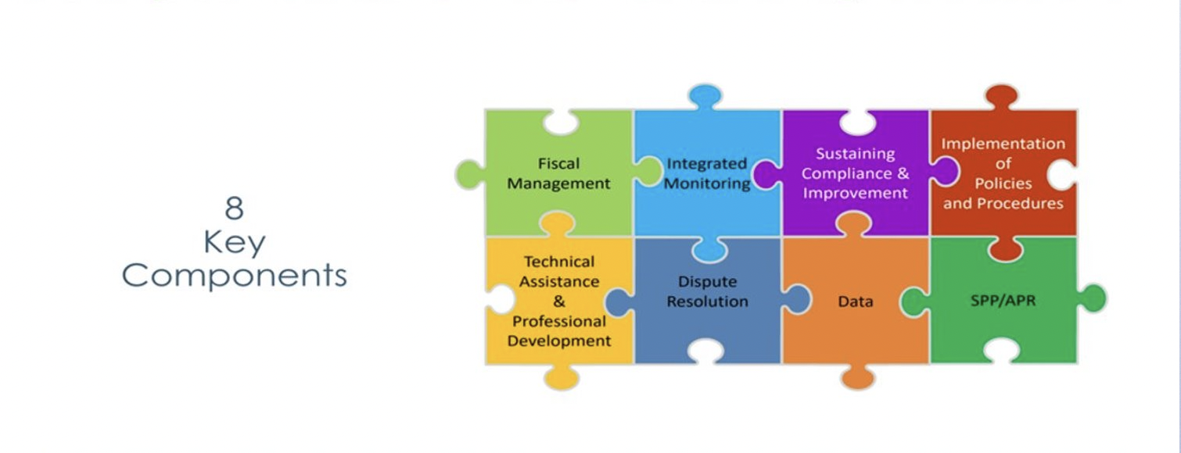
Components of General Supervision

Slide 6
Special Education Priorities
2024-2025
OASES Monitoring Procedures
PRS General Education Procedures
Champ Software Development Across Offices
Fiscal Monitoring Procedures
LEA Determinations and Aligned Technical Assistance
Policies and Procedures
Collection, Reporting, and Use of Data
Special Education Website

Slide 7
OSEP Monitoring Review
DESE received a letter from the United States Department of Education’s Office of Special Education Programs (OSEP) in response to targeted monitoring activities conducted in February and March 2024.
The letter is publicly posted on OSEP’s website, and on DESE’s Office of Special Education Programs (OSEP) - Special Education website.
OSEP acknowledged the state's efforts to improve its systems of general supervision and implementation of IDEA Part B and identified certain areas of non-compliance in the state’s system of general supervision and require corrective actions to be taken by DESE.

Slide 8
Background – OSEP Monitoring
OSEP assesses state educational agencies (SEAs) on their compliance with IDEA requirements and on outcomes for students with disabilities.
Every year, OSEP reviews specific elements and outcome data from each SEA and issues an annual determination. In June 2024, DESE received a “Meet Requirements” determination on its annual determination for the sixth consecutive year. Only 9 other states have consistently received Meets Requirements over those six years.
OSEP conducts additional monitoring of SEAs, including targeted monitoring the Differentiated Monitoring Reviews (DMS).

Slide 9
Actions Taken and Next Steps
Prior to receipt of OSEP’s letter, DESE had already taken steps to enhance its system of general supervision, including updating policies and hiring additional staff.
DESE is already working to implement the corrective actions required and will continue its ongoing improvement efforts.
The corrective actions required will not reduce the level of IDEA funding provided for serving students with disabilities.
DESE will continue to work closely with schools and districts on strengthening our system for special education.

Slide 10
ESEA New Guidance
New guidance from November 2024
Ensuring Educational Stability and Success for Students in Foster Care
Updated non-regulatory guidance to further support the SEAs, LEAs, and child welfare agencies working directly with students in foster care
Students in foster care deserve the same academic opportunities as their peers who are not in foster care
Working together, educational and child welfare agencies can ensure that involvement in the child welfare system does not deprive students of the opportunity to reach their full academic potential.

Slide 11
Special Education Updates

Slide 12
State Agency Collaboration
Executive Office of Health and Human Services

Slide 13
Interagency Review Team (IRT)
M.G.L. c. 6A, section 16R authorizes HHS, in partnership with the DESE to conduct interagency reviews of complex cases.
101 CMR 27.00 ( 101 CMR 27.00: Interagency review of complex cases | Mass.gov), sets forth the definition for a complex case and processes for referral to and review by the Interagency Review Team or IRT.
The IRT is required to conduct reviews of eligible cases and act within prescribed timeframes.
101 CMR 27.03 defines complex cases as cases where there is "a lack of consensus or resolution between state agencies as to the individual's current service needs or placement, and the individual is waiting in a hospital emergency department, a medical bed, at home or other location and in urgent need of a disposition (placement or identifying entity responsible for placement).“

Slide 14
Interagency Review Team (IRT)
A complex case will not include: Individuals who are deemed to meet hospital level of care requiring admission to an acute care hospital or inpatient psychiatric facility inclusive of the Department of Mental Health (DMH) Adolescent Continuing Care Unit (ACCU), an Intensive Residential Treatment Program (IRTP), or at a psychiatric inpatient developmentally disabled unit; or cases where there is agreement as to the services or placement necessary for the individual, including agreement as to which entity is responsible for payment, and the individual has been on the waiting list for such services or placement for less than 60 days.
The IRT replaces the United Planning Team (UPT).

Slide 15
When to refer to IRT?
Area level and regional level meetings have occurred to explore all service options and there is a lack of consensus or resolution.
A youth/young adult is waiting in a hospital emergency department, a medical bed, at home or other location and in urgent need of a disposition (placement or identifying entity responsible for payment).
IRT Website Interagency Review Team for Complex Cases | Mass.gov
Email for IRT: irt-complexcases@mass.gov

Slide 16
Department (DESE) Collaboration

Slide 17
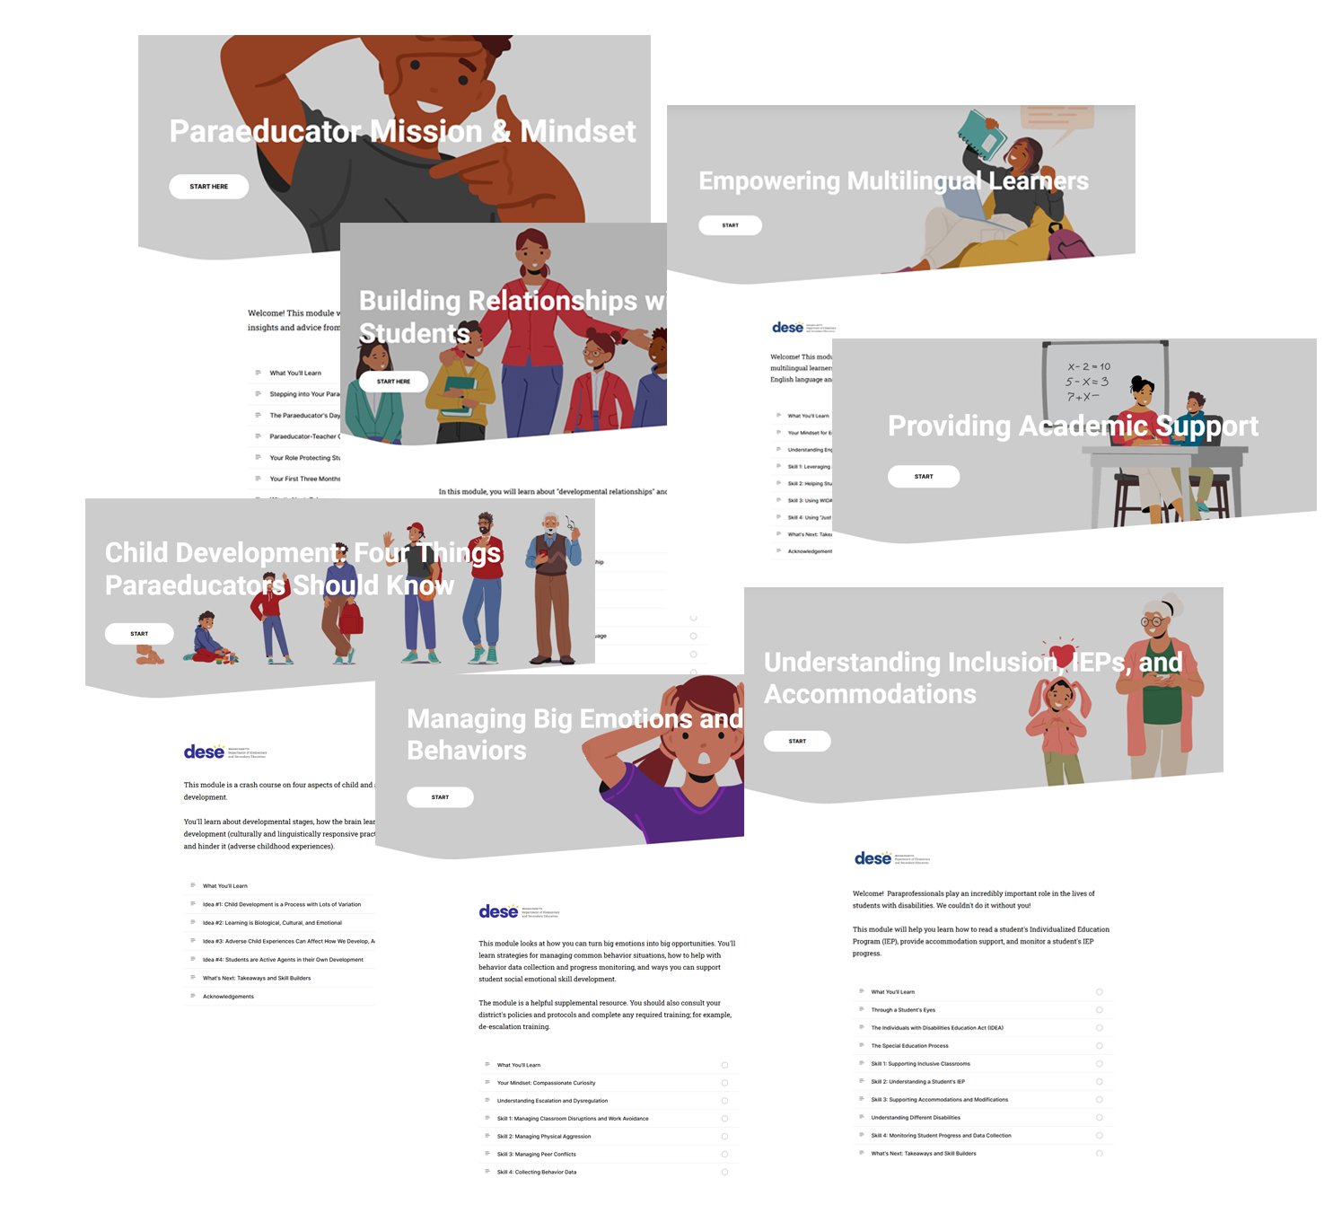
Paraeducator
E-Learning Modules
Andrea Ricotta (DESE) and Nora Priest (MindMoxie)
Special Education Director Meeting
February 2025

Slide 18


The Need
Massachusetts districts are hiring more paraeducators than ever (DESE Employed Educator Report, 2024)
DESE provides professional learning for teachers, support staff, and administrators. DESE has not offered any professional learning opportunities for paraeducators.
=
Paraeducator E-Learning Modules

Slide 19

The Process: Module Design
Designed and launched initial e-modules in fall 2024
Finish e-modules and teacher/admin modules
Focus groups in spring 2024
Launched summer 2023

Slide 20
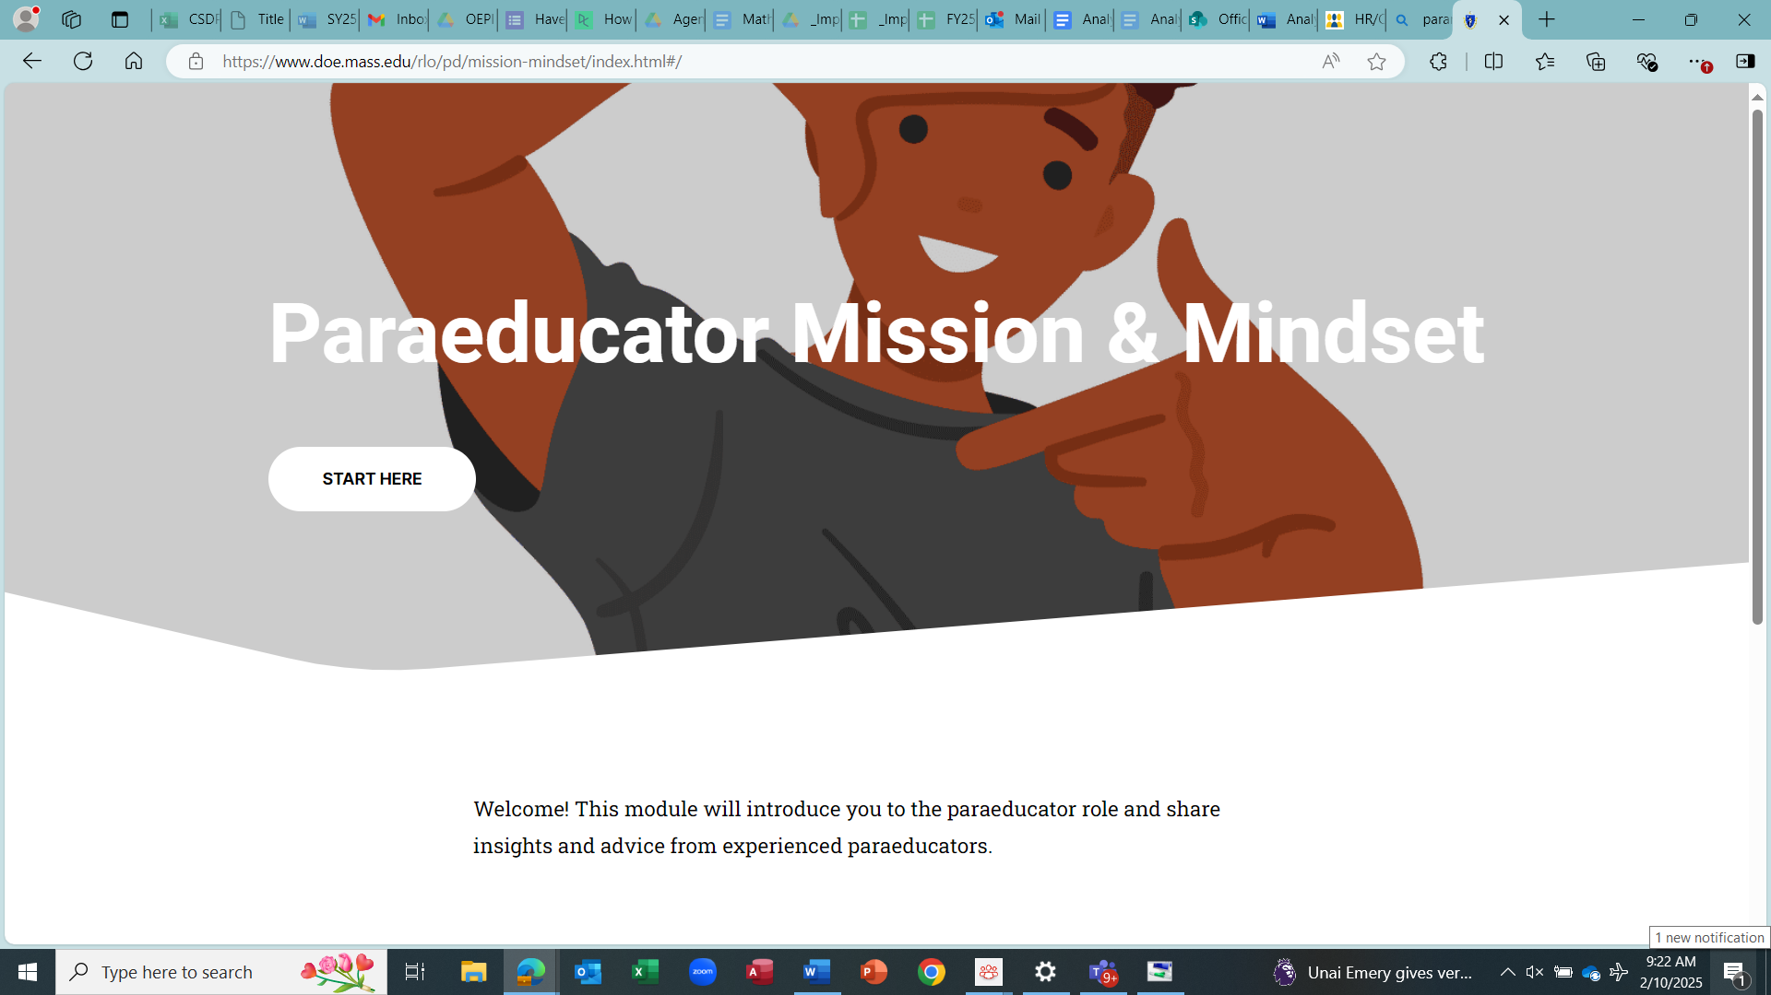

The Resources: www.doe.mass.edu/pd/paraeducator
Total of 7 E-Learning Modules (currently 2 available):
Paraeducator Mission & Mindset – available now!
Building Relationships with Students – available now!
Managing Big Emotions and Behavior – available any moment!
Child Development: 4 Things Paraeducators Should Know - available any moment!
Understanding Inclusion, IEPs, and Accommodations – available soon!
Empowering Multilingual Learners – available early spring
Providing Academy Support – available early spring
www.doe.mass.edu/pd/paraeducator/default.html
Proposed
For general education teachers: teacher-paraeducator collaboration
For administrators: supporting paraeducators (hiring, retention, professional development)

Slide 21
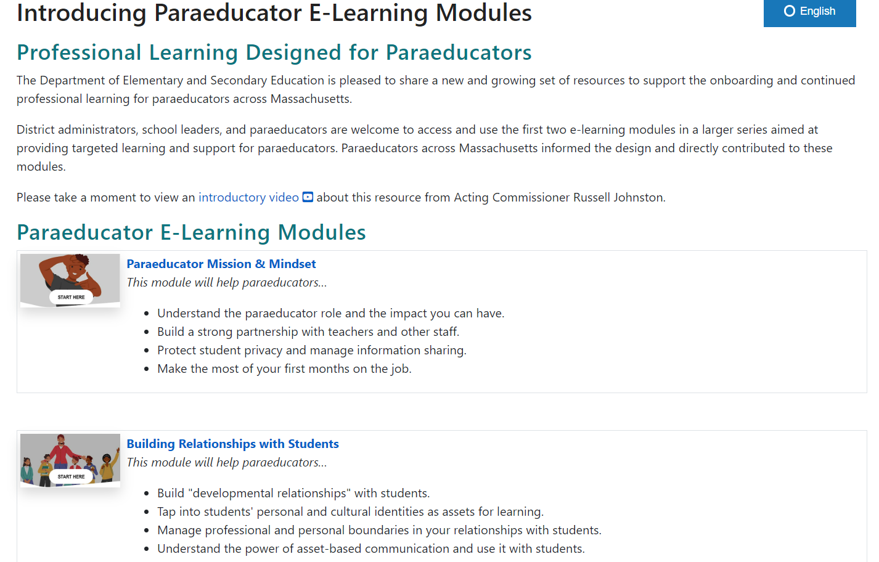

Slide 22
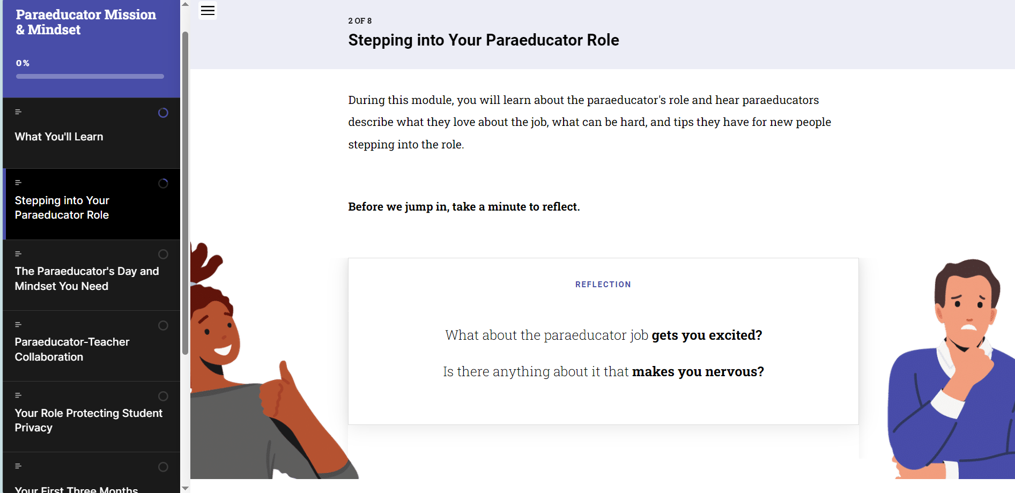

Slide 23
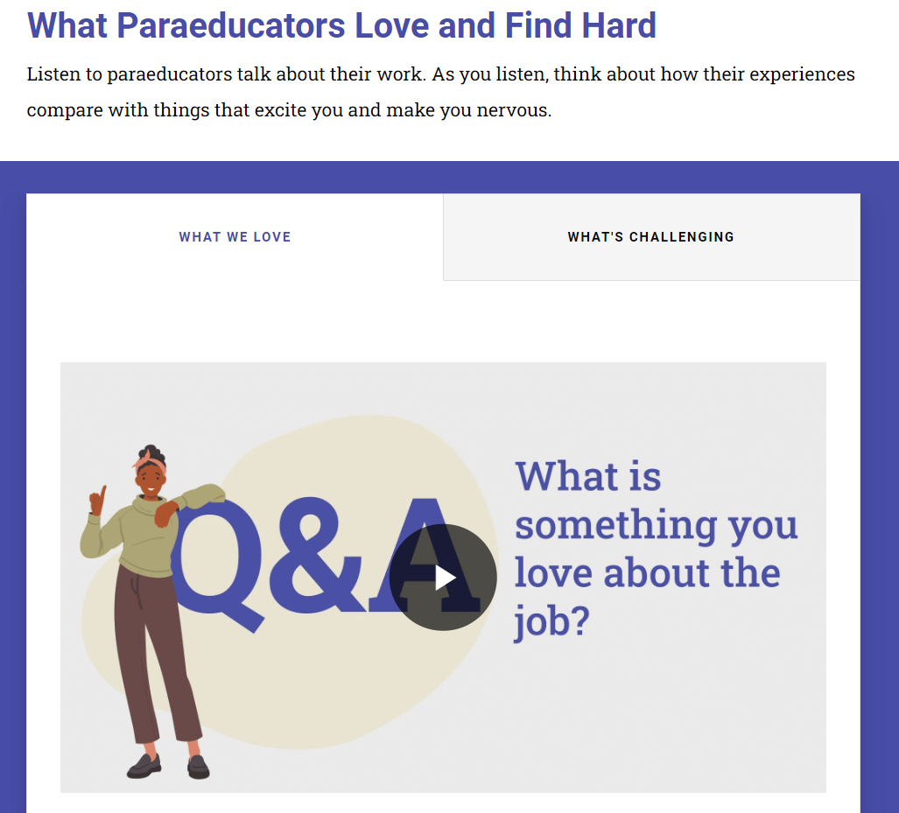
All modules feature Massachusetts paraeducators
speaking about their experiences in the role.

Slide 24




The E-Learning Modules
Designed to take approximately 45-minutes to complete each module
Done independently or in discussion groups (each module has an activity guide)
Used as onboarding or ongoing professional learning
All modules feature Massachusetts paraeducators talking about their experiences in schools

Slide 25




Next Steps and Your Input
5 more paraeducator e-learning modules coming soon!
Modules will be announced and sent out via the Commissioner's Weekly email update and we can send through this list.
Teacher and administrator modules designed this winter/spring - would love your input (and maybe feature you!) in these modules.
Possibly hold regional network sessions about paraeducator professional learning systems and practices. We would love your input here!
Please complete the survey in the chat!

Slide 26
DESE Updates
Professional Development and Technical Assistance
IDEA Data
IDEA Fiscal

Slide 27
Early Childhood (EC) Transition Collaborative Convenings
AnLar is hosting several statewide EC Transition Collaborative Convenings throughout the 2024-2025 school year. These convenings will feature a panel discussion highlighting strategies that LEAs and EIS providers are using to support smooth transitions from Part C early intervention to Part B early childhood special education services. They will also include opportunities for you to connect with your colleagues and partner agencies to discuss specific topics related to early childhood transition. Each meeting will feature a different topic, outlined below. We encourage you to register for each meeting and invite your catchment area partners in early childhood transition!
Register here for March 13, 2025, 2:00 - 3:30 PM: Transition Conference
Register here for May 14, 2025, 10:30 - 12:00 PM: Streamlining Data Collection

Slide 28
Pyramid Model Implementation Data System Community of Practice
Pyramid Model Schools/Districts
PIDS Data Discussions: Using your PIDS program data for informed decisions
To register: https://www.eventbrite.com/e/pids-data-discussions-using-your-pids-program-data-for-informed-decisions-tickets-1236570960029?aff=oddtdtcreator

Slide 29


Slide 30
Annual Special Education Determinations
Updates for the 2024-2025 School Year

Slide 31
OSEP Requirements
Consistent with requirements set forth in the State General Supervision Responsibilities Under Parts B and C of the IDEA guidance, the factors that States must consider when making annual determinations are:
  Performance on compliance indicators (4B, 9, 10, 11, 12, and 13)
  Valid and reliable data
  Correction of identified noncompliance
  Other data available to the State about the LEA’s compliance with IDEA
Additionally, States may considered other factors such as:
  Results and functional outcomes data that may come from results indicators in the State’s SPP/APR (1, 2, 3, 5, 6, 7, 8, and 14), and
  Monitoring findings made that are not already included in the SPP/APR compliance Indicators.

Slide 32
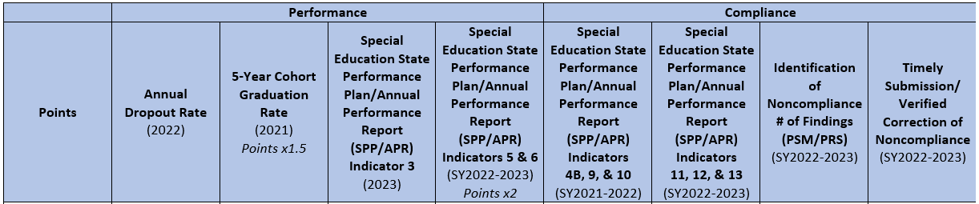
2023-24 Determination Rubric
From 2020-2024 the Department used a rubric and school/district data to assign a rating for all schools and districts in the State.
The above criteria were used in the 2023-2024 school year Determination ratings.
MA DESE has been continually refining the criteria, data points, and how Determinations are made to ensure alignment with OSEP requirements.

Slide 33
Rubric Limitations
Multiple data points were grouped together:
  Indicators 5 and 6 – Combined Full Inclusion Percentage
  Indicators 11-13 – Compliance Percentage for districts that went through TFM
  Indicators 4B, 9, and 10 – Compliance status on Significant Discrepancy or Disproportionate Representation
Achievement data for a single group of students:
  Indicator 3D- Gap in Proficiency Rates between Students with Disabilities and All Students- Grade 8 ELA MCAS
    Schools and districts without the requisite student population was not rated on this category

Slide 34
Moving to a Matrix
Changing the look of Determinations
Moving from a 4-point assignment rubric to 2-point score on LEA performance against the State targets
Separating out grouped data points to their own criteria
Including additional data points to get a more holistic view of LEA performance and compliance
Referencing of future data points to be included, but not used in this year’s Determinations

Slide 35
Matrix Criteria
Performance
SwD Graduation Rate (Ind. 1)
SwD Drop Out Rate (Ind. 2)
SwD Proficiency Rate for Grade 4, 8, and HS in ELA and Math (Ind. 3B)
School Age Full Inclusion (Ind. 5A)
Preschool Full Inclusion (Ind. 6A)
Indicator 7A*
Indicator 14C*
Compliance
Indicator 4B
Indicator 9
Indicator 10
Indicator 11
Indicator 12
Indicator 13
Number of Findings of Noncompliance (PRS and PSM) from SY23-24
Number of findings of noncompliance not corrected in one year from SY22-23
Fiscal Monitoring/Audit Findings*
Other Considerations
Maintenance of Effort
Child Count Information
Useable Records
  Indicator 7
  Indicator 14
*Criteria will not be used in the 2024-2025 Determinations, but will be included in the future
The Department will also consider additional data points or information when issuing Determinations

Slide 36
Maintenance of Effort – FY25 Compliance
End of Year Report (EOYR)
Districts, Regional, Vocational – September 30, 2024
Charters - November 29, 2024
Virtual – January 31, 2025
Standard – FY23 Determination available in FY25 GEM$
Application

Slide 37
Maintenance of Effort: Compliance
An LEA will meet its compliance standard if it spends the same or more in State and local funds in the aggregate or per pupil
LEAs who meet the compliance standard by only the per pupil standard, will be afforded the opportunity to report and demonstrate valid exceptions and adjustments to potentially reduce the LEA’s aggregate MOE standard to be applied going forward.
For exceptions to be applied, completion of the Exceptions and Adjustment Workbook and supporting documentation for the claimed expenses are required

Slide 38
FY24 & 25 Proportionate Share for Equitable Services
No more Resolution Funds for Equitable Services
FY24 Carryover Funds expire on September 30, 2025
  Eligible to receive written permission to revert any outstanding FY24 proportionate share balance as of June 15, 2025 for general allowable Part B expenditures only if demonstrated compliance with all requirements including child find and meaningful consultation three (3) times a year
FY25 Mid-Year Self Assessment due March 7, 2025
First in, First Out
Separate general ledger accounting for each FY

Slide 39
General Supervision: Financial Management and Monitoring
LEA IDEA Part B Fiscal Self-Assessment
LEA Fiscal Risk Assessment
Uniform Grant Guidance Title 2 Code of Federal Regulations Part 200
Maintenance of Effort
Excess Cost Calculation
Allowable IDEA Part B Expenditures
Proportionate Share for Equitable Services
  USED Q&A for Equitable Services for Parentally-Placed Private School Students
Comprehensive Coordinated Early Intervening Services (CCEIS)
Grants for Education Management System (GEM$)
  LEA Grant Writer

Slide 40
GEMS Survey

Slide 41
New IEP Updates

Slide 42
FY2025 Fund Code 274
Eligibility: Grant funds are available to public schools, charter schools, education collaboratives and approved special education schools providing special education services for students with disabilities
Funding: Grantees are eligible for funding based on the number of Students With Disabilities (SWDs) enrolled
Use of Funds: Grant funds are to be used to implement IEP Improvement Project, with a strong emphasis on transitioning to utilization of the newly revised forms and processes.
Due Date: Friday, February 7, 2025

Slide 43
Upcoming Meeting with IEP Vendors
DESE will continue to meet with IEP Vendors to provide direction on the implementation of the new IEP
The next meeting is scheduled for February 21, 2025
We appreciate the communication we are receiving from you regarding the implementation of the new IEP
Please continue to reach out to us at specialeducation@mass.gov so we can support you!

Slide 44
Information for Special Education Leaders
Regular Updates and Information
  Special Education Bulletin
  Special Education Website (Announcements)
Update Information in the Directory Administration
  Special Education Leaders Meeting Invites and Memos
Email Contacts
  specialeducation@mass.gov (General Special Education Inquiries)
  IDEAfiscal@mass.gov (IDEA Fiscal Inquiries)
  IDEAdata@mass.gov (IDEA Data Inquiries- Special Education or SPP/APR Data)

Slide 45
Special Education Leaders Meetings
2024-2025
  March 14, 2025 11:00-12:00
  April 18, 2025 11:00-12:00
  May 16, 2025 11:00-12:00
  June 13, 2025 11:00-12:00

Slide 46
Q&A

