Slide 1
Special Education
Leaders Meeting
Friday, May 16, 2025

Slide 2

2025 Massachusetts Teacher of the Year
Luisa Sparrow
Fifth and Sixth Grade Special Education Teacher
Oliver Hazard Perry School Boston Public Schools

Slide 3
Educational Vision
Maintaining Our Commitment During Current Times

Slide 4
Our Commonwealth’s Educational Vision for All Students
What does this look like in a classroom?
What do we envision?
All students in Massachusetts, particularly students from historically underserved groups and communities, will have equitable opportunities to excel in all content areas across all grades.
Culturally and linguistically sustaining classroom and school practices will support students to thrive by creating affirming environments where students:
  have a sense of belonging,
  engage in deeper learning,
  and are held to high expectations with targeted support.
Learning experiences
Individualized supports
Enable students to excel at grade level or beyond
Are relevant, real-world and interactive
Are known and valued
All students
Learn more: https://www.doe.mass.edu/commissioner/vision/default.html

Slide 5
Today’s Agenda
General Supervision Updates
Special Education Updates
Professional Development Opportunities

Slide 6
General Supervision

Slide 7
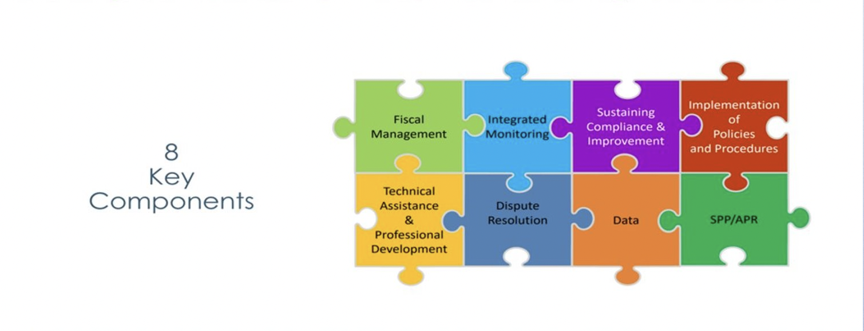
Components of General Supervision

Slide 8
Special Education Priorities
2024-2025
OASES Monitoring Procedures
PRS General Education Procedures
Champ Software Development Across Offices
Fiscal Monitoring Procedures
LEA Determinations and Aligned Technical Assistance
Policies and Procedures
Collection, Reporting, and Use of Data
Special Education Website

Slide 9
Special Education Updates

Slide 10
OSEP's January 16, 2025 Monitoring Report
January 16, 2025: Massachusetts Department of Elementary and Secondary Education (DESE) received a letter from the U.S. Department of Education's Office of Special Education Programs (OSEP) that summarized findings from OSEP's monitoring visit conducted in February and March 2024
OSEP reviewed portions of DESE's general supervision system under the Individuals with Disabilities Education Act (IDEA) Part B
The letter from OSEP identified specific areas where DESE was not in compliance with certain IDEA Part B requirements and outlined corrective actions that DESE must take

Slide 11
Proposed Documents for Public Comment
Department gathered public input on the following documents:
  Revised Special Education State Complaint Procedures Guide
  Revised Notice of Procedural Safeguards State Complaints and Independent Educational Evaluations (Proposed changes are highlighted in yellow)
  Revised Intake Form

Slide 12
Noteworthy Updates
Revised Notice of Procedural Safeguards
  Updates narrative regarding the state complaint process to more accurately reflect the process and clarifies parents’ rights regarding independent education evaluations under Massachusetts state law and its interplay with the applicable federal law.
Revised Intake Form
  Only to be used for complaints raising allegations of IDEA Part B and state special education law/regulations.
Revised Special Education State Complaint Procedures Guide
  Only applicable to complaints raising allegations of IDEA Part B and state special education law/regulations.
  Streamlines opportunity for local response (formerly Request for Local Report).

Slide 13
IDEA Data
Annual LEA Determinations
Significant Disproportionality
CCEIS

Slide 14
24-25 Determinations Issued
Annual IDEA LEA Determinations issued Friday, May 2
  Posted in Dropbox Central – Special Education Performance Plan
Determination Webinar hosted Wednesday, May 7
  Issue with registration link
  Future links will not have these issues
Resources on LEA Determination website
  Recording and Slides
  Frequently Asked Questions
  Quick Reference Guide

Slide 15
Determinations Moving Forward
Timelines
  Data from previous school year used in Determinations
  Late April/Early May Determinations Released (SY24-25)
  Root cause analysis and action planning (SY25-26)
  Implementation of action planning and M3 reservation (SY26-27)
Criteria
  Changes to criteria made for this year based on feedback received from a variety of interested parties
  Aligned with State Performance Plan and Annual Performance Report Indicators
  Additional Criteria may change year to year, based on data trends
  Indicators 7 and 14 and Fiscal Finding criteria will be used in coming years with notice going out before implementation

Slide 16
Significant Disproportionality
Root Cause Analysis and Action Plans from Identified districts were due last week
  Department will review and provide feedback on Action Plan and CCEIS budget before consolidated grant applications open
  CCEIS budget in Action Plan should match what is entered in GEM$ when application is submitted
Looking ahead
  SY25-26 Identifications going out in early Fall
  Root Cause Analysis and Action Planning occur between October and February
  Department will be issuing a list of criteria which Action Plans will be assessed by next year

Slide 17
SY24-25 CCEIS
Districts implementing and using CCEIS funds for SY24-25 (FY25)
  Department will be contacting you in June for some information regarding the use of funds
  Information to submit about who was receiving services using CCEIS funds:
    Number of students ages 3-5 (not in K)
    Number of students ages 5 (in K) through 21
    Number of students with disabilities
    Number of students without disabilities

Slide 18
IDEA Fiscal
CCEIS
FY26 Consolidated FC 240/262 Application
IDEA Fiscal Monitoring
FY24 Proportionate Share for Equitable Services Carryover

Slide 19
SY24-25 CCEIS: Fiscal Monitoring
SY24-25 (FY25) Funds
  Massachusetts policy is to expend funds in the single fiscal year in which they are reserved
  CCEIS general ledger and supporting documentation evidencing allowable CCEIS expenditures must be submitted
  Districts that do not fully expend FY25 CCEIS funds by June 30, 2025 must submit a written action plan to expend the remaining FY25 CCEIS funds forthwith and no later than June 30, 2026
  Significant Disproportionality Fiscal Requirements Quick Reference Guide

Slide 20
FY26 Consolidated FC 240/262 Application
Available July 2025
Maintenance of Effort Eligibility Standard (FY24 Compliance)
Equitable Services – Evidence of 3 meaningful consultations
Private school(s) enrollment counts
Conditions of Assistance – multiple signatures needed
GEPA Statement
Due: September 30, 2025
Substantially approvable application

Slide 21
Federal Grant Application: Conditions of Assistance
Under the IDEA, an LEA is eligible for fiscal assistance under Part B of the Act for a fiscal year if the agency submits a plan that provides assurances to the Department that the LEA meets each of the conditions in 34 C.F.R. § 300.201 through 34 C.F.R. § 300.213. 34 C.F.R. §300.200.
The LEA, in providing for the education of children with disabilities within its jurisdiction, must also have in effect policies, procedures, and programs that are consistent with the state policies and procedures established under 34 C.F.R. § 300.101 through 300.163, and § 300.165 through 300.174.
Every LEA must submit a new Conditions of Assistance: IDEA Part B Funding Certifications (Individual Districts and Schools, or Consortium) to the Department annually.
Any policies, procedures related documents need to be available for the public upon request if it is not published on a website or any public platform.

Slide 22
General Supervision: Financial Management and Monitoring
Uniform Grant Guidance Title 2, Code of Federal Regulations (CFR) Part 200
Education Department General Administrative Regulations (EDGAR) Title 34, Code of Federal Regulations (CFR)
LEA IDEA Part B Fiscal Risk Assessment (High, Medium, Low)
LEA IDEA Part B Self-Assessment

Slide 23
General Supervision: Fiscal Management and Monitoring
Grants for Education Management System (GEM$)
  LEA FC 0240/0262 - IDEA Consolidated (Federal/ENT) GrantWriter role
  Application Supplements for Monitoring
    Equitable Services Carryover Questionnaire & Document Upload
    LEA IDEA Part B Self-Assessment
    Excess Cost Calculation
    Child Count & Equitable Services Data Reporting

Slide 24
FY24 Proportionate Share for Equitable Services Carryover
FY24 Carryover Funds expire on September 30, 2025
  Grants for Education Management System (GEM$)
    FY24 Equitable Services Carryover Questionnaire
  May be eligible to receive written permission to revert any outstanding FY24 proportionate share balance for general allowable Part B expenditures
  Must upload demonstrated compliance with all requirements including child find and meaningful consultation three (3) times a year, and no known or anticipated allowable expenses prior to September 30, 2025

Slide 25
FY24 Equitable Proportionate Share for Equitable Services Carryover
Completed and FY24 Carryover Questionnaire
Copies of all written affirmations and other evidence of meaningful consultation and participation by schools and families at least three (3) times a year including a narrative description of all efforts and results to engage and expend the funds.
Detailed explanation and all supporting documentation supporting the rationale claimed in the Questionnaire for not expending the funds.
General ledger evidence of the accounting of your district's FY24 proportionate share funds.
Copy of the district's child find procedures for parentally placed private and home school students in the district .

Slide 26
Professional Development Opportunities

Slide 27
Literacy Launch Institutes
Are you an educator supporting students, or pre-service teachers, in grades PreK-3? Do you want to deepen your understanding of evidence-based and culturally and linguistically sustaining early literacy practices?
The Department of Elementary and Secondary Education (DESE) and the Department of Early Education and Care (EEC), in collaboration with the HILL for Literacy, are thrilled to announce the Literacy Launch Institutes! These Institutes offer FREE professional learning to deepen understanding of evidence-based, culturally and linguistically sustaining early literacy practices.
  Differentiated tracks available: Novice, Advanced, Preschool, School & District Leaders, and Educator Prep Program Faculty & Staff
  4-Day Literacy Launch Institutes this summer - be ready for liftoff when the new school year begins!

Slide 28
What to Know about Literacy Launch
Open to any public school educator who supports early literacy, as well as MA educator preparation faculty, personnel, and staff
Offered in two locations this August (Devens and Foxboro)
Individual educators and teams are encouraged to register; school or district teams that attend the Institute together will be eligible to apply for free coaching at your school from HILL for Literacy
Participants are eligible to receive PDPs and a stipend; optional graduate credit available
Visit mass.gov/literacylaunch for more info and to register today!

Slide 29
IEP Training for Schools and Districts
The SEPP office has contracted with the Federation for Children with Special Needs (FCSN) to provide training to schools and districts throughout the Commonwealth. The focus is on the adaptive changes required to have successful IEP meetings and developing reasonably calculated IEPs to promote student success.
Please watch for the registration invitation from the FCSN.
Dates are the training are:
May 5 at Edison Academy in Brockton
May 21 at Fitchburg State University
May 30 at Fitchburg State University
June 4 at Holyoke Community College
The New IEP – Federation for Children with Special Needs

Slide 30
Special Education Leaders Meetings
2024-2025
  June 13, 2025 11:00-12:00

Slide 31
Information for Special Education Leaders
Regular Updates and Information
  Special Education Bulletin
  Special Education Website (Announcements)
Update Information in the Directory Administration
  Special Education Leaders Meeting Invites and Memos
Email Contacts
  specialeducation@mass.gov (General Special Education Inquiries)
  IDEAfiscal@mass.gov (IDEA Fiscal Inquiries)
  IDEAdata@mass.gov (IDEA Data Inquiries- Special Education or SPP/APR Data)

Slide 32
Q&A

