Slide 1
Special Education Leaders Meeting
Friday, June 13, 2025

Slide 2
Today’s Agenda
General Supervision Updates
Special Education Updates
New IEP Updates
Planning for Summer and Next School Year

Slide 3
Our Commonwealth’s Educational Vision for All Students
What does this look like in a classroom?
What do we envision?
All students in Massachusetts, particularly students from historically underserved groups and communities, will have equitable opportunities to excel in all content areas across all grades.
Culturally and linguistically sustaining classroom and school practices will support students to thrive by creating affirming environments where students:
have a sense of belonging,
engage in deeper learning,
and are held to high expectations with targeted support.
Learning experiences
Individualized supports
Enable students to excel at grade level or beyond
Are relevant, real-world and interactive
Are known and valued
All students
Learn more: https://www.doe.mass.edu/commissioner/vision/default.html

Slide 4
General Supervision

Slide 5
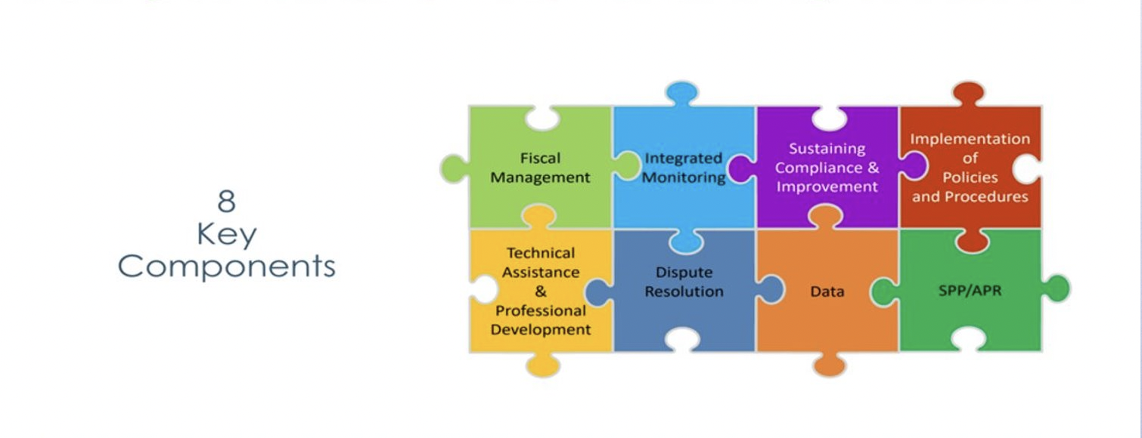
Components of General Supervision

Slide 6
Special Education Priorities 2024-2025
OASES Monitoring Procedures
PRS General Education Procedures
Champ Software Development Across Offices
Fiscal Monitoring Procedures
LEA Determinations and Aligned Technical Assistance
Policies and Procedures
Collection, Reporting, and Use of Data
Special Education Website

Slide 7
Special Education Updates

Slide 8
OSEP's January 16, 2025 Monitoring Report
January 16, 2025: Massachusetts Department of Elementary and Secondary Education (DESE) received a letter from the U.S. Department of Education's Office of Special Education Programs (OSEP) that summarized findings from OSEP's monitoring visit conducted in February and March 2024
OSEP reviewed portions of DESE's general supervision system under the Individuals with Disabilities Education Act (IDEA) Part B
The letter from OSEP identified specific areas where DESE was not in compliance with certain IDEA Part B requirements and outlined corrective actions that DESE must take
DESE released several draft documents earlier this spring. After engagement with stakeholders, a public hearing with the SEAP and SAC and reviewing the public comment, DESE team incorporated comments and has released the updated documents.

Slide 9
Noteworthy Updates
Revised Intake Form
Only to be used for complaints raising allegations of IDEA Part B and state special education law/regulations.
Revised Special Education State Complaint Procedures Guide
Only applicable to complaints raising allegations of IDEA Part B and state special education law/regulations.
Streamlines opportunity for local response (formerly Request for Local Report).
Temporary Public Reporting of State Complaint Data
Revised Notice of Procedural Safeguards
Updates narrative regarding the state complaint process to more fully reflect the process.
Clarifies parents’ rights regarding independent education evaluations under Massachusetts state law and the applicable federal law.

Slide 10
Independent Educational Evaluations
Purpose is to clarify school district’s responsibilities under federal and state special education laws and regulations for providing a publicly funded independent educational evaluation (IEE) for a student.
The federal Individuals with Disabilities Education Act (IDEA), Part B regulation relating to IEEs is found at 34 C.F.R. § 300.502.
The additional state standard, which exceeds the minimum requirements set by IDEA and provides parents and guardians with a separate, entirely voluntary option is described at M.G.L. c. 71B, § 3 ¶ 10 and 603 CMR 28.04(5).
Districts should refer parents to the Parent’s Notice of Procedural Safeguards for more information on their right to an IEE under both federal and state law. Districts are required to provide a copy of the Parent’s Notice of Procedural Safeguards upon parents’ request. 34 C.F.R. § 300.504(a)(4).

Slide 11
Next Steps for the CAP
Updated OASES monitoring criteria on the topic of student discipline
Updated PSM monitoring criteria on the topic of MTSS and special education
Policy Memorandum regarding the responsibilities of schools and districts for students placed in private schools by public agencies
Sample Out of District Monitoring Form

Slide 12
State Agency Collaboration
Massachusetts Department of Mental Health (DMH)

Slide 13
Overview of the Massachusetts Department of Mental Health

Slide 14
Mental Health Services at Mass DMH
DMH provides specialized services for children, youth and adults with the most serious mental health needs.
The Department of Mental Health (DMH) provides supports and services that complement those provided by other agencies or systems (commercial insurance, MassHealth, other state agencies such as DCF, schools, community programs, etc.)

Slide 15
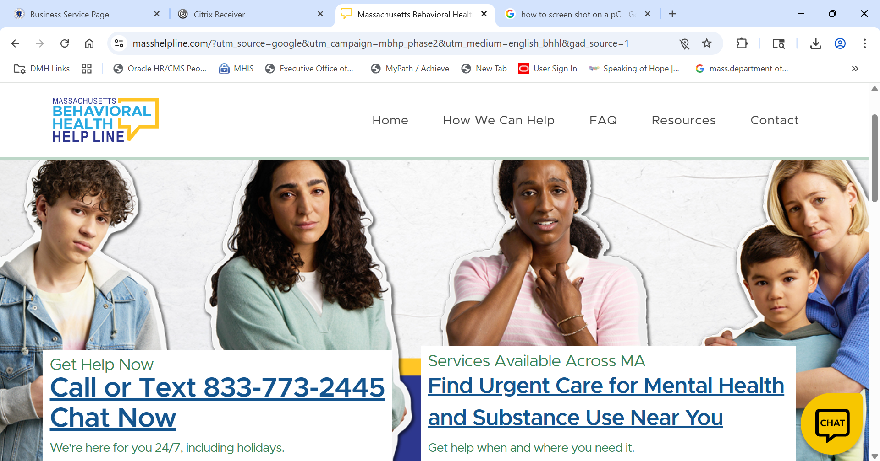
Behavioral Health Helpline

Slide 16
688 Referrals to DMH
When To Refer to DMH
When emotional impairment is primary
What is needed
IEP
Clinical Assessment
Educational Assessment
688 Approval Form
Timing
Between 6 mos. & 1 year prior to graduation/SPED Date
3-6 months is ok, we can try to expedite
Less than 3 months – not preferable- please call us
Communication

Slide 17
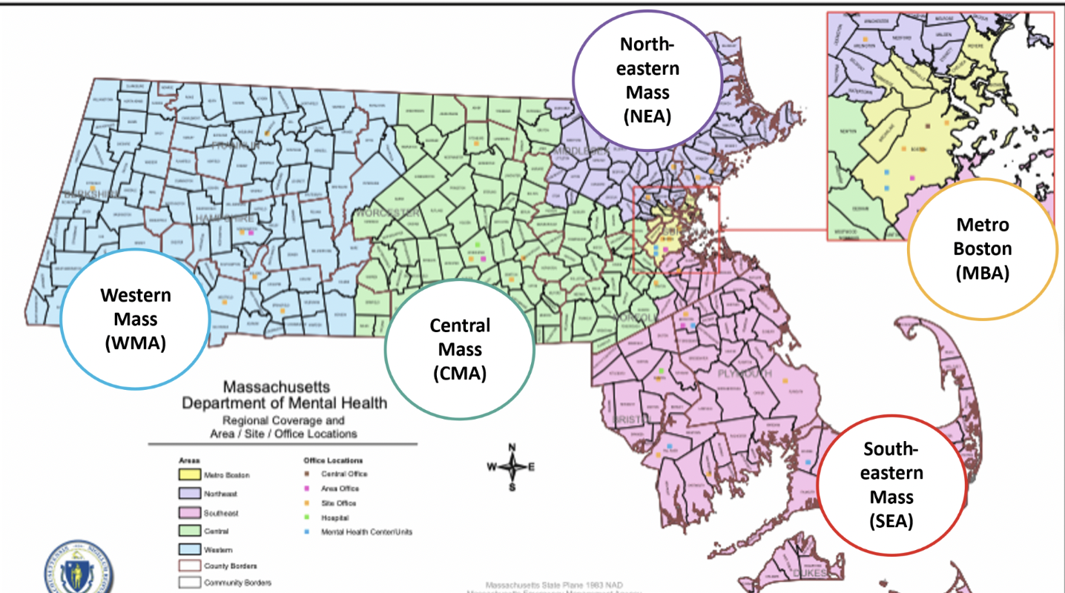
Five Geographic Areas Across Massachusetts

Slide 18
Accessing DMH Specialized Services
Clinical Determination
Confirm that the person has a qualifying diagnosis*;
Identify urgent needs; and
Support navigation to other needed resources.
*Qualifying diagnoses include: Schizophrenia and other psychotic disorders, Major Mood Disorders, Anxiety Disorders, Dissociative Disorders, Eating Disorders, Borderline Personality)
Determine functional impairment in multiple domains due to qualifying diagnosis*
*For youth must have a serious emotional disturbance which is the primary cause of the functional impairment
Establish duration-has lasted for at least one year or is expected to last one year

Slide 19
Accessing DMH Specialized Services.
Needs and Means
Identifies the specialized services that the person needs and
Confirms that these needs can’t be met by other available resources
To Submit an Application for DMH Services go to our website:
https://www.mass.gov/orgs/massachusetts-department-of-mental-health

Slide 20
Specialized Services for Children, Youth and Families
Child, Youth & Family Services
Community-Based Services
Case Management
Flexible Support Services
Day Services
Intensive In-Home Treatment
Therapeutic Group Care
Young Adult Staffed and Supported Apartments
Program for Assertive Treatment for Youth
Facility-Based Treatment
Adolescent Continuing Care Units
Intensive Residential Treatment
Clinically Intensive Residential Treatment

Slide 21
Specialized Services for Adults
Adult Mental Health Services
Community-Based Services
Case Management
Adult Community Clinical Services
Respite
Clubhouse
Program for Assertive Treatment (PACT)
Homeless support services
Facility-Based Treatment
Adult Continuing Care Units
Recovery from Addictions Program (RAP) – Section 35
Clinic-Based Treatment
Outpatient Services (Boston & Southeast)

Slide 22
Specialized Supports for Young Adults 18-26
Young Adult​ Services
Requiring Service Authorization
Young Adult Staffed and Supported Apartments
Adult Community Clinical Services
(some specialized supports for YA)
Supports for YA with early/first episode psychosis
Some YA Case Management specialists
TIP –Transitions to Independence Process
Low Barrier Supports
Young Adult Access Centers
Community Based
Young Adult Peer Mentors
www.speakingofhope.org
https://www.brooklinecenter.org/centers/mpath/
https://www.mapnet.online/program-directory
https://youthmovemassachusetts.net/

Slide 23
Find a Young Adult Access Center:
www.speakingofhope.org
Offering community supports for young adults with mental health challenges
A dynamic and diverse community of YA 16-26
Amenities and supports to meet basic needs.
Young adult Peer Mentors with lived experiences of their own.
Evidence-supported interventions empowering young adults to explore their chosen paths at their own pace.
Expedited pathways to community supports and services

Slide 24
Contact
Heidi Holland, (she, her, hers) M.Ed.
Director of Young Adult Transitional Services
Department of Mental Health
heidi.holland@mass.gov
617-386-6738

Slide 25
Department of Developmental Services and the Office of the Child Advocate

Slide 26
Autism, Wandering, and Water Safety: Information for Caregivers
Drowning is the leading cause of death for children with ASD, often as the result of wandering. This usually happens at home, but can happen at school, programming, or on an outing.
Up to half of children with Autism Spectrum Disorder (ASD) will leave a safe place without telling anyone.
The Department of Developmental Services with the Office of the Child Advocate and several partner agencies has developed a brochure and other resources to prepare for emergencies, prevent wandering and improve water safety.
You will find resources for educators, families and other caregivers here:
Autism, Wandering, and Water Safety: Information for Caregivers | Mass.gov.

Slide 27
DESE Updates

Slide 28
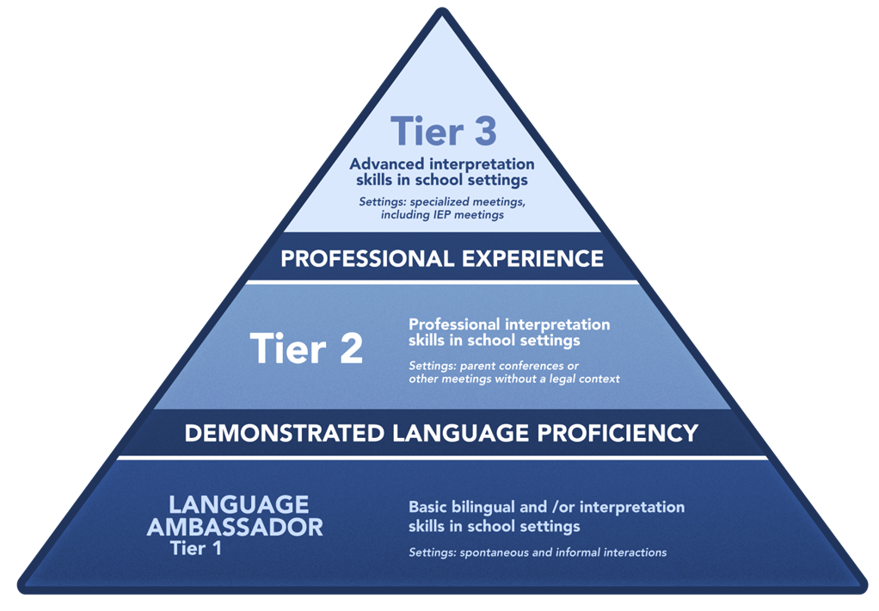
Interpreters in the Education Setting
For more information visit : Interpreters in the Education Setting - Language Access Services for Families

Slide 29
Implementation of 603 CMR 28.05(7) Parent response to proposed IEP and proposed placement
State special education regulations at 603 CMR 28.05(7) require districts to adhere to the following timelines:
Parent response to proposed IEP and proposed placement. Immediately following the development of the IEP, and within 45 school working days after receipt of the parent's written consent to an initial evaluation or reevaluation, the district shall provide the parents with two copies of the proposed IEP and proposed placement along with the required notice, except that the proposal of placement may be delayed according to the provisions of 603 CMR 28.06(2)(e) in a limited number of cases.
In this context, the Department defines the term immediately as occurring within 45-school working days and no later than 5 school days after the team meeting.
Notes:
A parent may voluntarily agree to receive an electronic version of the IEP, if the district offers that as an option. For more information, please see Letter to Brenton (OSEP March 21, 2024), available at https://sites.ed.gov/idea/files/idea/policy/speced/guid/idea/memosdcltrs/acc-14-000862r-me-breton-email-3-21-14.pdf .

Slide 30
Written Consent & End of the Year
In cases where written consent is received toward the end of the school year, districts must follow the requirements outlined in 603 CMR 28.05(1):
...If consent is received within 30 to 45 school working days before the end of the school year, the school district shall ensure that a Team meeting is scheduled so as to allow for the provision of a proposed IEP or written notice of the finding that the student is not eligible no later than 14 days after the end of the school year.

Slide 31
Website Update
Today we’re excited to share a high-level update on the reorganized DESE Special Education webpage launching in July
This update reflects our shared goals of clarity, accessibility, and equity.
Districts play a key role in ensuring families and staff benefit from this webpage.

Slide 32
What’s Changing and Why it Matters
The webpage was reorganized based on feedback from families, schools, and DESE staff.
Key improvements:
Streamlined navigation & user-friendly landing page
Audience-specific pages (e.g., District Monitoring, IEP, Special Education Data Reporting) that align with IDEA general supervision requirements and guidelines
Centralized access to laws, regulations, and professional development

Slide 33
What to Expect Next
Outreach & engagement: Be on the look out for communication in July once the webpage is live
Support for Districts:
A brief video will be sent out before the new school year
We will have URL redirects available for top frequented pages
Action Steps: Let your staff know that bookmarked content may redirect to its new location
Feedback will be gathered to support continuous improvement.

Slide 34
Help Us Get the Word Out
How you can support:
Share newly updated URLs and pages with special education teams
Refer families to newly updated URLs and pages
Embed updated links in local materials, newsletters, and IEP documents
Provide feedback to support continuous improvement

Slide 35
IDEA Data
Indicator 14

Slide 36
Indicator 14: Post-School Outcomes Data Collection
The start of the data collection and reporting period on students with IEPs who exited during the 2023-2024 school year is being pushed back to later this summer.
The current plan is to open data collection on Monday, July 21, 2025 with a kickoff webinar to be held via Zoom from 1:00 to 2:30 p.m. that day. This webinar will be MANDATORY for LEAs who were required to submit Indicator 14 Action Plans last fall.
The data collection period is scheduled to end in mid-to-late September 2025.
We will be posting the exiters lists in your district’s Indicator 14 Dropbox in DESE’s Security Portal and all supporting resources on our Indicator 14 web page as soon as they are finalized.
The contact information for questions related to Indicator 14 has also changed. For all Indicator 14 questions, please contact the Indicator 14 Data Collection team at IDEAdata@mass.gov until further notice.
More information will be released in the coming weeks via MailChimp and posted on our Indicator 14 website.

Slide 37
IDEA Fiscal

Slide 38
FY26 Consolidated FC 240/262 Application
Available July 2025
Maintenance of Effort Eligibility Standard (FY24 Compliance)
Equitable Services – Evidence of 3 meaningful consultations
Private school(s) enrollment counts
Conditions of Assistance – multiple signatures needed
GEPA Statement
Due: September 30, 2025
Substantially approvable application

Slide 39
Federal Grant Application: Conditions of Assistance
Under the IDEA, an LEA is eligible for fiscal assistance under Part B of the Act for a fiscal year if the agency submits a plan that provides assurances to the Department that the LEA meets each of the conditions in 34 C.F.R. § 300.201 through 34 C.F.R. § 300.213. 34 C.F.R. §300.200.
The LEA, in providing for the education of children with disabilities within its jurisdiction, must also have in effect policies, procedures, and programs that are consistent with the state policies and procedures established under 34 C.F.R. § 300.101 through 300.163, and § 300.165 through 300.174.
Every LEA must submit a new Conditions of Assistance: IDEA Part B Funding Certifications (Individual Districts and Schools, or Consortium) to the Department annually.
Any policies, procedures related documents need to be available for the public upon request if it is not published on a website or any public platform.

Slide 40
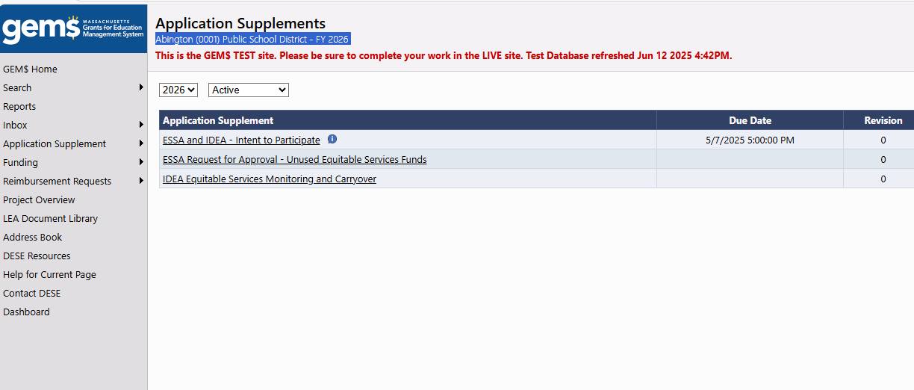
FY24 Proportionate Share for Equitable Services Carryover
FY24 Carryover Funds expire on September 30, 2025
Grants for Education Management System (GEM$)

Slide 41
FY24 Equitable Proportionate Share for Equitable Services Carryover
Completed FY26 IDEA Equitable Services Application Supplement in GEM$
Copies of all written affirmations and other evidence of meaningful consultation and participation by schools and families at least three (3) times a year including a narrative description of all efforts and results to engage and expend the funds.
Detailed explanation and all supporting documentation supporting the rationale claimed in the Questionnaire for not expending the funds.
General ledger evidence of the accounting of your district's FY24 proportionate share funds.
Copy of the district's child find procedures for parentally placed private and home school students in the district .

Slide 42
SY24-25 CCEIS: Fiscal Monitoring
SY24-25 (FY25) Funds
Massachusetts policy is to expend funds in the single fiscal year in which they are reserved
CCEIS general ledger and supporting documentation evidencing allowable CCEIS expenditures must be submitted
Districts that do not fully expend FY25 CCEIS funds by June 30, 2025 must submit a written action plan to expend the remaining FY25 CCEIS funds forthwith and no later than June 30, 2026
Significant Disproportionality Fiscal Requirements Quick Reference Guide

Slide 43
The New IEP

Slide 44
The New IEP 2025-2026 School Year
Professional Development and Resources
Schools and Districts
Families
Targeted Resources
Updated Forms
Progress Report
SLD Forms
IEP Platforms and Vendors
Communication with Vendors

Slide 45
Planning for Next Year

Slide 46
Coming Soon!
End of Year Checklist
Survey for Special Ed Leaders
Dates for Meetings for Next Year
Guidance Documents
Information Related to New Requirements Competency Determination

Slide 47
Information for Special Education Leaders
Regular Updates and Information
Special Education Bulletin
Special Education Website (Announcements)
Update Information in the Directory Administration
Special Education Leaders Meeting Invites and Memos
Email Contacts
specialeducation@mass.gov (General Special Education Inquiries)
IDEAfiscal@mass.gov (IDEA Fiscal Inquiries)
IDEAdata@mass.gov (IDEA Data Inquiries- Special Education or SPP/APR Data)

Slide 48
Q&A

