Slide 1
Special Education Leaders' Meeting
August 22, 2025

Slide 2
Agenda
Welcome Back!
Special Education Updates and Key Special Education Topics
Policy Updates
Planning for the 2025-2026 School Year
  Monitoring Activities
  Professional Development and Targeted Assistance
  Dispute Resolution
  IDEA Data Fiscal
Resources

Slide 3

Welcome Back!
2025-2026 School Year
“Education is the key to unlocking a world of possibilities and opportunities.”
-Unknown

Slide 4
Special Education Updates and Key Special Education Topics

Slide 5
DESE Special Education Leadership
Iraida J. Alvarez, Acting Executive Director of Special Education
Jamie Camacho, Acting State Director of Special Education
Office of Approved Special Education Schools
Jannelle Roberts, Director
Special Education Planning and Policy Development
Jamie Camacho, Director
Patrick Fitzgerald, Assistant Director
Martha Daigle, Assistant Director
Office of Public School Monitoring
Vani Rastogi-Kelly, Director
Amy Paulin, Assistant Director
Office of Problem Resolution System
Kelsey LoDuca-Towne, Director
Julie Garell, Assistant Director
Special Education in Institutional Settings
Shawn Connelly, Director

Slide 6
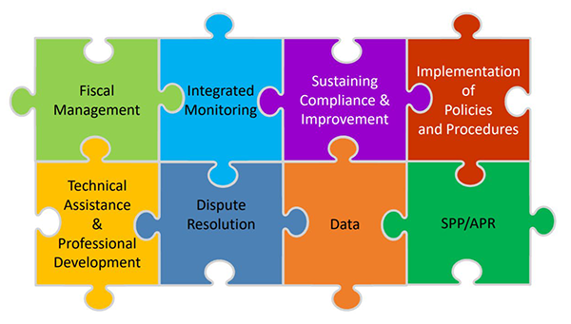
General Supervision
As the State Educational Agency, the Massachusetts Department of Elementary and Secondary Education (DESE) has responsibility for general supervision under Part B of the Individuals with Disabilities Education Act (IDEA).
DESE provides technical assistance and monitors local education agencies’ (LEAs) implementation of IDEA and state special education law. General supervision has eight distinct but interconnected components, creating a cohesive system

Slide 7
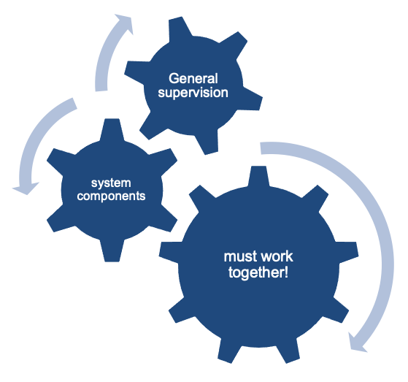
7
Coherence Matters!
Imagine a general supervision system as a sophisticated machine comprised of many interlocking gears that all must operate in concert to produce the desired outcomes.
Notes:
Review slide

Slide 8
Differentiated Monitoring System 2.0
The Office of Special Education Programs monitors States by reviewing a state’s general supervision system to ensure compliance with IDEA.
The goal of DMS 2.0 is to improve outcomes and results for infants, toddlers, children and youth with disabilities and their families in conjunction with compliance.
OSEP’s monitoring will focus on States’ systems of general supervision integrating both results and compliance.

Slide 9
DMS Monitoring: Three Phases
Discovery October 2025
(5 months prior to engagement)
  Document Request
  State Overview Call
  Stakeholder engagement
  Local Component
Engagement March 2025
(1 month (visit) through issuance of the DMS Monitoring Report)
  Onsite and Virtual monitoring interview calls
  Issuance of the DMS Monitoring Report
Close-out
(up to one year after the issuance of the DMS Monitoring Report)
  Review of evidence of correction
  Technical Assistance

Slide 10
OSEP's January 16, 2025 Monitoring Report
January 16, 2025: Massachusetts Department of Elementary and Secondary Education (DESE) received a letter from the U.S. Department of Education's Office of Special Education Programs (OSEP) that summarized findings from OSEP's monitoring visit conducted in February and March 2024
OSEP reviewed portions of DESE's general supervision system under the Individuals with Disabilities Education Act (IDEA) Part B
The letter from OSEP identified specific areas where DESE was not in compliance with certain IDEA Part B requirements and outlined corrective actions that DESE must take

Slide 11
Noteworthy Updates from the Spring
Revised Intake Form
  Only to be used for complaints raising allegations of IDEA Part B and state special education law/regulations.
Revised Special Education State Complaint Procedures Guide
  Only applicable to complaints raising allegations of IDEA Part B and state special education law/regulations.
  Streamlines opportunity for local response (formerly Request for Local Report).
Temporary Public Reporting of State Complaint Data
Revised Notice of Procedural Safeguards
  Updates narrative regarding the state complaint process to more fully reflect the process.
  Clarifies parents’ rights regarding independent education evaluations under Massachusetts state law and the applicable federal law.

Slide 12
New Noteworthy Updates
Continue OASES monitoring related to the topic of suspensions/removals
PSM monitoring related to the topic of Child Find/MTSS and district monitoring for students placed out of district
Policy Memorandum regarding the responsibilities of schools and districts for students placed in private schools by public agencies
Sample Out of District Monitoring Form and Memo

Slide 13
Special Education Webpage Update
The updated webpage is now live and easier to navigate.
A short navigation video will be posted soon to guide users
We are also launching a feedback survey to hear from stakeholders about what’s working well and what can be improved.
Your input will help us continue to refine the webpage to best meet the needs of students, families, and educators.

Slide 14

Public Records Reminder
Special education settlement agreements are subject to the public records law and must be stripped of all personally identifiable information and provided, upon request.
Champa v. Weston Public Schools, 473 Mass. 86 (2015) (contractually agreeing to keep a private agreement private cannot trump the public records law and the district's obligation to provide it).

Slide 15
Key Special Education Topics
Reducing and Eliminated the Use of Time Out
Improving the Validity and Reliability of IDEA Data
Timely Transition from IDEA Part C to Part B (Indicator 12)
Timely Evaluations (Indicator 11)
Outcomes for Students with Disabilities (ELA Proficiency and Graduation Rate)
English Learners with Disabilities (Eligible for Special Education)
Implementation of IDEA Policies and Procedures
Inclusive Practices

Slide 16



DESE ELSWD Projects for Fiscal Year 2026
ELSWD National Research Scan and Gap Analysis
ELSWD Advisory Group

Slide 17
Implementation of the New IEP
IEP Forms
  Progress Report (Stakeholder Feedback)
  Specific Learning Disability Forms
Topic Specific Professional Development
Feedback on the Forms

Slide 18
Policy Updates

Slide 19
Graduation and Transition Planning for Students with IEPs
Massachusetts state law does not explicitly address graduation requirements for students with IEPs. This has resulted in some confusion in determining when a student with an IEP is ready to graduate and, more specifically, whether and when a student may refuse a diploma to continue receiving transition and other special education services. Recent changes to the Massachusetts state requirements regarding the Competency Determination (CD) have further exacerbated the confusion.
Recently issued guidance is intended to clarify:
The issuance of a high school diploma to students with IEPs consistent with applicable federal and state law;
The impact of the passage of Question 2 in November 2024 and the May 2025 amendments to the state CD requirements in 603 CMR 30.00 on awarding a diploma to students with IEPs;
Considerations for Massachusetts students who are receiving a publicly funded education in an out-of-district placement; and
Best practices for schools, students, and parents in planning secondary transition services and student graduation, and reducing the potential for disputes.

Slide 20
603 CMR 28.05:
The Team Process and Development of the IEP
(1) Convening the Team. Within 45 school working days after receipt of a parent's written consent to an initial evaluation or reevaluation, the school district shall: provide an evaluation; convene a Team meeting to review the evaluation data, determine whether the student requires special education and, if required, develop an IEP in accordance with state and federal laws; and provide the parents with two copies of the proposed IEP and proposed placement, except that the proposal of placement may be delayed according to the provisions of 603 CMR 28.06(2)(e); or, if the Team determines that the student is not eligible for special education, the school district shall send a written explanation of the finding that the student is not eligible.

Slide 21
603 CMR 28.05:
The Team Process and Development of the IEP
(7) Parent response to proposed IEP and proposed placement. Immediately following the development of the IEP, and within 45 school working days after receipt of the parent's written consent to an initial evaluation or reevaluation, the district shall provide the parents with two copies of the proposed IEP and proposed placement along with the required notice, except that the proposal of placement may be delayed according to the provisions of 603 CMR 28.06(2)(e) in a limited number of cases.
Immediately Following- 5 Days (within the 45 days)
“Day 1”- Day following the IEP Meeting
Predetermination vs. Planning- Meaningful Input/Participation from Parents is Required

Slide 22
Examples of 45-day Requirement in 28.05(7)
Parent provides district with consent to evaluate (day 1). On day 39, a Team Meeting is held and an IEP is developed. On day 44, the district provides the parents with two copies of the proposed IEP, placement, and required notice. This is in compliance with the regulation as the IEP was received by the parent no later than 5 days after the Team Meeting and within 45 days from the date of consent to evaluate.
Team Meeting is held on day 44 after consent to evaluate is received and an IEP is developed. On day 48, the district provides the parents with two copies of the proposed IEP, placement and required notice. Even though the district “immediately” provided the parents with copies of the IEP, the district is out of compliance with the regulation as the parents did not receive the copies of the IEP within 45 days after receipt of consent to evaluate.
Team Meeting is held on day 35 after consent to evaluate is received and IEP is developed. On day 44, the district provides the parents with two copies of the proposed IEP, placement, and required notice. As the district did not “immediately” provide parents with copies of the IEP, the district is out of compliance with the regulation.

Slide 23
Independent Educational Evaluations
  Purpose is to clarify school district’s responsibilities under federal and state special education laws and regulations for providing a publicly funded independent educational evaluation (IEE) for a student.
  The federal Individuals with Disabilities Education Act (IDEA), Part B regulation relating to IEEs is found at 34 C.F.R. § 300.502.
  The additional state standard, which exceeds the minimum requirements set by IDEA and provides parents and guardians with a separate, entirely voluntary option is described at M.G.L. c. 71B, § 3 ¶ 10 and 603 CMR 28.04(5).
  Districts should refer parents to the Parent’s Notice of Procedural Safeguards for more information on their right to an IEE under both federal and state law. Districts are required to provide a copy of the Parent’s Notice of Procedural Safeguards upon parents’ request. 34 C.F.R. § 300.504(a)(4).

Slide 24
Overview of Changes to 603 CMR 46.00 and 603 CMR 18.00
Update the definition of seclusion to align it more closely with the definition used by the U.S. Department of Education’s Office for Civil Rights for data collection purposes
Update the definition of time-out to specifically include “in an unlocked setting from which the student is permitted to leave”
Add requirements for any room or area that is used for time-out (e.g., size, lighting, ventilation, temperature, etc.)
Added emergency circumstances under which seclusion may be used with specific safeguards in place.

Slide 25
Monitoring of Out-of-District Placements
LEAs are required to monitor the provision of special education services to and the programs of students placed by the LEA in out of district placements, including private schools.
Children with disabilities who are placed in or referred to private schools by an LEA have all the rights of a child with a disability who is served by a public agency under IDEA Part B.
New memo provides LEAs with more information and reminders regarding their responsibilities to students placed in out-of-district placements.
New DESE “Out-of-District Program Monitoring” form that LEAs can use to help them document their monitoring of out-of-district placements.

Slide 26
Special Education in Institutional Settings
SEIS provides services in various institutional settings
  SEIS contracts with the Collaborative for Educational Services (CES) to provide special education services
DESE issued a technical assistance advisory to reconvene a student's IEP Team as soon as practicable after the student enters a Host Agency Facility.
After admission, some IEP related services are provided by the Host Agency as medical/clinical services
Some other IEP services are provided by the student’s district (e.g., educational 1:1 aide, vision therapist, music therapist, orientation and mobility specialist, counseling, etc.)
Additionally, the student’s district in collaboration with SEIS conducts annual IEP meetings and conducts educational evaluations as needed.

Slide 27
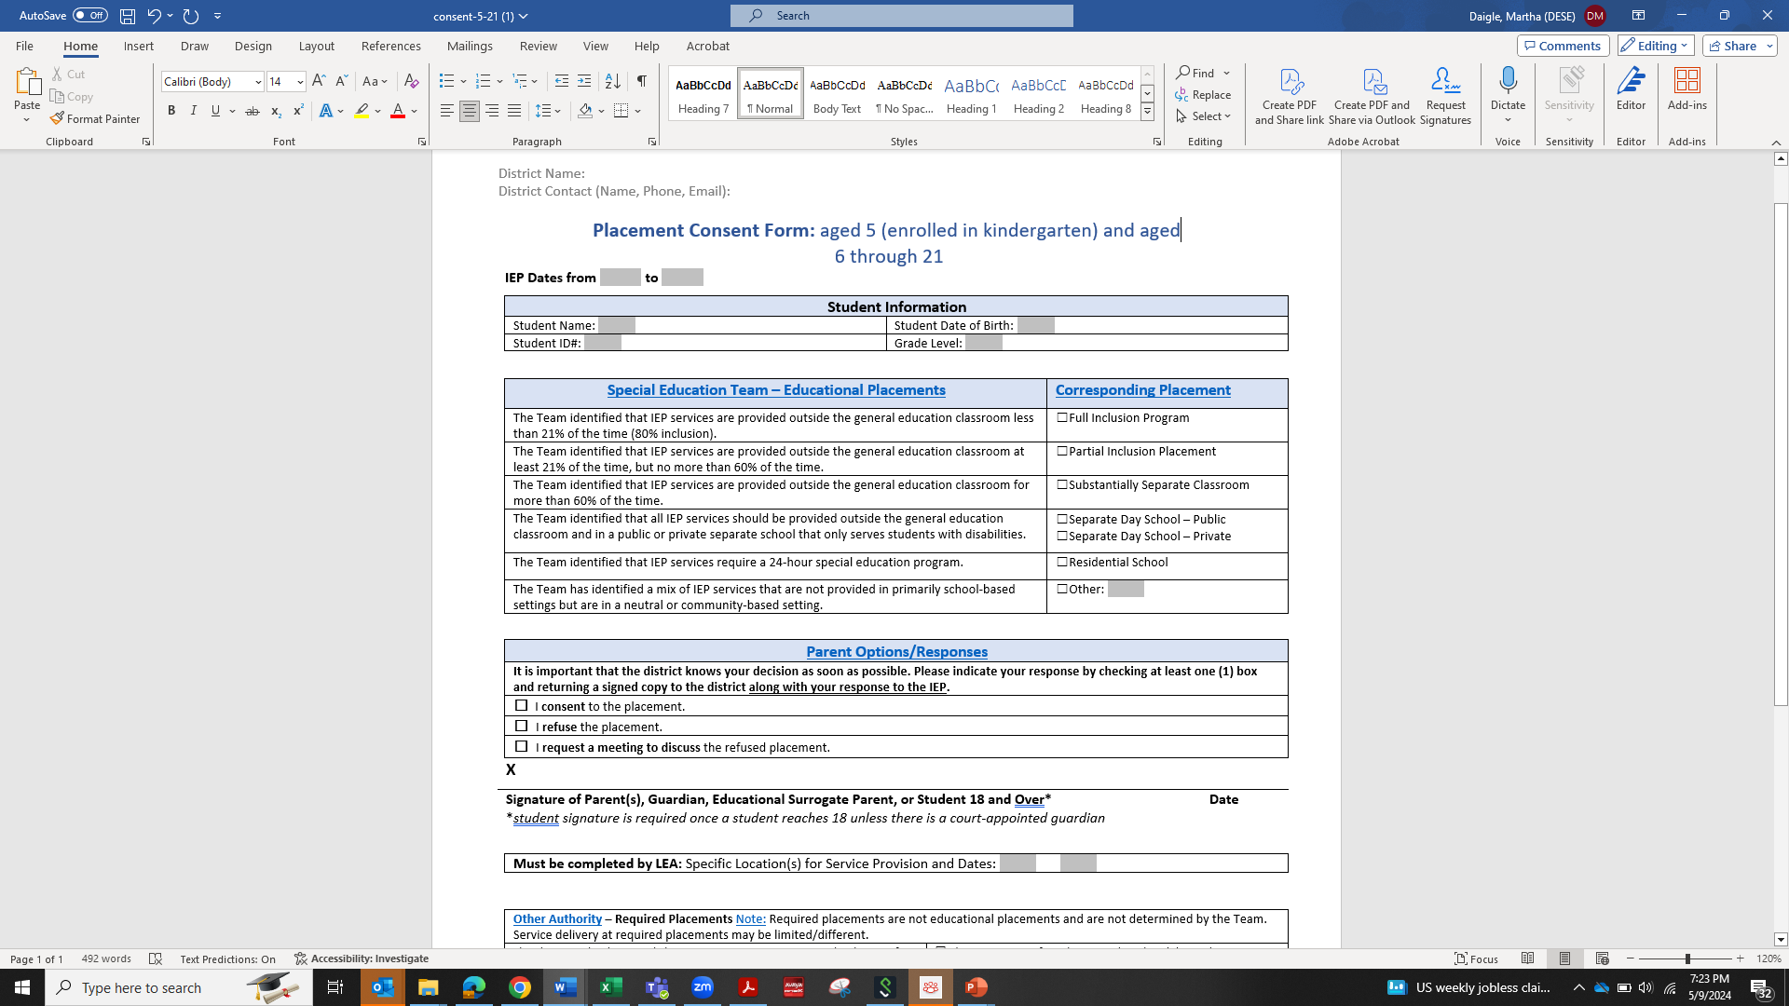
Placement Consent Form
https://www.doe.mass.edu/sped/ImproveIEP/consent-5-21/

Slide 28
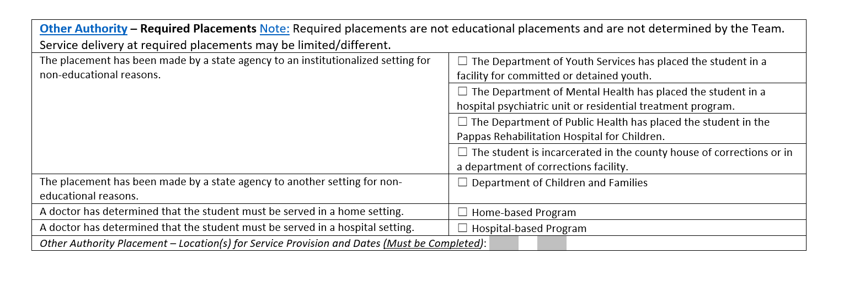
Placement Consent Form: Identifying Required Placements
https://www.doe.mass.edu/sped/ImproveIEP/consent-5-21/

Slide 29
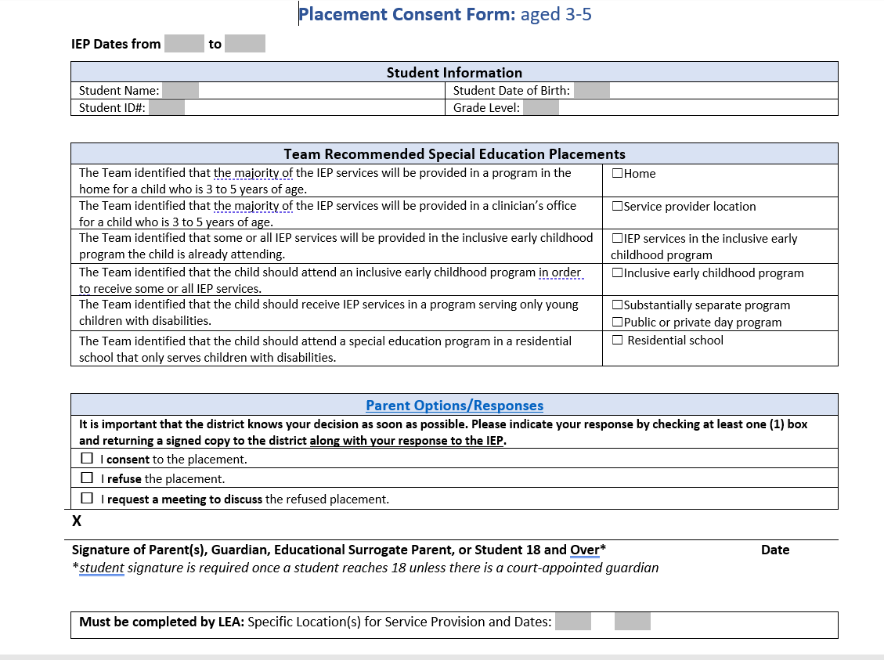
Placement Consent Form: Early Childhood
https://www.doe.mass.edu/sped/ImproveIEP/consent-3-5/

Slide 30
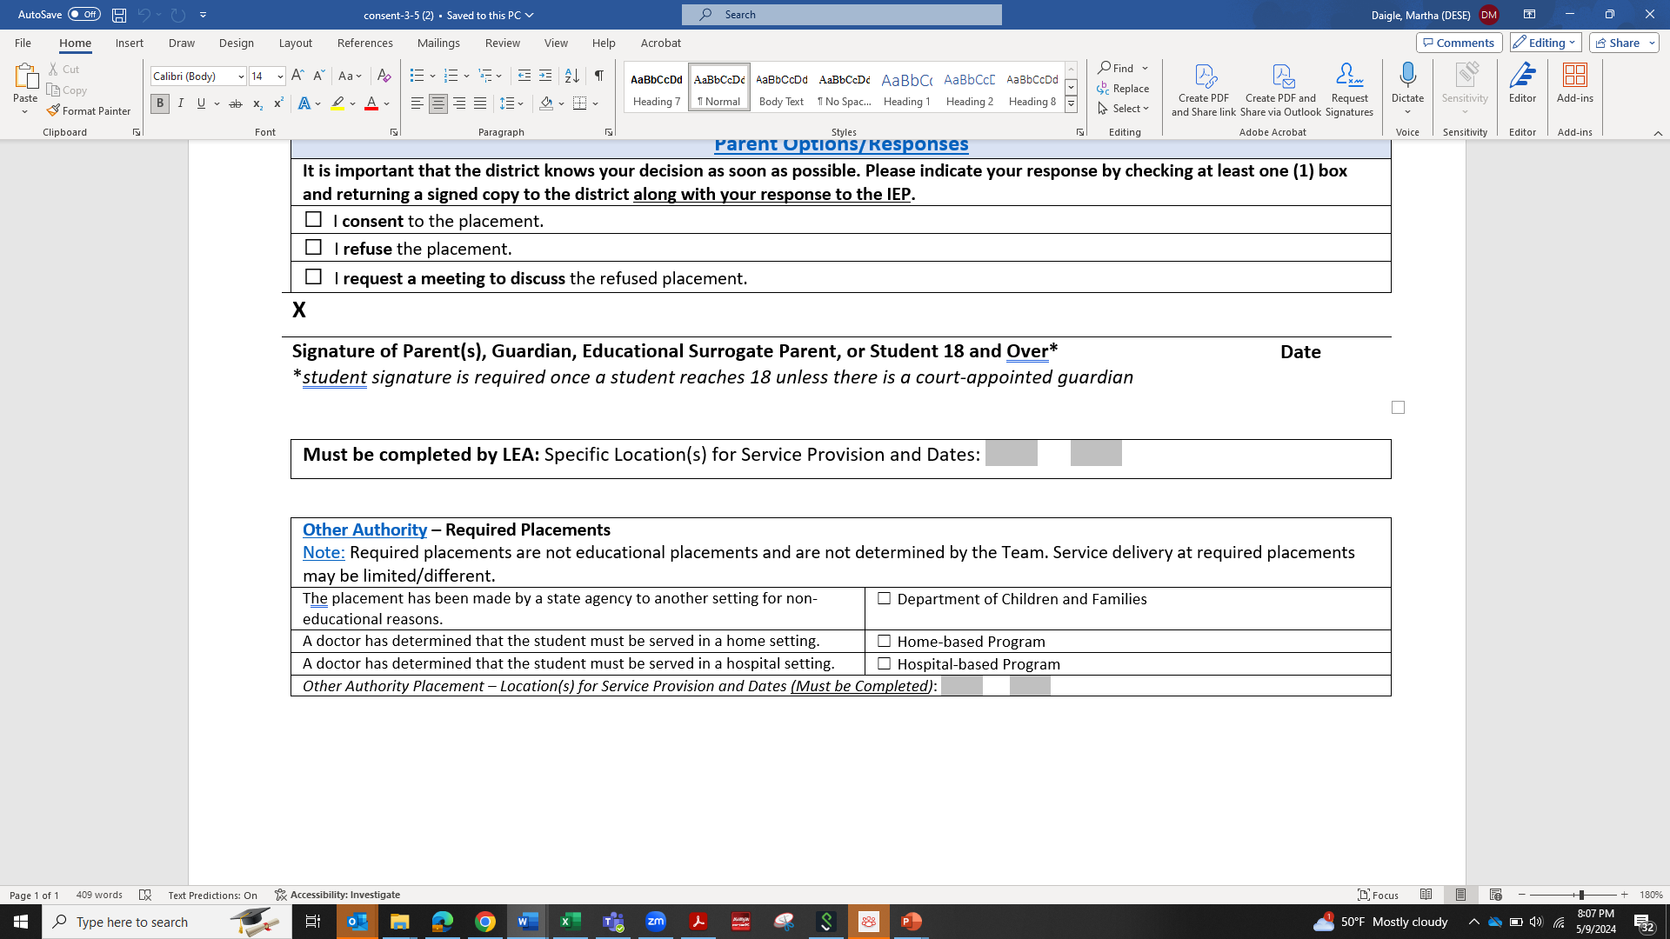
Placement Consent Form: Identifying Required Placements
Early Childhood
https://www.doe.mass.edu/sped/ImproveIEP/consent-3-5/

Slide 31
Planning for the 2025-2026 School Year

Slide 32
Monitoring Activities

Slide 33
Office of Approved Special Education Schools
Data Collections: Cohort 1 reviews are underway. Cohort 2 received training last week and data collections will be released soon. If you have any questions or challenges with your data collections, please contact your liaison, email OASES1@mass.gov, or join the CHAMP office hours.
Action Forms: Liaisons are closing out the 2024–2025 school year forms. Please check CHAMP to confirm there are no outstanding items.
CHAMP Enhancements: We continue to make improvements to the CHAMP system, including updates to email notifications to ensure accuracy and reliability.

Slide 34
Office of Public School Monitoring
Updates
Out of District Monitoring Form
Child Find & MTSS
Office Hours

Slide 35
Office of Public School Monitoring
Out of District Monitoring (SE 37)
The school district is required to monitor the provision of services to and the programs of individual students placed out-of-district. Documentation of monitoring plans and all actual monitoring shall be placed in the files of every eligible student who has been placed out-of-district. To the extent that this monitoring requires site visits, such site visits shall be documented and placed in the students' files for review. The duty to monitor out-of-district placements cannot be delegated to parents or their agents, to the Department, or to the out-of-district placement. The school district may, however, contract directly with a person to conduct such monitoring.
603 CMR 28.06(3)(b)

Slide 36
Office of Public School Monitoring
Child Find & MTSS
SE 2 Required and Optional Assessments
SE 15 Child Find
CR 18 Responsibilities of the School Principal

Slide 37
Office of Public School Monitoring
Use of tiered interventions or screening tools may not be used to delay or deny a full and individualized evaluation of a child suspected of having a disability.
An evaluation of a student may be conducted at the same time as the student receives tiered interventions and supports.

Slide 38
Office of Public School Monitoring
PSM Office Hours
September 9, 2025:
  MORNING: 8am to 9am
  AFTERNOON: 3pm to 4pm
September 23, 2025:
  MORNING: 8am to 9am
  AFTERNOON: 3pm to 4pm

Slide 39
Office of Public School Monitoring
This Zoom link is for all office hours and will not change:
https://us02web.zoom.us/j/87586189490
Meeting ID: 875 8618 9490
One tap mobile
+16465588656,87586189490# US (New York)
+16469313860,87586189490# US

Slide 40
Professional Development and Targeted Assistance

Slide 41
Professional Development on IEP Implementation
The Department’s Office of Special Education Planning and Policy, in collaboration with the Federation for Children with Special Needs, is offering four professional development sessions focused on implementing the updated Individualized Education Program (IEP) form. Two sessions are designed for educators, and two are tailored to the needs of school leaders. These sessions will offer practical guidance, tools, and strategies to support the development of meaningful and compliant IEPs.
Sessions for school leaders:
Virtual: 9:00 a.m. to 12:00 p.m. on Tuesday, August 19
Boston: 9:00 a.m. to 12:00 p.m. on Wednesday, August 20
Sessions for educators:
Brockton: 9:30 a.m. to 1:30 p.m. on Wednesday, August 27
Westfield: 9:00 a.m. to 1:00 p.m. on Wednesday, August 27
Registration is open online. The location or Zoom link will be emailed to participants after they register.

Slide 42
Technical Assistance Provider: AnLar
Education management consulting firm
Supports states and district-level staff
Expertise in early childhood special education (Part C Early Intervention and Part B Special Education)
AnLar is excited to work with all of you and are committed to being as responsive as possible, so we welcome your feedback & input as we collaborate.

Slide 43
Tiered System of Technical Assistance (TA)
Intensive TA
Individualized support provided to programs and districts identified by the state or who request intensive supports to address the transition process.
1
Targeted TA
Focusing on engaging personnel and programs directly to support the transition process.
2
Universal TA
Resources available statewide with consistent messaging of regulations, guidance, and procedures on Part C and Part B transition.
3

Slide 44
Universal Technical Assistance
Statewide support with consistent messaging of regulations, guidance, and procedures on the Part C to Part B Section 619 transition.
Updating existing DESE and DPH resources
Creation and publication of new resources
Creation of new webinars and asynchronous training resources for DESE and DPH as requested

Slide 45
Targeted Technical Assistance
Supports focused on engaging personnel and programs directly to support their transition process.
Facilitation of Early Childhood (EC) Collaborative Convenings
Facilitation of relationships between EIS programs and LEAs
Office Hours by appointment
Topic specific office hours as needed in collaboration with DESE and DPH
Leveraging partnership with the MA Early Childhood Special Education Administrator’s Leadership Institute (ECLI)

Slide 46
Intensive Technical Assistance
Individualized supports that are provided to EIS programs and LEAs identified by the state or who request intensive support to address the transition process.
Personalized support for EIS programs and LEAs with a strong desire to collaborate and increase transition supports and processes
Root cause analysis through direct consultation and coaching
Focused on EIS programs and LEAs identified by DPH and DESE
Consultation and Coaching

Slide 47
2025 Early Childhood Convenings
Yearly Schedule
Date & Time
October 15 at 11:30 - 1:00 PM
January 22 at 10:00 - 11:30 AM
March 25 at 1:00 - 2:30 PM

Slide 48
Connect with the AnLar Team
Office hours by appointment through Calendly
Or reach out by email:
Nancy Surbrook Goins nsurbrookgoins@anlar.com
Rachel Page rpage@anlar.com
Melanie Reese mreese@anlar.com

Slide 49
Indicator 7 Monthly Professional Learning Community (PLC)
The PLC is open to teachers and leaders from Massachusetts public schools and takes place on the fourth Tuesday of each month through June 2026.
The first PLC will be August 26th at 1 pm and you can register here: https://air-org.zoom.us/meeting/register/28VUM0eLRGySvbPGrjhVJw

Slide 50
LEA Determinations
Technical Assistance (TA)
SPED Strategies will continue to provide Special Education Determination improvement planning and support to LEAs with NI or NA status.
To access information and resources about the new Matrix and more go to
MA Local Education Agencies' (LEA) Special Education Determinations - Special Education
New Special Education Administrator? Or New to Your LEA?
  This year’s annual notification is available in your district’s Security Portal at -> “Dropbox Central” -> “Special Education State Performance Plan.”
  Visit School and District Profiles to:
    Check that your name and current email address are listed, and if not, contact your LEA’s Directory Administrator.
    Find where your LEA’s data is publicly posted

Slide 51
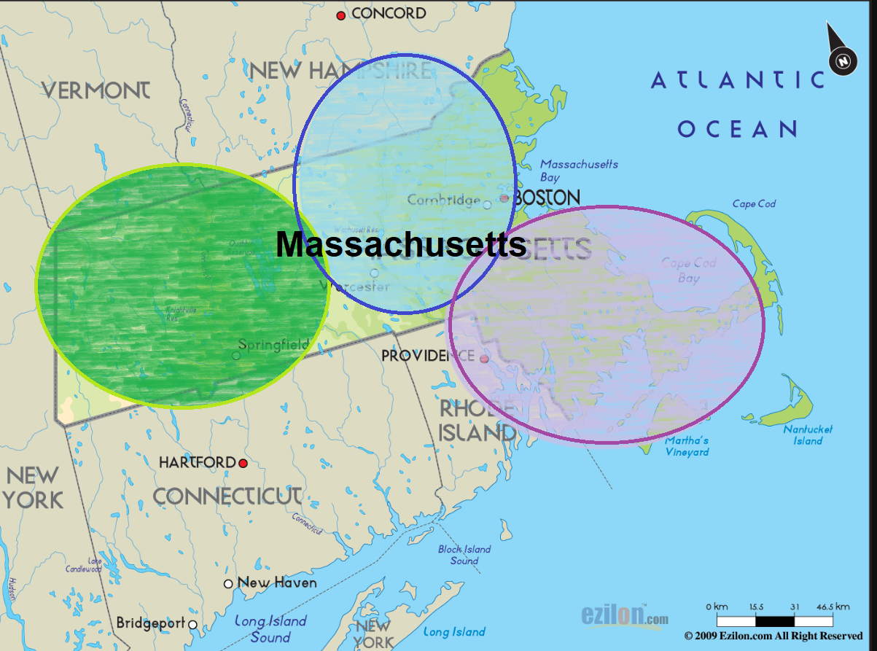
LEAs with NI or NA Determination
Save the Dates!
Orientation Webinar – September 10, 2025, 11a.m.-12p.m.
Office Hours – September 22, 2025, 2-3 p.m.
3. Fall In Person Regional Convenings
  Southeast (Taunton): Oct. 7-8 & Oct. 9
  Central/Northeast (Devens): Oct. 14-15 & Oct. 16
  OR
  c. West (Holyoke): Oct. 21-22 & Oct. 23

Slide 52
Special Education Staff and Leaders
Professional Development and Leadership Institutes
Early Childhood
Educational Team Leaders
New Directors/Experienced Directors
Paraprofessionals
Focus on Principal Leadership in Special Education
  Stay tuned for more information!

Slide 53
Dispute Resolution

Slide 54
PRS Complaint Intakes Received FY10-FY25

Slide 55
PRS Updates
Updated our PRS Technical Assistance telephone system to support language access.
Continued internal targeted effort to resolve overdue SE complaints.
  Have the parties resolved the dispute raised in the complaint?
Expect alternative investigation approaches that, at a minimum:
  Provides the Complainant an opportunity to provide additional information;
  Provides the District with the opportunity to respond to the complaint.
Anticipate a change to the PRS intake process.

Slide 56
Top Complaint Concerns & Strategies to Address Them
Special Education Procedural Concerns (ex., Evaluation timeline, IEP Development)
    Use Notices of District Action to memorialize what happened (and why)
    Remind teams about requirements related to the use of SLD forms
Special Education Implementation (ex., Provision of related services, accommodations)
  Keep records or logs of services provided and/or missed
  Engage families in discussions about how accommodations will be provided, and periodically check in with them
Bullying
  Encourage real-time communication between building-based leadership and special education teams if a student supported by an IEP is a party to alleged bullying
    SE Team consideration: whether steps need to be taken to address FAPE for the involved student?

Slide 57
Tips for Navigating PRS
Communicate with the specialist assigned to the complaint.
  What information may not be captured by documentation?
  Who in the District should the specialist speak with about the complaint?
Parties are encouraged to continue to work together to resolve their disputes before, during, and after a complaint has been filed.
  A complainant can withdraw some or all their concerns at any time before a determination.
    Local Agreement Form or Email to the Specialist
DESECompliance@mass.gov

Slide 58
IDEA Data and Fiscal

Slide 59
Indicator 14: Post-school Outcomes Data Collection
As a reminder, this year’s shortened data collection period for Indicator 14: Post-School Outcomes is scheduled to end on Monday, September 22, 2025.
New to Indicator 14 data collection? Or not sure where to begin? A great resource is our updated FFY 2024 Indicator 14 Step-by-Step Instructions and Guidance on our Indicator 14 web page.
Still have questions? Please contact DESE’s Indicator 14 Data Collection team at IDEAdata@mass.gov.

Slide 60
Significant Disproportionality Updates
Data will be uploaded and published to Edwin the second week of September.
Districts will be notified via email of their identification and required activities for the 2025-26 school year.
DESE has contracted with a vendor to provide more in-depth technical assistance around Root Cause Analysis and Action Planning
Identified districts will be required to attend in person convenings in October and January to complete these activities
For districts who are Identified and have a Determination status of Needs Assistance or Needs Intervention an overlap webinar will take place for them to participate, but will only be required to attend the Significant Disproportionality Convenings

Slide 61
Significant Disproportionality Dates
Notifications to be sent out September 2025
Fall In Person Convenings – Root Cause Analysis
  South – October 14 and 15, 2025
  North – October 20 and 21, 2025
  Root Cause Analysis will be due to SPED Strategies and DESE in December 2025
Winter In Person Convenings – Action Planning
  South – January 14, 2026
  North – January 21, 2026
  Action Plans will be due to SPED Strategies and DESE in March 2026
CCEIS Virtual Webinar May 2026

Slide 62
Comprehensive Coordinated Early Intervening Services (CCEIS) Fiscal Monitoring
All schools and districts required to reserve 15% of its total IDEA Part B allocation for CCEIS in FY25 must have expended those funds in FY25
FY25 monitoring reporting due August 22, 2025
If FY25 CCEIS funds are not fully expended in FY25, the school or district must submit a written action plan to expend any remaining FY25 CCEIS balance forthwith and no later than June 30, 2026.
Schools and districts that did not fully expend FY24 CCEIS funds in FY24 must now demonstrate full expenditure for budgeted allowable activities.
Audit documentation including general ledgers and evidence of allowable expenditures must be submitted to IDEAfiscal@mass.gov
CCEIS Quick Reference Guide

Slide 63
FY26 Consolidated FC 240/262 Application
Now Available in GEM$
FY26 IDEA Consolidated Application Webinar Materials
Applications due no later than September 30, 2025
May not use FY26 funds for expenses incurred prior to the date a "substantially approvable" application is submitted
Conditions of Assistance and other Assurances
General Education Provision Act (GEPA) Statement
FCs 240 & 262 Budget – allowable IDEA expenses
CCEIS – required 15% of combined FC 240 & FC 262 allocations
M3 – NI2 schools and districts required to reserve at least 2% of its FC 240 allocation
  M3: Determination Action Plan Template Coherence

Slide 64
IDEA Equitable Services Carryover and Monitoring
GEM$ Application Supplement
Due September 30, 2025
All districts of residence with a calculated FY24 and or FY25 proportionate share for equitable services must complete the IDEA Equitable Services Carryover and Monitoring Supplement
  At a minimum, all districts must upload evidence of actual or attempted timely and meaningful consultation with both school and parent representatives at least three (3) times during FY25 (fall, winter, spring)
  Districts must report any FY24 and or FY25 unexpended proportionate share carryover amounts and document how funds will be used prospectively
  Districts with any FY24 funds not expected to be fully expended by September 30, 2025 may request written permission to revert those funds for other allowable IDEA Part B expenses, including submission of additional documentation

Slide 65
Expiring IDEA Part B Funds
FY24 FC 240 and FC 262, and FY25 FC 274 (IEP Improvement) Funds expire September 30, 2025
Funds must be obligated on or before September 30, 2025, and liquidated no later than ninety (90) days thereafter
GEM$ Reimbursement Requests no later than November 30, 2025
GEM$ Final Expenditure Report (FER) due no later than December 31, 2025
  LEA may include final reimbursement requests in the FER
Failure to (1) fully expend and claim FY24 FC 240, FC 262 or FY25 FC 274 funds or 2) timely file the GEM$ FER will be considered in the LEA's annual fiscal risk assessment

Slide 66
FY25 Financial End of Year Reports
Final FY25 Financial End of Year Reports (EOYR) Due:
  September 30, 2025 - individual and regional districts and vocational schools with the Office of School Finance
  November 14, 2025 - charter schools with the Charter School Office
  January 30, 2026 – virtual schools with the Charter School Office
Ensure relevant expenses are distributed as special education as that total will be considered for the FY25 Maintenance of Effort (MOE) compliance determination in March 2026
Failure to timely file and certify, and making any subsequent corrections or amendments to the EOYR will be considered in the LEA's annual fiscal risk assessment

Slide 67
IDEA Part B Fiscal Monitoring
Local Education Agency (LEA) Annual Fiscal Risk Assessment
Tier I – Universal Annual Monitoring
Tier II – Cyclical Monitoring every six (6) years
  Same year as the LEA's Group B Intergrated Monitoring Review (IMR) with the Office of Public School Monitoring (PSM)
  FY26 LEA Orientation October 15, 2025
Tier III – Targeted Monitoring for LEAs with the highest relative risk based on annual fiscal risk assessment, credible allegation(s) of noncompliance, or any other reason at the Department's discretion

Slide 68
Annual IDEA LEA Fiscal Risk Assessment
Turnover in personnel
Length of time in operation and receiving IDEA Part B grant funding
Timely and accurate of end of year financial reporting
Significant Disproportionality identification and CCEIS required reservation
Amount of IDEA Part B allocations
Single Audit participation and findings
Maintenance of Effort (MOE) Compliance
Full and timely expenditure and claim of IDEA Part B funds, including FCs 240, 262, 213, and 274, and required CCEIS and proportionate share funds for equitable services
Timely, complete, and accurate child count submissions
Changes in child count and proportionate share allocations
Timely completion of annual excess cost calculation

Slide 69
IDEA LEA Fiscal Staff Data Submission
As we begin FY26 and School Year 2025-2026, the Department's IDEA Part B Fiscal Team requires your local education agency (LEA) complete and submit no later than August 22, 2025 the following brief fiscal data collection linked below to update the Department's records on LEA fiscal staff in your school or district who understand and implement federal fiscal requirements pursuant to Uniform Grant Guidance, 2 CFR Part 200, and IDEA Part B, 34 CFR Part 300. The required information facilitates the Department's implementation of required IDEA Part B general supervision responsibilities, including annual fiscal risk assessment, monitoring, and targeted technical assistance and professional development for LEAs.
Data Submission-on-LEA-Staff-with-IDEA-Part-B-Fiscal-Responsibilities

Slide 70
IDEA Fiscal Monitoring: Tier I – Universal
Review and approval of IDEA Part B Consolidated grant application and budgets, and required assurances under 34 CFR § 300.200
GEM$ budget revision review and approval
Submission and review of final expenditure reports (FER)
Maintenance of effort (MOE) compliance determination and substantiation of exceptions and adjustments
Excess cost calculation submission review
Monitoring the timely obligation of funds
Annual risk assessment
Review of Single Audit reports (if applicable)
Review of proportionate share for equitable services expenditure and carryover, and timely and meaningful consultation at least three (3) times each year (fall, winter, spring)
Review and audit of CCEIS expenditures against approved action plan and budget
Annual training provided to LEAs on IDEA fiscal compliance requirements

Slide 71
IDEA Fiscal Monitoring: Tier II – Cyclical
IDEA Part B LEA Fiscal Self Assessment
Written, board-approved, fiscal policies and procedures required by Uniform Grant Guidance, 2 CFR Part 200, and IDEA Part B, 34 CFR Part 300
Grant award letters, procurement files, documents, and related correspondence
Equipment purchases/inventory lists
Time and effort documentation
LEA budget, general ledger, and or expenditure documentation for FC 240, 262, 213, and 274 funds
IDEA Part B GEM$ applications, budgets, and budget revisions
Excess cost calculation detail
Financial Management Assurance Statement(s) and Audit reports
Proportionate share for equitable services expenditure documentation
Voluntary Coordinated Early Intervening Services (CEIS) expenditure documentation and data collection (if applicable)

Slide 72
Child Count of Parentally-Placed Private and Home School Students
Conducted as of October 1st each year
When collecting the count from private schools, request contact information for parent representatives of eligible students for meaningful consultation
October 1, 2025 Child Count and SY24-25 Equitable Services Record Keeping data submission due January 30, 2026
  Failure to submit the annual child count by January 31, 2026 will be considered in the LEA's Annual Special Education Determination
SY24-25 Equitable Services Child Count and Record Keeping Memorandum
SY24-25 Record Keeping
  Number of private and home school students evaluated by the district
  Number of private and home school students found eligible by the district
  Number of private and home school students who received equitable services from the district

Slide 73
Private School Enrollment Data Submission
Private school enrollment data is used in the annual LEA FC 240 and 262 allocation calculations
Private schools are asked to submit grade level enrollment data though a Department Education Security Portal Application each October 1st
Districts of residence encouraged to contact local private schools and remind them of the importance of this data submission
  Each district can find a list of last identified private schools in the Department's School and District Profiles / Relationship Membership for your district
  Can and should be done during annual child count collection and fall timely meaningful consultation for equitable services

Slide 74
IDEA Excess Cost Calculation
Excess costs are those costs for the education of an elementary school or secondary school student with a disability that are in excess of the average annual per student expenditure in an LEA during the preceding school year for an elementary school or secondary school student. An LEA must spend at least the average annual per student expenditure on the education of an elementary school or secondary school student with a disability.
Appendix A to Part 300, Title 34 - Excess Cost Calculation
GEM$ Application Supplement for all schools and districts this year
  Replaces calculation in End of Year Report (EOYR)
Due January 31, 2026
Failure to timely complete and submit the required annual calculation will be considered in the LEA's annual fiscal risk assessment

Slide 75
IDEA Fiscal Virtual Community of Practice
First Thursday, 3:00-4:00 pm
  September 4, 2025 – LEA Fiscal Universal, Cyclical, and Targeted Monitoring
  October 2, 2025 – Child Count & Timely and Meaningful Consultation for Equitable Services
  November 6, 2025 – Excess Cost Calculation
  December 4, 2025 – GEM$ Reimbursement and Final Expenditure Reports
  January 8, 2026 – GEM$ Budget Revision and Financial Activity Reporting
  March 5, 2026 – Maintenance of Effort, Exceptions and Adjustments
  May 7, 2025 – Proportionate Share for Equitable Services Carryover
  June 4, 2025 – FY27 Consolidated Application, Conditions of Assistance

Slide 76
Resources

Slide 77
K-12 AI Resources
We’re excited to share that DESE has released two foundational resources to support schools and districts as they navigate the use of generative artificial intelligence (AI) in education:
Massachusetts Generative AI Policy Guidance
AI Literacy Module for Educators
These resources, developed in response to the recommendations of the statewide AI Task Force, are designed to help school communities make thoughtful decisions about AI that are grounded in safety, ethics, and instructional purpose, and to promote a consistent, equitable approach across Massachusetts.

Slide 78
FY26 LEA Special Education At-A-Glance Calendar
Monthly Activities Related to:
  SPP/APR Indicator Data
  Other Data
  LEA Determinations
  Significant Disproportionality
  Fiscal
What other reminders would be helpful?

Slide 79
Information for Special Education Leaders
Regular Updates and Information
  Special Education Bulletin
  Special Education Website
Update Information in the Directory Administration
  Special Education Leaders Meeting Invites and Memos
Email Contacts
  specialeducation@mass.gov (General Special Education Inquiries)
  IDEAfiscal@mass.gov (IDEA Fiscal Inquiries)
  IDEAdata@mass.gov (IDEA Data Inquiries- Special Education or SPP/APR Data)

Slide 80
2025-2026 Meetings
Month | Proposed Meeting Date
October | Friday, October 3, 2025
November | Friday, November 7, 2025
December | Friday, December 12, 2025
January | Friday, January 23, 2026
February | Friday, February 27, 2026
March | Friday, March 13, 2026
April | Friday, April 10, 2026*
May | Friday, May 15, 2026*
June | Friday, June 12, 2026
*Dates are tentative for April and May as we are exploring an in-person convening in the spring

Slide 81
Survey for Future Meeting Topics

Slide 82
Questions
and
Answers

