Slide 1
Special Education Leaders' Meeting
October 3, 2025

Slide 2
Agenda
Metropolitan Council for Educational Opportunity (METCO)
MA Inclusive Concurrent Enrollment Initiative
Policy Updates and Key Special Education Topics
Fiscal Topics
Resources

Slide 3
Survey for Future Meeting Topics
Notes:
https://forms.office.com/Pages/ResponsePage.aspx?id=Fh2GPrdIDkqYBowE2Bt7KrexNIXVoEdPhsHF1JPBZAxUNkg0M1U3RFJFTk9LU05CV0gyRFo4SjRJOC4u

Slide 4
METCO Students:
IEPs vs. Learning Gaps

Slide 5
METCO Program Overview & Roles
DESE
  Fiscal Conduit
  Policy Approver
  Contracts METCO, Inc. and support METCO districts
METCO, Inc. (Boston) & Springfield Public Schools (Springfield)
  Manage the application lottery process and communicate and offer support to METCO families.
METCO Districts
  METCO districts oversee the day-to-day operations of the program and the vision for achieving racial balance within their school district.

Slide 6
METCO: Special Education Data
Dr. Elizabeth Setren
  METCO students are 10-15% more likely to get classified as special education students but are 3-4% less likely to have a substantially separate inclusion classification.
  It is unclear whether students are getting the culturally and linguistically responsive support they need or if this is more so an issue of over classification.
DESE
  Department data continues to show that Black/African-American boys are over identified for services in METCO districts.
  The Department continues to receive complaints, both formal and informal, regarding IEP implementation and program rejection based on METCO districts' inability to fulfill applicants' IEPs.

Slide 7
METCO Program Regulatory Authority
Massachusetts General Laws (MGL)
  Chapter 76, Section 12A : Plan for attendance in public school to eliminate racial imbalance; adoption; financial and technical assistance
  Chapter 71, Section 1I: Elimination of racial imbalance; assistance in formulation of plans; effect of non-compliance; denial of state aid; transportation costs; equal education improvement fund; guidelines
  Chapter 71, Section 37D: Racial imbalance; definitions; statistics; transfers; priorities; plans for elimination; public hearings; regulations; jurisdiction; costs; attorney's fees
  Chapter 71, Section 37I: Magnet school facilities; grants; application; approval; agreements; eligible costs; regulations
  Chapter 71, Section 37J: Magnet educational programs; reimbursement for cost; definition; contracts; joining programs
Code of Massachusetts Regulations (CMR)
  603 CMR 17.00: Racial Imbalance And Magnet School Programs
  603 CMR 28.10: School District Responsibility
  603 CMR 10.00: School Finance
Annual state budget
Notes:
DESE Accepted but Not Yet Enrolled Technical Assistance Guidance (2020): https://www.doe.mass.edu/sped/advisories/2020-3ta.html
This guide outlines the suggested IEP process that should be undertaken as soon as the METCO applicant has accepted their offer of admission from the METCO district but has yet to be enrolled, particularly when student needs are complex so that service equivalencies in the METCO district may be identified prior to enrollment and a temporary plan implemented upon enrollment .

Slide 8
Dilemma
How do we navigate the work around serving a student with a learning gap verses a student with an IEP? What advice do we need to give to METCO Directors and Special Education Directors?
Will having a conduit Special Education Director between Boston Public Schools and METCO districts help? If so, what would be their role?

Slide 9
Quarterly METCO Community Meeting Schedule
Session #1/4: Wednesday, October 22nd | 9:30-11am
  Requested Attendees: METCO Superintendents & Special Education Directors
Session #2/4: Thursday, December 11th | 11:30am-1pm
Session #3/4: Tuesday, February 10th | 9:30-11am
Session #4/4: Wednesday, April 8th | 9:30-11am

Slide 10
MA Inclusive Concurrent Enrollment Initiative

Slide 11

First of it’s Kind Legislation Passes in Massachusetts

Slide 12

New Law (MAIPSE) Task Force Established

Slide 13


Task Force/Advisory Board Members Worked Together on Report and Recommendations
Department of Developmental Services
MassAbilities
MAIPSE
Department of Higher Education
Council of Presidents Mass State University System
Mass Association of Community Colleges
Mass Association of School Committees
Mass Advocates for Children
Mass Down Syndrome Congress
Advocates for Autism
School Districts
Alumni Students

Slide 14
Board of Higher Education Approves Regulations to Improve Post-Secondary Opportunities for Students with Disabilities
All public colleges and universities in Massachusetts are required to provide appropriate resources and supports for students with disabilities who wish to attend college and learn alongside their non-disabled peers.
Adult agencies supporting adults with disabilities working on guidelines to provide financial support for these students to attend college.
Campuses encouraged to apply for MAIPSE funding to help plan and implement a MAIPSE Program.

Slide 15
MAIPSE Expectations
Program Growth
Increase School District Partnerships
517 Public School Districts
73 Charter Schools
24 Collaboratives
MAIPSE 122 School District Partners
3 Charter Schools
5 Collaboratives
WE HAVE WORK TO DO

Slide 16



Expanding Partnerships
New legislation will open doors for so many adults with intellectual disabilities who want to continue to learn in college!
  Get the word out to families
  Get the word out to students over 21
  MAIPSE included in Adult Service Agencies meeting calendars

Slide 17
Spreading the Word
Present at Mass Down Syndrome Congress Conference
Present at State-of-the-Art Conference
Present at Southeast Post Secondary Education Alliance
Attend Transition Fairs throughout the state
Providing support to new MAIPSE campuses
Communicating with campuses who do not yet have MAIPSE
Creation of new MAIPSE Website

Slide 18

Working Together to Increase MAIPSE Throughout the State

Slide 19
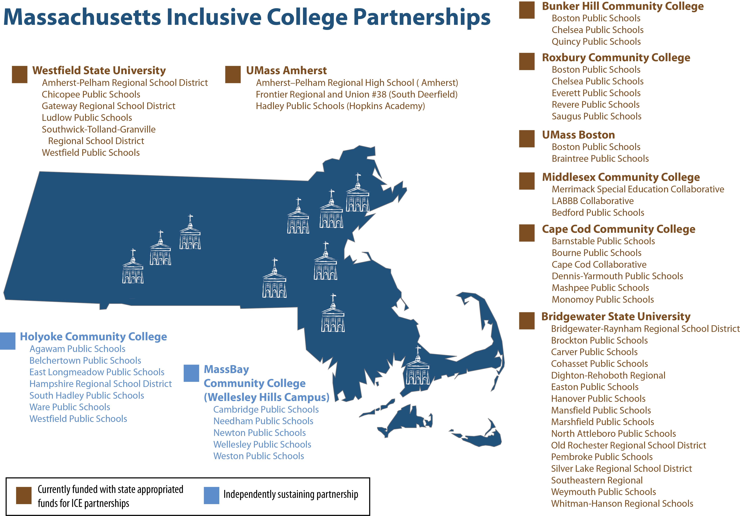
Massachusetts Inclusive College Partnerships

Slide 20
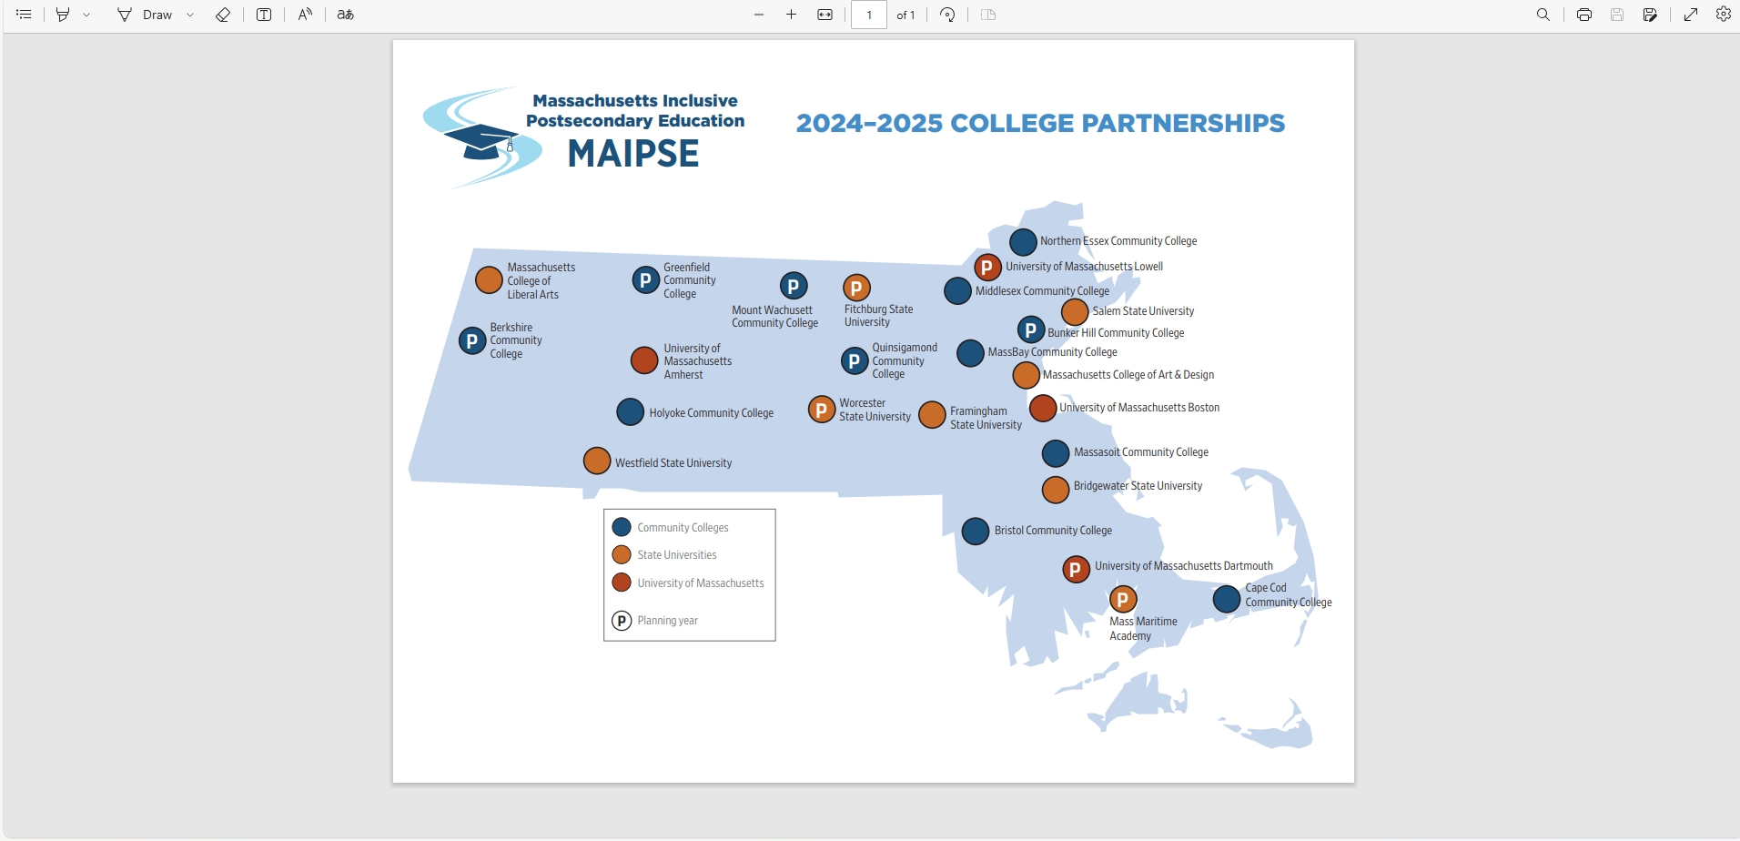
2024-2025 College Partnerships

Slide 21

What is MAIPSE Providing?
PARTIAL GRANT FUNDING
Onboarding all new partnership staff
Training for adult service agency staff
Continued outreach to families, students and educators
Working with MAIPSE Campuses to gain CTP (Comprehensive Transition Program) status
Assist MAIPSE campuses with the offering of a university endorsed certificate
Streamlining program fees across all partnerships
Work on increasing the number of students with paid employment outcomes
Increase the number of regional consortia

Slide 22
MassAbilities
Agency Criteria/Funding Opportunities
Department of Developmental Services (DDS)
Attending college with the intent of earning a degree
Attending a
Programs designed specifically for people with intellectual/developmental disabilities with a focus on career exploration and development of job skills
Tuition waiver and financial assistance for books & fees for those attending college with the intent of earning a degree
Must meet financial need threshold and complete FASFA application to receive funding
Certificate program at a college or university
trade Program (HVAC, graphic design etc.)
Associated career goals
Auditing a class that is of interest to you (creative writing, early childhood education, photoshop etc.)

Slide 23
How do I Obtain Access to DDS Funding Opportunities
STEP 1
STEP 5
The committee will send a decision letter to the regional Self Direction Manager who will then share it with your Support Broker/Service Coordinator.
You will receive notification from your Support Broker/Service Coordinator on the committee's decision.
STEP 6
If approved, you have the option of paying the school directly or being reimbursed. If you would like to have DDS pay the school directly, please ensure that there is a W9 on file for them and they are set up as a vendor through the PDP. Your Support Broker/Service Coordinator can help you with this.
STEP 2
STEP 3
STEP 4
Your Support Broker/Service Coordinator will submit an application to the regional Self Direction Manager for review.
The regional Self Direction Manager will send the application to the Post High School Education Review Committee at Central Office for approval.
The committee will review and reach out to your Support Broker/Service Coordinator with any questions.
Reach out to your DDS Support Broker/Service Coordinator for the guidance around the 5300P code and what is allowable.
They can also provide some suggestions of programs which are typically funded through 5300P.
Identify a program that meets your needs and will address your employment goals.
There must be an employment component to the program to apply for funding through 5300P
Follow up with your Support/Broker/Service Coordinator and request an application to be submitted for review.

Slide 24



How Can MA Department of Higher Education Help?
  Assist in the application process for State funding
  Connect you with experienced coordinators and staff
  Share common drive with document samples
  Connect you with training opportunities at Institute for Community Inclusion at UMASS Boston

Slide 25
Feel free to contact the DHE for Assistance!
Mary E. Price, M.Ed.
Director, Massachusetts Inclusive Postsecondary
Education (MAIPSE)
W 617-994-6905 / C 617-418-0496
mprice@dhe.mass.edu

Slide 26
Special Education Updates and Key Special Education Topics

Slide 27
DMS Monitoring: Three Phases
Discovery October 2025
(5 months prior to engagement)
  Document Request
  State Overview Call
  Stakeholder engagement
  Local Component
Engagement March 2025
(1 month (visit) through issuance of the DMS Monitoring Report)
  Onsite and Virtual monitoring interview calls
  Issuance of the DMS Monitoring Report
Close-out
(up to one year after the issuance of the DMS Monitoring Report)
  Review of evidence of correction
  Technical Assistance

Slide 28
Policy Updates

Slide 29
Monitoring of Out-of-District Placements
LEAs are required to monitor the provision of special education and related services and the programs of students placed by the LEA in out-of-district placements, including special education private schools.
Efficient and effective monitoring can be accomplished through regular communication, clear accountability, and coordinated planning between the LEA and out-of-district placement.
Students placed out-of-district by LEAs have all the rights of a child with a disability who is served by a public agency under IDEA Part B. LEAs are responsible for ensuring students placed out-of-district are receiving those rights and protections, the services in their IEPs, and, ultimately, FAPE.
Documentation of monitoring plans for each student placed out-of-district must be kept in the files of every eligible student placed out-of-district.
Newly created Out-of-District Monitoring Form can assist districts with implementing monitoring requirements.
Notes:
In addition, for students working towards a high school diploma, the IEP Team must discuss and document in the IEP, the student's progress towards attaining the CD in accordance with the placing school district's policy
OOD
For programs approved by the Massachusetts Department of Elementary and Secondary Education in accordance with 603 CMR 28.09 (the "approved" private and public day and residential programs), the placing public school district may assume that the approved special education school has aligned the school curriculum with the state curriculum frameworks consistent with 603 CMR 28.09(9)(b).
For unapproved programs, the placing public school district is responsible for confirming that the curricular program of the unapproved school is aligned to the Massachusetts state curriculum frameworks.
MCAS
All students who receive a publicly funded special education program must be provided with an opportunity to participate in the MCAS testing program (or alternate assessment) according to the federal special education law and MCAS administration guidelines published by the Department of Elementary and Secondary Education.
Diploma
As in the past, any school, including a public school, an educational collaborative, a private special education school, or other out-of-district education agency may issue a certificate to a publicly funded student. The certificate may recognize achievement, attendance, course completion, or participation.
A certificate issued to a publicly funded student by an out-of-district program may only be called a "diploma" and indicate "high school graduation" if the student has met the placing school district's local graduation requirements and its CD requirements.
CD
With respect to the CD requirement: the CD cannot be awarded by the out-of-district placement; rather, only the placing public school district may award a student the CD based on the requirements in its CD policy. By placing the student in an out-of-district program, the placing school district should confirm that the out-of-district placement is able to provide a program sufficient to meet its CD policy. At the annual IEP meeting, the IEP team should discuss the student's progress towards the district's CD requirement. Once the student has attained the district's CD requirement, the out-of-district placement should communicate that fact to the IEP Team and the placing school district. The placing district and out-of-district placement should collaborate to determine the technical details for how the CD will be documented, including the process for the placing school district to confer the CD upon the student.
Considerations for Students with Disabilities and English Learners
When creating a CD policy and implementing the updated requirements, it is essential that districts consider how they apply to various student groups to promote equitable access and support.
District CD Policy
As described in the regulations, each district is required to develop a CD policy. The district’s CD policy must be approved by the district’s governing body (i.e., local school committee or board of trustees). Districts must have their policy for the class of 2026 approved and submitted to DESE no later than December 31, 2025
Change of Placement/Disputes
Because receipt of the high school diploma ends a student's eligibility for special education and related services, the parent or student with decision-making authority may invoke due process protections under IDEA by requesting a hearing or other dispute resolution procedures
A parent or student with decision-making authority may not unilaterally "refuse" a diploma for which all requirements have been met. They may, however, reject the final IEP on the basis that the student did not receive FAPE. If this occurs, the student and district have opportunities to resolve the disagreement through mediation or formal dispute resolution procedures under the IDEA.

Slide 30
Monitoring of Out-of-District Placements – Critical Incidents and Disciplinary Matters
In the event of serious injury or death of a student, criminal activity on the part of a student or staff member, or other serious incident affecting the well-being of any student, the out-of-district placement must immediately notify, by telephone and letter, the parents/guardians, the sending LEA, any state agency involved in the student's care or program placement, and DESE.
A student with a disability in an out-of-district placement is entitled to the same disciplinary procedures under the IDEA as a child with a disability being educated by a public agency.
The LEA is primarily responsible, in coordination with the out-of-district placement, for ensuring the student receives the rights and procedures to which they are entitled.
Full discussion of responsibilities is discussed in the newly released Policy Memo.

Slide 31
Continuum of Alternative Placements
Each district must ensure that a continuum of alternative placements is available to meet the needs of children with disabilities and related services.
This continuum must include placements in general education, special education classrooms, special education schools, home instruction, and instruction in hospitals.
It also must include the provision of supplementary services, like a resource room or co-teaching, to be provided in conjunction with general education placement.

Slide 32
Continuum of Alternative Placements
Placement of students with disabilities on that continuum must be made on an individual, case-by-case basis, depending on the child’s unique needs and circumstances based on the child’s IEP.
Placement decisions must not be made solely on factors such as category of disability, availability of special education and related services, configuration of the service delivery system, availability of space, or administrative convenience.

Slide 33
Professional Development and Targeted Assistance

Slide 34
2025 Early Childhood Convenings
Yearly Schedule
Date & Time
October 15 at 11:30 - 1:00 PM
January 22 at 10:00 - 11:30 AM
March 25 at 1:00 - 2:30 PM
Notes:
Register for October 15 | 11:30 AM – 1:00 PM ET
Register for January 22 | 10:00 AM – 11:30 AM ET
Register for March 25 | 1:00 PM – 2:30 PM ET

Slide 35
Indicator 7 Monthly Professional Learning Community (PLC)
The PLC is open to teachers and leaders from Massachusetts public schools and takes place on the fourth Tuesday of each month through June 2026.
The next PLC will be 10/28 at 1 pm and you can register here: https://air-org.zoom.us/meeting/register/28VUM0eLRGySvbPGrjhVJw

Slide 36
Special Education Staff and Leaders
Professional Development and Leadership Institutes
Early Childhood – coming soon
Educational Team Leaders – coming soon
New Directors/Experienced Directors – coming soon
Paraprofessionals E-Learning Modules
Focus on Principal Leadership in Special Education
  Stay tuned for more information!

Slide 37
IDEA Fiscal

Slide 38
FY26 Consolidated FC 240/262 Application
Now Available in GEM$
FY26 IDEA Consolidated Application Webinar Materials
Applications were due no later than September 30, 2025
May not use FY26 funds for expenses incurred prior to the date a "substantially approvable" application is submitted
Conditions of Assistance and other Assurances
General Education Provision Act (GEPA) Statement
FCs 240 & 262 Budget – allowable IDEA expenses
CCEIS – required 15% of combined FC 240 & FC 262 allocations
M3 – NI2 schools and districts required to reserve at least 2% of its FC 240 allocation
  M3: Determination Action Plan Template Coherence

Slide 39
IDEA Equitable Services Carryover and Monitoring
GEM$ Application Supplement
Was Due September 30, 2025
All districts of residence with a calculated FY24 and or FY25 proportionate share for equitable services must complete the FY2026 IDEA Equitable Services Carryover and Monitoring Supplement
  At a minimum, all districts must upload evidence of actual or attempted timely and meaningful consultation with both school and parent representatives at least three (3) times during FY25 (fall, winter, spring)
  Districts must report any FY24 and or FY25 unexpended proportionate share carryover amounts and document how funds will be used prospectively
  Districts with any FY24 funds not expected to be fully expended by September 30, 2025 may request written permission to revert those funds for other allowable IDEA Part B expenses, including submission of additional documentation

Slide 40
Expired IDEA Part B Funds
FY24 FC 240 and FC 262, and FY25 FC 274 (IEP Improvement) Funds expired September 30, 2025
Funds must have been obligated on or before September 30, 2025, and liquidated no later than ninety (90) days thereafter
GEM$ Reimbursement Requests no later than November 30, 2025
GEM$ Final Expenditure Report (FER) due no later than December 31, 2025
  LEA may include final reimbursement requests in the FER
Failure to (1) fully expend and claim FY24 FC 240, FC 262 or FY25 FC 274 funds or 2) timely file the GEM$ FER will be considered in the LEA's annual fiscal risk assessment

Slide 41
FY25 Financial End of Year Reports
Final FY25 Financial End of Year Reports (EOYR) Due:
  September 30, 2025 - individual and regional districts and vocational schools with the Office of School Finance
  November 14, 2025 - charter schools with the Charter School Office
  January 30, 2026 – virtual schools with the Charter School Office
Ensure relevant expenses are distributed as special education as that total will be considered for the FY25 Maintenance of Effort (MOE) compliance determination in March 2026
Failure to timely file and certify, and making any subsequent corrections or amendments to the EOYR will be considered in the LEA's annual fiscal risk assessment

Slide 42
Child Count of Parentally-Placed Private and Home School Students
Conducted as of October 1st each year
When collecting the count from private schools, request contact information for parent representatives of eligible students for meaningful consultation
October 1, 2025 Child Count and SY24-25 Equitable Services Record Keeping data submission due January 30, 2026
  Failure to submit the annual child count by January 30, 2026 will be considered in the LEA's Annual Special Education Determination and Annual IDEA Part B Fiscal Risk Assessment
SY24-25 Record Keeping
  Number of private and home school students evaluated by the district
  Number of private and home school students found eligible by the district
  Number of private and home school students who received equitable services from the district

Slide 43
Child Count - Parentally Placed Private and Home School Children
FC 240 (ages 3-21)
Number of eligible parentally placed private school students attending school in the district who reside in the district.
Number of eligible parentally placed private school students attending school in the district who reside outside the district.
Number of eligible students who reside in the district and homeschooled under a district-approved plan.
Questions and Answers on Serving Children with Disabilities Placed by Their Parents in Private Schools (PDF)

Slide 44
Child Count – Parentally Placed Private Preschool Students
FC 262 (ages 3 – 5 including Kindergarten)
Number of eligible both resident and nonresident students parentally placed in a private elementary preschool in the district
“Elementary school” is defined in 34 C.F.R. § 300.13 as a nonprofit institutional day or residential school, including a public elementary charter school that provides elementary education, as determined under State law.
In Massachusetts, an elementary school is a school that provides instruction for grades one through five, six, seven, or eight.
FC 262 Child Count is included in FC 240 Child Count

Slide 45
Record Keeping - Parentally Placed Private and Home School Students
Number of parentally placed private and home school students ages 3-21 evaluated by the district in SY 24-25
Of those students evaluated, the number of parentally placed private and home school students ages 3-21 found eligible for services by the district in SY 24-25
Total number of eligible parentally placed private and home school students ages 3-21 who received equitable services from your district in SY 24-25

Slide 46
Private School Enrollment Data Submission
Private school enrollment data is used in the annual LEA FC 240 and 262 allocation calculations
Private schools are asked to submit grade level enrollment data though a Department Education Security Portal Application beginning October 1, 2025 and due December 19, 2025.
Districts of residence encouraged to contact local private schools and remind them of the importance of this data submission
  Each district can find a list of last identified private schools in the Department's School and District Profiles / Relationship Membership for your district
  Can and should be done during annual child count collection and fall timely meaningful consultation for equitable services
  Email privateschools@mass.gov with any deletions to the private school list for your district in Profiles

Slide 47
Obligations Related to Private Schools
Attendance at a private school satisfies the compulsory attendance requirement if the school is approved by the school committee. Massachusetts General Laws (Mass. Gen. Laws) chapter (c.) 76, §1. (The "school committee" in Massachusetts is the local educational agency.)
School committees will approve a private school when satisfied that its instruction equals the public schools in the same town in thoroughness and efficiency and that private students are making the same progress as public school students. A school committee may not withhold approval based on the school's religious teaching. Mass. Gen. Laws c. 76, §1.
The supervisory officers of all private schools must report the name, age and residence of any child enrolled in the school to the superintendent of schools in the town where the children reside within 30 days of enrollment. If a child withdraws from the school, the officers must notify the superintendent within 10 days. Mass. Gen. Laws c. 72, §2.
Advisory on Approval of Massachusetts Private Schools Pursuant to G.L. c. 76 §1
Notification of New Private School Form

Slide 48
IDEA Fiscal Virtual Community of Practice
Thursdays, 3:00 - 4:00 pm Zoom Webinar
  October 9, 2025 – Child Count & Timely and Meaningful Consultation for Equitable Services and Private School Enrollment Data
  November 6, 2025 – Excess Cost Calculation
  December 4, 2025 – GEM$ Reimbursement and Final Expenditure Reports
  January 8, 2026 – GEM$ Budget Revision and Financial Activity Reporting
  March 5, 2026 – Maintenance of Effort, Exceptions and Adjustments
  May 7, 2025 – Proportionate Share for Equitable Services Carryover
  June 4, 2025 – FY27 Consolidated Application, Conditions of Assistance
  Register at:
  https://us02web.zoom.us/webinar/register/WN_PU0FvUW0QJiD-WL-UMNIHA

Slide 49
Resources

Slide 50
New Grant Opportunity
FY2026: Support Implementing of Updated Regulations Regarding Time-Out Practices
Support schools and districts in implementing updated Time-Out Regulations adopted by the Board (June 2025).
Grant Highlights
  3 million
  Competitive grant program
  Resources for strategies, interventions, and supports
Learn more & apply: https://www.doe.mass.edu/grants/2026/0213/

Slide 51
Information for Special Education Leaders
Regular Updates and Information
  Special Education Bulletin
  Special Education Website
Update Information in the Directory Administration
  Special Education Leaders Meeting Invites and Memos
Email Contacts
  specialeducation@mass.gov (General Special Education Inquiries)
  IDEAfiscal@mass.gov (IDEA Fiscal Inquiries)
  IDEAdata@mass.gov (IDEA Data Inquiries- Special Education or SPP/APR Data)

Slide 52

Special Education
Year at a Glance

Slide 53
2025-2026 Meetings
Month | Proposed Meeting Date
November | Friday, November 7, 2025
December | Friday, December 12, 2025
January | Friday, January 23, 2026
February | Friday, February 27, 2026
March | Friday, March 13, 2026
April | Friday, April 10, 2026*
May | Friday, May 15, 2026*
June | Friday, June 12, 2026
*Dates are tentative for April and May as we are exploring an in-person convening in the spring

Slide 54
Questions
and
Answers

