Slide 1
Special Education Leaders' Meeting
November 7, 2025

Slide 2
Agenda
Policy Updates and Key Special Education Topics
  Professional Development and Technical Assistance
Participation Cap for Alternate Assessment Based on Alternate Achievement Standards
Fiscal Topics
Circuit Breaker
Resources

Slide 3
Special Education Updates and Key Special Education Topics

Slide 4
Updates from the National Level
DESE- Continued Commitment to Students With Disabilities and their Families
IDEA is still the law
Massachusetts has state special education laws and regulations
Examples of Federal Statutory Requirements
IDEA Data Collection and Submission
SPP/APR Submission (February)
Annual State Determination (Spring)
IDEA Allocations (Late Spring)

Slide 5
The IEP and Transition Planning
Legally compliant development of the IEP is required.
IEP Teams MUST use the Postsecondary Transition Planning section of the IEP form at the IEP meeting when students are 14 – 22 years old, or younger, if appropriate.
The completion of this section by school personnel outside of the team process, without student or guardian input, is not permissible.
Transition Planning Form (TPF) was removed when the new IEP was completed.
Transition planning is now purposefully included in the new IEP form.
IEP Teams are required to conduct the transition discussion in the same manner as the rest of the IEP process.

Slide 6
Protect Education Equity Act
“Assessments and other evaluation materials used to evaluate said child shall be provided and administered in the child’s primary language and in the form most likely to yield accurate information on what the child knows and can do academically, developmentally, and functionally, unless it is clearly not feasible to so provide or administer.”

Slide 7
Protect Education Equity Act
In order to ensure that the Individualized Education program includes English language and special education services necessary to receive a free and appropriate education, the Individualized Education Program (IEP) team must consider the language needs of a child who is an English learner as those needs relate to the IEP with the participation of 1 or more individuals with the following:
  Requisite knowledge of the student’s language needs
  Training and expertise in second language acquisition, and
  An understanding of how to differentiate between the student’s limited English proficiency and the student’s disability.
To satisfy this participation requirement, such individual(s) may participate in the IEP meeting by either attending the IEP team meeting or by submitting, in writing to IEP team and parent or legal guardian, input into the development of the IEP prior to the meeting.

Slide 8
Grant Opportunity
FY2026: Support Implementing of Updated Regulations Regarding Time-Out Practices
Support schools and districts in implementing updated Time-Out Regulations adopted by the Board (June 2025).
Grant Highlights
  3 million
  Competitive grant program
  Resources for strategies, interventions, and supports
Learn more & apply: https://www.doe.mass.edu/grants/2026/0213/
Notes:
11/13 due date

Slide 9
Professional Development and Technical Assistance

Slide 10

Special Education
Year at a Glance

Slide 11
Educator High Quality Professional Development (HQPD)
Special Education PD Catalog – 2025

Slide 12

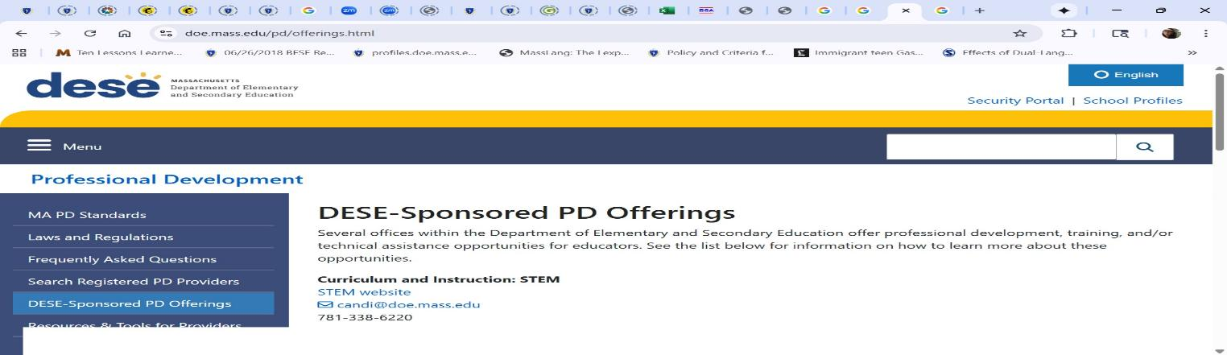
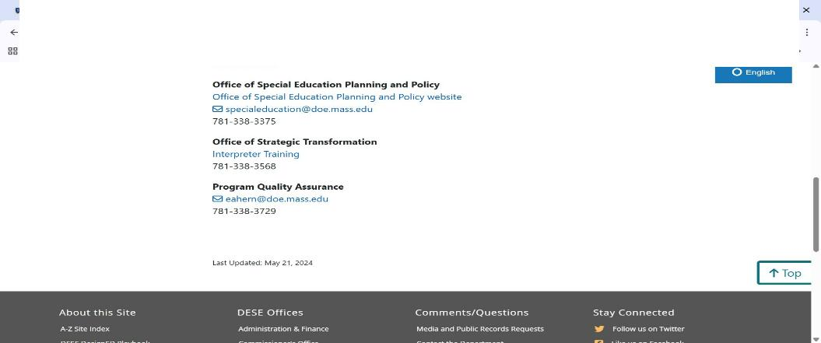
How to access the DESE PD Page?

Slide 13
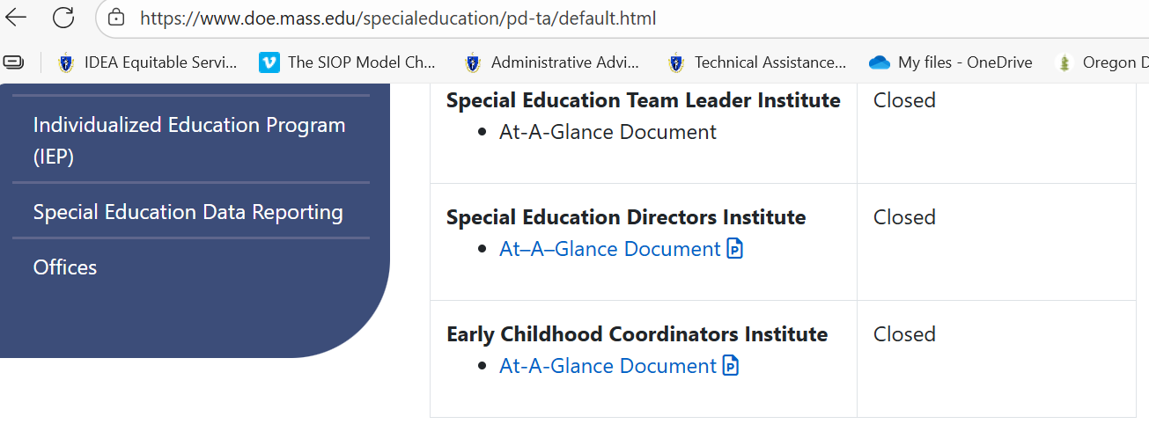
New PD Webpage for Special Education
PD Offers are available on the Special Education - Educator Professional Development & Technical Assistance webpage.
Notes:
PD Webpage Address: Educator Professional Development & Technical Assistance - Special Education
At-A-Glance for each PD provides a short description of the program that contains the Institute Goals and Key Topics
To the right, you will see the “Register” link when Institutes are open. The status will change to “closed” when the Institutes are full.

Slide 14
Special Education PD Offers for 2025-2026 School Year- Coming soon
IEP Team Leader Institute
Special Education Directors Institute
Early Childhood Institute
Inclusive Leadership Academy for General and Special Education Administrators

Slide 15
Center for School and District Partnership; Office of Effective Partnerships & Impact
Resource Allocation & Scheduling Networks: https://www.doe.mass.edu/sfss/prof-dev/
Inclusion & Access Networks: https://www.doe.mass.edu/sfss/prof-dev/
Student Support Academy: https://www.doe.mass.edu/sfss/prof-dev/
Paraeducator E-Learning Modules: https://www.doe.mass.edu/pd/paraeducator/default.html
Notes:
Some of the projects through the Center for School and District Partnership; Office of Effective Partnerships & Impact

Slide 16
Other IDEA Funded Projects – Continued
Programs and Related Initiatives:
Additional Learning Opportunities
Family Engagement
Notes:
Internal Office: Center for Educational Options – Office of Student and Family Support

Slide 17
Federation for Children with Special Needs Professional Development
Federation for Children with Special Needs (FCSN) offers PD opportunities, including IEP trainings throughout the year.
FCSN has an event calendar here
You will find PD information at https://fcsn.org/trainings/

Slide 18
2025 Early Childhood Convenings
Yearly Schedule
Date & Time
January 22 at 10:00 - 11:30 AM
March 25 at 1:00 - 2:30 PM
Notes:
Register for October 15 | 11:30 AM – 1:00 PM ET
Register for January 22 | 10:00 AM – 11:30 AM ET
Register for March 25 | 1:00 PM – 2:30 PM ET

Slide 19
Human-Centered Leadership Series
This professional development series equips early childhood leaders—including formal leaders like directors and informal leaders such as teacher leaders—with the knowledge, resources, and skills to navigate today’s evolving early childhood landscape. The series begins with a two-part foundational module on human-centered leadership, the leader’s role with different team structures, and the mindsets that support staff and child well-being. Aligned with the Pyramid Model, the training promotes workforce retention, leadership efficacy, and organizational wellness.
Open to all Districts
Kick Off- November 17th and 24th at 10:00 am to 12:00 pm
Register for Foundational Module
Additional registration links will be provided at the end of the Foundational Module.

Slide 20
COMING SOON: Two Exciting Opportunities to Strengthen Early Literacy
Massachusetts’ investment in early literacy continues this fall, with two returning opportunities that help districts and educators deepen evidence-based reading instruction and support for young learners.
Early Literacy Tutoring – Applications Opening Week of November 10
  DESE will open applications the week of November 10th for districts seeking to participate in the Early Literacy Tutoring initiative, providing no-cost, high-dosage tutoring for grades K–3, with a focus on foundational literacy skills and a priority on first grade.
  Tutoring will be delivered by DESE-approved vendors using evidence-based approaches through flexible models—in-person, virtual, before, during, or after school. Learn more on DESE's Early Literacy Tutoring webpage.
Literacy Launch Institutes – Registration Opening Week of November 17
  DESE and the Department of Early Education and Care (EEC), in collaboration with HILL for Literacy, will again offer free Literacy Launch Institutes to strengthen educators’ understanding of evidence-based, culturally and linguistically sustaining early literacy practices.
New this year: Friday/Saturday school-year options in Worcester and Northampton as well as expanded summer offerings in multiple regions to increase access for educators statewide.
To learn more about institute dates, locations, registration details, and the purpose of the Friday/Saturday sessions—including how leaders can support staff participation—see the linked overview on DESE’s Literacy Launch website.

Slide 21
Office of Student Assessment

Slide 22
Participation Cap for Alternate Assessment Based on Alternate Achievement Standards
ESSA requirements
The total number of student assessed in a subject using an alternate assessment aligned with alternate academic achievement standards…may not exceed 1 percent of the total number of students in the state that are assessed in that subject.
  Districts may exceed the 1% cap of all assessed students, if justification is provided.
  States may exceed the 1% cap, if a one-year waiver is *granted from US Department of Education (USDE).
    *A waiver of the 1% cap is granted based on states making progress reducing alternate assessment participation and implementing evolving plans to support districts reduce alternate assessment participation to meet the 1% cap.

Slide 23
Why is there a 1% Cap on Alternate Assessment?
Participation in an Alternate Assessment - Based on Alternate Academic Achievement Standards (e.g., MCAS-Alt) has significant implications for students
  Reduced academic expectations
  Reduced exposure to complex academic curriculum
  Reduced exposure to a range of academic curriculum
  Students participating in alternate assessments are more likely to be educated in segregated educational settings
Since 2003, there has been a 1% cap on Alt Assessments, but the 1% cap was based on the number of students that could be counted as proficient/advanced – not a participation cap.
  Participation rates in alternate assessments increased over time (prior to the ESSA 2017 legislation).*
Research* found that:
  students with learning disabilities and speech and language impairments were participating in alternate assessments.
  there is variable alternate assessment participation rates among states.
  there is inconsistent decision-making among schools and districts in how students meet eligibility to participate in alternate assessment.
*NCEO Reports: Alternate Assessments for Students with Significant Cognitive Disabilities: Participation Guidelines and Definitions (#406)

Slide 24
Massachusetts’ Approved Waiver Requirements from USDE Requires this Training
The approved waiver includes the following language:
The state will closely monitor each district regarding
  the percentage of assessed students taking the MCAS-Alt;
  progress and trends over two or more years in reducing the district’s overall MCAS-Alt percentage;
  whether the district has identified and is addressing any disproportionality in their student subgroup participation in the MCAS-Alt; and
  whether the district is using the revised definition for students with the most significant cognitive disabilities as their criteria.
  All districts that have over 2.0 percent of students participating in the MCAS-Alt assessment will receive a targeted webinar session, and DESE will ask for participation acknowledgement (e.g., names and titles of educators that attended that webinar).

Slide 25
Updated Participation Criteria
The Office of Special Education stated that, States that adopt Alternate Assessment based on Alternate Achievement Standards must create a “definition for students with the most significant cognitive disabilities.
Further in 34 CFR § 200.6 - Inclusion of all students ….
  “consistent with section 612(a)(16)(C) of the IDEA, [States must]… monitor implementation of clear and appropriate guidelines for IEP teams to apply in determining, on a case-by-case basis, which students with the most significant cognitive disabilities will be assessed based on alternate academic achievement standards. Such guidelines must include a State definition of “students with the most significant cognitive disabilities” that addresses factors related to cognitive functioning and adaptive behavior…”
References for additional information
    NCEO Reports: Alternate Assessments for Students with Significant Cognitive Disabilities: Participation Guidelines and Definitions (#406)
    NCEO Reports: 2018-19 Participation Guidelines and Definitions for Alternate Assessments based on Alternate Academic Achievement Standards (#415

Slide 26
MCAS-Alt Eligibility: Meet the definition for Students with the Most Significant Cognitive Disabilities
Only students that meet the definition for a student with the most significant cognitive disabilities are permitted to take the MCAS-Alt.
Massachusetts defines “students with the most significant cognitive disabilities” as students who:
  have cognitive disabilities evidenced by significant delays in attaining age-level academic achievement standards, even with systematic, extensive individually designed instruction, related services, and modifications; and
  have cognitive disabilities that significantly impact their educational performance and ability to apply learning from one setting to another; and
  require extensive, direct individualized instruction and substantial support to achieve measurable gains on the challenging State academic content standards for the grade in which the student is enrolled; and
  perform significantly below average in general cognitive functioning and adaptive behavior. This is defined as a student functioning two or more standard deviations below the mean on commonly accepted norm-referenced assessments in both cognitive functioning and adaptive behavior (e.g., two or more adaptive skill areas such as daily living skills, communication, self-care, social skills, and academic skills).

Slide 27
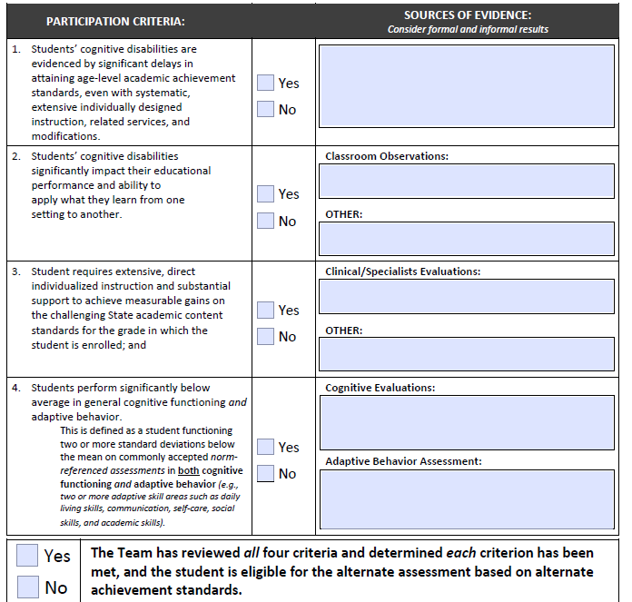
Alternate Assessment Participation Tool is a required document to be maintained by schools (SE 5).

Slide 28
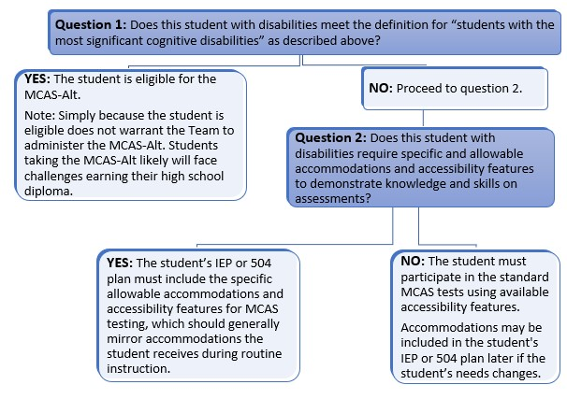
Flow chart to determine student eligibility

Slide 29
A student should not take the MCAS-Alt based solely on…
a particular disability or placement
lack of standards-based instruction
participation in MCAS-Alt the previous year (since this is an annual decision)
English learner (EL) status (ACCESS Alt should not be given unless student meets same criteria as a student with the most significant disabilities)
low income, child in foster care, or interrupted formal education
potential impact on a school’s accountability rating
previous low achievement on MCAS

Slide 30
IDEA Fiscal

Slide 31
Expired IDEA Part B Funds
FY24 FC 240 and FC 262, and FY25 FC 274 (IEP Improvement) Funds expired September 30, 2025
Funds must have been obligated on or before September 30, 2025, and liquidated no later than ninety (90) days thereafter
GEM$ Reimbursement Requests no later than November 30, 2025
GEM$ Final Expenditure Report (FER) due no later than December 31, 2025
  LEA may include final reimbursement requests in the FER
Failure to (1) fully expend and claim FY24 FC 240, FC 262 or FY25 FC 274 funds or 2) timely file the GEM$ FER will be considered in the LEA's annual fiscal risk assessment

Slide 32
FY25 Financial End of Year Reports
Final FY25 Financial End of Year Reports (EOYR) Due:
  September 30, 2025 - individual and regional districts and vocational schools with the Office of School Finance
  November 21, 2025 - charter schools with the Charter School Office
  January 30, 2026 – virtual schools with the Charter School Office
Ensure relevant expenses are distributed as special education as that total will be considered for the FY25 Maintenance of Effort (MOE) compliance determination in March 2026
Failure to timely file and certify, and making any subsequent corrections or amendments to the EOYR will be considered in the LEA's annual fiscal risk assessment

Slide 33
Child Count of Parentally-Placed Private and Home School Students
Conducted as of October 1st each year
IDEA Child Count and Record Keeping Application Supplement NEW!
LEA FC 240/262 Consolidated (Federal/ENT) Grantwriter
October 1, 2025 Child Count and SY24-25 Equitable Services Record Keeping data submission due January 30, 2026
  Failure to submit the annual child count by January 30, 2026 will be considered in the LEA's Annual Special Education Determination and Annual IDEA Part B Fiscal Risk Assessment
SY24-25 Record Keeping
  Number of private and home school students evaluated by the district, found eligible by the district, and who received equitable services from the district

Slide 34
Excess Cost Calculation & Compliance Determination
GEM$ Excess Cost Calculator Application Supplement NEW!
LEA IDEA Excess Cost Calculator Writer – NEW GEM$ Role
Requires LEA Fiscal Representative and Superintendent/Chief Executive Approval
Excess Cost Calculation and Compliance Determination submission is due no later than Friday, January 30, 2026
  Failure to complete the Excess Cost Calculator Application Supplement by January 30, 2026, will be considered in the LEA's Annual Special Education Determination and Annual IDEA Part B Fiscal Risk Assessment

Slide 35
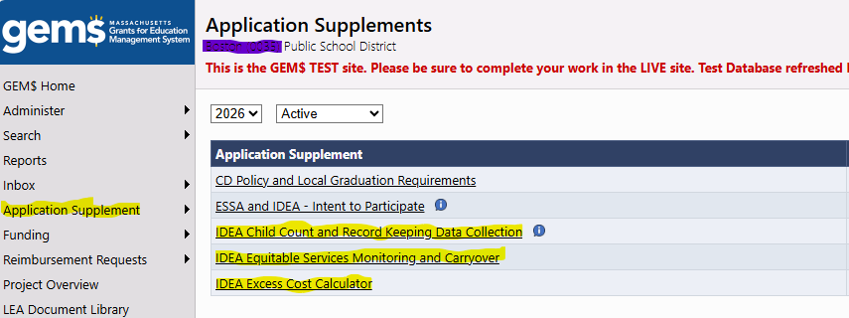
GEM$ Application Supplements

Slide 36
IDEA Fiscal Virtual Community of Practice
Thursdays, 3:00 - 4:00 pm Zoom Webinar
  December 4, 2025 – GEM$ Reimbursement and Final Expenditure Reports
  January 8, 2026 – GEM$ Budget Revision and Financial Activity Reporting
  March 5, 2026 – Maintenance of Effort, Exceptions and Adjustments
  May 7, 2025 – Proportionate Share for Equitable Services Carryover
  June 4, 2025 – FY27 Consolidated Application, Conditions of Assistance
  Register at:
  https://us02web.zoom.us/webinar/register/WN_PU0FvUW0QJiD-WL-UMNIHA

Slide 37
Overview of the
Special Education Circuit Breaker Program
Special Education Leaders Monthly Webinar
Office of District & School Finance
November 2025

Slide 38
Agenda
Program Overview
Claiming Cycle
Cost Eligibility
Questions Submitted

Slide 39
Agenda
Program Overview
Claiming Cycle
Cost Eligibility
Questions Submitted

Slide 40
Circuit Breaker History
Commonwealth’s Special Education Reimbursement Program (“Circuit Breaker”) passed into law in 2001 and went into effect in 2004
Legal References:
  Mass General Law Chapter 71B section 5A
  School Finance Regulations 603 CMR 10.07
Student Opportunity Act (SOA) passed in 2019 and implemented in 2021 provided two significant changes:
  Out-of-district transportation an eligible cost phased in
  Annual threshold frozen and only increased annually tied to inflation

Slide 41
Circuit Breaker Program Summary
The special education circuit breaker program:
  Provides public school districts annual financial assistance
  Supports delivery of “high cost” special education services to students ages 3 through 21
Qualified per-student special education expenditures must meet a “high cost” annual threshold for reimbursement:
  $53,431 in FY26
Target is for districts to be reimbursed for 75% of eligible costs above the threshold
  Total available amount is subject to annual legislative appropriation
  Actual reimbursement is also dependent on total claims submitted statewide
  Reimbursement for tuition and instruction are reimbursed statewide first, then remaining funds available to reimburse for transportation

Slide 42
Reimbursement Calculation
FY26 claim threshold: $83,431 in FY26
Total qualified expenses for student Harry Potter in FY26: $83,431
  Tuition at out-of-district approved program: $63,431
  Transportation and monitor: $20,000
Calculation Example:
  Total qualified expenses for Harry: $63,431
  Tuition reimbursable amount is $63,431 minus $53,431, or $10,000
  Tuition reimbursement is 75% of $10,000, or $7,500
  Transportation reimbursement is 75% of $20,000 or $15,000 (if available)

Slide 43
Agenda
Program Overview
Claiming Cycle
Cost Eligibility
Questions Submitted

Slide 44
Circuit Breaker Claiming
Districts claim expenses and then are reimbursed from state funds in two cycles annually:
  Extraordinary Relief Claiming
    Available only to districts spending 25% more on special education tuition & instruction expenses in the current FY than they spent last FY
    Claims are filed in March for current FY expenses (projected through year-end), and reimbursement is paid in May
  Final Year End Claiming
    Available to all districts with financial responsibility for student(s) where qualified expenditures meet or exceed the “high cost” threshold
    Claims are filed in July for previous FY expenses, and reimbursement is paid quarterly

Slide 45
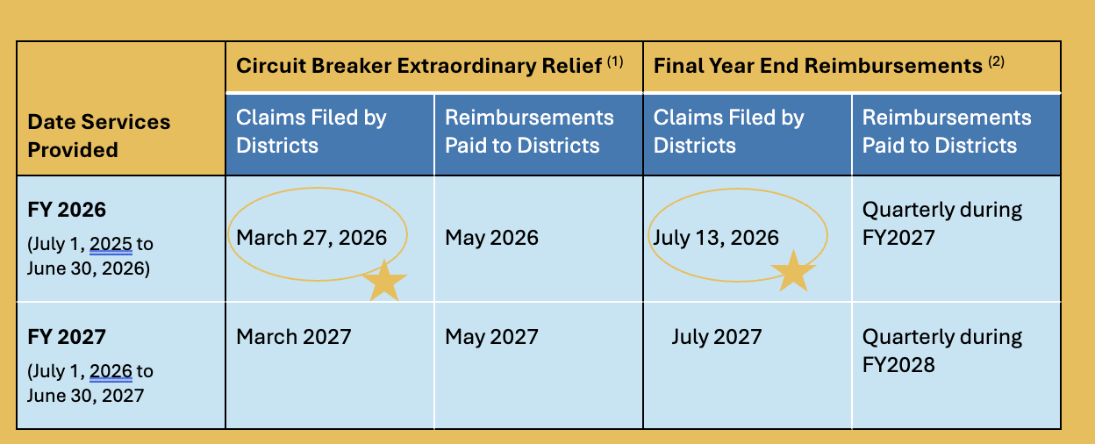
Circuit Breaker Claiming Cycle
(1) Extraordinary Relief is available only to districts with a 25% or greater increase in tuition/instruction expenses between FY25 and FY26.
(2) Final Year End reimbursements are available to all districts with financial responsibility for student(s) with services that meet or exceed the “high cost” threshold

Slide 46
Filing Claims
Online claim system launched February 2025 (no more XLS files)
District resources specified as “Circuit Breaker Claim Contact” in DESE school profiles are sent email with instructions for establishing login credentials
Important preparation steps:
  Make sure districts have received OSD approval for services requiring ISPs or IPAs
  Make sure all students have been included on your district roster in SIMS (three reporting periods annually: October, March, June)
  Make sure all students meeting definition of ‘homeless’ or ‘state ward’ have been reported to DESE through the Homeless and Foster Care Student Data Collection process
Any supporting documentation (settlement agreements, e.g.) should be uploaded to Special Education dropbox via the DESE Security Portal

Slide 47
Agenda
Program Overview
Claiming Cycle
Cost Eligibility
Questions Submitted

Slide 48
Circuit Breaker Cost Eligibility
Examples of Eligible Expenses | Examples of Ineligible Expenses
Provided Instruction (based on IEP) Tuition Out-of-district transportation | Evaluations Building Adaptation Administrative & overhead costs In-district transportation
Instruction & tuition costs are further defined in School Finance Regulations 603 CMR 10.07
Questions related to expense eligibility can be directed your district’s Circuit Breaker Liaison

Slide 49
Eligible Out-of-District Costs (1 of 2)
Instruction and Tuition Services
Student placement at Public Program | Student placement at Approved Private Program | Additional 1:1 Services at Approved Private Program Requires IPA | Student placement at “Unapproved” Private Program Requires ISP
Out-of-district public program at a public school or collaborative where tuition is paid by the student’s sending district | Programs are approved by DESE and rates are set by Operational Services Division (OSD) DESE/OSD Approved Summer Programs DESE/OSD Approved 10/12 Month Programs | Requires OSD pricing authorization per individual student Seek approval for Individual Pricing Authorization (IPA) online: Individual Price Authorization Form (OSD) Services <$20 per hour can be self-authorized | Requires both DESE approval and OSD authorization per individual student Seek approval for Individual Student Program (ISP) and Request for Pricing Authorization online: Individual Student Program Authorization (PRS service-now)

Slide 50
Eligible Out-of-District Costs (2 of 2)
Transportation Services
The Student Opportunity Act (SOA) allows districts to claim transportation costs for students attending out-of-district programs only
Vehicle Transportation: provided by third-party contractor | Vehicle Transportation: provided by in-house resources | Monitor Services | Nursing Services, ABA Aide or Aide on vehicle
Category may include: Transportation services provided by 3rd party (bus company) Parent reimbursement per signed agreement | District uses its own resources (vehicle, driver) to transport out-of-district Costs based on expenses reported in most recent End-of-Year Report: Schedule 7 of the FY24 End-of-Year Report (EOYR) Total special ed OOD costs reported divided by total students reported to determine max annual rate | Provided by the same third-party provider as vehicle transport Needs to be claimed as per-student cost, and tied back to invoices (with student initials, for example) Must be included in IEP | Claimed as part of the transportation placement Cost based on state rates, not on actual cost billed Must be included in IEP

Slide 51
Eligible In-District Costs
Reimbursable costs are instructional services provided associated with implementing Individualized Education Plans (IEPs)
  All services being claimed must be documented in an IEP
  All services claimed must have been provided
Reimbursement rates for in-district services:
  Price set by the state
  Not based on actual district expenses
  Adjusted annually

Slide 52
Agenda
Program Overview
Claiming Cycle
Cost Eligibility
Questions Submitted

Slide 53
Q. What are the most common types of claims?
Transportation claims are about 37% of total expenses claimed.
  Instruction/Tuition claims break out approximately as:
    74% for tuition at approved programs
    16% for tuition at collaborative programs
    5.5% for supplemental services at approved programs or provided by the district
    3% for in-district services
    1.5% for tuition unapproved programs (ISPs)

Slide 54
Q. How can I determine if in-district students qualify?
Yes. As with all other schools, expenses exceeding $53,431 per-student qualify for reimbursement.
You can total the costs of services either by:
    Using the claim system to add a placement, which will calculate total cost of the services included
    Using the Excel-based in-district services calculator available on the circuit breaker website

Slide 55
Q. Are charter schools eligible for Circuit Breaker reimbursement?
Yes. As with all other schools, expenses exceeding $53,431 per-student qualify for reimbursement.

Slide 56
Q. Are any categories of students are reimbursed at greater than 75% over the claim threshold?
Yes. Students claimed with “special indicators” of homeless, state ward or abandoned are reimbursed at 100% over the threshold, per statute.
Homeless and state ward statuses on circuit breaker claims are confirmed based on data reported from districts to DESE through the Homeless and Foster Care Student Data Collection process.

Slide 57
Q. How do you claim expenses that are impacted by settlement agreements?
Enter the full cost of the placement, and add a cost share equivalent to the amount the district is not paying.
    Indicate the entity that is sharing expenses (i.e. DCF, 2nd LEA, or ‘other’ if sharing with parent)
    Non-district share can be specified as total dollar amount or as percentage

Slide 58
Q. What is the most efficient way to claim transportation?
Best practice is to track per-student costs for vehicle and monitor monthly based on invoiced amounts. Claim nursing services based on hours delivered and supported in IEP.
    Vehicle cost of route needs to be allocated to all students on the route
    Monitor cost should be allocated only to students receiving monitor service on the route, as supported in IEP
    Nursing on transport is claimed based on the amount of time the nurse was with the student (example: 1.5 hours per day of individual services), as supported in IEP

Slide 59
Q. Why are not all special education programs considered ‘approved programs,’ including some ESY programs at schools with other approved programs?
Schools can apply to DESE for their program(s) to be considered ‘approved programs’. Not all schools apply, not all schools submit all their programs for DESE evaluation, and not all programs meet DESE criteria for approval.

Slide 60
Q. How are rates determined for tuition at out-of-district private programs?
Program rates are determined by the Operational Services Division (OSD). Consideration includes budgets submitted to OSD by the school.
  Rates at DESE approved programs can increase by an annual factor determined by OSD. Expenses for students receiving additional services not covered by the approved tuition amount need approval from OSD through an Individual Price Authorization (IPA).
  Rates at unapproved special education programs are set per individual student through the Individual School Program (ISP) approval process

Slide 61
Q. How are rates determined for tuition at public collaborative programs?
Program rates at collaboratives are determined by the collaborative’s Board of Directors.
  Collaboratives sometimes set different rates for member and non-member districts
  Collaboratives sometimes set a base tuition rate and then charge additional amounts for one-to-one services
  All qualified instruction/tuition service costs at collaboratives can be claimed through the circuit breaker program

Slide 62
Q. How long do we need to maintain circuit breaker records?
Contact your legal counsel for guidance.
  There are no specific requirements for circuit breaker versus other public records. In general, records need to be kept for 7 years in Massachusetts.

Slide 63
Q. Where can I find additional training for circuit breaker?
Video training modules are available on the DESE YouTube page.
  The current list of all available modules is on the DESE circuit breaker webpage. (24 modules and counting!)

Slide 64
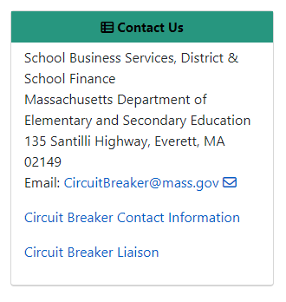
Thank you!
The Circuit Breaker office is here to help!
Please contact your liaison with any questions to support your claims.

Slide 65
Resources

Slide 66
Information for Special Education Leaders
Regular Updates and Information
  Special Education Bulletin
  Special Education Website
Update Information in the Directory Administration
  Special Education Leaders Meeting Invites and Memos
Email Contacts
  specialeducation@mass.gov (General Special Education Inquiries)
  IDEAfiscal@mass.gov (IDEA Fiscal Inquiries)
  IDEAdata@mass.gov (IDEA Data Inquiries- Special Education or SPP/APR Data)

Slide 67
2025-2026 Meetings
Month | Proposed Meeting Date
November | Friday, November 7, 2025
December | Friday, December 12, 2025
January | Friday, January 23, 2026
February | Friday, February 27, 2026
March | Friday, March 13, 2026
April | Friday, April 10, 2026*
May | Friday, May 15, 2026*
June | Friday, June 12, 2026
*Dates are tentative for April and May as we are exploring an in-person convening in the spring

Slide 68
Questions
and
Answers

