Slide 1
Special Education Leaders' Meeting December 12, 2025
Notes:
…

Slide 2
Agenda
688 Referrals- Bureau of Transitional Services
Key Special Education Topics and Policy Updates
Time-out Guidance
Professional Development and Technical Assistance
IDEA Fiscal

Slide 3
Bureau of Transitional Planning title slide
Bureau of Transitional Planning
Carolyn J. Kain, Director

Slide 4
Chapter 688
Massachusetts Chapter 688 of the Acts of 1983, also known as the “turning 22” law, stipulates that students receiving special education who will require continued disability related services upon exiting school (by graduating or turning twenty-two years of age, whichever ever occurs first) shall be entitled to formal transitional planning. As such, M.G.L.c.71B Sec 12-A-C establishes the Bureau of Transitional Planning (BTP). The primary function of the BTP is to coordinate and monitor implementation of the formal transition planning process.

Slide 5
688 Referral
A 688 referral is not an application for agency eligibility. Schools submit the 688 referral, but families are responsible for submitting an application to the agency. Agencies must receive a complete application so they can decide whether the student will be eligible to receive adult services

Slide 6
Who should have a Chapter 688 Referral?
To have a Chapter 688 referral, a student must:
Have an Individualized Education Program (IEP)
Need continuing services because of the severity of their disability
Be unable to work 20 or more hours per week in competitive employment

Slide 7
Chapter 688 referral process continued
The Chapter 688 referral process is important for two reasons:
It allows adult agencies to advocate for funding from the state legislature to serve students with disabilities when they exit from school.
The Chapter 688 referral also alerts the adult agency to work with the student, family, and school to complete an Individualized Transition Plan (ITP) that will help to plan the supports the student may need after they exit school.

Slide 8
Chapter 688 referral process continued
The school must submit the referral electronically at least 2 years before the student is expected to graduate from high school or turn 22.

Slide 9
When to assign a 688 Referral to the BTP
If the IEP Team is not able to decide on one adult agency for a student, the Chapter 688 referral should be submitted to the Bureau of Transition Planning, which will select the agency they decide best fits the student’s needs.
Notes:
....

Slide 10
Chapter 688 referral process continued
Once the BTP assigns the 688 referral to a specific state agency, the family will receive an application to apply for eligibility through the state agency.

Slide 11
Virtual Gateway – T22
How is the District notified which agency the BTP assigned the 688 referral?
Once the BTP designates the referral to an agency, the agency receives a notification AND the LEA Referral List, on the T22 platform, is automatically updated to show which agency was chosen.

Slide 12
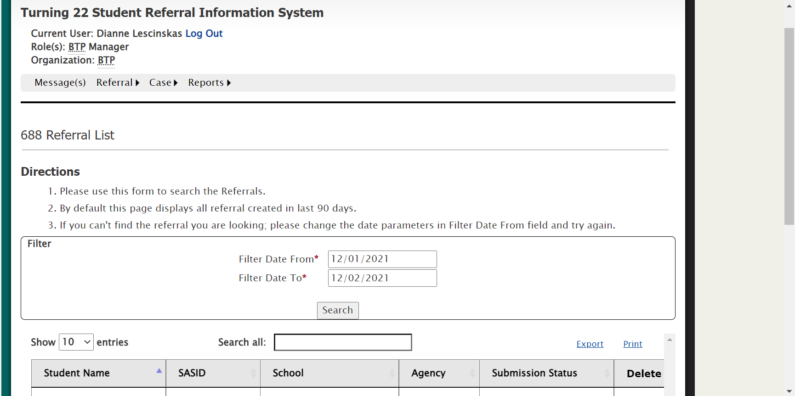
Turning 22 Student Referral Information System

Slide 13
Resources and Contact Information
Bureau of Transitional Planning | Mass.gov
The BTP website contains information on how to become a T22 user, how to add or delete a user from the system, help desk email information, a link to find training information on for new users of T22 and resources for educators and families.
Contact the BTP
Dianne Lescinskas
Dianne.Lescinskas@mass.gov
Carol Gracia
Carol.M.Gracia@mass.gov

Slide 14
Special Education Updates and Key Special Education Topics

Slide 15
Updates from the National Level
DESE- Continued Commitment to Students With Disabilities and their Families
IDEA is still the law
Massachusetts has state special education laws and regulations
Examples of Federal Statutory Requirements
IDEA Data Collection and Submission
SPP/APR Submission (February)
Annual State Determination (Spring)
IDEA Allocations (Late Spring)

Slide 16
Time-out Guidance
Anticipated Release
The Department anticipates releasing guidance by the beginning of the new year to support schools, districts, and programs in preparing for the implementation of the August 17, 2026, effective date.
What to Expect in the Guidance
Clarifies requirements and definitions for time-out, seclusion, documentation, and reporting.
Examples to help districts, schools, and programs align practices with the new regulations.
Sample tools and templates (logs, checklists, notification forms) to support consistent and compliant practice.

Slide 17
Updates on the New IEP
Regular Updates to the IEP
Updates to Assessment, English Learners, and Transition
Additional Updates Still to Be Completed:
Progress Report
SLD Forms
Ongoing Training and Professional Development

Slide 18
Professional Development and Technical Assistance

Slide 19
Special Education PD Offers for 2025-2026 School Year- Coming Soon
IEP Team Leader Institute
Special Education Directors Institute
Early Childhood Institute
Inclusive Leadership Academy for General and Special Education Administrators

Slide 20
Center for School and District Partnership; Office of Effective Partnerships & Impact
Resource Allocation & Scheduling Networks: https://www.doe.mass.edu/sfss/prof-dev/
Inclusion & Access Networks: https://www.doe.mass.edu/sfss/prof-dev/
Student Support Academy: https://www.doe.mass.edu/sfss/prof-dev/
Paraeducator E-Learning Modules: https://www.doe.mass.edu/pd/paraeducator/default.html
Notes:
Some of the projects through the Center for School and District Partnership; Office of Effective Partnerships & Impact

Slide 21
Federation for Children with Special Needs Professional Development
Federation for Children with Special Needs (FCSN) offers PD opportunities, including IEP trainings throughout the year.
FCSN has an event calendar here
You will find PD information at https://fcsn.org/trainings/

Slide 22
Orton Gillingham Training Opportunity
The Department is offering, through Literacy Launch Institutes, free Orton-Gillingham training for licensed reading specialists, special education teachers, and educators responsible for delivering specialized literacy or special education instruction to students in grades K–3 (e.g., inclusion teachers and interventionists). Educators who are selected and complete this course will receive Orton-Gillingham Level 1 certification. There will be a winter and a spring virtual, synchronous cohort; each will meet live on Zoom from 4:00 to 7:15 p.m. on Tuesdays and Thursdays for 10 sessions. The winter session begins on Tuesday, January 20, and the spring session on Tuesday, March 31. Please visit the Literacy Launch webpage to learn more and apply by Friday, December 12.

Slide 23
Educational Stability Office Hours on Special Education Responsibility
The Department’s Educational Stability Team will host an office hour for homeless liaisons, foster care points of contact, staff from the Department of Children and Families, districts, and providers from 10:00 to 11:30 a.m. on Thursday, December 18. The session will focus on which district or education agency is responsible for the special education program of highly mobile students with disabilities. The Department encourages participation in office hours, as the sessions provide a time for collaboration and an opportunity to learn about specific content areas connected to supporting highly mobile students, families/caregivers, and school staff. Please register online for the office hour.

Slide 24
2025 Early Childhood Convenings
Yearly Schedule
Date & Time
January 22 at 10:00 - 11:30 AM
March 25 at 1:00 - 2:30 PM
Notes:
Register for October 15 | 11:30 AM – 1:00 PM ET
Register for January 22 | 10:00 AM – 11:30 AM ET
Register for March 25 | 1:00 PM – 2:30 PM ET

Slide 25
IDEA Fiscal

Slide 26
Expired IDEA Part B Funds
FY24 FC 240 and FC 262, and FY25 FC 274 (IEP Improvement) Funds expired September 30, 2025
Funds must have been obligated on or before September 30, 2025, and liquidated no later than ninety (90) days thereafter
GEM$ Final Expenditure Report (FER) due no later than December 30, 2025
At this time LEAs must include final reimbursement requests in the FER
Failure to (1) fully expend and claim FY24 FC 240, FC 262 or FY25 FC 274 funds or 2) timely file the GEM$ FER will be considered in the LEA's annual fiscal risk assessment

Slide 27
FY25 Financial End of Year Reports
Final FY25 Financial End of Year Reports (EOYR) Due:
September 30, 2025 - individual and regional districts and vocational schools with the Office of School Finance
November 21, 2025 - charter schools with the Charter School Office
January 30, 2026 – virtual schools with the Charter School Office
Ensure relevant expenses are distributed as special education as that total will be considered for the FY25 Maintenance of Effort (MOE) compliance determination in March 2026
Failure to timely file and certify, and making any subsequent corrections or amendments to the EOYR will be considered in the LEA's Annual IDEA Part B Fiscal Risk Assessment

Slide 28
Private School Enrollment Data Submission
Private school enrollment data is used in the annual LEA FC 240 and 262 allocation calculations
Private schools are asked to submit grade level enrollment data though a Department Education Security Portal Application beginning October 1, 2025 and due December 19, 2025.
Districts of residence encouraged to contact local private schools and remind them of the importance of this data submission
Each district can find a list of last identified private schools in the Department's School and District Profiles / Relationship Membership for your district
Can and should be done during annual child count collection and fall timely meaningful consultation for equitable services
Email privateschools@mass.gov with any changes to the private school list for your district in Profiles

Slide 29
Child Count of Parentally-Placed Private and Home School Students
Conducted as of October 1st each year
IDEA Child Count and Record Keeping Application Supplement NEW!
LEA FC 240/262 Consolidated (Federal/ENT) Grantwriter
October 1, 2025 Child Count and SY24-25 Equitable Services Record Keeping data submission due January 30, 2026
Failure to submit the annual child count by January 30, 2026 will be considered in the LEA's Annual Special Education Determination and Annual IDEA Part B Fiscal Risk Assessment
SY24-25 Record Keeping
Number of private and home school students evaluated by the district, found eligible by the district, and who received equitable services from the district

Slide 30
Excess Cost Calculation & Compliance Determination
GEM$ Excess Cost Calculator Application Supplement NEW!
LEA IDEA Excess Cost Calculator Writer – NEW GEM$ Role
Requires LEA Fiscal Representative and Superintendent/Chief Executive Approval
Excess Cost Calculation and Compliance Determination submission is due no later than Friday, January 30, 2026
Failure to complete the Excess Cost Calculator Application Supplement by January 30, 2026, will be considered in the LEA's Annual Special Education Determination and Annual IDEA Part B Fiscal Risk Assessment

Slide 31
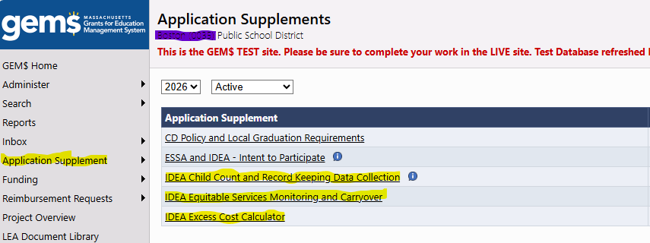
GEM$ Application Supplements

Slide 32
IDEA Fiscal Virtual Community of Practice
Thursdays, 3:00 - 4:00 pm Zoom Webinar
January 8, 2026 – GEM$ Budget Revision and Financial Activity Reporting
March 5, 2026 – Maintenance of Effort, Exceptions and Adjustments
May 7, 2026 – Proportionate Share for Equitable Services Carryover
June 4, 2026 – FY27 Consolidated Application, Conditions of Assistance
Register at:
https://us02web.zoom.us/webinar/register/WN_PU0FvUW0QJiD-WL-UMNIHA

Slide 33
Resources

Slide 34

Special Education
Year at a Glance

Slide 35
Information for Special Education Leaders
Regular Updates and Information
Special Education Bulletin
Special Education Website
Update Information in the Directory Administration
Special Education Leaders Meeting Invites and Memos
Email Contacts
specialeducation@mass.gov (General Special Education Inquiries)
IDEAfiscal@mass.gov (IDEA Fiscal Inquiries)
IDEAdata@mass.gov (IDEA Data Inquiries- Special Education or SPP/APR Data)

Slide 36
2025-2026 Meetings
Month | Proposed Meeting Date
January | Friday, January 23, 2026
February | Friday, February 27, 2026
March | Friday, March 13, 2026
April | Friday, April 10, 2026*
May | Friday, May 15, 2026*
June | Friday, June 12, 2026
*Dates are tentative for April and May as we are exploring an in-person convening in the spring

Slide 37
Questions
and
Answers

Slide 38

38

