Slide 1
Special Education Leaders' Meeting
January 23, 2026

Slide 2
Agenda
Key Special Education Topics and Policy Updates
  OSEP and DMS
  LEA Guidance Updates to Criteria for 25-26
  Release of Restraint Data
  Guidance on Reducing and Eliminating the Use of Time Out
  Early Literacy Screening Survey
Professional Development and Technical Assistance
IDEA Fiscal
IDEA Data

Slide 3
Special Education Updates and Key Special Education Topics

Slide 4
DESE Special Education
Robert Curtin, Deputy Commissioner
Iraida J. Alvarez, Acting Executive Director of Special Education
Jamie Camacho, Acting State Director of Special Education
Office of Approved Special Education Schools
Jannelle Roberts, Director
Special Education Planning and Policy Development
Jamie Camacho, Director
Patrick Fitzgerald, Assistant Director
Martha Daigle, Assistant Director
Office of Public School Monitoring
Vani Rastogi-Kelly, Director
Amy Paulin, Assistant Director
Office of Problem Resolution System
Kelsey LoDuca-Towne, Director
Julie Garell, Assistant Director
Special Education in Institutional Settings
Shawn Connelly, Director

Slide 5
Special Education Staffing Updates
Bob Hanafin
  specialeducation@mass.gov
  ideafiscal@mass.gov
Lisa Hanafin
  leaassignment@mass.gov

Slide 6
Differentiated Monitoring System 2.0
The Office of Special Education Programs monitors States by reviewing a state’s general supervision system to ensure compliance with IDEA.
The goal of DMS 2.0 is to improve outcomes and results for infants, toddlers, children and youth with disabilities and their families in conjunction with compliance.
OSEP’s monitoring will focus on States’ systems of general supervision integrating both results and compliance.

Slide 7
DMS Monitoring: Three Phases
Discovery October 2025
(5 months prior to engagement)
  Document Request
  State Overview Call
  Stakeholder engagement
  Local Component
Engagement May 2026
(1 month (visit) through issuance of the DMS Monitoring Report)
  Onsite and Virtual monitoring interview calls
  Issuance of the DMS Monitoring Report
Close-out
(up to one year after the issuance of the DMS Monitoring Report)
  Review of evidence of correction
  Technical Assistance

Slide 8
2024-2025-7 Clarification of Independent Educational Evaluations
The purpose of this policy memo is to clarify school district's responsibilities under federal and state special education laws and regulations for providing a publicly funded independent educational evaluation (IEE) to a student. The federal Individuals with Disabilities Education Act (IDEA), Part B regulation relating to IEEs is found at 34 C.F.R. § 300.502 . The additional state standard, which exceeds the minimum requirements set by IDEA and provides parents with a separate, entirely voluntary option, is described at M.G.L. c. 71B, § 3 ¶ 10 and 603 CMR 28.04(5).
As part of the Integrated Monitoring Review, the Department will monitor for the implementation of the requirements outlined in the Memo.

Slide 9
PSM Integrated Monitoring Review Update:
SE 11 Independent Educational Evaluation
Voluntary Cost-Share Option Under State Law: Do your procedures make clear…
Parents may choose, on a voluntary basis, to share the costs of the independent evaluation with the school committee pursuant to a sliding fee scale established in the special education regulations, and the school district must pay its share of the costs?
If the parent requests the voluntary cost-share option, the district does not have the option to request a due process hearing to show that its evaluation of the student is appropriate?
Under the voluntary cost-share option, the district must abide by the sliding fee scale in 603 CMR 28.04(5)(c)4?
Under the voluntary cost-share option, students who are eligible for free or reduced cost lunch or who are in the custody of a state agency and have an Educational Surrogate Parent appointed in accordance with federal law must be provided with an IEE that is equivalent to the assessments done by the district without submission of additional documentation of the family's financial status?
Under the voluntary cost-share option, the parent has the right to request a publicly funded IEE under this provision for 16 months from the date of the evaluation with which the parent disagrees?
If the family does not meet income eligibility standards, chooses not to provide financial documentation to the district establishing family income level, or does not decide to voluntarily utilize the Massachusetts sliding fee scale for any reason, the school district shall respond in accordance with the requirements of federal law?

Slide 10
PSM Integrated Monitoring Review Update:
SE 11 Independent Educational Evaluation
Additional requirements: Do your procedures make clear...
Independent educational evaluations funded by the district require that the evaluations are conducted by qualified persons who are registered, certified, licensed, or otherwise approved and who abide by the rates set by the state agency responsible for setting such rates?
Unique circumstances of the student may justify an individual assessment rate that is higher than the normally allowed rate?
When a parent disagrees with the evaluation or reevaluation obtained by the public agency, the parent has the right to request an IEE at public expense?
If a parent requests an IEE at public expense, the LEA must, without unnecessary delay, either:
  file a due process complaint to request a hearing with the Bureau of Special Education Appeals (BSEA) to show that its evaluation is appropriate; or
  ensure that an IEE is provided at public expense, unless the LEA demonstrates in a BSEA hearing that the evaluation obtained by the parent did not meet agency criteria?
The school committee may initiate within five school working days of the request, a hearing with the Bureau of Special Education Appeals to show that its evaluation is appropriate, in accordance with the provisions of the Individuals with Disabilities Education Act" and its regulations?
Do the procedures address the completion of the evaluation and provision of a written evaluation report that includes all the required information no later than 30 days, whenever possible, after the date of parental request for independent educational evaluation? (If publicly funded, the report is sent to the parents and to the school district)
Do the procedures require that the Team reconvenes within 10 school days from the time the school district receives the report of the independent educational evaluation and considers the results of the independent educational evaluation (which may be publicly or privately funded) and whether a new or amended IEP is needed?

Slide 11
Restraint Data released for 2024-2025
Student restraint data for the 2024-25 school year was posted online on Thursday, January 22nd.
As in previous years, the data documents instances in which students in public schools, collaboratives, and approved day and residential special education schools were restrained by staff during school hours, as reported by each school. A link can be found: http://profiles.doe.mass.edu/statereport/restraints.aspx.

Slide 12
Next Steps for the Implementation of Regulatory Amendments to 603 CMR 46 and 603 CMR 18
Time-out Practices
Grant Funding
213 Grant
Training
Spring – Procedures and training for seclusion documentation requirements to the Department
Spring/Summer – Asynchronous online modules to support staff training
Guidance
Will be posted soon!

Slide 13
Guidance on the Implementation of Regulatory Amendments to 603 CMR 46 and 603 CMR 18 Time-out Practices
The guidance document is intended to:
  Clarify definitions and regulatory requirements related to time-out practices;
  Distinguish time-out from seclusion and other prohibited practices;
  Provide implementation guidance and examples to support compliant and appropriate use;
  Address common questions related to documentation, oversight, and monitoring; and
  Support schools and programs in developing policies, training, and systems aligned with the amended regulations.

Slide 14
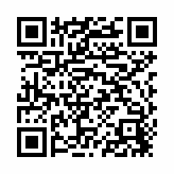
Opportunity for Input:
DESE is launching an update of the Early Literacy Screening Approved Assessment List and Guidance.
The 5-minute survey is intended for educators who work in or support grades K–3.
Educator feedback will inform the revised guidance document and future supports.
Share with colleagues!
The survey closes Feb. 13th
We Want to Hear from You!
https://survey.alchemer.com/s3/8621403/Early-Literacy-Screening-Survey

Slide 15
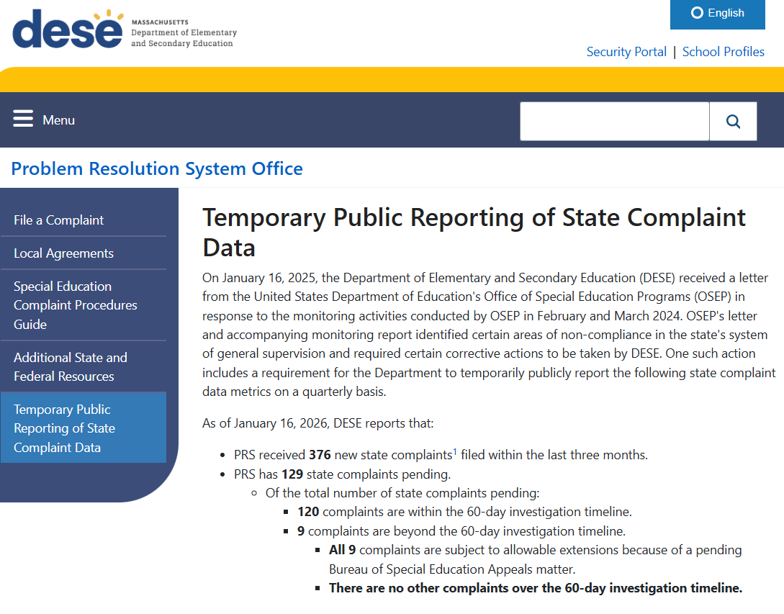
PRS Temporary Public Reporting Update
https://www.doe.mass.edu/prs/complaint-data/default.html

Slide 16
Please share with your SEPAC!

Slide 17
Professional Development and Technical Assistance

Slide 18
Special Education PD Offers for 2025-2026 School Year- Coming Soon
Leadership Institutes are developing schedules and are beginning the registration process
  IEP Team Leader Institute: Registration
  Special Education Directors Institute:Registration
  Inclusive Leadership Academy for General and Special Education Administrators: Registration
  Early Childhood Institute: Registration coming soon
All special education leaders should look for emails and notifications regarding registration

Slide 19
Federation for Children with Special Needs Professional Development
Federation for Children with Special Needs (FCSN) offers PD opportunities, including IEP trainings throughout the year.
FCSN has an event calendar here
You will find PD information at https://fcsn.org/trainings/

Slide 20
2025 Early Childhood Convenings
Yearly Schedule
Date & Time
March 25 at 1:00 - 2:30 PM

Slide 21
IDEA Fiscal Virtual Community of Practice
Thursdays, 3:00 - 4:00 pm Zoom Webinar
  March 5, 2026 – Maintenance of Effort, Exceptions and Adjustments
  May 7, 2026 – Proportionate Share for Equitable Services Carryover
  June 4, 2026 – FY27 Consolidated Application, Conditions of Assistance
  Register at:
  https://us02web.zoom.us/webinar/register/WN_PU0FvUW0QJiD-WL-UMNIHA

Slide 22
IDEA Fiscal

Slide 23
Child Count of Parentally-Placed Private and Home School Students
Conducted as of October 1st each year
IDEA Child Count and Record Keeping Application Supplement NEW!
LEA FC 240/262 Consolidated (Federal/ENT) Grantwriter
October 1, 2025 Child Count and SY24-25 Equitable Services Record Keeping data submission due January 30, 2026
  Failure to submit the annual child count by January 30, 2026 will be considered in the LEA's Annual Special Education Determination and Annual IDEA Part B Fiscal Risk Assessment
SY24-25 Record Keeping
  Number of private and home school students evaluated by the district, found eligible by the district, and who received equitable services from the district

Slide 24
Excess Cost Calculation & Compliance Determination
GEM$ Excess Cost Calculator Application Supplement NEW!
LEA IDEA Excess Cost Calculator Writer – NEW GEM$ Role
Requires LEA Fiscal Representative and Superintendent/Chief Executive Approval
Excess Cost Calculation and Compliance Determination submission is due no later than Friday, January 30, 2026
  Failure to complete the Excess Cost Calculator Application Supplement by January 30, 2026, will be considered in the LEA's Annual Special Education Determination and Annual IDEA Part B Fiscal Risk Assessment

Slide 25
IDEA Data

Slide 26
Special Education Data Survey
In early January, the Department sent a survey out to Special Education Directors regarding Special Education data
  The Department received 131 Responses as of last week
Special Education Leaders Meetings over the next few months will feature special education data topics from the survey responses

Slide 27
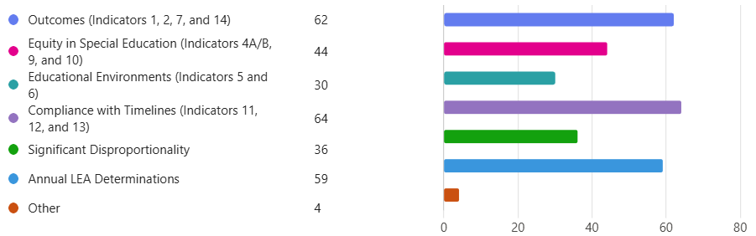
Question 1
Which State Performance Plan Indicators or data topics would be most help for your district to review or better understand?

Slide 28
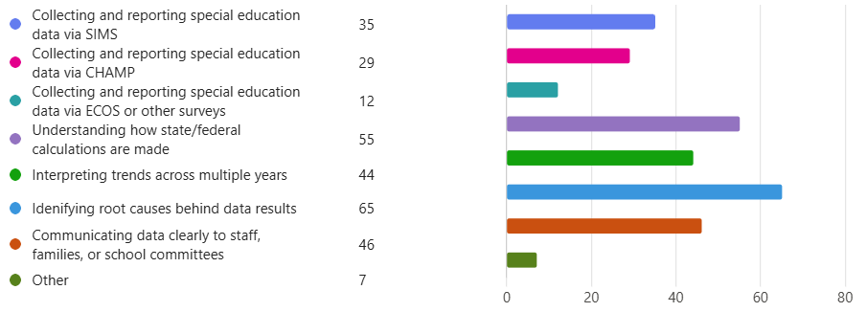
Question 2
Which areas pertaining to special education data are most challenging for your district?

Slide 29
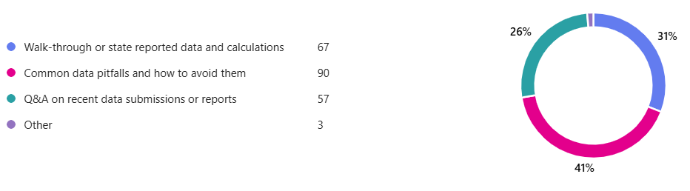
Question 3
What type of support would you find most valuable during a monthly leaders meeting?

Slide 30
Question 4
Are there specific questions, reports, or data issues you would like addressed in an upcoming webinar? (Open Response)
Common Themes
  Data Systems, Platforms, and Burden
  Determinations, Targets, and Year-to-Year Changes
  Disproportionality
  Indicator Confusion
  Monitoring, Oversight, and Accountability
  Communication, Training, and Engagement
  Record Management and Compliance

Slide 31
What is IDEA Data?
IDEA data is information collected under the Individuals with Disabilities Education Act (IDEA)
It describes who students with disabilities are, what services they receive, and how they are doing
Collected by states and districts and reported annually to the U.S. Department of Education

Slide 32
Why is IDEA Data Important?
To ensure students with disabilities receive a Free Appropriate Public Education (FAPE)
To monitor equity, access, and outcomes across districts and student groups
To meet federal accountability and compliance requirements
To guide improvement, technical assistance, and resource allocation

Slide 33
What is Collected?
Child Count and Demographics
  Number of students with disabilities
  Disability categories, age, race/ethnicity
Services and Program Data
  Educational environments (full inclusion, separate settings, etc.)
Results and Outcomes
  Graduation and Dropout rates of students with disabilities
  Post school outcomes
  Assessment
Discipline and Equity Data
  Suspension and Expulsion Rates
  Identification Rates
Timelines and Compliance Data
  Evaluations and Transition
  IDEA procedural requirements

Slide 34
How is IDEA Data Used?
Annual 618 Submissions from the Department to USED/OSEP
  Child Count and Educational Environments, Discipline, Exiting, Assessment, Personnel
State Performance Plan and Annual Performance Report (SPP/APR) Indicators
District Performance
Targeted monitoring, supports, and professional development
Annual Special Education Determinations
Significant Disproportionality

Slide 35
What IDEA Data is Not
A single test score or snapshot of a student
Not used to label or rank students
Not solely about compliance – it also focuses on results and outcomes
IDEA data tells a story of how well systems are serving students with disabilities
It helps ensure rights are protected, inequities are addressed, and outcomes improve over time

Slide 36
How is IDEA Data Collected?
Most Special Education Data is reported directly from districts via yearly SIMS, SSDR, and EPIMS submissions
  Child Count, Educational Environments, Discipline, Exiting, and Personnel
Other data is reported to the Department via other data systems
  CHAMP, ECOS, Alchemer
When put together and analyzed, these submissions generate the Department’s 618 and SPP/SPR submissions to OSEP

Slide 37
Where is IDEA Data Published?
Special Education Data Reporting
School and District Profiles
  Updated by May of each year with the previous Federal Fiscal Year’s reporting, districts can select their own district for a more detailed view of all Indicator data
Edwin Analytics – SP301 Significant Disproportionality in Special Education
Annual LEA Special Education Determinations and District Reports uploaded to the Special Education State Performance Plan Dropbox in the Security Portal
  Individual Indicator Reports currently only include Indicators 8, 11, 12, 13, and 14

Slide 38
Next Steps
Transparency and Clarity
  Use the Special Education Leaders Meetings as opportunities to review how special education data is collected, reviewed, and used and provide clearer explanations of data sources, timelines, and calculations
Clarify Existing Guidance
  Provide (or update) FAQs, crosswalks, and clarifications around special education data collection, measurements, and use
Year-to-Year Changes
  Provide context around SPP/APR changing targets, convene workgroups around methodologies, and provide explanation around use of multiple data points within Determinations
Improving Support for Data Systems
  Provide practical technical assistance and quick reference guides regarding data collection and submissions
Strengthen Communication
  Share regular status updates and provide advanced notice of timelines
Engagement and Collaboration
  Explore options for increased conversations and connections among districts and continue gathering feedback to inform training topics and formats

Slide 39
Resources

Slide 40

Special Education
Year at a Glance

Slide 41
Information for Special Education Leaders
Regular Updates and Information
  Special Education Bulletin
  Special Education Website
Update Information in the Directory Administration
  Special Education Leaders Meeting Invites and Memos
Email Contacts
  specialeducation@mass.gov (General Special Education Inquiries)
  IDEAfiscal@mass.gov (IDEA Fiscal Inquiries)
  IDEAdata@mass.gov (IDEA Data Inquiries- Special Education or SPP/APR Data)

Slide 42
2025-2026 Meetings
Month | Proposed Meeting Date
February | Friday, February 27, 2026
March | Friday, March 13, 2026
April | Friday, April 10, 2026
May | Friday, May 15, 2026
June | Friday, June 12, 2026
*The department is still exploring an in-person convening in the spring

Slide 43
Questions
and
Answers

