Slide 1
Special Education Leaders' Meeting February 27, 2026

Slide 2
Agenda
Special Education Updates and Key Special Education Policy Topics
Licensed Practical Nurses (LPN), In-School 1:1 Nursing Services for Students with Medical Complexities, and School Based Medicaid Program (SBMP)
Professional Development and Technical Assistance
IDEA Fiscal

Slide 3
Special Education Updates and Key Special Education Topics

Slide 4
Differentiated Monitoring System 2.0
The Office of Special Education Programs monitors States by reviewing a state’s general supervision system to ensure compliance with IDEA.
The goal of DMS 2.0 is to improve outcomes and results for infants, toddlers, children and youth with disabilities and their families in conjunction with compliance.
OSEP’s monitoring will focus on States’ systems of general supervision integrating both results and compliance.

Slide 5
DMS Monitoring: Three Phases
Discovery October 2025
(5 months prior to engagement)
Document Request
State Overview Call
Stakeholder engagement
Local Component
Engagement May 2026
(1 month (visit) through issuance of the DMS Monitoring Report)
Onsite and Virtual monitoring interview calls
Issuance of the DMS Monitoring Report
Close-out
(up to one year after the issuance of the DMS Monitoring Report)
Review of evidence of correction
Technical Assistance

Slide 6
Guidance on the Implementation of Amendments to 603 CMR 46 and 603 CMR 18 – Time-out Practices
The guidance document was released on February 5 and is intended to:
Clarify definitions and regulatory requirements related to time-out practices;
Distinguish time-out from seclusion and other prohibited practices;
Provide implementation guidance and examples to support compliant and appropriate use;
Address common questions related to documentation, oversight, and monitoring; and
Support schools and programs in developing policies, training, and systems aligned with the amended regulations.

Slide 7
Implementation of Regulatory Amendments to 603 CMR 46 and 603 CMR 18 - Time-out Practices
Grant Funding
78 grants awarded to public school districts, charter schools, collaboratives and approved special education schools (Fund Code 213)
Total of $3.6 million
Training
Spring 2026 – release of procedures and training for reporting requirements to the Department effective August 2026
Summer 2026 – asynchronous online training modules to support staff training

Slide 8
Background on the Protect Education Equity Act
Signed by Governor Healey on August 5, 2025
Key Provisions
Requires the adoption of regulations relative to discipline procedures for students with disabilities, as required by federal law and were in effect as of January 1, 2025;
Requires the Board of Elementary and Secondary Education (Board) to promulgate regulations establishing standards for the provision of interpretation and translation services in public schools;
Requires consideration of the language needs of a student with a disability who is an English learner when developing an IEP and prescribes specific procedures for doing so; and
Adds immigration or citizenship status and disability to the list of protected classes of students under state law.

Slide 9
DESE Regulations Proposed in Response to the Protect Education Equity Act
Proposed Amendments to Regulations on Special Education to Conform to State Law, 603 CMR 28.00
Proposed New Regulations for Interpretation and Translation Services in Schools, 603 CMR 57.00

Slide 10
Proposed Amendments to Regulations on Special Education to Conform to State Law
Amend definition of IEP to include a reference to the new state law, which adopts the language from federal law regarding the consideration of the language needs of English learners with disabilities and requires the participation of an individual with knowledge of the differences between the student's special education and language needs or submission of their report.
603 CMR 28.02: Definitions
(11) Individualized Education Program (IEP) shall mean a written statement, developed and approved in accordance with federal and state special education law in a form established by the Department that identifies a student’s special education needs and describes the services a school district shall provide to meet those needs.

Slide 11
Proposed Amendments to Regulations on Special Education to Conform to State Law
Effectuate the Act’s mandate for the Department to promulgate regulations to continue the effect and enforce the provisions in the federal Individuals with Disabilities Education Act (IDEA), regarding discipline protections applicable to students with disabilities
Adds a new section 603 CMR 28.11 - Discipline Procedures for Eligible Students – incorporating the discipline provisions already in the IDEA

Slide 12
Proposed Regulations for Interpretation and Translation Services in Schools
Background
There are existing legal requirements to provide interpretation and translation services to parents who have limited English proficiency, for example:
603 CMR 28.07(8) requires that communication be in both English and the primary language of the home if such primary language is other than English
DESE has offered approximately $1 million in grant funding to support over 50 districts' interpretation and translation efforts over the past two years
There is no dedicated or new funding source to support this

Slide 13
Proposed New Regulations for Interpretation and Translation Services in Schools
Statutory language requires BESE to promulgate regulations establishing the standards for the provision of interpretation and translation services, including standards for the qualification of interpreters and translators including:
Bilingualism
Knowledge in both languages of specialized terms or concepts
Training
Ethics and confidentiality
603 CMR 57.00, effective date shall be September 1, 2027

Slide 14
Proposed Regulations for Interpretation and Translation in Schools
Qualifications
Interpretation Services:
General Education Interpreter (for non-specialized settings)
Requires proficiency in English and another language, as determined by DESE
Requires completion of DESE-approved training course (terms, role, ethics/confidentiality)
Advanced Interpreter (for specialized settings)
Requires proficiency in English and another language, as determined by DESE
Requires completion of DESE-approved training course (specialized terms, role, ethics/confidentiality)
Translation Services:
School Translator
Requires written proficiency in English and another language, as determined by DESE
Demonstration of ethics, confidentiality, terms

Slide 15
Anticipated Next Steps
Public comment may be submitted via an online form, or sent via email to BESERegulationComments@mass.gov, or sent via mail to Regulations Public Comment, c/o Commissioner’s Office, Department of Elementary and Secondary Education, 135 Santilli Highway, Everett, MA 02149.​
The deadline for the public comment period is Friday, April 24, 2026, at 5:00pm.
​
The Board is expected to vote on the proposed amendments at its regular monthly meeting scheduled for June 23, 2026.

Slide 16

Licensed Practical Nurses (LPN) and In-School 1:1 Nursing Services for Students with Medical Complexities
February 27, 2026
February 2026
Notes:
Make sure to introduce FFS team

Slide 17
Agenda
1. | Introduction to MassHealth Members Receiving Continuous Skilled Nursing (CSN) | Abby Newton MassHealth
2. | Review LPN Scope of Practice | Jay Prosser Nursing Council on Workforce Sustainability
3. | How Schools May Work with LPNs and Agencies | Karen Robitaille Dept. of Public Health
4. | Review School-Based Medicaid Program (SBMP) | Margot Tracy MassHealth
5. | Questions
February 2025

Slide 18
Introduction to MassHealth Members Receiving Continuous Skilled Nursing
Presented by: Abby Newton
Senior Policy Manager: Home Health, Hospice, Therapies, CSN
MassHealth Office of Long Term Services and Supports
18

Slide 19
Introduction to MassHealth Members Receiving Continuous Skilled Nursing (CSN also known as Private Duty Nursing)
What is CSN? MassHealth-covered in-home services for individuals with medical complexities who require greater than 15hrs of skilled nursing interventions per week. | Common Diagnoses Genetic disorders (21%) Neurological disorders (14%) Pulmonary disease (13%) Cerebral Palsy (13%) Many members have comorbidities (multiple medical conditions)
Who are the MassHealth Members receiving CSN? Approx 1100 people 68% are under the age of 22 On avg, members are authorized approx. 60 hours per week Reside across the state, with majority living in Middlesex (21%), Worcester (13%) and Essex (12%) counties | MassHealth Member In-School healthcare needs Often Require 1:1 nursing and/or 1:1 personal care Polypharmacy (5 or more medications) High-tech/Durable Medical Equipment needs (e.g. vent, g-tube/j-tube, mobility devices) Continuous monitoring, respiratory care, etc Absent these interventions members may be unable to attend school in-person
February 2026

Slide 20
MassHealth’s Core Purpose for Organizing This Presentation
MassHealth understands some school districts struggle to staff a member/student’s 1:1 nursing
Due to the absence of 1:1 care, MassHeath has heard reports that members/students have
Missed in-person school days, or
Have had to use at-home MassHealth authorized services to ensure school attendance.
While MassHealth understands some families prefer to use their MassHealth authorized services in school, generally this is not a recommended approach as members/students will overall receive less hours of care.
To assist with the issue, the team would like to inform school districts how they may use LPNs to provide 1:1 nursing care for complex-care students
We understand a few school districts do use LPNs to support complex-care students,
While other school districts may require further information on how to use LPNs.
February 2026

Slide 21
Review LPN Scope of Practice
Presented by: Jay Prosser DNP, RN
Executive Director
Massachusetts Nursing Council on Workforce Sustainability
21

Slide 22
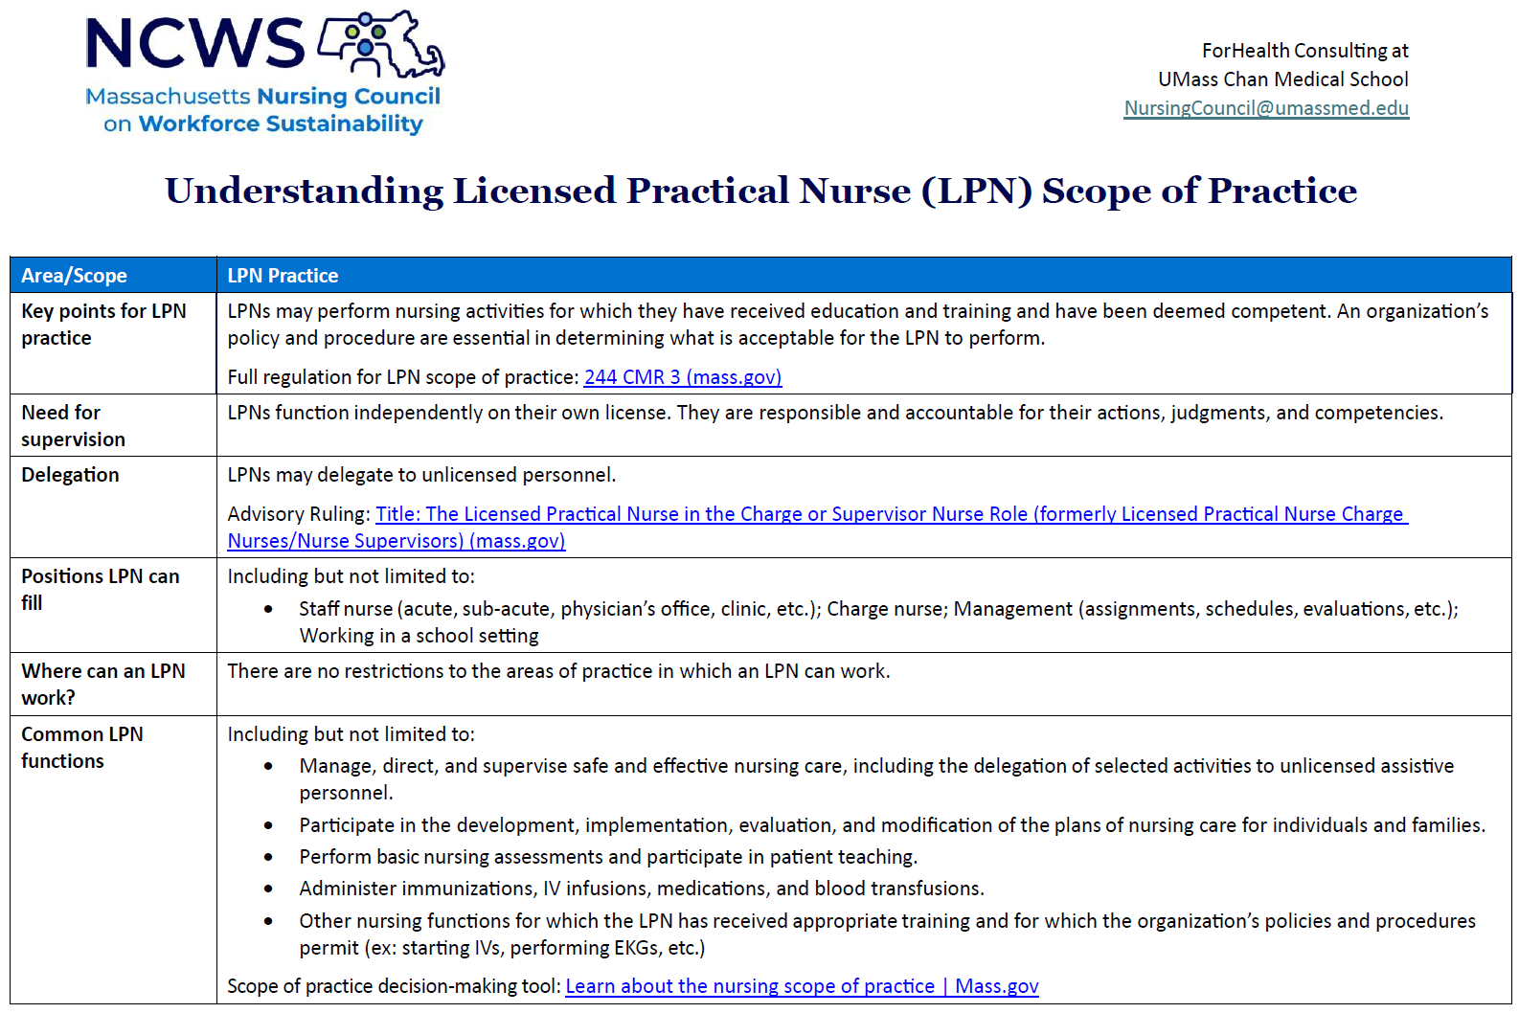
Review LPN Scope of Practice
February 2026

Slide 23
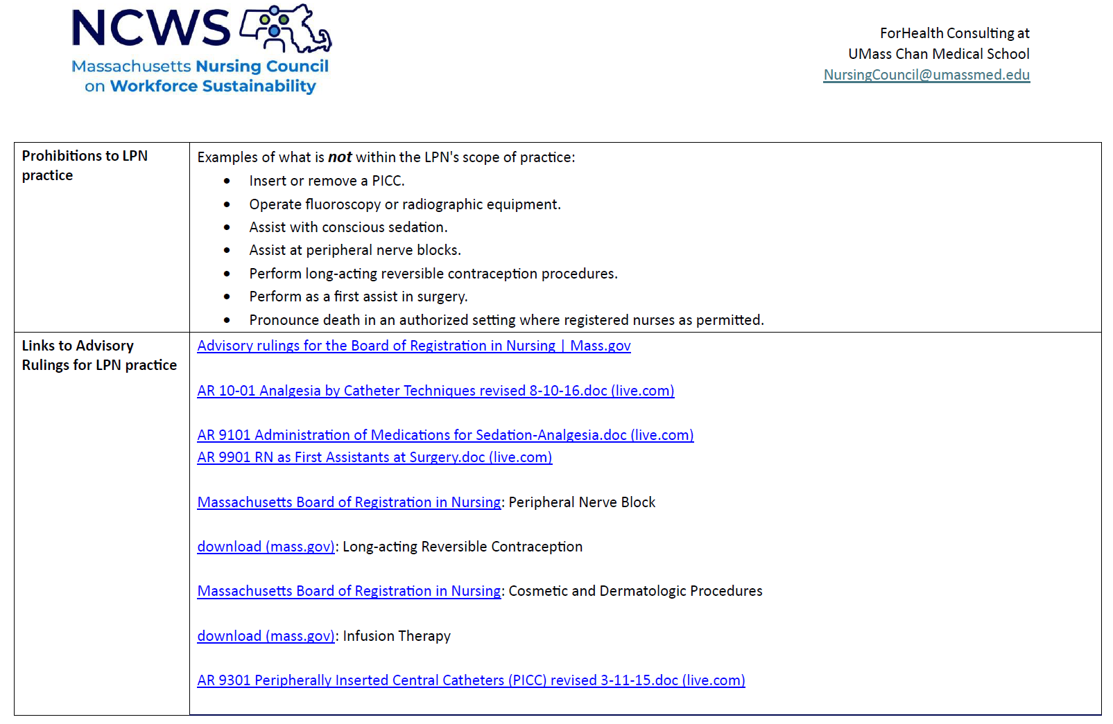
Review LPN Scope of Practice Continued
February 2026

Slide 24
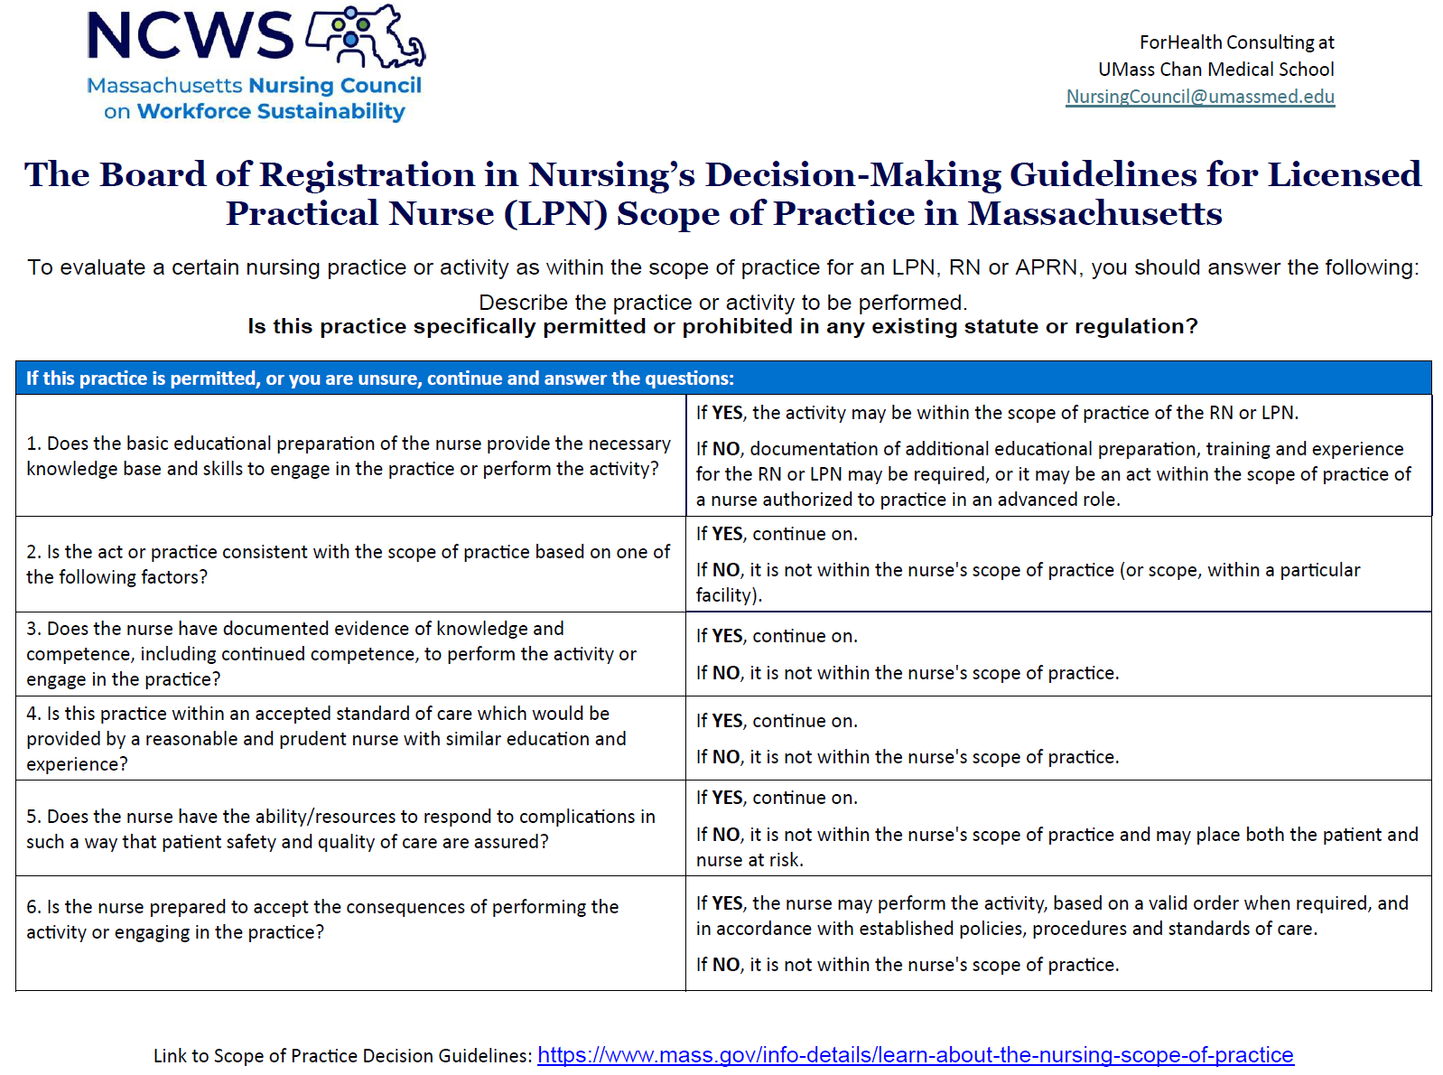
Review LPN Scope of Practice Continued
February 2026

Slide 25
Key Aspect of LPNs Practicing in School Settings
LPNs may not delegate the administration of medications
Only RNs can delegate medication administration to unlicensed staff
Reference: 105 CMR 210
February 2026

Slide 26
How Schools May Work with LPNs and Agencies
Presented by: Karen Robitaille, MBA MSN, RN, NCSN
Director, School Health Services
MA Department of Public Health
26

Slide 27
How Schools May Work with LPNs and Agencies Continued
Districts can hire LPN’s directly as district employees or contract with nursing agencies.
Use of LPN's to care for medically complex students is more cost-efficient than hiring RN's, with no loss in scope of care, since LPNs generally will have no limits on implementing the plan of care developed by the school RN.
Please note, LPNs do not develop plans of care.
Considerations for district employment | Considerations for employment through agency
Contractual structures may not accommodate these employees | Will need to contract with agency; contract should spell out communication structure/documentation systems with district nursing staff
Need to consider competitive pay structure | Higher hourly costs going through agency
School schedules and benefits are attractive and may improve recruitment and retention | School schedules and benefits are attractive and may improve recruitment and retention
Nursing supervision can be given in-house | Nursing supervision occurs via the agency
Retention year over year improves trust and relationships with caregivers | Turnover among agency staff is high
February 2026

Slide 28
Review the School-Based Medicaid Program (SBMP)
Presented by: Margot Tracy
School Based Medicaid Program Manager
MassHealth
28

Slide 29
School-Based Medicaid Program (SBMP)
SBMP provides federal funds that help LEAs offset the costs of delivering medically necessary services to students who are enrolled in MassHealth
Covered services are delivered by LEA employed/contracted health providers, e.g., nurses, PT/OT/SLP, school social workers, school psychologists
It also reimburses for the costs of administrative activities that support Medicaid-covered services (e.g., when LEA personnel help families enroll in MassHealth and access services, coordinate care, arrange for specialized transportation)
In 2019 SBMP expanded so that LEAs could claim both for IEP and non-IEP related services delivered to their MassHealth enrolled students
Per statute, reimbursement is unrestricted revenue returned to municipality
Local decision at discretion of municipality
Some set up special education stabilization funds that are replenished by the reimbursement
Others have MOA/MOU to split the reimbursement between town and school
February 2026

Slide 30
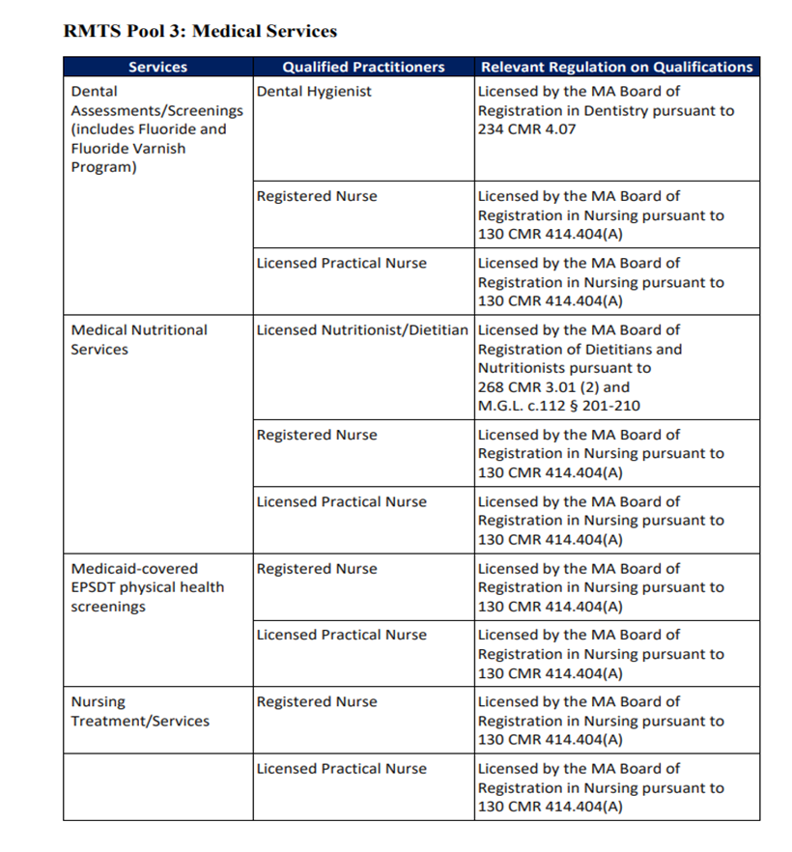
SBMP Covered Services and Qualified Providers
SBMP covers a variety of services and providers, including Registered Nurses (RN) and Licensed Practical Nurses (LPN) who provide nursing services.
Visit the SBMP Resource Center for more general program information.
SBMP facilitates a professional learning community (PLC) for LEA Medicaid Coordinators and just published tools to help LEAs strengthen their programs (or get them started): LEA Toolkit for SBMP Success
February 2026

Slide 31
Questions
31

Slide 32
Professional Development and Technical Assistance

Slide 33
Special Education PD Offers for 2025-2026 School Year
Registration is finalized for all Leadership Institutes and Leadership Academy PD
IEP Team Leader Institute
Special Education Directors Institute
Early Childhood Institute
Inclusive Leadership Academy for General and Special Education Administrators
New Leadership Institutes and Leadership Academy PD to begin during the summer
look for emails and notifications regarding registration in the late spring

Slide 34

LEA Determination & Significant Disproportionality TA: Touchpoints for Success
Needs Intervention (NI) | Needs Assistance (NA) | Significant Disproportionality
Consult Call – RSVP and meet virtually with your consultant M³ webinar | NA Support webinar | Consult Call – RSVP and meet virtually with your consultant Dual-Identified webinar – For LEAs that also have a Determination of NI or NA
If you need the slides or recording for any of the webinars, contact supportma@spedstrategies.com
Action Plan Submissions Due

Slide 35
Learning Opportunities for Educators: Federation for Children with Special Needs
IEP process
Trainings designed to support educators in deepening their knowledge of the New IEP and process
Foundational knowledge
Community of Practice
Register here
Positive Solutions: Train the Trainer
Ten-hour Positive Solutions for Families: Train the Trainer, and customized technical assistance for schools and districts interested in strengthening family engagement
Designed to support meaningful learning experiences for families of children ages 2-5
March 28, 2026
Contact: Maddie Evans mevans@fcsn.org for more details

Slide 36
Learning Opportunities for Educators: Federation for Children with Special Needs
Strengthening Partnerships: Train the Trainer, Massachusetts Family Engagement Framework Series
This professional development series introduces educators and school staff to the Massachusetts Family Engagement Framework and prepares them to actively implement it within their schools and districts
April Virtual Cohort 6:00–8:00 PM (Virtual)
April 28, 29, 30 and May 6 & 7, 2026
July In-Person Cohort
July 13 & July 15 (8:30am-12:30pm, in person); July 17 (8:30am-10:30am, virtual)
September Strengthening Partnerships Train the Trainer – Early Childhood focus – dates to be determined
Contact Maddie Evans mevans@fcsn.org for more details or register here

Slide 37
2025 Early Childhood Convenings
Yearly Schedule
Date & Time
March 25 at 1:00 - 2:30 PM

Slide 38
IDEA Fiscal Virtual Community of Practice
Thursdays, 3:00 - 4:00 pm Zoom Webinar
March 5, 2026 – Maintenance of Effort, Exceptions and Adjustments
May 7, 2026 – Proportionate Share for Equitable Services Carryover
June 4, 2026 – FY27 Consolidated Application, Conditions of Assistance
Register at: https://us02web.zoom.us/webinar/register/WN_PU0FvUW0QJiD-WL-UMNIHA

Slide 39
IDEA Fiscal

Slide 40
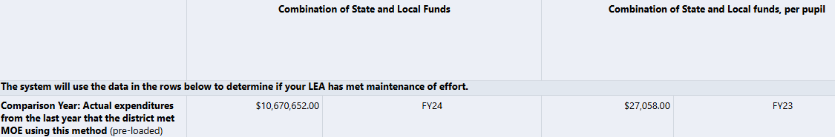
Maintenance of Effort – FY25 Compliance
FY25 End of Year Report (EOYR)
Districts, Regional, Vocational – September 30, 2025
Charters - November 17, 2025
Virtual – January 30, 2026
FY25 Circuit Breaker Reimbursements
FY25 Standards – Last time MOE met = FY26 Eligibility Standards available in FY26 GEM$ Consolidated FC 240/262 Application

Slide 41
Maintenance of Effort: Compliance
An LEA will meet its compliance standard if it spends the same or more in State and local funds in the aggregate or per pupil
LEAs that meet the compliance standard by only the per pupil standard, will be afforded the opportunity to report and demonstrate valid exceptions and adjustments to potentially reduce the LEA’s aggregate MOE standard to be applied going forward.
For exceptions and to be applied, completion of the Exceptions and Adjustment Workbook and supporting documentation for the claimed exceptions are required

Slide 42
IDEA Funds Expiring September 30, 2026
FY25 FC 240 and FC 262 funds expire on September 30, 2026
Funds must be obligated on or before September 30, 2026, and liquidated no later than ninety (90) days thereafter
Procedures for regular reimbursement requests to draw down funds
Revise budgets to claim first in first out
Monitoring communications to be sent out to those with 50% or more unclaimed balance

Slide 43
Resources

Slide 44

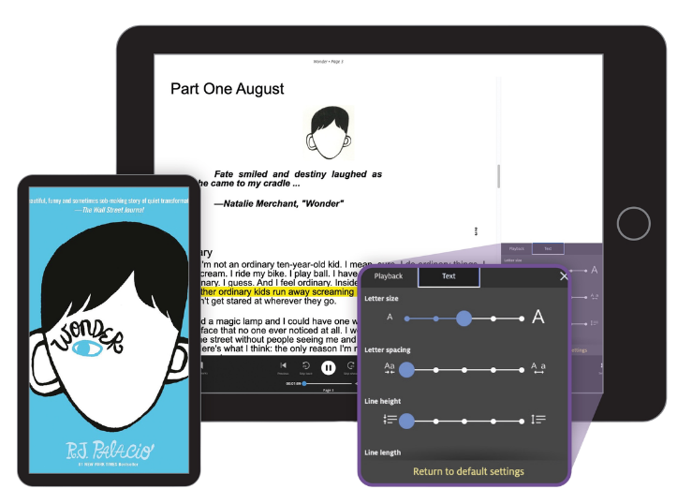

Learning Ally
March Ally Insider Newsletter
Learning Ally is a nonprofit that empowers learners with reading differences, including dyslexia, by providing innovative solutions such as the MA state-funded Audiobook Solution.
Details about this year’s Spring Into Reading program - kicking off March 9!
Great Reading Games Celebration: Live webinar featuring author Megan Nicolas on March 6
Curated audiobook recommendations to
celebrate and honor Women’s History Month
Special virtual screening opportunity for the powerful Left Behind documentary
Click to Read More

Slide 45

Special Education
Year at a Glance

Slide 46
Information for Special Education Leaders
Regular Updates and Information
Special Education Bulletin
Special Education Website
Update Information in the Directory Administration
Special Education Leaders Meeting Invites and Memos
Email Contacts
specialeducation@mass.gov (General Special Education Inquiries)
IDEAfiscal@mass.gov (IDEA Fiscal Inquiries)
IDEAdata@mass.gov (IDEA Data Inquiries- Special Education or SPP/APR Data)

Slide 47
2025-2026 Meetings
Month | Date/Time
March | Friday, March 13, 2026 11:00 – 12:00
April | Wednesday, April 15, 2026 In-Person Meeting 9:30-3:00 Registration Please register no later than March 13, 2026
May | Friday, May 15, 2026 11:00 – 12:00
June | Friday, June 12, 2026 11:00 – 12:00

Slide 48
Questions
and
Answers

