Slide 1
Special Education Leaders Meeting
June 12, 2026

Slide 2
Agenda
Key Special Education Topics and Policy Updates
  2025-2026 Determinations of Need for Special Education Technical Assistance or Intervention
  Mileage Reimbursement for Parents under 603 CMR 28.07(6)
  IDEA Fiscal Updates
Implementation of Updated Regulations Regarding Seclusion and Time Out Practices
  Overview of 3 Training Modules and Implementation Guide- Dr. Ross Greene

Slide 3
Key Special Education Topics and Policy Updates

Slide 4
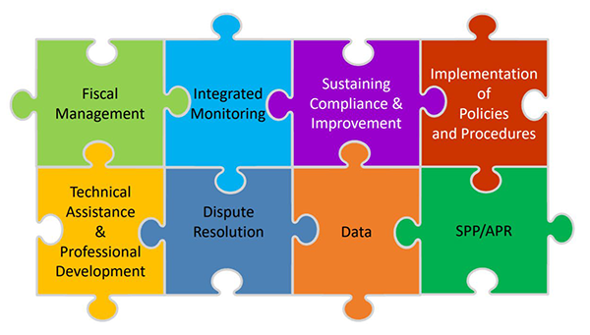
General Supervision
As the State Educational Agency, the Massachusetts Department of Elementary and Secondary Education (DESE) has responsibility for general supervision under Part B of the Individuals with Disabilities Education Act (IDEA).
DESE provides technical assistance and monitors local education agencies’ (LEAs) implementation of IDEA and state special education law. General supervision has eight distinct but interconnected components, creating a cohesive system

Slide 5
DMS Monitoring: Three Phases
Discovery October 2025
(5 months prior to engagement)
  Document Request
  State Overview Call
  Stakeholder engagement
  Local Component
Engagement May 2026
(1 month (visit) through issuance of the DMS Monitoring Report)
  Onsite and Virtual monitoring interview calls
  Issuance of the DMS Monitoring Report
Close-out
(up to one year after the issuance of the DMS Monitoring Report)
  Review of evidence of correction
  Technical Assistance

Slide 6
2025-2026 Determinations of Need for Special Education Technical Assistance or Intervention
Determinations issued May 1, 2026
  Posted in district Special Education State Performance Plan Dropbox
Special Education Policy Memo – 6
  Provides details on how determinations were made, statuses, and next steps for districts identified as Need Assistance (NA) or Need Intervention (NI)
Technical Assistance to be provided in the 2026-27 school year in conjunction with SPED Strategies
  Detailed calendar to be released before end of this school year
Questions?
  Data related IDEAdata@mass.gov
  Technical Assistance specialeducation@mass.gov or supportma@spedstrategies.com

Slide 7
Mileage Reimbursement for Parents under 603 CMR 28.07(6)
Effective April 19, 2026, state employees became eligible to receive reimbursement for transportation at the rate of $0.70 per mile. Therefore, if a parent provides transportation to an eligible student requiring special transportation consistent with the requirements of 603 CMR 28.05(5)(b) and 603 CMR 28.0(7)(6), the school district shall reimburse such parent the prevailing rate per mile for state employees. Reimbursement shall be for no more than the round-trip distance between the home and the school for school attendance and school-sponsored extracurricular activities. Mileage shall be determined based on a direct route between the student's home and school. No parent shall be obligated to provide such transportation.

Slide 8
IDEA Fiscal

Slide 9
FY27 Consolidated FC 240/262 Application
Available July 2026
Outstanding FY25 Maintenance of Effort Compliance
Conditions of Assistance – Multiple Signatures Needed
GEPA Statement Changes – Certification Only
Due: September 30, 2026
Must Have Substantially Approvable Application to Obligate FY27 funds
Webinar: Tuesday, August 4, 2026 – Invitation through GEM$ to follow

Slide 10
FY27 IDEA Part B: Subrecipient Conditions of Assistance
Under the IDEA, an LEA is eligible for fiscal assistance under Part B of the Act for a fiscal year if the agency submits a plan that provides assurances to the Department that the LEA meets each of the conditions in 34 C.F.R. § 300.201 through 34 C.F.R. § 300.213. 34 C.F.R. §300.200.
The LEA, in providing for the education of children with disabilities within its jurisdiction, must also have in effect policies, procedures, and programs that are consistent with the state policies and procedures established under 34 C.F.R. § 300.101 through 300.163, and § 300.165 through 300.174.
Every LEA must submit a new Conditions of Assistance: IDEA Part B Funding Certifications (Individual Districts and Schools, or Consortium) to the Department annually.
Any policies, procedures, and related documents must be available for the public upon request if it is not published on a website or any public platform.

Slide 11
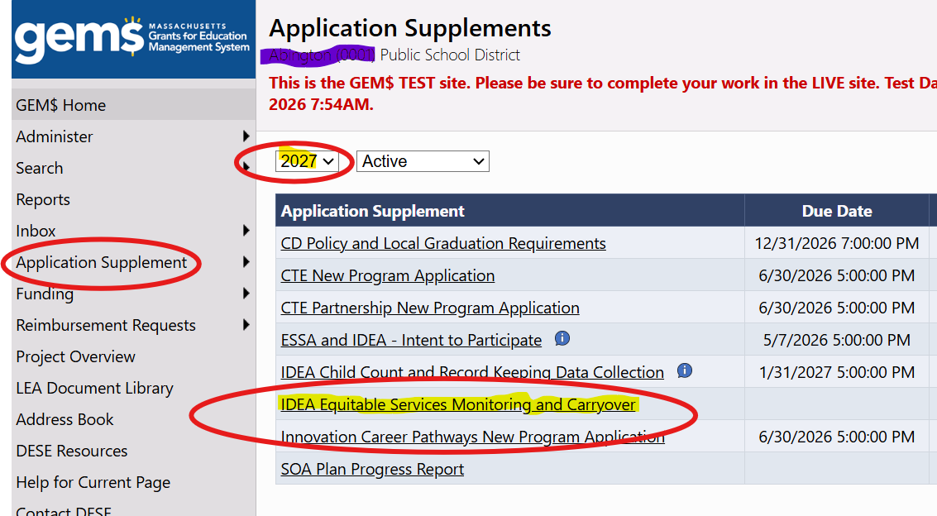
Proportionate Share Monitoring and Carryover

Slide 12
Additional Information and Resources

Slide 13

Special Education
Year at a Glance
&
Special Education Summer Checklist

Slide 14
Information for Special Education Leaders
Regular Updates and Information
  Special Education Bulletin
  Special Education Website
Update Information in the Directory Administration
  Special Education Leaders Meeting Invites and Memos
Email Contacts
  specialeducation@mass.gov (General Special Education Inquiries)
  IDEAfiscal@mass.gov (IDEA Fiscal Inquiries)
  IDEAdata@mass.gov (IDEA Data Inquiries- Special Education or SPP/APR Data)

Slide 15
2026-2027
Meetings
August 21, 2026
September 18, 2026
October 23, 2026
November 4, 2026 (In person meeting- no webinar)
December 4, 2026
January 22, 2027
February 26, 2027
March 19, 2027
April 14, 2027 (In person meeting- no webinar)
May 14, 2027
June 11, 2027

Slide 16
Implementation of Regulatory Amendments for 603 CMR 46.00 & 603 CMR 18.00

Slide 17
Implementation of Regulatory Amendments
Why These Changes?
Massachusetts has taken a phased approach to reducing the use of restrictive practices and strengthening behavioral supports for students.
Key drivers include:
National guidance from the U.S. Department of Education
Ongoing enforcement activity by the U.S. Department of Justice
Statewide stakeholder engagement
Monitoring findings and implementation data
Public feedback
Key Milestone: The amended regulations become effective August 17, 2026.

Slide 18
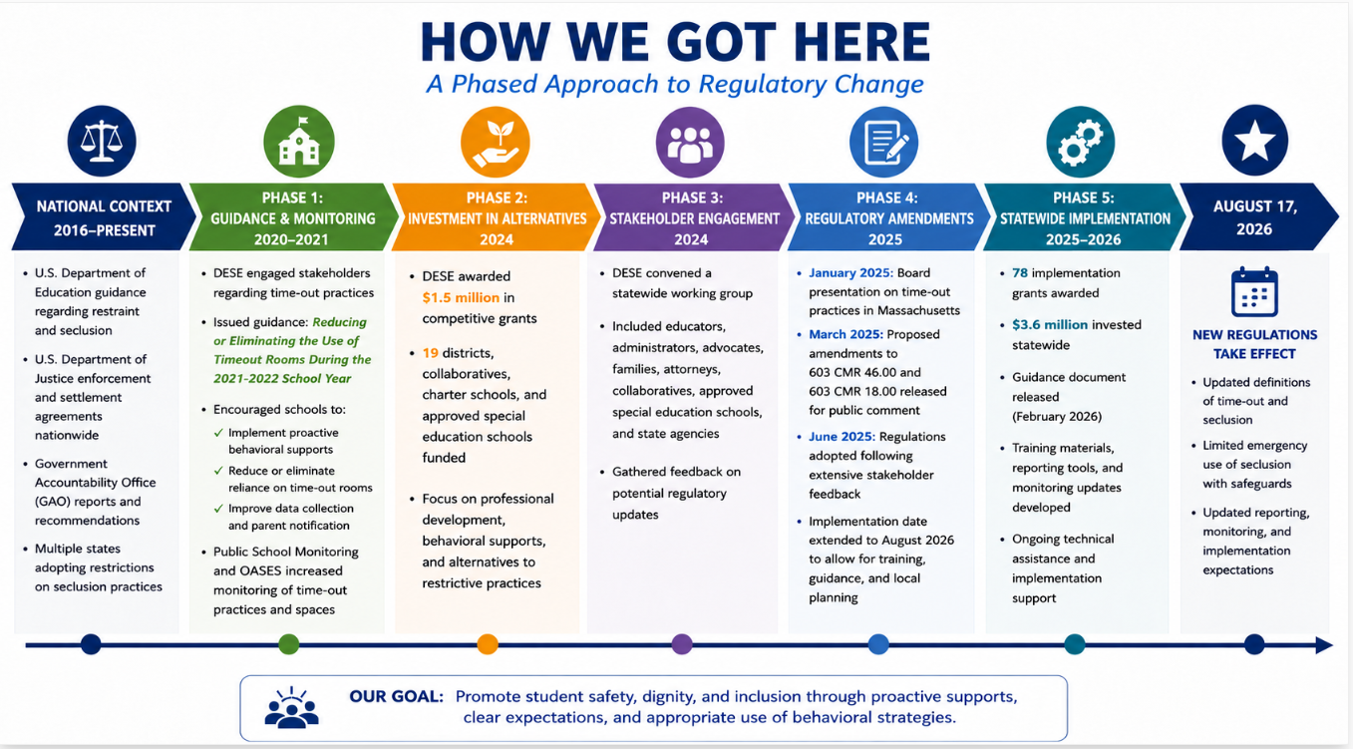
18

Slide 19
What Changed?
Updated definition of seclusion
Updated definition of time-out
Added requirements for any room or area used for seclusion
Added emergency circumstances under which emergency seclusion may be used
Added safeguards for emergency seclusion

Slide 20
Resources Available Now
Guidance document & Policy Memo (posted February 2026)
Updated Regulations
603 CMR 46.00 Amended Regulations
603 CMR 18.00 Amended Regulations

Slide 21
Resources to be Available in July
Frequently Asked Questions Document (FAQ)
Reporting Requirement Training
Updated Seclusion Reporting Memo and Tool
Updated Monitoring Criteria for LEAs
Three Asynchronous Professional Development Modules and Implementation Guide

Slide 22
Preparation for Implementation
Review and revise policies and procedures
Assess your spaces
Review your data to look at frequency patterns
Determine training and professional development needs
Develop parent notification letters, tracking logs or tools, update data forms, procedures, and processes (see templates and guildance document)

Slide 23
Definition of Seclusion Under State Regulations
Seclusion shall mean the involuntary confinement of a student alone in a room or area with or without adult supervision, from which the student is not permitted to leave. The term does not include: a classroom or school environment where, as a general rule, all students need permission to leave the room or area, such as to use the restroom; a behavior support technique that is part of the district’s, school’s or program’s designated procedures for behavior support which involves the monitored separation of a student in an unlocked setting, from which the student is allowed to leave and it is implemented for the purpose of calming; or placing a student in a separate location within a classroom with others or with an instructor, so long as the student has the same opportunity to receive and engage in instruction.

Slide 24
Definition of Seclusion Under State Regulations (Continued)
The key elements of this definition are that a student is:
1. Alone in a room or area with no adult present, and
2. Not permitted to leave.
In accordance with 603 CMR 46.07, seclusion is prohibited except in emergency situations as a last resort on an individual student basis and only when all requirements set forth in 603 CMR 46.07(2) have been met.

Slide 25
Emergency Seclusion Incident Reporting to the Department 46.07(3)(g)
Any public education program that uses the emergency intervention described in 603 CMR 46.07(2) must adopt and follow a procedure for:
(g) reporting such use to the Department in a manner, form, and with frequency specified by the Department.
  This reporting will occur through an online reporting tool that aligns with the current Restraint Incident Reporting.

Slide 26
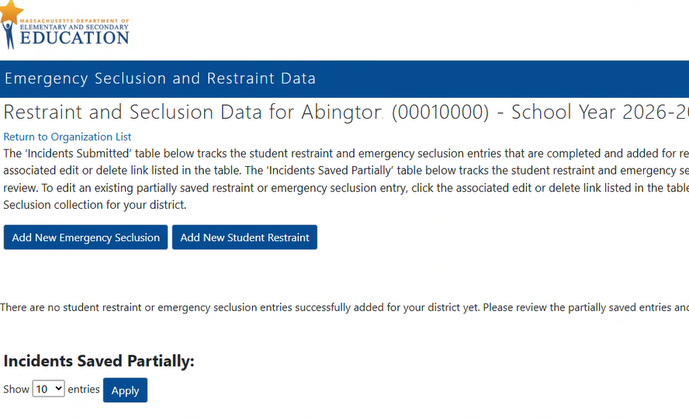
Reporting Requirements
Report all emergency seclusions that occur during school hours to the Department.
Every program shall collect and annually report data to the Department regarding the use of emergency seclusion by June 30th each year.
When an emergency seclusion results in an injury to a student the district shall:
Submit the Emergency Seclusion Report to the Department no later than three (3) school working days following the incident.

Slide 27

Introduction to Dr. Ross Greene
Founder of Lives in the Balance, a nonprofit dedicated to helping children, families, and schools.
Clinical psychologist and internationally recognized expert on challenging behavior in children and adolescents
Creator of the Collaborative & Proactive Solutions (CPS) model
Author of bestselling books, including The Explosive Child, Lost at School, Lost & Found, and Raising Human Beings
Former Harvard Medical School faculty member for more than 20 years

Slide 28
Questions
and
Answers

