Slide 1
Special Education Leaders Meeting
August 21, 2026

Slide 2
Agenda
Key Special Education Topics and Policy Updates
  General Supervision
  Implementation of Updated Regulations Regarding Seclusion and Time Out Practices
  Protect Education Equity Act and Updated Regulations
Planning for the 2026-2027 School Year
  MassAbility Update
  Monitoring
  TA and PD
  Dispute Resolution
  IDEA Data
  IDEA Fiscal Updates

Slide 3
Key Special Education Topics and Policy Updates

Slide 4
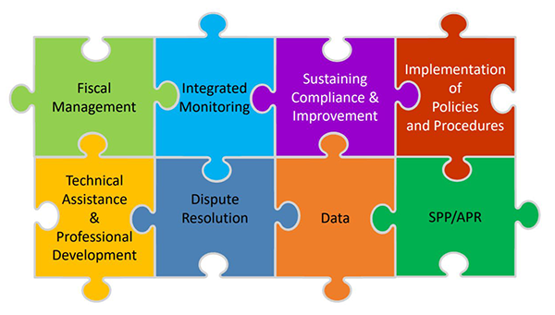
General Supervision
As the State Educational Agency, the Massachusetts Department of Elementary and Secondary Education (DESE) has responsibility for general supervision under Part B of the Individuals with Disabilities Education Act (IDEA).
DESE provides technical assistance and monitors local education agencies’ (LEAs) implementation of IDEA and state special education law. General supervision has eight distinct but interconnected components, creating a cohesive system

Slide 5
Implementation of Regulatory Amendments for 603 CMR 46.00 & 603 CMR 18.00

Slide 6
Context Setting: National and Massachusetts
Massachusetts has taken a phased approach to reducing the use of restrictive practices and strengthening behavioral supports for students.
The Department remains committed to reducing and eliminating the use of seclusion.
Key drivers include:
  National guidance from the U.S. Department of Education
    U.S. Secretary of Education Miguel A. Cardona policy letter on restraints and seclusion. January 8, 2025
  Ongoing enforcement activity by the U.S. Department of Justice
  Consultation with national experts
  Public feedback and statewide stakeholder engagement
  Monitoring findings and implementation data

Slide 7
Purpose
The amended regulations are designed to reduce and eliminate the use of seclusion and promote equitable access to safe learning environments that support both academic and social-emotional development for all students while ensuring students continue to receive meaningful access to instruction and the services and supports necessary to receive a free appropriate public education (FAPE).
The overuse or inappropriate use of seclusion can isolate students, hinder their connections to peers and staff, have a traumatic impact, and result in academic disruption.

Slide 8
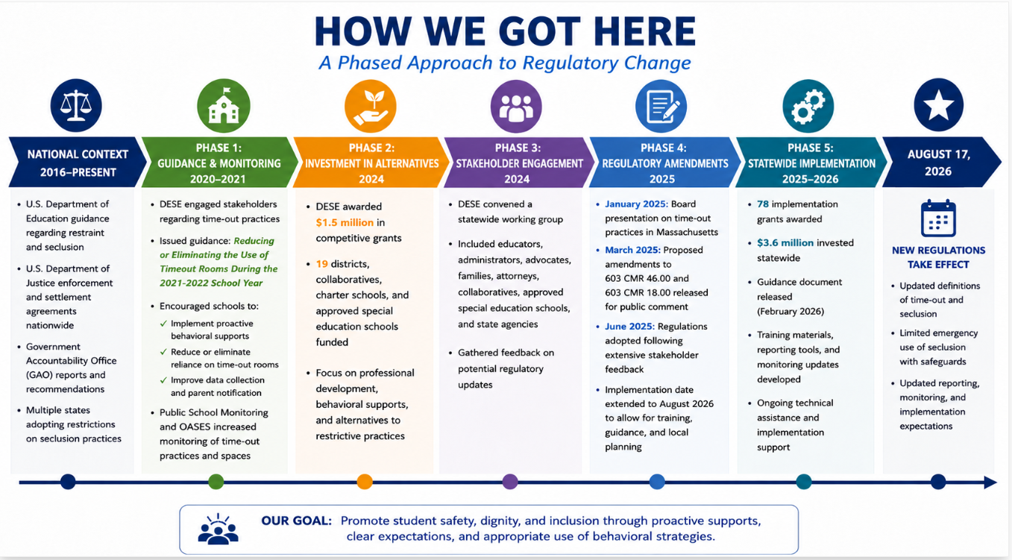
8

Slide 9
Definition of Seclusion
Seclusion shall mean the involuntary confinement of a student alone in a room or area, with or without adult supervision, from which the student is physically prevented from not permitted to leaveing. Seclusion does not include a time-out as defined in 603 CMR 46.02.

Slide 10
FAQ Question 2: What is seclusion?
The key elements of this definition are that a student is:
1. alone in a room or area with no adult present, and
2. not permitted to leave.
Seclusion occurs when a student is alone in a room or area and not permitted to leave, regardless of whether school staff supervise a student through an observation window or video feed.

Slide 11
Seclusion Does Not Include
a classroom or school environment where, as a general rule, all students need permission to leave the room or area, such as to use the restroom;
a behavior support technique that is part of the district’s, school’s or program’s designated procedures for behavior support which involves the monitored separation of a student in an unlocked setting, from which the student is allowed to leave and it is implemented for the purpose of calming;
or placing a student in a separate location within a classroom with others or with an instructor, so long as the student has the same opportunity to receive and engage in instruction

Slide 12
FAQ Question 3: What constitutes "not permitted to leave?"
"Not permitted to leave" means a student is directed, verbally or physically, or otherwise prevented from leaving a room or area.
A student is not considered secluded solely because they are subject to the same restrictions on movement that apply to all students in that setting or circumstance.

Slide 13
FAQ Question 4: What constitutes being alone in a room or area with no adult present?
A student is considered alone when no adult is physically present in the room or area with the student.
Observation through a window, camera, doorway, or other means does not constitute an adult being present in the room or area.

Slide 14
Use of Emergency Seclusion Permitted If:
Seclusion shall be prohibited in a public education program except-
As a last resort, in an emergency situation, where a student’s behavior poses:
  imminent threat of assault, or
  imminent threat of serious physical harm to self/others
--BUT ONLY IF--
documented history of repeatedly causing serious self-injuries and/or injuries to other students or staff
not responsive to directives or less intrusive behavior interventions, or such interventions deemed inappropriate under the circumstances
other forms of interventions have failed to ensure the safety of the student and/or the safety of others

Slide 15
Using Emergency Seclusion
Schools, districts, and programs must examine and adopt alternatives and strategies for reducing and eliminating its use no later than 3 years from the date of effectiveness in 603 CMR 46.08.

Slide 16
Additional Safeguards – Prior Documentation
No medical contraindications as documented by a licensed physician
A psychological or behavioral justification for the use, and there are no psychological or behavioral contraindications, as documented by a licensed mental health professional
Consent to use seclusion from the student’s parent or guardian and, if appropriate, the student
Use has been approved in writing by the principal
Any individual using it has received training about alternative behavior interventions and management techniques

Slide 17
FAQ Question 10: Who qualifies as a licensed mental health professional for purposes of 603 CMR 46.07(2)(e)?
A licensed mental health professional for purposes of 603 CMR 46.07(2)(e) follows the definition of “licensed mental health provider” in accordance with Massachusetts General Laws, which defines a “licensed mental health provider” as:
  1) a licensed physician who specializes in the practice of psychiatry,
  2) a licensed psychologist,
  3) a licensed independent clinical social worker,
  4) a licensed certified social worker,
  5) a licensed mental health counselor,
  6) a licensed supervised mental health counselor,
  7) a licensed psychiatric nurse mental health clinical specialist,
  8) a licensed psychiatric mental health nurse practitioner,
  9) a licensed physician assistant who practices in the area of psychiatry,
  10) a licensed alcohol and drug counselor I, as defined in section 1 of chapter 111J, or
  11) a licensed marriage and family therapist within the lawful scope of practice for such therapist.

Slide 18
Safeguards During the Emergency Seclusion
A staff member continuously observes and remains immediately available to the student.
The student is observable in all areas of the room.
Staff actively use calming and de-escalation strategies, unless unsafe or counterproductive to do so.
Not used for punishment or routine behavior management.
Ends immediately once the imminent threat has subsided.
If used for longer than 30 minutes obtain approval from the principal.

Slide 19
Safeguards After the Emergency Seclusion
Parents are notified verbally and in writing.
Principal is notified as soon as possible and provided a written report by the next school day.
Use of emergency seclusion is reported to DESE

Slide 20
Review and Reporting of Data (Seclusion)
Weekly review of students with multiple uses.
Review team is convened for repeated use, when applicable.
Monthly review of school-wide seclusion data is conducted.
Use of seclusion is reported to DESE in the required format and frequency.
Data must be used to examine and adopt alternatives and strategies for reducing and eliminating its use no later than 3 years from the date of effectiveness in 603 CMR 46.08.

Slide 21
Safety Standards – 603 CMR 46.07(1)
The space (room/area) must be:
Clean, safe, and sanitary and appropriate for calming
Appropriate size for age and needs of student
Well-lit and ventilated, heated/cooled like the rest of the building
Free from dangerous objects/fixtures
Fire and building code compliant

Slide 22
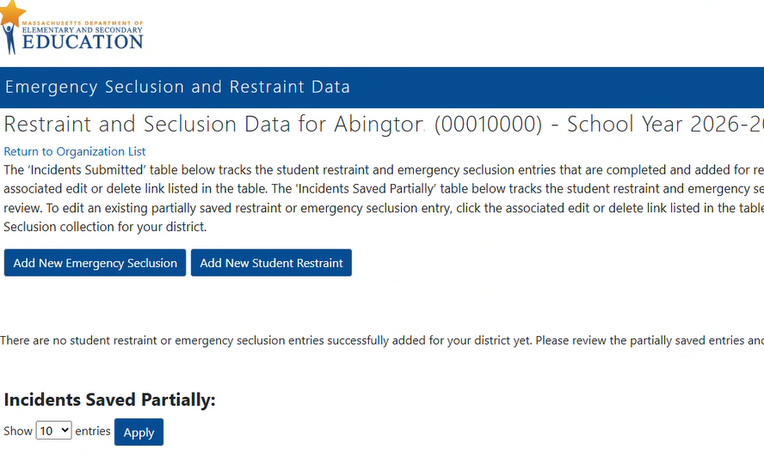
Reporting Requirements
Reporting via DESE Security Portal
Report all emergency seclusions that occur during school hours to the Department.
Every program shall collect and annually report data to the Department regarding the use of emergency seclusion by June 30th each year.

Slide 23
FAQ Question 15: What seclusion data must be reported to DESE?
Schools, districts, and programs should maintain appropriate tracking systems and records to support accurate reporting and compliance with Department requirements.
While all schools, districts, and programs are encouraged to report all incidents of seclusion in real time, the minimum requirement is to annually report and certify the data to the Department through the designated portal no later than June 30 of each calendar year.
The exception to this annual timeline is when an emergency seclusion results in an injury to a student or program staff member. In those instances, the school, district, or program shall submit a copy of the Emergency Seclusion Incident Report to the Department no later than three school-working days following the emergency seclusion.

Slide 24
Question 16 FAQ: Are schools, districts, and programs required to report the use of time-out to the Department?
No. Under 603 CMR 46.07(3)(g), schools, districts, and programs are only required to report the use of seclusion to the Department.
However, for students with disabilities, exclusionary disciplinary measures, if implemented repeatedly, could constitute a disciplinary removal from the current placement, implicating the student’s right to a free appropriate public education (FAPE).
Therefore, schools, districts, and programs may wish to track the use of time-out and other exclusionary disciplinary measures that could implicate the provision of FAPE.

Slide 25
Resources
Guidance on Time-Out Practices and Implementation of Amendments to 603 CMR 46.00 and 603 CMR 18.00
Special Education Policy Memo SY2026-2027: Implementation Resources to Help Schools Reduce and Eliminate the Use of Seclusion
Frequently Asked Questions (FAQ) on the Use of Emergency Seclusion
Emergency Seclusion Reporting Reference Guide
Reducing Reliance on Crisis Management Practices in MA Schools on Vimeo
Questions & Support:
Physical Restraint: restraint@mass.gov
Emergency Seclusion: specialeducation@mass.gov

Slide 26
2022 Federal Guidance
Dear Colleague Letter addresses disparities in the use of discipline for children with disabilities and the implementation of IDEA’s discipline provisions
  Dear Colleague Letter on Implementation of IDEA Discipline Provisions. OSEP DCL 22-01
Two accompanying guidance documents support state educational agencies’ and local educational agencies' efforts to fulfill their obligations to appropriately meet the needs of children with disabilities
  Questions and Answers: Addressing the Needs of Children with Disabilities and IDEA’s Discipline Provisions. July 19, 2022 (PDF)
  Positive, Proactive Approaches to Supporting Children with Disabilities: A Guide for Stakeholders. OSEP Policy Support 22-01 (TA guide). July 19, 2022. (PDF)

Slide 27
Preparation for Full Implementation
Review and revise policies and procedures
Assess your spaces
Review your data to look at frequency patterns
Determine training and professional development needs
Develop parent notification letters, tracking logs or tools, update data forms, procedures, and processes
Access reporting tool
Examine and adopt alternatives and strategies for reducing and eliminating the use of seclusion no later than 3 years from the date of effectiveness

Slide 28
Amendments to Regulations on Special Education, 603 CMR 28.00

Slide 29
Protect Education Equity Act
Signed into law in August 2025
Added state law requirements to the IEP development process for English learners
Required the adoption of regulations regarding discipline procedures for students with disabilities to enforce provisions of federal law that were in effect on January 1, 2025.

Slide 30
Amendments to Regulations on Special Education Regarding English Learners
Amend definition of IEP to include a reference to the new state law, which adopts the language from federal law regarding the consideration of the language needs of English learners with disabilities and requires the participation of an individual with knowledge of the differences between the student's special education and language needs or submission of their report.
603 CMR 28.02: Definitions
(11) Individualized Education Program (IEP) shall mean a written statement, developed and approved in accordance with federal and state special education law in a form established by the Department that identifies a student’s special education needs and describes the services a school district shall provide to meet those needs.

Slide 31
Amendments to Regulations on Special Education Regarding English Learners
Updates the requirement in 603 CMR 28.03 that school districts provide training to all staff on the requirements of special education to specifically include English as a Second Language (ESL) educators.
Updates 603 CMR 28.04 to incorporate requirements in the Protect Education Equity Act and state and federal law regarding consideration of the English language proficiency of students with disabilities during the IEP development process.
The amendments also clarify that assessments and evaluation materials must be provided and administered in the student's primary language and in the form most likely to yield accurate information on what the child knows and can do academically, developmentally, and functionally.

Slide 32
Created New Section in Special Education Regulations on Discipline Procedures for Eligible Students
Effectuate the Act’s mandate for the Department to promulgate regulations to continue the effect and enforce the provisions in the federal Individuals with Disabilities Education Act (IDEA), regarding discipline protections applicable to students with disabilities
Adds a new section 603 CMR 28.11 - Discipline Procedures for Eligible Students – incorporating the discipline provisions already in the IDEA

Slide 33
603 CMR 28.11
Largely reflect the IDEA’s discipline procedures.
For consistency with state law and to streamline implementation, 603 CMR 28.11 deviate from the federal regulations in the following ways:
    Consistent with state law and 603 CMR 53.00, require the provision of services during any disciplinary removal, regardless of length.
    The definition of “change of placement” has been amended from the federal regulations to be any removal for more than 10 days, cumulative or consecutive, consistent with the definition of “long-term suspension” under state law.

Slide 34
603 CMR 28.11 (cont.)
    The new state regulations require, consistent with state law, notice for all disciplinary actions, not only those constituting a change in placement.
    Include updated terminology to better reflect Massachusetts school districts by replacing "supervisory personnel" with "school or district administrators" for greater clarity.
    To improve consistency and clarity across state law, incorporate references to Massachusetts student discipline statutes and regulations and student records law, including M.G.L. c. 71, §§ 37H, 37H½, 37H¾, and 37L and 603 CMR 53.00, where applicable.

Slide 35
Planning for the 2025-2026 School Year

Slide 36
Preparing Students with Disabilities for
Life After High School
Joan Phillips, Career Services Assistant Commissioner
Rachel Reyes, Career Services Operations Director

Slide 37
MassAbility + Schools:
Preparing Students for Life After High School
Pre-ETS is not new. Our approach to delivering it is.
Since 2014, Pre-ETS has been a core responsibility of Vocational Rehabilitation. More than a decade later, MassAbility is evolving its Transition Services model to strengthen access, consistency, work-based experiences, and the connection to employment.
STATEWIDE PARTNERSHIP
EARLY CONNECTION
WHO CAN PARTICIPATE
MassAbility counselors serve as liaisons to Special Education departments statewide.
Referral to MassAbility is encouraged up to two years before graduation through Chapter 688 or direct referral.
Pre-ETS is available to students with disabilities in high school or post-secondary education or training.
1 | MassAbility Transition Services

Slide 38
Why Change the Model?
WHAT 10+ YEARS OF DATA TOLD US
MassAbility is shifting the Pre-ETS service model to expand access for high school and post-secondary students with disabilities.
~5,000
LIMITED REACH
~40%
UNEQUAL ACCESS
Often the same students participated across multiple years.
The existing structure did not consistently reach students statewide.
students reached annually
of high schools not referring
WBL
MORE WORK EXPERIENCE NEEDED
BEYOND
EXPAND ACCESS
Students need stronger opportunities for meaningful work-based learning.
School-based delivery affected the student’s academics and limited access. Services not-accessible to mainstreamed, non-traditional and post-secondary students with disabilities
hours below expectations
the school day
The goal: reach more students without asking schools to fit Pre-ETS into the academic day.

Slide 39
A New Model Built Around Student Access
LAUNCHING OCTOBER 1, 2026
After school • Evenings • Weekends • School breaks • In-person • Remote
1
GREATER FOCUS ON EMPLOYMENT
2
NEW SERVICE OPTIONS
All five required Pre-ETS services remain available, with increased emphasis on Workplace Readiness and Work-Based Learning.
Career Camps and supported internship opportunities give students more ways to build skills and gain experience.
3
STATEWIDE PROVIDER ACCESS
4
GREATER CONSISTENCY
A new provider network is designed to ensure every town in the Commonwealth has access to qualified Pre-ETS providers.
Enhanced curriculum supports consistent delivery of the five required Pre-ETS services across providers.
3 | MassAbility Transition Services

Slide 40
More Students. More Entry Points. Easier Access.
HOW STUDENTS CONNECT
Students do not need to be eligible for MassAbility VR services to participate in Pre-ETS
Student / Family
→
SIMPLE REFERRAL
QUALIFIED
PRE-ETS PROVIDER
→
Choose a preferred provider
OR
Submit the simple online application
School
→
MassAbility Counselor
→
If no provider is selected, MassAbility will connect the student based on geography and availability.
DDS / DCF / DMH / Other
→
WHAT WE NEED FROM SCHOOLS
Help us connect students early: identify students who may benefit, share the opportunity with students and families, and connect them with MassAbility or a qualified provider.

Slide 41
Monitoring Activities

Slide 42
Public School Monitoring
Monitoring Systems:
  CHAMP
  WBMS
Use of Seclusion and Monitoring Criteria:
  SE 55: Special Education Facilities and Classrooms
  CR 17A: Use of physical restraint on any student enrolled in a publicly-funded education program; seclusion prohibition and safeguards

Slide 43
SE 55: Special Education Facilities and Classrooms
Observations:
When used for time-out or seclusion, the facilities are:
Clean, safe, and sanitary;
Appropriate for the purpose of calming the student served, including but not limited to being of appropriate size for the age and needs of the student;
Appropriately lighted, ventilated, and heated or cooled, consistent with the rest of the building; and
Free of objects or fixtures that are inherently dangerous to the student.

Slide 44
CR 17A: Use of physical restraint on any student enrolled in a publicly-funded education program; seclusion prohibition and safeguards
Documentation:
LEA procedures to include the use of seclusion
Interviews to include:
Procedures
Safeguards
Tracking/Reviewing/Reporting data
Adopting alternatives and strategies

Slide 45
Office of Approved Special Education Schools
Themes from the past review cycle
Immediate Notification 4.5
Why There Were Findings
Not all serious incidents requiring immediate notification were reported to DESE. Established procedures were not consistently followed, and some staff responsible for reporting were not aware of all incidents that require notification to DESE.
Prevention Strategies
Review and revise the immediate notification procedure as needed.
Provide relevant staff training on immediate notification procedures and reporting requirements.
Conduct regular audits of incident files to ensure compliance with DESE reporting requirements.
Trends
As trends are identified, programs will be updated through newsletters and these meetings.

Slide 46
FAQ Question 14: How will DESE monitor and enforce these new regulatory requirements?
Schools, districts, and programs will be monitored for these requirements through cyclical monitoring, targeted monitoring, and investigations of complaints filed with the Department’s Problem Resolution System Office and any credible allegations of noncompliance.
These activities will include monitoring of updated policies and procedures, facility observations, and implementation of the requirements outlined in 603 CMR 46.07(2) and (3).

Slide 47
Dispute Resolution

Slide 48
PRS Team Contact Information
DESECompliance@mass.gov
Director, Kelsey LoDuca-Towne - Kelsey.LoDuca-Towne@mass.gov
Assistant Director, Julie L. Garell - julie.l.garell@mass.gov
Investigation Team Supervisors
Dean Paolillo Dean.L.Paolillo@mass.gov
Paula Twomey Paula.T.Twomey@mass.gov
Rachel Rosen Rachel.E.Rosen@mass.gov
Dara Yaffe Dara.E.Yaffe@mass.gov
Corrective Active Team
Christina Farese Christina.S.Farese@mass.gov
Donna Feinberg Donna.Feinberg@mass.gov
George Haile George.K.Haile@mass.gov
Jane Ewing Jane.Ewing@mass.gov
Juan Rodriguez Juan.Rodriguez4@mass.gov
Technical Assistance Team
Rena Mello Rena.E.Mello@mass.gov
Nathania Onyeagoro Nathania.Onyeagoro@mass.gov
Investigation Team
Alexandra Swanson Alexandra.J.Swanson@mass.gov
Alison McLean Alison.McLean@mass.gov
Andrew Bloch Andrew.Bloch@mass.gov
Becky Reindel Becky.Reindel@mass.gov
Danielle Costa Danielle.Costa3@mass.gov
Darrell Johnson Darrell.Johnson@mass.gov
Gillian Thompson Gillian.Thompson@mass.gov
Kristen Burke Kristin.Burke@mass.gov
Leila Gray Leila.Gray@mass.gov
Maggie Murphy Maggie.Murphy@mass.gov
Matthew Nixon Matthew.V.Nixon@mass.gov
Nick Rodriques Nicholas.Rodriques@mass.gov
Samuel Gathungu Samuel.K.Gathungu@mass.gov
Stacey Klasnick Stacey.Klasnick@mass.gov
Tim Tichacek Timothy.Tichacek@mass.gov
Traci Podrazik Traci.A.Podrazik@mass.gov

Slide 49
LEA Assignments
603 CMR 28.10(8)(b)
A request for an assignment shall not limit the right of the student to timely evaluation, services, or placement in accordance with 603 CMR 28.00. The school district or state agency requesting assignment shall be responsible for providing to the Department all required documentation to ascertain the legal status or residence(s) of the student or the student's parent(s) or legal guardian.
Assignments date back to the beginning of the fiscal year in which the request for clarification is made, currently July 1, 2026, unless otherwise stated within the assignment.

Slide 50
IDEA Data

Slide 51
Significant Disproportionality
Beginning with the 2026-27 identification cycle, Massachusetts increased the minimum cell size from 6 to 10 students.
The cell size represents the number of students in a particular racial or ethnic group experiencing an outcome within the district
  Outcomes could be being identified as a student with a disability, being placed in a substantially separate setting, or being disciplined.
Reasons
  More stable calculations
  Less influenced by one or two students
  Better reflects meaningful patterns

Slide 52
Massachusetts Significant Disproportionality Methodology
Component | Standard
Years of Data | 3
Risk Ratio Threshold | 3.0
Minimum Cell Size | 10
Minimum N-Size | 20
Reasonable Progress | Improvement (or lessening) of threshold by 0.1 for two consecutive years
All criteria must be met before a district can be identified.

Slide 53
District Responsibilities
Identified Districts
At Risk Districts
Participate in DESE monitoring and technical assistance, both in-person and consult calls
  Review Policies, Practices, and Procedures
  Publicly report revisions
  Root Cause Analysis
  Action Plan
Reserve 15% IDEA funds for CCEIS
Submit required documentation
Participate in DESE webinars
  Root Cause Analysis
  PPP Review
  Action Planning
No fiscal reservation required
  Voluntary CEIS is available as an option to these districts

Slide 54
Indicator 14: Post-School Outcomes Data Collection
The data collection and reporting period on students with IEPs who exited during the 2024-2025 school year is due to close on Friday, September 25, 2026.
Exiters lists were posted in districts’ Indicator 14 Dropbox in DESE’s Security Portal in late April.
Districts are required to reach out to last year’s exiters to encourage them to complete the Massachusetts After High School Survey.
All data must be submitted via the electronic survey by Friday, September 25.
Districts with submitted surveys have been receiving emails from our vendor, Arielle Levin of Crescent Bend Consulting, with updates on the number of surveys collected.
Full information, including a Step-by-Step Guidance document is available on DESE’s Indicator 14 web page.

Slide 55
Indicator 7: Preschool Outcomes
Exit Data Due: August 31
  Complete data entry and certify your data.
Students Entering After March
  Not in ECOS yet? → They will appear after the next SIMS update.
  Keep their ratings in your district system for upload once they appear.
NEW Indicator 7 Resource
  Review the updated resource for guidance.
Questions?
  yu-ping.mao@mass.gov

Slide 56
Professional Development and Targeted Assistance

Slide 57
LEAs with NI or NA Determination
Save the Dates!
Orientation Webinar – August 10 (New) and August 12 (Returning)The recording has already been sent to you.
2. Returning Districts – Fall First Consult Calls: September 14–October 9
3. New Districts – Fall In-Person Convenings
  East: Oct. 5-6 & Dec. 9
  West: Oct. 13-14 & Dec. 7

Slide 58
Significant Disproportionality
Identified Districts
Orientation Webinar
  September 14
Fall In Person Convening
  October 19 – October 20
Consult Calls
  September – November
At Risk Districts
Webinars
  September 22, October 8, November 4, January 13
The Department anticipates publishing Significant Disproportionality data and sending notifications to LEAs by the second week of September.

Slide 59
IDEA Fiscal

Slide 60
FY27 Consolidated FC 240/262 Application
Available July 2026
Conditions of Assistance – Multiple Signatures Needed
GEPA Statement Changes – Certification Only
Application Due: September 30, 2026
Must Have Substantially Approvable Application to Obligate FY27 funds
Webinar: Tuesday, August 4, 2026. If you would like a recording, please email federalgrantprograms@mass.gov

Slide 61
Comprehensive Coordinated Early Intervening Services (CCEIS) Fiscal Monitoring
All schools and districts required to reserve 15% of its total IDEA Part B allocation for CCEIS in FY26. Identified districts will receive notification letter will be sent via GEM$
Audit documentation including general ledgers and evidence of allowable expenditures must be submitted to IDEAfiscal@mass.gov
CCEIS Quick Reference Guide

Slide 62
IDEA Equitable Services Monitoring & Carryover Application Supplement in GEM$
Due September 30, 2026
All districts of residence with a calculated FY25 and or FY26 proportionate share for equitable services must complete the IDEA Equitable Services Carryover and Monitoring Supplement
  At a minimum, all districts must upload evidence of actual or attempted timely and meaningful consultation with both school and parent representatives at least three (3) times during FY26 (fall, winter, spring)
  Districts must report any FY25 and or FY26 unexpended proportionate share carryover amounts and document how funds will be used prospectively
  Districts with any FY25 funds not expected to be fully expended by September 30, 2026, may request written permission to revert those funds for other allowable IDEA Part B expenses, including submission of additional documentation

Slide 63
Expiring IDEA Part B Funds
FY25 FC 240 and FC 262, and FY26 FC 213 (Time Out Practices) Funds expire September 30, 2026
Funds must be obligated on or before September 30, 2026, and liquidated no later than ninety (90) days thereafter
GEM$ Reimbursement Requests no later than November 30, 2026
GEM$ Final Expenditure Report (FER) due no later than December 31, 2026
  LEA may include final reimbursement requests in the FER
Failure to (1) fully expend and claim FC 240, FC 262 or FY26 FC 213 funds and 2) timely file the GEM$ FER may be considered in the LEA's annual fiscal risk assessment

Slide 64
FY26 Financial End of Year Reports
Final FY26 Financial End of Year Reports (EOYR) Due:
  September 30, 2026 - individual and regional districts and vocational schools with the Office of School Finance
  November 13, 2026 - charter schools with the Charter School Office
  January 29, 2027 – virtual schools with the Charter School Office
Ensure relevant expenses are distributed as special education as that total may be considered for the FY26 Maintenance of Effort (MOE) compliance determination in March 2027
Failure to timely file and certify, and making any subsequent corrections or amendments to the EOYR may be considered in the LEA's annual fiscal risk assessment

Slide 65
IDEA Part B Fiscal Monitoring
Local Education Agency (LEA) Annual Fiscal Risk Assessment
Tier I – Universal Annual Monitoring
Tier II – Cyclical Monitoring every six (6) years
  Same year as the LEA's Group B Integrated Monitoring Review (IMR) with the Office of Public School Monitoring (PSM)
Tier III – Targeted Monitoring for LEAs with the highest relative risk based on annual fiscal risk assessment, credible allegation(s) of noncompliance, or any other reason at the Department's discretion

Slide 66
Private School Enrollment Data Submission
Private school enrollment data is used in the annual LEA FC 240 and 262 allocation calculations
Private schools are asked to submit grade level enrollment data though a Department Education Security Portal Application each October 1st
Districts of residence encouraged to contact local private schools and remind them of the importance of this data submission
  Each district can find a list of last identified private schools in the Department's School and District Profiles / Relationship Membership for your district
  Can and should be done during annual child count collection and fall timely meaningful consultation for equitable services

Slide 67
IDEA LEA Fiscal Staff Data Submission
As we begin FY27 and School Year 2026-2027, the Department's IDEA Part B Fiscal Team requires your local education agency (LEA) complete and submit no later than September 4, 2026 the following brief fiscal data collection linked below to update the Department's records on LEA staff and systems that implement federal fiscal requirements pursuant to Uniform Grant Guidance, 2 CFR Part 200, and IDEA Part B, 34 CFR Part 300.
LEA Fiscal Data Collection: Personnel & Accounting

Slide 68
Additional Information and Resources

Slide 69

Special Education
Year at a Glance

Slide 70
Information for Special Education Leaders
Regular Updates and Information
  Special Education Bulletin
  Special Education Website
Update Information in the Directory Administration
  Special Education Leaders Meeting Invites and Memos
Email Contacts
  specialeducation@mass.gov (General Special Education Inquiries)
  IDEAfiscal@mass.gov (IDEA Fiscal Inquiries)
  IDEAdata@mass.gov (IDEA Data Inquiries- Special Education or SPP/APR Data)
  LEAassignment@mass.gov (LEA Assignment Inquiries)

Slide 71
2026-2027 Meetings
September 18, 2026
October 23, 2026
November 4, 2026 (In person meeting- no webinar)
December 4, 2026
January 22, 2027
February 26, 2027
March 19, 2027
April 14, 2027 (In person meeting- no webinar)
May 14, 2027
June 11, 2027

Slide 72
2026-2027 Special Education Bulletin Schedule
Bulletin | Anticipated Release
September 2026 | September 14, 2026
October 2026 | October 19, 2026
November 2026 | November 16, 2026**
December 2026 | November 30, 2026
January 2027 | January 19, 2027
February 2027 | February 22, 2027
March 2027 | March 15, 2027
April 2027 | April 12, 2027**
May 2027 | May 10, 2027
June 2027 | June 7, 2027

Slide 73
Questions
and
Answers

