Slide 1
Special Education Leaders Meeting
September 18, 2026

Slide 2
Agenda
Key Special Education Topics and Policy Updates
  Implementation of Regulatory Amendments for 603 CMR 46.00 & 603 CMR 18.00
  Implementation of Regulatory Amendments for 603 CMR 28.11
  IDEA Data
  TA and PD
  IDEA Fiscal
The 1% Cap: Alternate Assessment Participation

Slide 3
Key Special Education Topics and Policy Updates

Slide 4
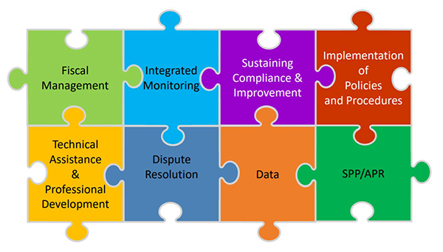
General Supervision
As the State Educational Agency, the Massachusetts Department of Elementary and Secondary Education (DESE) has responsibility for general supervision under Part B of the Individuals with Disabilities Education Act (IDEA).
DESE provides technical assistance and monitors local education agencies’ (LEAs) implementation of IDEA and state special education law. General supervision has eight distinct but interconnected components, creating a cohesive system

Slide 5
Implementation of Regulatory Amendments for 603 CMR 46.00 & 603 CMR 18.00

Slide 6
Use of Emergency Seclusion Permitted If:
Seclusion shall be prohibited in a public education program except-
As a last resort, in an emergency situation, where a student’s behavior poses:
  imminent threat of assault, or
  imminent threat of serious physical harm to self/others
--BUT ONLY IF--
documented history of repeatedly causing serious self-injuries and/or injuries to other students or staff
not responsive to directives or less intrusive behavior interventions, or such interventions deemed inappropriate under the circumstances
other forms of interventions have failed to ensure the safety of the student and/or the safety of others

Slide 7
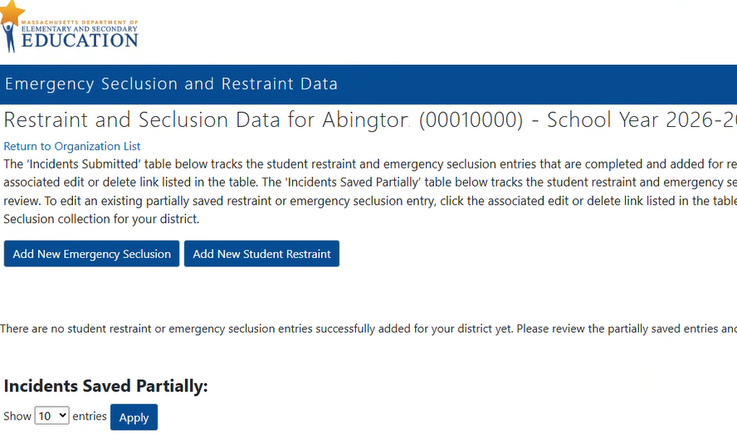
Reporting Requirements
Reporting via DESE Security Portal
Report all emergency seclusions that occur during school hours to the Department.
Every program shall collect and annually report data to the Department regarding the use of emergency seclusion by June 30th each year.

Slide 8
How will DESE monitor and enforce these new regulatory requirements?
Answer:
Schools, districts, and programs will be monitored for these requirements through cyclical monitoring, targeted monitoring, and investigations of complaints filed with the Department’s Problem Resolution System Office and any credible allegations of noncompliance.
These activities will include monitoring of updated policies and procedures, facility observations, and implementation of the requirements outlined in 603 CMR 46.07(2) and (3).

Slide 9
Resources
Guidance on Time-Out Practices and Implementation of Amendments to 603 CMR 46.00 and 603 CMR 18.00
Special Education Policy Memo SY2025–2026: Required Reporting on the Use of Seclusion and Emergency Seclusion
Frequently Asked Questions (FAQ) on the Use of Emergency Seclusion
Emergency Seclusion Reporting Reference Guide
Reducing Reliance on Crisis Management Practices in MA Schools on Vimeo
Questions & Support:
Physical Restraint: restraint@mass.gov
Emergency Seclusion: specialeducation@mass.gov

Slide 10
Amendments to Regulations on Special Education, 603 CMR 28.00

Slide 11
Protect Education Equity Act
Signed into law in August 2025
Added state law requirements to the IEP development process for English learners
Required the adoption of regulations regarding discipline procedures for students with disabilities to enforce provisions of federal law that were in effect on January 1, 2025.

Slide 12
Amendments to Regulations on Special Education Regarding English Learners
Amend definition of IEP to include a reference to the new state law, which adopts the language from federal law regarding the consideration of the language needs of English learners with disabilities and requires the participation of an individual with knowledge of the differences between the student's special education and language needs or submission of their report.
603 CMR 28.02: Definitions
(11) Individualized Education Program (IEP) shall mean a written statement, developed and approved in accordance with federal and state special education law in a form established by the Department that identifies a student’s special education needs and describes the services a school district shall provide to meet those needs.

Slide 13
Created New Section in Special Education Regulations on Discipline Procedures for Eligible Students
Effectuate the Act’s mandate for the Department to promulgate regulations to continue the effect and enforce the provisions in the federal Individuals with Disabilities Education Act (IDEA), regarding discipline protections applicable to students with disabilities
Adds a new section 603 CMR 28.11 - Discipline Procedures for Eligible Students – incorporating the discipline provisions already in the IDEA

Slide 14
28.11 - FAQ Clarification
28.11(1)(d)(1). An eligible student who is removed from their current placement pursuant to 603 CMR 28.11 must receive educational services during periods of removal consistent with M.G.L. C. 71, §§ 37H, 37H½, and 603 CMR 53.00.
Does NOT impose any new or additional requirements on school districts
Districts should provide academic services to all students, including students with disabilities, consistent with 603 CMR 53.13
  For all removals, regardless of length, students must be given the opportunity "to earn credits, as applicable, make up assignments, tests, papers, and other school work as needed to make academic progress during the period of his or her removal from the classroom or school."
For removals lasting 10 days or longer, students with disabilities are entitled to special education and related services, consistent with the IDEA and 28.11.

Slide 15
IDEA Data

Slide 16
Significant Disproportionality
Beginning with the 2026-27 identification cycle, Massachusetts increased the minimum cell size from 6 to 10 students.
Significant Disproportionality data can be retrieved by going to Security Portal > Edwin Analytics > Student Enrollment-Indicators > Special Education -> SP301 Significant Disproportionality in Special Education.
  Identified and At Risk districts were notified on Tuesday, September 8 and Wednesday, September 9 of their status
  If you did not receive an email from IDEAData@mass.gov your district has “No Status” for this school year and no further action is required on your behalf

Slide 17
Indicator 14: Post-School Outcomes Data Collection
The data collection and reporting period on students with IEPs who exited during the 2024-2025 school year was due to close on Friday, September 25, 2026.
However, to support the great outreach work of our districts this year, we are now extending the data collection and reporting window one more week!
Districts are required to reach out to last year’s exiters to encourage them to complete the Massachusetts After High School Survey.
All data must now be submitted via the electronic survey by 5:00 p.m. on Friday, October 2, 2026.
Districts have been receiving emails from our vendor, Arielle Levin of Crescent Bend Consulting with updates on the number of surveys collected. Kristin Castner of the DESE Indicator 14 Data Collection Team has also reached out to districts with no completed surveys submitted as of Tuesday, September 8.
Full information, including a Step-by-Step Guidance document is available on DESE’s Indicator 14 web page.

Slide 18
Professional Development and Targeted Assistance

Slide 19
LEAs with NI or NA Determination
Save the Dates!
Returning Districts – Fall First Consult Calls: September 14–October 9
New Districts – Fall In-Person Convenings
  East: Oct. 5-6 & Dec. 9
  West: Oct. 13-14 & Dec. 7

Slide 20
Significant Disproportionality
Identified Districts
Fall In Person Convening
  October 19 – October 20
Winter In Person Convening
  December 10
Consult Calls
  October – November
At Risk Districts
Webinars
  September 22, October 8, November 5, January 13

Slide 21
IDEA Fiscal

Slide 22
FY27 Consolidated FC 240/262 Application
Available July 2026
Conditions of Assistance – Multiple Signatures Needed
GEPA Statement Changes – Certification Only
Application Due: September 30, 2026
Must Have Substantially Approvable Application to Obligate FY27 funds
August 4, 2026 webinar slides on the GEM$ homepage.

Slide 23
Comprehensive Coordinated Early Intervening Services (CCEIS) Fiscal Monitoring
All schools and districts required to reserve 15% of its total IDEA Part B allocation for CCEIS in FY26. Identified districts will receive notification letter will be sent via GEM$
Audit documentation including general ledgers and evidence of allowable expenditures must be submitted to IDEAfiscal@mass.gov
CCEIS Quick Reference Guide
Due September 11, 2026.

Slide 24
IDEA Equitable Services Monitoring & Carryover Application Supplement in GEM$
Due September 30, 2026
All districts of residence with a calculated FY25 and or FY26 proportionate share for equitable services must complete the IDEA Equitable Services Carryover and Monitoring Supplement
  At a minimum, all districts must upload evidence of actual or attempted timely and meaningful consultation with both school and parent representatives at least three (3) times during FY26 (fall, winter, spring)
  Districts must report any FY25 and or FY26 unexpended proportionate share carryover amounts and document how funds will be used prospectively
  Districts with any FY25 funds not expected to be fully expended by September 30, 2026, may request written permission to revert those funds for other allowable IDEA Part B expenses, including submission of additional documentation

Slide 25
Reminders Related to Equitable Services
FC 262/Preschool child count and meaningful consultation involve only pre-K students who attend a school that also includes K-5 elementary education
Head Start programs should not be included in child counts and timely and meaningful consultation with private school representatives.
LEA should account for equitable services funds separately and apart from other FC 240 and FC 262 funds in their general ledgers.
  The IDEA Fiscal Team reviews these general ledger reports when reviewing LEA requests to revert equitable services funds.

Slide 26
Expiring IDEA Part B Funds
FY25 FC 240 and FC 262, and FY26 FC 213 (Time Out Practices) Funds expire September 30, 2026
Funds must be obligated on or before September 30, 2026, and liquidated no later than ninety (90) days thereafter
GEM$ Reimbursement Requests no later than November 30, 2026
GEM$ Final Expenditure Report (FER) due no later than December 31, 2026
  LEA may include final reimbursement requests in the FER
Failure to (1) fully expend and claim FC 240, FC 262 or FY26 FC 213 funds and 2) timely file the GEM$ FER may be considered in the LEA's annual fiscal risk assessment

Slide 27
FY26 Financial End of Year Reports
Final FY26 Financial End of Year Reports (EOYR) Due:
  September 30, 2026 - individual and regional districts and vocational schools with the Office of School Finance
  November 13, 2026 - charter schools with the Charter School Office
  January 29, 2027 – virtual schools with the Charter School Office
Ensure relevant expenses are distributed as special education as that total may be considered for the FY26 Maintenance of Effort (MOE) compliance determination in March 2027
Failure to timely file and certify, and making any subsequent corrections or amendments to the EOYR may be considered in the LEA's annual fiscal risk assessment

Slide 28
IDEA LEA Fiscal Staff Data Submission
As we begin FY27 and School Year 2026-2027, the Department's IDEA Part B Fiscal Team requires your local education agency (LEA) complete and submit the following brief fiscal data collection linked below to update the Department's records on LEA fiscal staff in your school or district who understand and implement federal fiscal requirements pursuant to Uniform Grant Guidance, 2 CFR Part 200, and IDEA Part B, 34 CFR Part 300. The required information facilitates the Department's implementation of required IDEA Part B general supervision responsibilities, including annual fiscal risk assessment, monitoring, and targeted technical assistance and professional development for LEAs.
Data Submission-on-LEA-Staff-with-IDEA-Part-B-Fiscal-Responsibilities

Slide 29
Private School Enrollment Data Submission
Private school enrollment data is used in the annual LEA FC 240 and 262 allocation calculations
Private schools are asked to submit grade level enrollment data though a Department Education Security Portal Application each October 1st through th MA DESE Security Portal
Districts of residence encouraged to contact local private schools and remind them of the importance of this data submission
  Each district can find a list of last identified private schools in the Department's School and District Profiles / Relationship Membership for your district
  Can and should be done during annual child count collection and fall timely meaningful consultation for equitable services
  Private Schools may contact privateschools@mass.govto obtain access to the Security Portal application

Slide 30
IDEA Fiscal Virtual Community of Practice
Thursdays, 3:00 - 4:00 pm Zoom Webinar
Thursday, October 2, 2026 – Child Count and Meaningful Consultation for Equitable Services
Thursday, November 5, 2026 – Excess Cost Calculation
Thursday, December 3, 2026 – Budget Revision & Final Expenditure Reporting
Thursday, March 4, 2027 – Maintenance of Effort, Exceptions & Adjustments
Thursday, May 6, 2027 – Equitable Services Carryover
Thursday, June 3, 2027 – Tier II & III (Cyclical & Targeted) Monitoring
Register Here
https://us02web.zoom.us/webinar/register/WN_XJGzymXBRZi2VZyq9cTA2g

Slide 31
The 1% Cap
Alternate Assessment Participation

Slide 32
Statewide Assessment Options
      As required by state and federal law, all students must participate in the state-wide assessments.
        Not a question of whether, but how the student will participate.
      Available assessment options:
        Standard MCAS tests computer-based test using accessibility features
        Standard MCAS tests with Accommodations (including special access accommodations)
      MCAS-Alt, which is only for students with the most significant cognitive disabilities (see eligibility criteria).
        The student’s IEP Team determines and documents how the student will participate in the required state-wide assessments.

Slide 33
Alternate Assessment Participation Cap
ESSA states in part that
…"a State may provide for alternate assessments…for students with the most significant cognitive disabilities, if the State…ensures that, for each subject, the total number of students assessed in such subject using the alternate assessments does not exceed one percent of the total number of all students in the State who are assessed in such subject“
and
States…must create a "definition for students with the most significant cognitive disabilities …which addresses factors related to cognitive functioning and adaptive behavior…"

Slide 34
1% Participation Cap Method
Defines “1%” based on total number of students assessed in a subject.
  Districts may exceed 1% of all assessed students if justification is provided.
    Districts must address any disproportional representation of students from all subgroups taking the MCAS-Alt.
  States may exceed 1%, if a one-year waiver was granted based on assessing 95% of students and other factors.

Slide 35
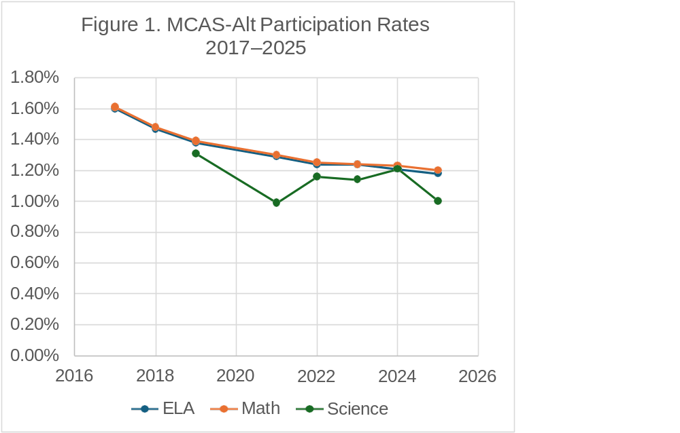
Since 2017, districts and DESE have annually taken steps that have achieved a steady reduction in the participation rate. Yet, Massachusetts must continue to submit a waiver since we are over the 1% Cap
Year | ELA | Math | Science
2017 | 1.60% | 1.61% | NA
2018 | 1.47% | 1.48% | NA
2019 | 1.38% | 1.39% | 1.31%
2021 | 1.29% | 1.30% | 0.99%
2022 | 1.24% | 1.25% | 1.16%
2023 | 1.24% | 1.24% | 1.14%
2024 | 1.21% | 1.23% | 1.21%
2025 | 1.18% | 1.20% | 1.00%
2026 | ~1.30 | ~1.30 | ~1.30

Slide 36
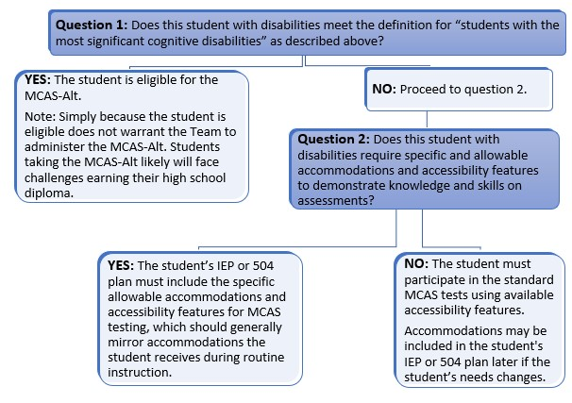
Decision-Making Tool for MCAS-Alt Participation

Slide 37
Who qualifies as a Student with the Most Significant Cognitive Disabilities?
Massachusetts defines “students with the *most significant cognitive disabilities” as those who meet all four of the following criteria:
*This is a definition for assessment not a disability category.
The student must have a cognitive disabilities evidenced by: significant delays in attaining age-level academic achievement standards, even with: systematic extensive individually designed instruction related services modifications | The student has cognitive disabilities that: significantly impact their educational performance; and ability to apply learning from one setting to another
The student requires: extensive, direct individualized instruction; and substantial supports to achieve measurable gains on the challenging State academic content standards for the grade in which the student is enrolled | The student performs significantly below average in general cognitive functioning and adaptive behavior (defined on next slide)…..
1
2
3
4

Slide 38
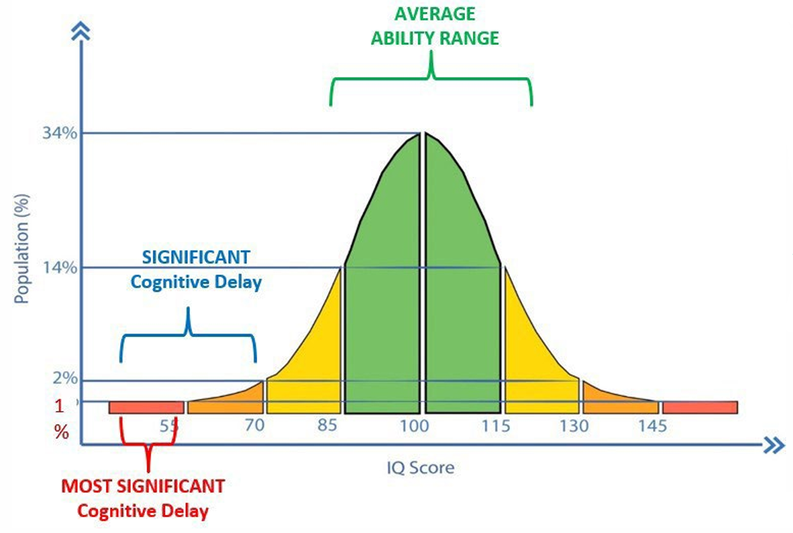
Significantly Below Average…
Significantly below average is defined as a student functioning two or more standard deviations below the mean on commonly accepted norm-referenced assessments in both cognitive functioning and adaptive behavior (e.g., two or more adaptive skill areas such as daily living skills, communication, self-care, social skills, and academic skills).

Slide 39
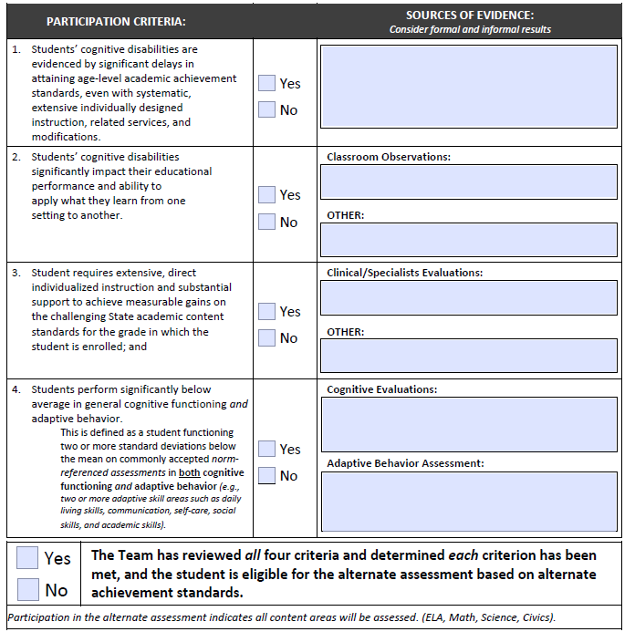
Alternate Assessment Participation Tool
This is a required companion document and must be retained with the student's special education forms. It is not a part of the student’s MCAS-Alt submission, however the date of completion will be listed on the MCAS-Alt Cover Sheet
* New -- IEP Teams must now annually review and update this form each year.
Students should not participate in the MCAS-Alt in only one subject area.

Slide 40
ESSA Requirement
Parent Notification Letter
Parents and/or guardians must be informed as part of the IEP process that:
their child’s academic achievement will be measured based on “alternate achievement standards” that reflect lower expectations than those for other students; and
participation in an alternate assessment may eventually delay or otherwise affect completion of the requirements for a diploma.
A Sample Parent Notification Letter, translated in five languages, may be copied onto school/district stationery and must either be sent or provided at the IEP meeting.

Slide 41
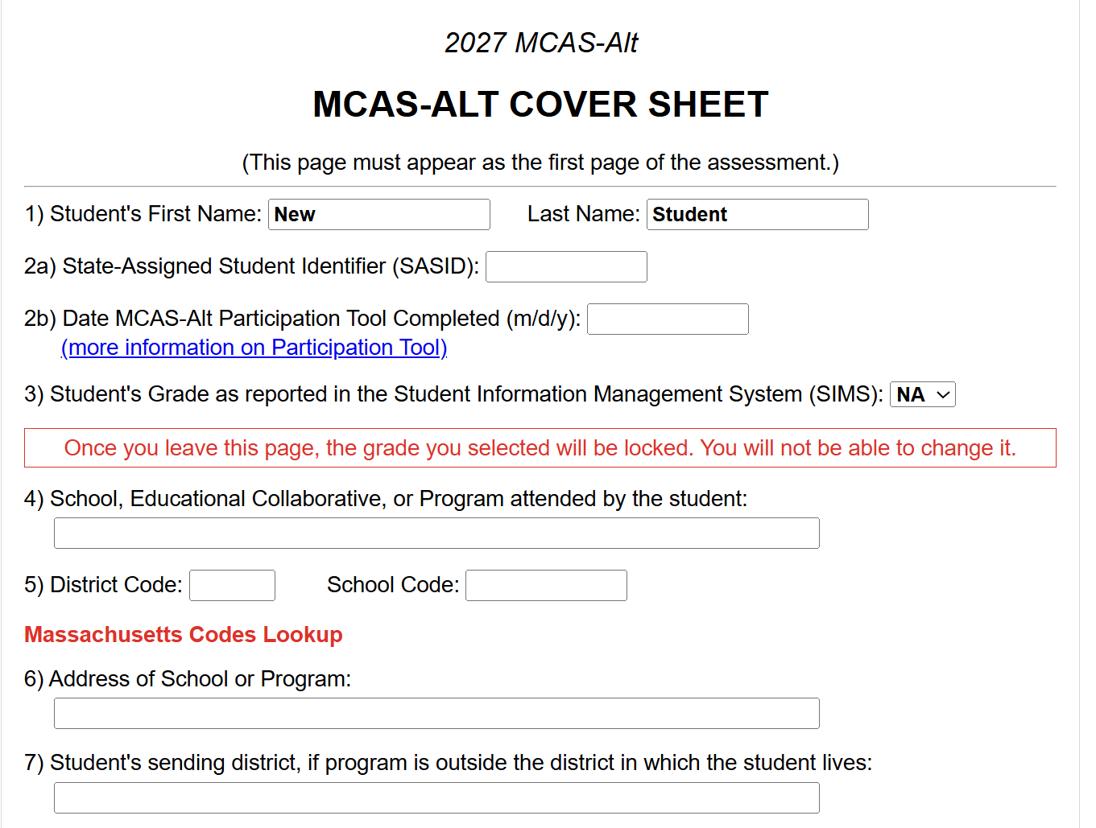
MCAS-Alt Cover Sheet
Educators inputting MCAS-Alt data for students must document the date the MCAS-Alt Participation Tool was completed for the student (Date of completion does not have to be in current school year, but form must be updated annually).

Slide 42
Statement of Assurances Requirement
Since Massachusetts is over the 1% Cap, DESE must annually apply for a Waiver.
  Waiver application requirements include:
  DESE reports assessment participation by number and percentage of all students in each subgroup that participated in MCAS and MCAS-Alt. DESE posts district participation rate.
  A statement of assurance that DESE verified that each LEA over 1% completed monitoring and oversight
  Ensure LEAs address any disproportionality in the percentage of students in any student group taking the AA-AAAS
  Ensure LEAs statement of assurances are publicly available

Slide 43
Statement of Assurances
A Statement of Assurances will be required of all districts that assessed 1.0% or more students with an MCAS-Alt in 2026. Based on the projected participation %, different justifications and assurances are required.
  Tier 1: The district does not expect to exceed 1.0 percent of the number of tested students taking the MCAS-Alt in the 2026—2027 school year.
    Districts must submit Statement of Assurances only on eligibility guidelines and disproportionality.
  Tier 2: The district expects to exceed 1.0 percent but less than 1.75 percent of the number of tested students taking the MCAS-Alt in the 2026—2027 SY.
    Districts must submit Statement of Assurances that includes rationale and justification for exceeding the 1%.
  Tier 3: The district expects to exceed 1.75 percent of the number of tested students taking the MCAS-Alt in the 2026—2027 SY and acknowledges that this is significantly higher than the state average.
    Districts must submit Statement of Assurances that includes rationale and justification for exceeding the 1% and a DESE directed MCAS-Alt eligibility training may be required and documented.

Slide 44

Special Education
Year at a Glance

Slide 45
Information for Special Education Leaders
Regular Updates and Information
  Special Education Bulletin
  Special Education Website
Update Information in the Directory Administration
  Special Education Leaders Meeting Invites and Memos
Email Contacts
  specialeducation@mass.gov (General Special Education Inquiries)
  IDEAfiscal@mass.gov (IDEA Fiscal Inquiries)
  IDEAdata@mass.gov (IDEA Data Inquiries- Special Education or SPP/APR Data)
  LEAassignment@mass.gov (LEA Assignment Inquiries)

Slide 46
2026-2027 Meetings
No October Meeting
November 4, 2026 (In person meeting- no webinar)
December 4, 2026
January 22, 2027
February 26, 2027
March 19, 2027
April 14, 2027 (In person meeting- no webinar)
May 14, 2027
June 11, 2027

Slide 47
2026-2027 Special Education Bulletin Schedule
Bulletin | Anticipated Release
October 2026 | October 19, 2026
November 2026 | November 16, 2026**
December 2026 | November 30, 2026
January 2027 | January 19, 2027
February 2027 | February 22, 2027
March 2027 | March 15, 2027
April 2027 | April 12, 2027**
May 2027 | May 10, 2027
June 2027 | June 7, 2027

Slide 48
Questions
and
Answers

