Slide 1
Indicator 7 Data Collection, Entry, and Submission
April 2024

Slide 2
Agenda
Introduction to Indicator 7 data collection
Overview of the Childhood Outcomes Summary (COS) Process
Entering data into the Early Childhood Outcome Summary (ECOS) database
Frequently asked questions about data entry and submission
Questions and answers

Slide 3
Introduction

Slide 4
Why do we collect Indicator 7 early childhood outcomes data?
The U.S. Department of Education’s Office of Special Education Programs requires states to report on three child outcomes annually.
The data help us understand the impact of preschool special education programs on key child outcomes.

Slide 5
Indicator 7 Data Measures Three Child Outcomes
Positive social-emotional skills (including social relationships),
Acquisition and use of knowledge and skills (including early language/communication and early literacy), and
Use of appropriate behaviors to meet their needs.

Slide 6
Why are the data important?
Allow us to look at trends to understand children’s outcomes over time.
Outcome | FFY 2017 | FFY 2018 | FFY 2019 | FFY 2020 | FFY 2021
Social Relationships | 81 | 81 | 81 | 78 | 79
Knowledge and Skills | 82 | 82 | 82 | 79 | 79
Action to Meet Needs | 81 | 81 | 81 | 79 | 79
Outcome | FFY 2017 | FFY 2018 | FFY 2019 | FFY 2020 | FFY 2021
Social Relationships | 60 | 59 | 56 | 56 | 55
Knowledge and Skills | 56 | 55 | 53 | 52 | 51
Action to Meet Needs | 65 | 64 | 62 | 61 | 61
http://ectacenter.org/eco/pages/childoutcomeshighlights.asp

Slide 7
Which children need Indicator 7 data?
All children who enter or exit preschool special education annually.
Cohort system phase-out will be complete in 2024–25 school year (meaning all children should have entry and exit data).

Slide 8
Indicator 7 Data Collection and Entry
Data Points to Collect | Entry | Exit
Date | Date the child started receiving preschool special education services; may not always be the IEP date | Date the child exited preschool special education services
Exception for collecting data | -- | “Exit Exception:” Did the student exit the district without having exit data collected? Y/N
Outcome ratings on a 1–7 scale (described later) | Data should be collected within 4–6 weeks of first day of services | Data should be collected before the child exits
Exit progress questions | -- | Y/N progress question for all three outcomes

Slide 9
Overview of the Child Outcomes Summary Process

Slide 10
The Child Outcome Summary (COS) Process
Involves a team of individuals who are familiar with a child (including parents)
Includes multiple sources of information
Summarizes that information using a 7-point scale at entry and exit, and a progress question

Slide 11
The COS Process Is Conducted by a Team
Tip: Include those who know the child the best
Family
Interventionists
Teachers
Service providers
Paraprofessionals

Slide 12
Use Multiple Sources of Information
Curriculum-based assessment
Norm-referenced assessment
Developmental screening tool
Observation across settings and situations
Parent report

Slide 13
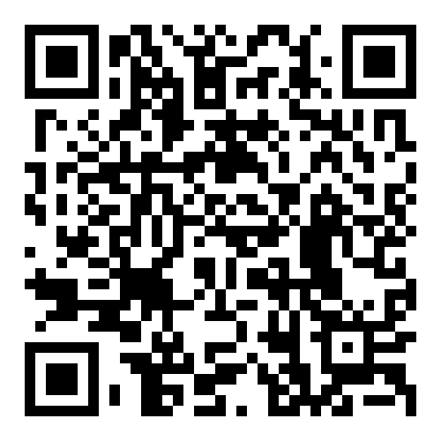
COS Form
Use the form to summarize information that you collect from multiple sources to address the three child outcomes.
Use the form to document evidence to support your ratings.

Slide 14
Definitions for COS Ratings
Child’s functioning generally is considered appropriate for his or her age, but there are some significant concerns about the child’s functioning.
Although age appropriate, the child’s functioning may border on not keeping pace with age expectations.

Slide 15
Decision Tree for Summary Ratings Discussions

Slide 16
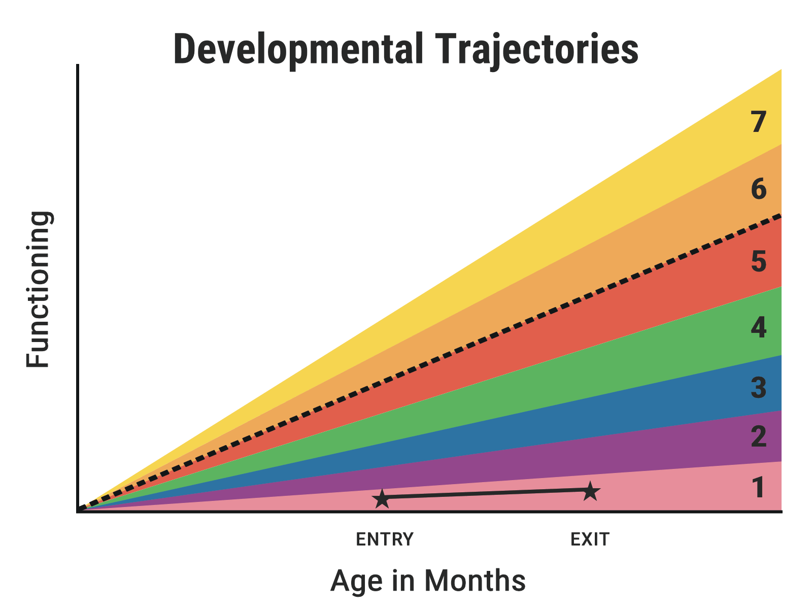
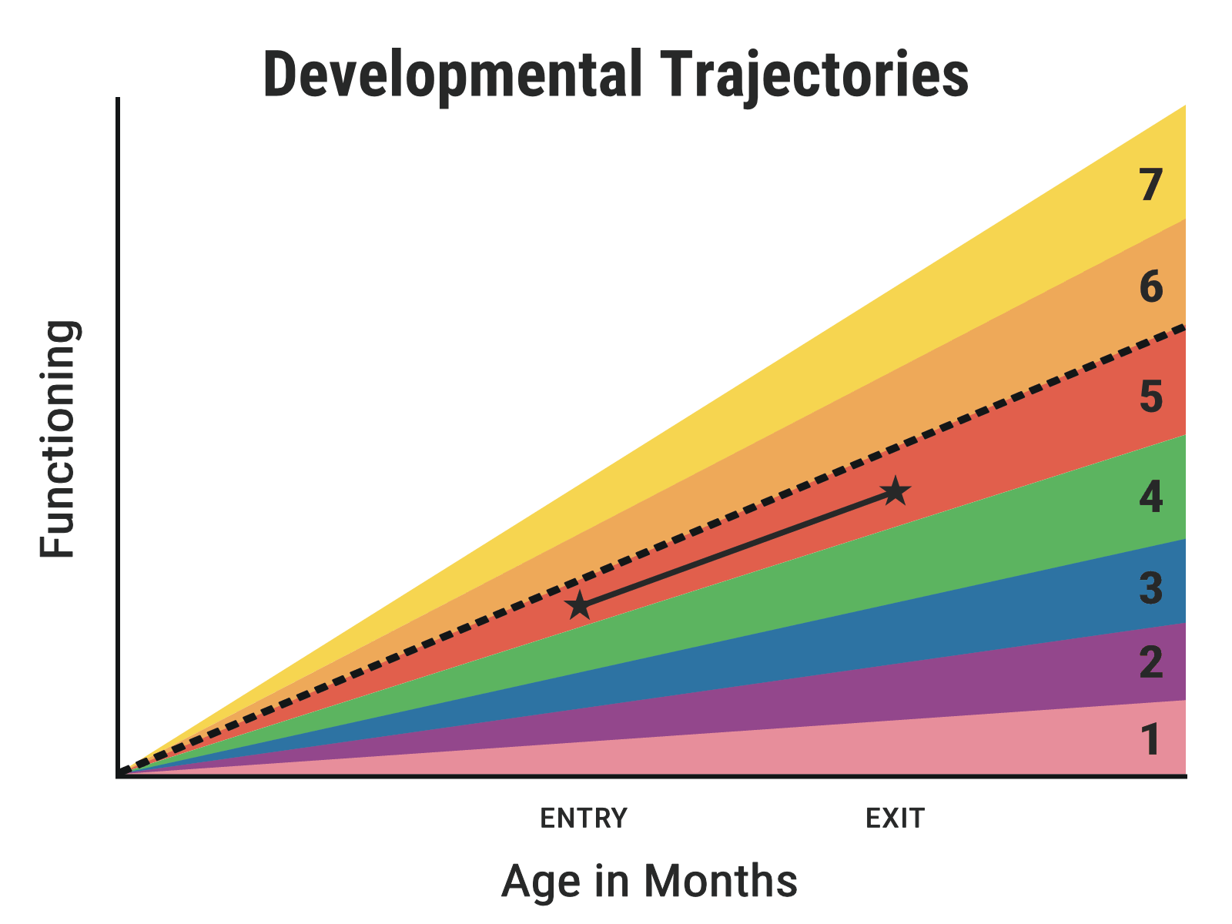
The COS Progress Question
Has the child shown any new skills or behaviors related to this outcome since the last outcomes summary?
For example, if the child uses even one new word or gesture to get his or her needs met, answer “yes.”
The answer to the progress question could be “yes” even if the rating goes down.

Slide 17
COS Professional Development Module

Slide 18
Entering Data Into the Early Childhood Outcomes Summary Database

Slide 19
The Early Childhood Outcomes Summary (ECOS) Database Quick Facts
Web based
Users can access ECOS on PCs & Macs—optimized for Chrome or MS Edge browsers.
User-friendly data entry
Includes edit checks to capture more complete and accurate data.
Reports for data use
The state AND districts can use the data for program improvement.
Educators can use it as a tool for professional development and stakeholder engagement.

Slide 20
Celebrate Data Completeness Improvements!

Slide 21
Understand the ECOS Data Timeline

Slide 22
Tip: Enter Data After Each SIMS Certification Is Transferred to ECOS
October SIMS Data in ECOS
Add entry data for new students.
March SIMS Data in ECOS
Add entry data for new students.
July SIMS Data in ECOS
Add entry data for new students.
Update exit data for any students who exited.
Update exit data for any students who exited.
Update exit data for any students who exited.
Notify directory administrator of SIMS errors identified in ECOS.
Notify directory administrator of SIMS errors identified in ECOS.
Notify directory administrator of SIMS errors identified in ECOS.
August 31 ECOS Certification
Certify once a year after all data have been entered.
If needed, data can be decertified for correction before August 31.
October SIMS Data in ECOS
Add entry data for new students.
Update exit data for any students who exited.
Notify directory administrator of SIMS errors identified in ECOS.
March SIMS Data in ECOS
Add entry data for new students.
Update exit data for any students who exited.
Notify directory administrator of SIMS errors identified in ECOS.
July SIMS Data in ECOS
Add entry data for new students.
Update exit data for any students who exited.
Notify directory administrator of SIMS errors identified in ECOS.
August 31 ECOS Certification
Certify once a year after all data have been entered.
If needed, data can be decertified for correction before August 31
22

Slide 23
Poll – Where are you in Indicator 7 data entry?
I have
Entered complete data for all students currently listed in the database
Entered data for some students and have more data to enter
Entered data for some students and have error messages in the database
Entered data in my own spreadsheet but haven’t entered yet the data into ECOS
Logged on to ECOS and looked at my district’s page but haven’t entered data
Know about ECOS but haven’t logged on yet
I’m new. What’s ECOS?

Slide 24
Tip: Create a Secure Way to Store Data Throughout the Year
SASID | First Name | Last Name | DOB | Start Date | Entry Outcome 1 | Entry Outcome 2 | Entry Outcome 3
Exit Date | Exit Exception | Exit Outcome 1 Rating | Exit Outcome 2 Rating | Exit Outcome 3 Rating | Outcome 1 Progress Question | Outcome 2 Progress Question | Outcome 2 Progress Question
ECOS is updated with new students 3 times per year, so it is helpful to have a place to store ratings before it is possible to enter the data in ECOS. It can also help you use your data (see last section).

Slide 25
Sustainability/Institutionalization
Develop a page of resources/quick directions for new staff.
Reach out early with questions, before teams leave for the summer and before the deadline is looming.

Slide 26
Frequently Asked Questions About Indicator 7 Data Entry

Slide 27
How do I access ECOS and how do I grant my staff access? (Part 1)

Slide 28
How do I grant my staff access? (Part 2)

Slide 29
What do I do if I don’t have entry data for a student?
Tip: Starting in 2024–25, all districts should collect and input entry data for ALL students.

Slide 30
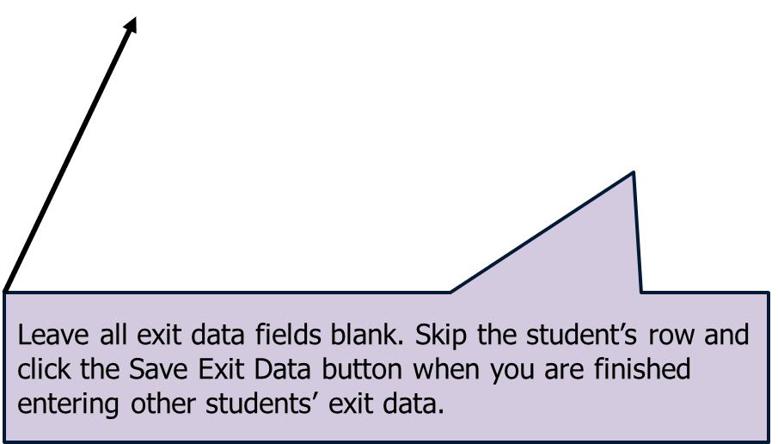
What do I do if a student isn’t exiting this year?

Slide 31
How do I communicate with DESE for questions about specific students?
Email only SASIDs
Use Drop Box to send and receive files with personally identifiable student information.
Please do not email student names and dates of birth.

Slide 32
How to I edit entry data (slide 1)?

Slide 33
How to I edit entry data (slide 2)?

Slide 34
How to I edit entry data (slide 3)?
Re-enter the entry date and ratings for all 3 outcomes and click the Save Entry Data button. The student’s record will then move back to the Part 2: Exit data panel.

Slide 35
How do I clear errors? (Entry Data Error)
Because there is an entry date, there must be entry ratings. Delete the entry date, then press the Save Entry Data button to clear the error.

Slide 36
How do I clear errors? (Exit Data Error #1)
If there is any entry in the Exit Exception field (including “y”), then the Exit Date must be filled out (an estimate is OK if the exact date is unknown).

Slide 37
How do I clear errors? (Exit Data Error #2)
If there is an N entry in the Exit Exception field and no other data, or only that and the Exit Date, then the exit ratings and the progress question must be filled out.

Slide 38
How do I clear errors? (Exit Data Error #3)
The child has the same rating of 2 when they entered at age 3.25 years and when they exited at age 4.5. To receive the same rating at an older age, they must have made progress, so change the N to Y for the progress questions.

Slide 39
How do I complete end of year reporting?
The deadline is August 31. You only need to certify the data once for the school year after you have completed all data entry for all students. That might be in the spring before the school year ends and after the March SIMS certification data is uploaded into ECOS. we recommend planning to review and certify in August to close out the prior school year and get ready for the coming school year.

Slide 40
How do I use the reports in the ECOS database?
(Why is it beneficial for a district and/or school in addition to the Commonwealth?)

Slide 41
ECOS Report Access

Slide 42
ECOS Report Features
You can display the state and/or a specific school to compare to district data.

Slide 43
ECOS Reports Features (continued)
Provides tables and charts to help you understand the data and look at them in different ways.
Provides answers to questions about students, schools, districts, and the Commonwealth.

Slide 44
Question: How can districts use Indicator 7 data to measure student progress?

Slide 45
Question: How can districts use Indicator 7 data for continuous improvement?
Summary Statements | State: Outcome 1 | State: Outcome 2 | State: Outcome 3 | District 1: Outcome 1 | District 1: Outcome 2 | District 1: Outcome 3 | School 1: Outcome 1 | School 1: Outcome 2 | School 1: Outcome 3
1. Of those children who entered the program below age expectations, the percent that substantially increased their rate of growth by the time they exited. | 85.39% | 84.13% | 84.60% | 98.46% | 96.67% | 94.44% | 100.00% | 96.49% | 94.64%
2. Percent of children who were functioning within age expectations by the time they exited. | 45.43% | 48.42% | 55.50% | 63.89% | 62.50% | 73.61% | 61.54% | 58.46% | 70.77%

Slide 46
Questions and Answers

Slide 47
Summary of Key Points
Indicator 7 data are critical for understanding the outcomes of children with disabilities over time.
The COS process is conducted by a team using multiple sources of information at the child’s entry and exit.
All children receiving special education services should have ratings for entry and exit.
Set up a process for sharing information about Indicator 7 requirements with staff.
Use the data for continuous improvement at the school and district level.

Slide 48
Poll: Next Steps
Which of the following are your next steps for Indicator 7 data collection and submission?
Access the ECOS database and begin entering data
Share and/or explore resources on how to complete the COS process
Establish an internal spreadsheet to track entry and exit ratings
Communicate with staff about Indicator 7 timelines and expectations
Explore the reporting feature in ECOS

Slide 49
Final Tips: Useful Links
DESE Resources on ECOS and Child Outcomes
https://www.doe.mass.edu/sped/ecse/StrategicAreas.html#outcome
DESE Directory Administrators: https://www.doe.mass.edu/infoservices/data/diradmin/list.aspx
Early Childhood Technical Assistance (ECTA) Center & IDEA Center for Early Childhood Data Systems (DaSy) Center COS Resources
https://ectacenter.org/~pdfs/eco/cos-quick-reference-guide.pdf
https://ectacenter.org/~pdfs/eco/three-child-outcomes-breadth.pdf
https://ectacenter.org/~pdfs/eco/cos-resources.pdf
https://ectacenter.org/eco/pages/cospd.asp
Early Childhood Age Expectation and Developmental Milestones Example for North Dakota (selected by Michele Regan-Ladd, a Pyramid Model Coach)
https://ectacenter.org/eco/assets/pdfs/3_NDearlychoutcomesmilestones.pdf

Slide 50
Evaluation Survey
Please complete a brief survey. We appreciate your feedback!

Slide 51
Presenters
Zach Weingarten
Senior Researcher
202.403.5567
zweingarten@air.org
Taletha Derrington
Senior Researcher
808.306.5825
tderrington@air.org
Notice of Trademark: “American Institutes for Research” and “AIR” are registered trademarks. All other brand, product, or company names are trademarks or registered trademarks of their respective owners.
Copyright © 2024 American Institutes for Research®. All Rights Reserved. No part of this publication may be reproduced, distributed, or transmitted in any form or by any means, including photocopying, recording, website display, or other electronic or mechanical methods, without the prior written permission of the American Institutes for Research. For permission requests, please use the Contact Us form on www.air.org
24668_04/24

