Slide 1
Indicator 14 District Reports
Based on School Year 2022-2023 Indicator 14 Data Collection
SEPP and PIAR
April 2025

Slide 2
Agenda
Overview of Indicator 14
Purpose
Reports
  Factors to Consider
  Overview of the Content
  Overview of Statewide Data
Wrap-up

Slide 3
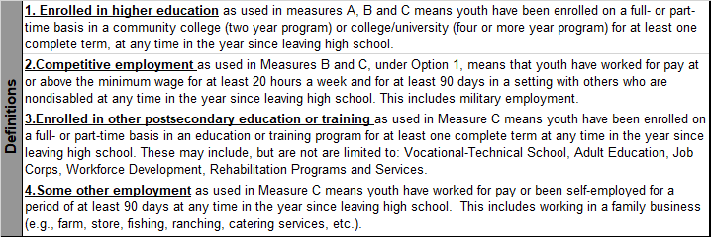
Overview - Engagement Types

Slide 4
Overview - Measurement
Percent of youth who are no longer in secondary school, had IEPs in effect at the time they left school, and within one year of exiting high school were:
A. Enrolled in higher education
B. Enrolled in higher education or competitively employed
C. Enrolled in higher education or in some other postsecondary education or training program or competitively employed or in some other employment
Notes:
.

Slide 5
Overview - Calculations

Slide 6
Purpose
Provide districts with:
  An in-depth view of their exiter data
  More than just a simple percentage of engagement
  A tool to do a deep dive into demographic categories across each measurement
Question(s) to Consider:
  How does this data impact programmatic decisions during high school?

Slide 7
Factors to Consider
Three Main Factors:
  The Number of Respondents;
  Your District's Response Rate; and
  If your Response Group is Demographically Similar to your Exiter Group.
District reports are structured to facilitate your focus upon these factors as you consider how Representative your data is.

Slide 8
Organization of Reports
Page One:
  Indicator 14 Introduction
  District and Statewide Engagement Totals represented in pie charts.
  Introduction to Representativeness
Page Two:
  Table displaying your Exiters’ demographics compared to Respondents’ demographics
Pages Three and Four:
  Indicator 14 Engagement across six demographic categories

Slide 9
Demographic Groups
Gender
Ethnicity
Exit Type
Level of Need
Type of Disability
Economically Disadvantaged

Slide 10
Let’s look at today’s sample, the statewide report.

Slide 11
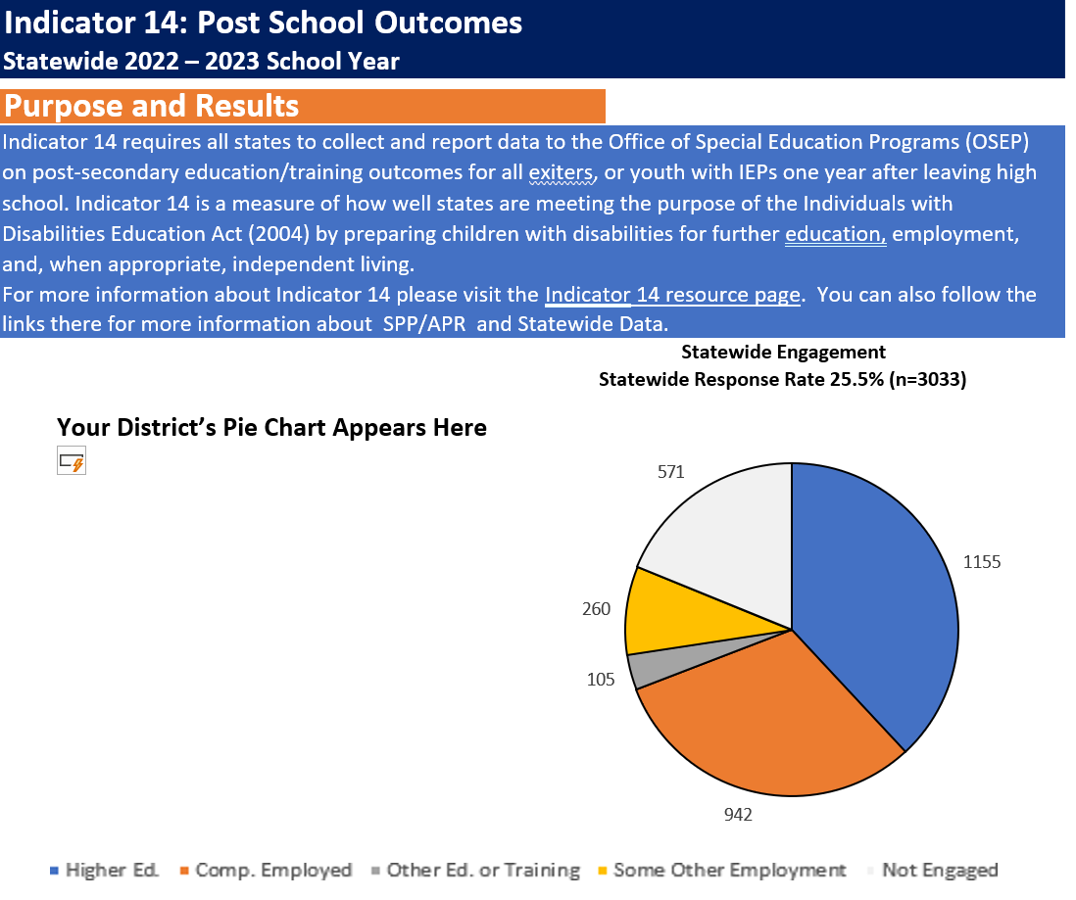
Page One
Report Title
Short introduction with link to information about Indicator 14
District Engagement
Statewide Engagement
Each pie chart includes each measurement in Indicator 14:
  Higher Education
  Competitive Employment
  Other Education
  Other Employment
  Not Engaged

Slide 12
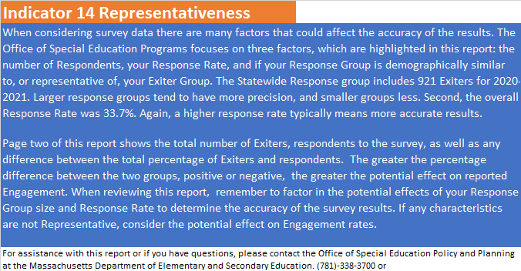
Page One (continued)
Reviews the factors to consider:
The number of Respondents
Your district’s Response Rate
Introduces Page Two and explains how to determine if your Response Group is demographically similar your Exiter Group

Slide 13
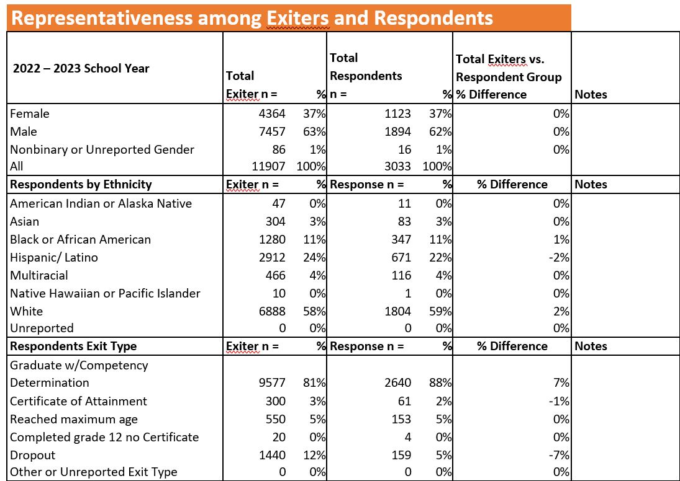
Page Two
Comparison of Exiters and Respondents by:
Gender
Ethnicity
Exit Type

Slide 14
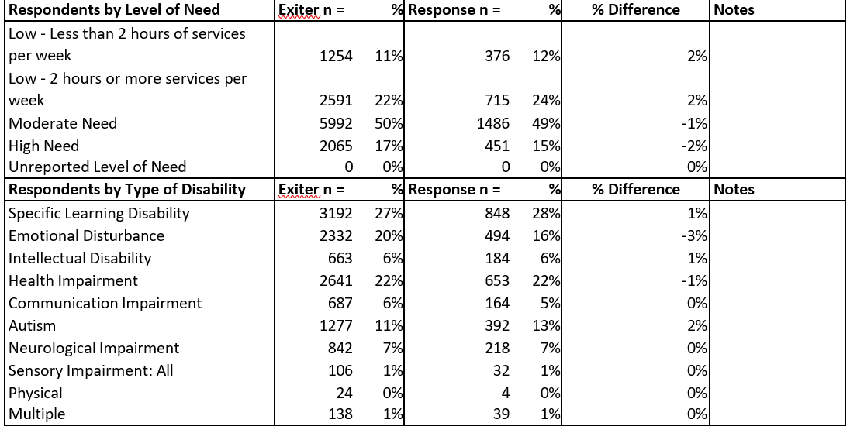
Page Two
Comparison of Exiters and Respondents by:
Level of Need
Type of Disability

Slide 15
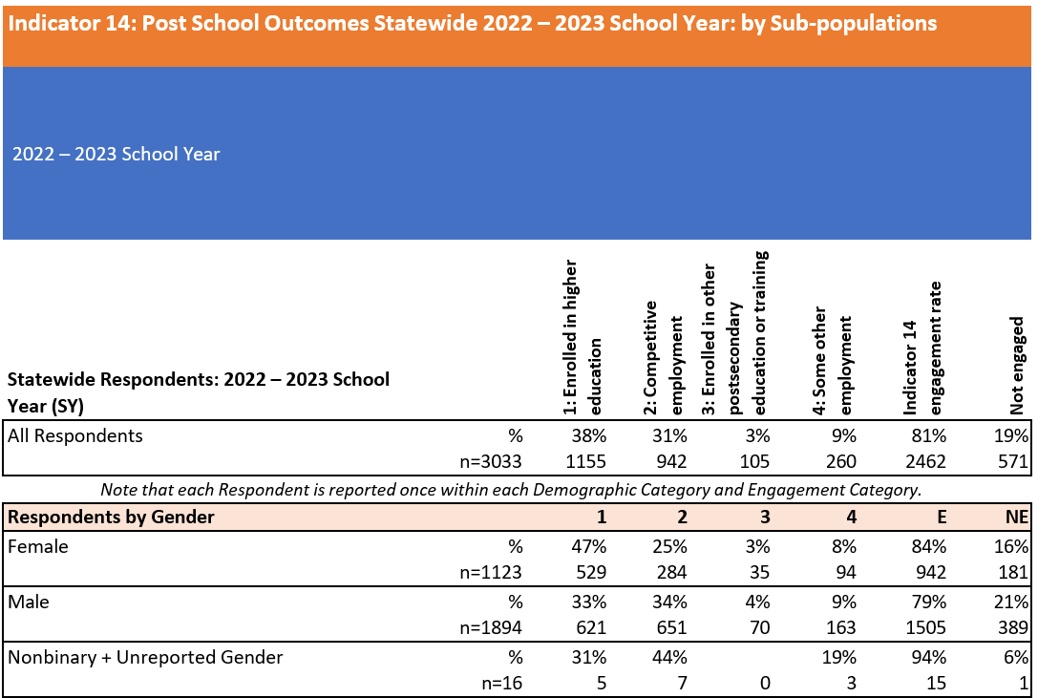
Page Three
Includes a table of Indicator 14 Engagement by demographic groups, by each measurement type:
1 - Higher Ed
2 - Competitive Employment
3 - Other Education
4 - Other Employment
E - Total Engagement
NE - Not Engaged
Start by comparing E and NE for all:
Then consider the detail that is provided
Let’s look at the first Demographic group, Gender
Notes:
Here respondents are separated into six demographic categories: Gender, Ethnicity, Exit Type, Level of Need, and Type of Disability, and Economically Disadvantaged. After reviewing how accurate and representative your survey results are, consider the demographic categories by their reported type of engagement. This can provide insight into how well prepared each demographic group was prepared for further education and employment and independent living after high school. The columns below represent the Demographic Category, count of respondents in each row, the count and percentage of respondents by their type of Engagement under Indicator 14, the total Indicator 14 Engagement Rate for the row, and any respondents who did not report meeting Indicator 14’s criteria for being Engaged.

Slide 16
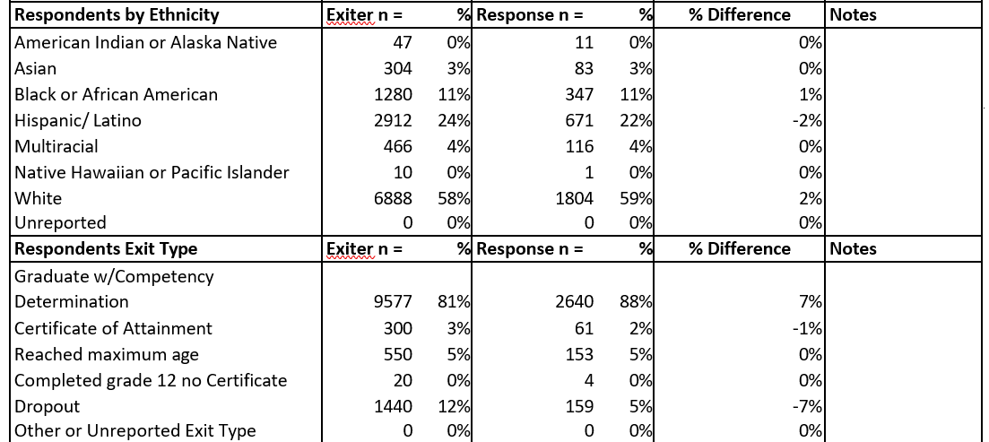
Page Three
Ethnicity:
  First review the proportion of all for each Ethnic group focusing on groups including larger numbers of respondents
  Then consider Engagement vs Not Engaged percentages
  Then consider detail provided under each of the Measures, especially M1 and M2
Exit Type

Slide 17
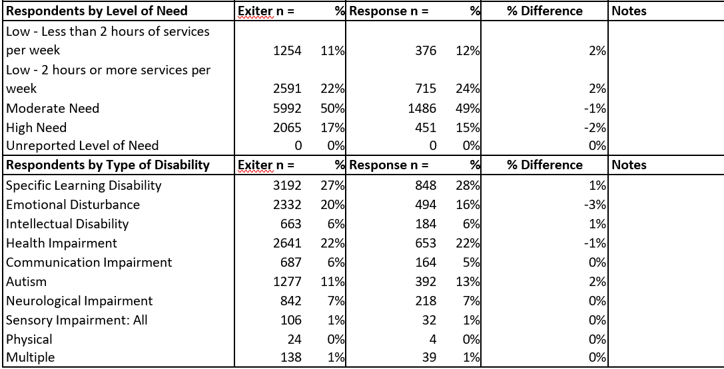
Page Four
Respondents by Level of Need
Respondents by Type of Disability

Slide 18
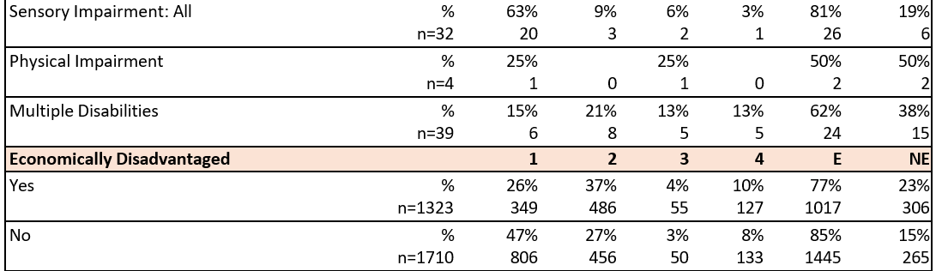
Page Four (continued)
Type of Disability
Economically Disadvantaged:
Although overall Engagement is similar for each group, there is great variation in the type of Engagement reported, for example:
1 Higher Education: Yes 26% vs No 47%
Considering what you know as educators, what might explain this?

Slide 19
Contact Information
DESE
PIAR
Kristin Castner, Indicator 14 Lead
kristin.castner@mass.gov
781-338-3576
Dr. Patrick Turbett
turbetjp@potsdam.edu
Robert Shepherd
shephers@potsdam.edu
315-267-2718

