Slide 1
Indicator 14: Post-School Outcomes Data Collection Updates for 2025 (FFY 2024)
July 21, 2025
Kristin Castner, MA DESE Education Policy Specialist
Rachel Wilkinson, CBC Project Lead

Slide 2
Agenda
Overview of Indicator 14
How to Prepare for the Online Survey
How to Administer the Online Survey
A Few Reminders
Wrap-Up

Slide 3
Communication Updates for FFY 2024
MailChimp
Indicator 14 Resources
https://www.doe.mass.edu/specialeducation/reporting/spp-apr/indicators/indicator14/
Dropbox
Indicator 14 > FFY2024_indicator 14_2023_2024_exiters_all districtDISTRICT CODE.xlxs

Slide 4
Overview of Indicator 14

Slide 5
Why is this work important?
The focus of Pre-K to Age 22 education in Massachusetts is to prepare our students for success in their adult lives.
Using the Indicator 14 survey, you will follow up with your former students with IEPs one year after they leave high school to find out whether they have been engaged in employment and/or further education or training.
This summative information gives us an indication of the success of our educational efforts at the state and local level.

Slide 6
What is Indicator 14?
At the district and state leveI, Indicator 14 measures the percent of youth who are no longer in secondary school, had IEPs in effect at the time they left school, and within one year of leaving secondary school are:
Enrolled in higher education,
Competitively employed,
In some other postsecondary education or training program, or
In some other employment.

Slide 7
How are Indicator 14 data collected?
Your district will use an online survey in English, Spanish, Haitian Creole, Cape Verdean Creole, Vietnamese, Chinese (simplified), or Portuguese to collect information from your former students with IEPs.
https://bit.ly/WorkSchoolSurvey2025
This can be done in one of three ways:
The former student can complete the survey themselves;
District staff can complete the online survey with the former student; OR
A parent, guardian, or caregiver can complete the survey with/or on behalf of a former student who left high school about one year ago.

Slide 8
When are Indicator 14 data due?
All data are due and surveys must be completed by:
September 22, 2025.
All online surveys must be completed by this date.
Please ensure that all surveys are completed and submitted online by September 22, since we must meet federal reporting requirements, including timelines.

Slide 9
How to Prepare for the Online Survey

Slide 10
Indicator 14: Getting Started
Identify your Indicator 14 survey team and plan how you will train and orient them.
Review all of the resource documents that are available on the Indicator 14 website and share these documents with district staff who are working on collection.
To collect data effectively, your team will need to know:
What is an exiter?
Who are your district’s exiters, and how will you contact them?
How will you administer the survey and submit data?

Slide 11
What is an exiter?
Exiters are students with IEPs who during the 2023-2024 school year:
Graduated from high school, OR
Aged out of special education, with or without a certificate of attainment, OR
Dropped out of high school (i.e., didn’t return for the 2024-25 school year, even though they had been expected to return).
Note: Must include students who were in Out-of-District Placements.

Slide 12
Who are your district’s exiters?
DESE will provide each district with an exiter list generated using the data your district submitted to SIMS in 2024.
Each district’s list is available in the DESE Security Portal.
Once logged in, browse to Dropbox Central and then to Indicator 14.
Download and save your district’s SIMS exiter file securely.

Slide 13
Confirm Your Exiter List
Using your district’s records and the Indicator 14 Student Contact Information Sheets your district completed last school year, carefully review the list to verify it is correct and complete.
If there are any discrepancies, create an Excel spreadsheet on which you list your district name and org code, as well as the SASID, name, and birthdate for each discrepant record.
Indicate whether you are adding the individual to the official list of exiters, or whether you are removing them.
Enter the reason for adding or removing the individual.
Upload this spreadsheet to the Indicator 14 dropbox on the DESE Security Portal.
Contact Crescent Bend Consulting (CBC) team member Arielle Levin (ariellelevin@westat.com) to request that exiters be added or removed. Arielle has DESE clearance to discuss individual exiter information with school staff.

Slide 14
Compile Exiters’ Contact Information
Once all 2023-2024 exiters have been identified:
Use the Student Contact Information Forms that were completed by students in Spring 2024 to compile contact information.
If you don’t have the Student Contact Information Forms for any exiters, there is no need to worry. You can review exiters’ emergency contact forms and other information in their cumulative records.

Slide 15
How to Administer the Online Survey

Slide 16
Plan Ahead
Make a plan to contact your exiters so that all surveys are completed online at https://bit.ly/WorkSchoolSurvey2025 by September 22, 2025.
Will you use email, phone calls, mail, social media?
How often will you contact exiters?
Which district staff will reach out to your exiters?
Note: Your district’s response rates will be higher if exiters are contacted by school staff whom they know and trust.

Slide 17
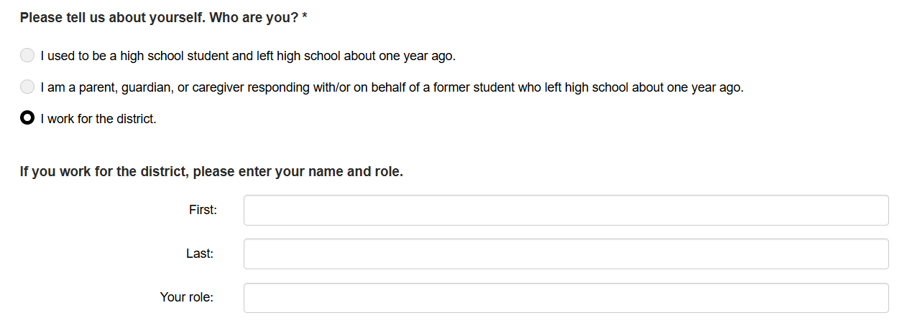
Ensure Every Completed Survey Counts
Remind district staff to:
Click “I work for the district” and enter their name

Slide 18
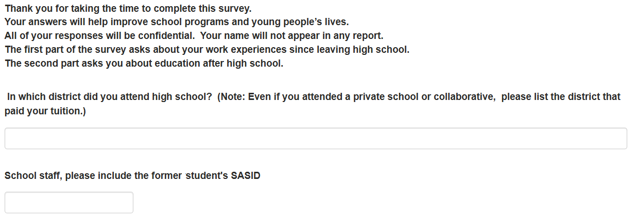
Ensure Every Completed Survey Counts (cont.)
Remind district staff to:
Enter the former student’s SASID.

Slide 19
Plan Your Outreach
The procedure you use is up to your district.
We suggest that you:
Mail and/or email your exiters shortly before you plan to start calling and allow time to complete the survey online.
Consider sending a follow-up letter after a week or two to encourage completing the survey online.
If more than a month has passed from the initial mailing, consider sending additional reminders that staff will be trying to contact them soon.

Slide 20
Plan Your Outreach (cont.)
Please make at least three attempts to reach your exiters.
Contact attempts = Phone calls, emails, letters, and/or texts.
When calling, try different days of the week and different times of day.
Note: Districts with high response rates tend to attempt outreach to exiters more than three times.

Slide 21
How will you know whether students have completed the online survey?
CBC staff will send regular emails to your Indicator 14 district contact (usually the special education administrator) to let you know which exiters have completed the survey.
If you want someone other than your district’s special education administrator to receive these updates, please email the correct contact information to CBC team member Arielle Levin, ariellelevin@westat.com, copying to IDEAdata@mass.gov.

Slide 22
How will you know whether students have completed the online survey? (cont.)
Email updates from CBC will be sent to each district’s Special Education Director weekly from early August
We request that all communications be shared with the appropriate Indicator 14 staff at the district level
Please let CBC staff person Arielle Levin, ariellelevin@westat.com, know if you need additional information about who has completed surveys or have other questions.

Slide 23
A Few Reminders

Slide 24
Definition of Competitive Employment
Critical characteristics of Competitive Employment:
Youth have worked for pay at or above the minimum wage:
But not less than the customary wage.
With the same level of benefits that the employer provides for the same or similar work performed by individuals who are not disabled.
In the competitive labor market.
On a full-time or part-time basis
In a setting with others who are nondisabled/in an integrated setting.
Includes military employment.

Slide 25
Improving Response Rates
Benefits of increasing response rates
To understand the experience of all types of former students with disabilities, we need to hear from all types of former students with disabilities proportionately.
Higher response rates generally provide a more accurate picture of the actual engagement rates of students with disabilities after high school.
The statewide report and your district reports will be more complete.
With better survey data, better decisions can be made.

Slide 26
Improving Response Rates (continued)
Use interviewers whom former students know and trust.
Have on-hand information about helpful local resources.
The information you provide can help your former students to connect with programs and services in their community that can assist them in attaining their goals.
Sharing these kinds of resources will improve the reputation of the survey and may encourage other exiters to contact you to complete the survey.

Slide 27
Improving Response Rates (cont.)
Consider publicizing the survey effort.
Make plans to provide assistive technology, translation, or other support to help ensure that exiters who need them can participate in the survey.
Plan strategically the times when staff will try to contact former students and revise times as needed to reach your former students with fewer attempts.

Slide 28
Evidenced-Based Practices to Improve Response Rates
Before exiting, confirm contact information with Seniors.
Begin initial outreach with an email and follow
up with a call.
Contact family to ask for assistance.
Leverage personal connections with former students.
Develop a set of internal procedures.
Explain the importance of the survey to Seniors before leaving.
Utilize multiple contact points.
Use Student Contact Information Sheets to track information and record survey answers.
Create an internal tracking system and student information collection system.
Students may request a certain individual (e.g., case manager, adjustment counselor, guidance counselor) contact them.
Use multiple ways of outreach and various times of day.
Maintain an ongoing relationship with the families.
Engage staff familiar with former students – stipend offered for staff?
Make multiple attempts (phone calls and home visits).
Persistence is key.

Slide 29
Wrap-Up

Slide 30
Whom should districts contact for Indicator 14 assistance?
For questions about the online survey (e.g., how to access it or whether your district’s exiters have completed the survey yet), please contact CBC team member Arielle Levin at ariellelevin@westat.com. Arielle has clearance to discuss individual exiter information with school staff, should schools wish to know whether specific exiters have responded to the survey.
For all other Indicator 14 questions, please contact Kristin Castner at Kristin.castner@mass.gov or IDEAdata@mass.gov.

Slide 31
Thank you!

