Slide 1
Indicator 14: Post-School Outcomes Data Collection Unpacking LEA Profiles

Slide 2
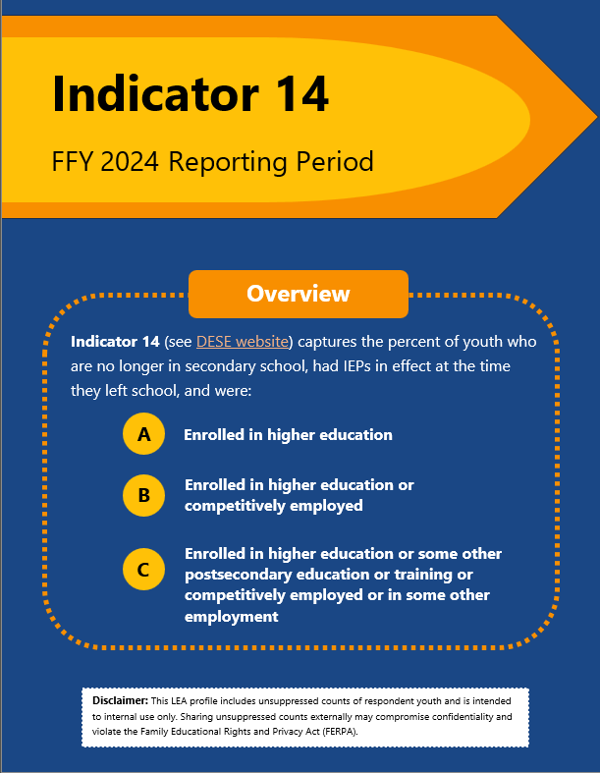
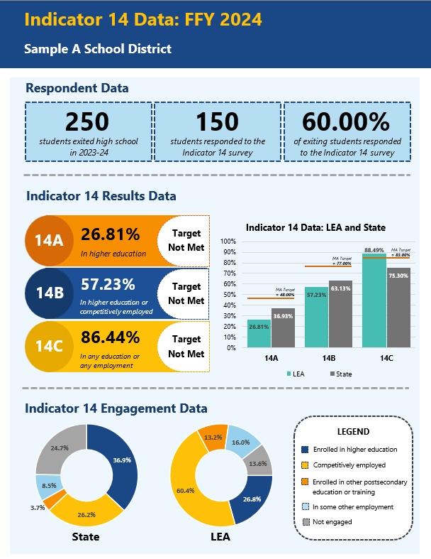
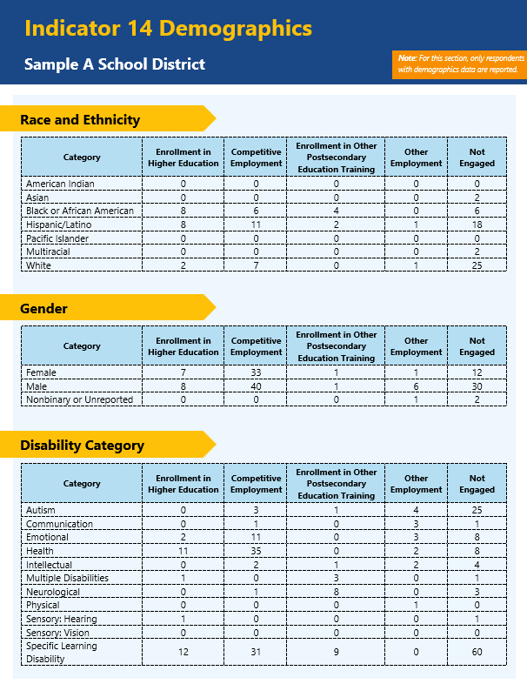
High-Level Review
Indicator 14 LEA Profiles provide an overview of district performance on Indicator 14 of the State Performance Plan/Annual Performance Report (SPP/APR). These details can help districts with internal planning and future work related to postsecondary outcomes and student engagement.

Slide 3
Page 1 Overview
PAGE

Slide 4
Page 1 Details
This link will take districts to the MA DESE Indicator 14 website
High-level overview of the three Indicator 14 outcome areas
Disclaimer that counts in the profiles are not suppressed and intended for internal use

Slide 5
Page 2 Overview
PAGE

Slide 6
Page 2 Details – Respondent Data
Details on the number of students who exited special education in the designated period, the number of these students who responded, and the district response rate
Bar chart of district-level data to state-level data for Indicator 14 components A-C. The orange lines reflect the state-established targets
District-level performance on Indicator 14 components A-C, including an indication of whether state targets were met
Pie charts displaying the state and district-level data for different postschool engagement categories that are incorporated in Indicator 14 components A-C

Slide 7
Page 3 Overview
PAGE

Slide 8
Page 3 Details – Respondent Data
Note that only students with demographics data available are included in the totals reported for each of the categories. Students without demographics data are included in Indicator 14 data, but not in this analysis
Counts of respondents based on their racial/ethnic group and the engagement category they reported in the survey
Counts of respondents based on their gender and the engagement category they reported in the survey
Counts of respondents based on their disability category at the time of exit and the engagement category they reported in the survey

Slide 9
Thank you!

