Slide 1
IEP Improvement Project Training of Trainers (TOT)

Slide 2
Welcome & Introductions

Slide 3
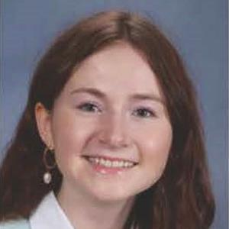
American Institutes for Research (AIR) Team
David Bateman
Presenter
Timara Davis
Presenter
Sara Evans
Presenter
Donna Sacco
Presenter
Adaline Arnold
Support
Jill Battal
Support
Julia Casasanto-Ferro
Support
Abby Foley
Support

Slide 4
DESE Team
April Rist
Jamie Camacho
Zhaneta Liti
Assistant Director
Office of Special Education Planning and Policy
Director
Office of Special Education Planning and Policy
Special Education IDEA Equitable Services Supervisor
Office of Special Education Planning and Policy

Slide 5
Welcoming Remarks from DESE Special Education Policy & Planning (SEPP)
Russell Johnston
Deputy Commissioner
District and School Assistance Centers
Jaime Camacho
Director
Office of Special Education Policy & Planning

Slide 6
Housekeeping

Slide 7
Learning Objectives
Trainers will…
Understand the technical changes to new IEP form, in relation to existing form(s), systems, policies, and guidance.
Identify & increase opportunities for adaptive change that result in effective and efficient collaboration between general educators, special educators, related service providers, parents, and students to support students eligible for special education.
Learn how to train educators and other stakeholders on the new IEP form. Explore resources to support effective IEP implementation to guide their own training.
Notes:
Emphasis on trainers – everyone in attendance is expected to support the training of educators and other stakeholders

Slide 8
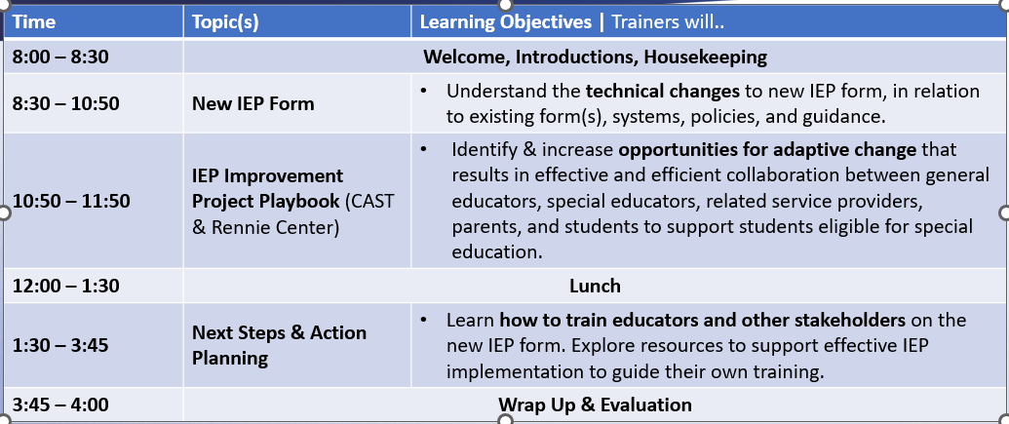
Agenda

Slide 9
Working Assumptions & Norms
Working Assumptions
Norms
Everyone has wisdom, and we need it!
This is a space of mutual learning.
Everyone’s time is valuable.
Be Present
Be Active
Be Open
Take breaks as you need them!

Slide 10
New IEP Form

Slide 11
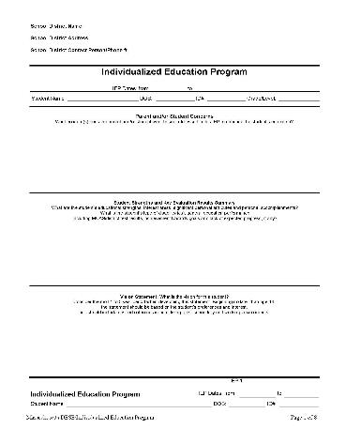
What Do These Things Have in Common?
Nokia 1100
MA IEP 1-8
The DaVinci Code
Notes:
Answer: They are 20 Years Old

Slide 12
IEP Project Goals
To improve outcomes for all students with disabilities by providing guidance, technical assistance, and tools on equitable processes to school and district professionals, families, and students so that all students with disabilities have meaningful access to the curriculum frameworks and life of the school.

Slide 13
Areas of Focus for Improved IEP Form
Family and student voice
Form documents process
Least Restrictive Environment
Integrated transition planning
Accessibility of language
Notes:
David

Slide 14
Getting to Know Your MA IEP
20 min
Step | Description of Step
Set the Stage (5 minutes) | The purpose of this activity is to help participants locate information in the new IEP form. Please have your blank copy of the new MA IEP Form in front of you as we go through this activity.
Round 1 (7 minutes) | To start, we’ll locate some of the key sections of the MA IEP form.
Round 2 (8 minutes) | For round two, we’ll go into some more nuanced sections of the MA IEP form, and in some cases highlight some of the changes to the new form, which we will discuss in more depth soon.
Discussion (10 minutes) | With others at your table, please discuss the following: Did this activity help you feel more familiar with the layout of the new IEP form? Which sections of the IEP form are most (and least) familiar? If you were a student or family member, which sections of the IEP form might feel most (and least) familiar?
Content adapted from PROGRESS Center
Notes:
Setting the stage: The purpose of this activity is not to give you an in depth understanding of each section, but rather to give you familiarity and understanding with the form overall. As trainers, you will be training a variety of audiences, including some people who may never have seen the actual IEP form (old or new). Please note that for this activity, our goal is to provide you with something that is turnkey and easy to bring back to your communities; and while we know that some of the information may be very familiar for you all as trainers and experts in the special ed process, we have put this together with your broader range of trainees in mind.

Slide 15
spinner
Measurable Annual Goals
Present Levels
Accommodations & Modifications
SPIN
Student and Team Vision
Postsecondary Transition Planning
Service Delivery Grids
Student and Parent Concerns
tekhnologic
Notes:
7 Segments

Slide 16
Spinner 2
Autism Specific Questions
Bullying Questions
Testing Accommodations
SPIN
ESY Service Grid
Transportation Needs
Schedule of Progress Monitoring
ESY Transportation Needs
tekhnologic
Notes:
7 Segments

Slide 17
Getting to Know Your MA IEP - Reflection
With others at your table, please discuss the following:
Did this activity help you feel more familiar with the layout of the new IEP form?
Which sections of the IEP form are most (and least) familiar?
If you were a student or family member, which sections of the IEP form might feel most (and least) familiar?

Slide 18
Student and Parent Concerns
Notes:
Page 1 of new IEP- Box 1- Student and Parent Concerns (follow the animation on the slide to identify box 1)
New IEP (Page 1, top) – The format has changed in this section but the same information is required as previous IEP version.
Page 1 of new IEP- Box 2 Student and Team Vision (follow the animation on the slide to identify box 2)
New IEP (page 1 bottom) – The Student and Team Vision section is the same as the vision section from the previous version except in a new format. The new IEP breaks apart vision questions by student age group and team.
Postsecondary goals will not appear unless the child is aged 14 – 22
KEY DIFFERENCES TO NOTE (reference the omission of the student strength section on the first page of the previous version IEP)
There is one key difference to note from the previous version. The previous version’s first page included a “Student Strengths and Key Evaluation Results Summary” section. This section was split into different areas of the new IEP document. The key evaluation results summary falls into the new document under “Student Profile”. The student strengths is now embedded with in the Present Level of Academic and Functional Performances Sections on pages 4, 5 and 6. This will be highlighted when we review the Student Profile and Present Level statements sections a little later.

Slide 19
Vision Activity
10 min
Step | Description of Step
Set the Stage (2 minutes) | The purpose of this activity is to brainstorm changes to process that may help IEP Teams write high-quality student vision statements that incorporate student and family perspectives.
Tabletop Discussions (5 minutes) | As a group, select a specific age range to focus on (e.g., preschool, elementary, middle, high). Discuss approaches for gathering information about the student’s vision. Are there specific questions and/or processes that could lead to increased student engagement and participation in IEP development and implementation?
Discussion (3 minutes) | For the age range your group focused on, what challenges exist for capturing a student’s vision in the IEP? For the age range your group focused on, how might increased student engagement and participation in IEP development support improved and equitable student outcomes?

Slide 20
Student Profile
STUDENT PROFILE
The student is identified as having the following disability or disabilities. Include all that apply.
Autism Communication Impairment Developmental Delay (ages 3–9) Emotional Impairment | Health Impairment Intellectual Impairment Neurological Impairment Physical Impairment | Sensory Impairment Hearing Vision Deaf-Blind Specific Learning Disability
English Learner
Has the student been identified as an English learner?
Yes ☐ No
If yes, describe the student’s English Learner Education program, English as a Second Language services, and progress toward English language proficiency benchmarks:
Identify any language needs and consider how they relate to the student’s IEP:
Assistive Technology
Does the student require assistive technology devices or services?
Yes ☐ No
If yes, this need will be addressed in the following section(s) of the IEP:
Accommodations/Modifications Goals/Objectives | Services Delivery Grid Additional Information
Notes:
Page 2- Box 1- Student Profile
On page two of the new IEP document is the Student Profile. This sections includes information regarding the student’s identified disability based on the most current evaluation results. A major addition to this section of the IEP is the inclusion of information regarding students’ English as a Second Language services, if applicable. This change is intended to help us better support our dually identified students.
In this section, you will also indicate whether or not the student requires assistive technology devices or services. If you select yes, then you will be prompted to identify one or more sections in the IEP which will address these assistive technology devices or services.

Slide 21
Know Your Student!
35 min
Step | Description of Step
Set the Stage (5 minutes) | The purpose of this activity is to practice describing (step 1) and documenting (step 2) students’ strengths, interests, and areas of need.
Step 1 (7 minutes) | With a partner, engage in a seven-minute conversation to describe a student that one of you knows well. Both partners will take notes and ask clarifying questions to summarize the student and team vision and the student strengths, interests and preferences.
Review Slides (10 minutes) | Review the Present Level pages and slides in more depth. Highlight key technical features of the Present Level pages in the new form, and opportunities for adaptive changes to systems, processes, and practices.
Step 2 (5 minutes) | Based on the conversation from Step 1, work with your partner to transfer key information into one Present Levels page from the new IEP form.
Discussion (7 minutes) | What additional information would need to be included to support your statements (ex. Data, parent and student input)? What adjustments will teams need to make to document this information?

Slide 22
Know Your Student! Step 1: DESCRIBE
Person 1:
Select a student with a disability you know well. Describe your vision or desired post-school outcomes for the student.
In 4 minutes or less, describe the disability and its impact on the student’s access and benefit from public education, and what you think needs to happen for the student to be successful.
Focus on the student and team vision, and the student’s strengths, interests and preferences.

Slide 23
Know Your Student Step 1: DESCRIBE
Person 2:
As Person 1 speaks, create a list of the student and team vision and the student’s strengths, interests and preferences. Include high level notes about students areas of need.
When Person 1 finishes, take 2 minutes to ask questions for clarification:
What does the student need to learn to access and benefit from general education? Or need to access from special instruction?
What does the school need to provide to ensure access?
What do teachers need to support the students?
Together:
Take 1 minute to confirm your description of the student, their strengths, needs, and what supports would be best.
Notes:
Once participants have confirmed the information, ask them to set the list aside. The list will be needed after the review of the present level slides.

Slide 24
The Gift of the Present
Notes:
The next four pages of the new IEP form are Present Level of Academic Achievement and Functional Performance statements. We will refer to these pages as “Present Levels” pages moving forward and contain some of the major changes from the previous IEP form and are designed to address the three major goals of the larger IEP Improvement Project: (1) Improve Outcomes, (2) Equitable Process, and (3) Meaningful Access. We want to pause here to highlight some of the opportunities that these new sections provide.
The Present Levels pages of the New IEP Form
At the top of each Present Level’s page, you’ll see that “data” is defined broadly here to extend beyond evaluation results, in include curriculum-based measurements, input from parents, students and/or teachers, and information about classroom performance. [LOOK AT TECHNICAL GUIDE FOR LANGUAGE?]
The Present Levels pages also leverage a strengths-based approach, by including a center column to capture student strengths, interest areas, and preferences across all domains.
At the end of each Present Levels page, you’ll also see a designated space to address additional concerns. The important thing to note here is that nothing has changed in terms of the requirements around these considerations; the only thing that has changed is a designated place in the IEP to document those considerations.

Slide 25
Present Levels Academic
PRESENT LEVELS OF ACADEMIC ACHIEVEMENT AND FUNCTIONAL PERFORMANCE: ACADEMICS
Describe the student’s present levels of academic achievement and functional performance in the relevant areas listed below.
Consider the areas of learning listed below and complete only the sections that apply to the student. Include relevant information and data from sources such as initial or most recent evaluations; documentation from classroom performance; parent(s), student, and teacher observations; and curriculum-based and standardized assessments, including MCAS.
Briefly describe current academic performance. Check all that apply: English Language Arts History and Social Sciences Math Science, Technology, and Engineering | Strengths, interest areas, and preferences | Impact of student’s disability on involvement and progress in the general education curriculum or appropriate preschool activities
Autism-Specific Question: Does the student have needs resulting from the disability that impact progress in the general curriculum, including social and emotional development (e.g., organizational support, generalizing skills, practicing skills in multiple environments)?
Yes ☐ No
If yes, this need will be addressed in the following section(s) of the IEP:
Accommodations/Modifications Goals/Objectives | Services Delivery Grid Additional Information
Notes:
Page 3- Box 1-Present Level of Academic Achievement and Functional Performance : Academics
The first Present Levels page is focused on academics. It is designed to give a clear picture of how the disability is impacting the student’s performance in academic areas.
Take 30 seconds to look at the new layout. (Pause and let the audience review the form). The three major box contain the current performance, strengths and preferences and then the impact statement. Data must be included in all three boxes to show the student’s strength and needs in the area. IEP team will include evaluation results from three-year or initials in all three boxes. Teams also need to include other assessment data such as CBM, screenings, progress monitoring, etc. that has been collected outside of the evaluation process to build a robust statement of student’s needs in the area of academic achievement.

Slide 26
Present levels Behavioral Social Emotional
PRESENT LEVELS OF ACADEMIC ACHIEVEMENT AND FUNCTIONAL PERFORMANCE: BEHAVIORAL/SOCIAL/EMOTIONAL
Briefly describe current behavioral/social/emotional performance. Consider the use of positive behavioral interventions and supports, and other strategies, to address behavior that impedes learning. | Strengths, interest areas, and preferences | Impact of student’s disability on involvement and progress in the general education curriculum or appropriate preschool activities
Bullying Describe any disability-related skills and proficiencies the student needs in order to avoid and respond to bullying, harassment, or teasing. This section must be completed for students who have a disability that affects social skills development; students vulnerable to bullying, harassment, or teasing; and students with autism. | Specify how these needs, if any, will be addressed in the IEP.
Autism-Specific Question: Does the student require any positive behavioral interventions, strategies, and supports to address their behavioral difficulties resulting from autism spectrum disorder?
Yes ☐ No
Autism-Specific Question: Does the student need to develop social interaction skills and proficiencies?
Yes ☐ No
Autism-Specific Question: Does the student have needs related to changes in environment or to daily routines?
Yes ☐ No
Autism-Specific Question: Does the student have needs related to repetitive activities and movements?
Yes ☐ No
Autism-Specific Question: Does the student have needs resulting from their unusual responses to sensory experiences?
Yes ☐ No
If yes to any of the above, these needs will be addressed in the following section(s) of the IEP:
Accommodations/Modifications Goals/Objectives | Services Delivery Grid Additional Information
Notes:
Speaker Notes:
Page 4- Box 1-PLAAFP: Behavioral/Social/Emotional
The behavior/social/emotional section is laid out in the same manner as the academic Present Level of Academic Achievement and Functional Performance with three boxes capturing current performance, strength and preferences, and the impact statement. Take 30 seconds to review this page. (pause for the audience to review). It is important to highlight both evaluation and classroom-based data will also need to be included in all three boxes in this Present Level of Academic Achievement and Functional Performance statement.
KEY DIFFERENCES TO NOTE
This page has two important changes to note. The Behavioral/Social/Emotional Present Level of Academic Achievement and Functional Performance now includes the bullying and needs statement as well as the area 5 Autism-specific questions. It is important the questions/considerations have not changed and come from the Massachusetts regulations. The new IEP gives teams a designated location to address the questions/considerations.

Slide 27
Present levels communication
PRESENT LEVELS OF ACADEMIC ACHIEVEMENT AND FUNCTIONAL PERFORMANCE: COMMUNICATION
Briefly describe current communication performance. | Strengths, interest areas, and preferences | Impact of student’s disability on involvement and progress in the general education curriculum or appropriate preschool activities
Does the student require the use of augmentative and alternative communication (AAC)? Consider any AAC needs for non-speaking students or those with limited speech.
Yes ☐ No
If yes, describe how the Team will address the student’s needs (including acquiring, designing, customizing, maintaining, repairing, and/or replacing AAC device/system).
The student needs an AAC device/system at school.
The student needs an AAC device/system at home or in other non-school settings to receive a free appropriate public education.
The student needs training and/or technical assistance to use the AAC device/system.
The student’s family needs training and/or technical assistance concerning the AAC device/system.
Educators, other professionals, employers, or others who work with the student need training and/or technical assistance concerning the AAC device/system.
These needs will be addressed in the following section(s) of the IEP:
Accommodations/Modifications Goals/Objectives | Services Delivery Grid Additional Information
Autism-Specific Question: Does the student have needs in the areas of verbal and nonverbal communication, including but not limited to those identified in assistive technology/AAC evaluation(s)?
Yes ☐ No
If yes, these needs will be addressed in the following section(s) of the IEP:
Accommodations/Modifications Goals/Objectives | Services Delivery Grid Additional Information
Notes:
Speaker Notes:
Page 5- Box 1-PLAAFP: Communication
As you take a moment to review the Communication Present Level of Academic Achievement and Functional Performance notice the configuration is the same as the previous two slide. The page starts off with the same three boxes designated to capture the current performances and needs of the student.
KEY DIFFERENCES TO NOTE
As you review this page you may have noticed a few additions to this Present Level of Academic Achievement and Functional Performance page. New augmentative and alternative communication questions were added to document the need and use of and AAC device. In addition to the AAC questions area 1 Autism-specific questions were added to this section as well.

Slide 28
Present levels Additional Areas
PRESENT LEVELS OF ACADEMIC ACHIEVEMENT AND FUNCTIONAL PERFORMANCE: ADDITIONAL AREAS
Additional Areas, as Applicable (such as activities of daily living, health, hearing, motor, sensory, and vision) Briefly describe current performance and any applicable documentation. Please note that parent(s) are only asked to share health information voluntarily. | Strengths, interest areas, and preferences | Impact of student’s disability on involvement and progress in the general education curriculum or appropriate preschool activities
Deaf or Hard of Hearing
☐ | The student is deaf or hard of hearing, and their language and communication needs will be addressed in the following section(s) of the IEP: Accommodations/Modifications Services Delivery Grid Goals/Objectives Additional Information
Blind or Visually Impaired (including Cortical Visual Impairment)
☐ | Braille is needed and will be addressed in the following section(s) of the IEP: Accommodations/Modifications Services Delivery Grid Goals/Objectives Additional Information
☐ | Screen readers or other assistive technology are needed and will be addressed in the following section(s) of the IEP: Accommodations/Modifications Services Delivery Grid Goals/Objectives Additional Information
☐ | Orientation and mobility services are needed and will be addressed in the following section(s) of the IEP: Accommodations/Modifications Services Delivery Grid Goals/Objectives Additional Information
Notes:
Speaker Notes:
Page 6- Box 1-PLAAFP: Additional Areas
The final present level page can be used to address other areas of needs that do not fall in the previous three pages. Potential uses for this page could be needs for visual or hearing impairments, vocational, sensory impairments, etc. The format continues to follow that of the previous three pages.
KEY DIFFERENCES TO NOTE
Notice on this page, documentation and question related to students with deaf or blindness needs have been included.

Slide 29
Know Your Student! Step 2: CAPTURE
Person 1 and 2 (5 minutes)
Take out your list from the previous activity.
Select the Present Levels page that contains the primary areas of concern for the student and work together to capture key information within the form.
Discussion (7 minutes):
What additional information would need to be included to support your statements (e.g., data, parent and student input)?
What adjustments will teams need to make to capture this information on the new form?
Notes:
Speaker Notes:

Slide 30
Present Levels Academics
PRESENT LEVELS OF ACADEMIC ACHIEVEMENT AND FUNCTIONAL PERFORMANCE: ACADEMICS
Describe the student’s present levels of academic achievement and functional performance in the relevant areas listed below.
Consider the areas of learning listed below and complete only the sections that apply to the student. Include relevant information and data from sources such as initial or most recent evaluations, documentation from classroom performance, parent(s), student, and teacher observations, and curriculum-based and standardized assessments, including MCAS.
Briefly describe current performance. Check all that apply: English Language Arts History and Social Sciences Math Science, Technology and Engineering | Strengths, interest areas and preferences | Impact of student’s disability on involvement and progress in the general education curriculum or appropriate preschool activities
On the Battelle Developmental Inventory, Second Edition (BDI-2), Nia demonstrated age-appropriate skills in two out of three cognitive areas (reasoning and academic skills, and perception and concepts). She has a mild delay in attention and memory skills. She could not repeat 3-digit sequences or retell a story that had been told or read to her. During large group activities, she participates in songs, fingerplays, and movement activities independently. She is working on increasing her attention to group instructional activities and stories read aloud. Currently, she is only able to attend to instructional activities for 1 minute before needing redirection from staff. Nia has begun to answer questions and share her personal experiences; however, it can be difficult to understand her, especially when she is speaking out of context. | Nia can count to 10 and was able to show some one-to-one correspondence of items to two objects. She is able to sort by a single attribute (e.g., color or size). She is able to identify five colors (red, blue, green, yellow, and orange). Nia does better learning a new tasks when they are adult directed with visual cues. She shows excitement (clapping, smiling, laughing) when it is story time. Nia especially likes hearing books and stories by Eric Carle. | Developmental delays in attention and memory and challenges with expressive communication impact Nia's ability to make progress in age-appropriate learning standards in English language arts, math, and science, technology, and engineering and share what she knows and needs with adults and peers.
Notes:
Another resource that you have available to use as Trainers are the sample IEPs that are available on the IEP Improvement Project website. Here we’ve included a slide with the Present Levels (Academic) page from the pre-k sample IEP so that you can see an example of a completed present levels page.

Slide 31
Post secondary transition planning
POSTSECONDARY TRANSITION PLANNING*
Complete for eligible students aged 14–22 and update annually. Complete also for students who are 13 and will turn 14 during this IEP period. The dotted lines indicate the pages of this IEP that are dedicated to secondary transition planning.
Postsecondary Transition Briefly describe current performance. | Strengths, interest areas, and preferences | Impact of student’s disability on involvement in the general education curriculum and/or specific area of postsecondary transition
Education/training
Employment
Community experiences/postschool independent living, if applicable
REMINDER!
The transition pages will only be used when the IEP team is engaging in post-secondary transition planning.
The identified areas of postsecondary transition will be addressed in the following section(s) of the IEP:
Accommodations/Modifications Goals/Objectives | Services Delivery Grid Additional Information
Projected date of graduation/program completion:
Projected type of completion document (diploma, certificate of attainment, or other locally defined completion document):
Planned Course of Study
What requirements does the student need to meet to receive the type of completion document above? What is the student’s planned course of study?
What is the student’s current status regarding meeting those requirements?
* The dotted line indicates that this page of this IEP is dedicated to secondary transition planning.
Notes:
Speaker Notes:
As we move into the next three slides, we will discuss transition planning. To signify the focus on transition the focus boxes are now green. Look at Technical guide - Careful with language - transition plan was outside of the IEP – Frame when students transition planning is a bigger part of present levels – include critical information in the overarching document to develop services etc and all that is needed…
Page 7- Box 1-POSTSECONDARY TRANISTION PLANNING
Please take a few moments to review the first page of the transition plan (Pause and allow the audience 30 seconds to review the page). During your review you may have noticed the addition of the last two questions on this page. Team’s will need to include documentation on the student’s progress toward graduation and a course of study.
KEY DIFFERENCES TO NOTE
(Advance the reminder call out as the last statement before advancing the slide) REMINDER! The transition pages will only be used when the IEP team decides to address transition
Take time to point out

Slide 32
Community and interagency Connections Part of IEP
COMMUNITY AND INTERAGENCY CONNECTIONS
Agency | Description of Support Provided | Role and contact information of school staff who will be the liaison to the agency
TRANSFER OF RIGHTS TO STUDENT
The student and parent(s) must be notified at least 1 year before the student’s 18th birthday that decision-making rights will transfer from parent(s) to the student when the student turns 18. Is the student 17 or will they turn 17 during the timeframe of this IEP?
Yes ☐ No
On what date was the student provided with the notice of transfer of rights and a copy of procedural safeguards concerning special education rights?
On what date was the parent(s) provided with notice of transfer of rights and a copy of procedural safeguards concerning special education rights?
* The dotted line indicates that this page of this IEP is dedicated to secondary transition planning.
Notes:
Speaker Notes:
In the top box of this page, you will find community and interagency connections. This is a new section within the transition plan. It is important to not confuse this section with the 688 referral on the next page.
Page 8- TRANSITION: COMMUNITY AND INTERAGENCY CONNECTIONS
The community and interagency connections section is a location to capture any current (make a strong emphasis on current) connections and supports that exist thought outside agencies. Many students access services from DDS, MCDHH, MCB, DMH while still in school. MRC does work with students still in HS through the Pre-ETS model. A team may also capture other community connections that the parents may share during the meeting. Teams will need to gather a release of information from the community and interagency providers to allow for open communication.
Page 8- Box 2- TRANSFER OF RIGHTS
As you can see in the second box on this page, the IEP team will now document the notification of transfer of right.
KEY DIFFERENCES TO NOTE
It is important to remember an IEP team should not wait till the required 1 year prior to the 18th birthday to start discussing the transfer of rights. This conversation should start early and include the parents and student. Teams should focus on incorporating skills into the IEP that students may need to assist with assuming their rights. Think bigger then just attending and signing the IEP.

Slide 33
Decision making options for the student
DECISION-MAKING OPTIONS FOR STUDENT*
Complete for student who has turned 18. Please indicate the decision-making option that the student or court-appointed legal guardian has selected:
☐ The student will make their own educational decisions. ☐ The student will share decision-making with their parent, caregiver, or other adult. Individual with whom the student will share decision-making: ☐ The student has delegated decision-making to their parent, caregiver, or other adult. Individual to whom the student has delegated decision-making: ☐ A court has appointed a legal guardian for the student who will make educational decisions. Name of court-appointed legal guardian: Date of determination:
TRANSITION TO ADULT SERVICE AGENCY OR AGENCIES—688 REFERRAL
Is the student within 2 years of exiting special education services? | Yes No
If yes, has the Team discussed whether the student meets the criteria for a 688 referral? | Yes No
Has a 688 referral been submitted for this student? | Yes (If so, date the 688 referral was submitted: )* No (If so, date the 688 referral will be submitted: )* The Team has determined that the student does not meet the criteria for a 688 referral.
If yes, please identify the agency to which referral was made:
* The dotted line indicates that this page of this IEP is dedicated to secondary transition planning.
Notes:
Speaker Notes:
Page 9 Box 1- TRANSITION: DECISION MAKING OPIONS FOR STUDENTS
The first box on the last page of the transition portion of the IEP is a location to document who will take over the decision making for the student on the 18th birthday. It is still a requirement of a school or district to have students sign-off indicating the decision-making choice. Again, it is important to start discussing this with students and families early in the transition process.
Page 9 Box 2- TRANSITION TO ADULT SERVICE AGENCY OR AGENCIS- 688 Referral
The 688-referral process has not changed. This section as been incorporated into the transition planning portion of the IEP to remind team to have the discussion early and well before these decisions are made.
KEY DIFFERENCES TO NOTE
(Read with emphasis) Schools and districts are still required to complete all the other forms used in this process. For example, 688 forms will still be processed separately.

Slide 34
Accommodations and modifications
ACCOMMODATIONS AND MODIFICATIONS
Accommodations: List the accommodations the student needs to make progress in the areas of academic achievement and functional performance. Leave blank any boxes that are not appropriate for the student.
 | Presentation of Instruction The way information is presented. | Response The way the student responds. | Timing and/or Scheduling The timing and scheduling of the instruction. | Setting and/or Environment The characteristics of the setting.
Classroom accommodations
Nonacademic settings (lunch, recess, etc.)
Extracurricular activities
Community/workplace
Modifications: List the modifications, if any, that are needed to the student's program so they can meet their goals, make progress, and participate in activities alongside students with and without disabilities. Leave blank any boxes that are not appropriate for the student.
 | Content | Instruction | Student Output
Classroom modifications
Nonacademic settings (lunch, recess, etc.)
Extracurricular activities
Community/workplace
Notes:
Speaker Notes:
Page 10- Box 1- Accommodations
When considering accommodations for learning remember accommodations do not change what students learn but rather how they access learning. The accommodation section is broke down into four parts. IEP teams need to address each part and the four delivery methods. As stated in the IRIS Module "students with disabilities often face challenges or barriers that inhibit or restrict their ability to access and demonstrate learning." To eliminate these barriers consider the following definitions taken for the IRIS module on accommodation.
Presentation of Instruction: how information is presented (e.g., as text, in a lecture)
Response: the manner in which students are asked to respond (e.g., in writing, through speech)
Timing and/or Scheduling: the timing and scheduling of instruction (e.g., the time of day, the length of a given assignment)
Setting and or Environment: the characteristics of the setting (e.g., the levels of noise and lighting)
Page 10- Box 2 – Modifications
Remember modifications are adaptations that change what students learn and are used with students who require more support or adjustments than accommodations can provide. Whereas accommodations level the playing field, modifications change the playing field.
KEY DIFFERENCES TO NOTE
Accommodations and modification were embedded in several sections of the previous IEP document. This new pages is to allow teams to capture all accommodations and modification into one area. This will help families, general education teachers and other staff easily locate the needs for these services.
It is also important to note, if an accommodation or modification are needed in multiple settings, repeat in each section. Do not just say “see classroom accommodations" etc.

Slide 35
Accommodation vs. Modification
 | Accommodations | Modifications
Purpose | Provide access to the general education curriculum by addressing barriers or challenges. Level the playing field so students can fully participate in educational activities. | Make changes to curriculum, instruction and/or assessment directly tailored to individual needs. Alter what is being taught or assessed to match the student's abilities and learning goals.
Nature of Changes | Content and standards of the curriculum are not changed. The ways in which educators present information and the ways in which students demonstrate their knowledge or skills are adjusted to allow for access to curriculum and instruction. | The curriculum is adapted to focus on key concepts. Content is simplified. Complexity of assignments or tasks is reduced. Alternative assessments are provided.
Examples | Providing extra time on tests. Using assistive technology. Providing visual prompts and instructions. | Using alternative assignments. Direct, explicit, multi-sensory instruction. In language arts, providing modified materials at a different reading level.
Notes:
Define Accommodations and Modifications, provide examples.

Slide 36
Tabletop Sorting - 1
20 min
Step | Description of Step
Set the Stage (3 minutes) | The purpose of this activity is to help participants understand the difference between accommodations and modifications, and how to document both in the new IEP form.
Review Examples (2 minutes) | With the whole group, review some example accommodations and modifications (from the Pre-K Sample IEP) and where they fit in the Accommodations/Modifications Table in the MA IEP form.
Tabletop Sorting (10 minutes) | Using the accommodations and modifications provided on your table, work with your group to sort each into the MA IEP form.
Discussion (5 minutes) | Which accommodations and/or modifications were challenging for your group? In what ways do IEP accommodations and modifications contribute to more meaningful access and equitable outcomes for students with disabilities?
Notes:
Introduce Activity. Participants with work in small groups to sort example accommodations and modifications using the MA IEP form.

Slide 37
Tabletop Sorting (Review Examples)
EXAMPLE:
When Nia makes an articulation mistake, adults should model the correct sounds back immediately. Provide Nia with clear and simple directions.
Does this change HOW a student learns, or WHAT a student learns?
In what way is this change made?
In what setting(s) will this change apply?
For Accommodations: Presentation, Response, Timing or Setting
For Modifications: Content, Instruction, or Student Output
Notes:
Present example. Walk participants through questioning to determine if this is an accommodation or modification and in what setting(s) it would be best situated.

Slide 38
Tabletop Sorting (Review Examples) 2
EXAMPLE:
Provide explicit instruction and modeling, using think-aloud and guided practice before asking Nia to complete independent work.
Does this change HOW a student learns, or WHAT a student learns?
In what way is this change made?
In what setting(s) will this change apply?
For Accommodations: Presentation, Response, Timing or Setting
For Modifications: Content, Instruction, or Student Output
Notes:
Present example. Walk participants through questioning to determine if this is an accommodation or modification and in what setting(s) it would be best situated.

Slide 39
Tabletop Sorting (Review Examples) 3
EXAMPLE:
Nia can use visual story maps and prompting to retell a story.
Does this change HOW a student learns, or WHAT a student learns?
In what way is this change made?
In what setting(s) will this change apply?
For Accommodations: Presentation, Response, Timing or Setting
For Modifications: Content, Instruction, or Student Output
Notes:
Present example. Walk participants through questioning to determine if this is an accommodation or modification and in what setting(s) it would be best situated.

Slide 40
Tabletop Sorting - 2
On your tables are a list of accommodations and modifications.
As a group, discuss where you might place each example within the IEP form.
Does this change HOW a student learns, or WHAT a student learns?
In what way is this change made?
In what setting(s) will this change apply?
For Accommodations: Presentation, Response, Timing or Setting
For Modifications: Content, Instruction, or Student Output
Notes:
Participants will work in small groups to complete the tabletop sorting activity. Participants will receive example accommodations and modifications, which they will use to sort using the accommodations and modifications page within the IEP form.

Slide 41
Tabletop Sorting (Discussion)
Which accommodations and/or modifications were challenging for your group?
In what ways do IEP accommodations and modifications contribute to more meaningful access and equitable outcomes for students with disabilities?
Notes:
Turn&talk discussion.

Slide 42
Alternate assessment – State and district wide
STATE AND/OR DISTRICTWIDE ASSESSMENT/ALTERNATE ASSESSMENT
Identify the state or districtwide assessments planned during the IEP period. Consider MCAS (Grades 3–12), ACCESS (Grades K–12), etc.
How does the student participate in state and/or districtwide assessments?
The student participates in on-demand assessment with no accommodations under routine conditions in all content areas.
The student participates in on-demand assessment with accommodations.
Please indicate which testing accommodations the student requires:
English Language Arts | Math | Science | Other
The student participates in state and/or districtwide alternate assessment(s).
Please select the subject(s) below in which the student needs alternate assessment(s). Please explain why the student needs alternate assessment(s), and why the alternate assessment you have chosen is appropriate for them.
English Language Arts | Math | Science | Alternate Access for ELLs
Explanation: | Explanation: | Explanation: | Explanation:
Notes:
Speaker Notes:
Page 11- Box 1-STATE AND/OR DISTRIWIDE ASSESSMENTS/ALTERNATE ASSESSMENT
The state and district assessment page similar to the previous version of the IEP. The new format now allows for a team to decide the best way to meet a student’s needs when assessing with district or state assessments.
KEY DIFFERENCES TO NOTE
At the bottom of this page is the addition of a question regarding the alternate assessment. This was built in to allow a team to successful document how and why a student will need alternative assessment(s). (Note that a student can take the alternate assessment in one or all of the designated areas)

Slide 43
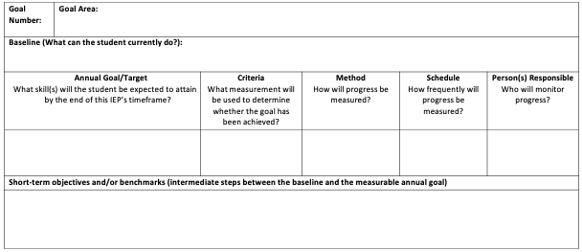
Blank Measurable annual goals
MEASURABLE ANNUAL GOALS
Please identify the academic and functional goals for this student this year. The goals must be measurable and meet the student’s needs that result from their disability to enable them to be involved in and make progress in Early Childhood Outcomes (ages 3–5) or the Massachusetts Curriculum Frameworks (older students). The goals must meet each of the student’s other educational needs that result from their disability. Please include additional goals as necessary.
SCHEDULE OF PROGRESS REPORTING
Explain how and when parent(s) will be periodically informed of the student’s progress toward meeting the annual goal(s):
Notes:
Speaker Notes:
Page 12- Box 1-MEASURABLE ANNUAL GOALS
Take a moment a review page 12. (Pause and allow for 30 seconds to review). During your review you may have noticed some similarities and some differences between the previous version and the new IEP form. The previous version required a current performance level, the goal, and benchmarks/objectives. The new version had taken those three elements and break them down to allow for more specificity.
Let’s break it down. The current performance level from the previous version is now the baseline of the student. (NOTE) The baseline information should be taken from the data within the PLAAFP. The measurable annual goal is now separated into three parts annual goal, criteria, and method with schedule and person responsible for monitoring progress added.
KEY ITEMS TO NOTE
For person responsible – write role, not name
There is no required state progress report form.

Slide 44
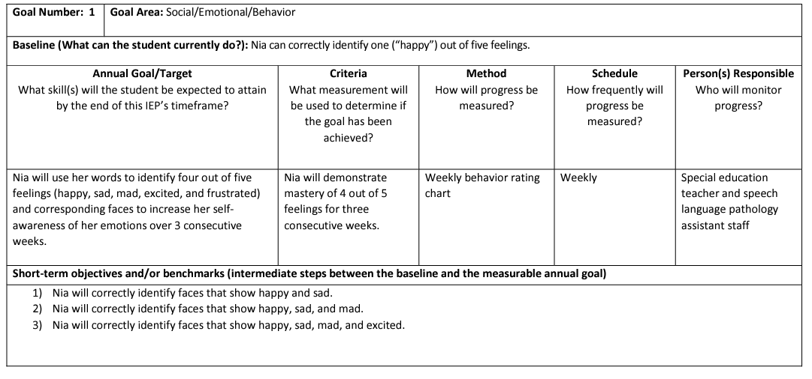
Sample Goal completed
Sample Goal
Nia will use her words to identify four out of five feelings (happy, sad, mad, excited, and frustrated) and corresponding faces to increase her self-awareness of her emotions over 3 consecutive weeks. Nia will demonstrate mastery of 4 out of 5 feelings for three consecutive recorded on weekly behavior rating chart by the special education teacher and speech language pathology assistant staff
Notes:
Note: Area in which the goal elements are written depends on the information laid out in the overall goal. For example the timeframe may be placed prior to the condition in some instances and after the performance criterion in others.

Slide 45
More on Participation in General education setting
PARTICIPATION IN THE GENERAL EDUCATION SETTING
Can the student’s educational needs be met in the general education setting, with or without the use of supplementary aids and services?
Yes ☐ No
If no, provide an explanation of the extent to which the student will not participate in general education. Include a description of the specific supplementary aids and services considered before determining that the student would be removed from a general education class or activity.
SERVICE DELIVERY
Include specially designed instruction, related services, and supports based on peer-reviewed research to the extent practicable (including, if applicable, positive behavioral supports and support/training for school personnel and/or parent[s]). Consider providing services in general education settings before considering other options.
Notes:
Speaker Notes:
Page 13- Box 1- PARTICIPATION IN THE GENRERAL EDUCATION SETTING
In the previous version there was a nonparticipation justification sections. That section of the IEP has now been updating to the participation in the general education setting. Team will be documenting the least restrictive environment (LRE) in this section. (NOTE with emphasis) This is a change in the order from the previous version. The LRE question now comes before the service delivery grid.
Page 13- Box 2- SERVICE DEVLIERY
Within the service delivery grid you will find one new addition. Teams will now be asked to identify the location in which the service will be provided. For example, general education classroom, special education classroom, community site, etc.

Slide 46
More on transportation services
TRANSPORTATION SERVICES
Transportation will be provided in the same manner as it would be for students without disabilities. (Please note that if the student is placed in a program located at a school other than the school the student would have attended if not eligible for special education, then transportation will be provided.)
The student requires transportation supports and/or services as a related service.
Student will be transported on a regular transportation vehicle with the following assistance, attendants, modifications, and/or specialized equipment and precautions:
Specify the disability-related need(s) that require support(s) during transportation (e.g., seizures, a tendency for motion sickness, behavioral or
communication difficulties):
Student will be transported on a special transportation vehicle with the following assistance, attendants, modifications, and/or specialized equipment and precautions:
Specify the disability-related need(s) that require support(s) during transportation (e.g., seizures, a tendency for motion sickness, behavioral or
communication difficulties):
SCHEDULE MODIFICATION
Does the student require a different duration to their school program, including the length of their day or year so that they can receive a free appropriate public education?
Yes ☐ No
If yes, what are the student’s disability-related needs that require a different schedule?
If yes, describe the change in schedule to the student’s educational program.
If the student requires a longer year, please include the services they will receive (including, if applicable, positive behavioral supports and support/training for school personnel and/or parent[s]) during Extended School Year in the service delivery grid below.
Notes:
Speaker Notes:
It is important to note the order of these two sections have changed in the new IEP document. Schedule modifications now comes before the transportation schedule.
Page 14- Box 1- TRANSPORTATION SERVICES
Make sure you address the fact that there is a transportation section and grid for the Schedule Modification section (Extended School Year)
Page 2- Box 2 SCHEDULE MODIFICATIONS
Table transportation services – DESE to follow up with additional guidance
Schedule Modification – biggest change is to not highlight the fact that a shortened day is an option.

Slide 47
Service delivery for Extended school year - more
SERVICE DELIVERY FOR EXTENDED SCHOOL YEAR SERVICES
Describe the specially designed instruction, related services, and supports that the student needs to avoid substantial regression during summer break and to continue to make effective progress.
Extended School Year Transportation Services
Transportation will be provided in the same manner as it would be for students without disabilities. (Please note that if the student is placed in a program located at a school other than the school they would have attended if not eligible for special education, transportation will be provided.)
The student requires transportation supports and/or services as a related service.
Student will be transported on a regular transportation vehicle with the following assistance, attendants, modifications, and/or specialized equipment and precautions:
Specify the disability-related need(s) that require support(s) during transportation (e.g., seizures, a tendency for motion sickness, behavioral or communication difficulties):
Student will be transported on a special transportation vehicle with the following assistance, attendants, modifications, and/or specialized equipment and precautions:
Specify the disability-related need(s) that require support(s) during transportation (e.g., seizures, a tendency for motion sickness, behavioral or communication difficulties):
Notes:
Speaker Notes: Have to ID – ESP transportation -
Page 15- Box 1- SERVICE DELIVERY FOR EXTENDED SCHOOL YEAR
IEP team will need to consider the need for Extended School Year services. If the student is in need this new section allows the team to document what the services should look like for the student. This is separate from the Service Delivery for the school year. If a student is not in need of Extended School Year services, level the box blank.
Page 15- Box 2- ESY Transportation
On the last section of this page teams will need to consider and document transportation needs for the Extended School Year program. It is critical that teams consider how a location or schedule change may impact the need for transportation to Extended School Year. Transporation could look different from the regular school year.

Slide 48
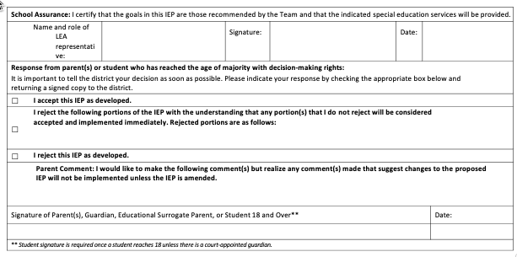
More on additional information
ADDITIONAL INFORMATION
Record other IEP information not previously stated (e.g., information about the student that is important to know but is not addressed through IEP goals and services).
RESPONSE SECTION
Meeting Request
☐ | I request a meeting to discuss the rejected IEP or rejected portion(s).
Massachusetts DESE Individualized Education Program
Date of Last Revision May 1, 2023
Notes:
Speaker Notes:
Page 16- Box 1- ADDITIONAL INFORMATION
This section is a location for IEP teams to capture any additional relevant information about the student that did not fit into other sections of the IEP document. If there is not additional information to add, do not leave the box blank. Use a general statement such as "no additional information at this time" to document the team addressed this section of the IEP.
Page 16- Box 2- RESPONSE SECTION
This section is the same as the previous IEP.

Slide 49
Reflection – IEP Form
As you think about using these forms moving forward…
What opportunities do you see to improve outcomes for students with disabilities?
What supports will you need?
Notes:
Speaker Notes:
We have just covered a lot of detailed information about each page of the IEP form itself. If we “zoom out” a little bit and consider the broader goals or purpose of improving outcomes and meaningful access for students with disabilities, what opportunities come to mind? Related, what supports are you thinking about?
Activity Guide (do not read aloud)
Step 1: Pause and allow 5-10 minutes for participants to reflect on their notes.
Step 2: After the given time bring the group back together for a larger group share out.
Step 3: Capture the answer to the questions for future planning and training.
Step 4: Ensure all stakeholders have an opportunity to share reflections.
Discuss with your table –or shoulder partner…
TRANSITION TO RENNIE AND CAST

Slide 50
IEP Improvement Project Playbook
Rennie Center & CAST
Laura Cinelli
Deputy Director
Rennie Center
Ruth Templeton
IEP Implementation Specialist
CAST

Slide 51
Systems Change for IEP Improvement
Lessons Learned from Early Adopters
October 2023
Notes:
Share what we did

Slide 52
What we’ll cover today
Project background
Technical vs. adaptive change
Introduction to IEP Improvement Playbook
Sample promising practices
Reflection and next steps

Slide 53
Project background

Slide 54
Students and Families First Coalition
CAST, Inc.
Rennie Center for Education Research & Policy
Federation for Children with Special Needs
Perennial Education

Slide 55
Project goals
To build school and district capacity to
identify
analyze
address
challenges with the IEP/Special Education process in order to create the conditions to improve student outcomes.

Slide 56
Project timeline
Year One
Year Two
Year Three
Gain a clear understanding of current practices
Identify a focus area and begin testing change ideas
Implement successful practices and test new ideas
Goals
Activities
Self assessment and data collection
Data analysis, identifying priorities, practicing improvement process
Using improvement process, planning for sustainability

Slide 57
Project focus was on systemic improvement
Teams worked on multiple levers for change to promote sustainability:
Infrastructure (e.g., people, teams, and schedules)
Data (gathering information on the progress of new practices)
Interventions (the substance of the changes; what gets adjusted)
Culture (identifying IEP improvement as a priority)

Slide 58
Technical vs. adaptive change

Slide 59
What is a technical change?
Responds to a clear issue or challenge
Often involves changing a process or procedure
Clear path forward with easily defined next steps
Usually requires decisions and action from a defined group of people
Sample situations that may require technical changes
IEP meetings are scheduled at the busiest time of the school day and many interruptions occur.
IEP forms are not kept in a common place for all to access.

Slide 60
What is an adaptive change?
Responds to a complex issue or challenge
Often involves changing culture (“hearts and minds”)
No clear path forward or easily defined next steps
Usually requires ongoing input and feedback from a large group of stakeholders
Sample situations that may require adaptive changes
Families feel disengaged from the school community.
Special educators do not have a clear sense of what students with IEPs are learning in general education classes.

Slide 61
Technical vs. adaptive changes
Technical | Adaptive
Responds to a clear issue or challenge | Responds to a complex issue or challenge
Often involves changing a process or procedure | Often involves changing culture (“hearts and minds”)
Clear path forward with easily defined next steps | No clear path forward or easily defined next steps
Usually requires decisions and action from a defined group of people | Usually requires ongoing input and feedback from a large group of stakeholders

Slide 62
One more difference…
There is usually less resistance to technical changes than to adaptive changes, because adaptive changes may challenge deeply held beliefs and longstanding practices

Slide 63
Relationship to the new IEP form
New IEP forms are a technical change…
They will result in changes to school processes and procedures
They require clearly defined next steps, such as training staff and communicating with families
…but they also provide an opportunity for adaptive changes to the culture and practices of the special education system.

Slide 64
Reframing technical challenges as adaptive opportunities
Adaptive opportunity
Rennie Elementary School focuses on building staff culture around peer support and observation, leading to a new staffing model that allows greater teacher leadership and peer-to-peer consultation
Technical challenge
Rennie Elementary School is implementing a new reading curriculum in grades K-5
Implementation will require staff training and supervision, despite limited administrative capacity for classroom observations

Slide 65
Reframing technical challenges as adaptive opportunities
Adaptive opportunity
“How can we leverage all staff to provide insights into curriculum implementation?”
“How can we build a culture that encourages staff to seek–or offer–additional support?”
Technical challenge
“How do we schedule teacher observations to support effective implementation of a new curriculum?”

Slide 66
Small group or independently
Reflect on these questions independently or in table groups
What do you see as the primary technical challenges of implementing the new forms?
What opportunities do these offer for making adaptive changes in your IEP process?

Slide 67
Introduction to IEP Improvement Playbook

Slide 68
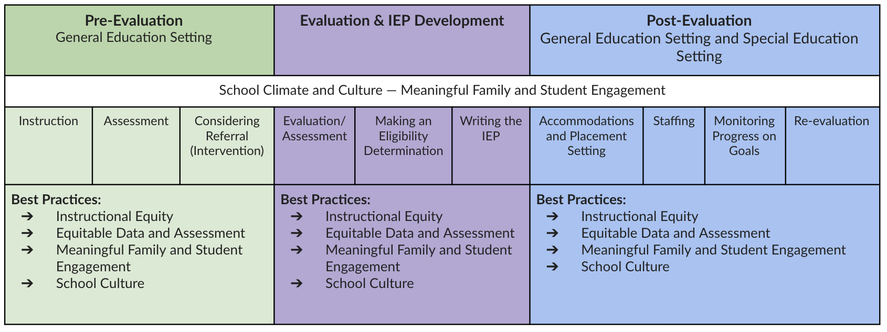
Full special education process

Slide 69
Our theory of improvement
And a good way to do that could be:
If we want to:
Then we must improve:
With:
Create the conditions for improvement of student outcomes
Instructional Equity
Data & Assessment
Best
Practices
Change Ideas
Family Engagement
School Culture

Slide 70
IEP Improvement Playbook will capture teams’ process + outcomes
Full playbook (expected to come out this spring) will look at how early adopter teams:
Established a team to support the improvement process
Critically examined their IEP process from multiple perspectives
Zeroed in on a high-priority focus area for improvement
Defined and tested specific changes to see which ones led to better outcomes
It will also highlight some of the changes teams implemented that show promise

Slide 71
Our theory of improvement
And a good way to do that could be:
If we want to:
Then we must improve:
With:
Create the conditions for improvement of student outcomes
Instructional Equity
Data & Assessment
Best
Practices
Change Ideas
Family Engagement
School Culture
These are the practices that will be featured in the IEP Improvement
Playbook

Slide 72
Change ideas
Important note
These ideas are not intended to be “best practices” for all schools or districts to adopt. Instead, they are starting points that you may want to consider testing–and then adapting or adopting, if they lead to improvement.

Slide 73
Sample promising practices
Data Collection

Slide 74
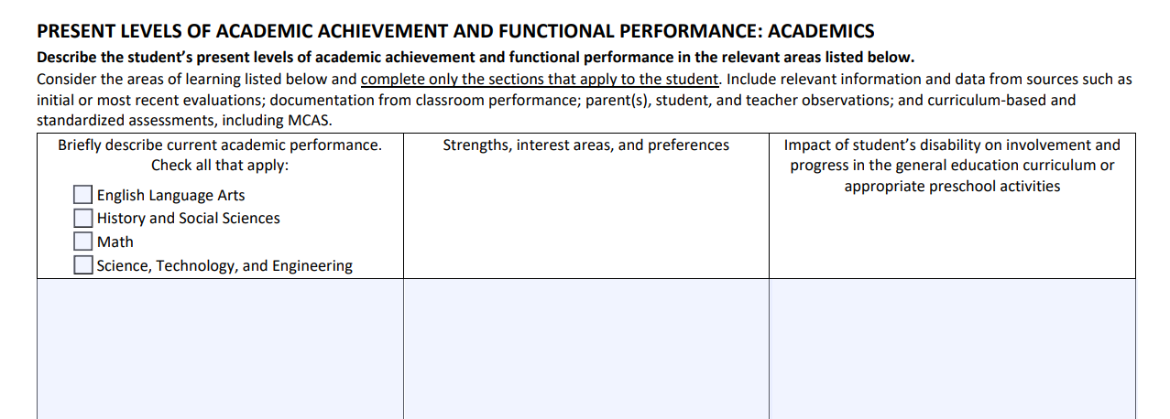
Where does data collection come up in the new IEP forms?
Collecting and sharing data on Present Levels of Academic Achievement and Functional Performance
Academics
Behavioral/Social/Emotional
Communication
Additional Areas

Slide 75
What are some promising practices that can help in this process?
Create staff training modules to build a shared understanding of data collection processes
District B created online training modules to standardize their approach to eligibility determinations for specific learning disabilities (SLDs). The modules included information and resources on how to identify SLDs and how to conduct a thorough and accurate evaluation.
School A created training modules to introduce all staff (including new hires) to standardized data collection practices and protocols and contextualize the role of data collection within the IEP process.

Slide 76
What are some promising practices that can help in this process?
Develop standardized data collection tools and templates to measure student progress across multiple areas
School A provided staff with a universal data collection sheet to record data on academics, social communication, and emotional regulation. The sheet included instructions on who should collect data and how often. Data was stored on shared drives so that all staff who needed it could access it. School A’s data collection toolkit also included a teacher reflection tool to help staff design tiered interventions and IEP goals.

Slide 77
What are some promising practices that can help in this process?
Create a single evaluation report template where all staff participating in IEP evaluations can record their results and recommendations
District D, realizing the opportunity to streamline and standardize how evaluation reports were written, consulted with special education experts to determine what a unified report should look like. The template they produced as a result helped to foster collaboration among staff, creating a shared protocol that served as a foundation for staff conversations and consultations prior to IEP meetings.

Slide 78
Where does data collection come up in the new IEP forms?
Highlighting the student’s vision for the future and incorporating family perspectives into the team vision statement

Slide 79
What are some promising practices that can help in this process?
School C created a student vision tool and parent-guardian vision tool that are completed for every student as part of the IEP process. The school tailored the student vision tool for student use, adding visuals and references to functional living skills. Students are invited to attend IEP meetings to present their vision so that their voice is centered.
The student vision tool prompts students to consider topics like:
Their favorite school subject
What they want to do for fun in the future
What they want to do for work in the future
Where they want to live in the future
Who they want to help them in the future
Create tools for collecting information on student and family vision

Slide 80
Sample promising practices
Family Engagement

Slide 81
Where does family engagement come up in the new IEP forms?
Gathering information on student and family concerns

Slide 82
Where does family engagement come up in the new IEP forms?
Highlighting the student’s vision for the future and incorporating family perspectives into the team vision statement
And throughout the IEP, where teams should be attentive to family questions, suggestions, and concerns

Slide 83
What are some promising practices that can help in this process?
Structure IEP meetings thoughtfully so family members feel welcomed and included rather than overwhelmed
Staff at School F are intentional about how they enter the IEP meeting so families don’t feel overwhelmed. The special education teacher leading the meeting brings staff in gradually so that they can introduce themselves to the family one at a time—typically beginning with the school psychologist, then specialists, then the student’s general education teacher, and ending with the adjustment counselor, who most families already know.

Slide 84
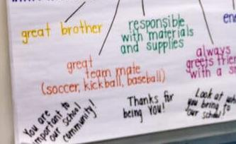
What are some promising practices that can help in this process?
Center student strengths by “strength mapping” during IEP meetings
School F has implemented “strength mapping” in every IEP meeting. The meeting begins with each attendee stating one strength that the student possesses. They record strengths on a poster as a web of attributes surrounding the student’s name and hang the poster on the wall throughout the meeting. They have found that the exercise empowers families at the onset to be active participants throughout the meeting. Families and students love having the strength map to take home, and many students choose to display it in their bedrooms.

Slide 85
What are some promising practices that can help in this process?
If possible, offer pre- and post-IEP meetings to ensure families are comfortable with the process and result
School F holds pre- and post-IEP meetings for families. The pre-meetings run for approximately 15-20 minutes and cover what to expect during the IEP meeting. Post-meetings are longer (generally 30-45 minutes) and include a section-by-section discussion of the student’s IEP so that the family fully understands the services that will be provided. As a result of these meetings, the school has had very few IEPs rejected by families.

Slide 86
What are some promising practices that can help in this process?
Think proactively about how to build relationships with families and convey critical information—including before the evaluation process begins.
School F partnered with their local food pantry. School personnel staffed a table and distributed supplies to families as a means to initiate conversation. The school also established a presence at dinners hosted by their local Boys and Girls Club. This work fostered trust and camaraderie with families.
District E developed a website containing resources informing families about the special education referral process, tiered interventions, and the District Curriculum Accommodation Plan, centralizing resources in one place.

Slide 87
Stay tuned for the full IEP Improvement Playbook, coming later this year!
It will include:
Sample tools and templates
Additional strategies for supporting systemic improvement in IEP processes
A process your school or district can follow to understand and address key challenges

Slide 88
Reflection and next steps

Slide 89
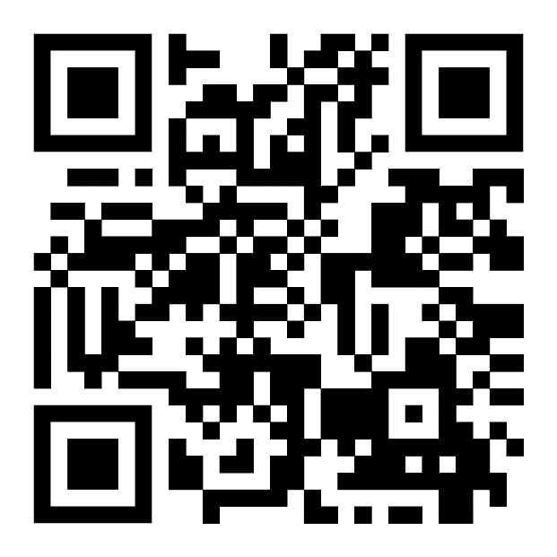
Take time to explore the resources in the Playbook sample section
Thinking about the technical challenges and adaptive opportunities you identified earlier…
What sections or ideas from the Playbook are most helpful in responding to your team’s needs?
What are the next steps to apply these ideas in practice?

Slide 90
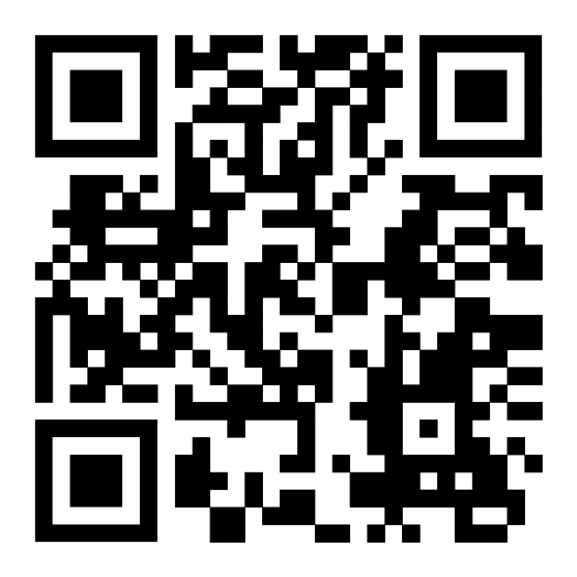
Report out
We want to hear from you!
Use this QR code or click the link on the final page of the Playbook to share your thoughts on your team’s next steps and how the Playbook examples will inform your change process.

Slide 91
Thank you!
For any questions on the IEP Improvement Project or Playbook, feel free to reach out to:
Laura Cinelli
Deputy Director, Rennie Center for Education Research & Policy
lcinelli@renniecenter.org
Ruth Templeton
IEP Implementation Specialist, CAST
rtempleton@cast.org

Slide 92
Lunch

Slide 93
Connections!
30 min
Step | Description of Step
Set the Stage (5 minutes) | The purpose of this activity is to understand the extent to which the IEP is reasonably calculated to improve student outcomes by addressing the student vison, identified needs and corresponding goals and services.
Identify needs, aids, services, and goals (15 minutes) | Using the HS Sample IEP: For each specific student need described within the vision statement, and present level, locate the corresponding aids, services, and/or goals.
Discussion (10 minutes) | As a whole group or in small groups, have participants reflect and discuss. The following are potential questions to consider: To what extent is the student’s current reality and needs clearly identified in the vision, parent concerns, and present level statements? Is it clear that the needs are a result of the child’s disability? To what extent did every need have a clearly aligned service, aid, or program modification and goals? Do you see internal consistency?
Content adapted from PROGRESS Center

Slide 94
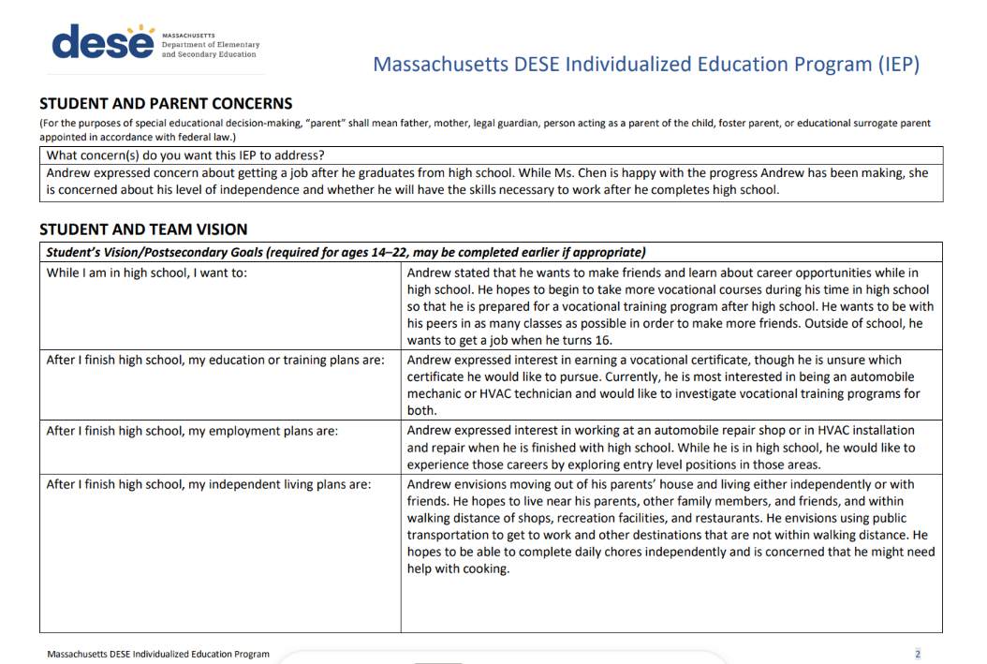
Student and parent concerns

Slide 95
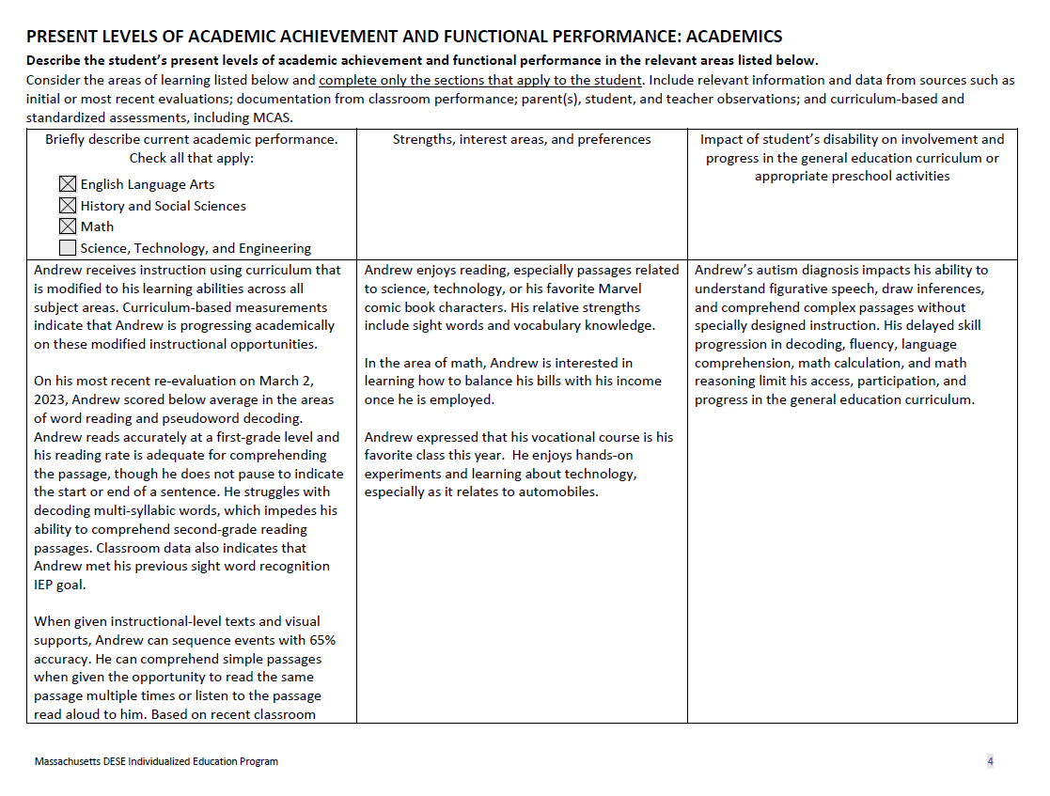
Present levels of academic achievement and functional performance: academics

Slide 96
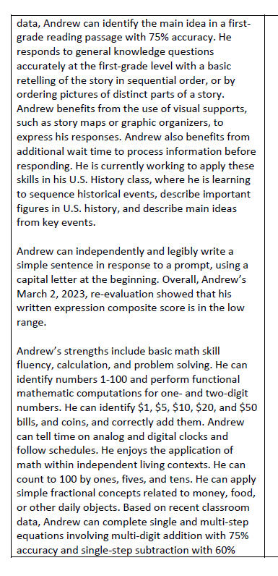
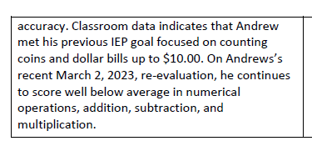
Sample iep

Slide 97
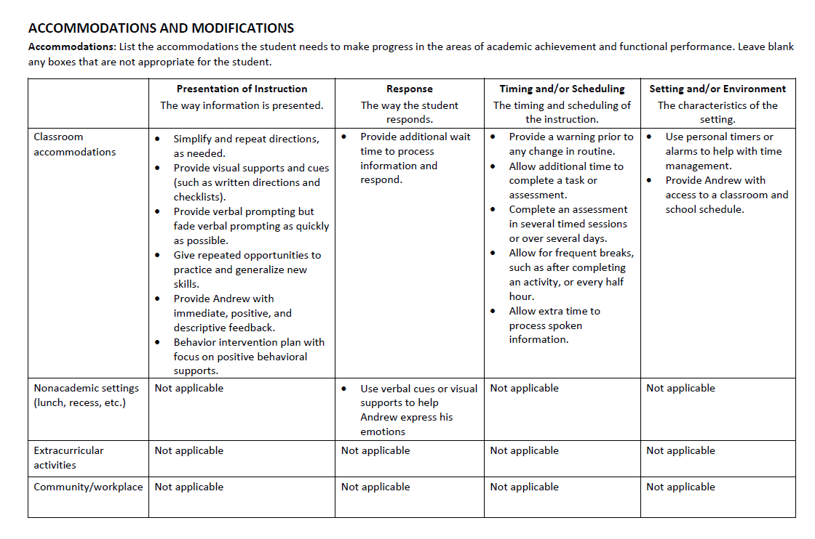
Accommodations and modifications

Slide 98
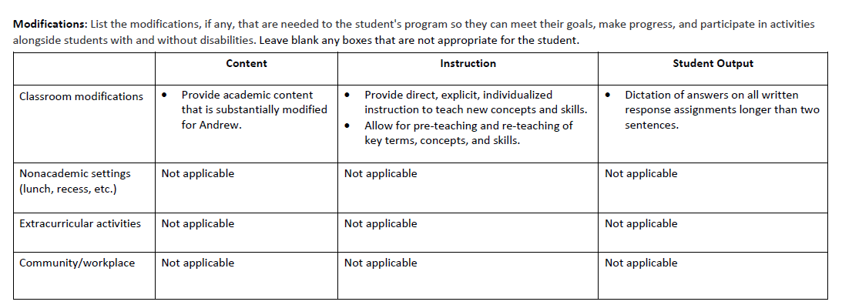
modifications

Slide 99
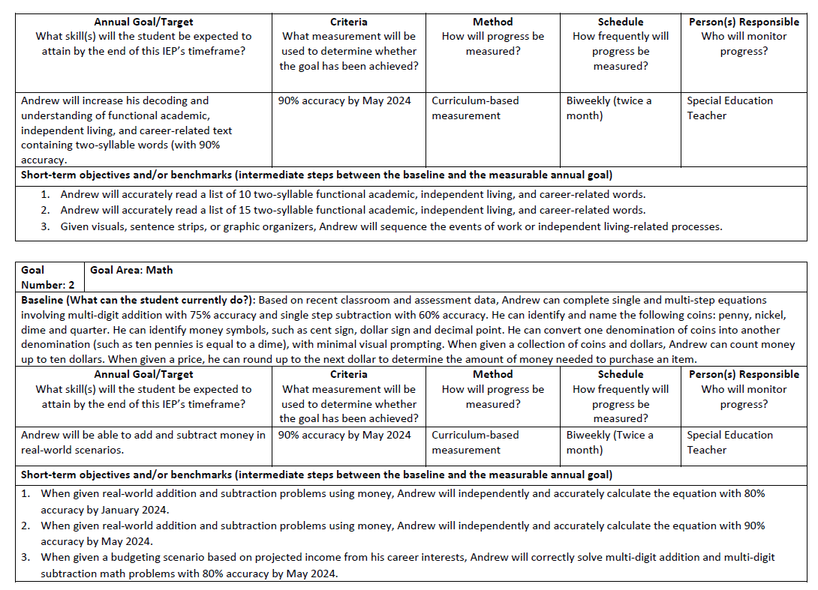
criteria

Slide 100
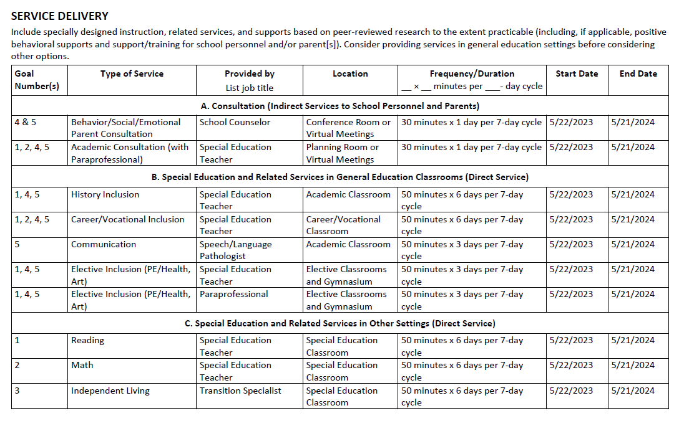
Service delivery

Slide 101
Connections! (Discussion)
To what extent is the student’s current reality and needs clearly identified in the vision, parent concerns, and present level statements?
Is it clear that the needs are a result of the child’s disability?
To what extent did every need have a clearly aligned service, aid, or program modification and goals? Do you see internal consistency?
What practices or systems will need to change to ensure internally consistent IEPs that will lead to increased outcomes for students with disabilities?

Slide 102
Next Steps & Action Planning
Notes:
The remainder of these slides may not be relevant for all training audiences and are primarily designed to support trainers and systems level teams to successfully implement adaptive change that results in effective and efficient collaboration between general educators, special educators, related service providers, parents, and students to support students eligible for special education.

Slide 103
Action Planning

Slide 104
Action Planning Template
Determine District-Level Training and Implementation Team
Develop Communication Plan
Develop a Training Plan for School-Level Teams
Customize Training Materials
Train Existing and New Staff on New IEP Forms and Development
Develop Roll-out Plan
Monitor Progress of School-level Teams’ Early Adoption Experiences
Notes:
This document is designed as a tool to help you develop a plan for successful adoption of the new IEP forms in your district / organization. We have put some sample language here around goals and action steps, but teams are encouraged to modify this form as needed to build a comprehensive roll-out plan for your setting. This is a tool/plan for your internal purposes only, and there is no obligation or expectation to share this plan with DESE.

Slide 105
Action Planning 2
Please return at 3:30 PM and be ready to share a few highlights.

Slide 106
Share Out – Sailboat Retrospective
The wind blowing represents the strengths of the team.
The island or shore that represents the goals or visions of the team.
The anchor represents the things holding the team back or delaying progress (areas of weakness, etc.).
Notes:
Independent reflection: What stands out for you as either wind, island/shore, or anchors for your team and local context? (3 minutes)
Now, find someone that you don’t know. Introduce yourself and your setting, and then share about at least one wind, shore, or anchor that you’re bringing with you on your journey.

Slide 107
Wrap Up & Evaluation

Slide 108
Evaluation Form
Please take 5 minutes to provide feedback on this Symposium!
All Feedback is Anonymous
Feedback will be used to inform future training and resources
https://www.research.net/r/DESE-ToT-23
Notes:
https://www.research.net/r/DESE-ToT

Slide 109
Additional Questions?
For questions specific to the IEP Improvement Project and/or IEP Form(s), please email
specialeducation@doe.mass.edu

Slide 110
Thank You

