Slide 1
Special Education LEA Determinations
March 22, 2024

Slide 2


DESE’s Educational Vision
All students in Massachusetts, particularly students from historically underserved groups and communities, will have equitable opportunities to excel in all content areas across all grades.
Culturally and linguistically sustaining classroom and school practices will support students to thrive by creating affirming environments where students have a sense of belonging, engage in deeper learning, and are held to high expectations with targeted support.
All students are known and valued
Learning experiences are relevant, real-world, and interactive
Individual supports enable students to excel at grade-level (or beyond)

Slide 3
Webinar
Objectives
Understand the calculations used to make the special education determinations
Identify appropriate DESE office to assist with questions related to the determinations
Understand fiscal implementation of special education determinations
Integrate data from the special education determinations in school and district improvement planning
Become familiar with various frameworks and evidenced-based practices for improvement planning

Slide 4
Special Education Accountability and Assistance – The Big Picture

Slide 5
States must have a reasonably designed system of general supervision – an accountability and support system – that monitors local education agencies (LEAs) and assists LEAs to implement the Individuals with Disabilities Education Act (IDEA).
Primary focus:
Educational Results
Functional Outcomes

Slide 6
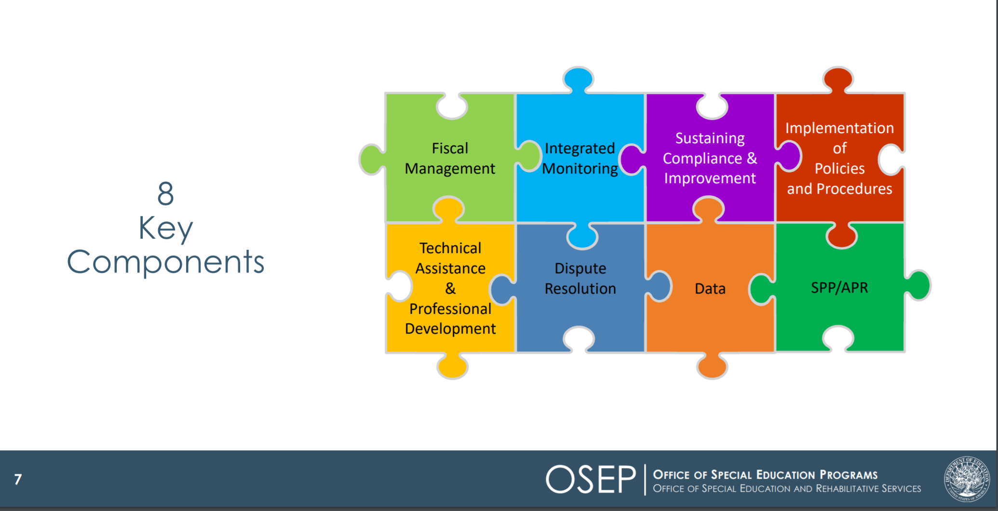
Components of General Supervision

Slide 7
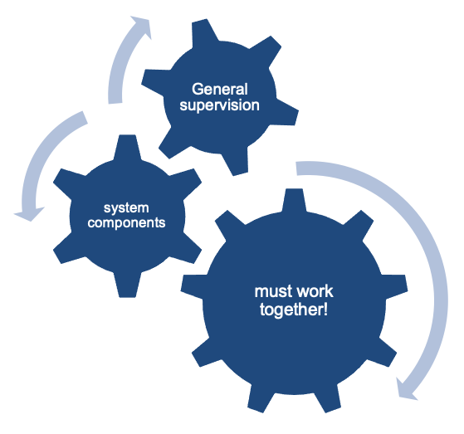
Coherence Matters!
Imagine a general supervision system as a sophisticated machine comprised of many interlocking gears that all must operate in concert to produce the desired outcomes.

Slide 8
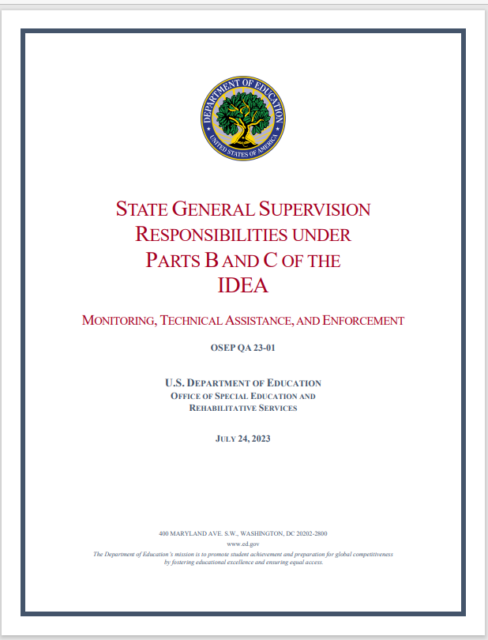
General Supervision Guidance

Slide 9
LEA Determinations
Under the federal Individuals with Disabilities Education Act (IDEA), the Department must make annual determinations regarding LEA’s specific needs for technical assistance or intervention in special education. Massachusetts does so based on four categories:
Meets Requirements (MR)
Needs Assistance (NA)
Needs Intervention (NI)
Needs Substantial Intervention (NSI)

Slide 10
Question D-1: When making LEA determinations, must States use the same categories that OSEP uses with States?
States must use the same four determination categories that OSEP is required to use with States: meets requirements, needs assistance, needs intervention, and needs substantial intervention.

Slide 11
Understanding Determination Calculations

Slide 12
Question D-2: What factors must a State consider when making annual determinations?
A State must consider the following factors:
(1) performance on compliance indicators;
(2) valid and reliable data;
(3) correction of identified noncompliance; and
(4) other data available to the State about the LEA’s compliance with IDEA, including any relevant audit findings.

Slide 13
How did the Department Make the 2023-2024 Determinations?
Assessed LEAs’ performance and compliance data, including data from the general Accountability and Assistance System, Tiered Focused Monitoring process, State complaints, State Performance Plan/Annual Performance Reports, and other data available to the State about the LEA’s compliance with IDEA.
Changes were made to the rubric this year to align it with the U.S. Department of Education’s Office of Special Education and Rehabilitative Services Memo 23-01: State General Supervision Responsibilities Under Parts B and C of the IDEA.

Slide 14
LEA Determination Rubric Categories
 | Performance |  |  |  | Compliance
Points | Annual Dropout Rate (2022) | 5-Year Cohort Graduation Rate (2021) Points x1.5 | Special Education State Performance Plan/Annual Performance Report (SPP/APR) Indicator 3 (2023) | Special Education State Performance Plan/Annual Performance Report (SPP/APR) Indicators 5 & 6 (SY2022-2023) Points x2 | Special Education State Performance Plan/Annual Performance Report (SPP/APR) Indicators 4B, 9, & 10 (SY2021-2022) | Special Education State Performance Plan/Annual Performance Report (SPP/APR) Indicators 11, 12, & 13 (SY2022-2023) | Identification of Noncompliance # of Findings (PSM/PRS) (SY2022-2023) | Timely Submission/ Verified Correction of Non-Compliance (SY2022-2023)
Notes:
https://www.doe.mass.edu/sped/spp/maspp.html

Slide 15
Special Education Determination Rubric - 1
Determinations are made using the following eight measures:
Special Education Performance
    Annual Dropout Rate (2022)
    5-Year Cohort Graduation Rate (2021)
    Special Education SPP/APR Performance Indicator 3D (SY2022-2023)
    Special Education SPP/APR Performance Indicators (5 & 6) (SY2022-2023)
Special Education Compliance
    Special Education SPP/APR Compliance Indicators (4B, 9, & 10) (SY2021-2022)
    Special Education SPP/APR Compliance Indicators (11, 12, & 13) (SY2022-2023)
    Identification of Non-Compliance (SY2022-2023)
    Timely Submission/Verified Correction of Non-Compliance (SY2022-2023)
    Bolded text indicates new or revised measures from previous year.

Slide 16
Question B-4: What does the State’s “identification of noncompliance” mean?
Identification of noncompliance (i.e., a finding) means the determination by a State that an LEA’s policy, procedure, or practice, including those that are child-specific, is inconsistent with an applicable IDEA requirement, another IDEA-related Federal requirement, or any specific IDEA grant award terms or conditions.
This includes requirements related to GEPA, under EDGAR, and the OMB Uniform Guidance.

Slide 17
Question B-5: How must a State notify LEAs or providers of any identified noncompliance?
The State must inform LEAs in writing of any identified noncompliance to provide notice.

Slide 18
Question B-10: What is the standard for correction of noncompliance?
In order to demonstrate that noncompliance has been corrected, the State must verify that the LEA:
  (1) Is correctly implementing the specific regulatory requirements (i.e., achieved 100 percent compliance with the relevant IDEA requirements) based on a review of updated data and information, such as data and information subsequently collected through integrated monitoring activities or the State’s data system (systemic compliance); and
  (2) Has corrected each individual case of child-specific noncompliance.

Slide 19
Question B-13: What is the timeline for correcting noncompliance under the IDEA?
To correct noncompliance as soon as possible, but no later than one year after the State’s written notification of noncompliance.

Slide 20
Special Education Determination Rubric - 2
Points are assigned based on each district’s performance on each of the measures
 | Performance |  |  |  | Compliance
 | Annual Dropout Rate (2022) | 5-Year Cohort Graduation Rate (2021) Points x1.5 | Special Education State Performance Plan/Annual Performance Report (SPP/APR) Indicator 3 (2023) | Special Education State Performance Plan/Annual Performance Report (SPP/APR) Indicators 5 & 6 (SY2022-2023) Points x2 | Special Education State Performance Plan/Annual Performance Report (SPP/APR) Indicators 4B, 9, & 10 (SY2021-2022) | Special Education State Performance Plan/Annual Performance Report (SPP/APR) Indicators 11, 12, & 13 (SY2022-2023) | Identification of Non-Compliance # of Findings (PSM/PRS) (SY2022-2023) | Timely Submission/ Verified Correction of Non-Compliance (SY2022-2023)
4 | Annual dropout rate for students with disabilities at or below the state’s all students rate (2.1%) | 5-year cohort graduation rate for students with disabilities at or above the state’s all students rate (91.8%) | Gap equal to or below state goal (29 percentage points) | Combined full inclusion rate of 75.0% or higher for students ages 3-21 | No compliance findings | All Indicators compliance percentages at or above 95.0% | Less than 1.0 findings of special education noncompliance (per 1000 SWD) | All findings of noncompliance have been corrected or submitted in a timely manner (per 1000 SWD)
3 | Annual dropout rate for students with disabilities at or below the state’s students with disabilities rate (3.4%), but above the state’s all students rate (2.1%) | 5-year cohort graduation rate for students with disabilities at or above the state’s students with disabilities rate (80.6%), but below the state’s all students rate (91.8%) | Gap above state goal (29 percentage points), but below 50th percentile (32 percentage points) | Combined full inclusion rate from 50.0% to 74.9% for students ages 3-21 | At Risk for any 1 indicator (4b, 9, 10). All others must be labelled No Status | Any one Indicator compliance percentage from 75.0% to 94.9% | 1.0-2.9 findings of special education noncompliance (per 1000 SWD) | 0.1 to 1.0 findings of noncompliance not resolved within 1 year or not submitted in a timely manner (per 1000 SWD)

Slide 21
Special Education Determination Rubric - 3
Points are assigned based on each district’s performance on each of the measures
 | Annual Dropout Rate (2022) | 5-Year Cohort Graduation Rate (2021) Points x1.5 | Special Education State Performance Plan/Annual Performance Report (SPP/APR) Indicator 3 (2023) | Special Education State Performance Plan/Annual Performance Report (SPP/APR) Indicators 5 & 6 (SY2022-2023) Points x2 | Special Education State Performance Plan/Annual Performance Report (SPP/APR) Indicators 4B, 9, & 10 (SY2021-2022) | Special Education State Performance Plan/Annual Performance Report (SPP/APR) Indicators 11, 12, & 13 (SY2022-2023) | Identification of Non-Compliance # of Findings (PSM/PRS) (SY2022-2023) | Timely Submission/ Verified Correction of Noncompliance (SY2022-2023)
2 | Annual dropout rate for students with disabilities from 3.5% to 5.9% | 5-year cohort graduation rate for students with disabilities from 66.7% to 80.5% | Gap equal to or above 50th percentile (32 percentage points) but below 75th percentile (40 percentage points) | Combined full inclusion rate from 35.0% to 49.9% for students ages 3-21 | Identified for any 1 indicator | Any one Indicator compliance percentage from 55.0% to 74.9% | 3.0-3.9 findings of special education noncompliance (per 1000 SWD) | 1.1 to 2.0 findings of noncompliance not resolved within 1 year or not submitted in a timely manner (per 1000 SWD)
1 | Annual dropout rate for students with disabilities of 6.0% or higher | 5-year cohort graduation rate for students with disabilities below 66.7% | Gap equal to or above 75th percentile (40 percentage points) | Combined full inclusion rate below 35.0% for students ages 3-21 | Identified for 2 or more indicators | Any one Indicator compliance percentage below 55.0% | 4.0 or more findings of special education noncompliance (per 1000 SWD) | 2.1 or more findings of noncompliance not resolved within 1 year or not submitted in a timely manner (per 1000 SWD)

Slide 22
Calculation
Sum of Points Earned across all Categories with Reportable Data | = | Special Education Determination Percentage
Total Number of Possible Points in Categories with Reportable Data
Meets Requirements (MR) | Needs Assistance (NA) | Needs Intervention (NI) | Needs Substantial Intervention (NSI)
LEA determination percentage 75.0 – 100.0 | LEA determination percentage 65.0 – 74.9 | LEA determination percentage 0 – 64.9 | A substantial failure to comply with a condition of LEA eligibility under Part B of the IDEA (300.200-300.213)

Slide 23
Identification and Correction of Non-Compliance

Slide 24
Number of Findings
Point values based on 2022-2023 special education findings of non-compliance from both PSM and PRS
Identification of Noncompliance # of Findings | Point Value
Less than 1.0 finding (per 1000 SWD) | 4
1.0-2.9 findings (per 1000 SWD) | 3
3.0-3.9 findings (per 1000 SWD) | 2
4.0 or more findings (per 1000 SWD) | 1

Slide 25
What is PRS?
PRS Mission Statement
The Problem Resolution System (PRS) Office provides students, families, school districts, and other community members with easy access to information regarding students' rights and educational options and access to a forum for the resolution of disputes that is prompt, accurate and fair.

Slide 26
Key Governing Authority
Special Education Complaints: Federal regulation requires each state education agency to maintain a state complaint process to investigate complaints filed alleging a violation of the Individuals with Disabilities Education Act, Part B. (34 C.F.R. §§ 300.151 - 300.153)
General Education Complaints: State regulation requires PRS to investigate complaints and enforce compliance with the Department’s special education regulations, as well as with other statutes and regulations relating to the provision of publicly funded education. (603 CMR 28.08(2))

Slide 27
What Types of Issues Might PRS Address?
504
Approved Special Education Schools
Bullying
Career & Vocational Technical Education
Diploma/Graduation Disputes
Discipline
English Learners
Free Appropriate Public Education and Appropriateness of Special Education Services
Home Hospital Services
Language Access Services
Learning Time Requirements
METCO
Provision of Student Records
Residency/Admissions/Enrollment
Restraint and Time Out Procedures and Reporting
School Facilities/Accessibility
Special Education Implementation
Special Education Procedures
Student Fees
Transportation

Slide 28
34 CFR § 300.152 - Minimum State Complaint Procedures
(a) Time limit; minimum procedures. Each SEA must include in its complaint procedures a time limit of 60 days after a complaint is filed under § 300.153 to—
  (1) Carry out an independent on-site investigation, if the SEA determines that an investigation is necessary;
  (2) Give the complainant the opportunity to submit additional information, either orally or in writing, about the allegations in the complaint;
  (3) Provide the public agency with the opportunity to respond to the complaint, including, at a minimum—
    (i) At the discretion of the public agency, a proposal to resolve the complaint; and
    (ii) An opportunity for a parent who has filed a complaint and the public agency to voluntarily engage in mediation consistent with § 300.506;
  (4) Review all relevant information and make an independent determination as to whether the public agency is violating a requirement of Part B of the Act or of this part; and
  (5) Issue a written decision to the complainant that addresses each allegation in the complaint and contains—
    (i) Findings of fact and conclusions; and
    (ii) The reasons for the SEA's final decision.

Slide 29
Contacting PRS
Problem Resolution System Office
Massachusetts Department of Elementary and Secondary Education
135 Santilli Highway - Everett, MA 02149
Main Telephone: 781-338-3700
TTY: N.E.T. Relay: 1-800-439-2370
Fax: 781-338-3710
Email: compliance@doe.mass.edu
http://www.doe.mass.edu/prs/
Barry Barnett, Director
Kelsey LoDuca-Towne, Assistant Director

Slide 30
Public School Monitoring
Rubric calculation includes:
  Number of findings of special education noncompliance from the 2022-2023 Tiered Focused Monitoring Review
  Special education noncompliance not resolved within one year
Public School Tiered Focused Monitoring Reports:
https://www.doe.mass.edu/psm/tfm/reports/
Contact PSM

Slide 31
Data Resources
Measure | Resources/Reports
Annual Dropout Rate | Profiles: https://profiles.doe.mass.edu/statereport/dropout.aspx Security Portal: Dropout Data Summary Report
Graduation Rate | Profiles: https://profiles.doe.mass.edu/statereport/gradrates.aspx Security Portal: Graduation Rate Reports
SPP/APR Performance (3) – Grade 8 Reading Gap in Proficiency Rates | Profiles: https://profiles.doe.mass.edu/statereport/nextgenmcas.aspx Security Portal: Assessment – Achievement Analysis
SPP/APR Performance (5, & 6) | 3-21 LRE rate is calculated by DESE specifically for these determinations Indicator 5: SIMS element DOE034 – 10 Indicator 6: SIMS elements DOE032 – 31 & 34
SPP/APR Compliance (4B, 9, & 10) | Flagged and Identified Districts have data emailed to the Superintendent and Special Education Director Publicly reporting on LEA status: https://profiles.doe.mass.edu/statereport/special_education.aspx
SPP/APR Compliance (11-13) | Indicators 11-13 data are submitted to the Department using the Web Based Monitoring System (WBMS) when a district goes through Group A of the TFM.
Identification of Non-Compliance and Timely Submission/Verified Correction of Non-Compliance | Public School Tiered Focused Monitoring Reports: https://www.doe.mass.edu/psm/tfm/reports/ PRS Specialist Assignments: https://www.doe.mass.edu/prs/specialist.html

Slide 32
Who do I Contact with Additional Data Questions?
Frequently Asked Questions can be found at https://www.doe.mass.edu/sped/osep/determinations-faq.docx.
Other general questions about Special Education Determinations should be sent to specialeducation@doe.mass.edu.
Measure | Resources/Reports
Annual Dropout Rate Graduation Rate | data@doe.mass.edu
SPP/APR Performance (3) | mcas@mass.gov
SPP/APR Performance (5, & 6) | specialeducation@doe.mass.edu
SPP/APR Compliance (4B, 9, & 10) | specialeducation@doe.mass.edu
SPP/APR Compliance (11, 12, & 13) | specialeducation@doe.mass.edu
Public School Monitoring Compliance | https://www.doe.mass.edu/psm/contact-info.html
Problem Resolution System Complaints | https://www.doe.mass.edu/prs/specialist.html

Slide 33
Maintenance of Effort (MOE)

Slide 34
Special Education Determinations and MOE ….
MOE is required for all LEAs
Any LEA receiving IDEA Part B funds must budget and spend at least the same amount of local or state and local funds for the education of children with disabilities on a year-to-year basis
Ways to Meet MOE
  The law gives LEAs 4 options to demonstrate they have met MOE:
    Local funds only*,
    Combination of State and local funds in the aggregate,
    Local funds on a per capita (e.g., per child with disability) basis,* or
    Combination of State and local funds on a per capita basis.

Slide 35
Special Considerations for MOE
Please note that most Massachusetts LEAs can use only methods:
  2. Total amount of state and local funds in the aggregate and
  4. Per capita amount of state and local funds.
In Massachusetts, we cannot separate out Chapter 70 state aid and funding from the local tax base because Chapter 70 goes into a community’s General Fund and therefore loses its identity as State funds when appropriated to the school department.
The only true State funds are Circuit Breaker funds.

Slide 36
Special Education Determinations and MOE
2 Parts to MOE
Eligibility standard – MOE levels for budgeting (Collected in the IDEA Consolidated Grant Application)
Compliance standard – MOE levels for spending (Collected in the End of Year Financial Report)

Slide 37
Eligibility Standard – MOE levels for budgeting (Collected in the IDEA Consolidated Grant Application)
For purposes of establishing the LEA's eligibility for a fiscal year, the LEA must budget for the education of children with disabilities, at least the same amount, from at least one of the following sources, as the LEA spent for that purpose from the same source for the most recent fiscal year for which information is available:
(1) local funds only; (2) the combination of of State and local funds in the aggregate; or (3) local funds only on a per capita basis; or (4) the combination of State and local funds on a per capita basis. See 34 CFR §300.203(a)(1).
Using the budgeted amounts to meet MOE that the LEA reports on the IDEA Consolidated Application DESE will determine the LEA’s eligibility for IDEA funding.
It is important that the LEA demonstrates compliance with the eligibility standard and if not, indicates on the grant application the reason for not meeting the eligibility standard.

Slide 38
Compliance Standard – MOE levels for spending (Collected in the End of Year Financial Report)
An LEA meets the compliance standard if it does not reduce the level of expenditures for the education of children with disabilities made by the LEA from the State and/or local sources from the level of expenditures from the same State and/or local sources for the preceding fiscal year, except as provided in §§ 300.204 (exceptions) and 300.205 (adjustments). 34 CFR eCFR :: 34 CFR 300.204 -- Exception to maintenance of effort.300.203(b)

Slide 39
Exceptions to MOE
Allowable exceptions are those due to:
  a) voluntary or for-cause departure of special education staff,
  b) decrease in enrollment of IDEA eligible children,
  c) termination of an exceptionally costly program for a particular child, under certain circumstances,
  d) termination of costly expenditures for long-term purchases, and
  e) assumption of cost by DESEs high-cost fund
  34 CFR 300.204
*Exceptions are allowed for all LEAs regardless of determination level.

Slide 40
Adjustments to MOE
Allowable adjustment:
  An LEA may:
  reduce its MOE obligation by up to 50 percent of any increase over the preceding year in its IDEA Part B Section 611 allocation (fund code 240) 34 CFR § 300.205 -- Adjustment to local fiscal efforts in certain fiscal years.
  Voluntarily use up to 15 percent of IDEA Part B Sections 611 and 619 funds (fund codes 240 and 262) to provide coordinated early intervening services (CEIS) or a combination of both.
*Adjustments can ONLY be used if the LEA has a special education determination level of ‘Meets Requirements’

Slide 41
Fiscal Review and Consequences for Failing to Meet MOE: Eligibility Standard
Eligibility Standard
An LEA is not eligible to receive IDEA Part B funds until it has met the MOE eligibility (i.e., budget) standard.
The LEA will be contacted by DESE to resolve MOE eligibility non-compliance based on review of the LEAs’ IDEA consolidated application and allowable exceptions.

Slide 42
Fiscal Review and Consequences for Failing to Meet MOE: Compliance Standard
Compliance Standard
If DESE determines following a review of EOY reports that an LEA failed to meet its MOE compliance (i.e., expenditure) standard and there are no acceptable reasons to allow reduction of MOE, the LEA must repay either the difference between what the LEA actually spent, and what it should have spent to meet the MOE requirement, or the amount of the LEA’s Part B subgrant for that fiscal year, whichever is less.

Slide 43
Resources for MOE
DESE LEA MOE Quick Reference Guide
CIFR LEA MOE Calculator
CIFR LEA MOE Organizer
34 CFR §300.203
34 CFR §300.204
34 CFR §300.205

Slide 44
Closing Gaps, Planning, and Next Steps

Slide 45
Districts Assigned as NA, NI, or NSI
Targeted and technical assistance related to special education
Coordinated assistance and intervention are available from multiple offices including, the Special Education Planning and Policy office (SEPP), Office of Public School Monitoring (PSM), Statewide System of Support (SSOS), Office of School Turnaround (OST), and Office of Charter Schools & School Redesign (CSSRD)
Assistance is tailored to meet an LEA’s needs, depending on the reasons for which an LEA was identified as needing technical assistance or intervention
The Department will communicate directly with LEAs about this assistance and intervention

Slide 46
Requirements for NA Districts
Engagement with SSOS, OST, or CSSRD; and/or
Engagement with PSM to address identified noncompliance or as part of Tiered Focused Monitoring activities; and/or
Engagement with SEPP and/or other Department offices to address other special education compliance and performance issues; and/or
Prohibited from using the flexibility available under the Maintenance of Effort provisions of IDEA.
Note- LEAs with this determination are encouraged to engage in improvement activities to address areas of need as identified by the data used in the determination.

Slide 47

Requirements for NI Districts
Engagement with SSOS, OST, or CSSRD; and/or PSM and SEPP.
Prohibited from using the flexibility available under the Maintenance of Effort (MOE) provisions of IDEA
Participation in required technical assistance activities (webinar)
Use of a portion of IDEA funds for the improvement of performance issues identified through the LEA determination system, i.e., Making Money Matter (M³)
Improvement activities coordinated by a LEA determination liaison including:
  Reviewing the district’s special education related data
  Development of a plan for providing targeted and technical assistance for special education
  Development of an improvement plan that includes root cause analysis
  Regular meetings/contact with a LEA determination liaison

Slide 48
Closing the Gaps and Improvement Planning

Slide 49




Closing the Gaps: What does the Research Show?
In schools where the general education population is successful, all students are more likely to do well.
Unequal access to high-quality core instruction beginning in early childhood and early elementary may be one reason for a system to identify some children as in need of special education services and subsequently place them in separate classrooms.
All students can benefit from evidence-based core instructional practices.
The achievement of PreK-12 students with disabilities and that of their general education peers is tightly linked.
O’Hara, N., Munk, T.E., Reynolds, H., and Collins, T. (2021, August). Success Gaps Toolkit: Addressing Equity, Inclusion, and Opportunity. IDEA Data Center. Rockville, MD: Westat.

Slide 50

What is a Gap?
Gaps may be in any outcome differences between groups of students
These poor outcomes may include the following:
  increased dropout and lower graduation rates;
  lack of achievement in reading or math;
  decreased postschool outcomes such as employment rates and college completion;
  increased likelihood of disciplinary actions;
  increased likelihood of identification of a disability;
  increased more-restrictive placements.
  Success Gaps Toolkit: Addressing Equity, Inclusion, and Opportunity. Handbook, page 9

Slide 51
Overarching Framework for Data Analysis
Gaps are not about an individual child or a group of children’s failure to perform.
Rather, work should center on the structural components of education (and other) systems that may have failed to provide equitable opportunities for some groups of students.
Specifically, using LEA data districts or schools should examine the differences in:
  opportunities that the group of students with disabilities identified with a success gap (e.g., children who are migrant, Black children, Hispanic/Latinx children) have experienced, and
  the outcome area where the gap is occurring (e.g., graduation rates, reducing suspensions, mathematics proficiency, or special education disproportionality).
Success Gaps Toolkit: Addressing Equity, Inclusion, and Opportunity. Handbook, page 13

Slide 52
Target Areas for Analysis & Improvement Planning
Categories with LEA data in rows 1 and 2 of the rubric.
 | Annual Dropout Rate (2022) | 5-Year Cohort Graduation Rate (2021) Points x1.5 | Special Education State Performance Plan/Annual Performance Report (SPP/APR) Indicator 3 (2023) | Special Education State Performance Plan/Annual Performance Report (SPP/APR) Indicators 5 & 6 (SY2022-2023) Points x2 | Special Education State Performance Plan/Annual Performance Report (SPP/APR) Indicators 4B, 9, & 10 (SY2021-2022) | Special Education State Performance Plan/Annual Performance Report (SPP/APR) Indicators 11, 12, & 13 (SY2022-2023) | Identification of Non-Compliance # of Findings (PSM/PRS) (SY2022-2023) | Timely Submission/ Verified Correction of Noncompliance (SY2022-2023)
2 | Annual dropout rate for students with disabilities from 3.5% to 5.9% | 5-year cohort graduation rate for students with disabilities from 66.7% to 80.5% | Gap equal to or above 50th percentile (32 percentage points) but below 75th percentile (40 percentage points) | Combined full inclusion rate from 35.0% to 49.9% for students ages 3-21 | Identified for any 1 indicator | Any one Indicator compliance percentage from 55.0% to 74.9% | 3.0-3.9 findings of special education noncompliance (per 1000 SWD) | 1.1 to 2.0 findings of noncompliance not resolved within 1 year or not submitted in a timely manner (per 1000 SWD)
1 | Annual dropout rate for students with disabilities of 6.0% or higher | 5-year cohort graduation rate for students with disabilities below 66.7% | Gap equal to or above 75th percentile (40 percentage points) | Combined full inclusion rate below 35.0% for students ages 3-21 | Identified for 2 or more indicators | Any one Indicator compliance percentage below 55.0% | 4.0 or more findings of special education noncompliance (per 1000 SWD) | 2.1 or more findings of noncompliance not resolved within 1 year or not submitted in a timely manner (per 1000 SWD)

Slide 53
Three Goals for Engaging in Closing Gaps
Use data and evidence to:
discover the root cause of the prioritized success gap(s);
fully understand how to address, compensate, or learn from any underlying issues within the root cause; and
apply what is learned from this analysis to systematically prevent future issues.
Success Gaps Toolkit: Addressing Equity, Inclusion, and Opportunity. Handbook, page 5

Slide 54
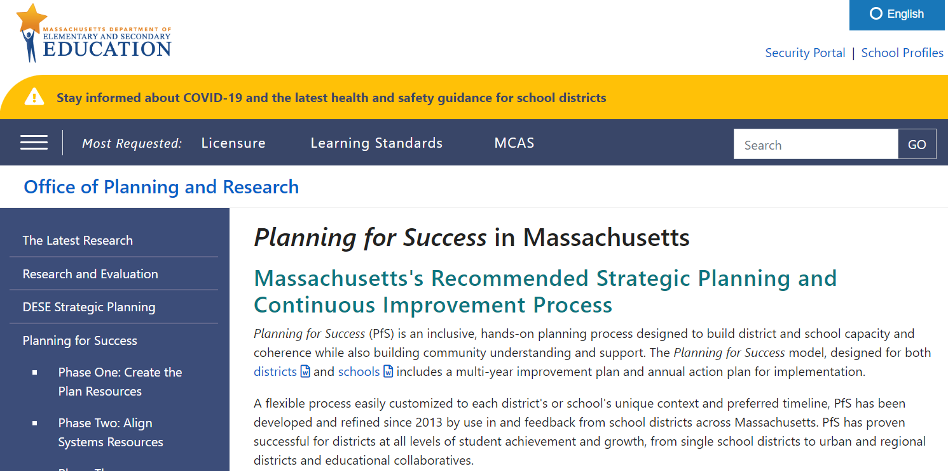
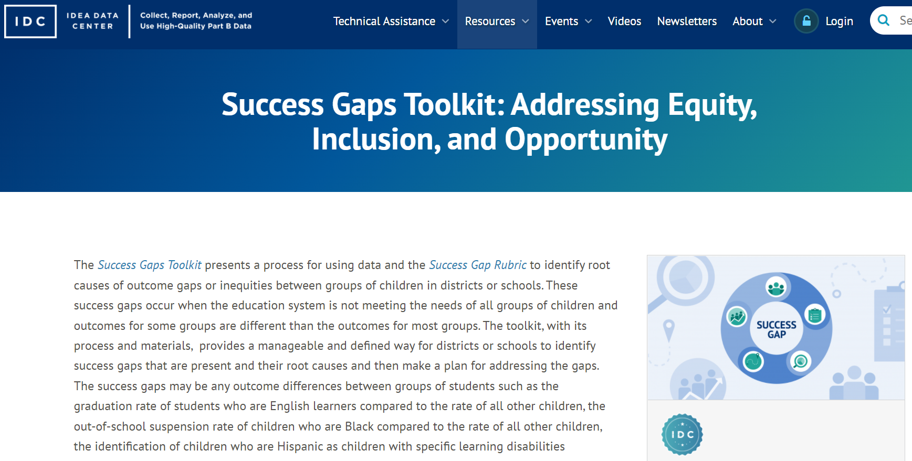
Research-based Planning Framework
Identification and use of a research-based planning framework that includes process benchmarks is required.
For example:
  Planning for Success in Massachusetts
  Success Gaps Toolkit: Addressing Equity, Inclusion, and Opportunity

Slide 55
Essential Elements of Improvement Planning
1. Data-based Decision Making
2. Cultural Responsiveness
3. Core Instructional Program
4. Ongoing assessment - Universal Screening and Progress Monitoring
5. Evidenced-Based Instructional and Positive Behavioral Interventions and Supports
6. District/School Leadership that Facilitates Improvement
7. Parent/Family Engagement throughout the Educational Process and System
Success Gaps Toolkit: Addressing Equity, Inclusion, and Opportunity. Handbook, page 9-13

Slide 56

If you don’t know where you’re going,
you might not get there.
-- Yogi Berra

Slide 57
Ensuring Diverse Perspectives: Stakeholder Engagement
How can we design an inclusive and equitable planning process that creates a shared vision for all students while strengthening community understanding and support?
Consider:
  What visioning protocol will you use?
  What are culturally responsive ways to outreach to the communities you serve?
  When and where will you conduct visioning sessions for various stakeholder groups?
  How will you ensure the engagement of stakeholder voices that are less often heard?

Slide 58
Foundations for Action Planning
Synthesize root cause data & stakeholder feedback to
identify common themes:
  Analyze feedback
  Identify common themes and key outliers
  Explore connections to root causes
  Share back to the community

Slide 59
Develop an action plan that addresses actionable root cause(s).
Describe in detail:
  Goals (SMART)
  Tasks
  Timelines
  Plan for evaluation
PfS Resources: |  | Success Gaps Toolkit:
Identifying Strategic Objectives and Initiatives Selecting Evidence-Based Practices and Programs Selecting Outcome Measures and Setting Targets Resource Mapping Aligning Systems |  | Video: Create an Action Plan PowerPoint: Create an Action Plan Facilitation Agenda: Create an Action Plan Equity Team Meeting Agenda: Create an Action Plan
And/Or

Slide 60
Additional Resources: Developing an Action Plan
PfS Plan Template
Template for Success Gap Action Plan
PfS Strategic Objective/Strategic Initiative Organizer
PfS Outcomes Worksheet
PfS Quality Review Feedback Form
Resource Mapping Worksheet

Slide 61

Fiscal Considerations to Serve Your Students Better
Making Money Matter ($M^{3}$)
Coordinated Early Intervening Services (CEIS)
At least 2% of IDEA set aside required for systemic improvements at LEAs with Needs Intervention Special Education Determination
Supports systemic activities and strategic planning, such as data collection, root cause analysis, action planning, & implementation of systemic interventions, with emphasis on equity, gap closing, and culturally responsive & inclusive practices.
For more information:
  https://www.doe.mass.edu/turnaround/redesign/m3/
  Email: specialeducation@doe.mass.edu
Services provided to students in K-12 who are not identified as needing special education or related services, but who need additional academic or behavioral support to succeed in general education.
Allows any LEA to reserve up to 15 percent of their IDEA Part B for CEIS services to address needs of students.
For more information:
  https://ideadata.org/sites/default/files/media/documents/2017-09/idc_ceis_chart.pdf
  Email: specialeducation@doe.mass.edu

Slide 62
THANK YOU

