Slide 1

Restraint Data Collection Application User Guide

Slide 2
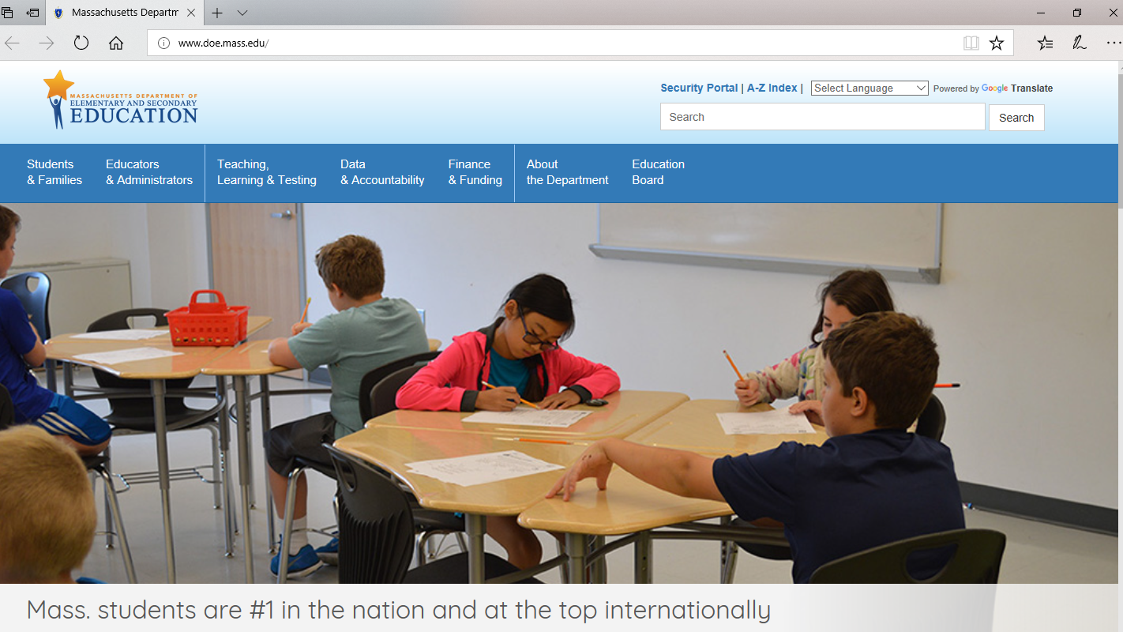
Step #1: Go to the Department’s home page (www.doe.mass.edu) and click on Security Portal

Slide 3
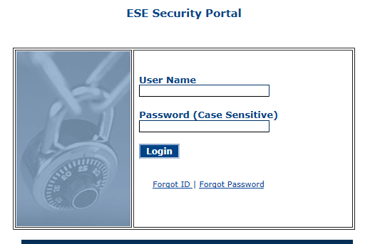
Step #2a: Log into the Security Portal
(If you do not have access to the Security Portal, please contact your Directory Administrator. To identify the Directory Administrator for your organization, click here.)

Slide 4
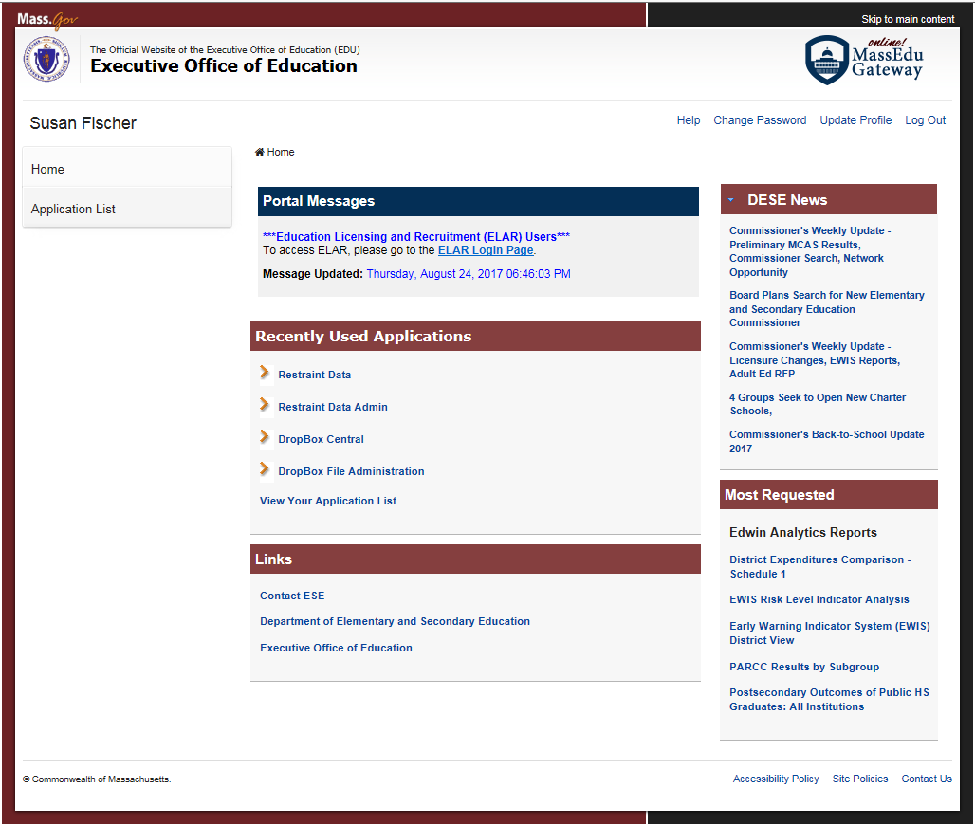
Step #2b: Click on Application List

Slide 5
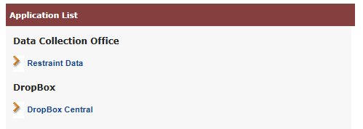
Step #2c: Click on Restraint Data
(If you do not have access to the Security Portal, please contact your Directory Administrator. To identify the Directory Administrator for your organization, click here.)

Slide 6
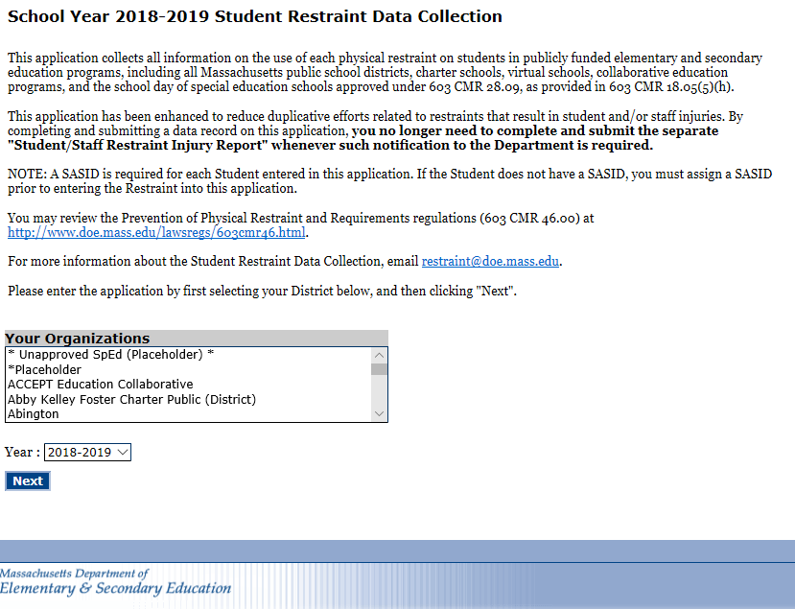
Step #3: Select your organization and then click on “Next.”

Slide 7
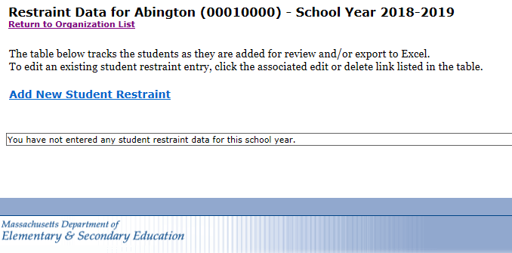
Step #4: To create a new restraint record click on “Add New Student Restraint.”

Slide 8
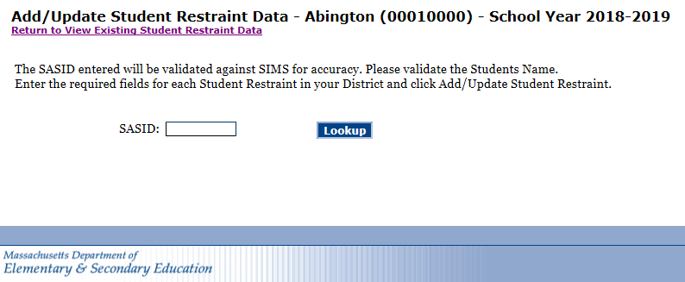
Step #5: Enter the SASID of the student and then click on “Lookup.”
This data collection is only for MA enrolled students and only for restraints occurring during the school day.
In the case of an injury, the separate Student/Staff Restraint Injury Form is no longer required to be completed and submitted to the Department. This online application form is designed to collect the required information, eliminating the previous duplicative work.

Slide 9
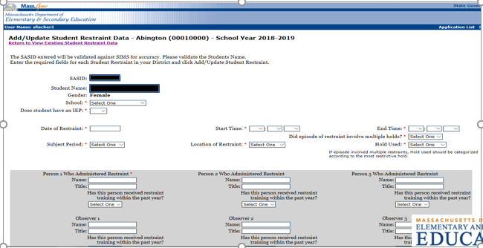
Step #6: Enter the restraint information
Sections with an asterisk (*) are required to be selected in order to close/submit the record.
The “School” section has a dropdown of individual schools/programs to select from.
At any time during the school year, a record is able to be edited to add information and/or to delete.

Slide 10
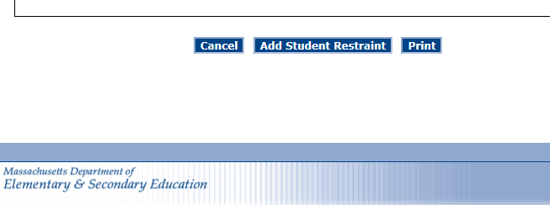
Step #7: Print, save and submit your record
Print: To print this record, scroll to the bottom of the form, click “Print” and proceed as you usually would when printing. Once saved to the database, you will be able to access this record at any time during the school year for printing.
Save and submit: To save this record to the database, click “Add Student Restraint.” Once saved to the database, you will be able to access this record at any time during the school year.

Slide 11
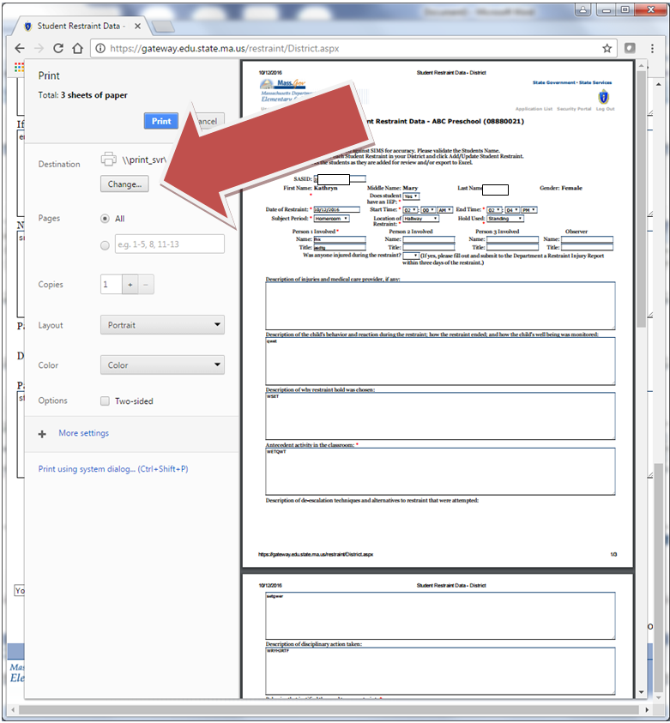
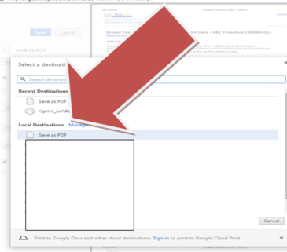
Optional: If using Google Chrome, the form can be saved to your computer as a PDF.
1) Click and then click on “Change” when the following box opens.
2) Click on “Save as PDF.”

Slide 12
PLEASE MAKE SURE TO DO THIS
When you are done printing and/or editing a record make sure to click “Add Student Restraint.” This will save your record to the database.
There is no longer a need to upload data at the end of the year because it will be submitted to ESE on a real-time basis when entered and saved. Restraint data can be edited or deleted until the whole data set is certified by the district at the end of the school year. Instructions to certify will be available in the spring.

Slide 13
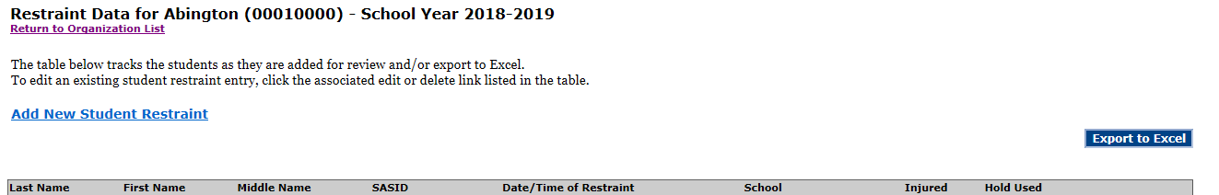
Saved restraint record data sets are able to be exported to an Excel spreadsheet. Click “Export to Excel.”

Slide 14
Thank you!
For questions, please contact Restraint@doe.mass.edu

