Slide 1
Taking a Deeper Dive into the Comprehensive Health and Physical Education Framework
Spring 2024

Slide 2
A little about us . . .
Sarah Benes (she/her)
Assistant Professor
&
Program Coordinator of
School Health Education
SHAPE America Past-President
Holly Alperin (she/her)
Associate Clinical Professor
&
Program Coordinator of
Health and Physical Education

Slide 3
A Welcome from DESE…
This session is provided in collaboration with the Massachusetts Department of Elementary and Secondary Education.
Anne DeMallie
Director of Science, Technology/Engineering, & Mathematics
Center for Instructional Support
Beth Williams-Breault
Comprehensive Health and Physical Education Lead
Center for Instructional Support
Kristen McKinnon
Assistant Director of Student and Family Support
Office of Student & Family Support

Slide 4
Connecting - Let’s make music together!
Perform the action that represents the grade level you work with…
Elementary - Clapping
Middle School - Stomping
High School - Snapping
All District - Drums on Table
Turn to the person next to you, and tell them one thing you are looking forward to related to the new standards

Slide 5
Thank you . . .
For what you do every day and for choosing to be here today . . . in May with only a few weeks left in the school year!

Slide 6
Objectives
By the end of this session, you will be able to:
Unpack the Massachusetts Comprehensive Health and Physical Education Framework
Explain key features and priorities of the CHPE Framework
Use the CHPE to review, modify, and design curriculum

Slide 7
Group Agreements & Expectations
At your table, have a conversation to come up with some group agreements you are willing to work with & expectations you have for today.
Notes:
Reviewed key points of each one

Slide 8
Agenda for the Day
8:30 Welcome and Group Agreements
Overview of the New CHPE Framework
Bio-Break
Opt-Out Law Reminder
Unpacking the Standards
11:30 Lunch
12:30 Implementing the Standards
3:00 Adjourn

Slide 9
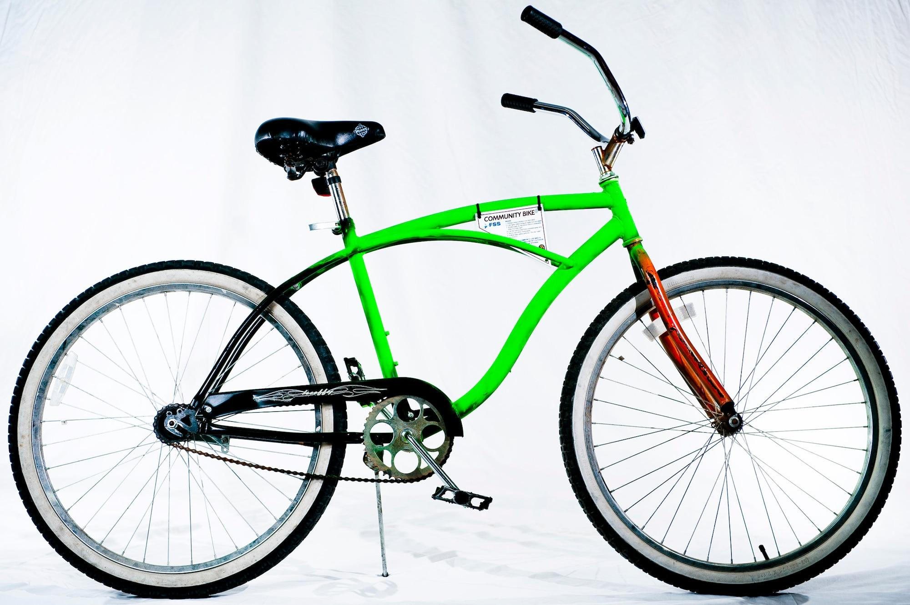
Logistics

Slide 10
Review of Process
Planning & Outreach |  | Writing & Revising |  | Public Comment & Presentation for Adoption
Stakeholder outreach Review of research, state/national models Recruitment of panel |  | Panel engagement and input Framework drafting Content advisor feedback |  | Public comment solicited Public comment review & analysis Proposed revisions Board discussion & vote on adoption

Slide 11
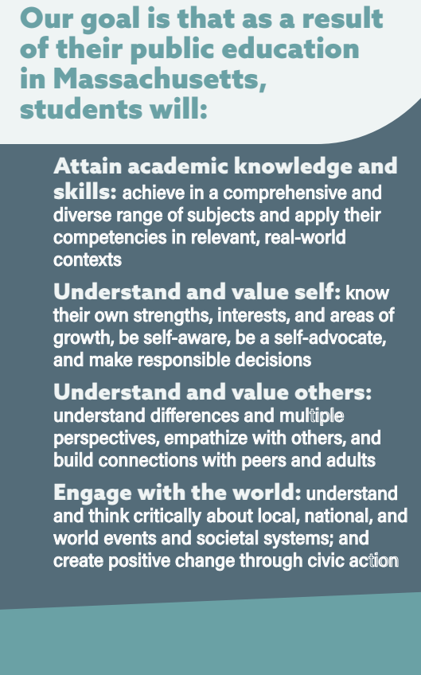
DESE Educational Vision
Educational Vision Handout

Slide 12
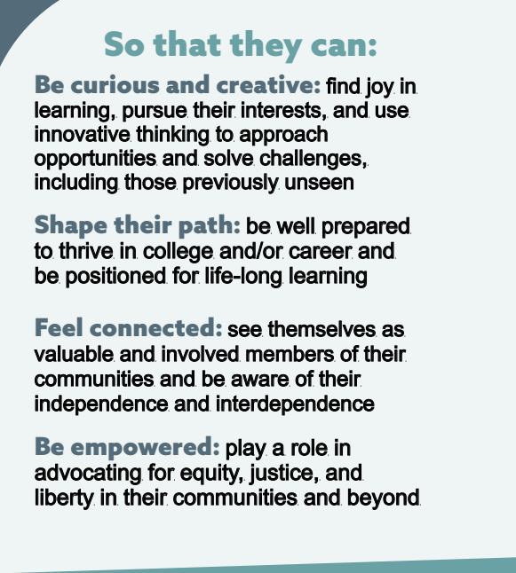
DESE Educational Vision

Slide 13
Overview of Comprehensive Health and Physical Education Framework

Slide 14
Guiding Principles

Slide 15
Discussion
Find your 8 group members (same color paper) - each person has 1 guiding principle.
Read each principle to your group.
Summarize your takeaways/key words/big ideas from the guiding principles in 6-8 words.

Slide 16
Guiding Principle 1
Students come from racially, culturally, and socially diverse backgrounds. Partnering with educators, families, and community stakeholders representing students’ backgrounds provides essential support for implementation of a successful Comprehensive Health and Physical Education program, in which all are invested in supporting students’ personal health and the overall health of their community.
Guiding Principle 2
Effective Comprehensive Health and Physical Education programs are developmentally and age-appropriate, inclusive, trauma-sensitive, culturally sustaining, and provide a safe and supportive learning environment so that all students, without exception to ability or circumstance, are supported as individuals, and can achieve the learning goals.

Slide 17
Guiding Principle 4
Every student deserves equitable access to effective Comprehensive Health and Physical Education programming, including dedicated courses for physical education and health education every year from Pre-Kindergarten (Pre-K) through grade 12, facilitated by qualified educators (e.g., licensed and/or trained in this health and/or physical education).
Guiding Principle 3
Effective Comprehensive Health and Physical Education programs incorporate diverse perspectives and acknowledge that attainment of equity and optimal health are individualized, contextual, and affected by intersections of race, ethnicity, culture, religion, education, economic condition, gender identity, sexual orientation, dis/ability, personal experience, and many other factors.

Slide 18
Guiding Principle 6
Comprehensive Health and Physical Education programs use a variety of effective implementation and assessment strategies such as scaffolding, collaboration, application, relevance and authenticity, differentiation and adaptation, and authentic performance-based assessment, and provide multiple opportunities for learning and demonstrating competency.
Guiding Principle 5
Effective Comprehensive Health and Physical Education programs foster equity-focused and trauma-informed approaches through school-wide collaboration to support and promote a sense of belonging, mental health and well-being, and the development of social and emotional skills including self-awareness, self-management, self-care, social awareness, responsible decision-making, and relationship skills in a wide variety of contexts and situations.

Slide 19
Guiding Principle 7
Effective Comprehensive Health and Physical Education programs develop students’ skills for research, reasoning, decision-making, critical thinking, problem-solving, and the habits of mind needed to be healthy across their lifespan. This includes being able to differentiate among a variety of factors affecting behavior such as culture, community, peers, and group dynamics.
Guiding Principle 8
Effective Comprehensive Health and Physical Education programs require a school-wide culture that promotes equity, health and well-being, integration and collaboration among education leaders and health professionals, and coherent district-wide support for implementation to improve each student’s cognitive, physical, social, and emotional development.

Slide 20
The Standards

Slide 21
Anatomy of a Standard
The Practice
Grades Pre-K-2 (The Gradespan)
Practice 1: Decision-making and problem-solving. Make health-promoting, informed, responsible decisions, and solve problems in a variety of health-related situations. [P1]
Nutrition and Balanced Eating [NE] [2.1.NE]
Identify situations when a nutrition-related decision needs to be made (e.g., when trying new foods, choosing snacks and beverages, eating breakfast). [HPE]
The Topic
Learning Standard
Coding

Slide 22
Gradespans
PreK-2
Grades 3-5
Grades 6-8
Grades 9-12
Achieve standards by the end of the grade span
Developmentally & medically appropriate
Multiple topics within a practice allow for variability across grade span
Grade spans build upon the previous and prepare for the next

Slide 23
Practices
✓ Practice 1: Decision-making and Problem-solving. Make health-promoting,
informed, responsible decisions and solve problems in a variety of health-related situations.
✓ Practice 2: Self-management and Goal Setting. Set goals, engage in
health-promoting behaviors, and avoid risky behaviors.
✓ Practice 3: Social Awareness, Relationship, and Communication Skills. Enhance
relationships, personal health, and the health of others through social awareness and effective communication.
✓ Practice 4: Movement Skills. Demonstrate competence in, and knowledge of, a variety of
movement concepts, principles, motor skills, and physical fitness components in order to engage in purposeful and health-promoting physical activity, including sports and games.

Slide 24
Practices
✓ Practice 5: Self-awareness and Analyzing Influences. Examine how emotions,
thoughts, needs, values, beliefs, and other factors (both internal and external) influence behaviors and articulate how these influences impact health behavior and outcomes.
✓ Practice 6: Information and Resource Seeking. Access, evaluate, and use valid and
reliable health information, products, services, and related resources.
✓ Practice 7: Self-Advocacy and Health Promotion. Promote personal, family, and
community health and well-being.

Slide 25
Considerations
Practices align with national health education and physical education standards & CDC Guidance
Practices must be developed & applied in authentic settings
Within a practice, learning standards are organized by topic, and allow for demonstration of the practice when taught together
Not all topics are underneath all practices
Assessment should consider application of practice and content knowledge

Slide 26
Find your group!
Find the people with the same Practice Code as you (bottom right corner of your name tag).
DM = Decision-Making & Problem Solving
SM = Self-Management & Goal Setting
SRC = Social Awareness, Relationship & Communication Skills
MS = Movement Skills
SAI = Self-Awareness & Analyzing Influences
IRS = Information & Resource Seeking
SHP = Self-Advocacy and Health-Promotion

Slide 27
In your small group, and for your assigned practice:
Step 1: Have 1 person come and get the materials.
Step 2: Discuss:
What do students need to learn in order to demonstrate this practice?
What are considerations when implementing this practice? What might impact students’ ability? What might you want to keep in mind for your instruction?
Step 3: On your paper, write down key ideas from your discussion.

Slide 28
Opt Out Law

Slide 29
Notification and Opt Out Guidance
G.L. c. 71, § 32A Parental Notification Law
DESE Advisory Opinion on the Parental Notification Law
603 CMR 5.00: Dispute Resolution under Parental Notification Law
No Change

Slide 30
What Counts for Opt Out? What Doesn’t?
Portions of the written curriculum that cover:
human sexual education,
the biological mechanics of human reproduction
human sexuality issues
Examples include:
Strategies to reduce STIs
Factors that contribute to pregnancy risk
Consequences of sexual activity
Programs that are voluntary (e.g. clubs)
Issues related to gender and sexual orientation
Body systems & puberty
Menstruation
Sexual violence
Healthy relationships
Safety (e.g. exploitation, abuse)

Slide 31
Unpacking the Practices

Slide 32
Topics
Healthy Relationships [HR]
Mental and Emotional Health [MH]
Nutrition and Balanced Eating [NE]
Personal Safety [PS]
Physical Activity and Fitness [PF]
Physical Health and Hygiene [PH]
Public, Community, and Environmental Health [CE]
Sexual Health [SH]
Substance Use and Misuse [SU]

Slide 33
Considerations
Topics are aligned to practices, but are not unique to each practice
Topics are aligned with best practice in the field, and reviewed by content experts to ensure timeliness & relevance
Within a practice, topics are the context - practice doesn’t change, topic does
Physical education crosses topics, be sure to review all topics and practices for PE connections

Slide 34
Learning Standards
Specific, measurable performance expectations
Each has two elements:
a performance element (the verb(s) that begin a standard), and
a concept and knowledge element (what is to be learned and applied)
When available, learning standards align with nationally recognized standards (e.g. physical education, health education, sexuality education)
Topics standards progress in developmentally and age appropriate ways

Slide 35
Coding
HPE - Health and Physical Education
PE - Physical Education
HE - Health Education
SE - Social and Emotional
Competencies
A guide for schools, not prescriptive
Support curriculum development & alignment
Supports cross-curricular integration

Slide 36
Find your group!
Find the people with the same NUMBER (1 through 14) in the bottom right corner of your name tag.
Have one person from each group come up to get the papers for your group:
1 & 14 = Practice 1 4 & 11 = Practice 4 7 & 8 = Practice 7
2 & 13 = Practice 2 5 & 10 = Practice 5
3 & 12 = Practice 3 6 & 9 = Practice 6

Slide 37
Examining practice progression:
For your assigned practice:
Examine the progression across grade spans
What do you notice about the progression of the practice?
What do you notice about the topics associated with the practice?
What questions or wonderings do you have?
What resources/supports might you need for implementation?

Slide 38
Processing & Questions
Turn & Talk with a partner next to you…
What has been clarified for you?
What do you still wonder about?

Slide 39
Lunch Break

Slide 40
Implementing the Standards

Slide 41
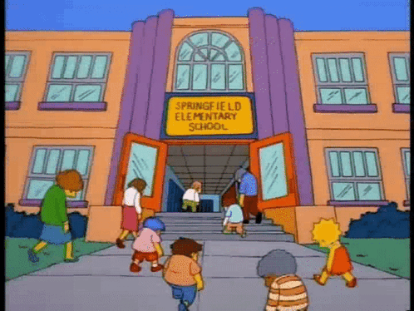
Implementing the Standards
Cross-curricular connections
Professional training & needed PD
Time
District goals, priorities & student need
Notes:
General considerations

Slide 42
Scope & Sequence
Practices form the foundation of units
Seek to design instruction that develops a base of functional knowledge & practice application
It is unlikely to address every practice every year - embrace the grade spans
Multiple topics are intended to provide both variability and reinforcement of practice
Allow time for developing an understanding, student application of the practice, and assessment

Slide 43
Health Ed Scope & Sequence - SAMPLE
 | Decision Making & Problem Solving | Self- Management & Goal Setting | Social Awareness, Relationship, and Communication Skills. | Self- awareness and Analyzing Influences. | Information & Resource Seeking | Self- Advocacy and Health Promotion
6th | Personal Safety | Mental & Emotional Health |  |  | Physical Health & Hygiene | Nutrition & Balanced Eating
7th |  | Physical Activity & Fitness | Healthy Relationships | Sexual Health |  | Mental & Emotional Health
8th | Healthy Relationships | Sexual Health | Substance Misuse | Personal Safety | Mental & Emotional Health

Slide 44
Sample HE Units
PreK-2 | Taking Care of My Mental Health Practice 2, MH 1-5
3-5 | Rockin’ Relationships (Social awareness, relationship and communication skills) Practice 3, HR 1-3, 6, 8, 9-11
6-8 | Promoting Balanced Eating Practice 7, NE 1-6

Slide 45
Physical Education Scope & Sequence - SAMPLE
 | Decision Making & Problem Solving | Self- Management & Goal Setting | Social Awareness, Relationship, and Communication Skills. | Movement Skills | Self- Awareness and Analyzing Influences. | Information & Resource Seeking | Self- Advocacy and Health Promotion
6th | Personal Safety | Physical Activity & Fitness | Mental & Emotional Health | Physical Activity & Fitness |  | Physical Health & Hygiene
7th | Physical Activity & Fitness |  | Physical Activity & Fitness | Physical Activity & Fitness |  |  | Nutrition & Balanced Eating
8th |  | Physical Activity & Fitness | Healthy Relationships | Physical Activity & Fitness | Public, Community & Environmental Health

Slide 46
Sample PE Units
PreK-2 | Ways to Move My Body (Locomotor & Cooperative Activities) Practice 3, HR 2 Practice 4, PF 1-7 Practice 5, MH 8
3-5 | Volley & Strike Practice 1, PF 1, 5 Practice 2, PF 1 Practice 4, PF 4, 7
6-8 | Invasive Games Practice 1, PF 1, 3 Practice 2, PF 4 Practice 4, PF 1, 3, 4

Slide 47
Roundtable Discussions

Slide 48
Roundtable Discussion
Break up into grade-level groups. In your group, discuss the following:
What aspects of the standards align with your current practice?
What aspects of the standards will require curricular changes?
What supports from school/district leadership will support implementation?
Discuss benefits and challenges you will encounter when implementing these standards.
On the flip chart paper, highlight key points of your discussion

Slide 49
Roundtable Discussion Protocol
Roundtable Discussion Protocol
Healthy Relationships [HR] Mental and Emotional Health [MH] Nutrition and Balanced Eating [NE] Personal Safety [PS] Physical Activity and Fitness [PF] | Physical Health and Hygiene [PH] Public, Community, and Environmental Health [CE] Sexual Health [SH] Social and Emotional Competencies Substance Use and Misuse [SU]
Which standards currently align with your current curriculum and what needs to change?
What resources would help you to implement the topic within the practice?
Discuss challenges of the topic & seek to find some solutions

Slide 50
Bringing this back home…
Something you are thinking
and want to share with others
An action you will take as a result of today

Slide 51
Misc.
STEM Newsletter
Promoting Safe and Healthy Learning Environment Option 2 CHPE
Evaluate and Select HQIM Network Support Grant
HQIM Implementation Grant
PD:
Food System Literacy PD Courses

Slide 52
Thank You
Find us at:
partners@lighthousehealthconsulting.com
@hollyalperin @sarahbenes12
beth.williams-breault@mass.gov

